Slide 1

K-2
Personal
Financial Literacy

Slide 2
The PFL Math TEKS
Personal financial literacy. The student applies mathematical process standards
to manage one’s financial resources effectively for lifetime financial security.
Kindergarten
K.9A identify ways to earn income
K.9B differentiate between money received as income
and money received as gifts
K.9C list simple skills required for jobs
K.9D distinguish between wants and needs and identify
income as a source to meet one’s wants and needs

Slide 3
The PFL Math TEKS
Personal financial literacy. The student applies mathematical process standards
to manage one’s financial resources effectively for lifetime financial security.
Grade 1
1.9A define money earned as income
1.9B identify income as a means of obtaining goods and
services, oftentimes making choices between wants
and needs
1.9C distinguish between spending and saving
1.9D consider charitable giving

Slide 4
Kindergarten, Lesson 1
The Money Making Farm
Objectives:
PFL Math K.9A: identify ways to earn income
Social Studies K.7A: identify jobs in the home, school, and community
Social Studies K.7B: explain why people have jobs

Slide 5
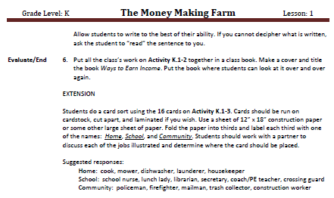
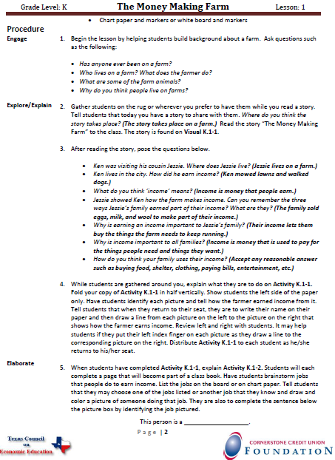
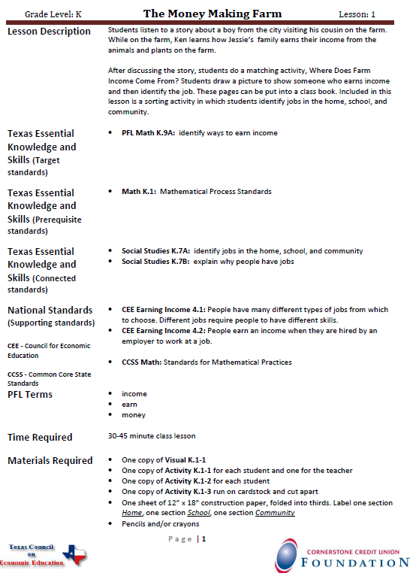

Slide 6
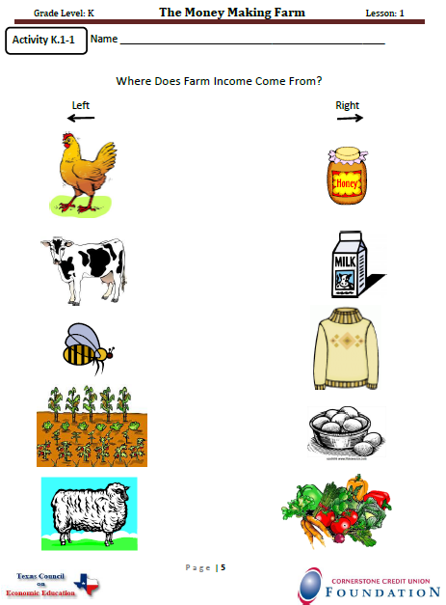
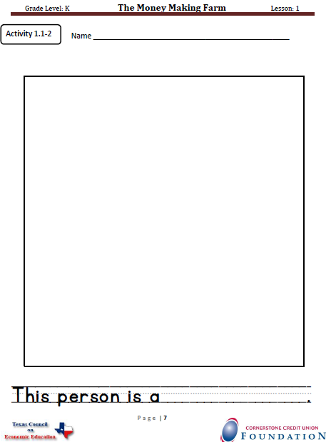

Slide 7

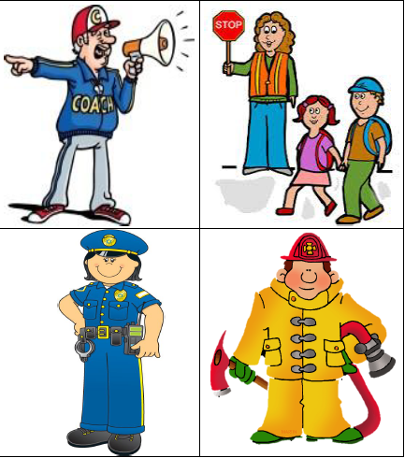
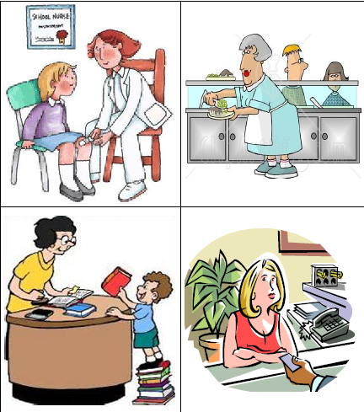


Slide 8
Grade 1, Lesson 3
My Eyes are Bigger than my wallet
Objectives:
PFL Math 1.9B: identify income as a means of obtaining goods and services, oftentimes making choices between wants and needs
PFL Math K.9A: identify ways to earn income
Social Studies K.7A: identify jobs in the home, school, and community
Social Studies K.7B: explain why people have jobs

Slide 9
Math 1.1: Mathematical Process Standards
Math 1.3A: use concrete and pictorial models to determine the
sum of a multiple of 10 and a one-digit number in problems up to 99
Math 1.5B: skip count by twos, fives, and tens to determine the
total number of objects up to 120 in a set
Social Studies 1.9A: identify examples of people wanting more than
they can have
Social Studies 1.9B: explain why wanting more than they can have
requires that people make choices
Social Studies 1.9C: identify examples of choices families make
when buying goods and services

Slide 10
Maria’s Wants
Item wanted | Why it is a good idea | Why it is a bad idea | Do I have enough money?
Phone | Can call home whenever needed | Will have to pay a monthly bill | no
TV in my room | Can watch my favorite programs while Dad watches football games | Mom says I need to pay attention to my schoolwork and can’t have a TV in my room | no
Trampoline | Can get exercise and play with my friends | Not much room in our backyard and someone could get hurt | no

Slide 11
Wants and Needs
Weekly income: $500
New phone | $100
chair | $ 90
haircut | $ 10
Movie & dinner | $ 40
New jacket | $ 60
Tennis shoes | $ 50
Groceries | $ 70
Rent | $120

Slide 15

Thank You
from TCEE
and Valerie Johse
vjohse@aol.com

