Slide 1
Caring for Our Heroes
Home Care for Veterans
A Guide to Programs & Opportunities

Slide 2
Your Presenter
Sandy Kaur – President: Nurse Next Door San Mateo
Sandy started her franchise with Nurse Next Door because of her own personal experiences in her family, taking care of her loved ones and her strong passion for giving back to her community. She and her team are dedicated to provide the highest quality of care to meet the unique needs of each veteran to provide support and assistance with daily activities, as well as specialized care for those with chronic conditions or other health concerns. She is focused on making a positive impact on the lives of her clients and caregivers. She is driven by her commitment to making a difference and revolutionizing the standard for home care in the communities she serves.

Slide 3
Home Care for Veterans
Overview
1. Aid & Attendance
2. Homemaker/Home Health Aide
3. Veteran Directed Care (VDC)
4. Comprehensive Assistance for Family
5. Program of General Caregiver Support
6. VA Authorization
Q&A

Slide 4
Veterans in Your Community
State | Ages 85+ | Ages 65-84 | All Ages
FL | 126,110.77 | 601,964.85 | 728,075.63
CA | 125,406.01 | 593,131.18 | 718,537.19
TX | 80,731.19 | 522,369.48 | 603,100.67
PA | 68,730.82 | 302,325.84 | 371,056.65
NY | 68,407.56 | 274,804.64 | 343,212.20
All US States | 1,355,042.68 | 7,187,571.07 | 8,542,613.76
Only 165,000 are enrolled in HHA program.

Slide 5
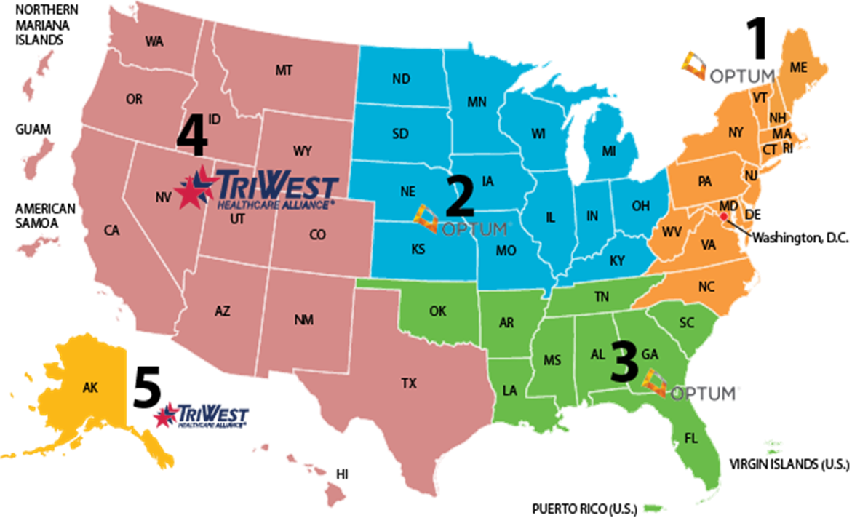
Homemaker & Home Health Aide
The Community Care Network (CCN) offers Home Health Aide/Homemaker and Respite Care programs for eligible veterans to receive home care services. This is a health program over a pension program.
The CCN is divided into five regions
Homemaker services typically include assistance with household tasks.
Home health aide services involve more direct and personal care.

Slide 6
What does it look like?
What is HHA program?
Non skilled caregiving services available to qualifying Veterans paid for by the VA
Help with Activities of Daily Living (ADLS)
Mobility and Independence
Medication Management
Housekeeping- Dishes, Cleaning, Laundry etc.
Companionship and Emotional Support
Personal Care and Hygiene- Showers, Dressing, Grooming etc
Dementia and Alzheimer’s
Hospice care
Contact Today
For an in person / over the phone consultation to assess and put together a Home Care Plan specially designed for YOU !!

Slide 7
Who can access this service
-Qualifying Veteran
-Must be enrolled in the VA health system
-Must have need for caregiving services
Confused?
Call me and I can
help you figure it out
.
Where to start
-Local Veteran Services Office (VSO)
-Member Services (VA)

Slide 8
Homemaker & Home Health Aide
What to expect after you Qualify
Average hours per week 6 to 168
Hours are determined by the needs of the Veteran and authorized by the service care coordinator.
Agency of your choice or picked by the case manager will provide caregiving for the allocated hours
Eligibility
Military history
Enrolment in the VA Health System
Need considerations
No income or network requirements

Slide 9
Frequently asked questions
I like my doctor from Kaiser or other health insurance. Do I have to leave him/her?
My family member is my caregiver through VA. Can I still get an outside caregiver?
Do I have to pay anyone for the paperwork needed for the process?
Can I choose my agency(provider)?
I get Aid and attendance(pension). Can I still get HHA?
Who do I reach out to if I need help with the process or have further questions?

Slide 10
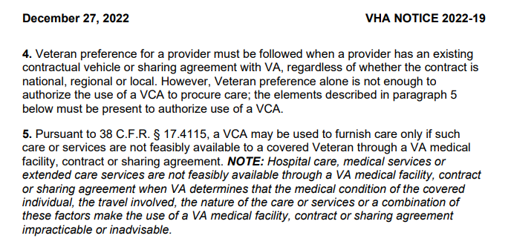
Veterans Community Care Program
The Care Act was passed in 2014 to grant Veterans the right to choose from who and where they will receive care.

Slide 11
Questions?
Sandy Kaur
President – Nurse Next Door San Mateo
650-622-6885, Sandy.kaur@nursenextdoor.com

