Slide 1
Denture Clone
Denture in one
or
2 visits.
No CAD, No Computer
With in-house Lab.
With an independent Lab.

Slide 2
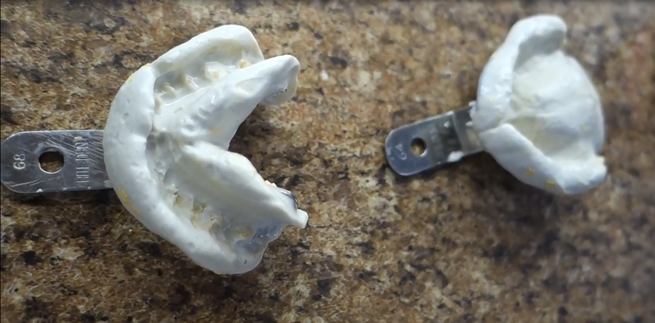
Upper, Lower Impression and VDO are taken

Slide 3
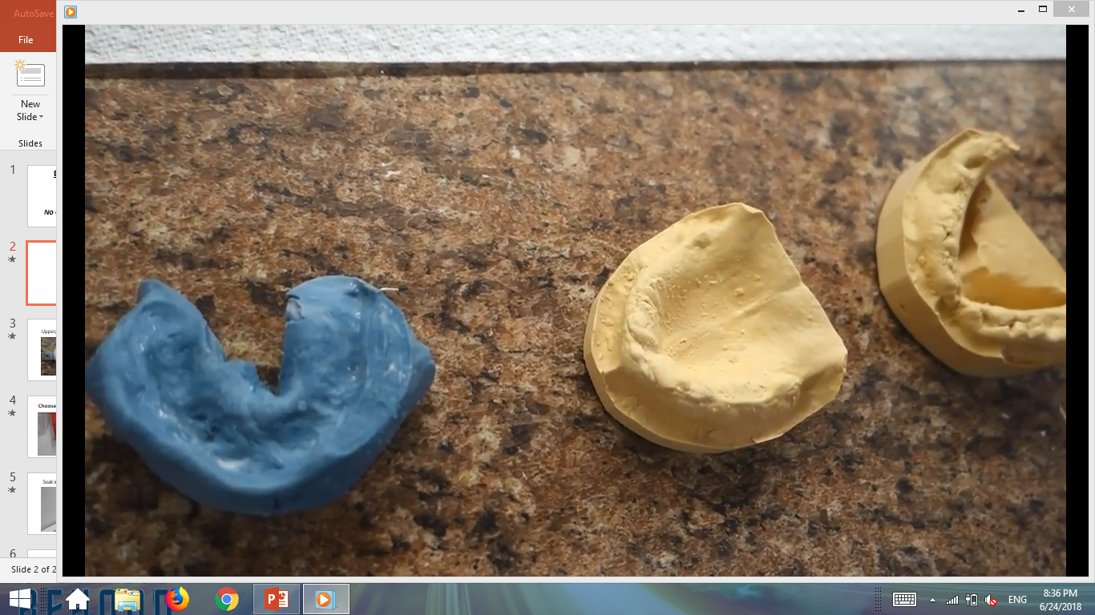
Measure VDO using Lab Putty of choice

Slide 4
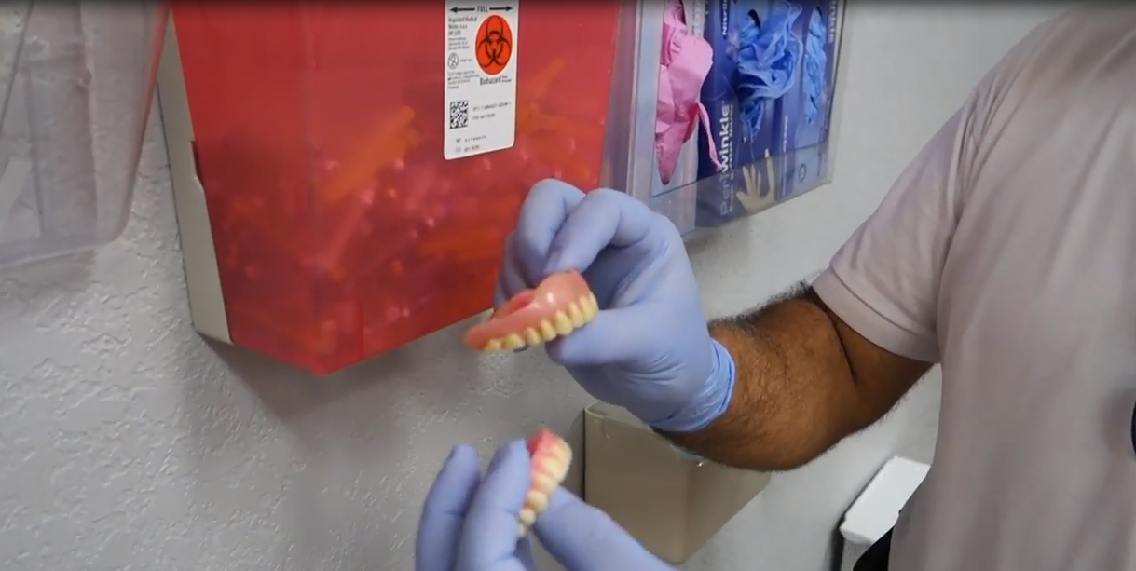
Choose from 5 different Denture Clone sizes

Slide 5
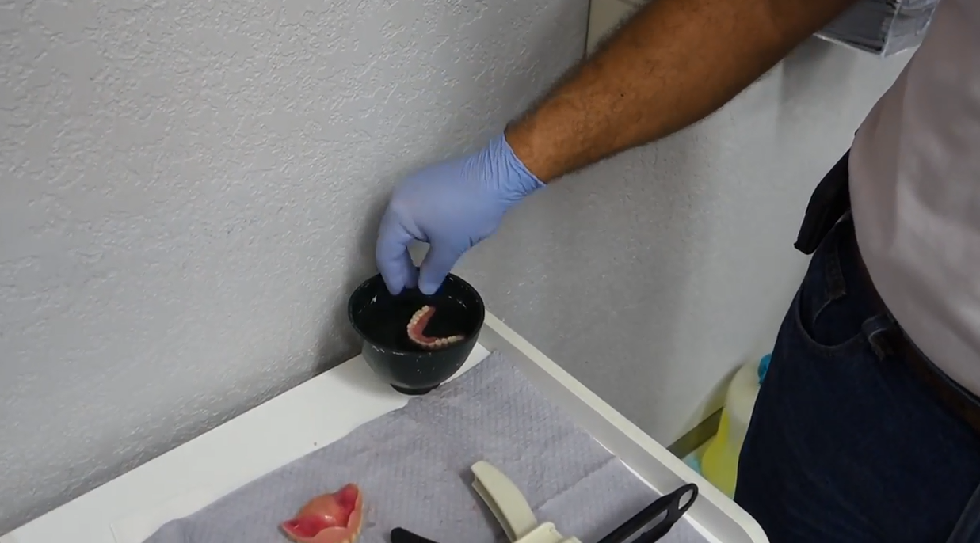
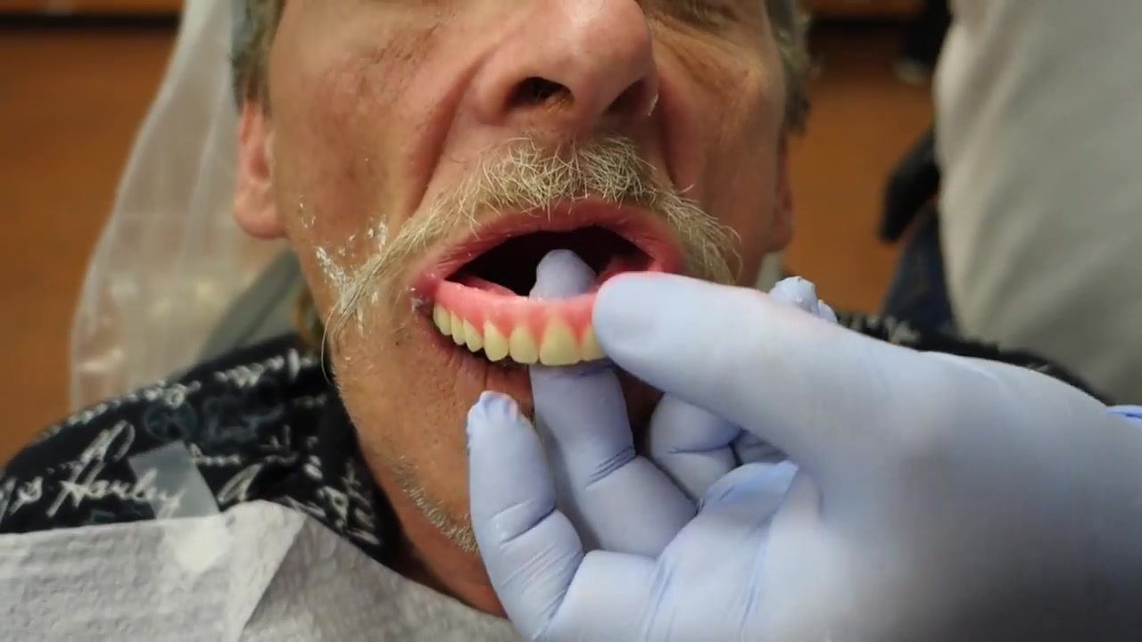
To open or close the arch, Soak in warm water for 20s at 125°F

Slide 6
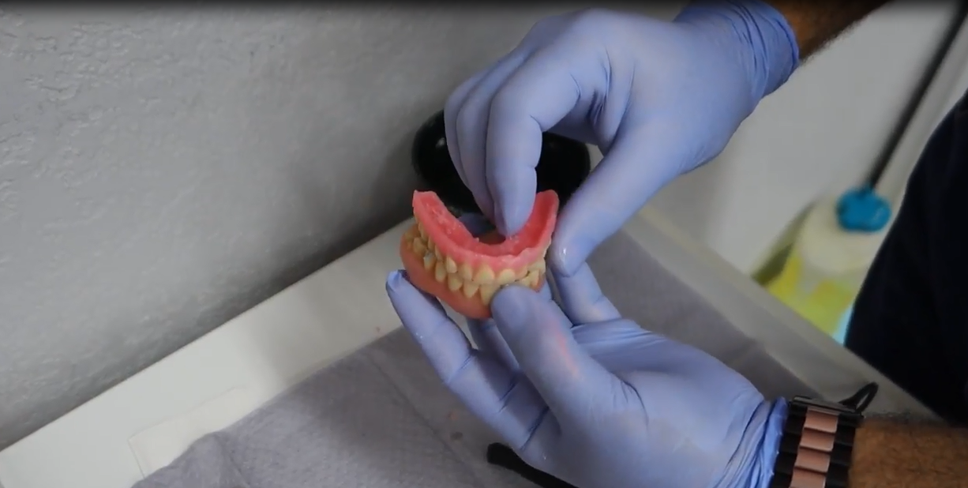
Adjust to arch size
Do not attempt to adjust denture Clone when cold

Slide 7
Very Important.
Denture Clone need to be cooled down before applying the PVS wash material or trying in the mouth

Slide 8
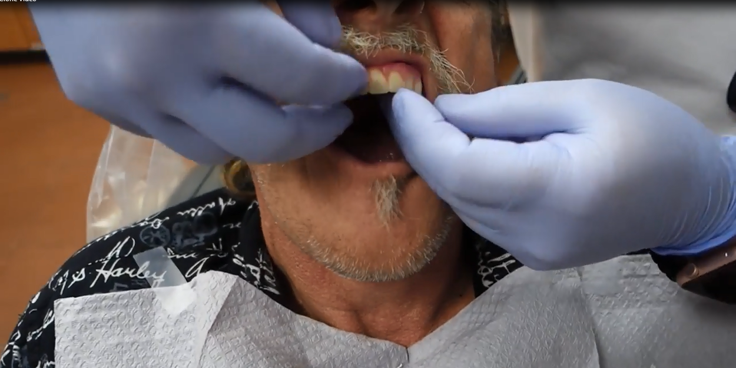
Cool down in cold water and check the fit

Slide 9
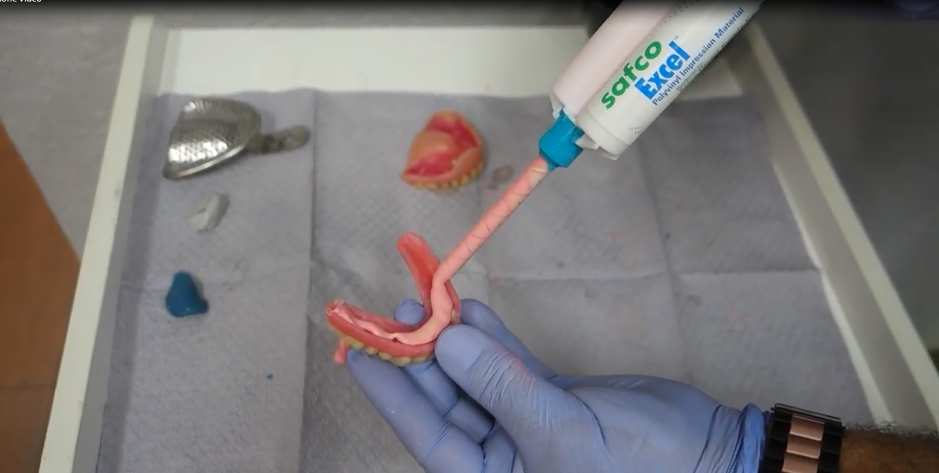
Load with medium PVS material of choice

Slide 10
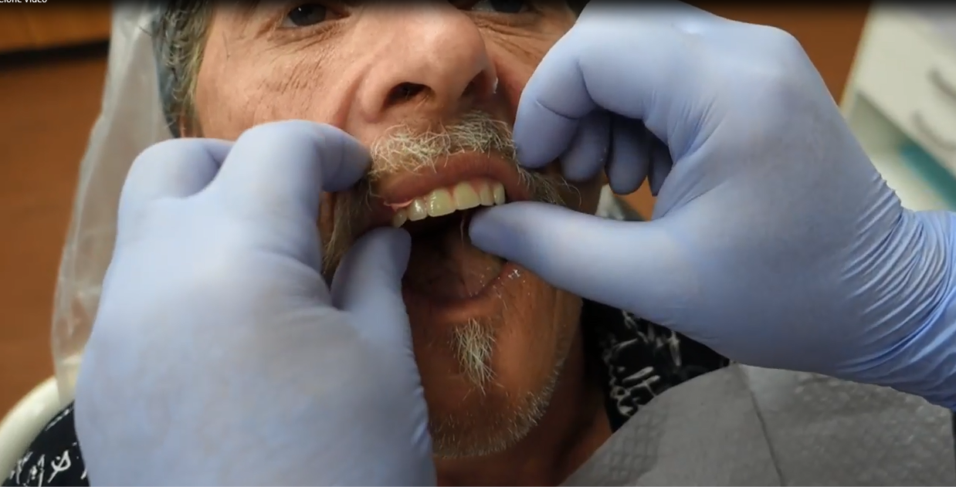
Position Denture Clone with:
Correct Mid line and Smile line.

Slide 11
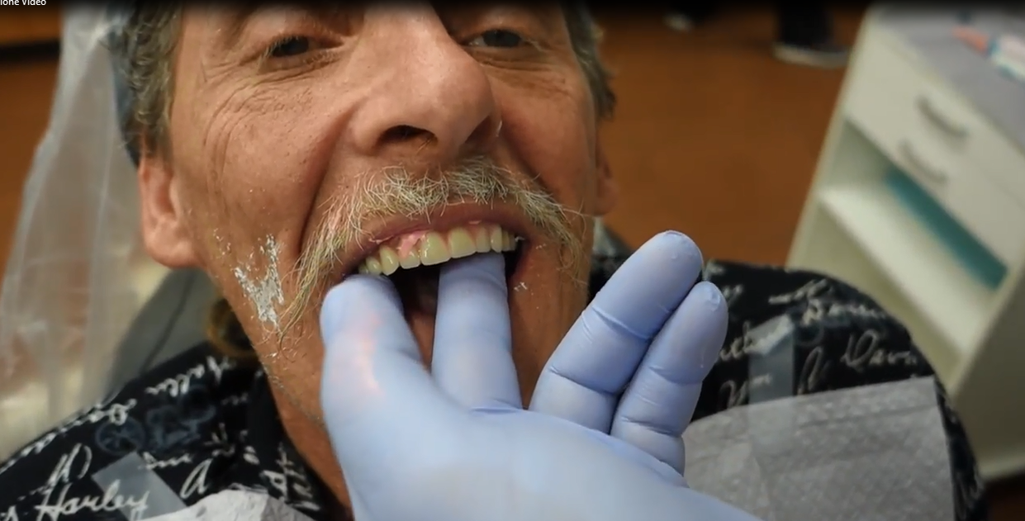
Approximate setting time 3min

Slide 12
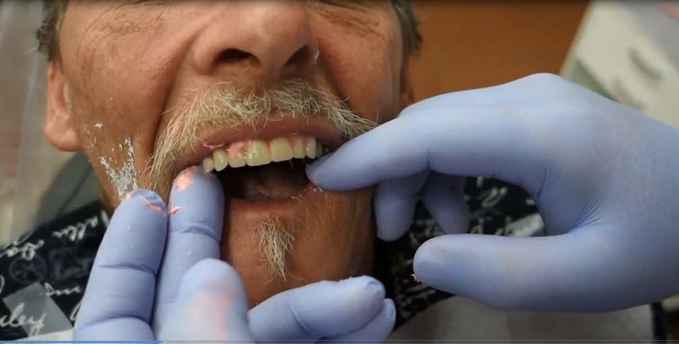
Check all landmarks for proper positions
Repeat or add PVS material if necessary

Slide 13
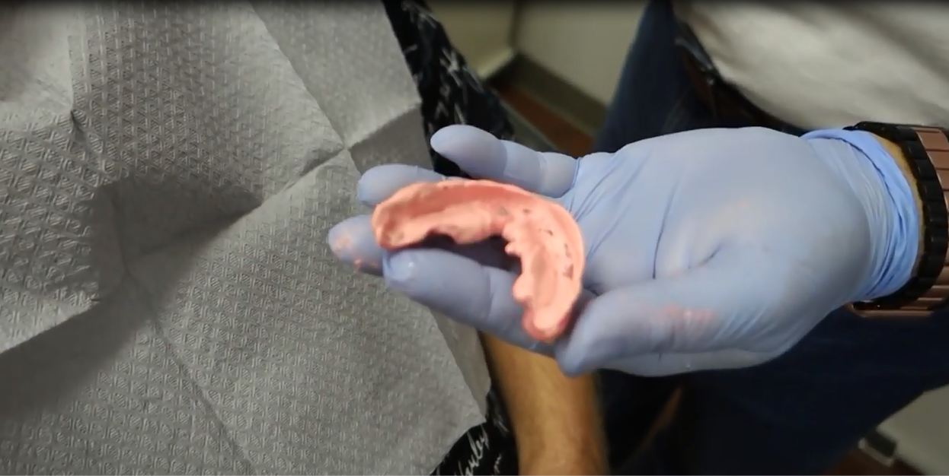
Denture Clone with wash ready for Lab process

Slide 14
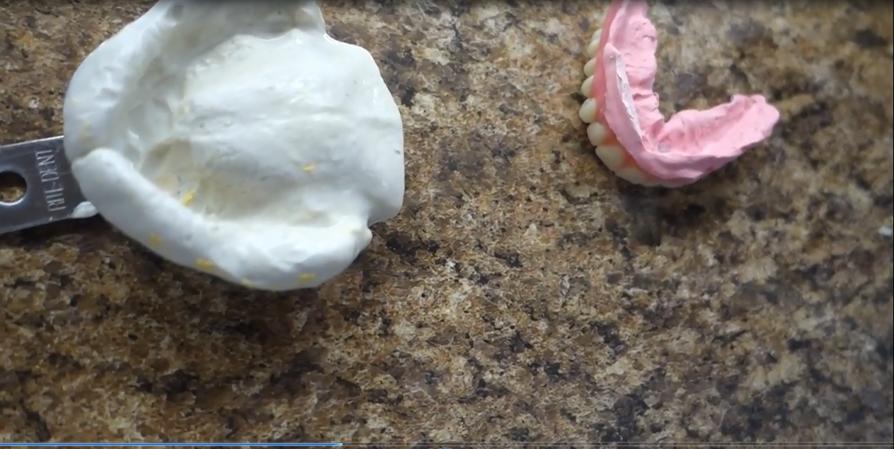
Lab procedure

Slide 15
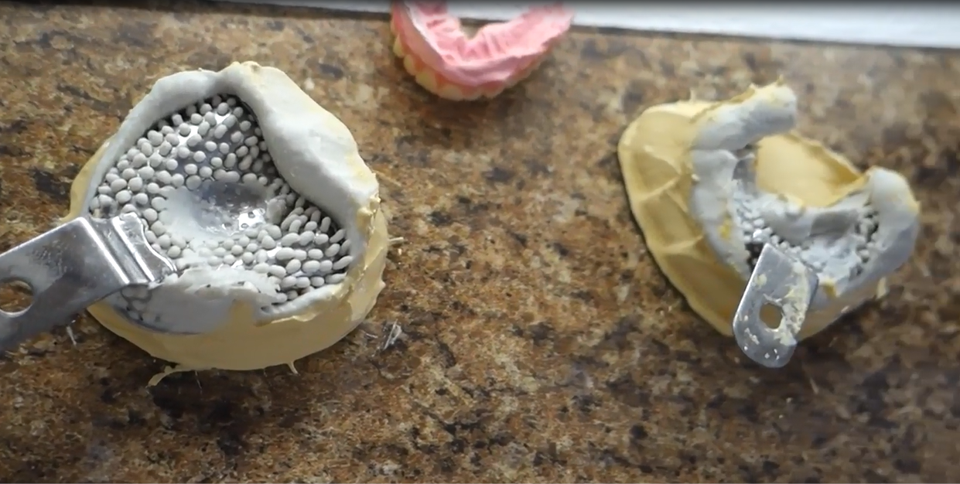
Upper & Lower at the lab

Slide 16
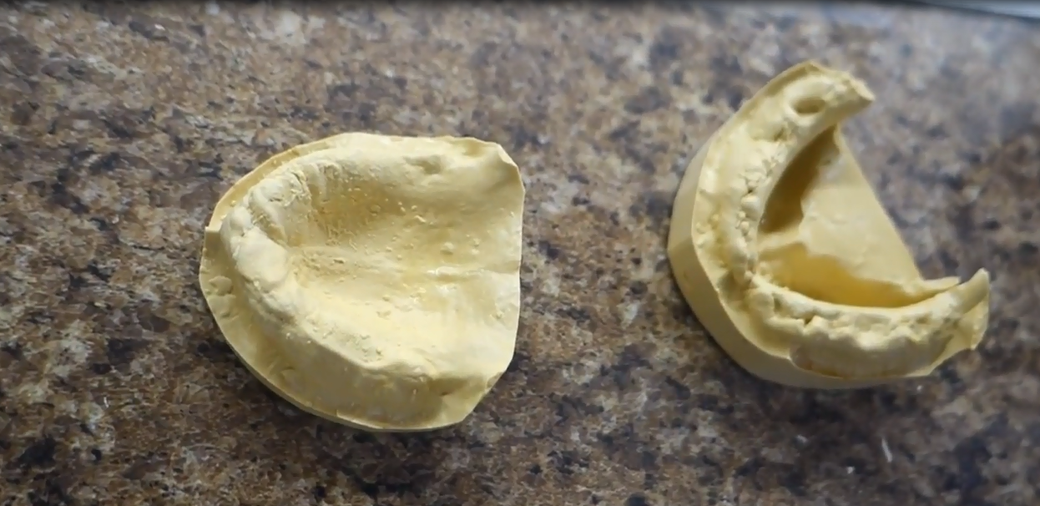
Models poured up

Slide 17
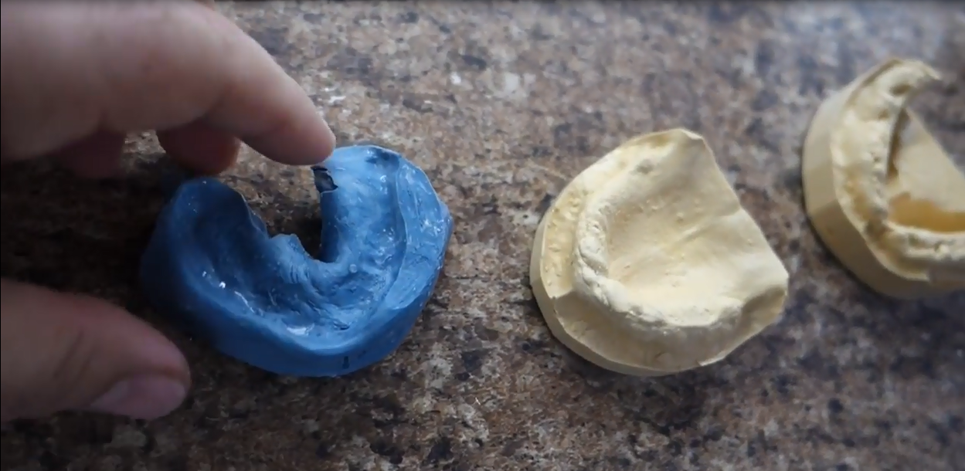
Upper, Lower and bite at the lab

Slide 18
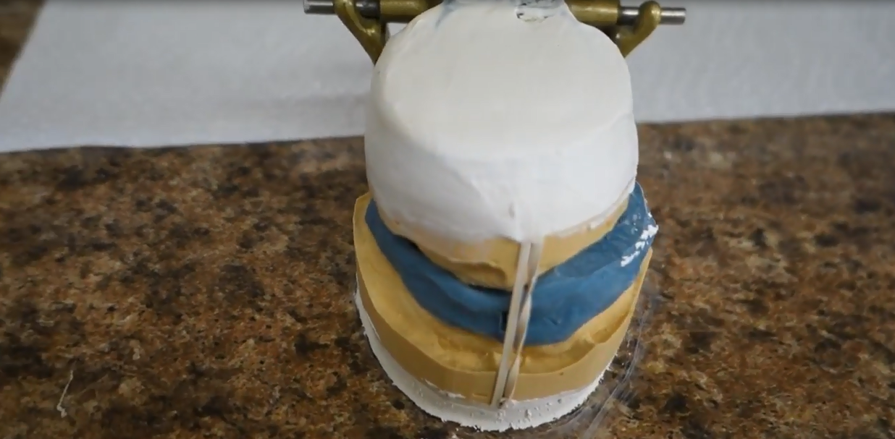
Case articulated with bite & VDO

Slide 19
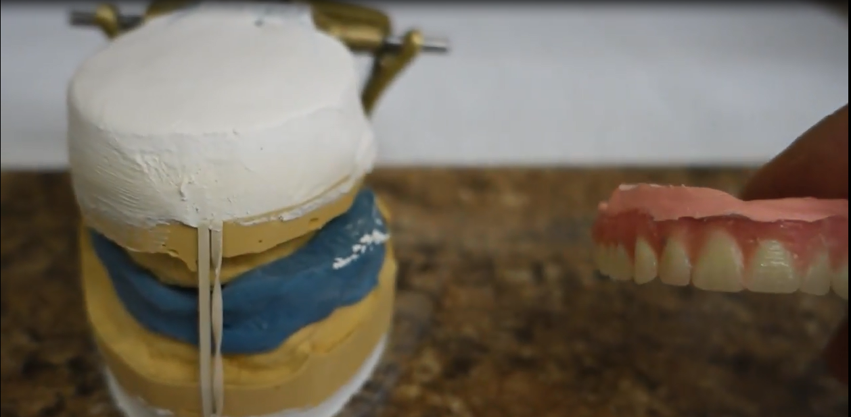
Models ready to accept Denture Clone

Slide 20
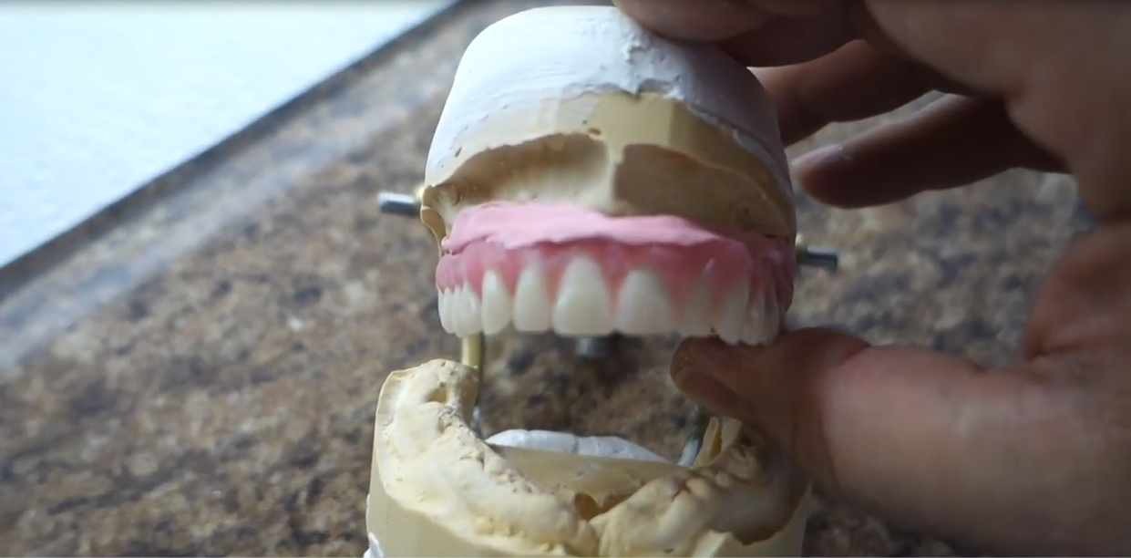
Transfer Denture clone to the model

Slide 21
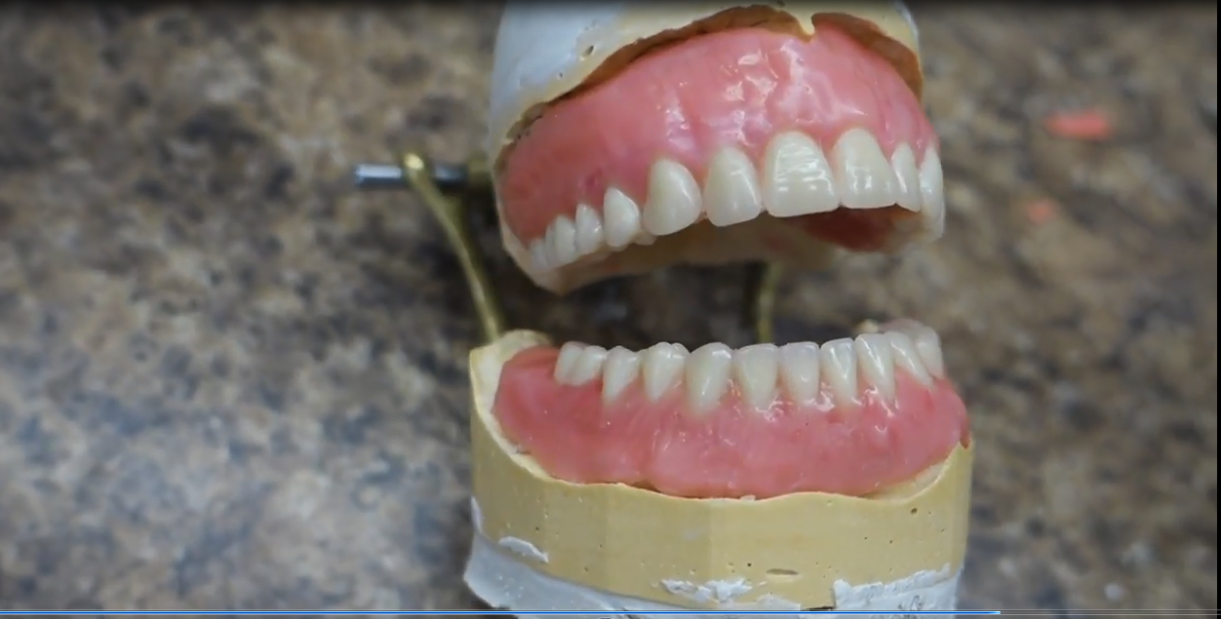
Wax up completed and processed

Slide 22
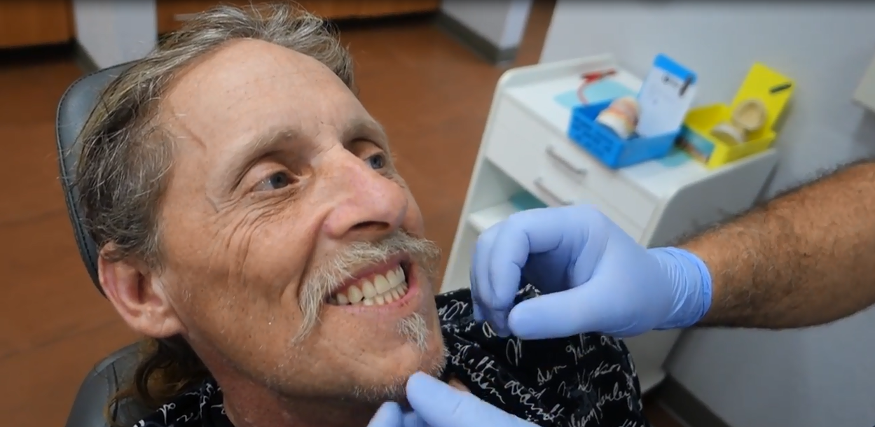
Denture delivered:
Same visit with in-house lab or 2nd visit with independent lab

