Slide 1
Transformations of the Graph y = f(x).
Tuesday, 09 February 2021
ALL will be able to identify transformations of a graph.
MOST will be able to sketch graphs after one or more transformation.
SOME will be able to use transformations to find the equation of a graph.
Lesson Objective: To be able to transform the graph of y = f(x) using various transformation conditions.
Starter Task
Sketch the graphs of each of the following functions…
y = x²
y = x³
y = $\frac{\text{1}}{\text{x}}$
y = sin x
y = cos x
y = tan x
Keywords: Function → Transform → Reflection → Translation → Scale Factor → Stretch → Vector.

Slide 2
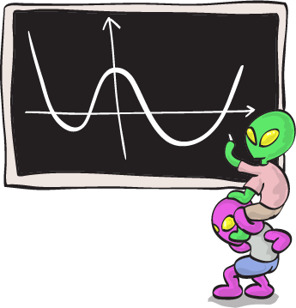
Transformations of the Graph y = f(x).
Tuesday, 09 February 2021
ALL will be able to identify transformations of a graph.
MOST will be able to sketch graphs after one or more transformation.
SOME will be able to use transformations to find the equation of a graph.
Lesson Objective: To be able to transform the graph of y = f(x) using various transformation conditions.
A New Notation…
So far, you are used to graphs being written in the form:
y = …
Today, another form is going to be shown to you…
Keywords: Function → Transform → Reflection → Translation → Scale Factor → Stretch → Vector.

Slide 3
Transformations of the Graph y = f(x).
Tuesday, 09 February 2021
ALL will be able to identify transformations of a graph.
MOST will be able to sketch graphs after one or more transformation.
SOME will be able to use transformations to find the equation of a graph.
Lesson Objective: To be able to transform the graph of y = f(x) using various transformation conditions.
A New Notation…
Today, we are going to get used to using the form:
f(x) = …
The notation f(x) is used to represent a function of x. A function of x is any algebraic expression in which x is the only variable. For example, f(x) = x + 3, f(x) = 2x² and f(x) = sin x.
Keywords: Function → Transform → Reflection → Translation → Scale Factor → Stretch → Vector.

Slide 4
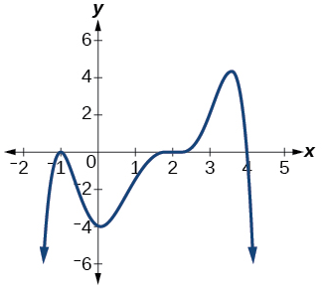
Transformations of the Graph y = f(x).
Tuesday, 09 February 2021
ALL will be able to identify transformations of a graph.
MOST will be able to sketch graphs after one or more transformation.
SOME will be able to use transformations to find the equation of a graph.
Lesson Objective: To be able to transform the graph of y = f(x) using various transformation conditions.
y = f(x)…
You will also experience graphs of y = f(x). Unlike linear, quadratic, cubic and reciprocal graphs, graphs of y = f(x) can take any shape and don’t have a specific form:
The graph to the right could be identified as y = f(x). In fact, any graph could be identified as y = f(x)!!
Keywords: Function → Transform → Reflection → Translation → Scale Factor → Stretch → Vector.

Slide 5
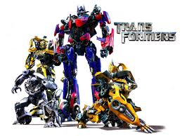
Transformations of the Graph y = f(x).
Tuesday, 09 February 2021
ALL will be able to identify transformations of a graph.
MOST will be able to sketch graphs after one or more transformation.
SOME will be able to use transformations to find the equation of a graph.
Lesson Objective: To be able to transform the graph of y = f(x) using various transformation conditions.
Graph Transformations…
Just like with shapes, graphs can be transformed by:
Reflection
Translation
Enlargement
There are six different transformations that can be applied to graphs and we are going to investigate them today!
Keywords: Function → Transform → Reflection → Translation → Scale Factor → Stretch → Vector.

Slide 6
Transformations of the Graph y = f(x).
Tuesday, 09 February 2021
ALL will be able to identify transformations of a graph.
MOST will be able to sketch graphs after one or more transformation.
SOME will be able to use transformations to find the equation of a graph.
Lesson Objective: To be able to transform the graph of y = f(x) using various transformation conditions.
https://www.desmos.com/calculator
To investigate these transformations, we are going to use a program called Desmos. Desmos enables us to plot graphs and subsequently makes it easier for us to understand these transformations.
In the following Shared Area link, you’ll find the workbook that you need to complete:
L://Maths/Resources/10x1/Graph Transformations Investigation
All of the instructions are in the booklet, so work through it in pairs and make sure you ask if you get stuck! ☺
Keywords: Function → Transform → Reflection → Translation → Scale Factor → Stretch → Vector.

Slide 7
Transformations of the Graph y = f(x).
Tuesday, 09 February 2021
ALL will be able to identify transformations of a graph.
MOST will be able to sketch graphs after one or more transformation.
SOME will be able to use transformations to find the equation of a graph.
Lesson Objective: To be able to transform the graph of y = f(x) using various transformation conditions.
y = f(x)
y = f(x) – 1
y = f(x) + 4
y = f(x) – 3
Investigation Findings: y = f(x) + a…
What do you notice about the effect of this transformation?
Looking at f(x) + 4, the graph of y = f(x) has been moved up (translated) by 4 units.
Looking at f(x) – 3, the graph of y = f(x) has been moved down (translated) by 3 units.
Keywords: Function → Transform → Reflection → Translation → Scale Factor → Stretch → Vector.

Slide 8
Transformations of the Graph y = f(x).
Tuesday, 09 February 2021
ALL will be able to identify transformations of a graph.
MOST will be able to sketch graphs after one or more transformation.
SOME will be able to use transformations to find the equation of a graph.
Lesson Objective: To be able to transform the graph of y = f(x) using various transformation conditions.
y = f(x)
y = f(x) – 1
y = f(x) + 4
y = f(x) – 3
Investigation Findings: y = f(x) + a…
What do you notice about the effect of this transformation?
Transformation 1:
The graph of y = f(x) + a is a translation of the graph y = f(x) by a vector $\left({\text{0} \atop \text{a}}\right)$.
Keywords: Function → Transform → Reflection → Translation → Scale Factor → Stretch → Vector.

Slide 9
Transformations of the Graph y = f(x).
Tuesday, 09 February 2021
ALL will be able to identify transformations of a graph.
MOST will be able to sketch graphs after one or more transformation.
SOME will be able to use transformations to find the equation of a graph.
Lesson Objective: To be able to transform the graph of y = f(x) using various transformation conditions.
y = f(x)
y = f(x + 1)
y = f(x + 2.5)
y = f(x – 4)
Investigation Findings: y = f(x + a)…
What do you notice about the effect of this transformation?
Looking at f(x + 2.5), the graph of y = f(x) has been moved across (translated) by -2.5 units.
Looking at f(x – 4), the graph of y = f(x) has been moved across (translated) by 4 units.
Keywords: Function → Transform → Reflection → Translation → Scale Factor → Stretch → Vector.

Slide 10
Transformations of the Graph y = f(x).
Tuesday, 09 February 2021
ALL will be able to identify transformations of a graph.
MOST will be able to sketch graphs after one or more transformation.
SOME will be able to use transformations to find the equation of a graph.
Lesson Objective: To be able to transform the graph of y = f(x) using various transformation conditions.
y = f(x)
y = f(x + 1)
y = f(x + 2.5)
y = f(x – 4)
Investigation Findings: y = f(x + a)…
What do you notice about the effect of this transformation?
Transformation 2:
The graph of y = f(x + a) is a translation of the graph y = f(x) by a vector $\left({\text{−}\text{a} \atop \text{0}}\right)$.
REMEMBER: It is shifted by –a so goes in the opposite direction to what you expect.
Keywords: Function → Transform → Reflection → Translation → Scale Factor → Stretch → Vector.

Slide 11
Transformations of the Graph y = f(x).
Tuesday, 09 February 2021
ALL will be able to identify transformations of a graph.
MOST will be able to sketch graphs after one or more transformation.
SOME will be able to use transformations to find the equation of a graph.
Lesson Objective: To be able to transform the graph of y = f(x) using various transformation conditions.
Pitstop Practice:
On the graph of f(x) above, sketch:
On the graph of f(x) above, sketch:
a) f(x) + 3
b) f(x + 2)
a) f(x + 3) – 1
b) f(x – 1) + 3

Slide 12
Transformations of the Graph y = f(x).
Tuesday, 09 February 2021
ALL will be able to identify transformations of a graph.
MOST will be able to sketch graphs after one or more transformation.
SOME will be able to use transformations to find the equation of a graph.
Lesson Objective: To be able to transform the graph of y = f(x) using various transformation conditions.
Investigation Findings: y = -f(x)…
What do you notice about the effect of this transformation?
The graphs have been reflected…
…in the x-axis…!
Keywords: Function → Transform → Reflection → Translation → Scale Factor → Stretch → Vector.

Slide 13
Transformations of the Graph y = f(x).
Tuesday, 09 February 2021
ALL will be able to identify transformations of a graph.
MOST will be able to sketch graphs after one or more transformation.
SOME will be able to use transformations to find the equation of a graph.
Lesson Objective: To be able to transform the graph of y = f(x) using various transformation conditions.
Investigation Findings: y = -f(x)…
What do you notice about the effect of this transformation?
Transformation 3:
The graph of y = -f(x) is the reflection of the graph y = f(x) in the x-axis.
Keywords: Function → Transform → Reflection → Translation → Scale Factor → Stretch → Vector.

Slide 14
Transformations of the Graph y = f(x).
Tuesday, 09 February 2021
ALL will be able to identify transformations of a graph.
MOST will be able to sketch graphs after one or more transformation.
SOME will be able to use transformations to find the equation of a graph.
Lesson Objective: To be able to transform the graph of y = f(x) using various transformation conditions.
Investigation Findings: y = f(-x)…
What do you notice about the effect of this transformation?
The graphs have been reflected…
…in the y-axis…!
Keywords: Function → Transform → Reflection → Translation → Scale Factor → Stretch → Vector.

Slide 15
Transformations of the Graph y = f(x).
Tuesday, 09 February 2021
ALL will be able to identify transformations of a graph.
MOST will be able to sketch graphs after one or more transformation.
SOME will be able to use transformations to find the equation of a graph.
Lesson Objective: To be able to transform the graph of y = f(x) using various transformation conditions.
Investigation Findings: y = f(-x)…
What do you notice about the effect of this transformation?
Transformation 4:
The graph of y = f(-x) is the reflection of the graph y = f(x) in the y-axis.
Keywords: Function → Transform → Reflection → Translation → Scale Factor → Stretch → Vector.

Slide 16
Transformations of the Graph y = f(x).
Tuesday, 09 February 2021
ALL will be able to identify transformations of a graph.
MOST will be able to sketch graphs after one or more transformation.
SOME will be able to use transformations to find the equation of a graph.
Lesson Objective: To be able to transform the graph of y = f(x) using various transformation conditions.
Pitstop Practice:
On the graph of f(x) above, sketch:
On the graph of f(x) above, sketch:
a) -f(x)
b) f(-x) – 1
a) f(-x)
b) -f(x) + 2

Slide 17
Transformations of the Graph y = f(x).
Tuesday, 09 February 2021
ALL will be able to identify transformations of a graph.
MOST will be able to sketch graphs after one or more transformation.
SOME will be able to use transformations to find the equation of a graph.
Lesson Objective: To be able to transform the graph of y = f(x) using various transformation conditions.
y = f(x)
y = 2f(x)
y = 3f(x)
y = ½f(x)
Investigation Findings: y = af(x)…
What do you notice about the effect of this transformation?
Looking at 3f(x), the graph of y = f(x) has been stretched downwards by scale factor 3.
Looking at ½f(x), the graph of y = f(x) has been stretched downwards by scale factor ½.
Keywords: Function → Transform → Reflection → Translation → Scale Factor → Stretch → Vector.

Slide 18
Transformations of the Graph y = f(x).
Tuesday, 09 February 2021
ALL will be able to identify transformations of a graph.
MOST will be able to sketch graphs after one or more transformation.
SOME will be able to use transformations to find the equation of a graph.
Lesson Objective: To be able to transform the graph of y = f(x) using various transformation conditions.
y = f(x)
y = 2f(x)
y = 3f(x)
y = ½f(x)
Investigation Findings: y = af(x)…
What do you notice about the effect of this transformation?
Transformation 5:
The graph of y = af(x) is a stretch of the graph y = f(x) by a scale factor of a in the y-direction.
NOTE: Points on the x-axis do not move. These are called invariant points.
Keywords: Function → Transform → Reflection → Translation → Scale Factor → Stretch → Vector.

Slide 19
Transformations of the Graph y = f(x).
Tuesday, 09 February 2021
ALL will be able to identify transformations of a graph.
MOST will be able to sketch graphs after one or more transformation.
SOME will be able to use transformations to find the equation of a graph.
Lesson Objective: To be able to transform the graph of y = f(x) using various transformation conditions.
y = f(x)
y = f(2x)
y = f(3x)
y = f(½x)
Investigation Findings: y = f(ax)…
What do you notice about the effect of this transformation?
Looking at f(½x), the graph of y = f(x) has been stretched across by scale factor 2.
Looking at f(2x), the graph of y = f(x) has been stretched across by scale factor ½.
Keywords: Function → Transform → Reflection → Translation → Scale Factor → Stretch → Vector.

Slide 20
Transformations of the Graph y = f(x).
Tuesday, 09 February 2021
ALL will be able to identify transformations of a graph.
MOST will be able to sketch graphs after one or more transformation.
SOME will be able to use transformations to find the equation of a graph.
Lesson Objective: To be able to transform the graph of y = f(x) using various transformation conditions.
y = f(x)
y = f(2x)
y = f(3x)
y = f(½x)
Investigation Findings: y = f(ax)…
What do you notice about the effect of this transformation?
Transformation 6:
The graph of y = f(ax) is a stretch of the graph y = f(x) by a scale factor of $\frac{\text{1}}{\text{a}}$ in the x-direction.
REMEMBER: It does the opposite to what you expect → f(2x) actually stretches the graph by SF ½.
Keywords: Function → Transform → Reflection → Translation → Scale Factor → Stretch → Vector.

Slide 21
Transformations of the Graph y = f(x).
Tuesday, 09 February 2021
ALL will be able to identify transformations of a graph.
MOST will be able to sketch graphs after one or more transformation.
SOME will be able to use transformations to find the equation of a graph.
Lesson Objective: To be able to transform the graph of y = f(x) using various transformation conditions.
Pitstop Practice:
On the graph of f(x) above, sketch:
On the graph of f(x) above, sketch:
a) 2f(x)
b) f(3x)
a) 2f(x)
b) f(2x)

Slide 22
Transformations of the Graph y = f(x).
Tuesday, 09 February 2021
ALL will be able to identify transformations of a graph.
MOST will be able to sketch graphs after one or more transformation.
SOME will be able to use transformations to find the equation of a graph.
Lesson Objective: To be able to transform the graph of y = f(x) using various transformation conditions.
Recap:
Stick in this sheet that summarises the six different transformations that we’ve just discovered.
Get remembering these!!
Keywords: Function → Transform → Reflection → Translation → Scale Factor → Stretch → Vector.

Slide 23
Transformations of the Graph y = f(x).
Tuesday, 09 February 2021
ALL will be able to identify transformations of a graph.
MOST will be able to sketch graphs after one or more transformation.
SOME will be able to use transformations to find the equation of a graph.
Lesson Objective: To be able to transform the graph of y = f(x) using various transformation conditions.
Task:
Complete the A3 sheet being handed out now applying knowledge to the six graph transformations.
Feel free to work in pairs and make sure to ask if you are stuck!
Keywords: Function → Transform → Reflection → Translation → Scale Factor → Stretch → Vector.

Slide 24
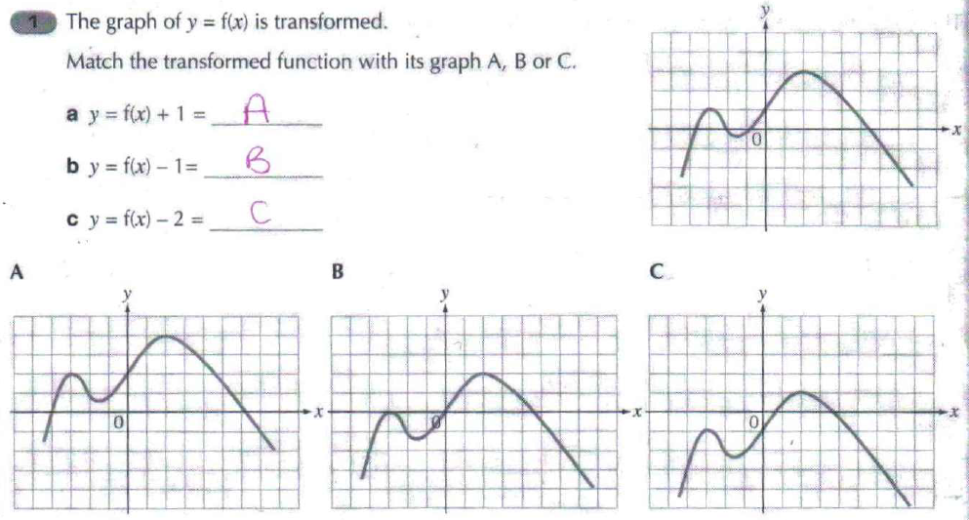
Transformations of the Graph y = f(x).
Tuesday, 09 February 2021
ALL will be able to identify transformations of a graph.
MOST will be able to sketch graphs after one or more transformation.
SOME will be able to use transformations to find the equation of a graph.
Lesson Objective: To be able to transform the graph of y = f(x) using various transformation conditions.
Task (ANSWERS):
Keywords: Function → Transform → Reflection → Translation → Scale Factor → Stretch → Vector.

Slide 25
Transformations of the Graph y = f(x).
Tuesday, 09 February 2021
ALL will be able to identify transformations of a graph.
MOST will be able to sketch graphs after one or more transformation.
SOME will be able to use transformations to find the equation of a graph.
Lesson Objective: To be able to transform the graph of y = f(x) using various transformation conditions.
Task (ANSWERS):
Keywords: Function → Transform → Reflection → Translation → Scale Factor → Stretch → Vector.

Slide 26
Transformations of the Graph y = f(x).
Tuesday, 09 February 2021
ALL will be able to identify transformations of a graph.
MOST will be able to sketch graphs after one or more transformation.
SOME will be able to use transformations to find the equation of a graph.
Lesson Objective: To be able to transform the graph of y = f(x) using various transformation conditions.
Task (ANSWERS):
Keywords: Function → Transform → Reflection → Translation → Scale Factor → Stretch → Vector.

Slide 27
Transformations of the Graph y = f(x).
Tuesday, 09 February 2021
ALL will be able to identify transformations of a graph.
MOST will be able to sketch graphs after one or more transformation.
SOME will be able to use transformations to find the equation of a graph.
Lesson Objective: To be able to transform the graph of y = f(x) using various transformation conditions.
Task (ANSWERS):
Keywords: Function → Transform → Reflection → Translation → Scale Factor → Stretch → Vector.

Slide 28
Transformations of the Graph y = f(x).
Tuesday, 09 February 2021
ALL will be able to identify transformations of a graph.
MOST will be able to sketch graphs after one or more transformation.
SOME will be able to use transformations to find the equation of a graph.
Lesson Objective: To be able to transform the graph of y = f(x) using various transformation conditions.
Task (ANSWERS):
Keywords: Function → Transform → Reflection → Translation → Scale Factor → Stretch → Vector.

Slide 29
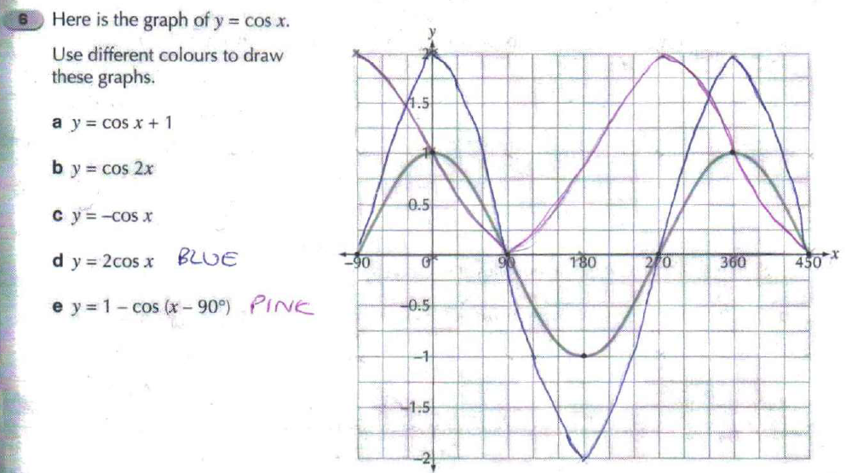
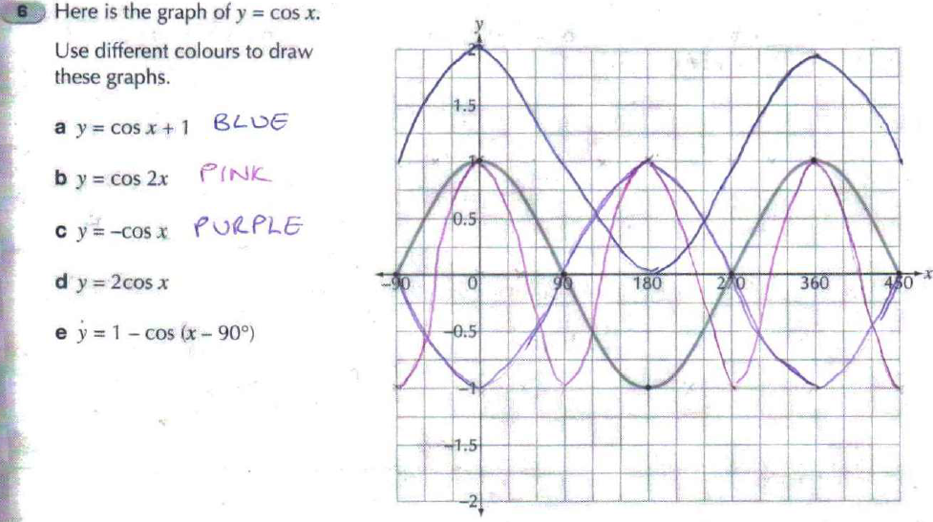
Transformations of the Graph y = f(x).
Tuesday, 09 February 2021
ALL will be able to identify transformations of a graph.
MOST will be able to sketch graphs after one or more transformation.
SOME will be able to use transformations to find the equation of a graph.
Lesson Objective: To be able to transform the graph of y = f(x) using various transformation conditions.
Task (ANSWERS):
Keywords: Function → Transform → Reflection → Translation → Scale Factor → Stretch → Vector.

Slide 30
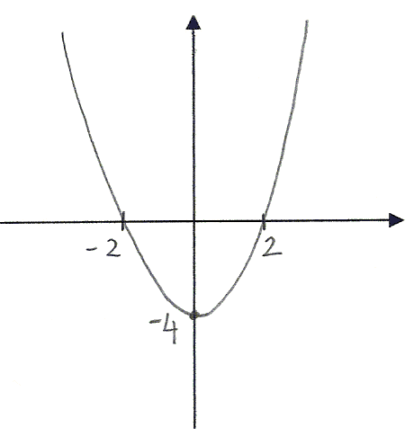
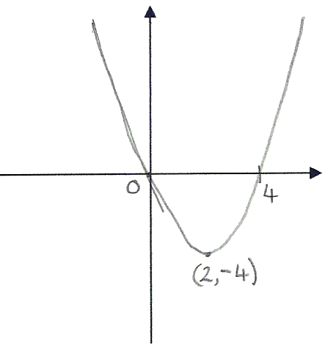
Transformations of the Graph y = f(x).
Tuesday, 09 February 2021
ALL will be able to identify transformations of a graph.
MOST will be able to sketch graphs after one or more transformation.
SOME will be able to use transformations to find the equation of a graph.
Lesson Objective: To be able to transform the graph of y = f(x) using various transformation conditions.
Plenary: Multiple-Choice Quiz…
y = f(x)
y = f(x) + 2
y = ?
y = f(x) – 2
y = f(x + 2)
y = f(x – 2)
Keywords: Function → Transform → Reflection → Translation → Scale Factor → Stretch → Vector.

Slide 31
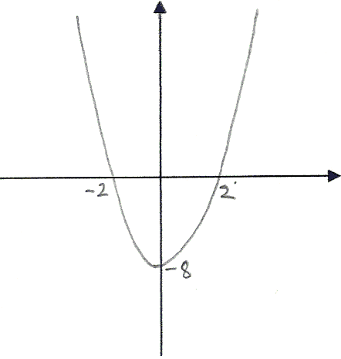
Transformations of the Graph y = f(x).
Tuesday, 09 February 2021
ALL will be able to identify transformations of a graph.
MOST will be able to sketch graphs after one or more transformation.
SOME will be able to use transformations to find the equation of a graph.
Lesson Objective: To be able to transform the graph of y = f(x) using various transformation conditions.
Plenary: Multiple-Choice Quiz…
y = f(x)
y = f(2x)
y = ?
y = f(½x)
y = 2f(x)
y = ½f(x)
Keywords: Function → Transform → Reflection → Translation → Scale Factor → Stretch → Vector.

Slide 32
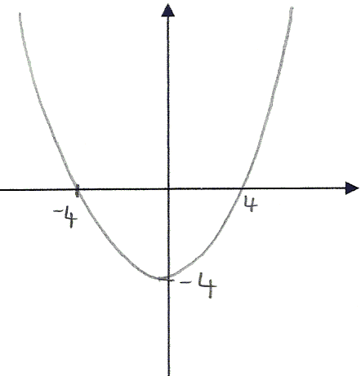
Transformations of the Graph y = f(x).
Tuesday, 09 February 2021
ALL will be able to identify transformations of a graph.
MOST will be able to sketch graphs after one or more transformation.
SOME will be able to use transformations to find the equation of a graph.
Lesson Objective: To be able to transform the graph of y = f(x) using various transformation conditions.
Plenary: Multiple-Choice Quiz…
y = f(x)
y = f(2x)
y = ?
y = f(½x)
y = 2f(x)
y = ½f(x)
Keywords: Function → Transform → Reflection → Translation → Scale Factor → Stretch → Vector.

Slide 33
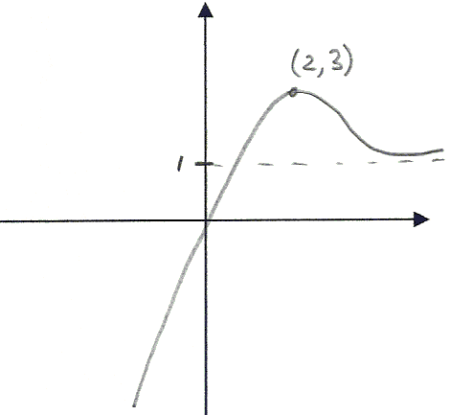
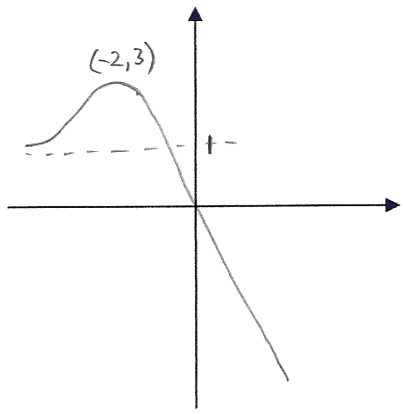
Transformations of the Graph y = f(x).
Tuesday, 09 February 2021
ALL will be able to identify transformations of a graph.
MOST will be able to sketch graphs after one or more transformation.
SOME will be able to use transformations to find the equation of a graph.
Lesson Objective: To be able to transform the graph of y = f(x) using various transformation conditions.
Plenary: Multiple-Choice Quiz…
y = f(x)
y = f(-x)
y = ?
y = f(x – 4)
y = -f(x)
y = f$\left(\frac{\text{1}}{\text{x}}\right)$
Keywords: Function → Transform → Reflection → Translation → Scale Factor → Stretch → Vector.

Slide 34
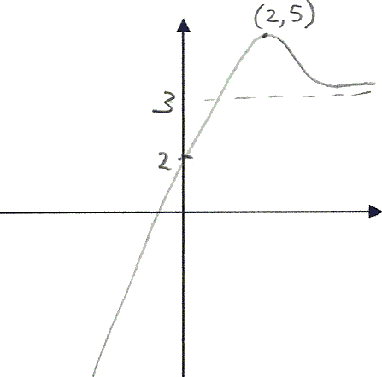
Transformations of the Graph y = f(x).
Tuesday, 09 February 2021
ALL will be able to identify transformations of a graph.
MOST will be able to sketch graphs after one or more transformation.
SOME will be able to use transformations to find the equation of a graph.
Lesson Objective: To be able to transform the graph of y = f(x) using various transformation conditions.
Plenary: Multiple-Choice Quiz…
y = f(x)
y = f(x) + 2
y = ?
y = f(x + 2)
y = f(x) – 2
y = f(x – 2)
Keywords: Function → Transform → Reflection → Translation → Scale Factor → Stretch → Vector.

Slide 35
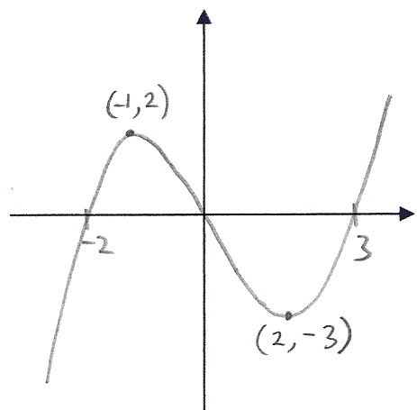
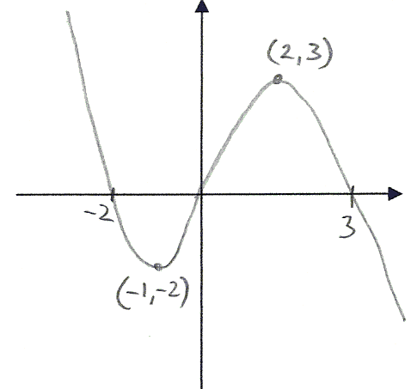
Transformations of the Graph y = f(x).
Tuesday, 09 February 2021
ALL will be able to identify transformations of a graph.
MOST will be able to sketch graphs after one or more transformation.
SOME will be able to use transformations to find the equation of a graph.
Lesson Objective: To be able to transform the graph of y = f(x) using various transformation conditions.
Plenary: Multiple-Choice Quiz…
y = f(x)
y = -f(x)
y = ?
y = f(-x)
y = f(x⁻¹)
y = f(x) – 4
Keywords: Function → Transform → Reflection → Translation → Scale Factor → Stretch → Vector.

Slide 36
Transformations of the Graph y = f(x).
Tuesday, 09 February 2021
ALL will be able to identify transformations of a graph.
MOST will be able to sketch graphs after one or more transformation.
SOME will be able to use transformations to find the equation of a graph.
Lesson Objective: To be able to transform the graph of y = f(x) using various transformation conditions.
HOMEWORK…! (Due: )
Complete the booklet of exam questions on graph transformations.
You must complete ALL of the questions.
Failure to complete the homework will result in a detention.
If you are struggling, PLEASE come and see me BEFORE the day it is due!!!! ☺
Keywords: Function → Transform → Reflection → Translation → Scale Factor → Stretch → Vector.

Slide 37
Transformations of the Graph y = f(x).
Tuesday, 09 February 2021
ALL will be able to identify transformations of a graph.
MOST will be able to sketch graphs after one or more transformation.
SOME will be able to use transformations to find the equation of a graph.
Lesson Objective: To be able to transform the graph of y = f(x) using various transformation conditions.
End of Lesson Reflection:
.
How do you feel about graph transformations now?
Keywords: Function → Transform → Reflection → Translation → Scale Factor → Stretch → Vector.

Slide 38
Transformations of the Graph y = f(x).
Tuesday, 09 February 2021
ALL will be able to identify transformations of a graph.
MOST will be able to sketch graphs after one or more transformation.
SOME will be able to use transformations to find the equation of a graph.
Lesson Objective: To be able to transform the graph of y = f(x) using various transformation conditions.
Stretch your Thinking:
Describe how a graph of y = f(x) is transformed into y = -f(-x).
The curve y = x³ + 2x + 4 is reflected in the y-axis. What is the equation of the new curve?
A reflection in the x-axis followed by a reflection in the y-axis.
y = -x³ – 2x + 4
Keywords: Function → Transform → Reflection → Translation → Scale Factor → Stretch → Vector.

