Slide 1

Completing the Square
LO: solve quadratics and find the minimum point (turning point) by completing the square
Starter
Multiply out the brackets:
(x+3)(x+3)
(x+2)²
(x-5)²
Factorise:
x² + 8x + 16
x² - 12x + 36
x² + 22x + 121
= x² + 6x + 9
= x² + 4x + 4
= x² – 10x + 25
= (x + 4)²
= (x – 6)²
= (x + 11)²

Slide 2


To complete the square there are 3 steps to follow:
Example:
Completing the Square
x² + 10x + 10 = 0
Half the coefficient of x
Then subtract that value squared
(x + 5)² – (5)² + 10 = 0
(x + 5)² – 25 + 10 = 0
Simplify
Minimum point
(-5, -15)
(x + 5)² – 15 = 0
(x + 5)² = 15
Rearrange and Solve
x + 5 = ± √15
x = - 5 ± √15
Make sure you have both + and – square root!
X = 5 + √15 =
OR
X = 5 - √15 =

Slide 3
To complete the square there are 3 steps to follow:
Completing the Square – alternative way
Example:
x² + 10x + 10 = 0
Half the coefficient of x
(x + 5)²
x² +10x + 25 = 0
Expand
Find what you need to make the original solution correct
(x + 5)² – 15 = 0
Minimum point
(-5, -15)
This is harder using this method. The x coordinate is always the opposite to what is in the bracket.
(x + 5)² = 15
Rearrange and Solve
x + 5 = ± √15
x = - 5 ± √15
X = 5 + √15 =
OR
X = 5 - √15 =
Make sure you have both + and – square root!

Slide 4
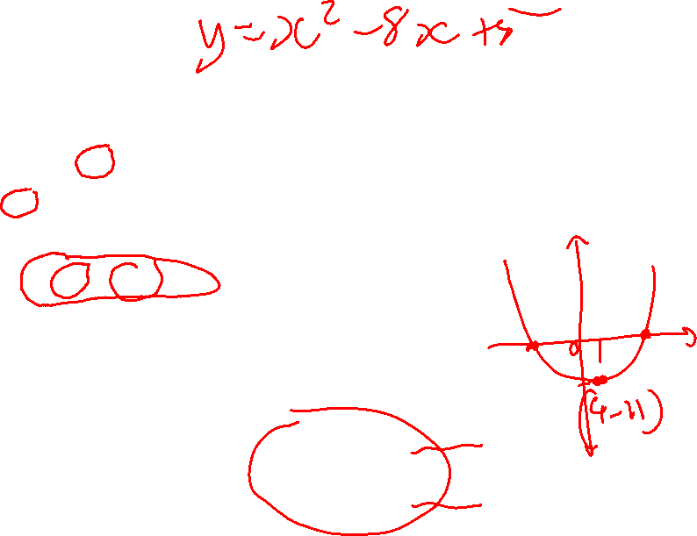
Your go
Completing the Square – Your go, first method
x² - 8x + 5 = 0
Half the coefficient of x and subtract the value squared
(x - 4)² – (-4)² + 5 = 0
(x - 4)² – 16 + 5 = 0
Simplify
Minimum point
(4, -11)
(x - 4)² – 11 = 0
(x - 4)² = 11
Solve
x - 4 = ± √11
x = 4 ± √11
Make sure you have both + and – square root!
X = 4 + √11 =
OR
X = 4 - √11 =

Slide 5
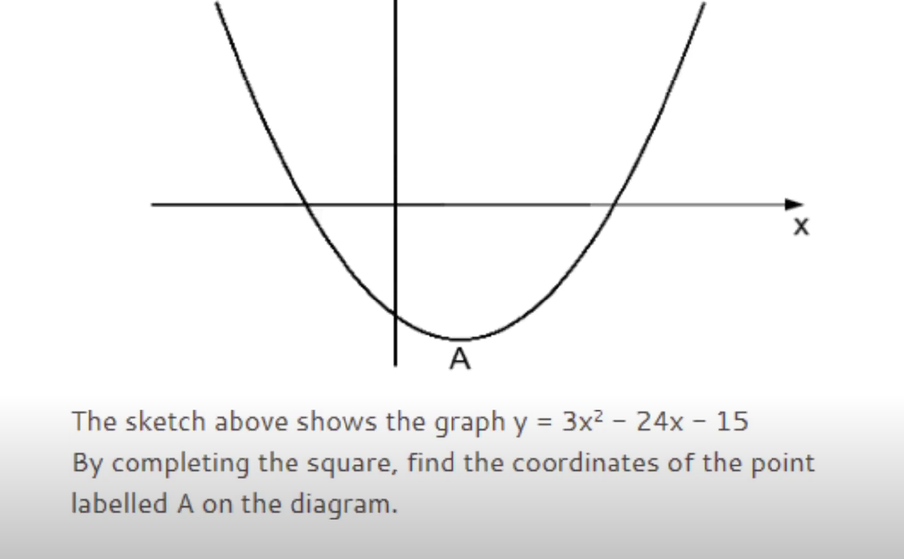
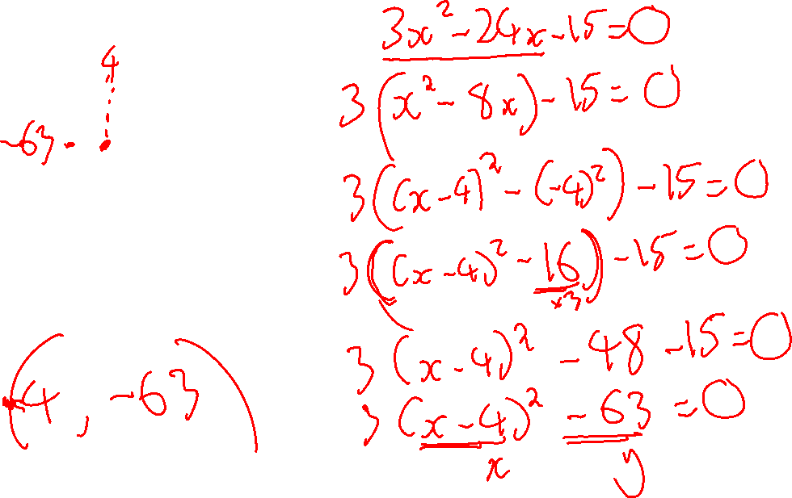


Slide 6
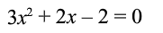
One other key message is…
The coefficient of x² MUST be 1
What do you do if you are given…
Divide EVERYTHING by 3 first.

Slide 7
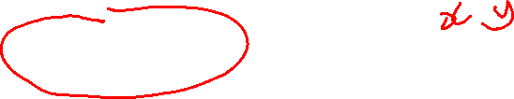
The minimum point
Minimum Points
(x + 5)² – 15 = 0 Minimum at (-5, -15)
(x - 4)² – 11 = 0 Minimum at (4, -11)
(x - 7)² – 58 = 0 Minimum at (7, -58)
(x - p)² + q = 0 Minimum at (p, q)

Slide 8
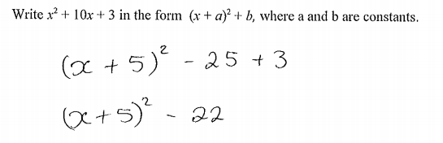
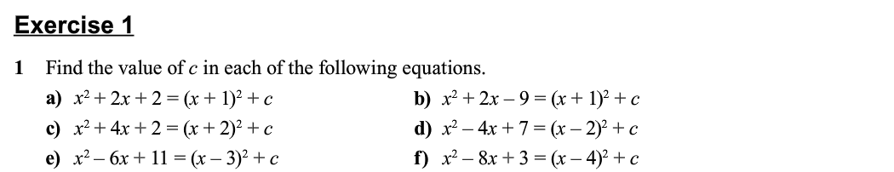
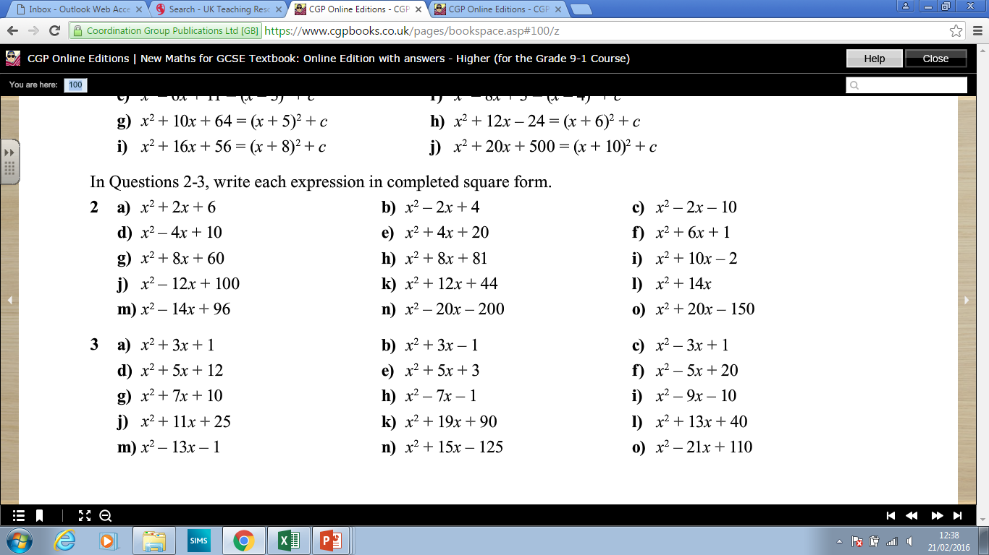
Writing in completed square form
(and write down the minimum point)
Example

Slide 9
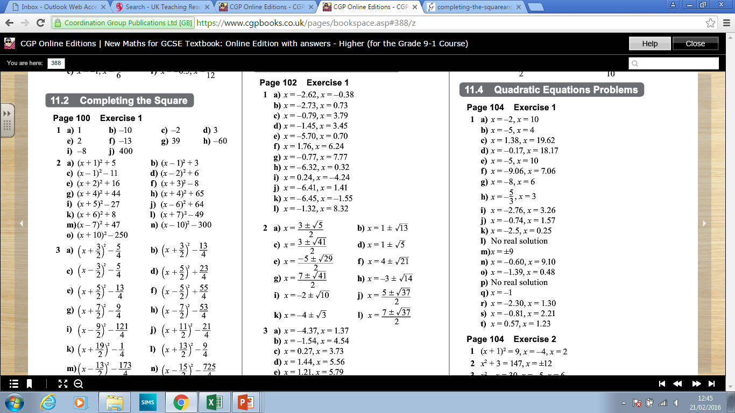
Answers

Slide 10
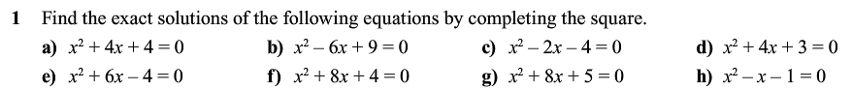

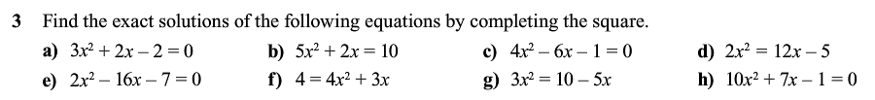
Solving Quadratics by Completing the Square
SECTIONS 1 & 3 – LEAVE IN SURD FORM! (Exact Solutions)

Slide 11
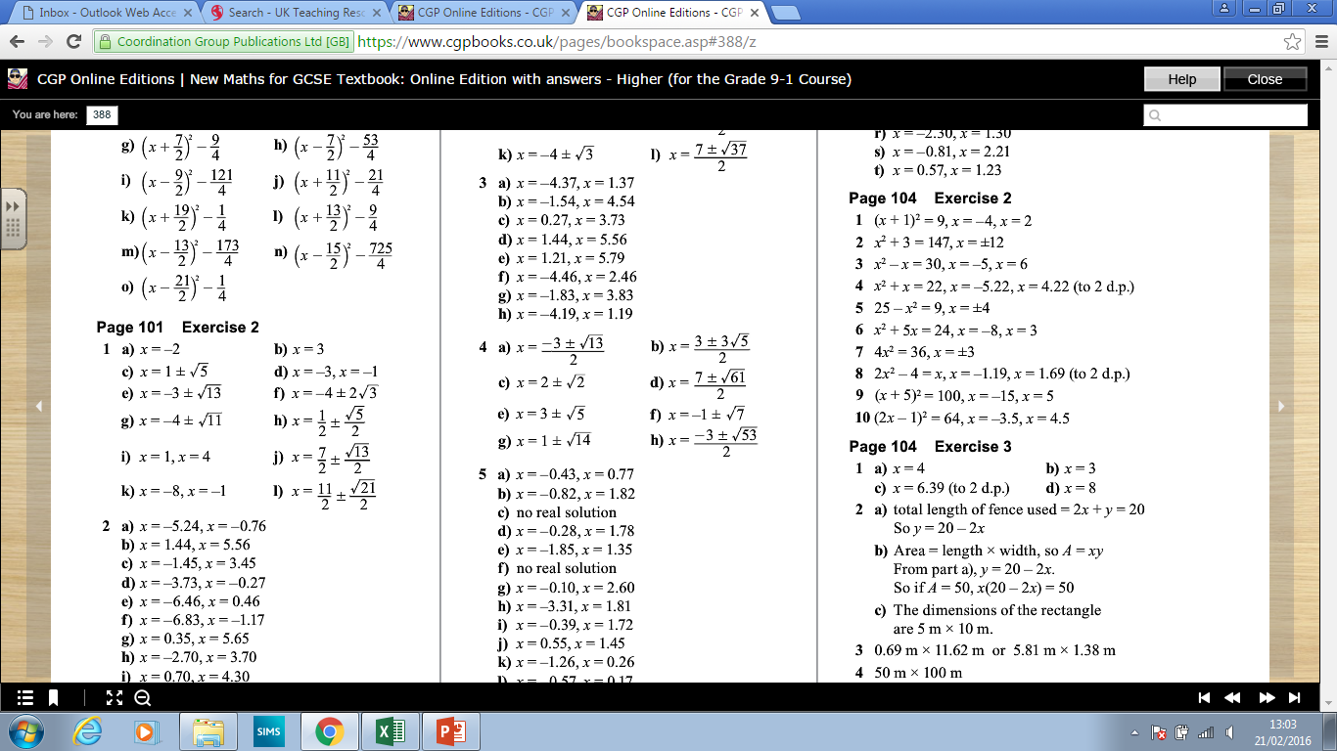
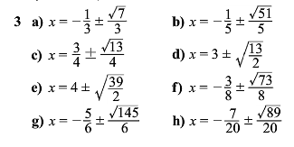
Answers

Slide 12
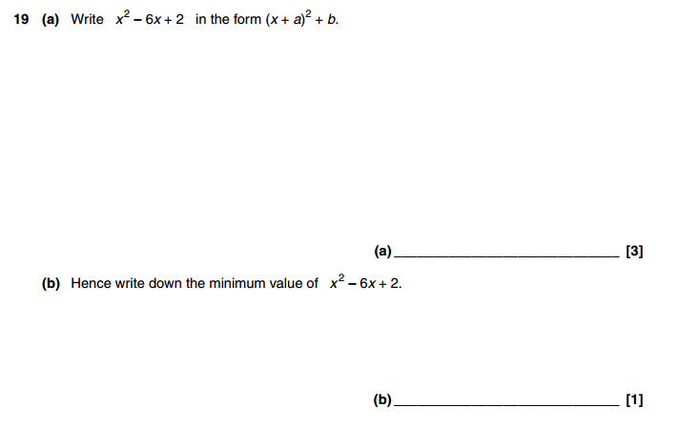
Exam Question
(Total 4 marks -> 4 mins)
OCR Nov 2012 – Paper 4

Slide 13
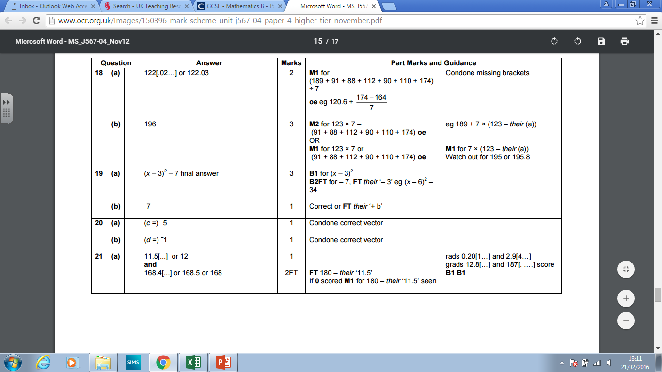
Answers

