Slide 1

Olivia – Number lesson
What we did today:
Dividing whole numbers and decimals by 10, 100 and 1000
5 a day practice

Slide 2

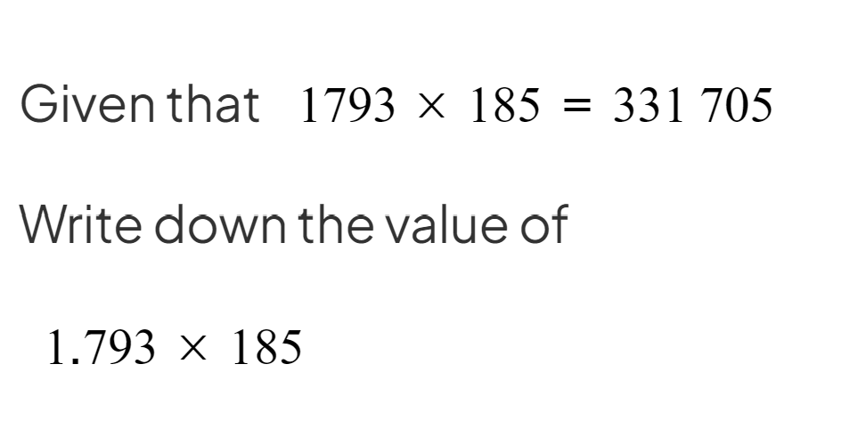


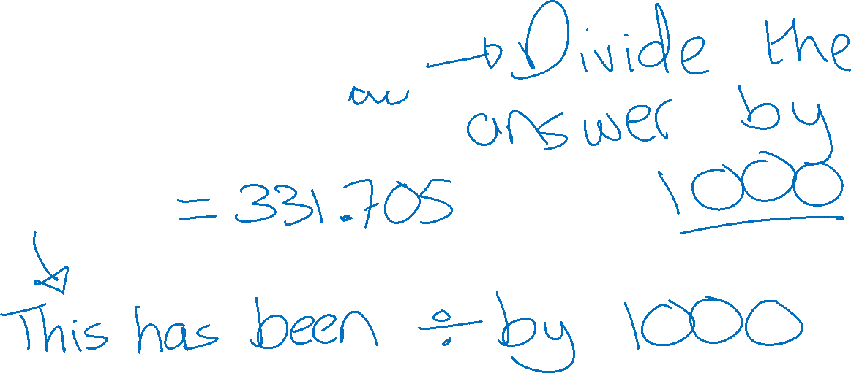
The starter problem

Slide 3
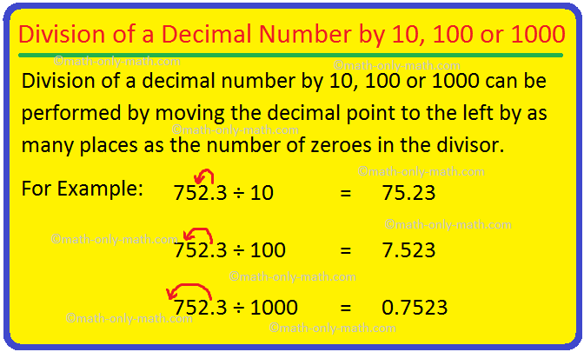
How to divide and move the decimal

Slide 4
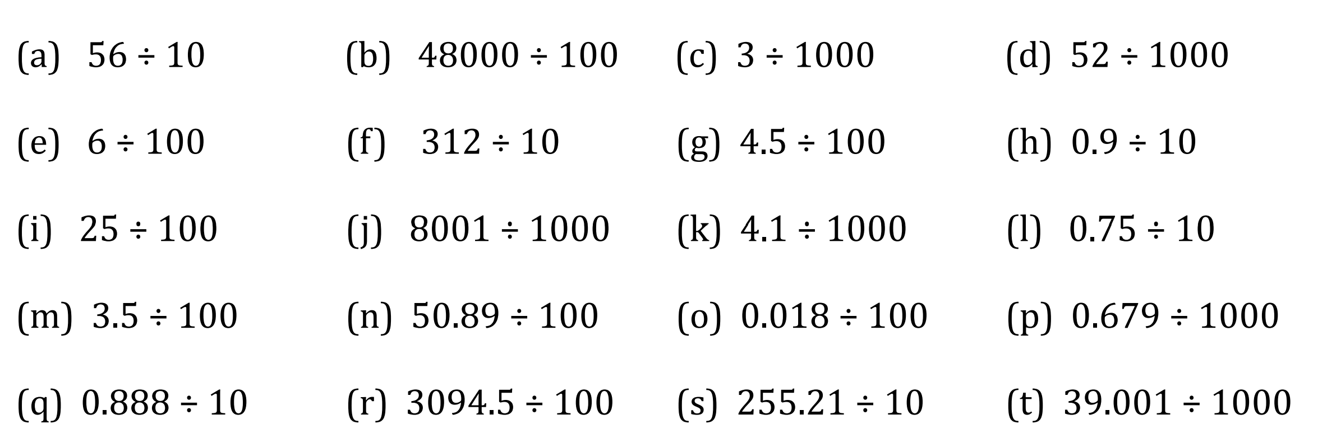
The questions we worked through

Slide 5
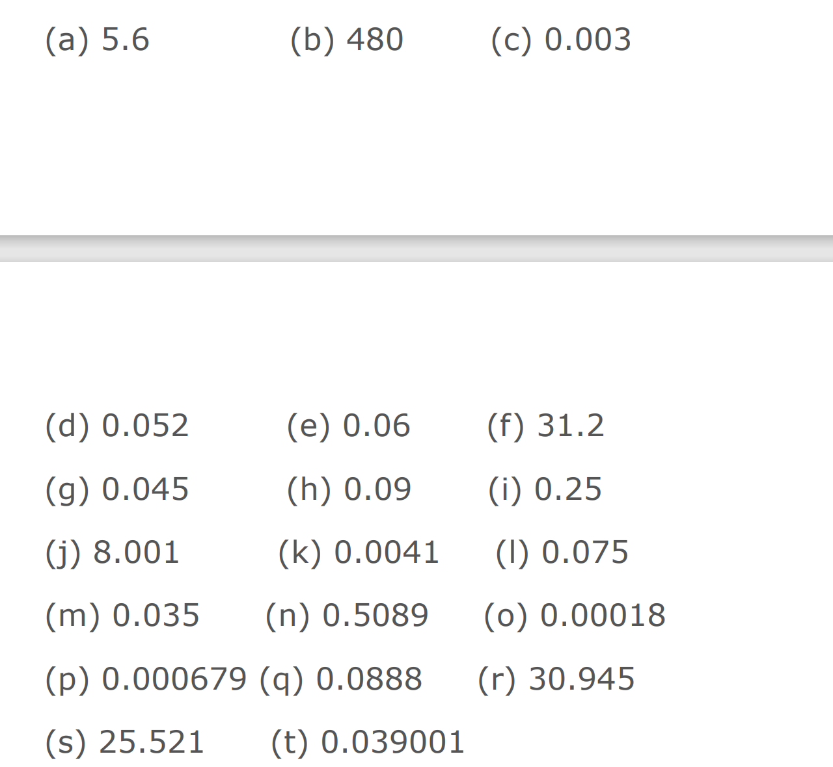
Answers

Slide 6
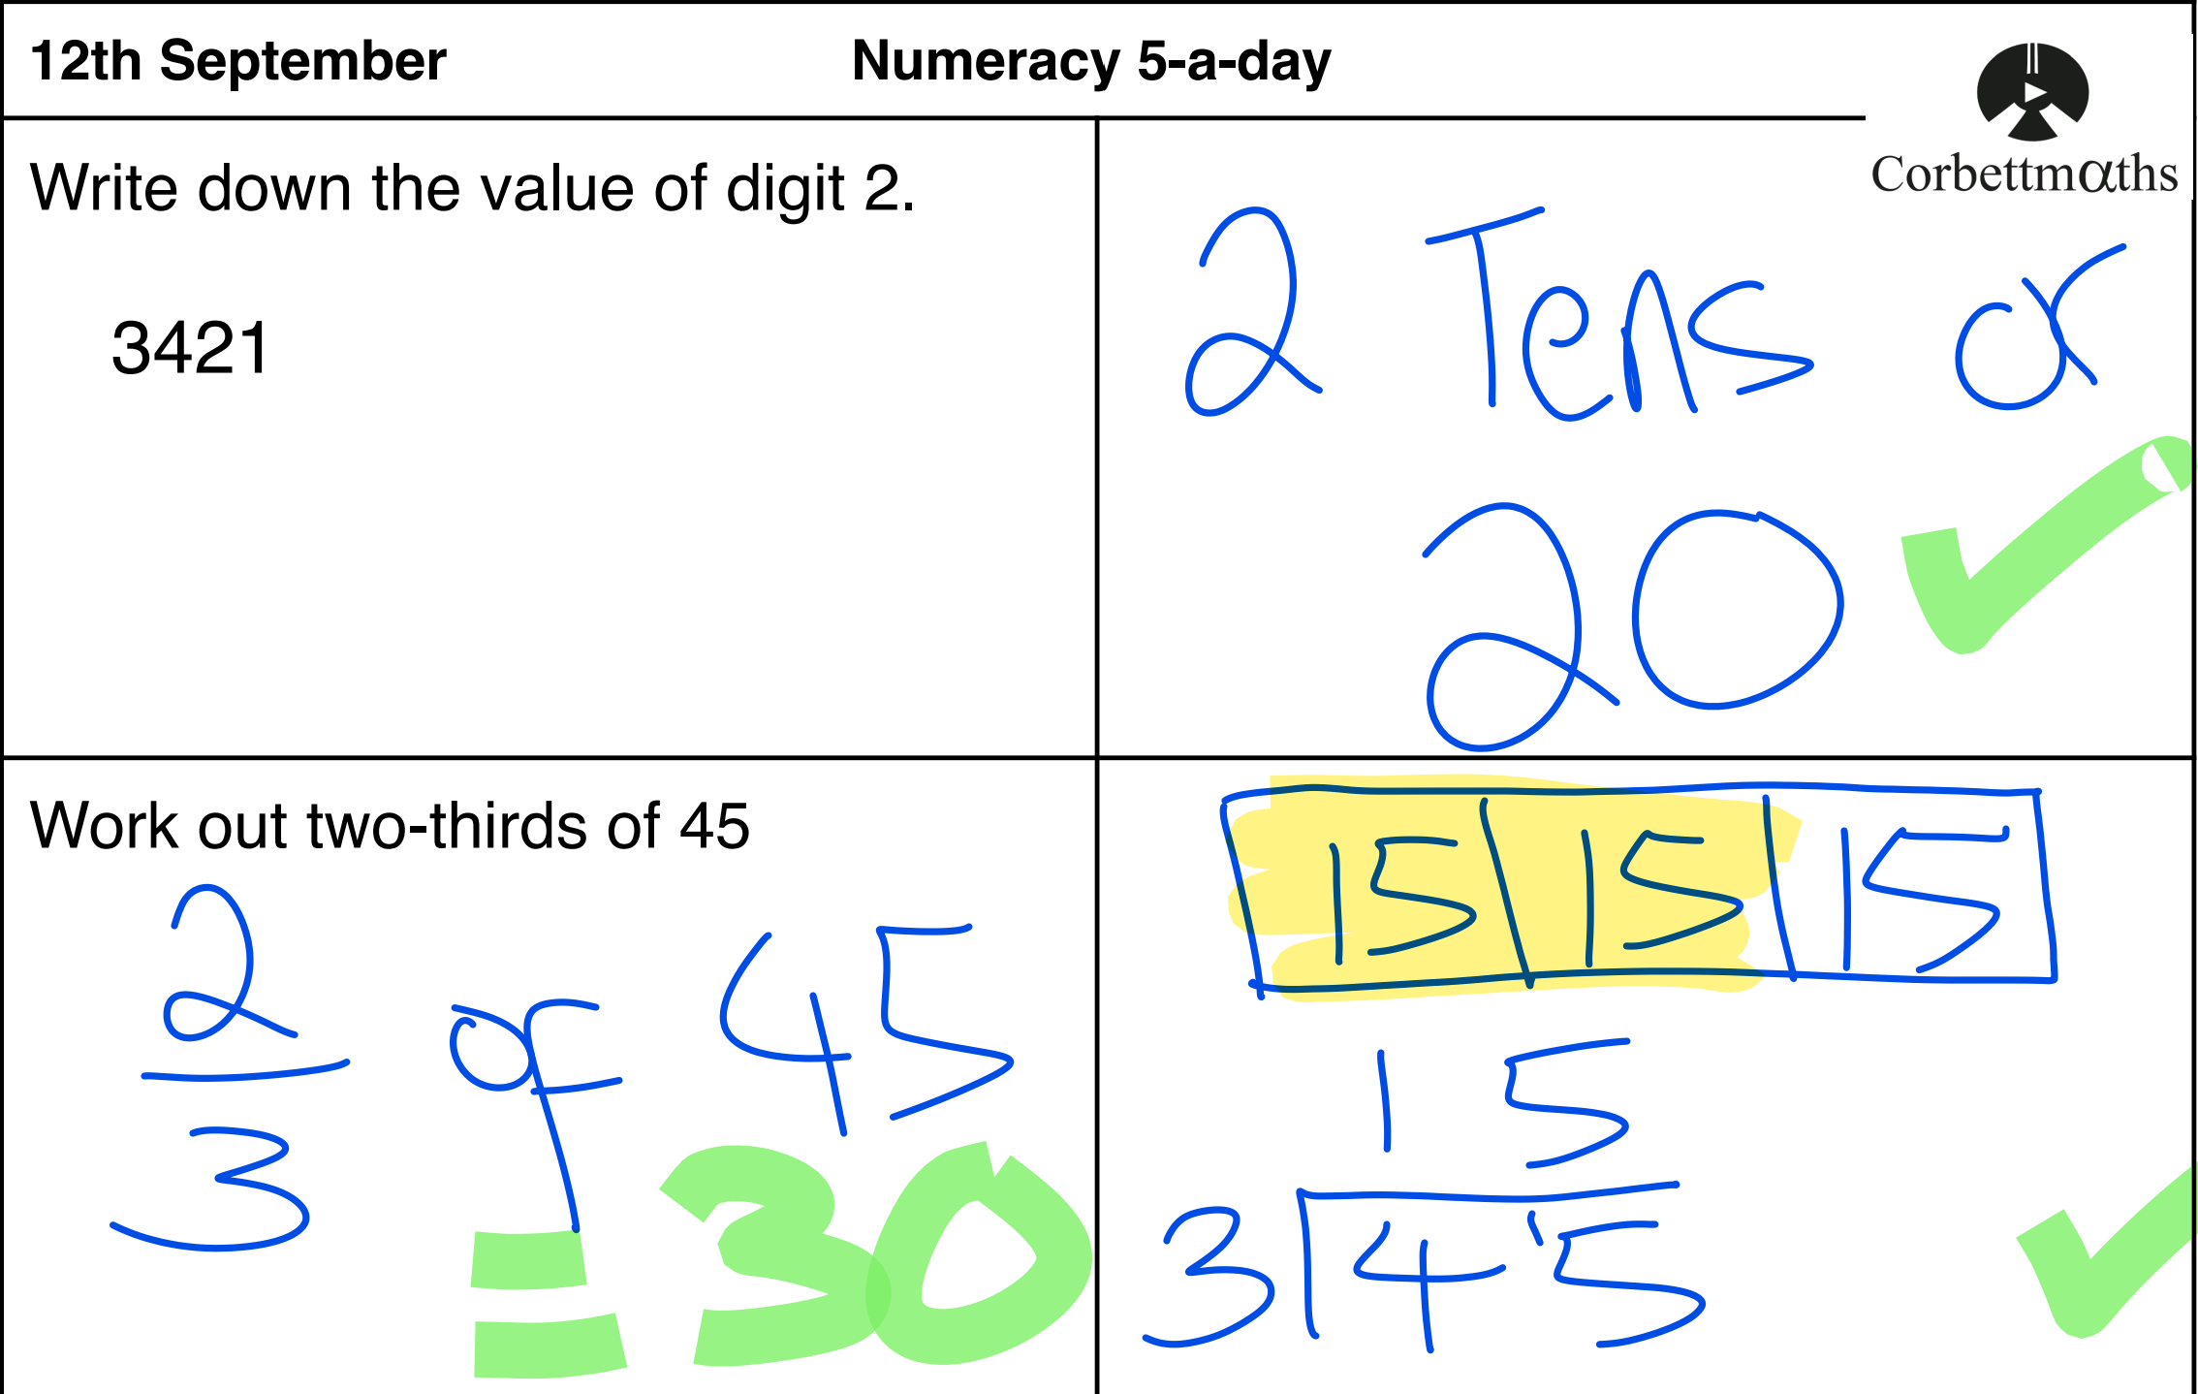

Slide 7
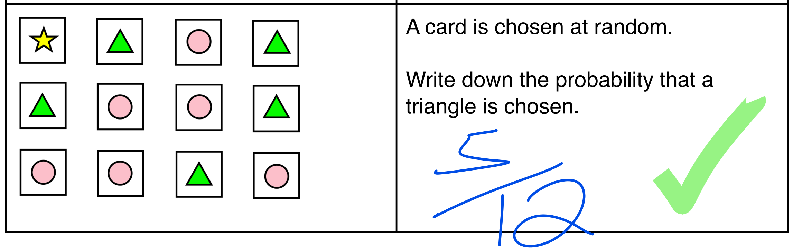

Slide 8
Well done Olivia!

