Slide 1
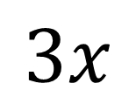
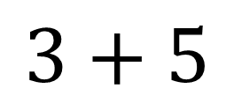
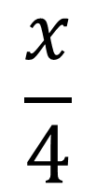
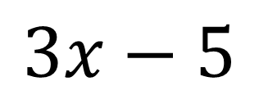
Expressions, Equations, Identities and Formulae
Expressions
An Expression is a statement which:
Has no equals sign
Has at least 2 variables and one operation
Examples:
$$\frac{x}{4}$$
$$3+5$$
$$3x$$
$$3x−5$$

Slide 2
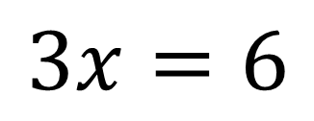
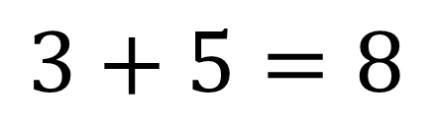
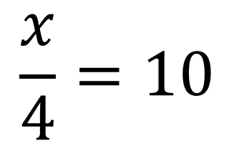
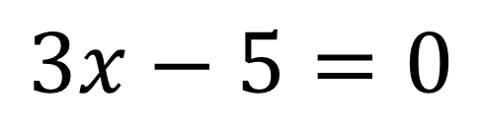
Expressions, Equations, Identities and Formulae
Equations
An Equation:
Has an equals sign
An answer can be found
Examples:
$$\frac{x}{4}=10$$
$$3+5=8$$
$$3x=6$$
$$3x−5=0$$

Slide 3
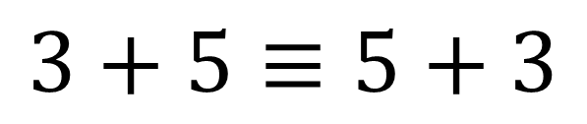
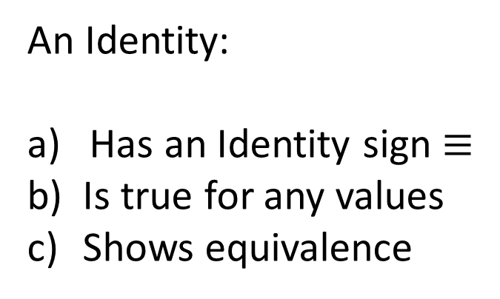
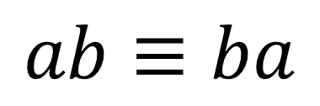
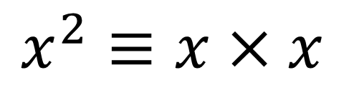
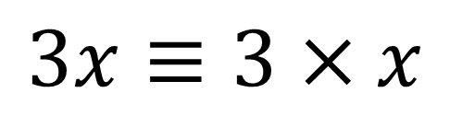
Expressions, Equations, Identities and Formulae
Identities
An Identity:
Has an Identity sign $≡$
Is true for any values
Shows equivalence
Examples:
$$3+5≡5+3$$
$$x^{2}≡x×x$$
$$3x≡3×x$$
$$ab≡ba$$

Slide 4
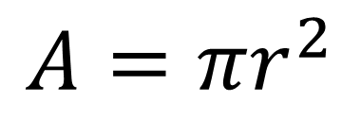
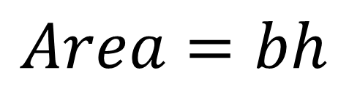
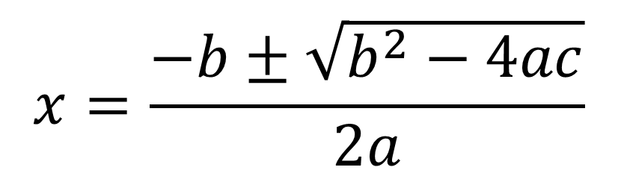
Expressions, Equations, Identities and Formulae
Formulae
Formulae:
Have more than one variable
Will have an equals sign
Can be applied to find a solution
Examples:
$$x=\frac{−b±\sqrt{b^{2}−4ac}}{2a}$$
$$Area=bh$$
$$A=πr^{2}$$

Slide 5
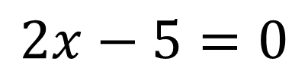
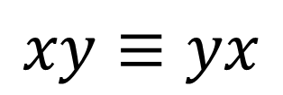
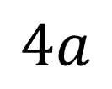

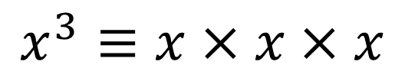
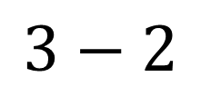
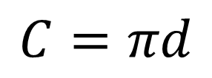
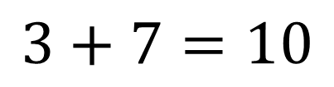
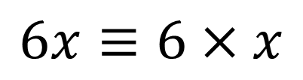

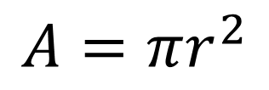
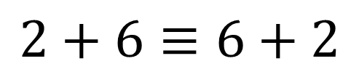
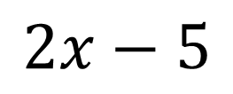
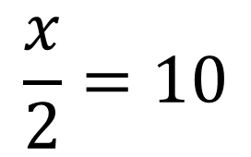
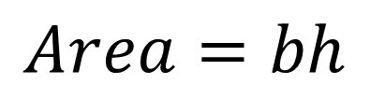
Decide whether each is an expression, equation identity or formula
Expressions
Equations
Identities
Formulae
$$2+6≡6+2$$
$$5x=5$$
$$2x−5$$
$$Area=bh$$
$$6x≡6×x$$
$$2x−5=0$$
$$3+7=10$$
$$\frac{x}{2}=10$$
$$xy≡yx$$
$$3−2$$
$$A=πr^{2}$$
$$C=πd$$
$$x^{3}≡x×x×x$$
Extension:
Give 2 more examples
for each category
$$\frac{x}{5}$$
$$4a$$

Slide 6
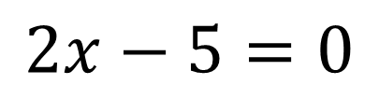



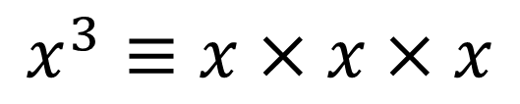


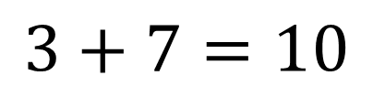
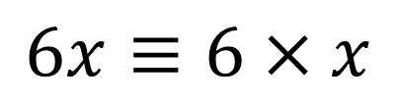


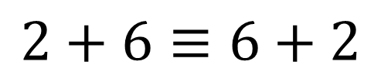


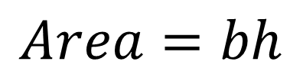
Answers
Expressions
Equations
Identities
Formulae
$$2x−5$$
$$3+7=10$$
$$2+6≡6+2$$
$$Area=bh$$
$$5x=5$$
$$6x≡6×x$$
$$A=πr^{2}$$
$$\frac{x}{5}$$
$$C=πd$$
$$2x−5=0$$
$$xy≡yx$$
$$3−2$$
$$\frac{x}{2}=10$$
$$x^{3}≡x×x×x$$
$$4a$$
Extension:
Give 2 more examples
for each category

