Slide 1


Angles and polygons
Angles in parallel lines recap
Interior and exterior angles

Slide 2
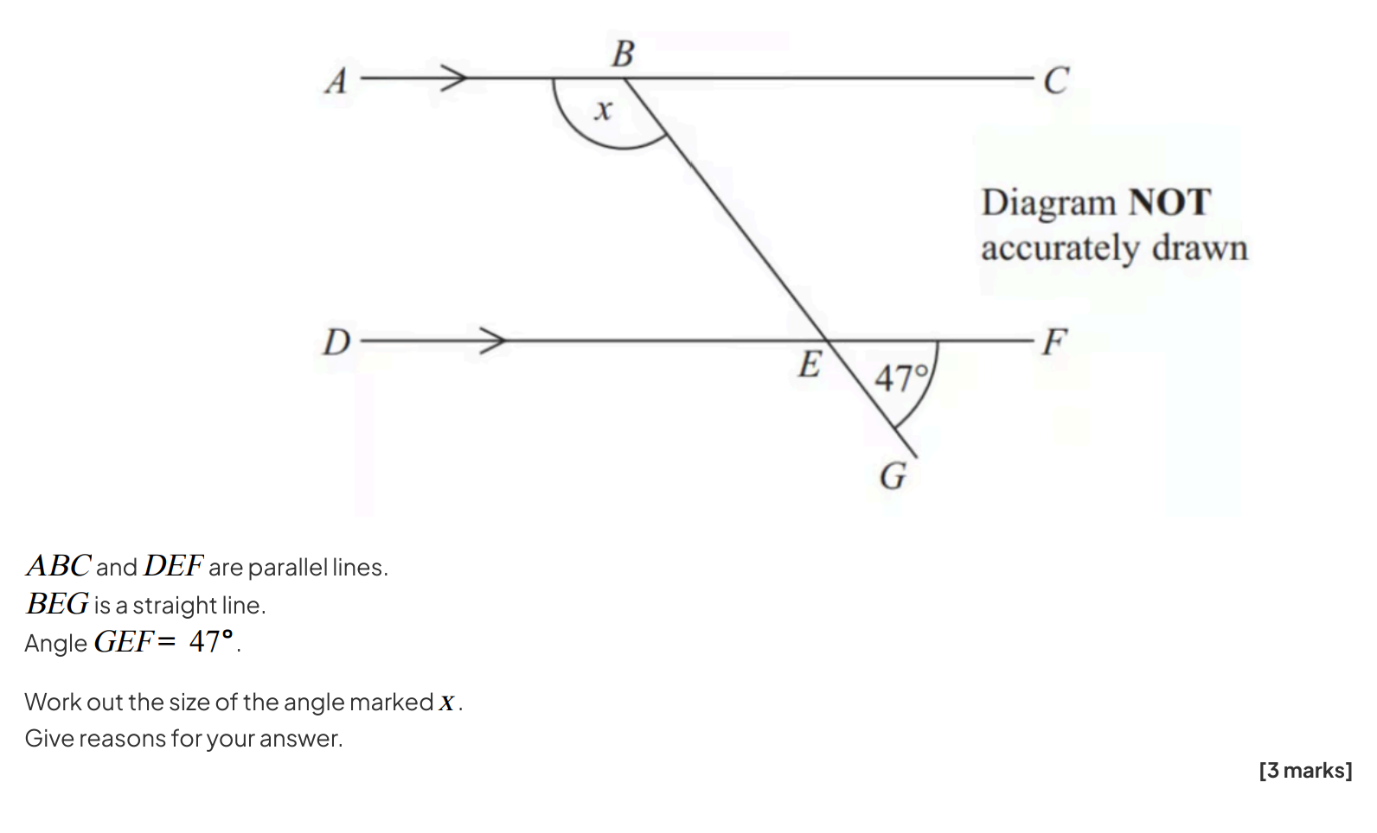


Slide 3
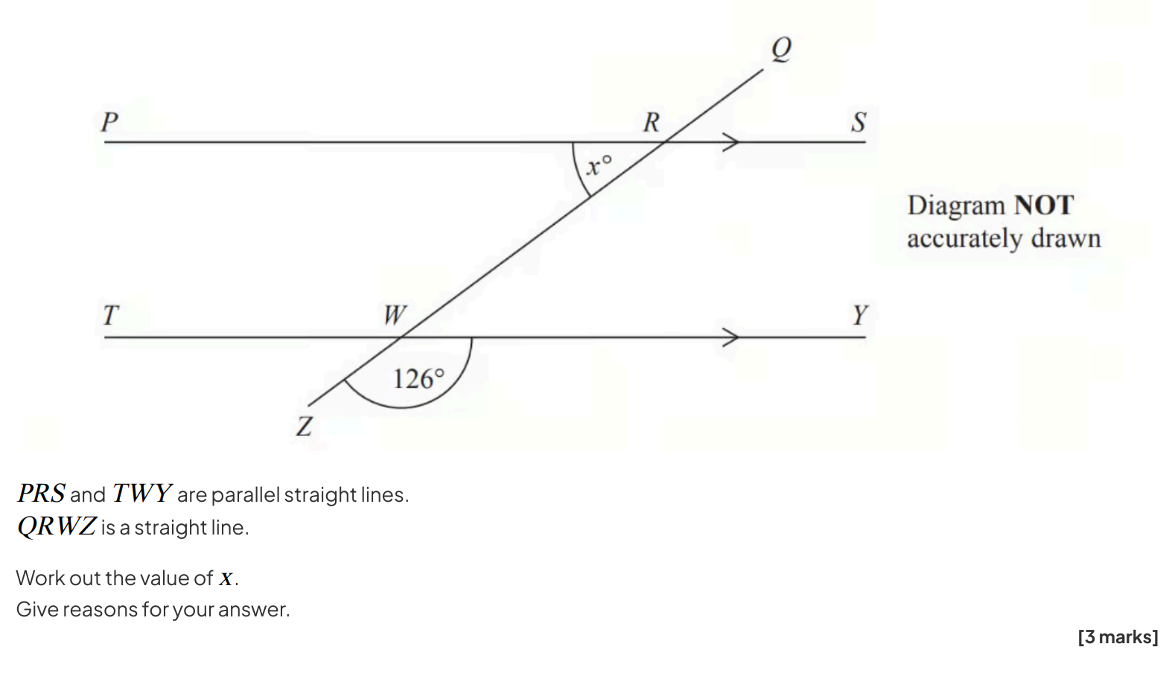

Slide 5
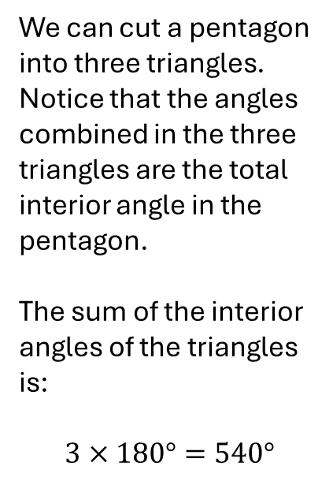

Sum of interior angles
Click to animate
We can cut a pentagon into three triangles. Notice that the angles combined in the three triangles are the total interior angle in the pentagon.
The sum of the interior angles of the triangles is:
$$3×180°=540°$$
! For an $n$-sided shape, the sum of the interior angles is:
$180(n−2)$
?

Slide 6


Interior Angles of Polygons
180º
180º
180º
180º
180º
4 sides
Quadrilateral
5 sides
Pentagon
2
2 x 180º = 360º
3
3 x 180º = 540º
180º
180º
180º
180º
180º
180º
180º
180º
180º
6 sides
Hexagon
7 sides
Heptagon/Septagon
4
4 x 180º = 720º
5
5 x 180º = 900º

Slide 7



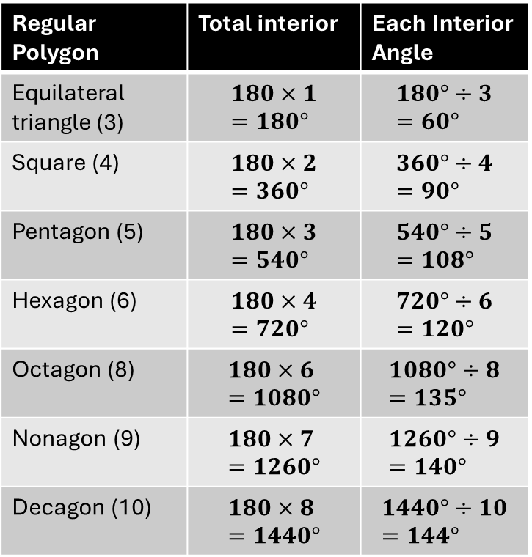




Examples
1
What is the total interior, and therefore, each interior angle, of each of these regular polygons?
2
Exam Tip: Memorise these for pentagon, hexagon and octagon.
$$70°$$
Determine $x$.
$$x$$
Regular Polygon | Total interior | Each Interior Angle
Equilateral triangle (3) | $$180×1=180°$$ | $$180°÷3=60°$$
Square (4) | $$180×2=360°$$ | $$360°÷4=90°$$
Pentagon (5) | $$180×3=540°$$ | $$540°÷5=108°$$
Hexagon (6) | $$180×4=720°$$ | $$720°÷6=120°$$
Octagon (8) | $$180×6=1080°$$ | $$1080°÷8=135°$$
Nonagon (9) | $$180×7=1260°$$ | $$1260°÷9=140°$$
Decagon (10) | $$180×8=1440°$$ | $$1440°÷10=144°$$
$$60°$$
$$110°$$
$$130°$$
?
6-sided so total interior angle:
$$180×\left(6−2\right)=720°$$
$$x=720−\left(90+110+130+60+70\right) \\ =720°−460° \\ =260°$$
?
?
?
?
?
?
?
?
?
?

Slide 8
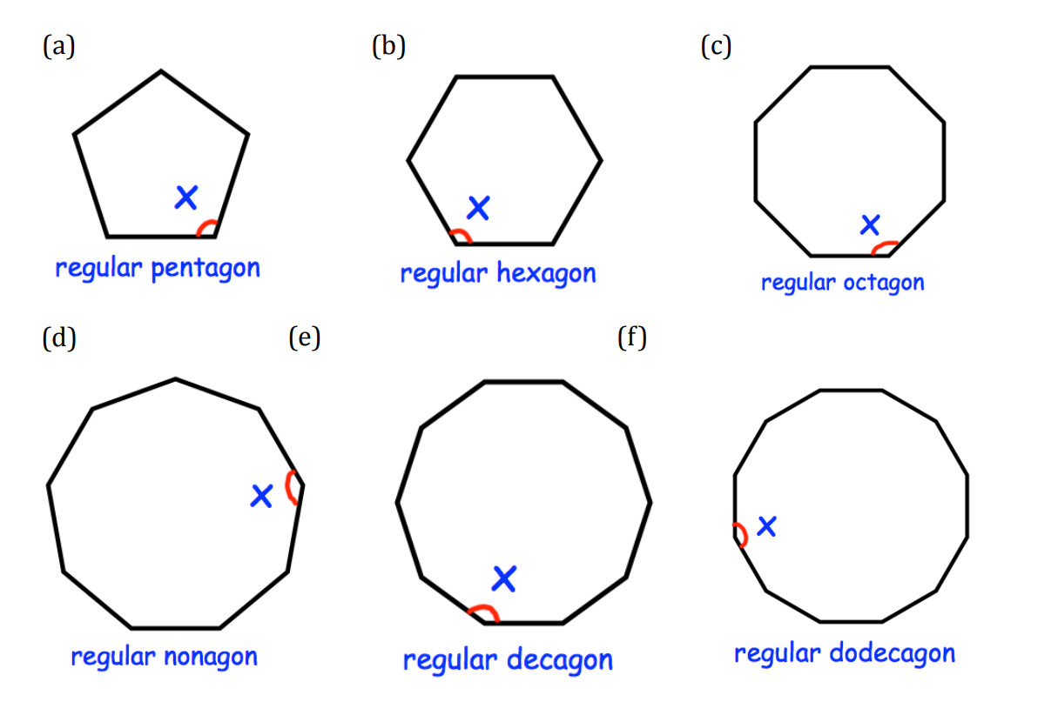
5 sides – 2 = 3 triangles. 3x180 = 540 each angle 540/5=108

Slide 9
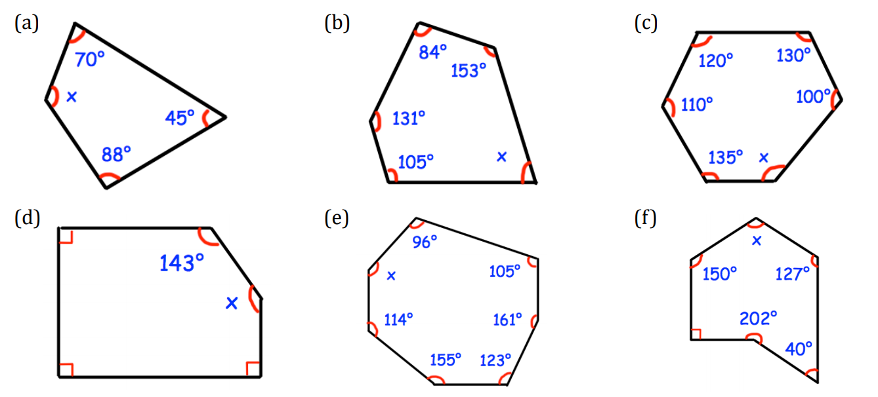

Slide 10
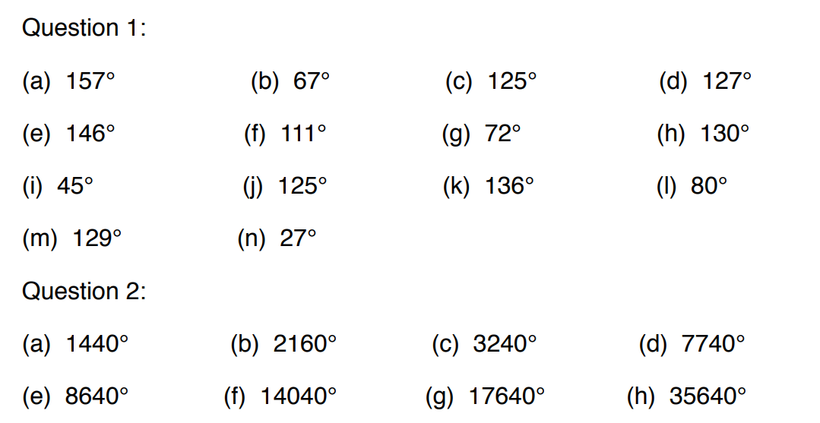
ANSWERS

Slide 11
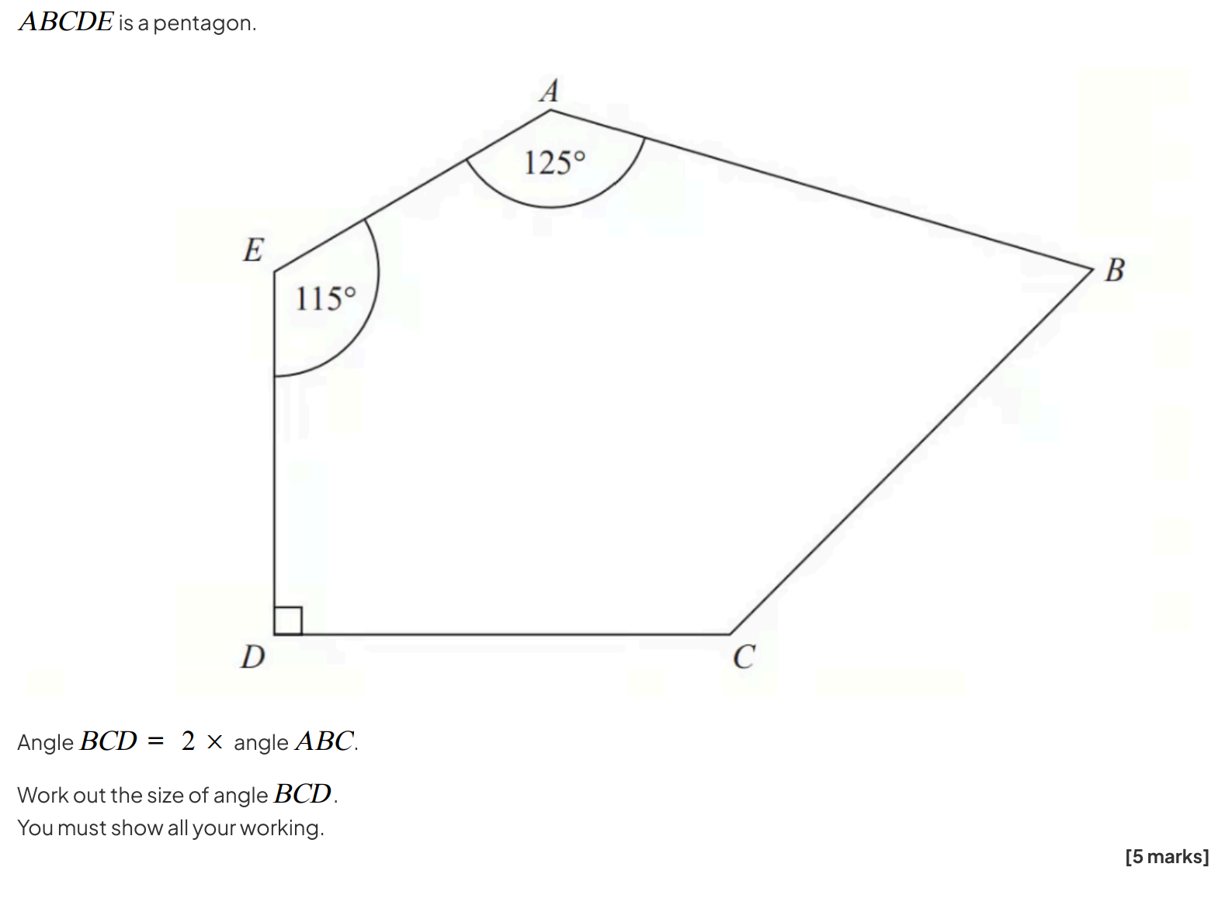

Slide 12
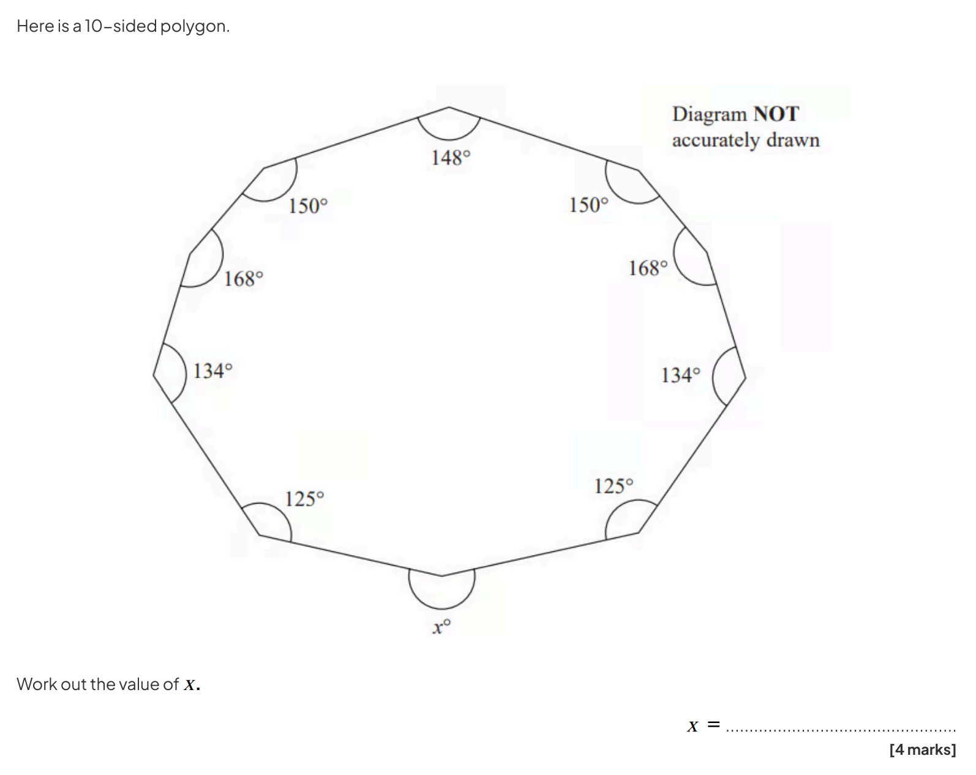

Slide 13
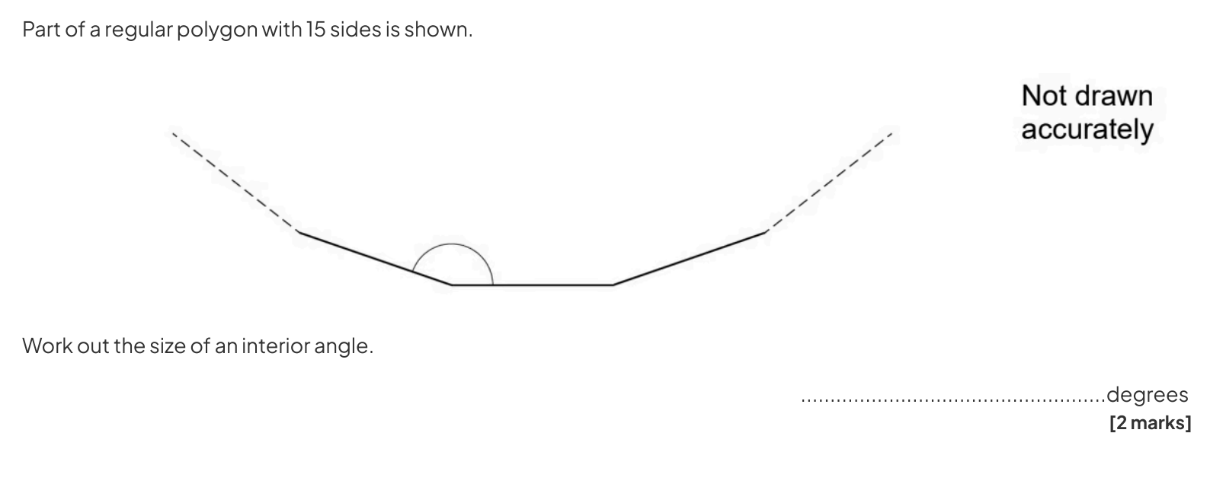

Slide 14
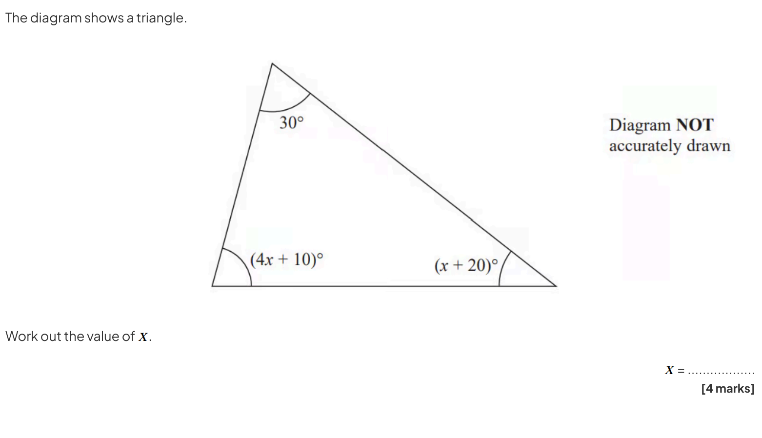

Slide 15
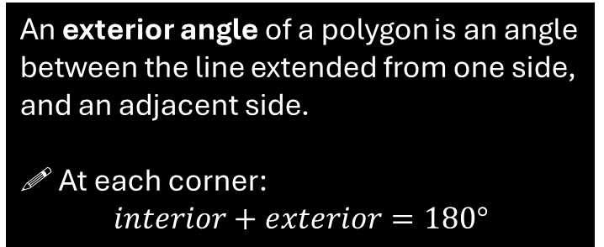
Exterior Angles
An exterior angle of a polygon is an angle between the line extended from one side, and an adjacent side.
! At each corner:
$$interior+exterior=180°$$
exterior
interior
?
Which of these are exterior angles of the polygon?
?
?
?
NO
YES
NO

Slide 16


Total Exterior Angle
What angle does the dog walk/turn in total?
He does one full rotation, so…
$$360°$$
?
! The sum of the exterior angles of any polygon is 360°.
Click to Start animation

Slide 17
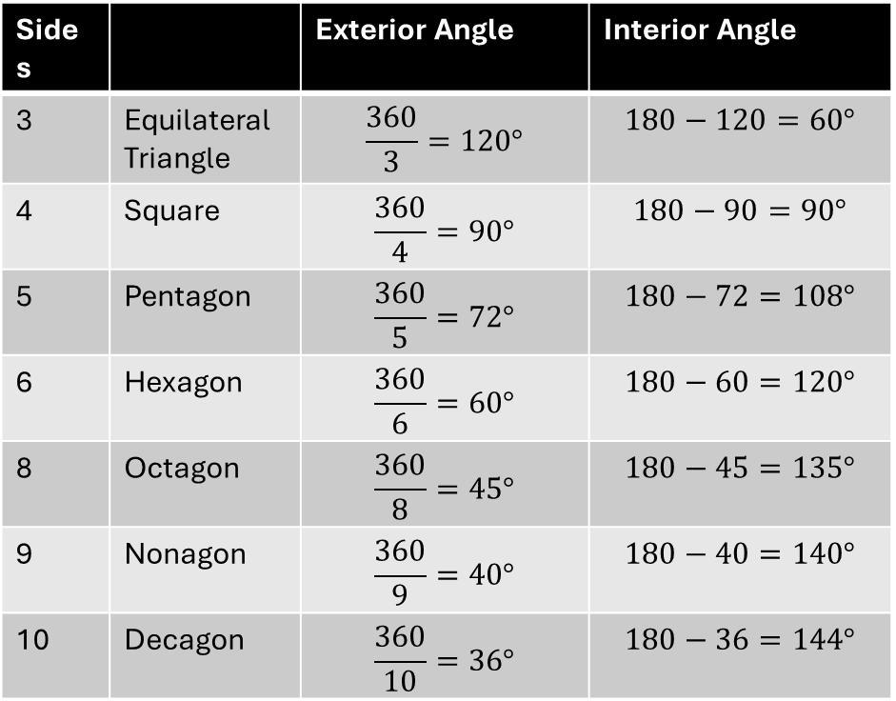
REGULAR POLYGONS
Sides |  | Exterior Angle | Interior Angle
3 | Equilateral Triangle | $$\frac{360}{3}=120°$$ | $$180−120=60°$$
4 | Square | $$\frac{360}{4}=90°$$ | $$180−90=90°$$
5 | Pentagon | $$\frac{360}{5}=72°$$ | $$180−72=108°$$
6 | Hexagon | $$\frac{360}{6}=60°$$ | $$180−60=120°$$
8 | Octagon | $$\frac{360}{8}=45°$$ | $$180−45=135°$$
9 | Nonagon | $$\frac{360}{9}=40°$$ | $$180−40=140°$$
10 | Decagon | $$\frac{360}{10}=36°$$ | $$180−36=144°$$
?
?
?
?
?
?
?
?
?
?
?
?
?
?

Slide 18
