Slide 1
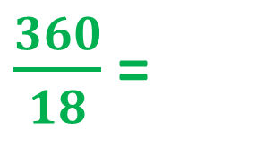
My Results
Pie Charts
“What is your favourite Quality Street?”
Sweet | Results
Strawberry Cream | 5
Orange Cream | 3
Purple Hazelnut | 6
Green Triangle | 2
Other | 2
TOTAL
Degrees
100°
60°
120°
40°
40°
Degrees
X 20
$\frac{360}{18}$ =
20°
360°
X 20
18

Slide 2
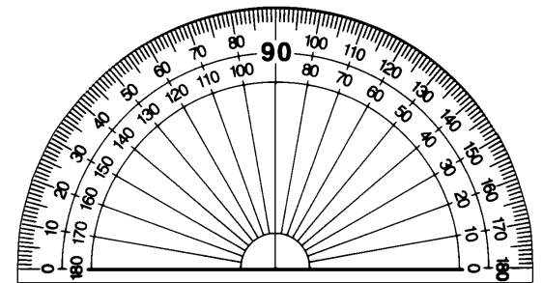
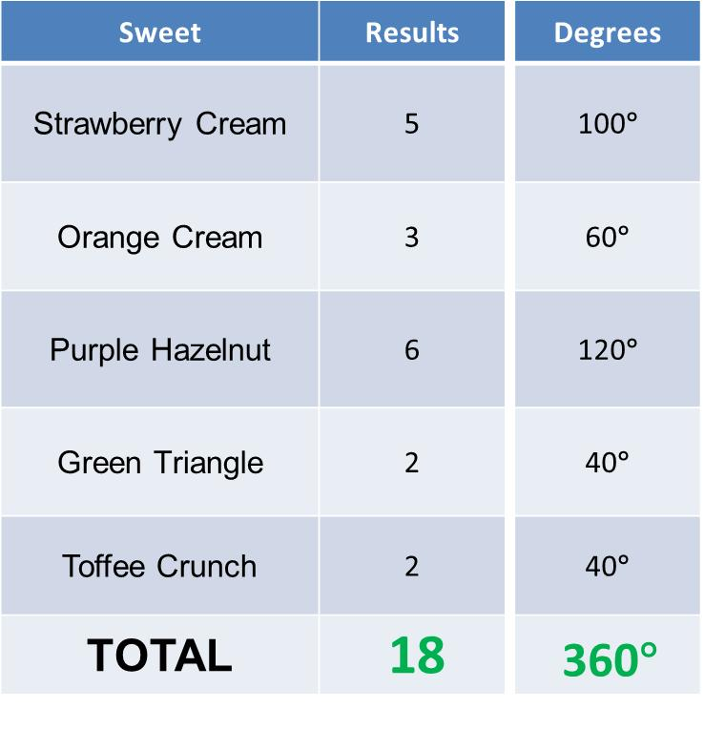
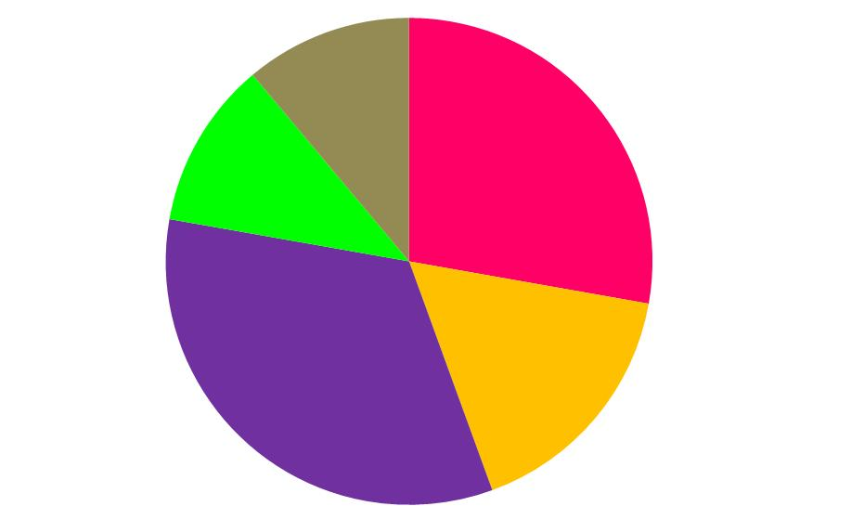
Pie Charts

Slide 3
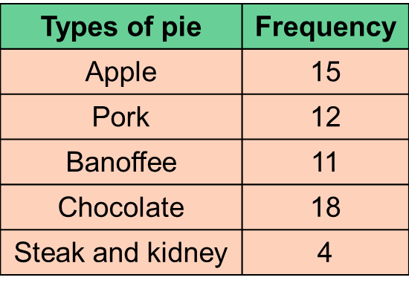
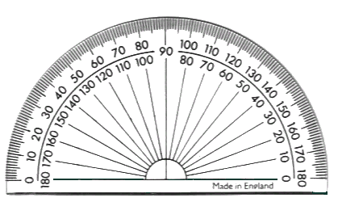
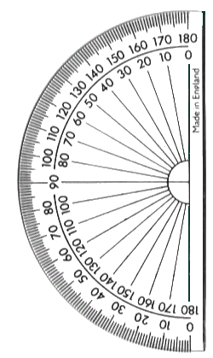

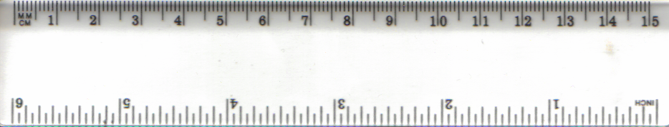

In a survey, people were asked to indicate which one of the pies they liked the best. The information is given in the table.
Display the information in a pie chart.
+
90°
+
72°
PORK
+
66°
APPLE
108°
.
+
24°
BANOFFEE
TOTAL =
60
360°
CHOCOLATE
360° in a full turn
Notes:
3

Slide 4
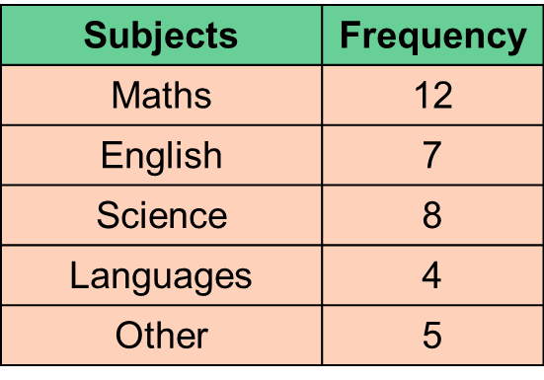

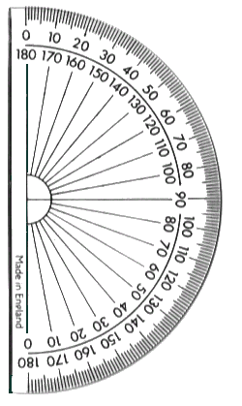
1) In a survey, people were asked to indicate which one of the subjects they liked the best. The information is given in the table.
Display the information in a pie chart.
+
120°
+
70°
80°
MATHS
+
ENGLISH
40°
.
+
50°
OTHER
TOTAL =
36
360°
SCIENCE
LANGUAGES
360° in a full turn
Notes:
4

Slide 5
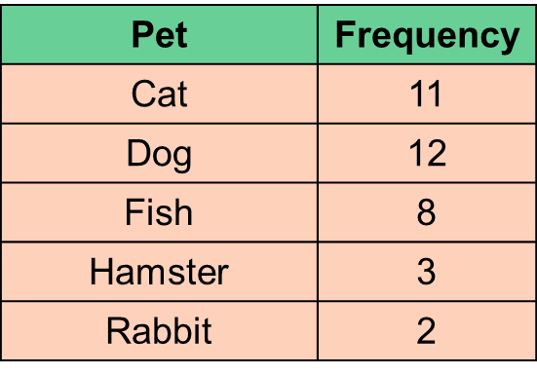

2) In a survey, people were asked to indicate their favourite pet. The information is given in the table.
Display the information in a pie chart.
+
110°
+
120°
CAT
+
80°
30°
.
+
DOG
20°
RABBIT
TOTAL =
36
360°
HAMSTER
FISH
360° in a full turn
Notes:
5

Slide 6
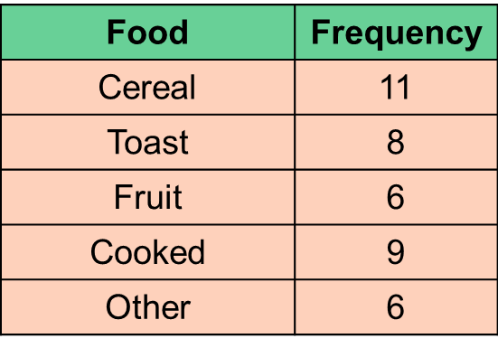

3) In a survey, people were asked to indicate their favourite food. The information is given in the table.
Display the information in a pie chart.
+
99°
+
72°
TOAST
CEREAL
+
54°
81°
.
+
54°
FRUIT
OTHER
TOTAL =
40
360°
COOKED
360° in a full turn
Notes:
6

Slide 7
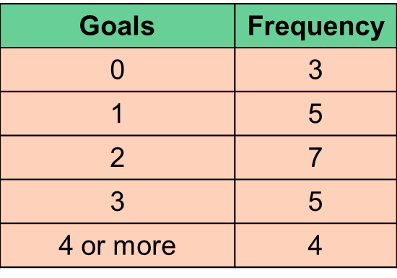
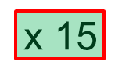
4) The table below shows the number of goals scored by an ice hockey team.
Display the information in a pie chart.
+
45°
75°
1
+
+
105°
0
75°
2
.
+
60°
TOTAL =
24
360°
4 or more
3
360° in a full turn
Notes:
7

Slide 8
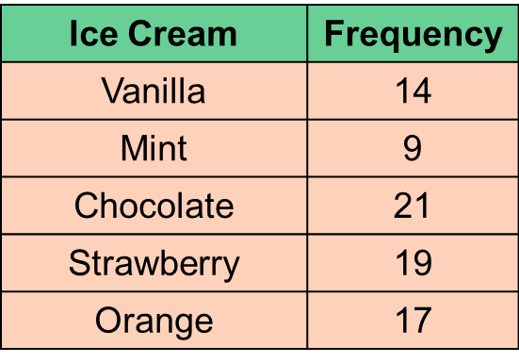
In a survey, people were asked to indicate which ice cream their liked the best. The information is given in the table.
Display the information in a pie chart.
14
=
63°
MINT
of
360
80
9
=
40.5°
of
360
CHOCOLATE
80
21
=
94.5°
VANILLA
of
360
80
.
19
=
85.5°
of
360
80
17
=
76.5°
ORANGE
of
360
80
TOTAL =
80
360°
STRAWBERRY
360° in a full turn
Notes:
8

Slide 9
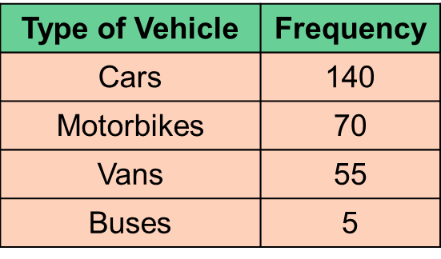
1) The table shows the record of traffic travelling down a road in Cleckheaton.
Display the information in a pie chart.
Leave until end
140
=
187°
of
360
270
70
=
93°
of
360
VANS
270
MOTORBIKES
55
=
73°
of
360
.
270
BUSES
5
=
7°
of
360
270
TOTAL =
270
360°
CARS
360° in a full turn
Notes:
9

Slide 10
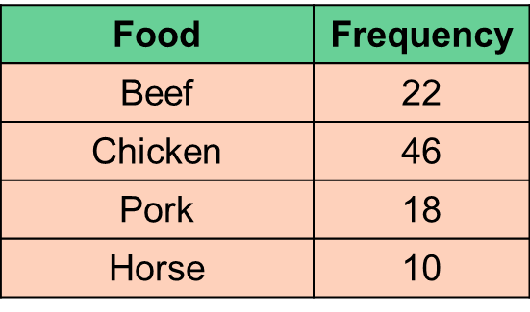
2) In a survey, people were asked to name their favourite food. This is shown in the table below.
Display the information in a pie chart.
22
=
82.5°
of
360
96
46
=
172.5°
of
360
BEEF
96
18
=
67.5°
of
360
.
96
CHICKEN
10
=
37.5°
of
360
96
HORSE
TOTAL =
96
360°
PORK
360° in a full turn
Notes:
10

Slide 11
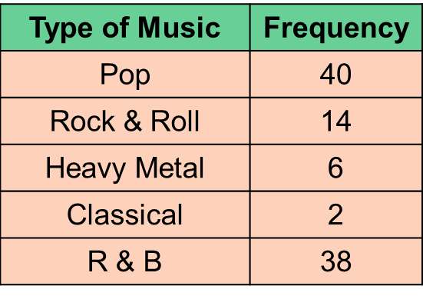
3) In a survey, people were asked to name their favourite music. This is shown in the table below.
Display the information in a pie chart.
40
=
144°
of
360
100
14
POP
of
=
50.4°
360
100
6
=
21.6°
of
360
.
100
2
ROCK & ROLL
of
=
7.2°
360
100
38
=
136.8°
HEAVY METAL
of
360
CLASSICAL
100
R & B
TOTAL =
100
360°
360° in a full turn
Notes:
11

Slide 12
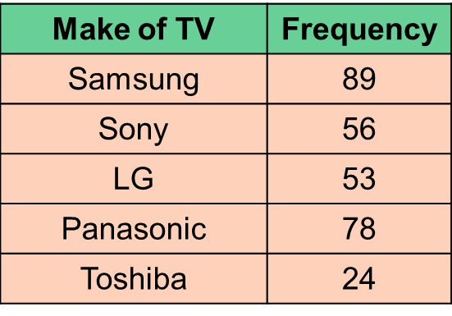
4) In a survey, people were asked to name their favourite make of TV. This is shown in the table below.
Display the information in a pie chart.
89
=
106.8°
of
360
300
56
=
67.2°
of
360
SONY
SAMSUNG
300
53
=
63.6°
of
360
.
300
78
=
93.6°
of
360
300
TOSHIBA
LG
24
=
28.8°
of
360
300
TOTAL =
300
360°
PANASONIC
360° in a full turn
Notes:
12

