Slide 1

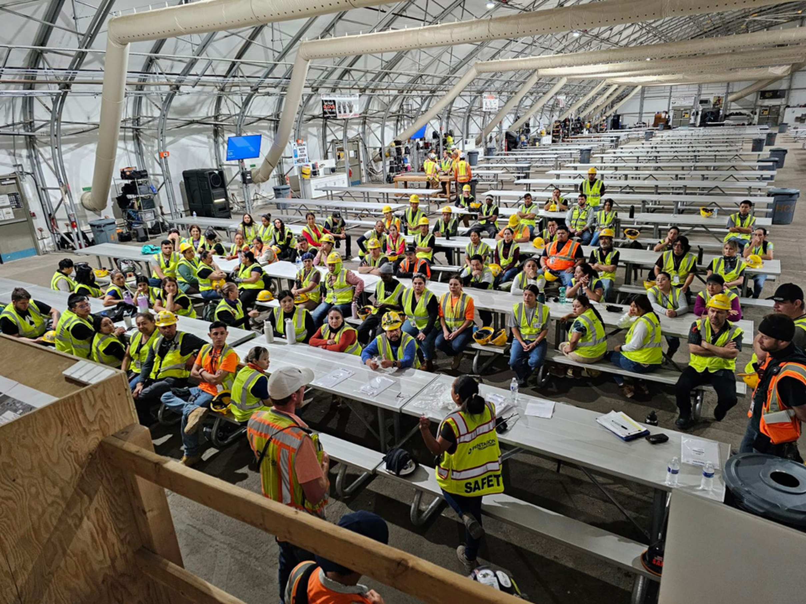


Training Refresher

Slide 2

F5 Violation's
Agenda
PPE
Fall Protection
Ladder Usage
LO/TO
Interstitial
Lift/Spotter
Confined Space
ITP
Chemical Hazard's
PTP
RMF/Barricades
Other/Opens

Slide 3




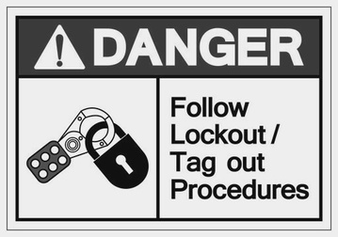
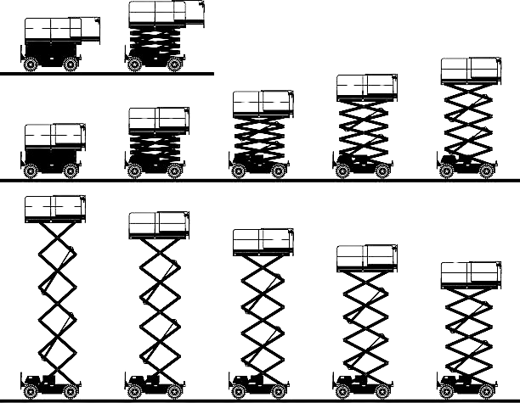
F5 Violation's
Fall Protection | Confined Space | Electrical Safety | LO/TO | MEWP

Slide 4



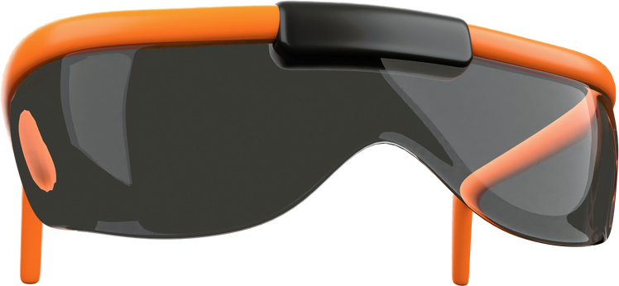

PPE Requirments
Level 3 Cut
Type 2
Helmet Class E
with Chin Strap
Z87
Steel Toe

Slide 5
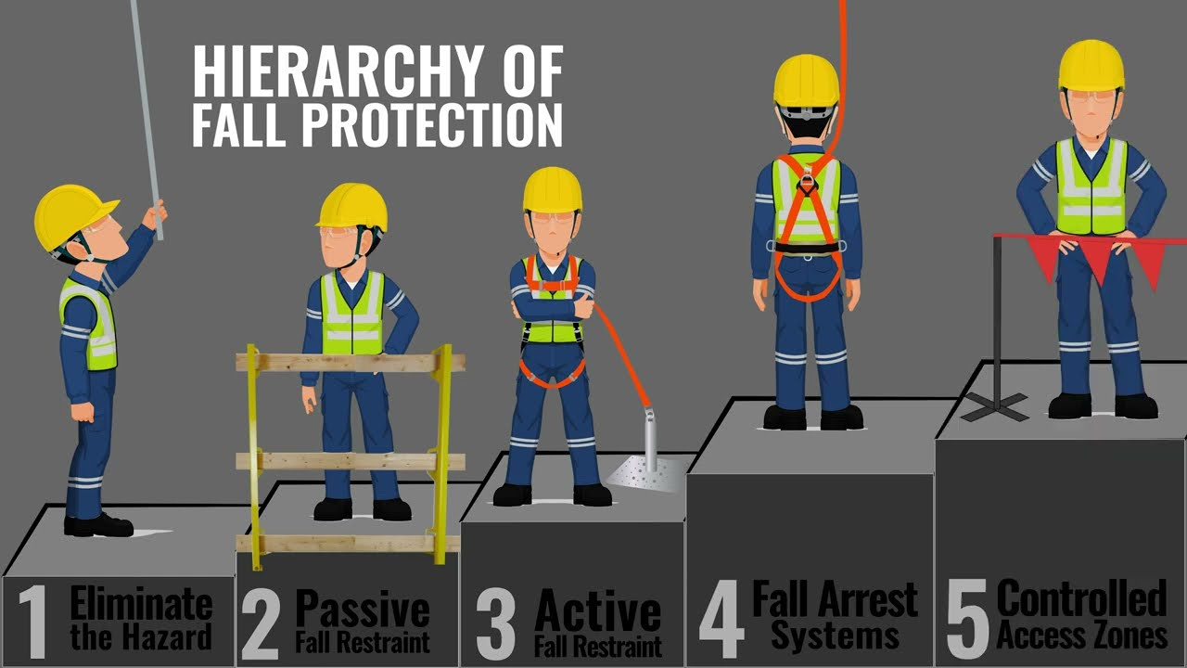
Fall Protection

Slide 6
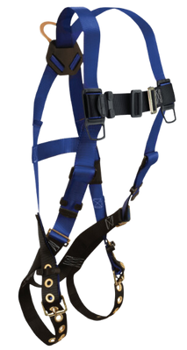
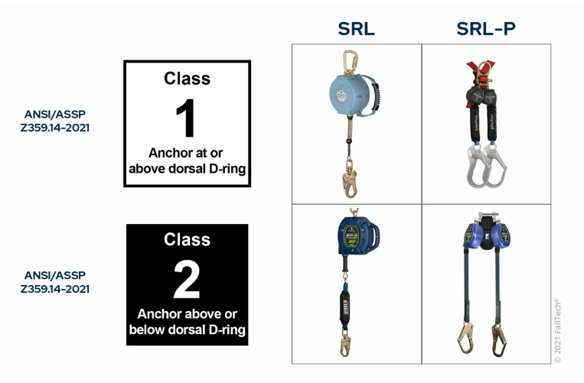
Fall Protection
  Personal Fall Arrest Systems - PFAS
  Harness
    Inspection List
  Self Retracting Lifeline - SRL
    Lanyard
    Housing Unit
      SRL
      SRL-P
    Inspection List

Slide 7
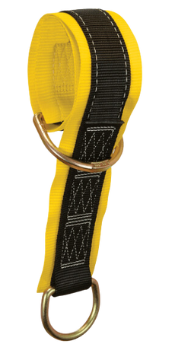
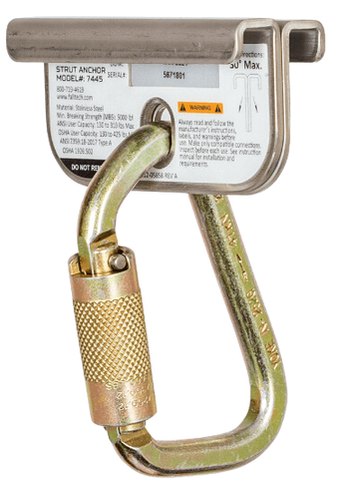
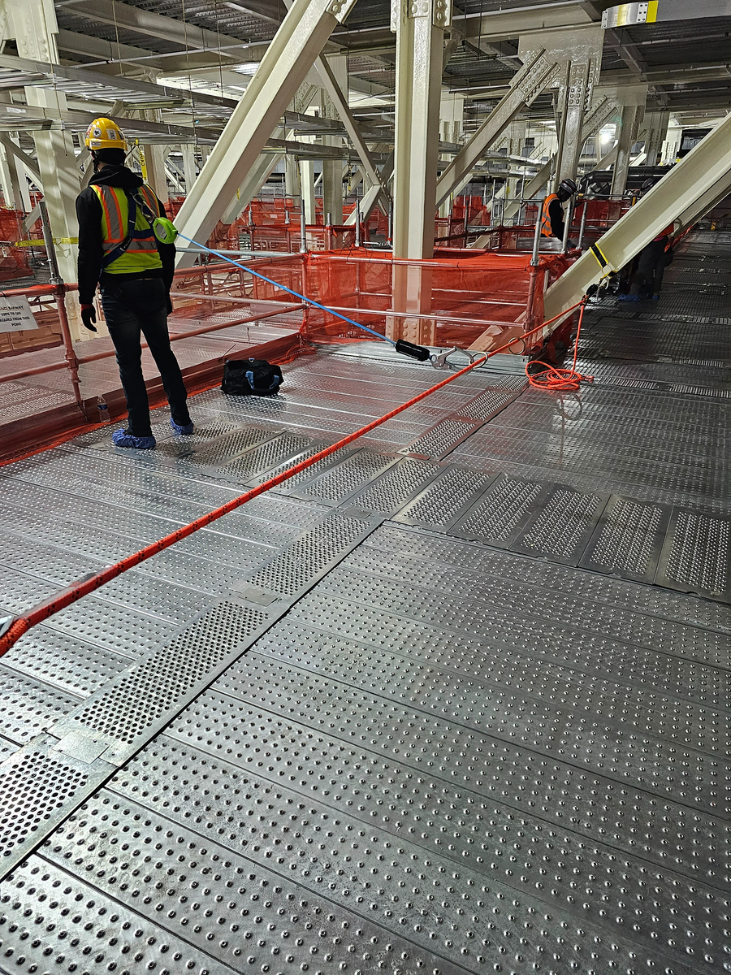
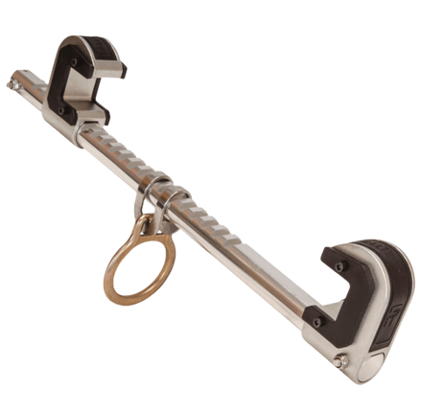
Fall Protection - Anchors
Beam Strap
Beam Clamp
Strut Channel Anchor
Horizontal Lifeline

Slide 8
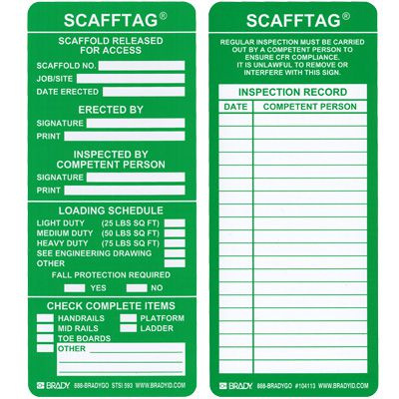
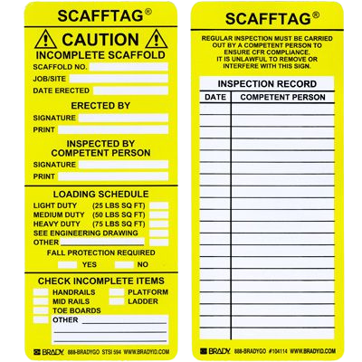
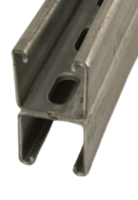
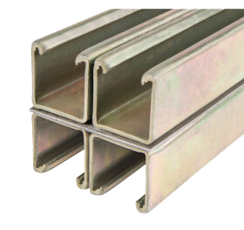
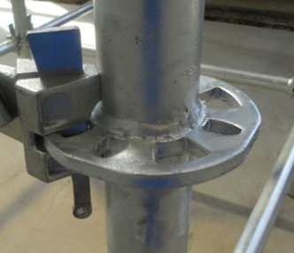
Fall Protection
  Anchor Points
    Intel Provided/Imbeds
    Double/Quad Unistrut
    Scaffolding

Slide 9
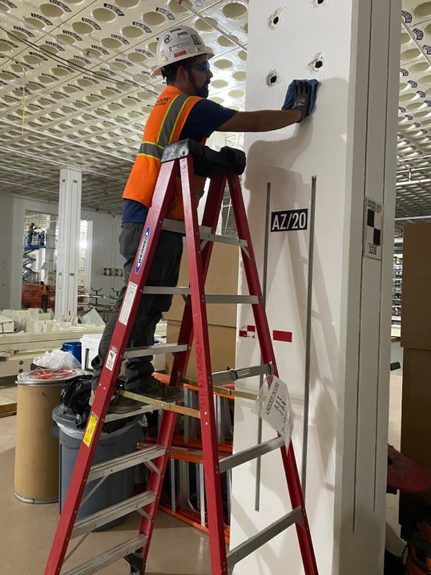
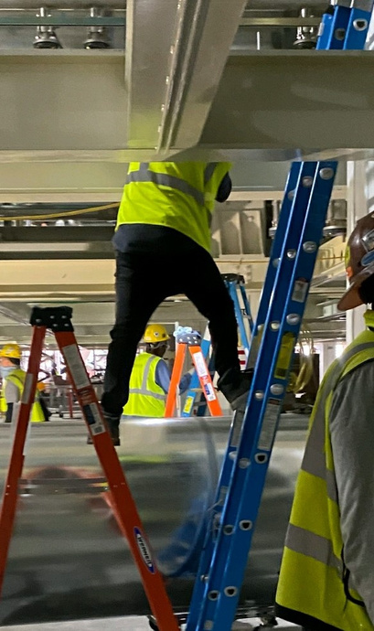
Ladder Usage
  3 points of contact at all times
  Ladder in Use Signage
  Over 6ft needs fall protection

Slide 10
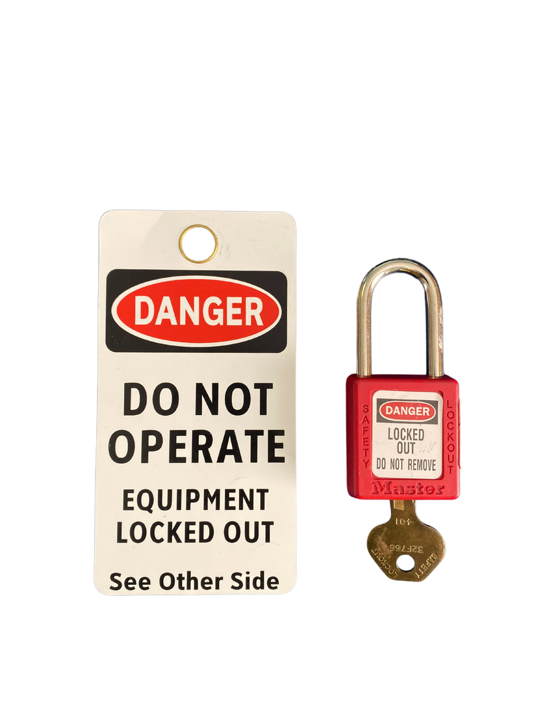
LO/TO - Lock Out Tag Out
Lockout is a technique used to prevent the release of hazardous energy, or to prevent the hazardous energy from escaping.
  Equipment
    Lock
      1 Key, 1 Lock
      Don’t ever have anyone else place/remove your lock.
    Tag
      Name
      Phone
      Company
    Lockbox
  LO/TO Equipment Log
  COHE Form

Slide 11
Interstitial
  Fab 12
    Access from designated ladder hatch, fab level.
    Weight Limit
      Component - 220lb
      Grid section (4x4) - 800lb or 2 person
    Fall protection needed only in designated areas by Intel or within 6ft of open hole.
  Fab 22,32,42
    Access from fan deck areas.
    Weight Limit
      Component - 220lb
      Grid section (4x4) - 800lb or 2 person
    Fall protection needed only in designated areas by Intel or within 6ft of open hole.

Slide 12
Interstitial
  Fab 52
    Access from EQ deck level catwalks.
    Weight Limit
      Grid section (4x4) - 300lb
    100% Fall protection needed throughout grid system.

Slide 13
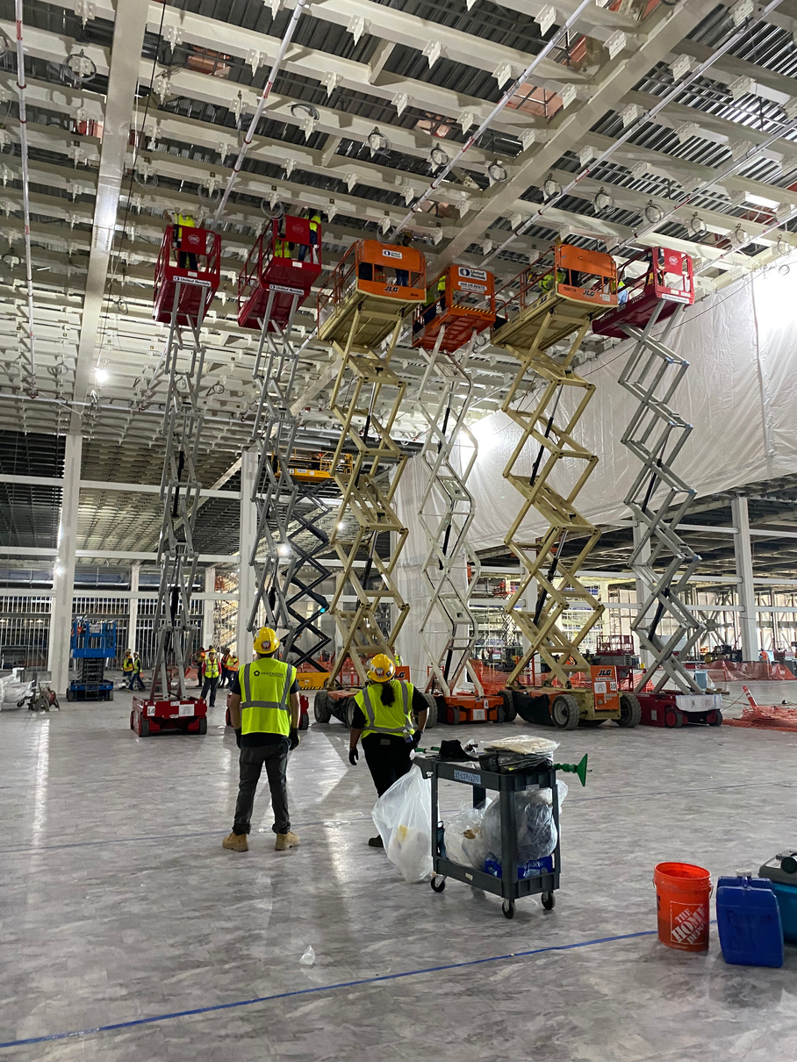
Lift/Spotter
  Lift - MEWP/Single Man
    Must be certified to Operate
    Must have Lift Operator Card on Person
  Before Operating
    MEWP Checklist
    PTP
  Driver
    A spotter is required to make any movement.
    Must have constant verbal communication with the spotter.
  Render Lift Dead
    Operator and Spotter
  Spotter
    Spotter cant be distracted. (No Phone, Conversation with other coworkers or trades).
    Must have vision of all sides to verify lift is clear of all hazards before move.

Slide 14
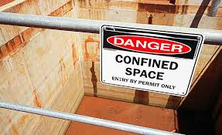
Confined Space
  All employees entering a confined space must be specifically trained for entry.
  Confined spaces will be either permit or non permit required. Contact your supervisor or safety professional for assessment prior to entry.
  If you suspect your work environment may be a confined space contact your supervisor and safety professional prior to entry.
  All paperwork must be in place prior to any confined space entry including but not limited to SIPP, JHA/AHA, Confined Space Entry Permit, Baseline Assessment and PTP. Some General Contractors may require additional paperwork.

Slide 15
ITP - Interruption To Production
Open discussion

Slide 16
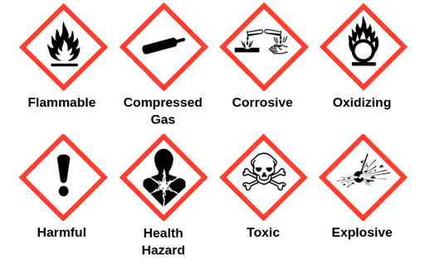
Chemical Hazard's
  Before any chemical is brought on site a CCGUN(Contractor Chemical/Gas Use Notification) must be filled out and approved by Intel EHS.
  Must have a SDS with the chemical at all times.
  Follow SDS for storage requirements.
  All flammable items must be stored in flame cabinets.
  DO NOT assume a liquid is water. There are multiple chemicals on site that look, act and feel like water but could be very dangerous to you.

Slide 17
PTP - Pre Task Plan
  Task Description
    Clearly define the scope of work for the task.
    Specify the specific activities involved in the task.
  Hazards Identification
    Identify potential hazards associated with the task.
    Consider physical, chemical, and ergonomic hazards.
  Mitigation
    Specify control measures to mitigate or eliminate identified hazards.
    Prioritize engineering controls, administrative controls, and personal protective equipment (PPE).

Slide 18
RMF/Barricades
  Hard barricades only for RMF pulls.
    Must fill out a Deviation form if it is not possible to use a hard barricade.
    Deviation form must be filled out buy Pentagon EHS and signed off by Intel EHS
    Deviation plan will include Red Danger Tape
  Signage
    RMF Barrier Ownership
    Gate
  Pulling a tile requires 2 people.

Slide 19
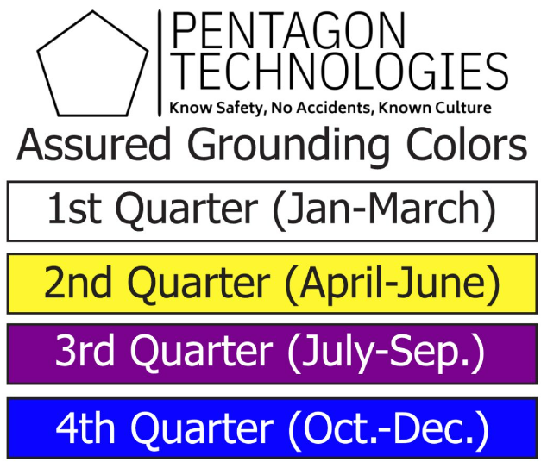

Other/Opens
Report all Injuries to Safety,
Yes even the small ones!

Slide 20
Other/Opens
MPR - Minimum Performance Requirements
Intel EHS Manual
https://www.intel.com/content/www/us/en/supplier/ehs/overview.html
Any concerns or questions?

