Slide 1


Slide 2
TSG STAC Call 3-19-2024
Agenda
Mike Funk
Welcome
Highlights
Intro Jeff Harbers
Mark Lovelady
Remind Staff STAC Mission & Values
Accountability-TSG Expectations & Program
Culture-Employee of the Month Program Overview
Culture-We Care Coin Program & March Winners
TSG March Shout Outs
Staff Birthdays
Bryan Funk
Safety Flow Chart & Updates
QPR Update
STAC New Hire Orientation Overview
Mike Funk
Business Updates

Slide 3
STAC (Safety, Training, Accountability, and Culture)
Mission Statement
At Pentagon Technologies, TSG Division, our mission is to prioritize safety, empower our employees through training, and cultivate a positive work culture. Through rigorous safety protocols, continuous training programs, and a focus on fostering a positive and inclusive workplace, we aim to ensure that every employee feels secure, valued, and motivated. We provide an environment where individuals take ownership and accountability of their responsibility and understand the impact of their actions on the organization. We are committed to creating an environment where the well-being of our team members is paramount.
VISION OF PENTAGON TECHNOLOGIES STAC PROGRAM
At Pentagon Technologies, our vision is to cultivate an environment where Safety stands as our top priority, providing numerous quality Training opportunities for all employees. We are committed to holding everyone Accountable to the highest standards and goals, fostering a positive work Culture that thrives on collaboration, innovation, and shared success.

Slide 4
ACCOUNTABILITY

Slide 5
ACCOUNTABILITY
Accountability at Pentagon Technologies refers to the expectation and responsibility of individuals and teams to fulfill their duties, meet performance standards, and take ownership of their actions and decisions. It involves a commitment to achieving specific goals, delivering results, and being answerable for one’s performance and conduct.
Picture a workplace where trust is unquestioned, commitments are clear, personal responsibility is high, people take ownership of problems, and mistakes are treated as opportunities to improve rather than reasons to blame. These conditions are the cornerstone of a positive work environment.

Slide 6
BENEFITS OF ACCOUNTABILITY
Increased efficiency & productivity
More participation & involvement
Increased feelings of competency
Increase sense of commitment
Higher morale & satisfaction

Slide 7
TWO TYPES OF ACCOUNTABILITY
Mutual Accountability- Counting on one another to keep commitments and agreements.
Personal Accountability- Taking responsibility for the consequences and outcomes of your choices and actions. This is accomplished primarily by building trust, seeking feedback, and learning from mistakes.

Slide 8
LACK OF ACCOUNTABILITY
Missing deadlines
Making excuses
Complaining
Blaming others for mistakes and problems
Lack of communication
Mistrust among team members, colleagues, and management
Rework/additional work
Victim mentality
Silo mentality
Conflict avoidance

Slide 9
Goals for TSG Accountability Expectations:
Employees have a clear sense of what results are expected of them.
Employees in their respective teams work to share information and collaborate with one another.
Conflicts are addressed in a forthright manner and resolved productively.
Clear standards of behavior are established and openly communicated.
Employees are held to these standards on a consistent basis.
Competence, follow-through, Intentional, and Integrity.

Slide 10
How can Pentagon Employees build trust through accountability:
I say what I mean, and I mean what I say.
I listen to understand a situation fully before given advice.
I don’t cover up, justify, or blame when I make a mistake.
I don’t simply apologize; I make amends when I make a mistake.
I keep every commitment I make.
I show trust to earn trust.
I listen carefully without being defensive.

Slide 11
TSG ACCOUNTABILITY PROGRAM
Implementing a program for accountability in the workplace involves establishing clear expectations, promoting responsibility, and creating a framework for tracking and evaluating performance. Here are some key components and steps for Pentagon TSG Employee accountability program:
1. Define Expectations: Clearly outline expectations for each role within the organization. This includes job responsibilities, performance standards, and any specific goals or targets.
Update Job Descriptions and review with each employee (Start-April 1st)

Slide 12
PENTAGON ACCOUNTABILITY PROGRAM
2. Communication: Ensure effective communication of expectations. Regularly communicate goals, updates, and any changes in priorities to keep everyone informed and aligned.
24-hour rule for response time on emails, calls, and text messages.
3. Training and Development: Provide training and development opportunities to enhance employees' skills and knowledge, ensuring they have the tools needed to meet expectations
Review at Next Month’s TSG STAC Call

Slide 13
PENTAGON ACCOUNTABILITY PROGRAM
4. Quarterly Performance Check-Ins: Conduct quarterly performance check-ins to discuss achievements, areas for improvement, and set new goals. When individuals have a say in their targets, they are more likely to feel a sense of ownership and accountability. This provides a formal opportunity to reinforce accountability. Encourage employees to proactively identify and solve problems. Create a culture where challenges are viewed as opportunities for growth and improvement.
Use Pentagon Performance Check-In document (Review and put into process in April)
5. Recognition and Rewards: Implement a recognition and rewards system to acknowledge and celebrate achievements. Positive reinforcement reinforces accountability and motivates employees. Employees will be involved in the nomination and voting process.
TSG Employee of the Month Program, TSG Shout Outs, and We Care Coin Program.

Slide 14
TSG EMPLOYEE OF THE MONTH PROGRAM

Slide 15
TSG EMPLOYEE OF THE MONTH PROGRAM
Criteria for selecting the Pentagon Technologies Employee of the Month is based upon the organization's values, goals, and culture. Below are some key criteria commonly considered when recognizing an outstanding employee:
1. Performance and Results
2. Initiative and Innovation
3. Teamwork and Collaboration
4. Customer Service
5. Adaptability
6. Leadership Qualities

Slide 16
TSG EMPLOYEE OF THE MONTH PROGRAM
7. Professionalism
8. Continuous Learning
9. Problem-Solving Skills
10. Reliability and Punctuality
11. Positive Attitude
12. Attendance and Work Ethic

Slide 17
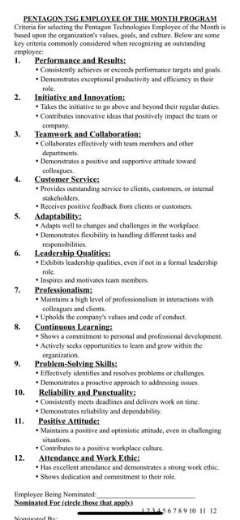

Slide 18
TSG WE CARE COIN PROGRAM

Slide 19
TSG WE CARE COIN PROGRAM
Recognizing individuals,
at Pentagon Technologies,
who go above and beyond
to care for others.

Slide 20
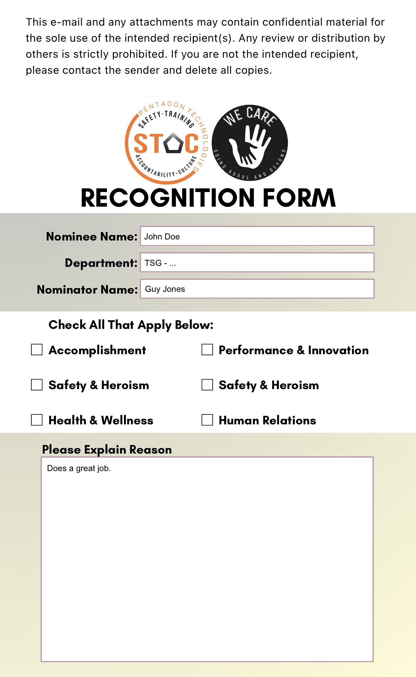

Slide 21
We Care Coin-March Awards
Arizona Steel Walking Crew
New Mexico Personal Medical Aid
Felix Rodriguez
Anthony Peraza - Foreman
Joel Morales
Juan Leon
Ely Nez
Waldamer Gamboa
Jose Fernandez
Fidel Vera
Steven Vallejo
Luis Lopez
Brandon Torres
Levi Charley
Steven Springer- Junior PM
Xitlali Najera – Junior PM
Luis Olivas
Alexander Silva

Slide 22
TSG
Shout-Outs

Slide 23
TSG March Shout-Outs
From Bryan Funk:
Rocio Torres has been promoted to Eagle Project Safety Field Supervisor.
From Ryan Littlewood:
I am excited to announce Shiv Kumar’s promotion to ME Program Manager. Over the last two years, the ME program has gone through numerous changes which have strengthened the overall program. However, with evolving customer needs, there is many more improvements on the horizon. The growth of the ME program and its need for focused improvements, we have decided it is time to have a dedicated resource to oversight.
From Mike Funk:
Tyler Gustafson has been promoted to Certification Program Manager.
Sandra Castaneda has been promoted to Protocol Manager and reports to Jeremy Klein.
Austin Davie has been promoted to Site Cleaning Manager and reports to Jeremy Klein.
Bryan Funk was promoted to TSG Safety Director and has recently added corporate responsibilities as well.
Marty Fisher is acting in a dual role as Director of Mission Critical (Supporting all Data Center Activities) and will remain engaged in Eagle Project Financials until otherwise announced.
Daisy Liguori- Passed her NEBB Professional Test!

Slide 24

March Birthday Celebrations
Arizona
New Mexico
Oregon
Virginia
ALLEN, KARMA W
CORACIDES, DENISE C
CUEN NIEBLA, RAFAEL
DEEG, NICHOLAS K.
GONZALEZ-ROSA, NIDIA
GUILLEN GONZALEZ, JORGE
HALONA, IDELLE L
HUNSTON, MELANIE
LOPEZ, OXANA
LUNA, DAVID
MARQUEZ GUILLEN, GUSTAVO
MEAGHER, IAN
MENDOZA, MIA A
NAJERA DIAZ, XITLALI J
NEZ, ELY
ONEILL, JAMES
OROZCO, SERGIO
PELLEGUAD, ELIZABETH
RAMIREZ, VALERIE X
RINCON, ANDREA P
RIORDAN, BRIAN P
RODRIGUEZ, GEIZY
SANCHEZ CAMPA, CHRISTIAN
SCALLY, TARA
VEGA SANCHEZ, SANDRA
WHITE, CARLOS
CHAVEZ, ITZEL A
GARCIA URIBE, JHONATAN S
MANCINAS-MARTINEZ, LUZ MARIA
MERCADO, BLANCA
SENA, ROSEMARY R
TSOSIE, DAVE
YAZZIE, NATHAN
SUAREZ PINO, ENMANUEL A
SWALLEY, JOHN H
VENTURA, PATRICIA M
VERA RIOS, VERONICA
GOMEZ MEJIA, VANESA A
This Photo by Unknown Author is licensed under CC BY-NC

