Slide 1
Faith Leaders for Life
Jane Ann Miller, MPH
Comprehensive Suicide Prevention Program Manager
October 10, 2026

Slide 2
Program Inception and Purpose
Utilize natural helpers to reach rural and underserved communities
Build off of the South Carolina model
Obtain feedback from a North Carolina faith leader

Slide 3
LivingWorks Faith: Course Characteristics
On-line
Self paced: approximately 6-8 hours
Christian doctrine: non-denominational
Includes Start training

Slide 4
Program Design: North Carolina Model
Selection of a North Carolina faith leader as facilitator​
Application process​
  Offered 3 times a year avoiding peak Christmas and Easter seasons
Provide LivingWorks Faith ​license
  Convene five weekly discussion groups led by a trained faith leader facilitator​
  Switched from Wednesday afternoon to Tuesday evenings
  Each faith leader is given 10 licenses for LivingWorks Start after completion​
  Participant follow up​

Slide 5
Program Design: North Carolina Model
Cost: $0
Value: $700
  License
  Facilitator
  Start licenses

Slide 6
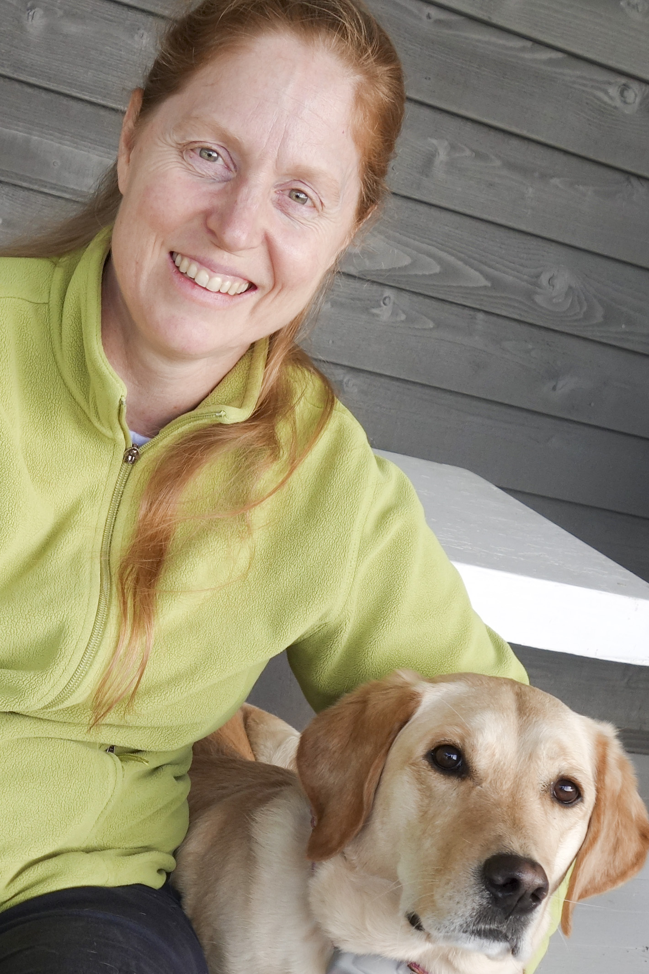
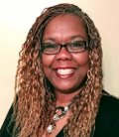
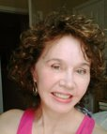
Program Design: North Carolina Model
Anne Geissinger
CSP Team Lead
FLFL Administrator
Kenya Procter
FLFL Group Facilitator
Jane Ann Miller
CSP Program Manager
FLFL Support and SME

Slide 7
Program Impact
Started in October 2022
Currently conducting group 14
FLFL participants averaged a 52-percentage point increase in feeling ‘very knowledgeable’ before and after the training.

Slide 8
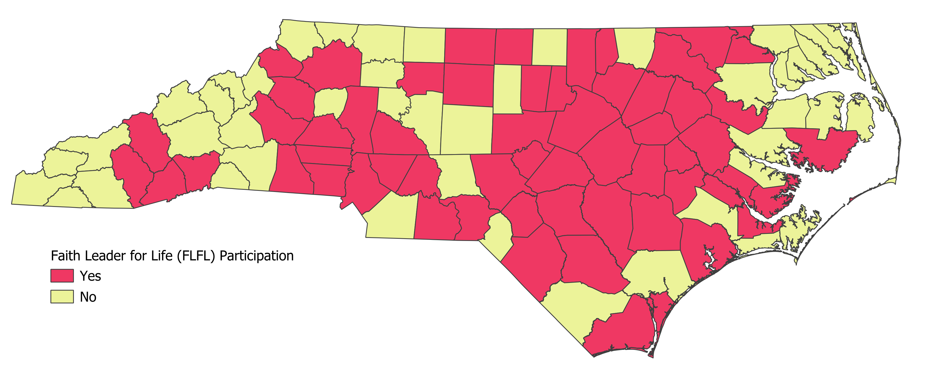
Program Impact

Slide 9
After the Training: Actions “Graduates” have Taken
Distributing Start licenses to partners
Organizing events at church
Collaboration with other churches
Participating in the Faith Leaders Building Bridges
Taking additional trainings
  Applied Suicide Intervention Skills Training (ASIST)
  Counseling on Access to Lethal Means (CALM)

Slide 10
Contact Us
jane.miller@dhhs.nc.gov
kenya.procter@dhhs.nc.gov
anne.Geissinger@dhhs.nc.gov

Slide 11
Thank You

