Slide 1

Building Bridges for
Healthy Aging &
Caregiver Well-Being
Healthcare and Faith Based Organization
Partnerships
Monique C. Bethell, Ph.D., MPH
Community Health and Engagement
UNC Health
October 10th, 2026
2026 FAITH IMPACT SUMMIT

Slide 2
Aging & caregiving by the numbers
The demographic shift is already reshaping care in homes, congregations and communities.
~10,000
~11,200
63 million
people cross the age-65 threshold each day
U.S. adults provide ongoing family care
U.S. Census Bureau, (2019)
Retirement Income Institute, 2024.
AARP + National Alliance for Caregiving, 2025
51 million
59 million
care for an adult age 50 or older
care specifically for an adult with complex needs
AARP + NAC companion report, 2026
Caregiving in the US 2025
A larger older population and a growing family-caregiving workforce
make healthy aging and caregiver support a healthcare and community priority.
Notes:
[Sources]
- U.S. Census Bureau (2019), By 2030, All Baby Boomers Will Be Age 65 or Older: https://www.census.gov/library/stories/2019/12/by-2030-all-baby-boomers-will-be-age-65-or-older.html
- AARP and National Alliance for Caregiving (2025), Caregiving in the US 2025: https://www.aarp.org/pri/topics/ltss/family-caregiving/caregiving-in-the-us-2025/
- Caregiving in the US 2025 report and downloads: https://www.caregivingintheus.org/report_categories/caregiving-in-the-us-report-2025-downloads/
- AARP and National Alliance for Caregiving (2026), Family Caregivers of Adults Age 50+: https://www.aarp.org/pri/topics/ltss/family-caregiving/family-caregiving-in-us-2025/
[/Sources]

Slide 3
Core healthcare concerns for aging populations
Clinical complexity
Functional vulnerability
Cognitive & behavioral health
Multiple conditions, medication changes, symptom recognition and fragmented specialty care.
Falls, mobility, frailty, vision/hearing, activities of daily living and safe home routines.
Memory concerns, dementia, depression, grief, anxiety and social disconnection.
Care transition gaps
SDOH / HRSN barriers
Planning awareness
Discharge instructions, follow-up, medication reconciliation and unclear escalation plans.
Transportation, food, housing, utilities, affordability, digital access and health literacy.
Advance care planning, goals of care, palliative/hospice awareness and emergency preparation.
Unplanned
30-day readmissions
Delayed access to care and treatment
Decreased patient outcomes
Increased caregiver stress and burden
Notes:
[Sources]
- https://www.cms.gov/About-CMS/Agency-Information/OMH/Downloads/OMH_Readmissions_Guide.pdf
- https://pmc.ncbi.nlm.nih.gov/articles/PMC11690153/
- Internal: 2020-social isolation and lonliness-aging-healthcare system.pdf
[/Sources]

Slide 4

Caregiver health: a separate healthcare priority
Physical health
Mental & emotional health
Fatigue, sleep loss, delayed preventive care, injury and chronic-condition management
Stress, grief, anxiety, depression, isolation and compassion fatigue
Financial & work strain
Role overload
Out-of-pocket costs, missed work, reduced income and benefits navigation
Multiple family roles, 24/7 vigilance, limited backup and crisis decision-making
Education needs
Support needs
Hands-on care, medications, dementia communication, safety, emergency planning and financial assistance
Respite, peer support, counseling, spiritual support and practical assistance
Caregiver health should be assessed, discussed and supported, not assumed.
Notes:
[Sources]
- https://pubmed.ncbi.nlm.nih.gov/37131304/

Slide 5
Caregivers and Seniors: Supporting social connections
U.S. FAMILY CAREGIVERS
SOCIAL CONNECTION AMONG SENIORS
64%
report emotional stress
ABOUT
ABOUT
1 in 3
1 in 4
39%
say respite would be helpful
feel lonely
lack social and
emotional support
13%
use respite care
+31%
Higher dementia risk
Associated with loneliness in a
large-scale analysis
Source: AARP & National Alliance for Caregiving, Caregiving in the US 2025.
Notes:
[Sources]
- CDC, Health Effects of Social Isolation and Loneliness: https://www.cdc.gov/social-connectedness/risk-factors/index.html
- National Institute on Aging, Social Isolation and Loneliness research highlights: https://www.nia.nih.gov/news/topics/social-isolation-and-loneliness
- Donovan & Blazer (2020), Social Isolation and Loneliness in Older Adults: https://pmc.ncbi.nlm.nih.gov/articles/PMC7437541/
- Internal: 2020-social isolation and lonliness-aging-healthcare system.pdf
- Internal: case manger mtg-presentation_V3.pptx
AARP and National Alliance for Caregiving, Caregiving in the US 2025.
64% report emotional stress: https://www.caregivingintheus.org/report_categories/caregiving-in-the-us-report-2025/
39% say respite would be helpful and 13% use it: Executive Summary, https://www.communitycarecorps.org/wp-content/uploads/2025/04/caregiving-in-us-2025-executive-summary.doi_.10.26419-2fppi.00373.003.pdf

Slide 6
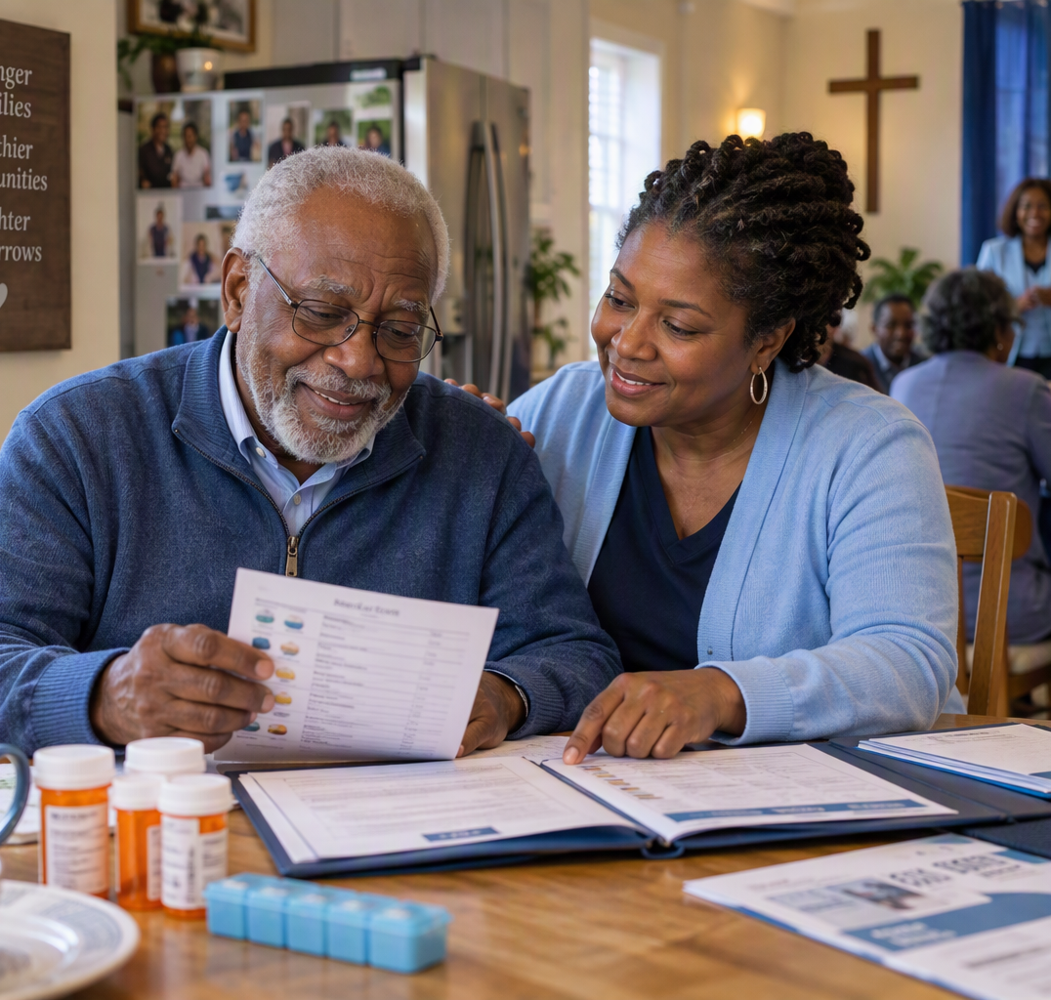
The opportunity: support the aging–caregiver partnership
Treat older adults and caregivers as partners in the health journey
What Matters
Older adult
Caregiver
Health, function, medication safety, cognition, mobility, nutrition, social connection, access and care transitions.
Preparedness, capacity, stress, sleep, physical health, financial strain, respite, navigation and confidence.
Shared outcome:
safe care at home
When either side lacks support,
the entire care plan becomes fragile.
Notes:
[Sources]
- Visual on this slide was generated with Microsoft Copilot.
- Internal: Aging_FY27_Logic Model_10.05.26-v2.xlsx
[/Sources]

Slide 7
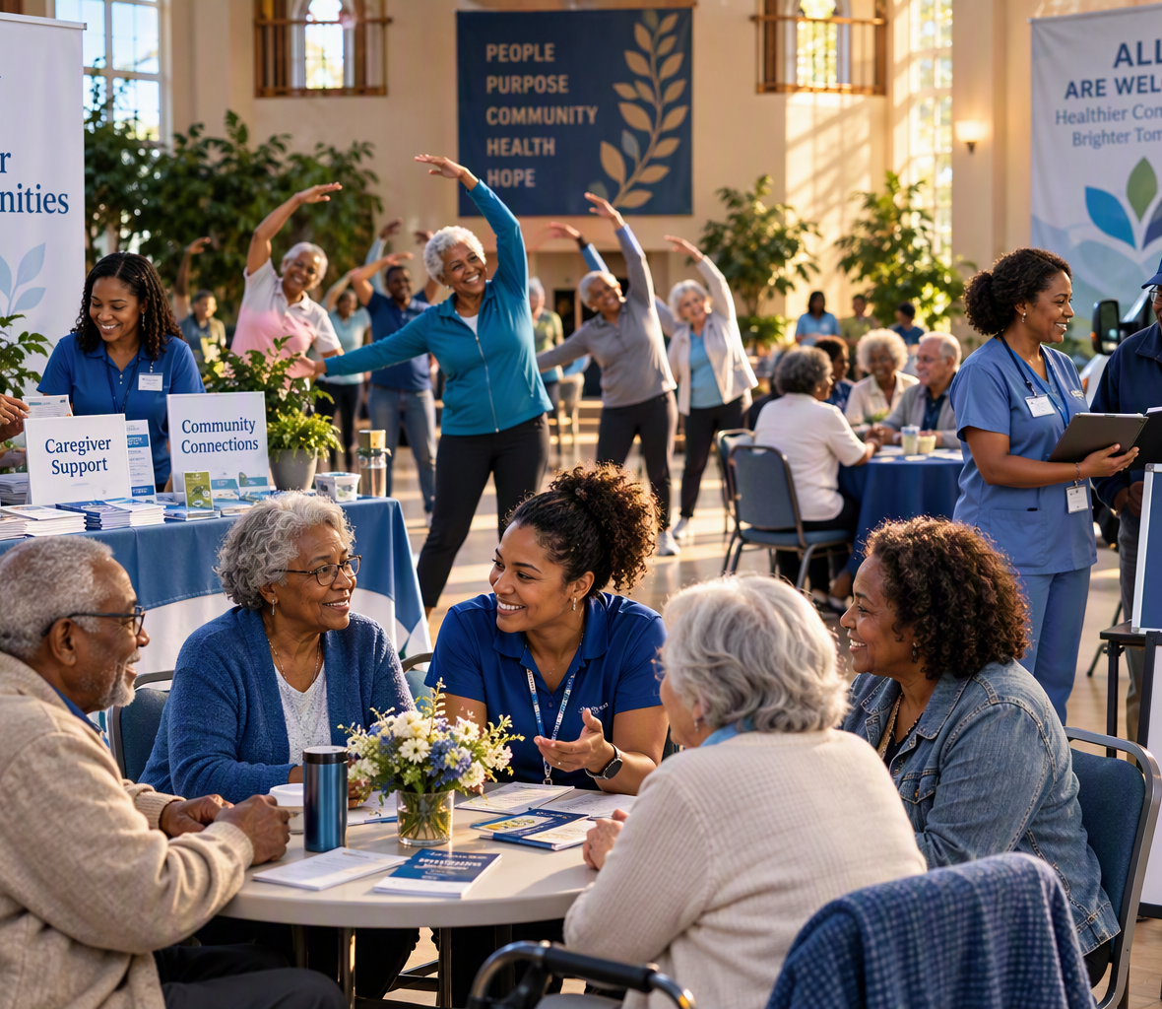
Why faith communities are a critical pathway
Trusted relationships, regular contact and local presence can reveal needs before they become crises.
TRUST + REACH
Faith communities are embedded in neighborhoods and can sustain relationships between healthcare encounters.
NOTICE CHANGE
Leaders and volunteers may notice withdrawal, grief, confusion, mobility limitations or caregiver strain during routine contact.
REDUCE STIGMA
Education, peer support and trusted conversations can normalize mental-health, memory and caregiver-support needs.
CONNECT + FOLLOW UP
Congregations can make warm referrals, assist with practical barriers and check whether support was received.
Notes:
- National Academies of Sciences, Engineering, and Medicine (2020), Social Isolation and Loneliness in Older Adults: Opportunities for the Health Care System.

Slide 8
Community resources for seniors and caregivers
Support for daily needs, caregiving and future planning
DAILY LIVING
CARE & CONNECTION
GUIDANCE & PLANNING
Transportation
Support groups & prayer circles
Medicaid/Medicare
financial support
Food & nutrition
Social support & connection
Legal assistance
Housing & utilities
Mental health agencies
Long-term care
Home safety support
Health and recreation facilities
Advance care planning
Confirm local availability, eligibility and cost before making a referral.
Notes:
- https://www.cms.gov/About-CMS/Agency-Information/OMH/Downloads/OMH_Readmissions_Guide.pdf
[/Sources]

Slide 9
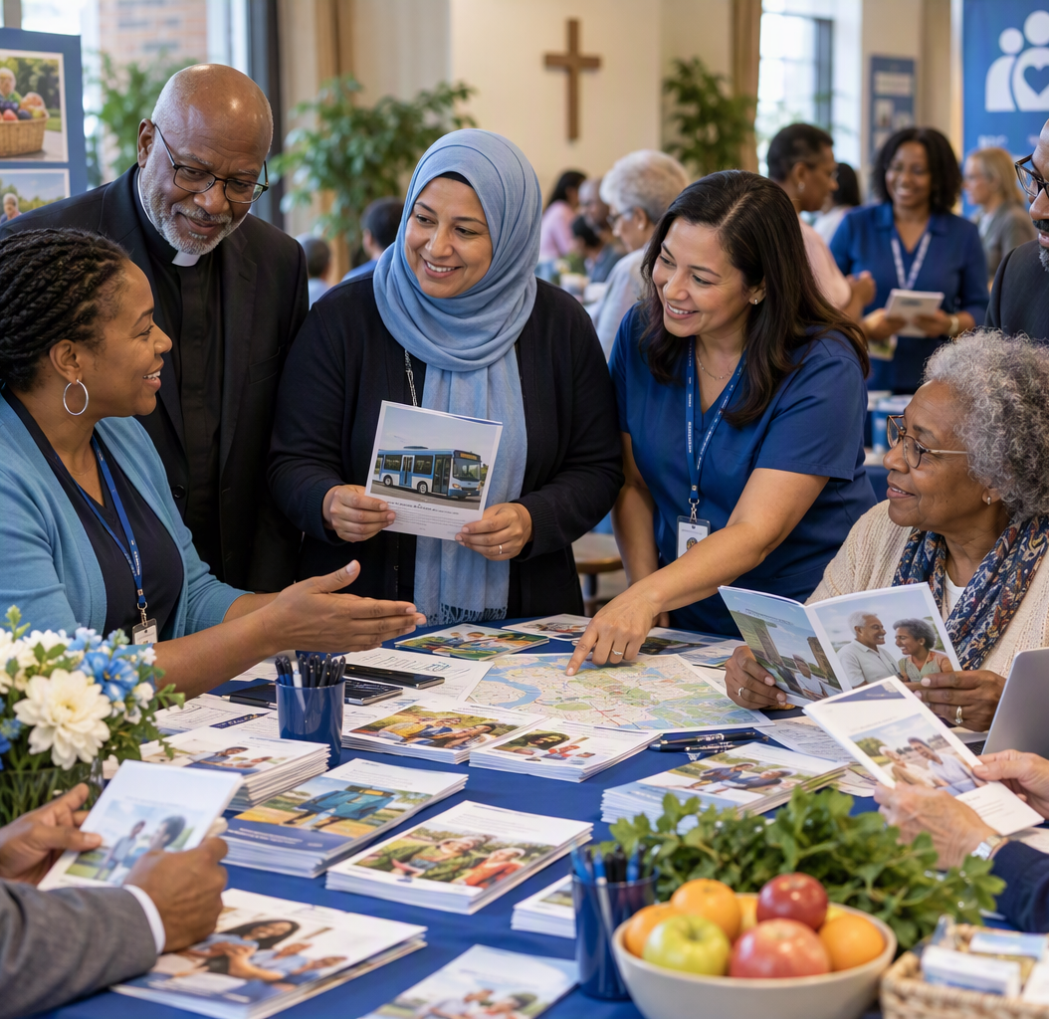
5 Ways Faith Communities Can S.E.R.V.E
SUPPORT
Check in after hospitalization; recognize isolation, caregiver strain and practical barriers.
EDUCATE
Host short, plain-language sessions with qualified health and community partners.
REFER
Maintain a current referral list for food, housing transportation, respite, aging and mental-health services.
VISIT
Offer calls, visits, meal trains, rides, technology help and appointment support within clear boundaries.
ENGAGE
Build formal relationships with health systems. Engage community partners including Area Agencies on Aging, CHWs and local nonprofits.
Notes:
- https://www.myamericannurse.com/wp-content/uploads/2026/03/Faith-Community-Nurses.pdf
[/Sources]

Slide 10
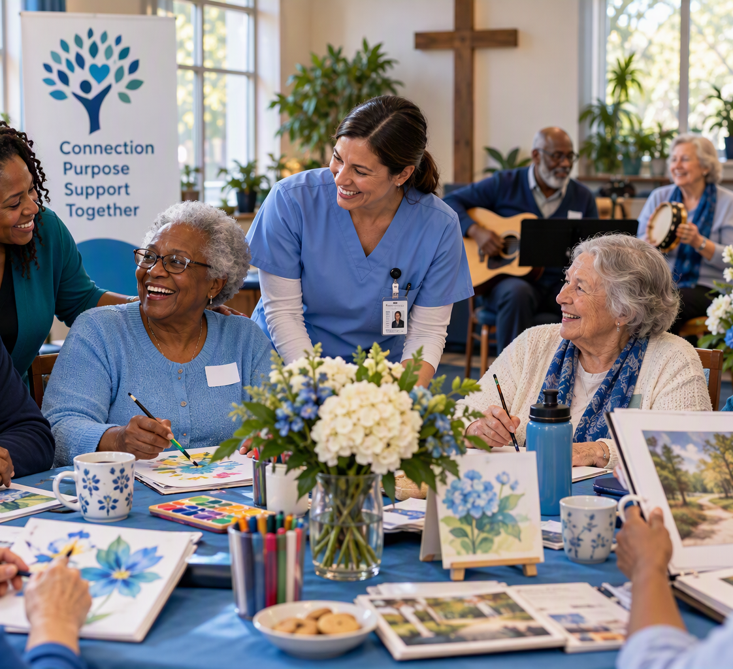
Proven and promising models faith communities can adapt
Successful programs combine trusted settings with trained partners, evidence-based education and clear referral boundaries.
Faith Community Nurse Connections
A 2023 quasi-experimental study embedded trained faith community nurses as care liaisons for older adults and informal caregivers; caregiver preparedness, meaning/purpose and self-esteem improved significantly.
Catholic Health Faith Community Nurse Program
The program helps faith communities establish health ministries offering education, counseling, screenings, presentations and referrals. Catholic Health reports that 12 nurses served 2,410 people in 4,600 hours in 2015.
Dementia-Friendly Church + Memory Cafés
Livability’s dementia-friendly church work reported enabling more than 1,000 people and 100 churches to build dementia-friendly communities. Memory cafés offer social activity with care partners in an accepting setting.
Start with one model, one trained partner and one measurable referral pathway.
Notes:
- Pomeroy et al. (2023), A Faith Community Nursing Intervention for Informal Caregiver–Older Adult Dyads: https://pubmed.ncbi.nlm.nih.gov/37131304/
- Catholic Health, Faith Community Nurse Program: https://www.chsbuffalo.org/mission/faith-community-nurse-program/
- Livability and Alzheimer’s Society, Developing a Dementia-Friendly Church: https://faithinlaterlife.org/assets/resources/downloads/dementia-friendly-church-guide-%281%29.pdf
- Spirituality and Dementia, Resources for Churches and Other Groups: https://www.spiritualityanddementia.org/for-churches-and-other-groups.html
[/Sources]

Slide 11





UNC Health and Community: CHE Partnership Pathways
Community Resource Connections
Aging and
Caregiver
Program
Hospice and
Palliative Care
Collaborative
Faith-Based
Health
Promotion
Community
Paramedicine /
Outreach & Support
Quality
Consultant
Program
Coordinated pathways connect clinical expertise, community trust, outreach and quality improvement.

Slide 12
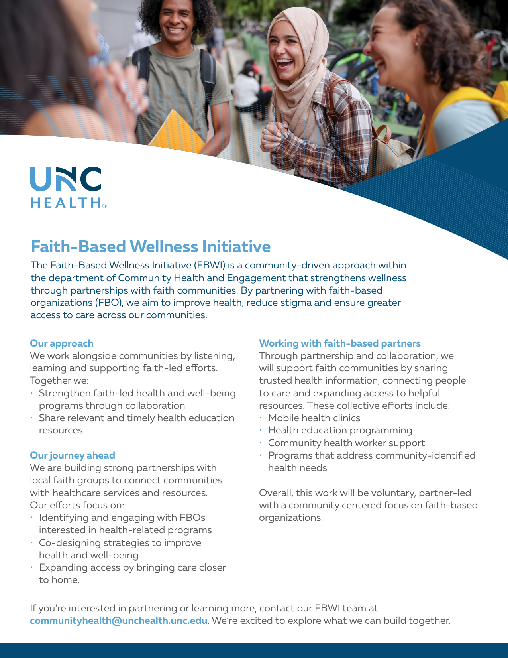
FBWI: a partnership channel with faith communities
Listen first, co-design locally and connect aging adults and caregivers with trusted information, care and resources.
ACCESS
Connect communities to UNC Health services and resources, including mobile health, education and community health worker support.
CO-DESIGN
Explore community-identified needs and develop strategies with faith-based organizations rather than bring a predetermined program.
ACT TOGETHER
Host health education sessions; strengthen social connection; share Medicare, brain health and advance-care resources; and support referrals.
LEARN & IMPROVE
Follow up on connections, identify resource gaps and bring community feedback into CHE planning.

Slide 13
Start small: a 90-day faith-community action plan
FIRST 30 DAYS
DAYS 31–60
DAYS 61–90
Host one-two brief education sessions
Connect with healthcare and community partners
Host events/ support groups
Recruit volunteers for calls, rides, meals or respite help
Name a health ministry / caregiver liaison
Map 10–15 verified local resources
Choose one older-adult health topic and one caregiver topic
Identify the needs of the congregation
Follow-up with members
Connect with healthcare/ community partners
Identify what worked well
What additional connections needed

Slide 14
Three key takeaways
1
Healthy aging and caregiver well-being
Identify health and daily living needs for aging population and partnerships for social connection, caregiver respite and emotional support.
2
Faith communities as a bridge to SERVE
Connect and S.E.R.V.E members with care
Support, Educate, Refer, Visit and Engage.
3
Faith leaders can build partnerships
Meet with community leaders and healthcare partners to identify shared needs. Identify referral contacts and community support services.

Slide 15




“Everybody can be great, because everybody can serve.”
— Martin Luther King Jr.
Our mission is to improve the health and well-being of North Carolinians and others whom we serve.
Thank you for this opportunity to Serve
Monique Bethell, Ph.D., MPH
CHE Quality Consultant
Aging & Caregiver Program Lead
Monique.Bethell@unchealth.unc.edu
Joe Conway, MHCM, CDM
FBWI Program Manager
Outreach & Support Director
Joe.Conway@unchealth.unc.edu
Alonza Pamplin, MPA
FBWI Program Lead
Community Health Consultant
Alonza.Pamplin@unchealth.unc.edu
Claudis Polk, MA
Program Manager
Outreach & Support
Claudis.Polk@unchealth.unc.edu
Notes:
[Sources]
Shirley Chisholm service quotation: https://elgl.org/service-is-the-rent-you-pay-for-room-on-this-earth-shirley-chisholm/
[/Sources]

