Slide 1
Differentiated mathematics for EHCP pupil.
This work is designed for an EHCP pupil in Year 2. The class has recently finished the White Rose Year 2 Autumn 2 term work on recognising an adding coins and notes but since remote learning has started the mother of the pupil has said that the pupil struggled with the concept and didn’t want to move on until she was secure. She stated that the pupil had the misconception that I something cost 43p, for example, then you could pay with a 43p coin. I used the scheme of work for the Year 1 work on money to create these slides that have a basic outline of money. This work is designed as a starting point to recognising and counting money at a Year 1 level to ease the pupil into understanding the concept. I made sure there was an introduction to each coin so the pupil was aware of what coins existed and then she can use them to make total.
After completing the tasks on these slides, the mother informed me that she was starting to understand the concept better. After using actual coins and the slides as guidance she was able to use her more than adequate addition skills to count and add coins.

Slide 2
Monday
LI. I can recognise coins.

Slide 3
£ p
This is the pound symbol. We use this when we are writing about pounds.
This is the pence symbol. We use this when we are writing about pence. What letter do we use to show pence?

Slide 4
£2
2£
5p
p5
We put the number after the pound symbol but before the pence symbol.

Slide 5


Recognising coins
This is a 1p coin.
It is worth 1 pence.
This is a 2p coin.
It is worth 2 pence.

Slide 6
Recognising coins
This is a 5p coin.
It is worth 5 pence.
This is a 10p coin.
It is worth 10 pence.

Slide 7
Recognising coins
This is a 20p coin.
It is worth 20 pence.
This is a 50p coin.
It is worth 50 pence.

Slide 8
Recognising coins
This is a £1 coin.
It is worth 100 pence.
This is a £2 coin.
It is worth 200 pence.

Slide 9
Can you label these coins?

Slide 10
Can you put these coins in order?
Smallest
Largest

Slide 11
Have a go at sorting the coins: https://www.topmarks.co.uk/money/coins-game

Slide 12
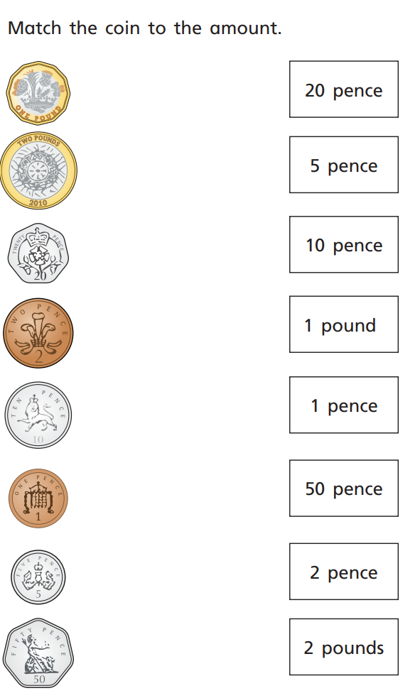

Slide 13
tuesday
LI. I can recognise coins.

Slide 14
Can you put these coins in order?
Smallest
Largest

Slide 15
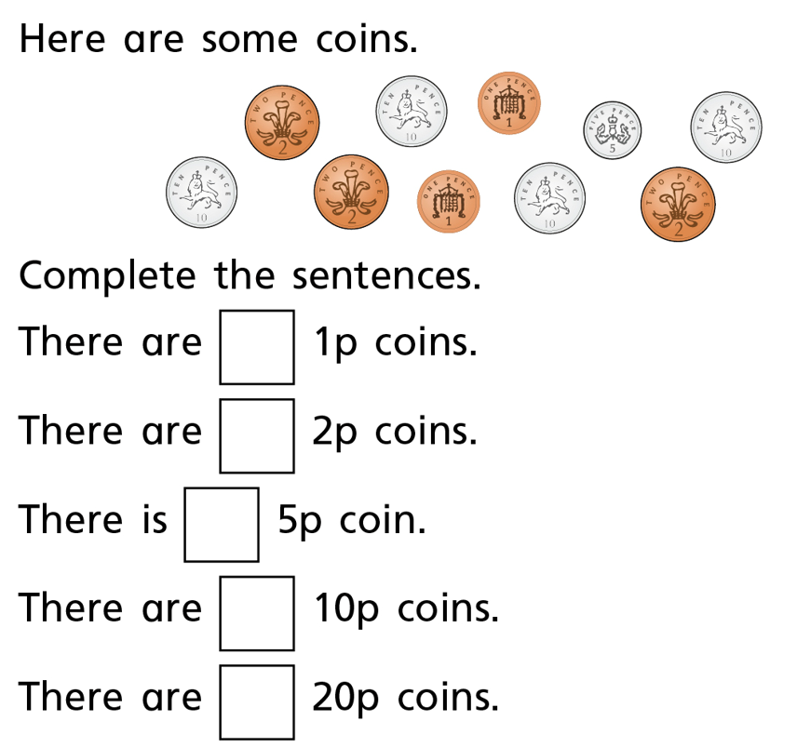

Slide 16
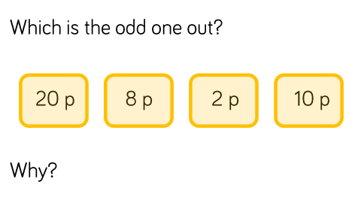

Slide 17
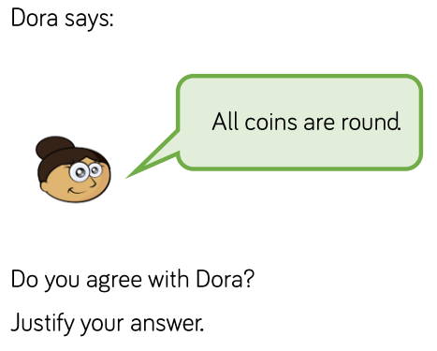
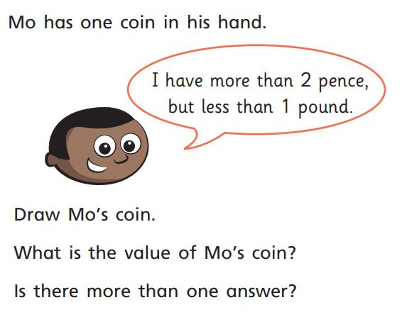

Slide 18
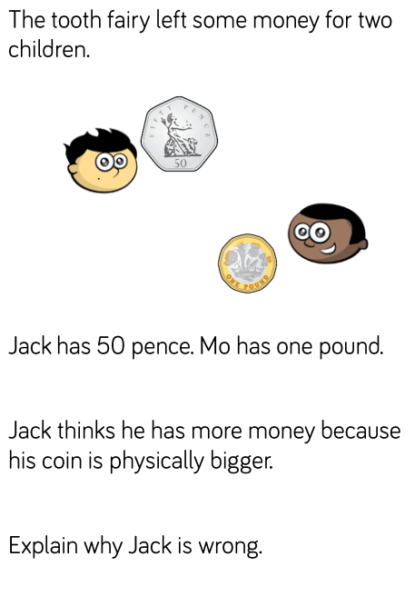

Slide 19
Wednesday
LI. I can recognise notes.

Slide 20
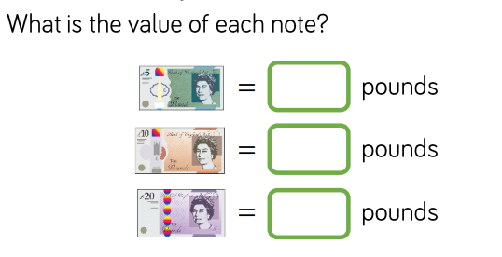
Notes
£5
£10
£20

Slide 21
=
=
=

Slide 23
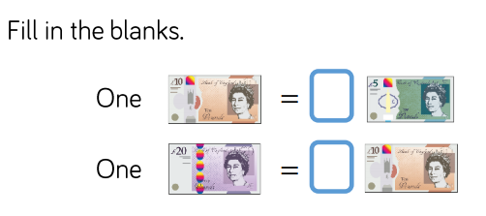

Slide 24
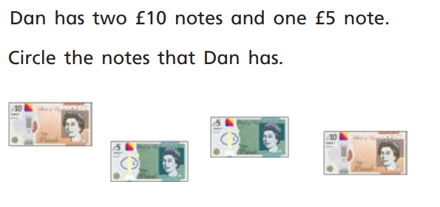

Slide 25
Thursday
LI. I can recognise notes.

Slide 27
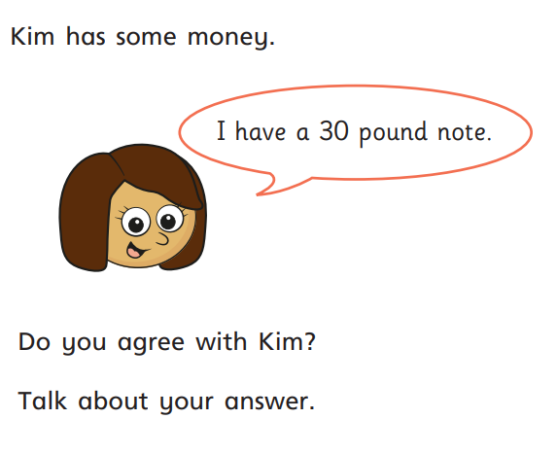
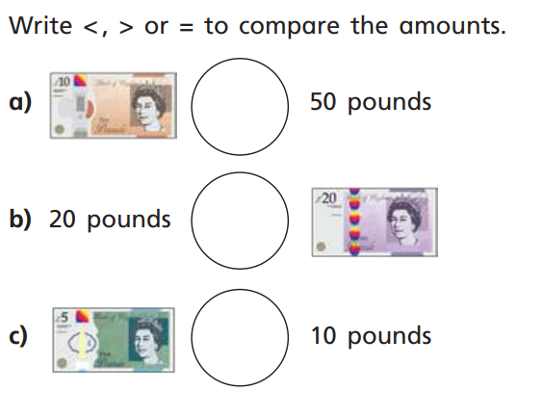

Slide 28
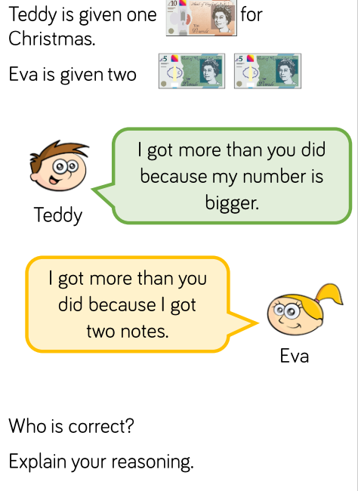

Slide 29
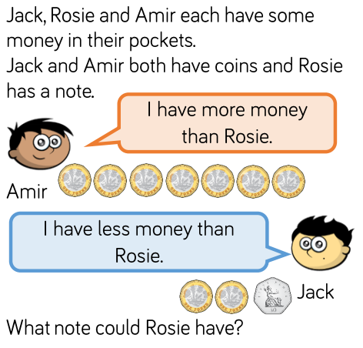
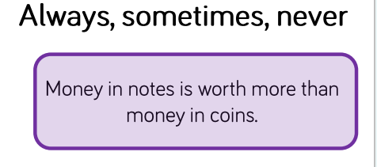

Slide 30
Friday
LI. I can count coins.

Slide 31

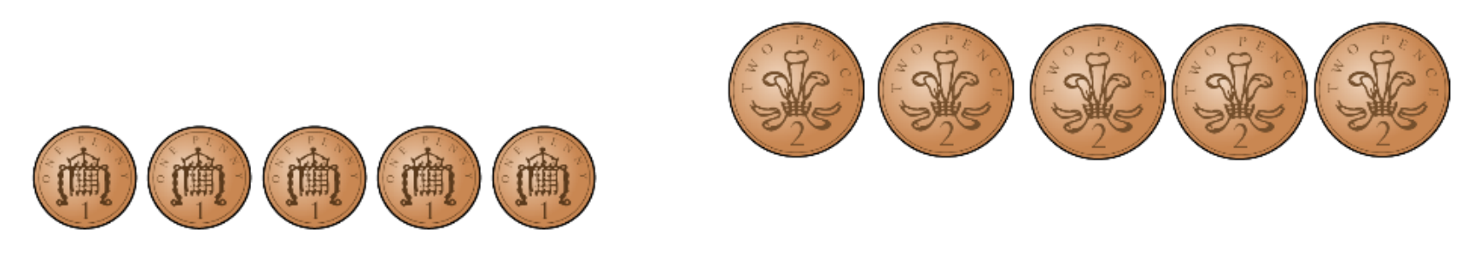
Can you count these coins and find the total?
Think about your times tables.

Slide 32
Count in 2s!
+2p
+2p
+2p
+2p
4p
6p
8p
10p
2p
= 10p

Slide 33
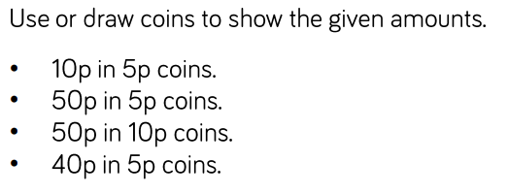

Slide 34
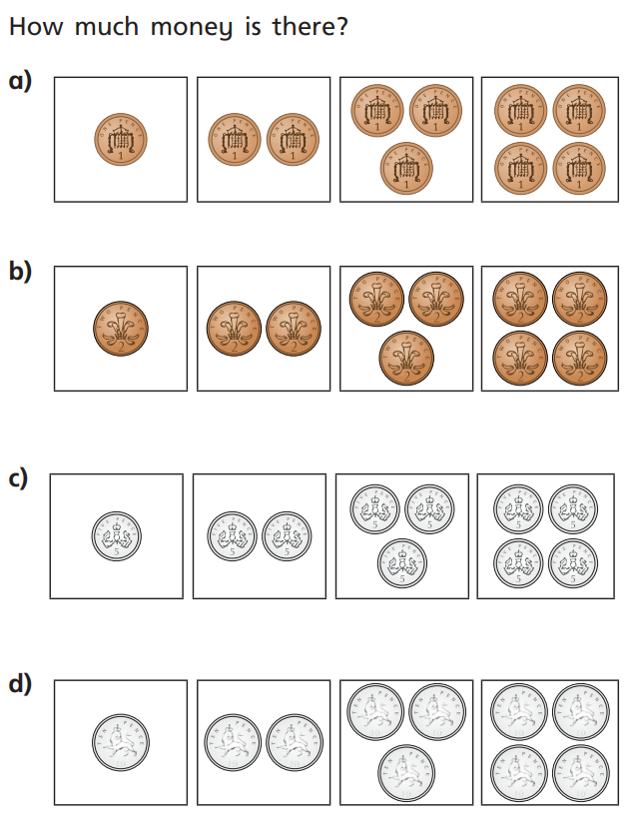

Slide 35
