Slide 1
Technical Offerings And System Solutions Pvt. Ltd.
BUSINESS PRESENTATION

Slide 2
“ YOUR HAPPINESS IS OUR PRODUCTIVITY ”

Slide 3
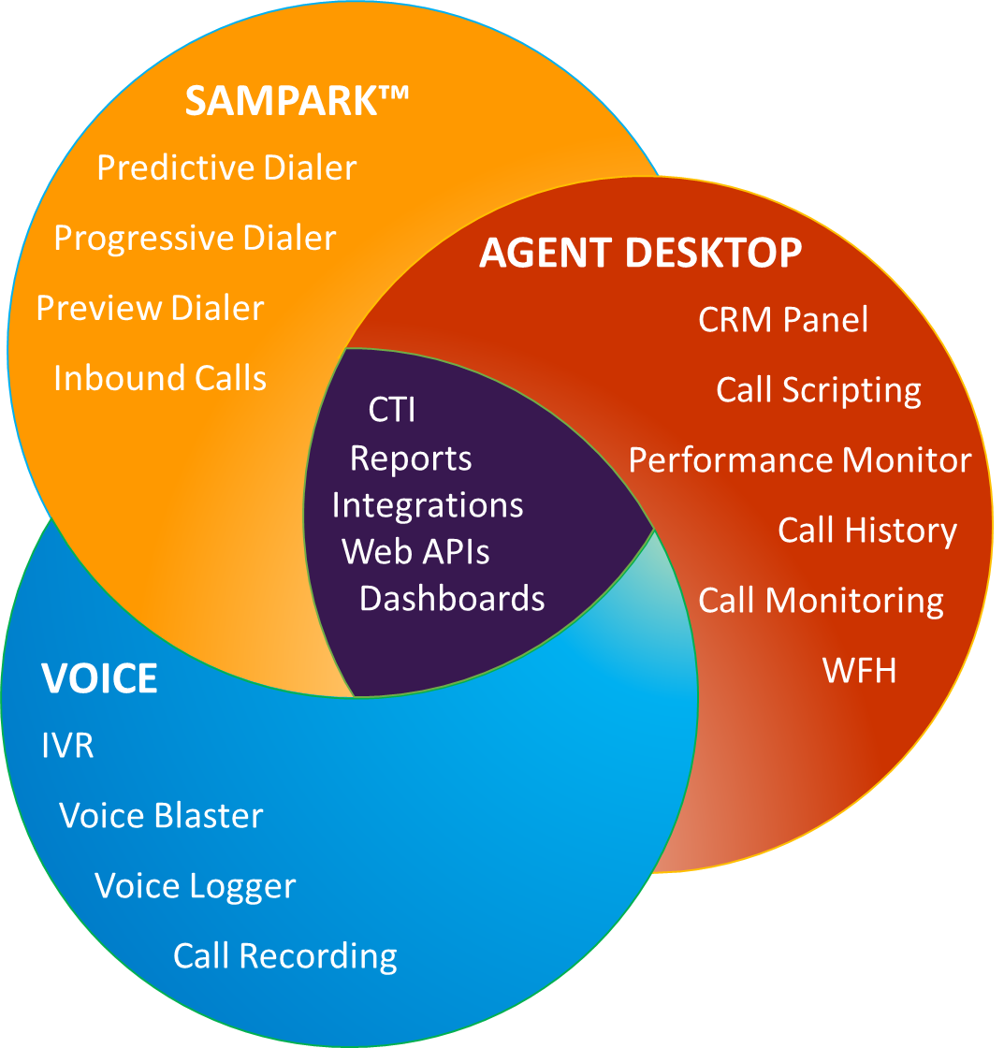
AN INTEGRATED SOLUTION
“ to make each conversation better and more efficient ”

Slide 4
OUR PRODUCT LINE
DIALER
CRM SOLUTION
CRM INTEGRATION (SMS & EMAIL)
VOICE (Automatic Voice Blaster)
“flexible, crystal clear, reliable voice channels ”
VOICE LOGGER SYSTEM
REPORTING TOOLS
OMNI-CHANNEL & AUTOMATION

Slide 5
DIALER
Inbound Call Dialer
Our Voice Platform comes complete with ACD,
IVR, Voice Recording, Quality Monitoring
Outbound Call Dialer
Our platform allows users to enjoy all the benefits of predictive dialing without any of the associated risks

Slide 6
CRM SOLUTION
Automatic CRM popup on phone calls
Agent performance tracking
Schedule follow up calls, and trigger text messages
Complete customer history records

Slide 7
CRM INTEGRATION
Seamless integration with apps like Email, SMS, ERP, etc. with the CRM Panel
Integration with the phone system
Availability of Dialer & CRM with REST APIs
Business Intelligence, Reports and Dashboards
Seamless Integration with the existing ERP system

Slide 8
VOICE TOOLS
Automatic Voice Blaster, Voice Broadcasting, Voice Blast with Interactive Voice Response (IVR)
Advanced call center telephony at a fraction of the cost
Deployed anywhere, SIP or ISDN, using any phones
Active blending – effective fine tuning of our SLAs
Real-time and historical tracking and reporting of agent performance along with recording, monitoring & much more

Slide 9
VOICE LOGGER SYSTEM
Our Voice Logger will record the call, store them in voice logger server and use the data for better logging purpose. Special Features:
keeping track of all your customer interactions i.e. call recordings, & reports
Quality Analysis & call audit purpose
Enterprise architecture with multi channel recording with T1/E1, Analog, IP and Mobile
Interoperable with any PBX and IP PBX
Search and download files based on date, time, source, destination, quality rating and duration

Slide 10
REPORTING TOOLS
Generate real-time & historical call volume reports and Analytics
Summary stats for line usage and campaign performance
A good set of predefined reports
Monitor agent activity and availability

Slide 11
OMNI CHANNEL & AUTOMATION
Automated omni channel responses for call center
environments & multi stage interactive processes
Facebook, WhatsApp, & other Social Media Integration
Adjusting workflows automatically for added efficiency
Streamlining the company’s interaction with the customer
Unique Automation Software Technology working in tandem with the CRM module form the perfect backbone for a Sales, Marketing & Customer Service Automation Services.

Slide 12
“ARTIFICIAL INTELLIGENCE AND AUTOMATION”

Slide 13
AI & AUTOMATION
Our AI has an interface like messaging apps. Popular conversational products include -
Voicebot
Chatbot
SMS Interactive Solutions
Missed Call Solutions
WhatsApp Interactive Messages
Machine learning allows the AI bot to understand and train itself based on the conversational data it gathers. AI keeps updating information post each interaction with the customers.

Slide 14
Voicebot
Put Voicebots to work in your call centre. AI Powered virtual assistants converse with your customers using natural language. Customers can self service through common questions and issues. If something is too complex or needs a human touch, it’s passed to a live agent. The agent receives all context and details to complete the call.
Voicebots also open up revenue growth opportunities through cross-selling and up-selling. They can make personalised recommendations based on customer history and preferences. Plus, the speed, accuracy and 24-hour availability of Voicebots directly improve customer experience.
Personalise Voicebot interactions at scale with easy access to customer and interaction insights using AI. Bots understand customers, their journeys and the context of the interactions. This enables bots to provide useful information or expedite transactions, giving customers quick results and allowing agents to focus on more complex tasks. Create smart conversation flows across channels using interaction data, customer history. One well-built bot can do it all.

Slide 15
Benefits of Voicebot
Reduce operational costs
Automate routine processes and tasks to save time & costs. One aspect is making Contact Center 24x7x365 - Customer experience, cost saving could be more than 40-50%. Save expenses on customer support agents by switching conversations to Voicebot
Process a vast amount of data for lead qualification and improve productivity of your sales team
Provide awesome customer experience
Reduce wait time and increase first call resolution by directly resolving the customer queries from the Voicebot using technology like Natural Language Processing (NLP), a Voicebot understands user’s intent and give a contextual response
Gather insights about customer behaviour and improve the quality of the interaction between the brand and its customers
Scalability and 24*7 availability
Can handle millions of conversations simultaneously, all to the same high standard with Voicebot
Spikes in the volume of calls can be handled efficiently without having to worry about infrastructure update or hiring new agents
Inbound Call Automation
Enhanced Self-Serve customer queries that saves your agents time and allows them to take up other important queries. Sampark AI Voicebot to take care of routine customer queries with option of transferring complex calls to the live agents with the context
Hassle-free appointment scheduling and confirmation without any intervention of the agents
Outbound Call Automation
Two way interaction – welcome call, reminders, service calls, confirmation call, feedbacks, Lead qualification calls, and renewal calls
Complement Strategic debt collection with intelligent outbound dialling, enhancing customer coverage, and improve Promise to Pay Ratio.
A snapshot of the customer coverage represents lead penetration by depicting uploaded leads versus the dialed leads.

Slide 16
Voicebot Use cases
Collections for Financial services (Banking & insurance)
Automate a few tasks of the existing collection process by creating custom call flows. Make data-driven decisions with the humanized collections bot by pushing the discussion’s outcome in real-time to the CRM.
Sampark’ AI collections bot integrates with core banking and backend systems to identify the context and personalize the conversation.
Contact Center Automation
Sampark’s Voice Bot can take care of up to 50-60% calls, which are routine in nature to provide cost savings and more productivity to the existing agents
Connect existing voice networks with Sampark’s speech-to-text (STT) engines. This connection provides you advanced call management functions such as call transfer, call disconnect, and call recording.
When a customer connects via a voice-based channel, Sampark provides information exchange between voice bot & customers’ data is saved in CRM, which can then be contextually retrieved for further conversations.
Conversational IVR (IVR bot)
The Conversational IVR system lets you understand the customers’ sentiment, context, and content spoken in Natural Language and provide a dynamic customer experience. Customers can converse with the voice bot in their own words, convey their issue or query, and get a suitable natural language response.
Unlike traditional menu-based IVR interactions, Sampark’s Voicebot reduces the wait time for customers by delivering a convenient and personalized self-service, allowing you to minimize churn, maximize productivity, and save costs.

Slide 17
Chatbot
Modern technology is constantly pressing forward with innovative optimization in mind. Progress in the tech world aims to simplify the human experience through the integration of computers, the internet, and artificial intelligence.
Chatbots are a brilliant fusion of all three. Capable of simulating human conversation through auditory or text methods, chatbots effectively automate basic problem-solving and request queries.
Sampark chatbot is an artificial intelligence software that seamlessly simulates human conversation using a series of advanced rule-based Question Answering systems and Natural Language Processing algorithms.
Improve customer acquisition
Faster response time
24/7 customer support
High degree of accuracy resulting in high-quality support
Increase revenue per user
Chatbot can perform the supporting tasks freeing up agent’s time, to do what they do best; sell products and services.
Gather, analyze and act on the customer’s preferences and their sentiments.
Minimize cost to serve
Opportunity to reduce costs depending upon the selected functionalities
Short payback period with low integration costs and high potential ROI
Mitigate security risks
Easily scale up and down depending on customer’s demand.

Slide 18
Benefits of Chatbot
24/7 Availability – Customers needn’t wait for the next available operator when chatbots are part of the communication strategy on a round-the-clock basis.
Instant Response – Chatbot can handle the queries of thousands of customers instantly as well as simultaneously and improve the average response time.
Consistency in Answers – The use of chatbots can help businesses maintain a great level of consistency in answers and improve customer experience with the brand.
Omni-channel – AI-powered Sampark Chatbot comes with omni-channel messaging support features which help customers communicate with businesses through various channels such as websites, Facebook, etc.
Personalization – Chatbot can ensure a touch of personalization by engaging customers with one-on-one conversations, maintaining a natural-sounding tone, and by being good at interactive communication.
Multilingual – Your business can program the sales bot to answer queries in the language of customers and expand the reach to new markets or territories.
Order without human help – Thanks to bots-driven automation, customers can book orders or do transactions without any human help.

Slide 19
Chatbot Use Cases
Customer Support
Common queries of the customers answered 24×7 by an NLP-driven chatbot on all the digital channels.
Industries such as BFSI, Ecommerce, Retail, Healthcare and Telecommunications use it to provide answers to common queries asked by the customers.
Lead qualifications
Chatbot gives you greater coverage to qualify leads at any time of the day 24*7.
Chatbots can assist in taking your sales to the next level. They can handle time-consuming tasks such as scheduling appointments, setting reminders, confirmations, and even prospecting a potential lead.
Collections for Financial Services (Banking & Insurance)
Automate a few tasks of the existing collection process by creating custom flows for customer conversation. Custom build journeys for EMI collection, policy renewals where Chatbot connects with the system in real-time to send notifications and reminders on different channels.
Sampark’s collections bot integrates with core banking and backend systems to identify the context and personalize the conversation.
Field Agent Support
Field Sales Agents have to remember all the products and services offered. The newer Agents with incomplete knowledge have to call different teams to get the right answers.
A bot provided to these agents can effectively answer any query pertaining to products and services!

Slide 20
Missed Call Solution
A missed call solution aids businesses to call back their customers who gave missed calls on their business numbers.
The call is processed via auto-dialer, connecting the target audience with either an automated IVR message, a voice bot or a live agent.
Miss Call : A call on a Virtual Number– mobile, landline, or toll-free – configured to hang-up on callers. Generate leads through effective campaigns targeting audience. Overcome language barrier. Retain callers’ numbers to build a leads database. Get DND subscribers to opt in. Then contact them and have no disputes. The best-missed call service saves you many disappointed customers who may encounter tough time while connecting the agents.
Reply - A call on a virtual number configured to hang-up on callers and followed by automated responses to complete the interaction loop. Send acknowledgement, instructions, or content such as product information and offers through SMS or voice message. Include a short URL in the SMS or IVR in the voice message as a call-to-action. Missed call marketing make operations easy for your company
Callback - A call on a virtual number configured to hang up on callers and followed by return calls to complete the interaction loop. With the missed call alerts service, you can track all the received missed calls over a single dashboard. Get back to callers at your convenience: return missed calls when agents are available; if agents are available, trigger return calls immediately or trigger a callback immediately after registering the missed call.

Slide 21
Benefits of Missed Call Solution
Increase Lead Generation
Ensure faster quality lead acquisition by receiving prospect details in real-time for engagement.
Expand Market Reach
Broaden brand awareness during promotional periods by launching missed call SMS campaigns.
Missed Call Services for Opt-ins
Seek customer confirmation on specific services, product interests efficiently for opt-ins by avoiding legal hassle for DND numbers.
Launch Outbound Calling Campaigns
Combine missed call solution with outbound calling solution processed through targeted messages to customer contact numbers.
Enhance Interactivity for Campaigns
Gather customer feedback, while also calling them back to share product insights and new launch information.
Easy CRM Integration
Integrate missed call solution with any leading CRM software to automatically incorporate customer data.

Slide 22
Missed Call Solution Use Cases
Boost Lead Generation-
By obtaining prospect information in real-time for interaction, you can ensure quicker quality lead generation.
Build Opt-in / Opt-out List-
Run successful and compliant opt-in campaigns with missed calls for your brand and build a database.
Customer Retention-
Engage customers with offers/coupons and gratify on the spot with SMS voucher give-aways for registration.
Local Brand Presence-
Provide a local brand presence using regional numbers for customers to call, choose from a long list of virtual DIDs.
Interactive Campaigns-
Play promotional content when a missed call is received or provide information on services/updates using outbound IVR.
On-Demand Information-
Push account information to customers in real-time using miss calls, push account balance, service status, app links, etc.

Slide 23
WhatsApp Interactive Messages
Being able to communicate with customers on the world’s most popular messaging app is no new phenomenon.
Ever since WhatsApp Business was launched, many companies have taken to it as one of their main channels to reach consumers.
Given the chat app’s (growing) popularity, WhatsApp has gone full-on with developing new features and tools to improve communication and boost transactions between businesses and customers.
One of its latest efforts is the introduction of WhatsApp Interactive Messages. As its name suggests, these offer a more efficient, advanced, and, of course, interactive messaging experience.
Up until the introduction of interactive messages, businesses could only use WhatsApp Business to send a text- and/or media-based messages to their customers.
While these types of content certainly already have much to offer, there’s actually a lot more that can be done with WhatsApp Interactive Messages.

Slide 24
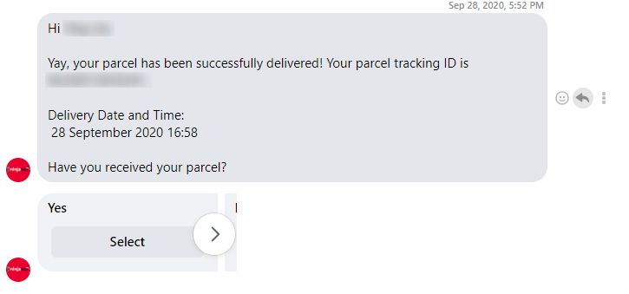
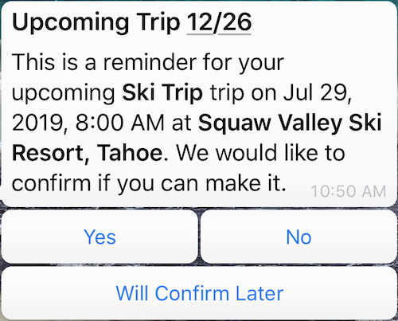
WhatsApp Interactive Messages Templates
WhatsApp Business currently offers two types of interactive message templates, mainly the addition of the following to WhatsApp messages:
Call-to-action buttons
Quick reply options
These can be tagged on to regular text and/or rich media messages (which are messages with images, videos, attachments, location sharing, etc.) that you send out to your customers.
Quick Reply Buttons
Quick replies are exactly as they sound: buttons that users can simply tap to immediately generate a reply consisting of a short text message.
Prior to launching them on WhatsApp

Slide 25
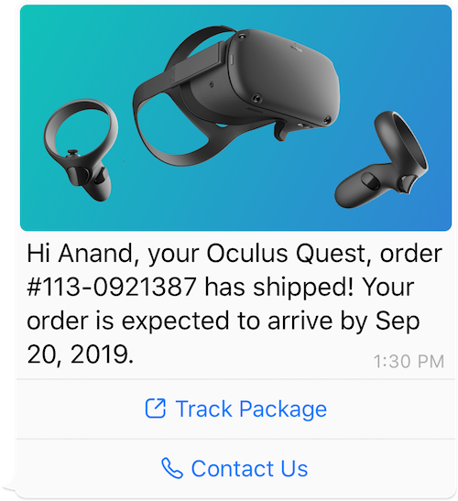
WhatsApp Interactive Messages Templates
Call-To-Action Buttons
Call-to-action buttons are similar to quick reply buttons in that a single tap is sufficient to generate and register a response.
However, they differ in their purpose.
Where quick reply buttons aim to provide businesses with responses so they can determine whether they need to follow up with the customer, call-to-action buttons facilitate the customer with an action they can take for their own benefit.
Here’s an example of an interactive WhatsApp message template with call-to-action buttons.
Benefits of Interactive Message Templates
Saving time and effort aside, there are plenty of other benefits these interactive message templates offer.
The ease of these clickable (or tappable) buttons provides customers with a more seamless and enhanced brand experience. Not only does it require less effort from both your end and theirs, but it also increases the amount of engagement a customer can have with you.
As a business, it’s a more direct way of guiding customers to where you want them to go, especially with the call-to-action buttons.
There’s also an added plus for marketers. These interactive messages give you insights into customer behaviour, which allows you to modify your communication with them and segment them based on their responses.

Slide 26
“ visible, relevant at the same time competitive, efficient and give a great customer experience ”

Slide 27
OUR SOLUTIONS
INDUSTRY BASED SOLUTION
FUNCTION BASED SOLUTION
WORK FROM HOME (WFH) SOLUTION
“ relevant, efficient & economical ”

Slide 28
INDUSTRY BASED SOLUTION
Ready to deploy solutions for various Industry verticals like :
Banking,
Insurance,
Telecom,
BPO,
Real Estate
Path Labs & many more
We are providing them with customized Customer Interaction Management Solutions.

Slide 29
FUNCTION BASED SOLUTION
Ready to deploy CIMs solutions to cater various standardized functions and processes like :
Lead Generation,
Collections,
Welcome call,
Helpdesk management and many more
Our solutions help in significant increase in operational efficiency, productivity, profitability and reducing operative costs.

Slide 30
WORK FROM HOME SOLUTION
With our WFH Solutions, agents working remotely can maintain a good level of productivity from the comfort of their homes via smartphone or laptop:
Fulfillment of inbound, outbound, blended & multimedia contact management requirements
Optimal use of all staff resources resulting in increased efficiency and profitability
Comprehensive functionality & feature rich capabilities
Bring together quality monitoring, call recording, workforce management, analytics, performance management

Slide 31
“ flexibility, ease of use and value for money ”

Slide 32
Why choose Us?
We are transforming the future of business communications. By integrating voice, video, contact center, and enterprise-class API solutions into one global, secure, reliable communications platform.
Single source provider for managing your complete communications needs
Bring together quality monitoring, call recording, workforce management, analytics, performance management
Comprehensive functionality & feature rich capabilities
people are more connected and productive no matter where they are in the world.

Slide 33
THANK YOU!

