Slide 1
Milestone List
0. Pre-Define | 1. Define | 2. Measure
1st Mar 2023
3. Analyse | 4. Improve | 5. Control
Project Sponsor
Lead / Black Belt
Team Members
Project Title
DMAIC
Step 0: Pre-Define Checklist
Include:
Narrow down your problem, discover the dollar value.
Include a Project Charter listing the problem, dollar value, gap from where you are to where you want to be, the sponsor, team members and high level schedule.
Step 1: Define
Include:
Flow Charts
SIPOCs
Value Stream Maps
Critical-To-Quality
Line Graphs / Gap Analysis
Step 2: Measure
Include:
Check sheets / Tally sheets
Raw Voice of Customer data
Benchmarking data
Step 3: Analyse
Include:
Pareto Charts
Scatter Plots
Histograms
Affinity Diagrams
Analysis of Variance (ANOVA)
Regression Analysis
Root Cause Analysis with a Fishbone Diagram
Five Whys
Control / Impact Matrix
Step 4: Improve
Pilot the improvements with a small area to start, and include:
Poka Yoke (mistake proofing)
Autonomation / Jidoka (check and catch)
5S
New Flow Charts / Maps
Scheduled improvements with Gantt Charts or Kanban boards
Action registers
Step 5: Control
Include:
Pareto Chart before / after
Line Graph before / after
SOP / Standard Operating Procedure updates
FMEA (Failure Mode Effects Analysis)
Control Charts

Slide 2
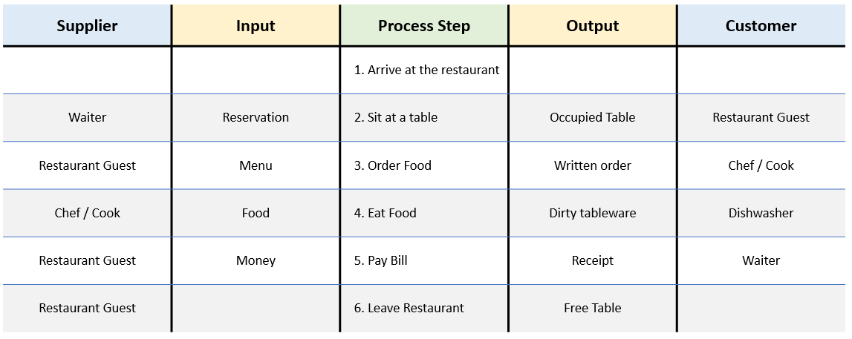
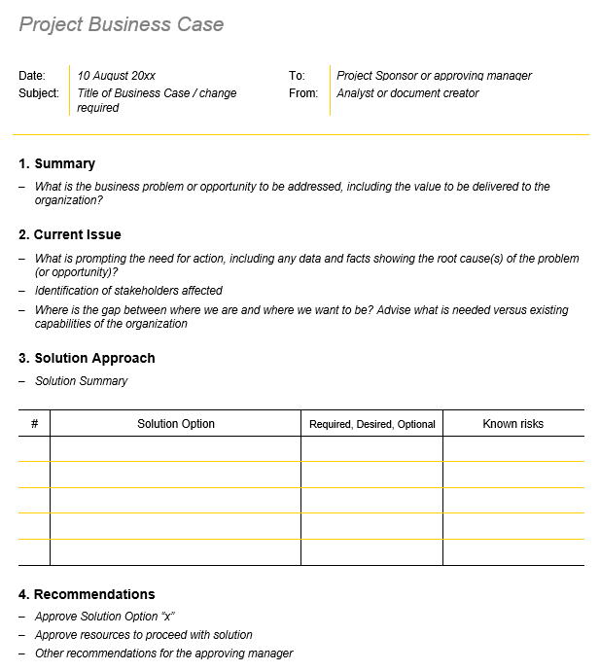
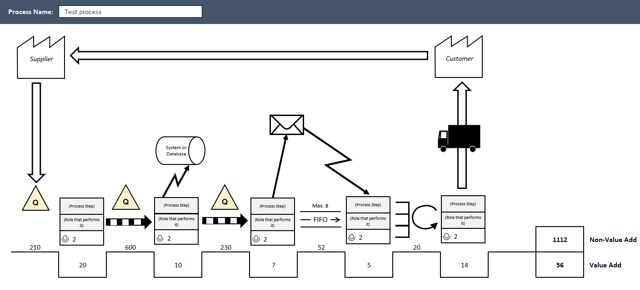
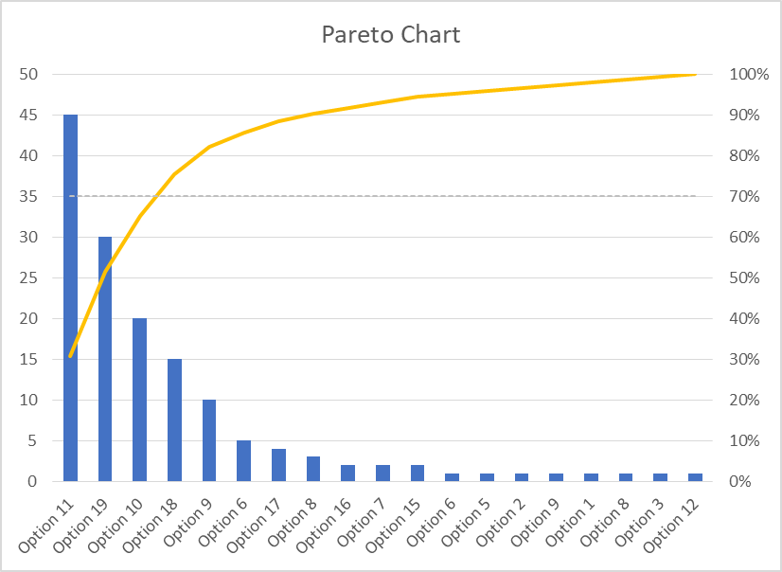
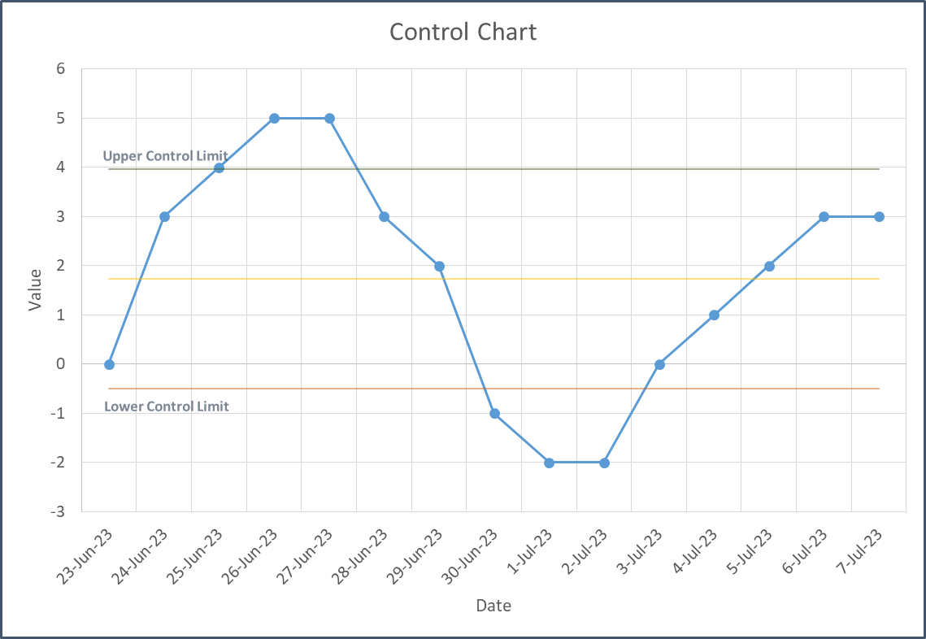
Milestone List
0. Pre-Define | 1. Define | 2. Measure
1 Mar 2023 | 15 Mar 2023 | 25 Mar 2023
3. Analyse | 4. Improve | 5. Control
10 Apr 2023 | 20 Apr 2023 | 29 Apr 2023
Project Sponsor | Michael Jenkins
Lead / Black Belt | Sally Brown
Team Members | Jim Fields, Anne Bindley, Sophie Ingrid
Example Project
DMAIC
Step 0: Pre-Define Checklist
Current State:
100 sales per day through online channel
Desired State:
200 sales per day through online channel
Step 1: Define
Step 2: Measure
Step 3: Analyse
Step 4: Improve
Step 5: Control

