Slide 1
Milestone List
Step 1 | Step 2 | Step 3 | Step 4
1st Mar 2023
Step 5 | Step 6 | Step 7 | Report Out
Project Sponsor
Project Lead
Team Members
Project Title
Step 1: Define the Problem
Include:
Problem statement:
Make it measurable, based on the gap between the current standard and the expected results.
Base it on improving the Customer Driven Metrics (Quality, Delivery, or Cost), or reducing the Eight Wastes (Defects, Overburden, Waiting, Non-effective use of people, Transport, Inventory, Motion, Excessive processing).
Step 3: Plan
Include:
Root Causes,
Brainstormed solutions,
Action Register
Step 5: Check
Gather data from the changes and compare against targets in Step 3:
# | Measure | Baseline | Target | Actual
1
2
3
4
# | Action Item | Assigned To | Due Date
1 |  |  | / /
2 |  |  | / /
3 |  |  | / /
4 |  |  | / /
Step 6: Act (or Adjust)
If desired results are met:
Document changes
Update Standard Operating Procedures
If desired results are not met:
Return to Step 3 - Plan
Step 2: Grasp the Current Situation
Go to the Gemba, hold Kaizen meetings and include:
SIPOCs,
Value Stream Maps,
Swim Lane Flow Charts,
Root Cause Analysis with a Fishbone Diagram and the Five Whys,
Pareto Charts.
Step 4: Do
Have your team-members implement the plan in Step 3, and include:
The details of the actual solution
Document process or layout changes
Step 7: Lessons Learned
Document lessons learned, such as Retrospective outcomes.
Use this A3 to pass on lessons learned to others.

Slide 2
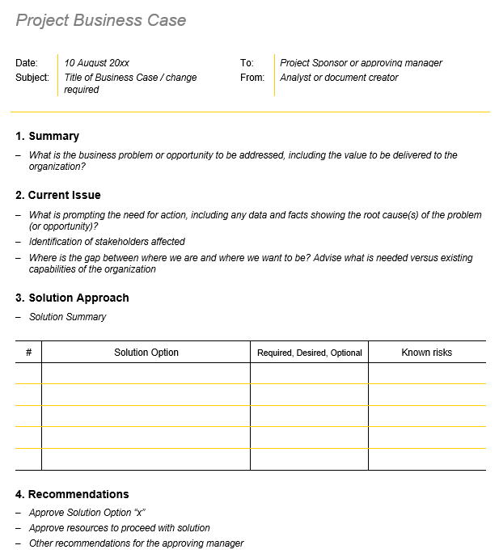
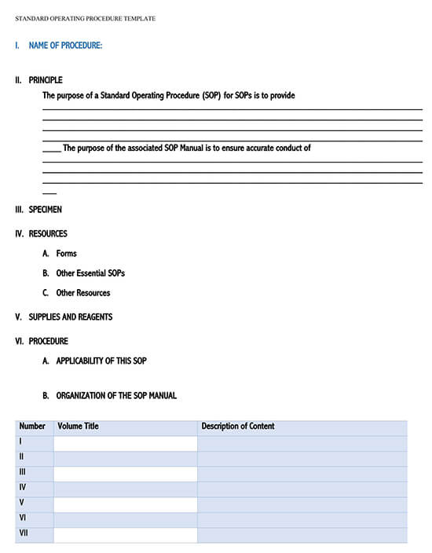
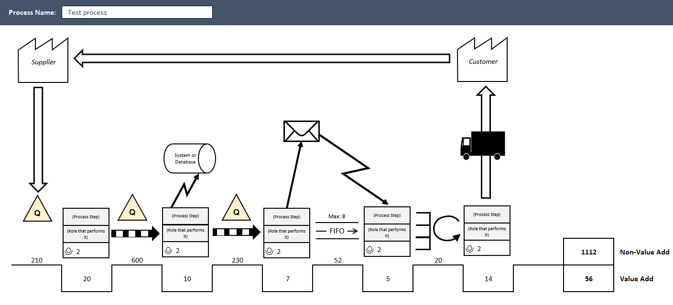
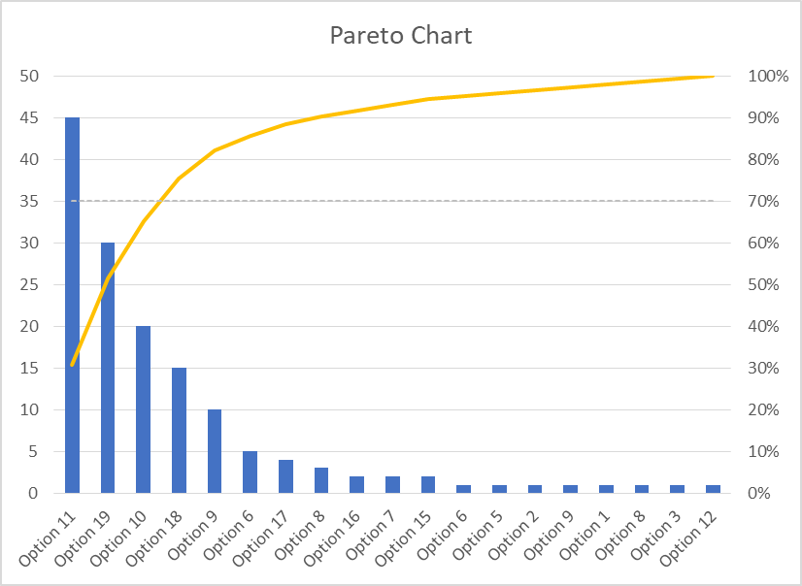
Milestone List
Step 1 | Step 2 | Step 3 | Step 4
1st Mar 2023 | 15 Mar 2023 | 25 Mar 2023 | 10 Apr 2023
Step 5 | Step 6 | Step 7 | Report Out
20 Apr 2023 | 29 Apr 2023 | 10 May 2023 | 15 May 2023
Project Sponsor | Michael Jenkins
Project Lead | Sally Brown
Team Members | Jim Fields, Anne Bindley, Sophie Ingrid
Example Project
Step 1: Define the Problem
Current State:
100 sales per day through online channel
Desired State:
200 sales per day through online channel
Step 3: Plan
Step 5: Check
# | Measure | Baseline | Target | Actual
1 | Sales | 100 | 200 | 210
2 | Interactions | 2000 | 4000 | 4300
3 | Clicks | 1000 | 2000 | 2100
# | Action Item | Assigned To | Due Date
1 | Design page flow | Henry | 2 / 04 / 23
2 | Develop page flow | Michelle | 9 / 04 / 23
3 | Test and Release page flow | Jacob | 11 / 04 / 23
Step 6: Act (or Adjust)
Desired results were met.
SOPs were updated:
Step 2: Grasp the Current Situation
Step 4: Do
Counter-measures:
Website layout change to reduce customer drop offs.
Step 7: Lessons Learned

