Slide 1
2021 Virtual Darby Family Reunion
Notes:
Developed by: Jacqueline Bain
Game co-hosts: Jacqueline Bain & Jennifer Long

Slide 2
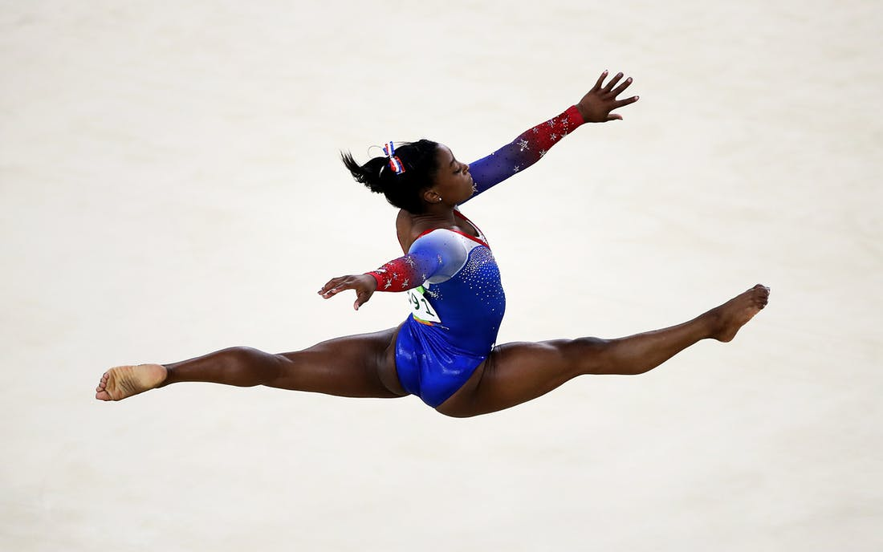
How many medals has US Olympian Simone Biles won?
20 seconds
3
4
5
6
Notes:
Practice Question. No Points.
----------------------------------------
Simone Biles, the greatest female gymnast of time, has 5 medals – 4 gold and 1 bronze. Her total number of World medals is 25 (19 gold).

Slide 3
Who is the most decorated female US Olympic track athlete of all time?
20 seconds
Evelyn Ashford
Allyson Felix
Jackie Joyner-Kersee
Sanya Richards-Ross
Notes:
Practice Question. No Points.
-------------------------------------------------
Allyson Felix has won 9 medals – 6 gold and 3 silver
Jackie Joyner-Kersee has 6 medals – 3 gold, 1 silver and 2 bronze
Evelyn Ashford has 5 medals – 4 gold and 1 silver
Sanya Richards-Ross has 5 medals – 4 gold and 1 bronze

Slide 4
Who is the most decorated Black male Olympic track athlete?
20 seconds
Carl Lewis
Usain Bolt
Michael Johnson
Jesse Owens
Notes:
Carl Lewis (US) won 10 total medals (9 gold)
Usain Bolt (Jamaica) won 8 total medals (8 gold)
Michael Johnson (US) won 4 total medals (4 gold)
Jesse Owens (US) won 4 total medals (4 gold)

Slide 5
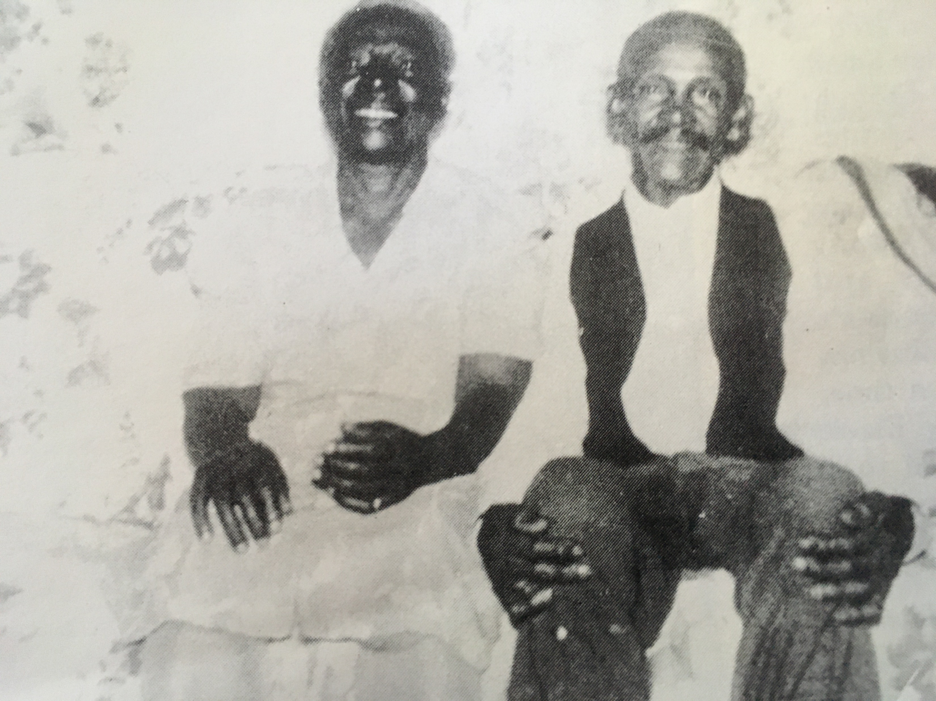
Who is the couple in this photograph?
20 seconds
Ruby & Ossie
Hannah and Adam
Eliza and Julius
Elizabeth & Samuel
Notes:
The two people in this photo are Julius and Eliza Darby. The Darby Clan originates from the union of Julius and Eliza. Our family is rooted in common ancestry (stemming from Julius and Eliza), but it extends beyond bloodlines to form a distinctive clan that is connected by love.
Adam and Hannah Phyall were Eliza’s parents.
We believe that Julius’ parents were named Samuel Sr and Elizabeth Darby.
Ossie Davis and Ruby Dee were famous actors and civil rights activists.

Slide 6
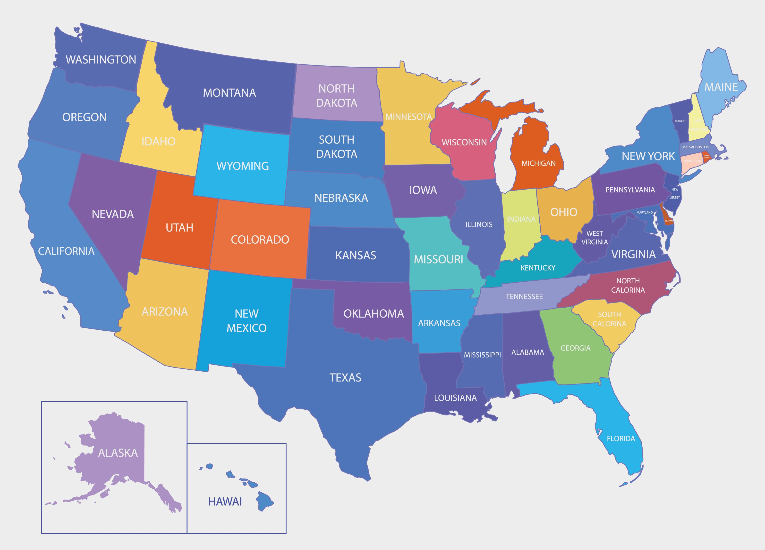
Where were Julius and Eliza born?
20 seconds
North Carolina
South Carolina
Georgia
Florida
Notes:
Julius and Eliza were born in South Carolina.
It is believed that Julius was born near St. Stephen, South Carolina, in 1873.
Eliza was born in St. Stephen in 1883.

Slide 7
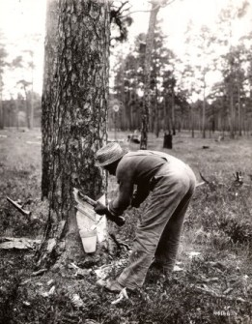
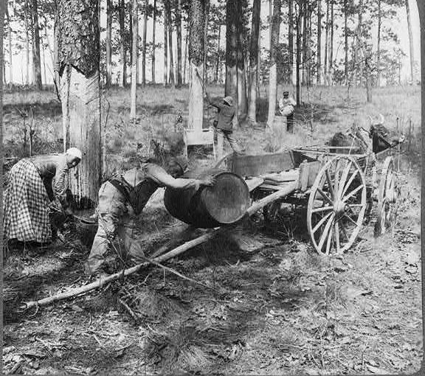
Eliza’s father was employed in what industry in the 1800s?
20 seconds
Turpentine
Shipping
Railroad
Textile
Notes:
Eliza’s father Reverend Adam Phyall worked in the turpentine industry in the 1800s.
Most of the turpentine workers were young, single black men, and many of them had been born in slavery. Adam was born around 1845 in South Carolina, so he was likely also born in slavery (The Emancipation Proclamation was not issued until 1863 and the 13th Amendment prohibiting slavery was not ratified until 1865.)
It’s the Turpentine Industry that brought the Darby’s to Florida. As pine trees stopped producing significant amounts of gum and resin in South Carolina, workers moved southward to find work. Adam followed that path with his family by horse and wagon as he looked for work, ending up in Georgia and then DeFuniak Springs, Florida.
----------------------------
https://www.state.sc.us/forest/scindust.htm
Turpentine : Turpentine was produced by distilling the pitch or “gum” from living pine trees. Workers would cut V-shaped galleries into the side of a pine tree and place a reservoir at the point of the V to collect the sap as it flowed from the wounds.
In South Carolina, turpentine trees were worked from March though October or November. One V-cut was added each week during the season, creating a chevron effect or “face” on the side of the tree. Old stumps and sometimes even living trees can still be found with the characteristic turpentine scars.
The collection cups were emptied of gum every three weeks. Barrels of crude gum were then hauled to a turpentine distillery (“still”) to be rendered into turpentine and various by-products.
The turpentine industry moved out of South Carolina in the 1940s.
The turpentine industry has its roots in North Carolina in the mid-1800s. Eventually the trees stopped producing any significant amount of resin and the turpentines gradually moved south to new stands of trees. Collecting the gum was very labor intensive and working the still was hot and very dirty work.

Slide 8
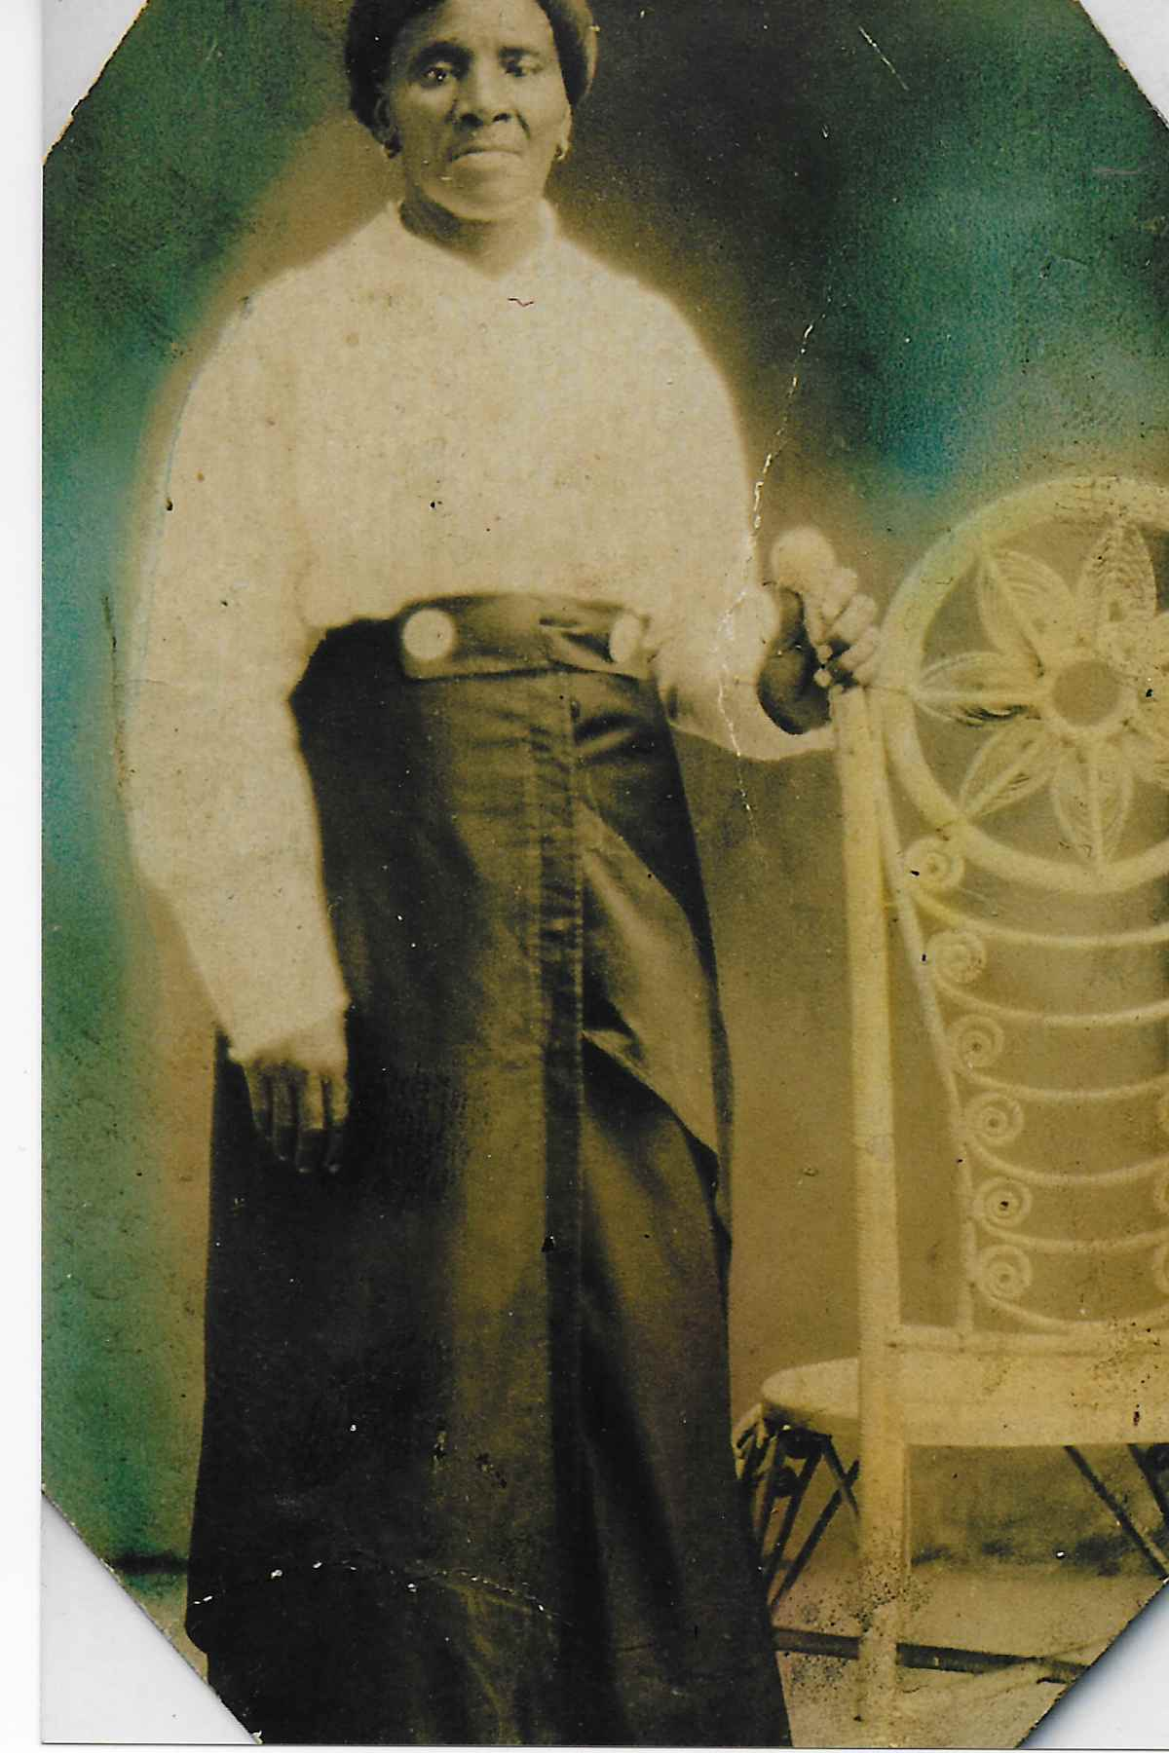
Who is this woman and what is her relationship to Eliza?
20 seconds
Eva, Grandmother
Hannah, Mother
Sarah, Aunt
Ruth, Sister
Notes:
This is Eliza’s mother Hannah Jefferson Phyall. Hannah was born in South Carolina in the 1850s.
It is believed that Eliza’s grandmother’s name was Eva.

Slide 9
Eliza and Hanna were both married at what age?
20 seconds
14
16
18
20
Notes:
According to US census records, they were both married at the age of 16.
In 1890, when the US Census Bureau started collected marriage data, it was recorded that the average age of a first marriage for men was 26 years, and the average age of marriage for women was 22. During the 19th century, the “age of consent” in the US varied between 10 years old and 16 years old, depending on the state and year.

Slide 10
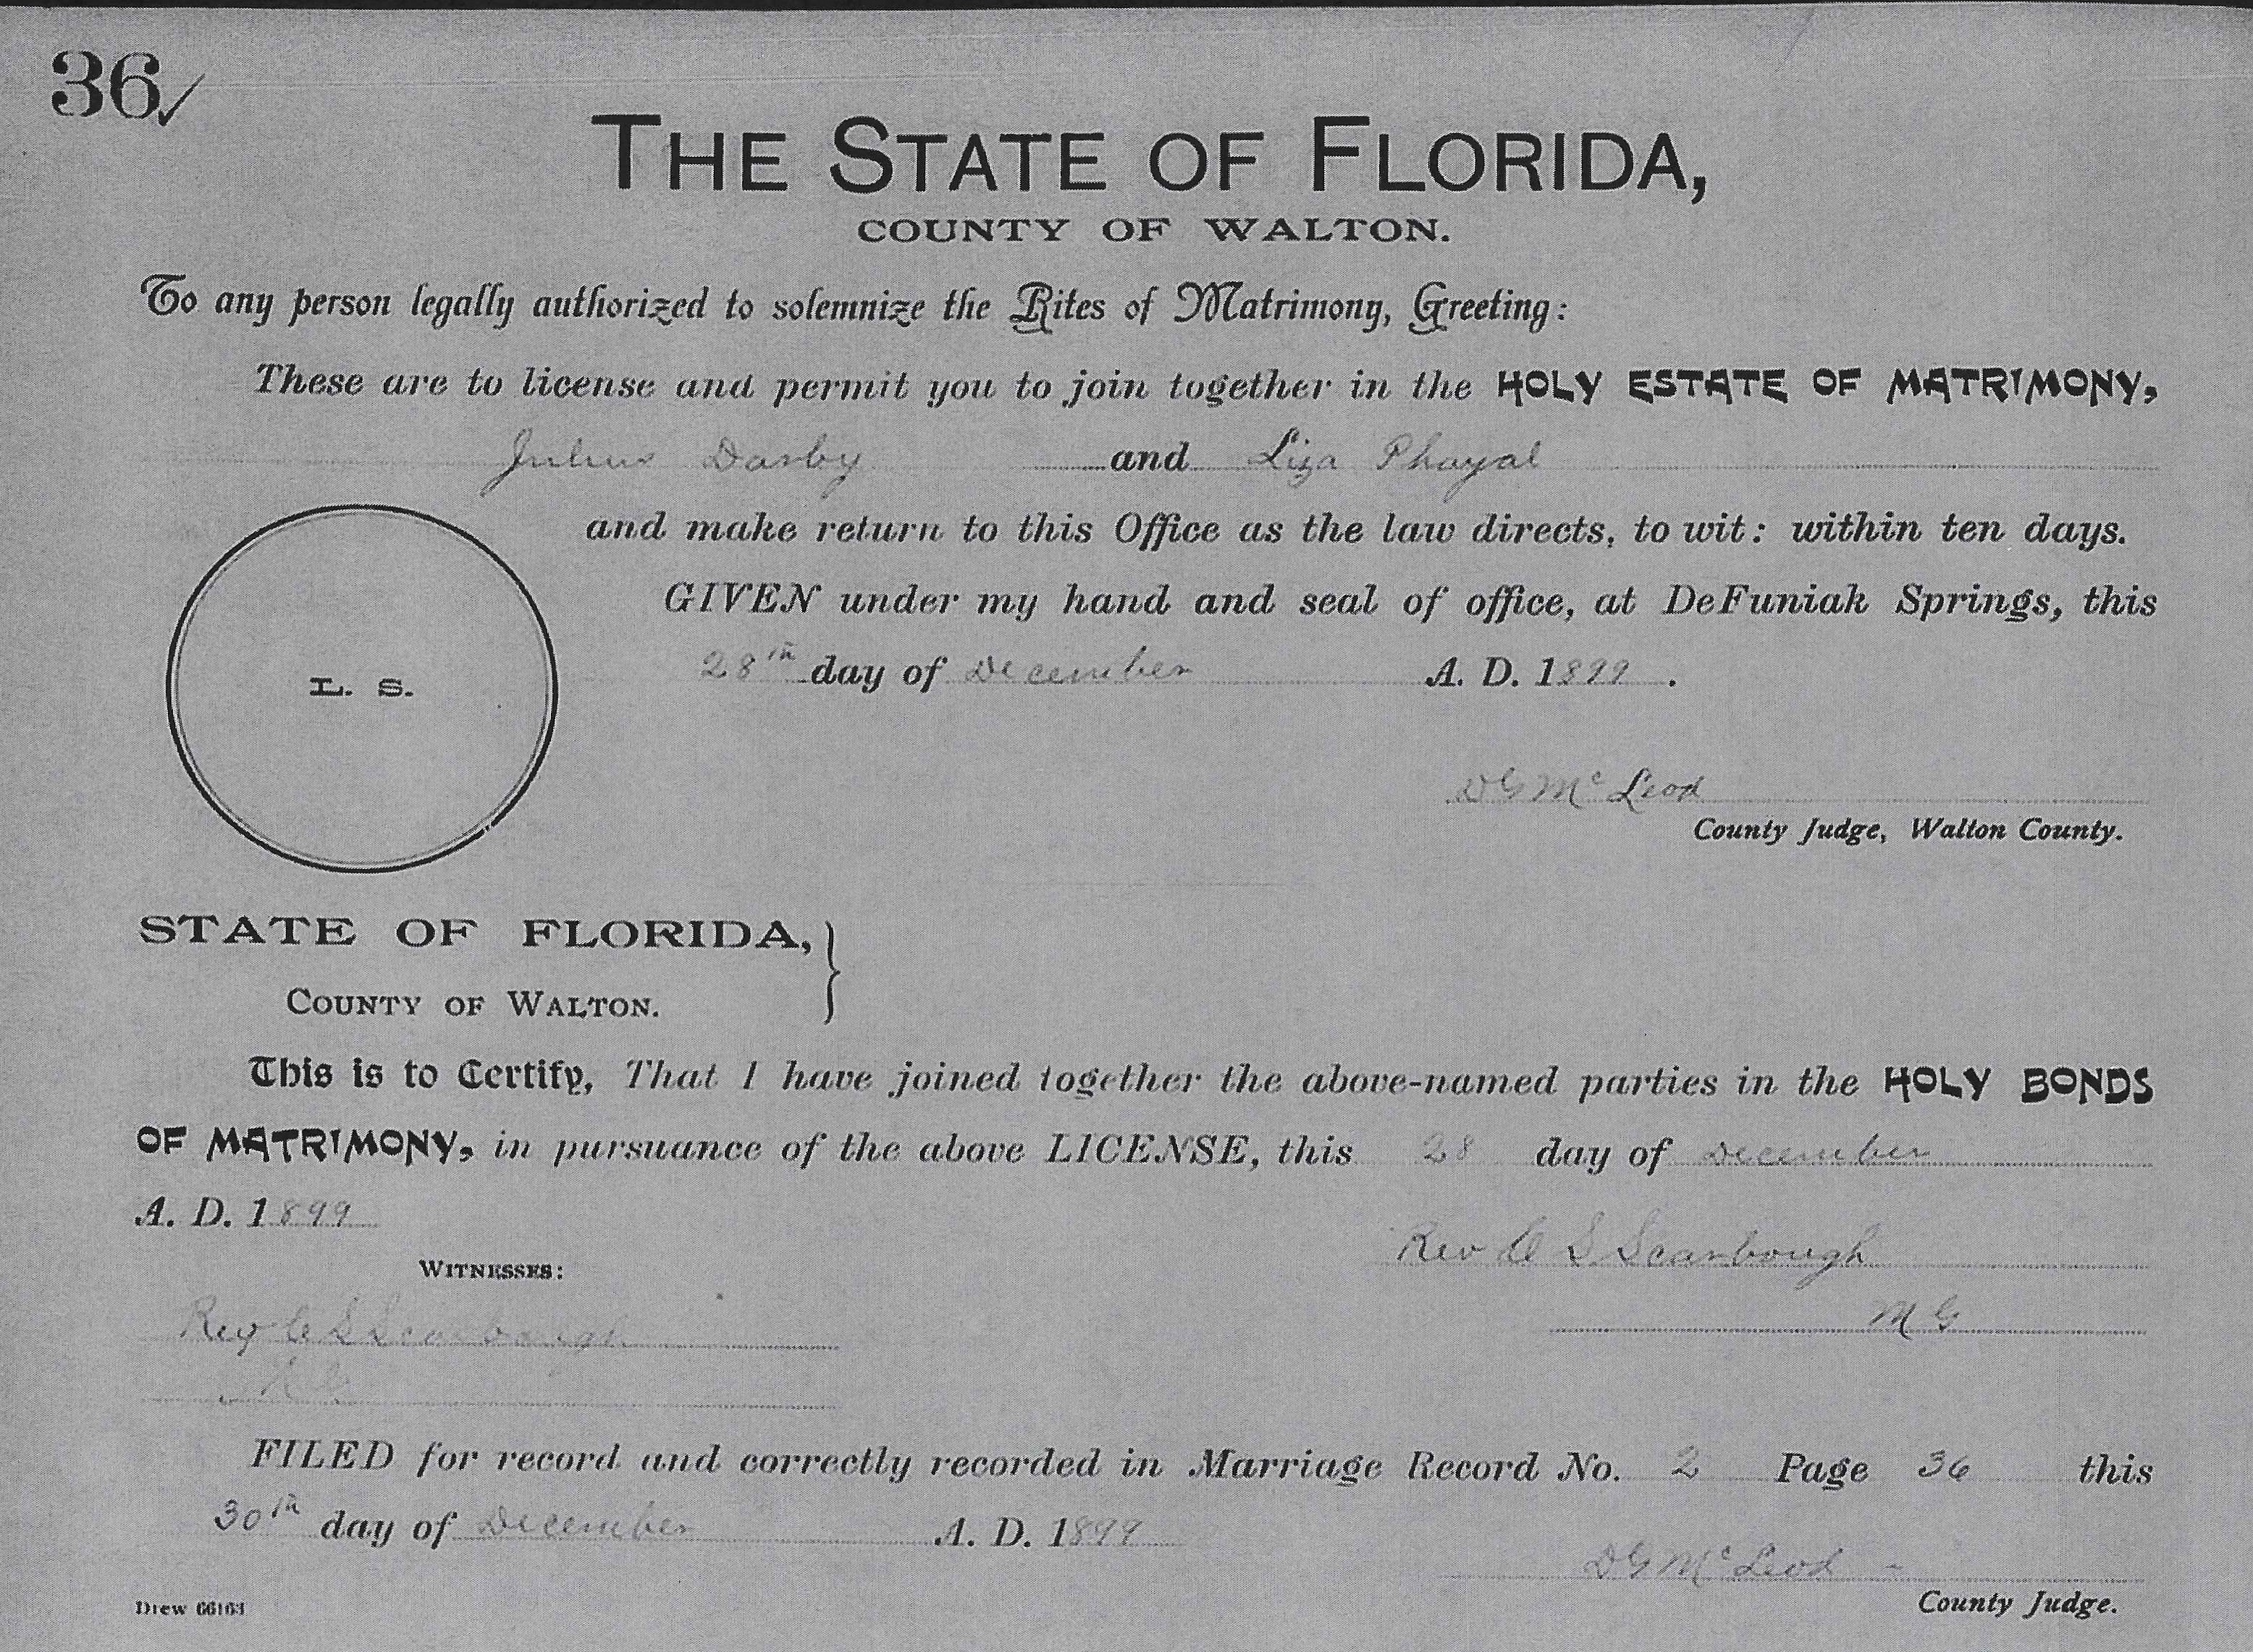
Julius and Eliza were married in 1898.
20 seconds
True
False
Notes:
In 2020, the Darby Family Historical Committee found their marriage license by working with the Bartow Historical and Genealogical Library.
Julius and Eliza were married in 1899 in DeFuniak Springs, Florida.
Eliza was 16 years old. Julius was about 26 years old.

Slide 11
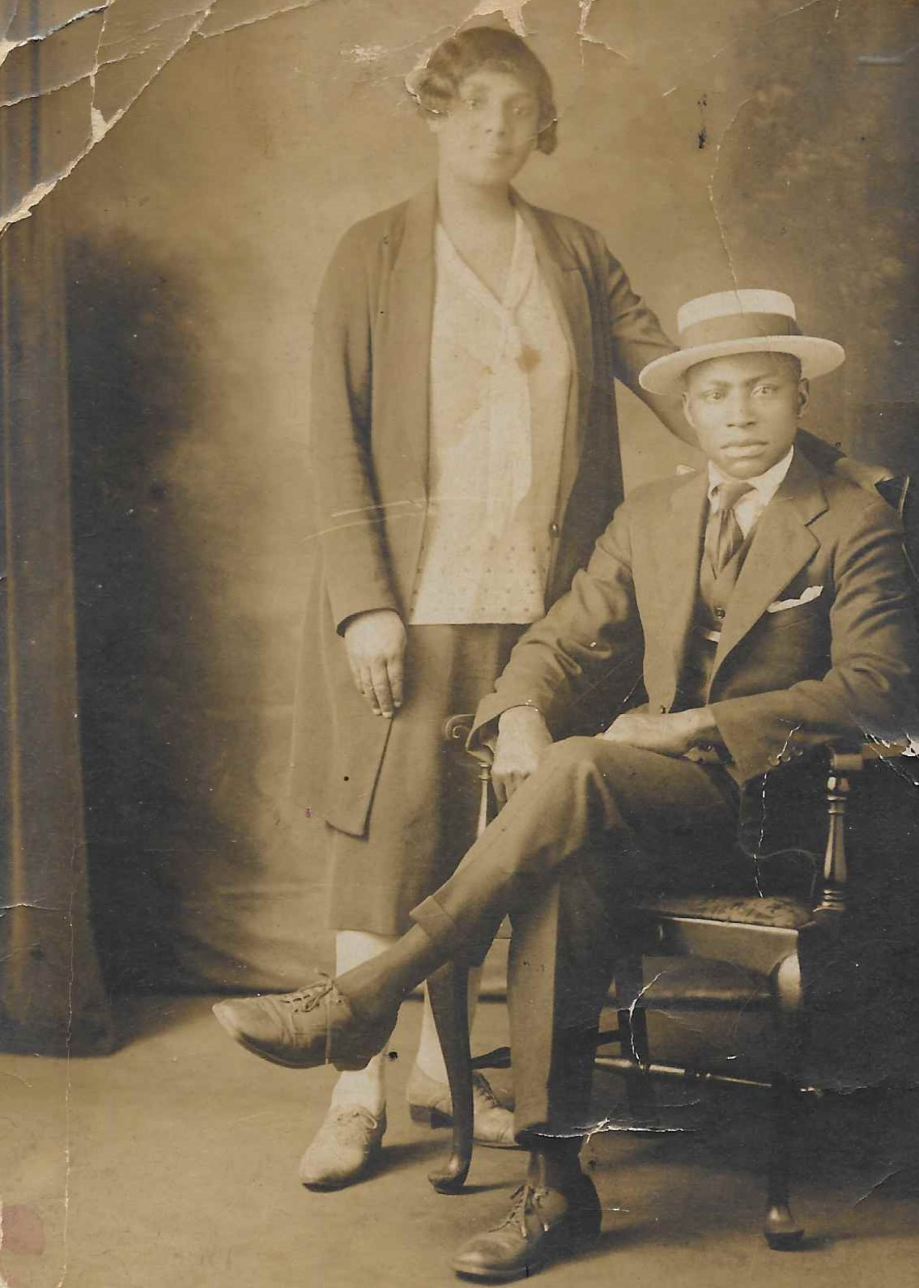
Who is this dapper fellow?
20 seconds
Primas
Peter
Johnny
Henry
Notes:
This picture is of Primas Phyall who was one of Eliza’s 5 brothers. (The woman in the photo is his wife Frankie.)
Eliza’s other brothers were Peter, Johnny, Henry and Frank.
She also had two sisters – Elizabeth and Regina – who died as babies. Eliza is likely named after her two sisters – Eliza taken from Elizabeth and Regina, which was Eliza’s middle name.

Slide 12
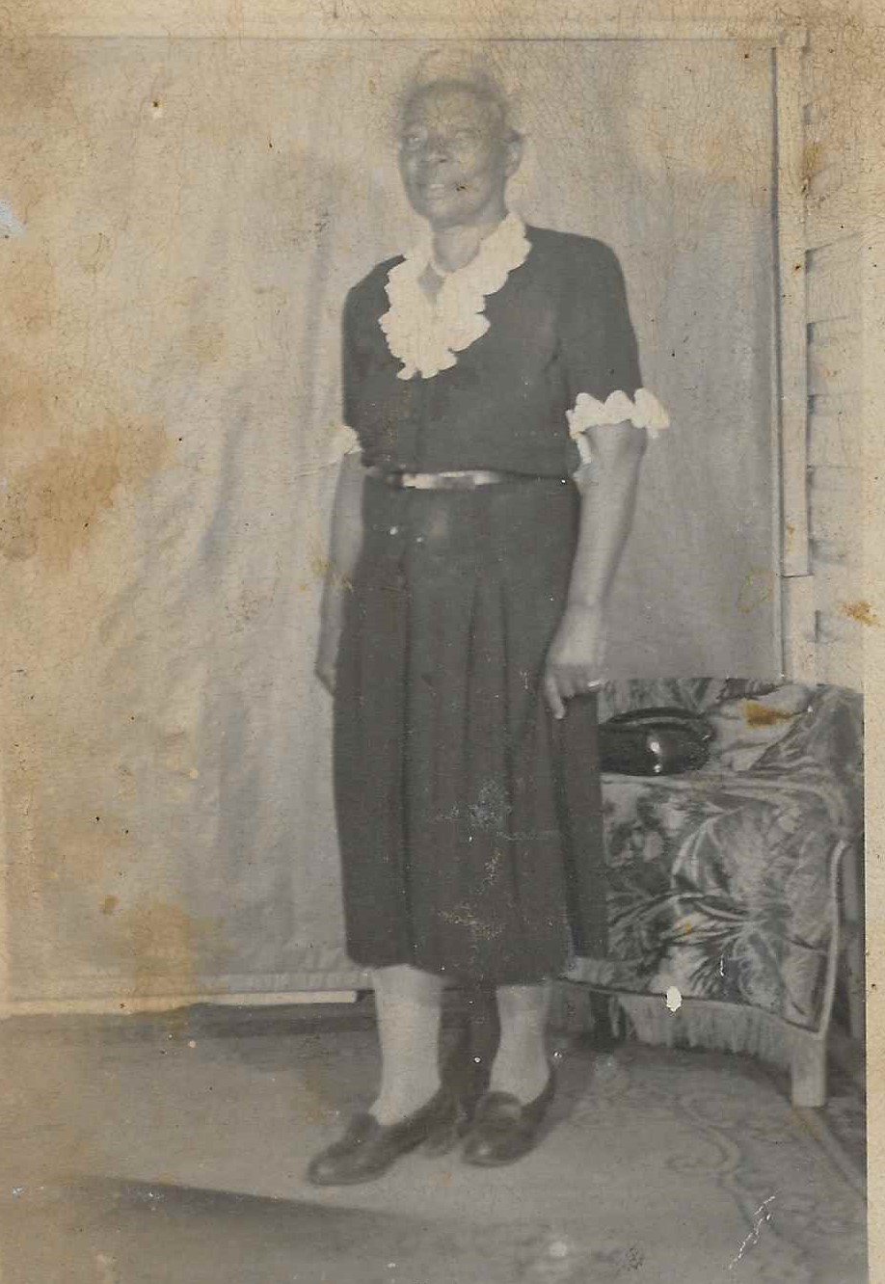
How many children did Eliza give birth to?
20 seconds
8
12
14
18
Notes:
Written by Wilhelmina Spires and Ann M. Hilliard in The Darby Gazette:
"Eliza and Julius had 14 children, not including "four miscarriages". There were seven girls and seven boys."
1. Samuel Darby (1900-1991)
2. Rosena Darby Bryant Best (1901-1992)
3. Adam Julius Darby (1903-1975)
4. John Henry Darby (1905 - 1967)
5 & 6. Mary and Martha Darby (1906)
7. Joseph Solomon Darby (1908-1999)
8. Sadie Darby (1910-1993)
9. Edward Franklin Darby (1912-1961)
10. Daniel Darby (1915-1917)
11. Howard Darby (1916-1917)
12. Eva Darby (1918)
13. Anna Eliza Darby Kennedy (1919-1961)
14. Wilhelmina Darby Spires (1922-2020)

Slide 13
Who were the first three children born to Julius and Eliza?
20 seconds
Samuel, Rosena & Adam Julius
Samuel, Rosena & John Henry
Samuel, Mary & Martha
Samuel, Sadie & John Henry
Notes:
Julius and Eliza’s three oldest children were Samuel born in 1900, Rosena born in 1901 and Adam Julius (AJ or Buddy) born in 1903.

Slide 14
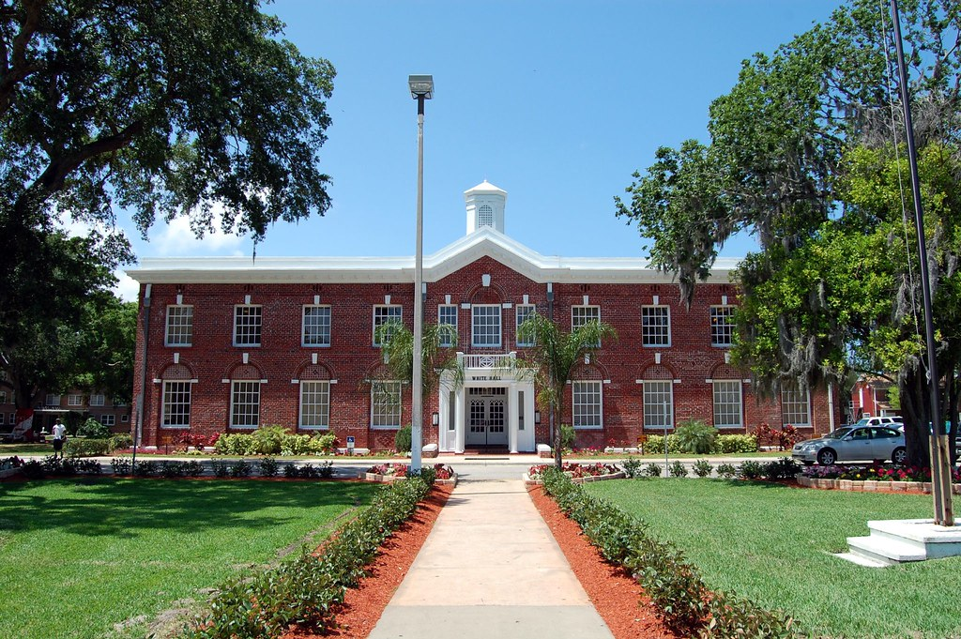
Which of these historically black colleges was founded in Florida in 1904?
20 seconds
Florida A&M
Bethune Cookman
Edward Waters
Florida Memorial
Notes:
The year after AJ Darby was born, Bethune-Cookman College was founded by Mary McLeod Bethune.
Wilhelmina Darby Spires, the youngest daughter of Julius and Eliza, would later graduate from Bethune.

Slide 15
Julius and Eliza’s descendants Joseph Darby, Jr., Michelle Smith McGriff and Joey Hilliard graduated from Florida A&M University.
True
False
Notes:
Joseph graduated from Bethune Cookman.
Michelle graduated from Edward Waters.
Joey graduated from FAMU.

Slide 16
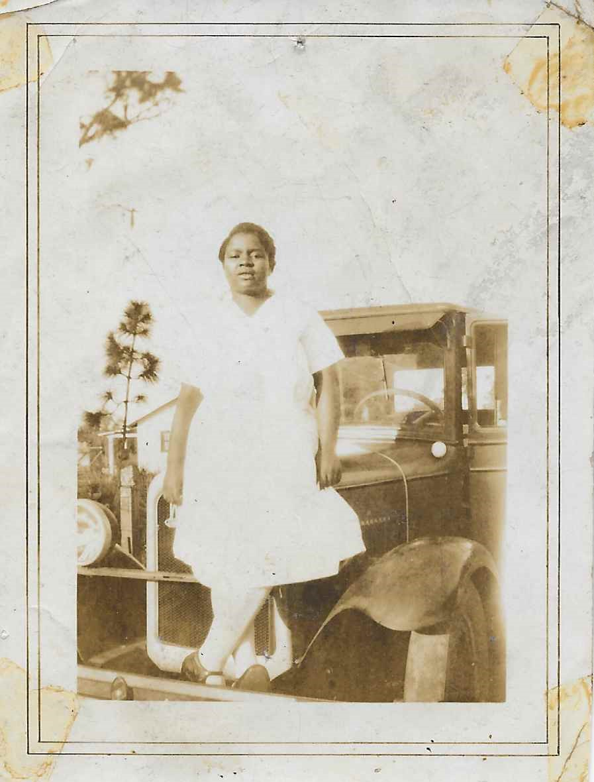
Sadie Darby was known for giving what treat?
20 seconds
Peppermint Sticks
Juicy Fruit Gum
Taffy
Candy Apples
Notes:
Sadie Darby was the 8th child of Julius and Eliza and was born in 1910.
She was known for her generosity – big and small.

Slide 17
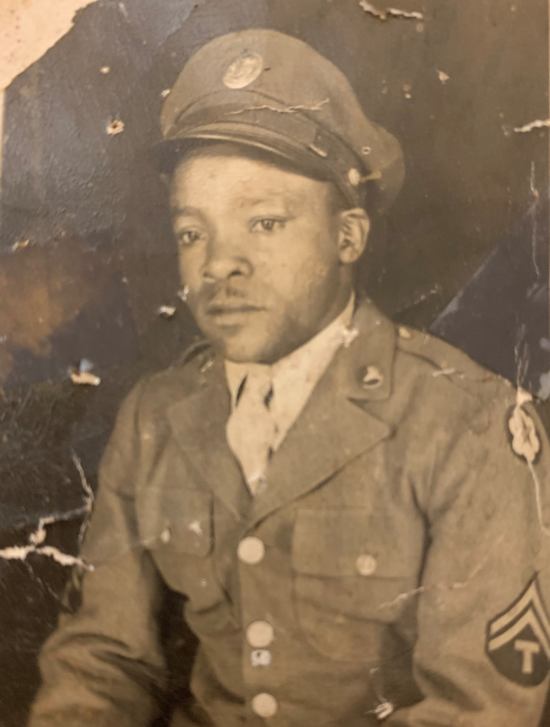
Who is this military man?
20 seconds
Adam Julius Darby
John Henry Darby
Edward Franklin Darby
Joseph Solomon Darby
Notes:
This is a picture of Edward Franklin Darby who was the 9th child of Julius and Eliza.
He registered for the U.S Army in 1940 at the age of 28. He served in World War II for more than 3 years.

Slide 18
Which of these family members served in the U.S. Army?
20 seconds
Joseph Solomon Darby, Sr.
John Marion Spires
Timothy Darby II
Christopher Alan Darby
Notes:
[You can select more than one person.] [Worth Double Points]
-----------------------------------------------
Joseph Darby, Sr. was the son of Julius and Eliza. He served in the US Army for almost two years during World War II.
John Spires was the husband of Wilhelmina Darby Spires (who was the daughter of Julius and Eliza). John served in the US Army in Korea.
Minister Timothy Darby II – the great grandson of Julius and Eliza – served in the US Army for almost four years.
Christopher Alan Darby served in the US AIR FORCE (not the Army) for about 18 years.

Slide 19
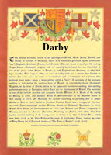
The surname Darby originates from what country?
20 seconds
Ireland
France
England
Wakanda
Notes:
English: It is a habitational name from the city of Derby, which is the county seat of Derbyshire in the United Kingdom (UK). It also originates from the smaller place called West Derby in Lancashire. Both are named from Old Norse "djur" (meaning deer) and "byr" (meaning a farm or settlement).

Slide 20
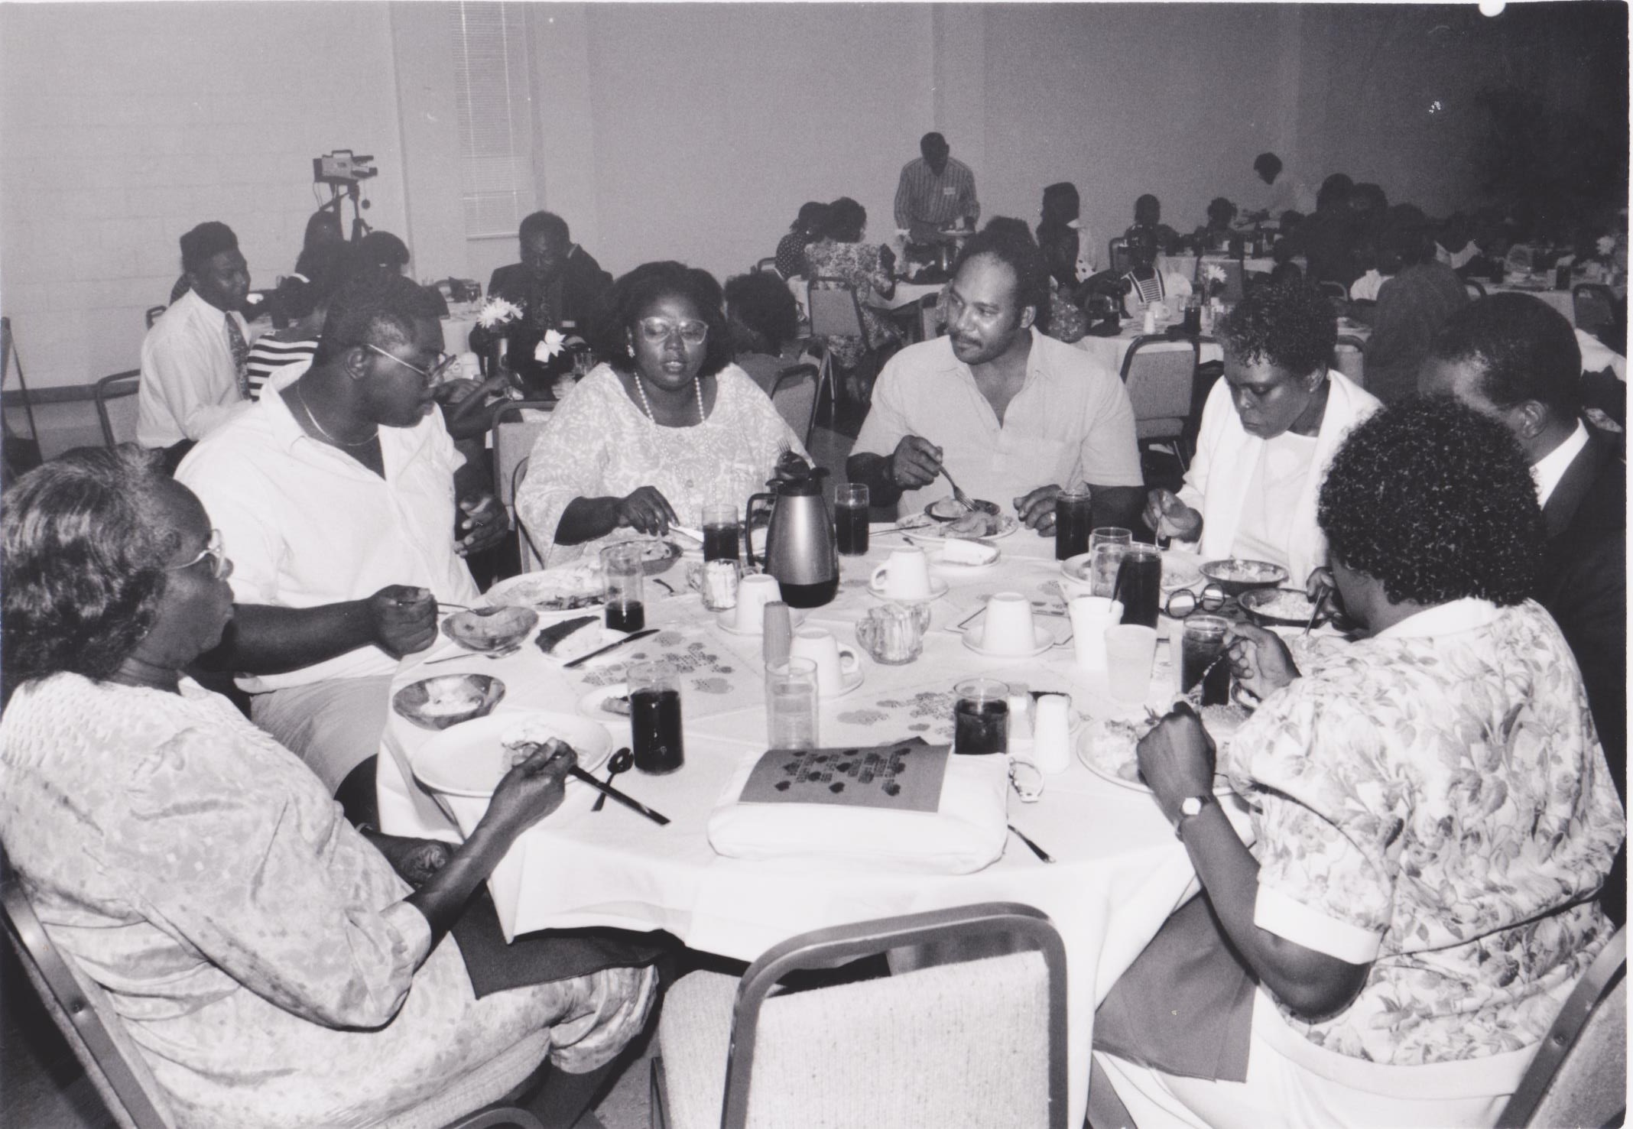
In what year was the first Darby Family Reunion held?
20 seconds
1989
1990
1991
1992
Notes:
The Darby Family Reunion was founded by Marilyn Smith.
It was first held in 1990 in Winter Haven, Florida.

Slide 21
Which of these black history events did not happen in the 1990s?
30 seconds
Nelson Mandela is released from prison in South Africa
Mae Carol Jemison is the first African American woman in space
The Million Man March is held in Philadelphia
Carol Moseley Braun is the first Black woman elected to serve in the US Senate
Notes:
[Double Points]
---------------------------------------------
The incorrect answer is the Million Man March. Although it took place in 1995, it was actually held in Washington, DC.
The Million Woman March was held two years later in Philadelphia.

Slide 22
How many reunions have been held in Winter Haven?
20 seconds
3
4
5
6
Notes:
1990 – Marilyn Smith, President
1991 – Dr. George Hilliard, President
1993 – David Darby, President
2001 – Doug and Annette Thomas, Co-Presidents
2007 – Constance Darby Price, President
2015 – Michael Smith and Michelle McGriff, Co-Presidents

Slide 23
Our first reunion outside of Winter Haven was held in what city?
20 seconds
DARBY FAMILY REUNION
Tallahassee, Florida
Washington, D.C.
Atlanta, Georgia
Charleston, South Carolina
Notes:
Our first reunion outside of Winter Haven was held in 1995 in Atlanta, Georgia. Jacqueline Bain was President that year.
The 1997 reunion was held in Washington, D.C in 1997. Karen Parker Thompson was President.
Linda Darby Wilson was President of the reunion in Charleston, South Carolina, in 2009.

Slide 24
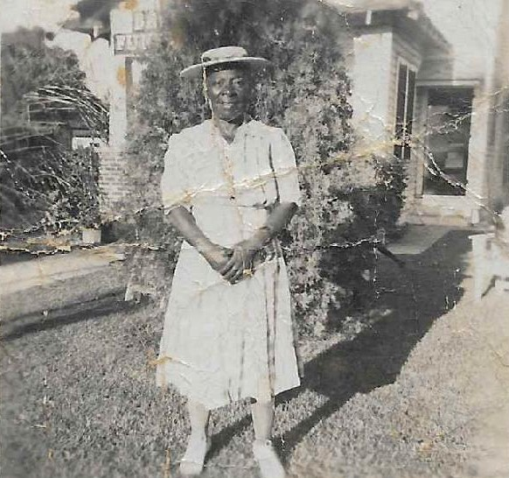
Eliza did not famously say which expression?
20 seconds
I might wear out but I will never rust out.
One bellyful don’t raise no puppy.
Don’t wake a negro to eat. Wake a negro to go to work.
One monkey don’t stop no show.
Notes:
One Monkey Don’t Stop No Show was the title of several different songs, mostly in the R&B genre.
It derived from a common African-American phrase with the general meaning of “one setback should not impede progress”.

Slide 25
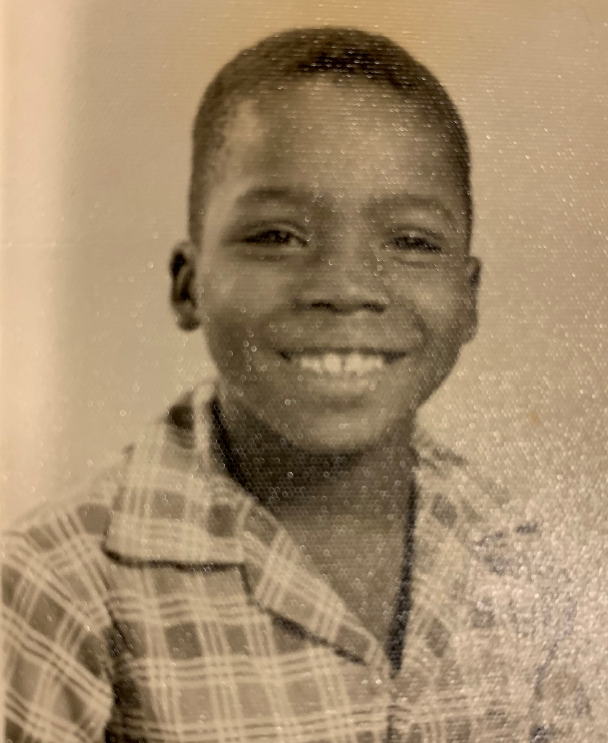
Name that Family Member
10 seconds
Alan Darby
David Darby
Ruben Darby
Marcus Darby

Slide 26
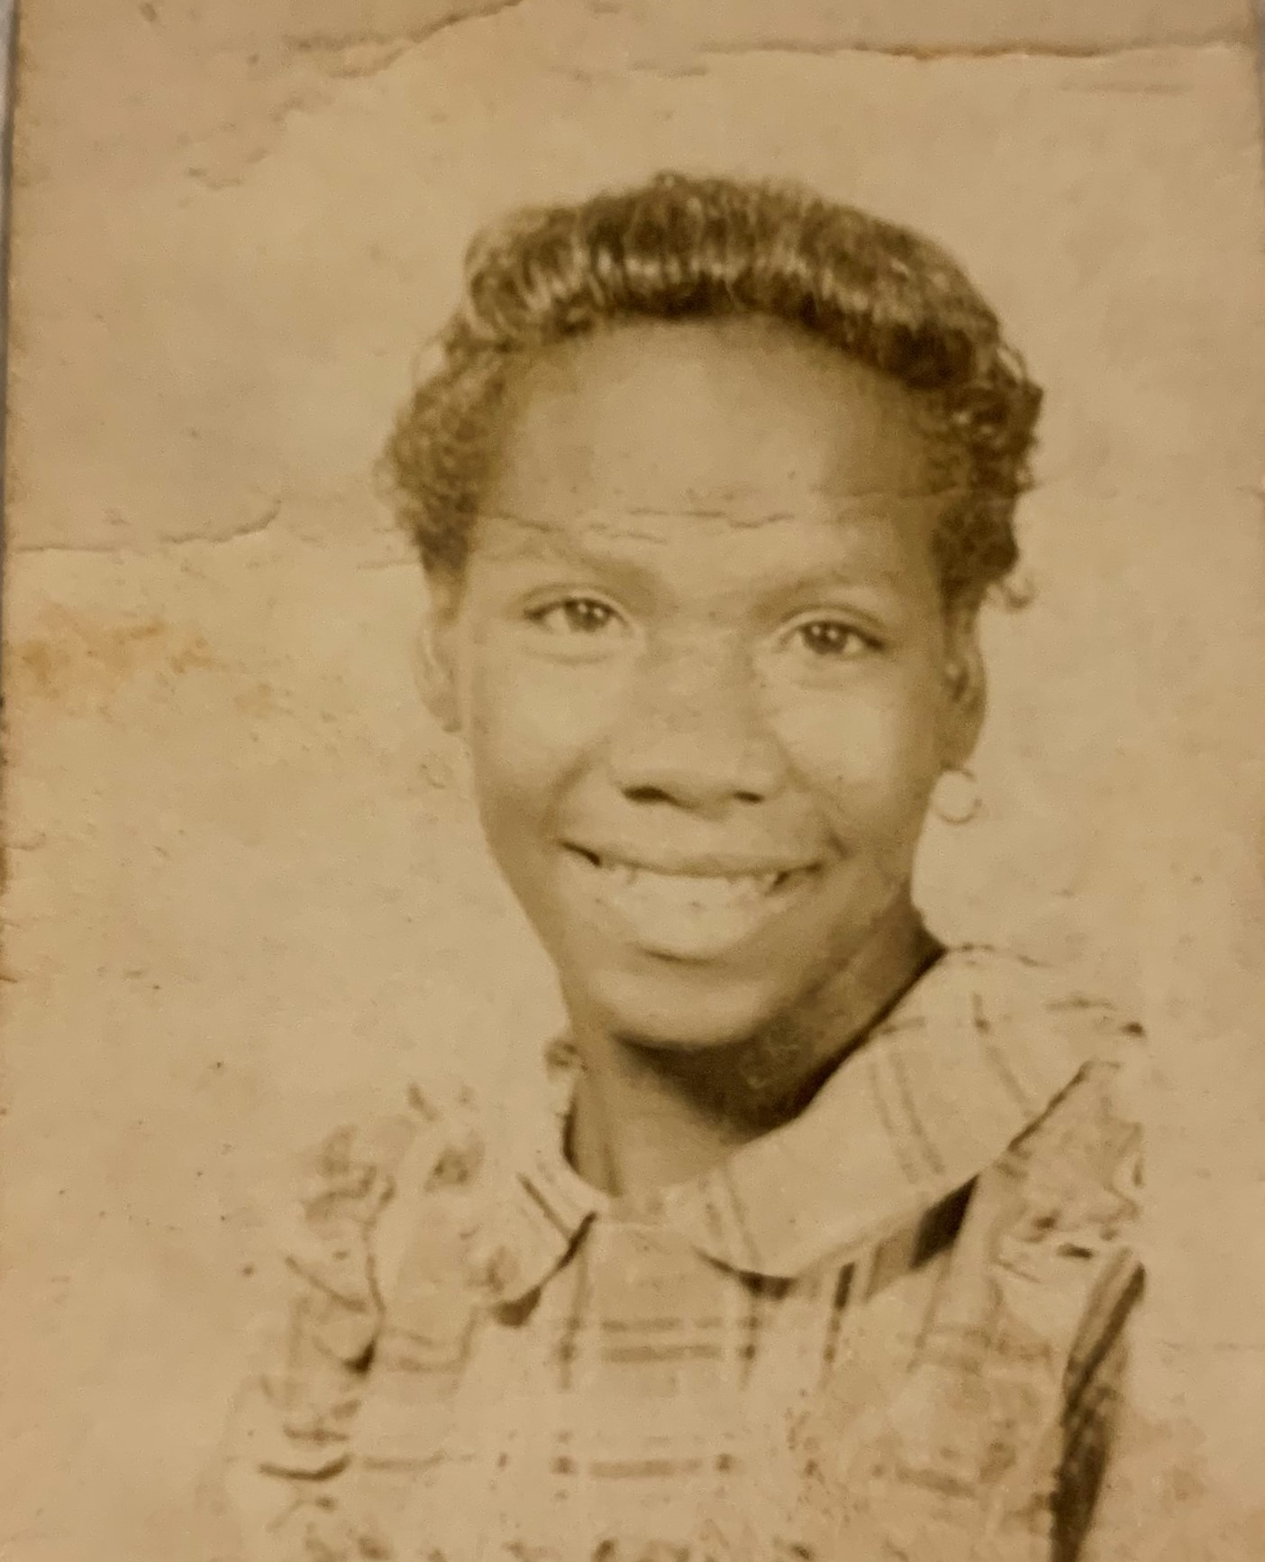
Name that Family Member
10 seconds
Marilyn Darby
Lois Darby
Leoza Darby
Janice Darby

Slide 27
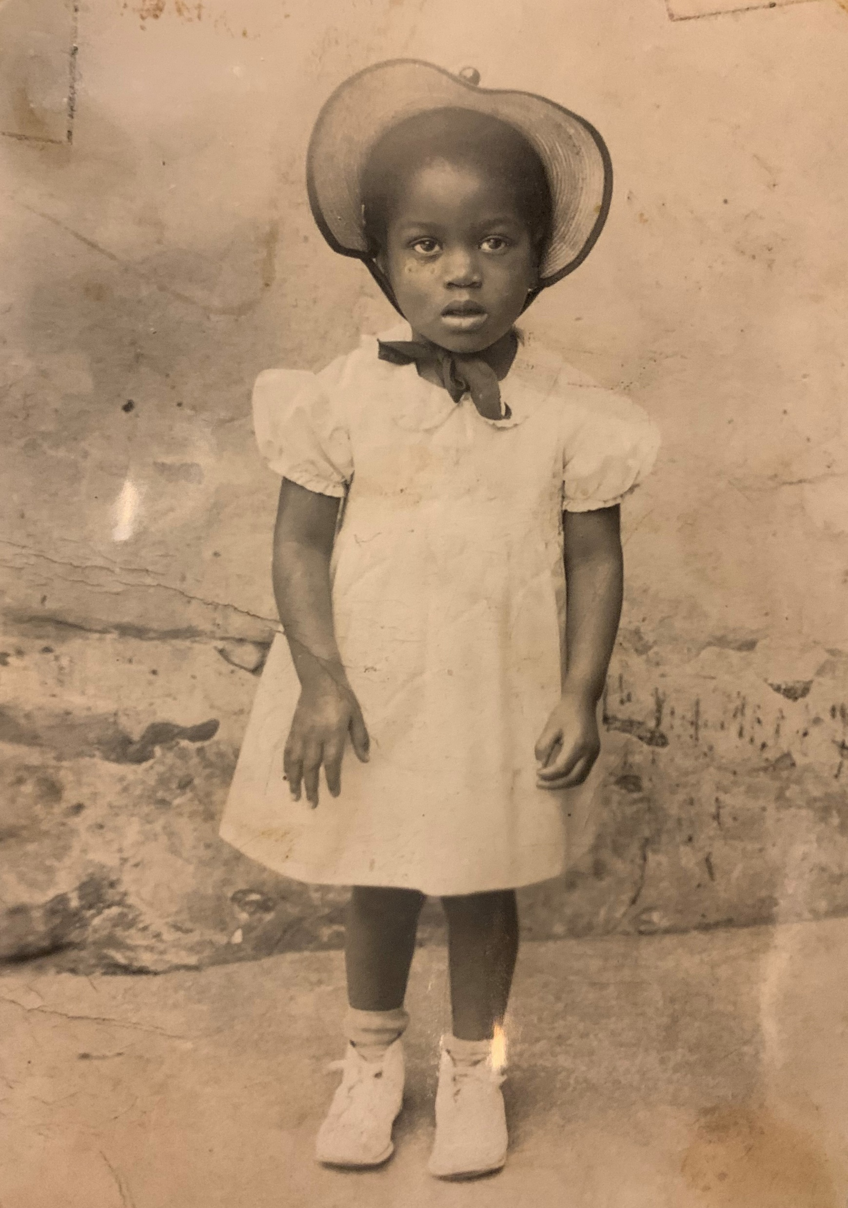
Name that Family Member
10 seconds
Francina Hilliard
Cheryl Hazzard
Constance Hilliard
Yvonne Hilliard

Slide 28
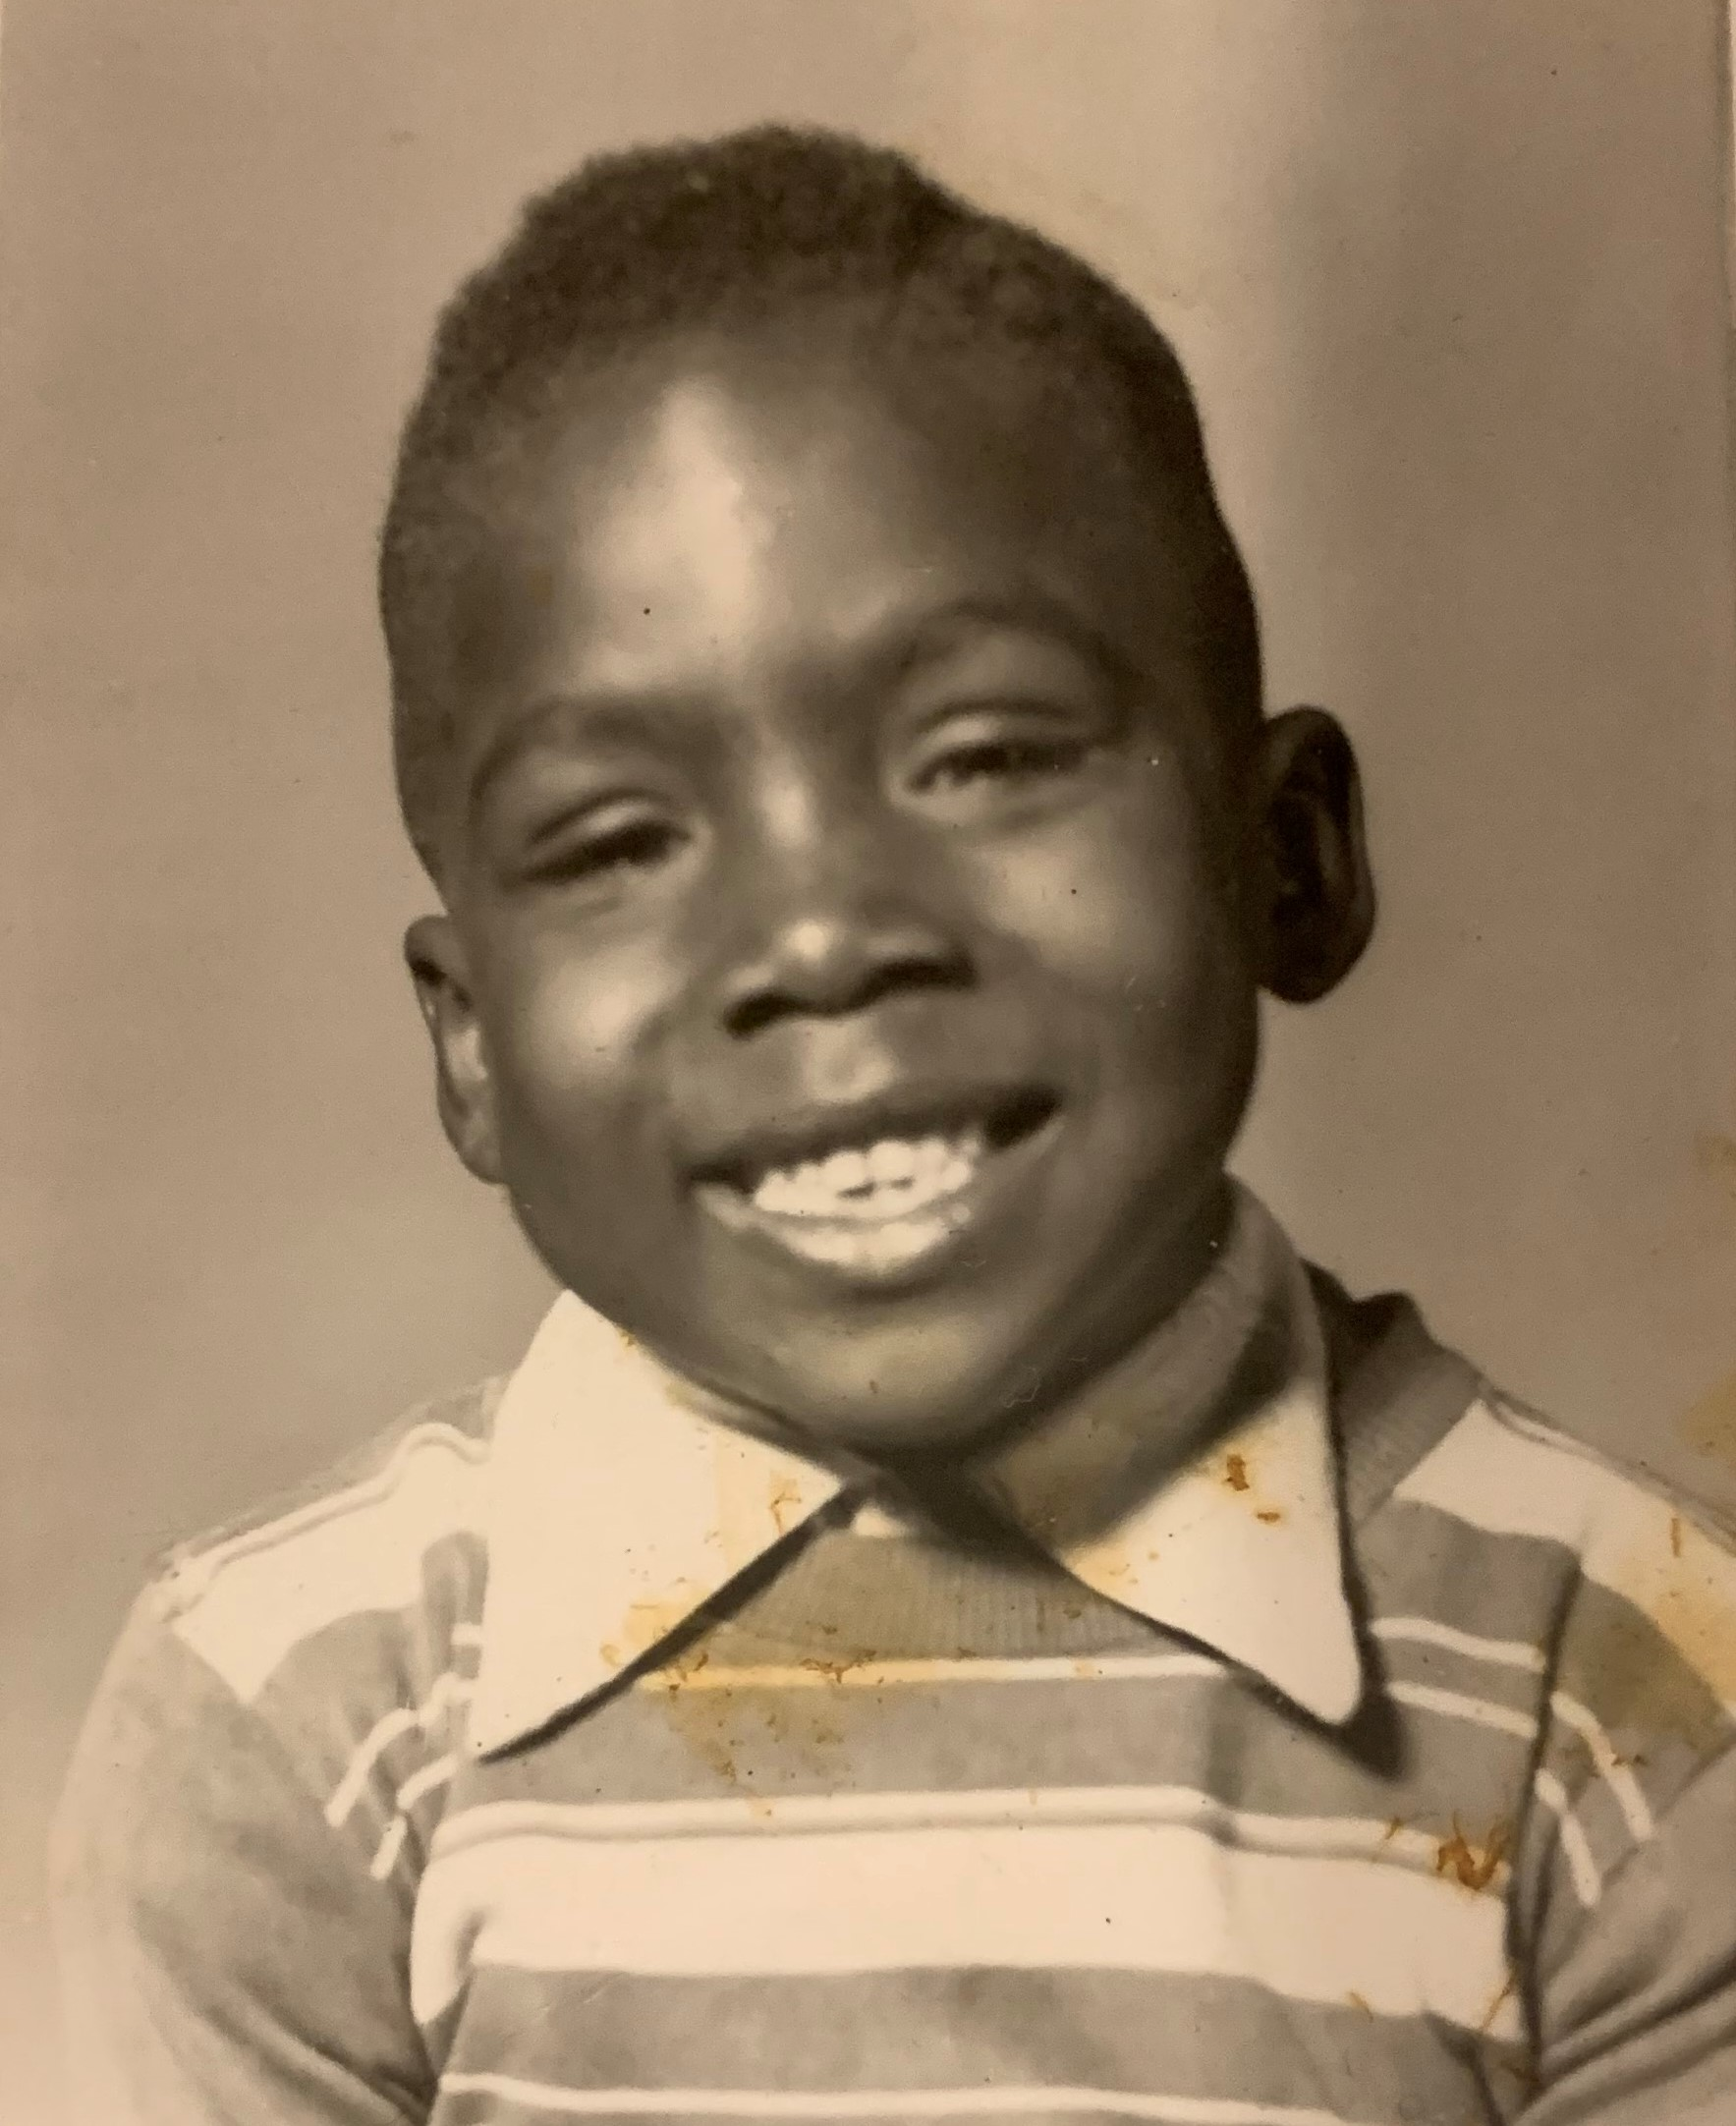
Name that Family Member
10 seconds
Alan Darby
David Darby
Ruben Darby
Marcus Darby

Slide 29
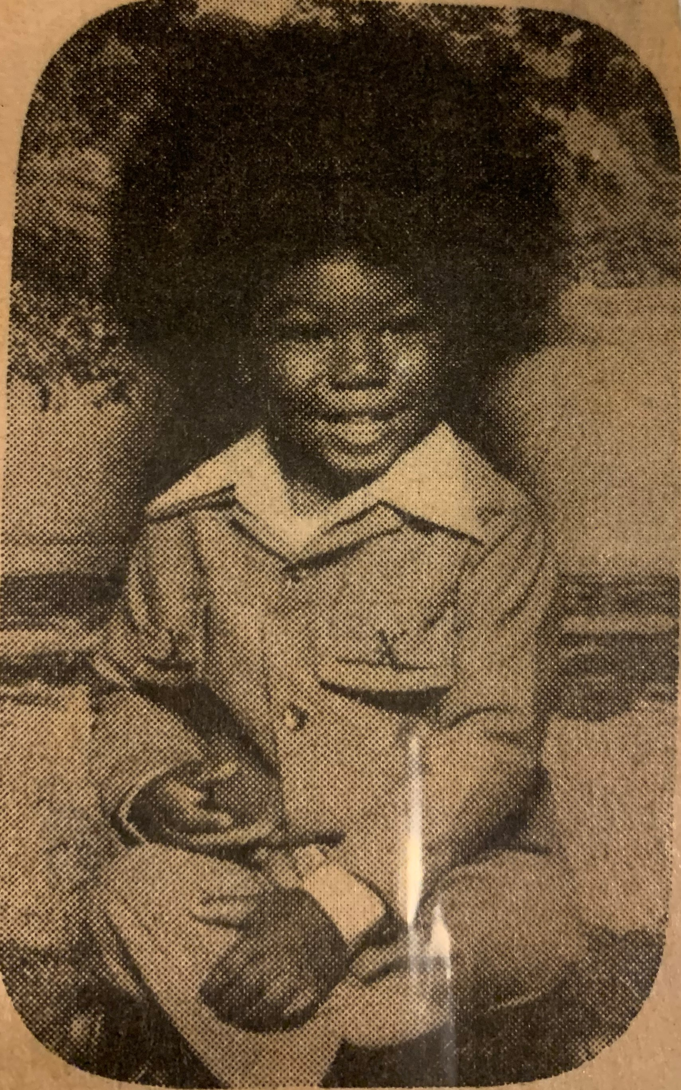
Name that Family Member
10 seconds
Stuart Thompson
Kendrick Long
Michael Smith
Cedric Lewis

Slide 30
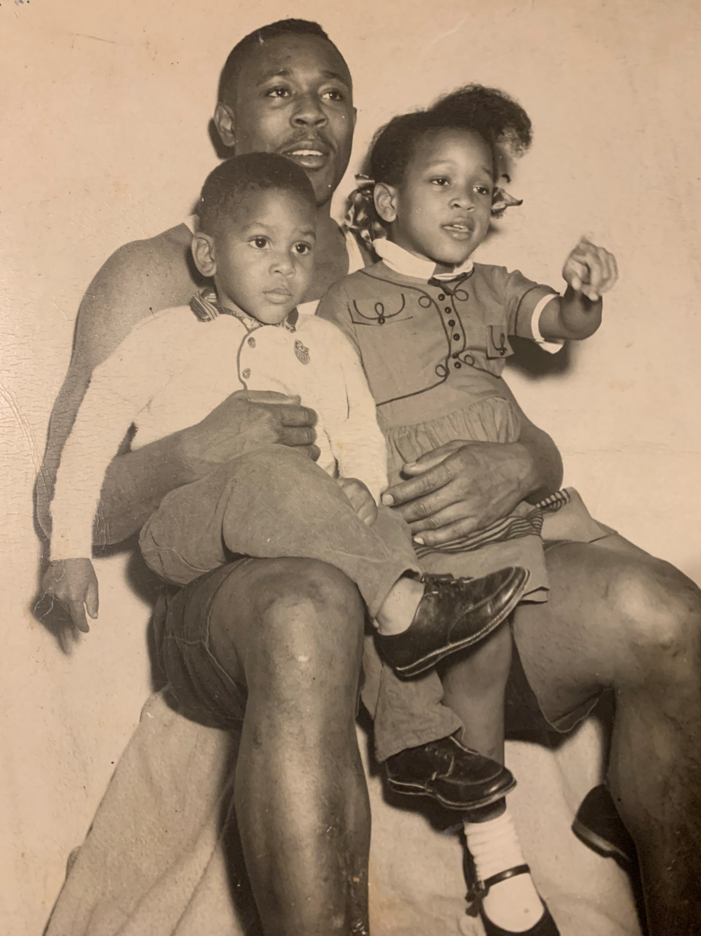
Name those Family Members
15 seconds
Arrie, Darrell & Karen
Arrie, Morris & Brenda
Arrie, Tyrell & Corey
Arrie, Darrell & April

Slide 31
Which of these things is not like the others?
20 seconds
Dr. George Hilliard
Dr. Lauret Hathcock
Dr. Jessica Spires
Dr. Jackson Avery
Notes:
Jesse Williams plays Dr. Jackson Avery (the head of plastic surgery at Grey Sloan Memoria Hospital) on Grey’s Anatomy.

Slide 32
Which of these judges / attorneys is not a family member?
10 seconds
Keith Ellison
Jennifer Long
Charles Dortch, Jr.
Cedric Lewis
Notes:
My co-host Jennifer Long is a judge.
Charles Dortch, Jr. is also a judge.
Cedric Lewis is an attorney and COO.
Keith Ellison is the lead prosecutor on all George Floyd cases in Minnesota, including that of Derek Chauvin who was recently sentenced to 22 ½ years for the killing of Floyd.

Slide 33
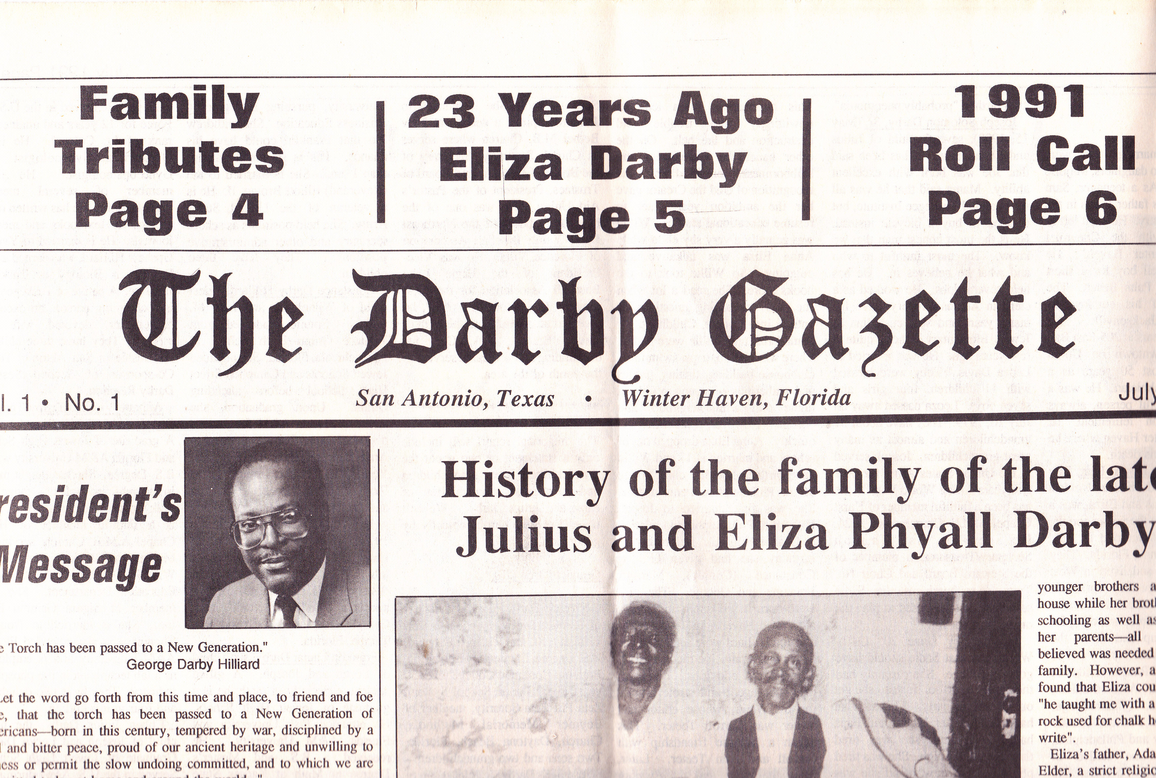
What was the name of our family’s newspaper?
20 seconds
The Darby Herald
The Darby News
The Darby Times
The Darby Gazette
Notes:
Our family’s newspaper was called The Darby Gazette.
It was created by Dr. George Hilliard during his presidency.
The first edition was published in 1991.

Slide 34
Our family’s song “The Darby Clan” is sung to what tune?
20 seconds
America
America the Beautiful
Living in America
The Star Spangled Banner
Notes:
Our family’s song “The Darby Clan” was created by Joseph Darby, Jr. to the tune of America the Beautiful.
Cheryl Hazzard will be singing “The Darby Clan” later in the reunion.

Slide 35
Darby Family Reunion President Peachie Rose West stems from which branch of our family tree?
20 seconds
Hilliard
Phyall
Darby
McKenzie
Notes:
Rose stems from the Hilliard branch of our family tree.
Wilhelmina Darby – the last child of Julius and Eliza – was first married to Joseph Hilliard.
One of Joseph Hilliard’s sisters was named Rose Hilliard.
Rose Hilliard had a daughter named Glady’s Hilliard.
Peachie was born in Philadelphia to Gladys Hilliard Frye and Clinton Maxwell Frye.
She is married to Keith West and they have two sons – Phillip Kyle West and Kevin Thomas West.

