Slide 1


Notes:
What I am going to discuss is problems facing ESG and Impact investing,
and an approach to solving these problems developed at the Frankfurt School of Finance and Management.

Slide 2
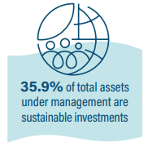
The Problem
A promising headline …
That delivers much less than it appears to
Notes:
This data point is from the 2020 Global Sustainable Investment Review.
Sustainable investing has made tremendous progress, but as it stands, I think it is unlikely to lead to achieving the SDGs.
What?!!

Slide 3
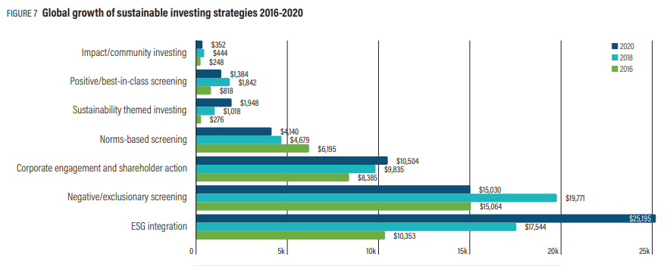
Strong Growth in Sustainable Investments.
What is the issue?
Quantity vs Quality
Notes:
GSIR data – breakdown of sustainable investing by strategies.
We face a problem of quantity vs quality.
Not all strategies are equal in terms of their ability to contribute to achieving the SDGs.
The majority of the strategies in this chart do not directly create impact, but rather, rely on indirect effects.
That is, they require a large number of investors to behave in the same way in order to change the price of capital in favor of positive assets and against negative assets.
There are however ESG and Impact strategies which contribute both directly and indirectly to achieving the SDGs – so why are these strategies hardly visible in the GSIR data?

Slide 4
Contribution to the SDGs
All Approaches to Sustainability
Are Not Equal
Direct
Indirect
Results are at Different Levels of Intensity
Exposures
None
Reduction of size and frequency of
negative events.
Reduction in negative outputs from existing assets. e.g. reduced consumption of fossil fuels.
(ii) Increase in positive outputs. e.g. additional access to education, additional clean energy.
Greater certainty that the effect of our actions on populations and ecologies is experienced in the intended manner.
Increased flow of capital away from
assets with negative characteristics
and to assets with positive
characteristics.
At sufficient scale, the cost of capital
falls for positive assets and rises for
negative assets.
This results in:
Better pricing of externalities
Reduction in funding gaps for
assets which are environmentally
or socially positive.
Risks
Increasing Intensity
Outputs
Outcomes
Managing all these four levels of intensity needs to happen at greater scale,
but particularly those that make a direct contribution to achieving the SDGs
Notes:
Let’s look at this idea of direct and indirect contributions to achieving the SDGs.
When we seek to achieve non-financial goals, we seek to achieve a combination of one or more of four things.
Ranked low-to-high by the intensity of the ESG or Impact results, these four things are:
Managing exposures: reduce exposure to negative assets, increase exposure to positive assets.
Reducing the risk of negative events: e.g. reduce labor accidents, chemical spills
Creating a quantity of positively impactful outputs: e.g. additional access to education or low-income housing, increased use of renewable energy.
Ensuring that our actions are experienced in the way we intend by the target population or ecology: e.g. do the students who gain access to education actually get the benefits we expect?
Each of these types of non-financial goal can indirectly contribute to achieving the SDGs via affecting the cost of capital – IFF done at sufficient scale. Iff.
Only three types of non-financial goal, managing risks, outputs and outcomes, contribute directly to achieving the SDGs. That is, our actions lead directly to results.

Slide 5
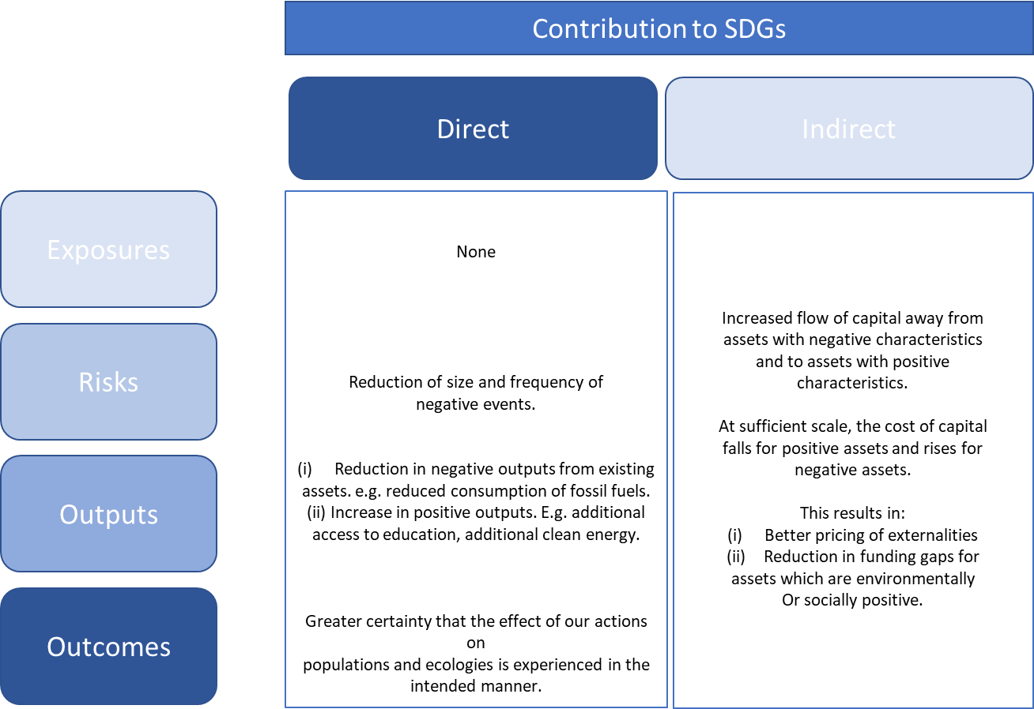
The Vast Majority of Capital is
Concentrated in Managing
Exposures
Which Make no Direct Contribution
to the SDGs
?
Notes:
While the strategies in the GSIR are not defined precisely enough to enable an exact mapping to exposures, risks, outputs and outcomes,
if we combine the previous two slides it is clear that the vast majority of capital is focused on managing exposures.
Exposure management is the least intensive of the four types of non-financial goals.
Exposure management makes no direct contribution to achieving the SDGs. It requires a mass effort to move enough funds to affect the cost of capital.
Little capital is focused on the more intensive strategies which make a direct contribution to achieving the SDGs.

Slide 6
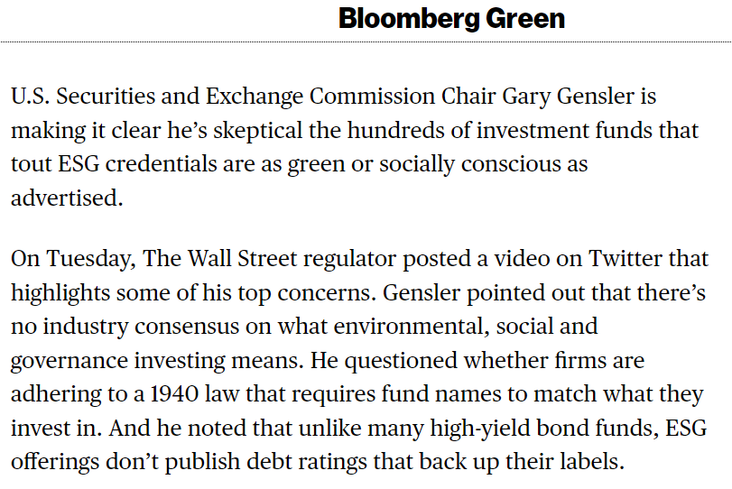
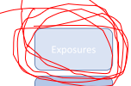

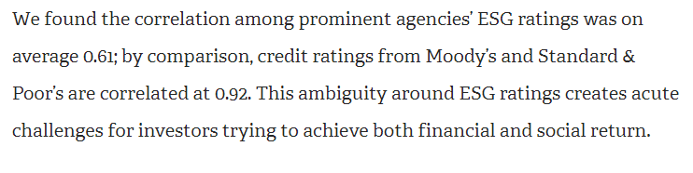
Exposures: Least Intense & Further Weakened by Definition and Data Issues
☹
Notes:
Further, exposure management suffers from some well-known problems,
which reduce its effectiveness as a route through which to create the mass movement required to alter the cost of capital.
If we are working from different definitions and different data, the movement of capital will be fragmented and less effective.

Slide 7
How To Improve on This Situation?
(1) Provide Greater Clarity on Exactly What is Being Managed
Increase focus on direct contributions to the SDGs by providing greater clarity
on exactly what it is that is being managed:
Exposures, Risks, Outputs, Outcomes
Notes:
How do we improve on this situation and increase the use of strategies which manage risks, outputs and outcomes?
Two things are necessary, the first of which is that
we need a framework which provides much greater clarity on what it is that our non-financial goals are managing in terms of Exposures, Risks, Outputs and Outcomes
We need to know exactly what it is that we are managing and what non-financial goals we are achieving.

Slide 8
Greater Clarity on What is Being Managed:
Analytical Framework Based on Contribution to Results
Quality Assurance (QA) Framework
© All rights reserved
Notes:
The Quality Assurance Framework developed at the Frankfurt School provides a method through which much greater clarity can be achieved.
It is a simple concept, illustrated in the chart.
Take the standard terms of SRI, Thematic, ESG and Impact
Identify the strategies used to implement these four approaches – we identified 8 independent strategies currently in use.
By independent, I mean these strategies do not overlap with each other and achieve quite different types of results
Map the 8 strategies to the type of non-financial goal they achieve: Exposures, Risks, Outputs and Outcomes
Order the strategies by the intensity of their direct results, to create a Quality Assurance framework
As I mentioned, each of the strategies is independent of the other strategies – they involve different actions and achieve different things.
This allows us to create a QA framework with which, if we can identify the actions someone is taking, we can identify the combination of strategies they are using.
Once we understand the combination of strategies being used, we know the exact claims that can be made in terms of Exposures, Risks, Outputs and Outcomes.
We understand what it is that is being achieved and how intense, or not intense, the results are

Slide 9
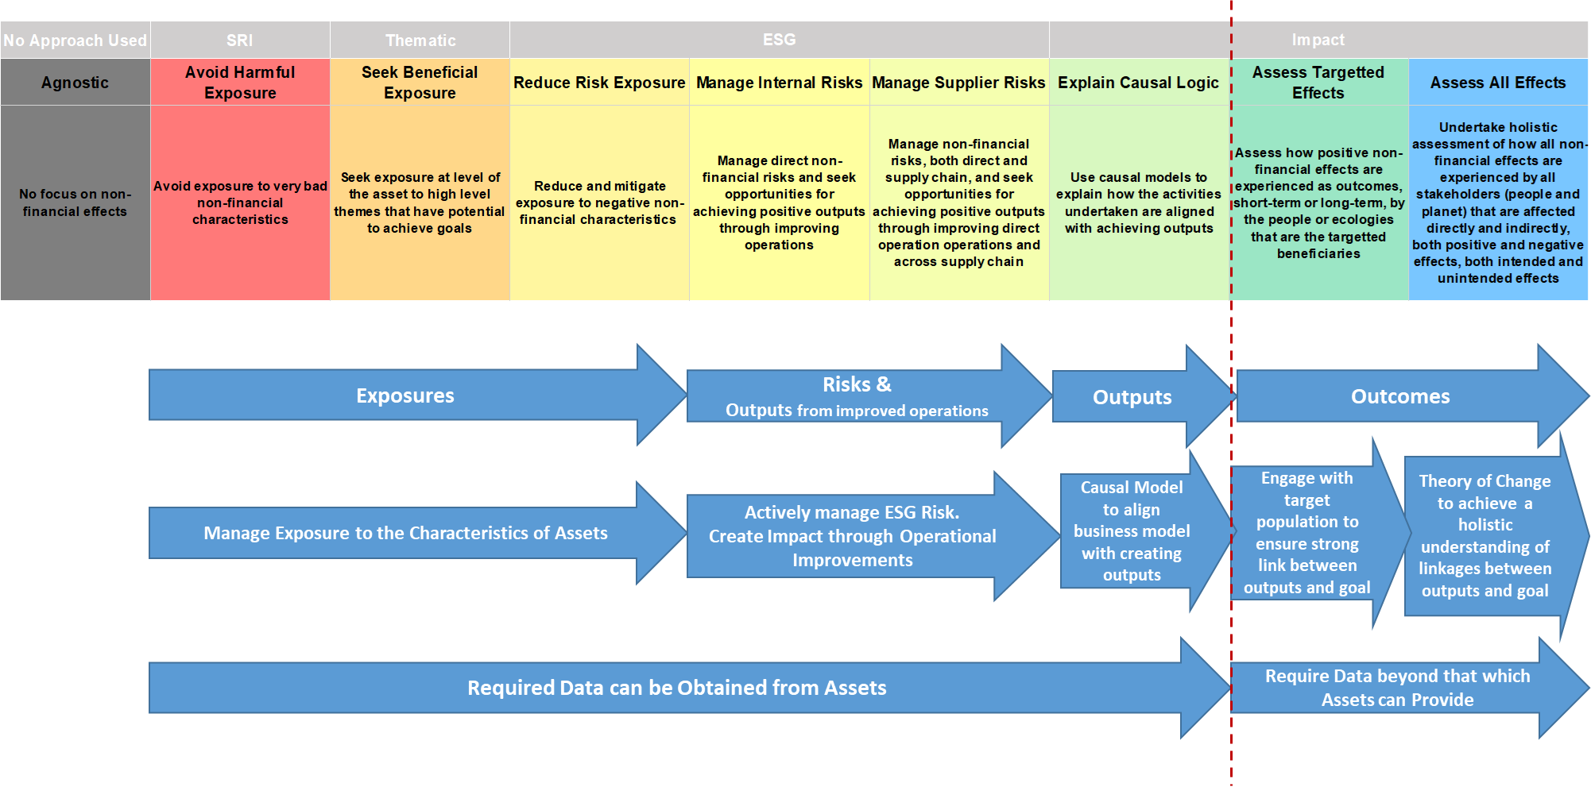
Greater Clarity on What is Being Managed:
Analytic Framework Based on Contribution to Results
© All rights reserved
Notes:
A little detail on each of the 8 strategies.
They are all in use currently and you will recognize them.
Avoid Harmful Exposure – No tolerance for any exposure. E.g. exclude coal, armaments
Seek Beneficial Exposure – Increase exposure to high-impact themes e.g. healthcare, climate
Manage Harmful Exposure – Willing to have some exposure, but want to reduce it as much as practical. E.g. carbon footprint
Manage Internal Risks – Actively mange the risks relevant to an activity using an ESMS, to reduce the possibility of negative events. E.g. labor accident, chemical spill
The knowledge obtained from the ESMS can also be used to create positive outputs by improving the operations of an asset to, for example, reduce energy consumption
Manage Supplier Risks – Require suppliers to use an ESMS to manage the risks relevant to their operations. Develop a clean supply chain.
Explain Causal Logic – Identify the ability of an asset to create a quantity of positive outputs by using a causal model to estimate the quantity of additional positive outputs likely to be created over
the holding period. E.g. additional students with access to education, additional carbon reduced
Assess Targeted Effects – Survey the target population or ecology to understand how they experience our actions and ensure that our actions have the intended effect.
Assess All Effects – Holistic approach. Develop a Theory of Change to identify the total effect of our actions, both direct and indirect, positive and negative.

Slide 10
Greater Clarity on What is Being Managed:
Analytic Framework Based on Contribution to Results
The QA framework enables us to:
Identify the combination of strategies we need to adopt to achieve our non-financial goals
Identify the valid non-financial claims another person can make, by identifying the actions they
are taking and so identifying the combination of strategies they are using.
Identify greenwashing.
Greenwashing is occurring if the non-financial claims being made are greater than the claims justified
by the combination of strategies being used.
Notes:
By identifying what it is that is being managed, and framing this in terms of the intensity of the non-financial results, we can …..

Slide 11
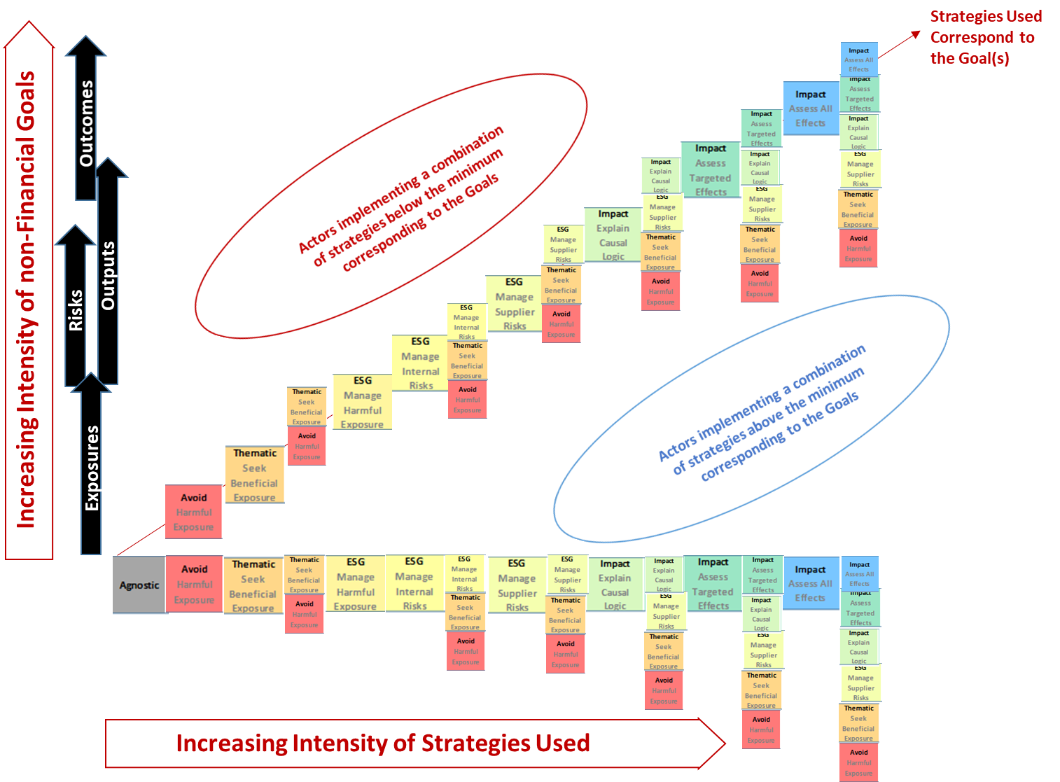
Greater Clarity on What is Being Managed:
Analytic Framework Based on Contribution to Results
© All rights reserved
Notes:
It is a simple, clean, framework.
To identify the strategies you need to use to achieve your non-financial goals, travel up the y-axis and then across to the 45-degree line.
To identify the goals that are supported by the combination of strategies that someone else is using, travel along the x-axis and then up toward the 45-degree line.
A position above the 45-degree line indicates that the combination of strategies being used is insufficient to achieve the targeted non-financial goals and that additional strategies need to be
used or the non-financial goals need to be scaled-back.
We now have clarity about what it is that is being managed in terms of exposures, risks,, output sand outcomes.
However, to align the management of non-financial goals with the management of financial goals,
to enable the optimization of both financial and non-financial goals within a portfolio
We need to do more.
We need to re-frame the discussion of impact.

Slide 12
How To Improve on This Situation?
(2) Align Impact with Portfolio Management
To increase adoption, Impact needs to better-align with portfolio management.
(i) The process for assessing and executing non-financial goals needs to correspond to the process for
financial goals.
- The analytical framework needs to be specified in terms of the scale or intensity of results.
The impact framework is currently specified in terms of the intensity of the mandate, not the scale of the results.
- The analytical framework needs to contribute to the entire investment process.
Existing approaches concentrate on the mandate and have little to contribute to portfolio optimization.
(ii) The framework used to address non-financial goals needs to apply equally to all root causes of problems
such as funding gaps, the mis-pricing of externalities or any other root cause.
Existing approaches to impact emphasize the closing of funding gaps.
However, the root cause of most consumption-related climate issues is the mis-pricing of externalities,
not funding gaps.
Notes:
The first step was to improve the clarity of what is being managed.
The second step is to re-frame the analysis of impact in terms of the intensity or scale of the results achieved.
The analysis of Impact is currently framed in terms of the impact-intensity of an actor’s mandate.
This framing is incredibly unhelpful as it:
Prevents the integration of Impact goals with financial goals in portfolio optimization.
Emphasizes closing funding gaps, rather than improving the pricing of externalities, as the solution to achieving the SDGs.
Most climate issues stem from over-consumption due to mispricing of externalities, not from funding gaps.
By:
Framing the analysis of non-financial goals in terms of the intensity of the results, not the intensity of the mandate.
Having a framework that can be applied across the entire investment process from mandate design to asset selection.
the analysis of non-financial goals can be (i) aligned with the analysis of financial goals, allowing both to be integrated into portfolio optimization,
and (ii) better aligned with achieving the SDGs,

Slide 13
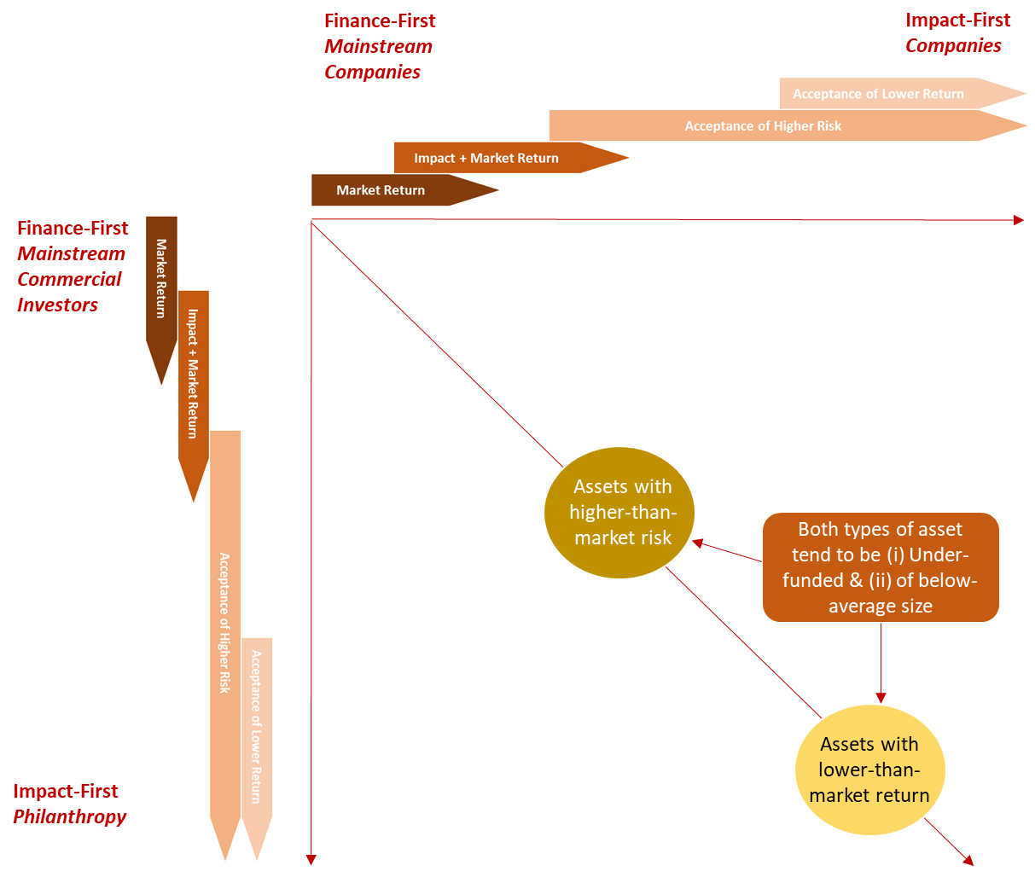
Currently, Impact is Organized Around the Intensity of the Mandate, Not the Scale or Intensity of the Results
© All rights reserved
Notes:
What is wrong with framing Impact in terms of the intensity of an actor’s mandate?
This chart is an abstraction of the framework used by the Impact Management Project to analyze Impact.
To become more ‘impactful’ an investor does not need to create ‘larger’ impact results.
Rather, to become more impactful an investor has to firstly take on more risk, and secondly accept lower return.
Assets with above market risk and/or below market return are typically those which suffer from funding gaps. – so the framework emphasizes closing funding gaps
How much can institutional investors, who control the vast majority of investable capital, be expected to change their mandates to accept more risk and lower returns?
If institutional investors are unable to do this, then the quantum of capital that needs to be re-allocated toward impactful assets to meet the combination of direct results and indirect pricing effects required to achieve the SDGs, will not be met.

Slide 14
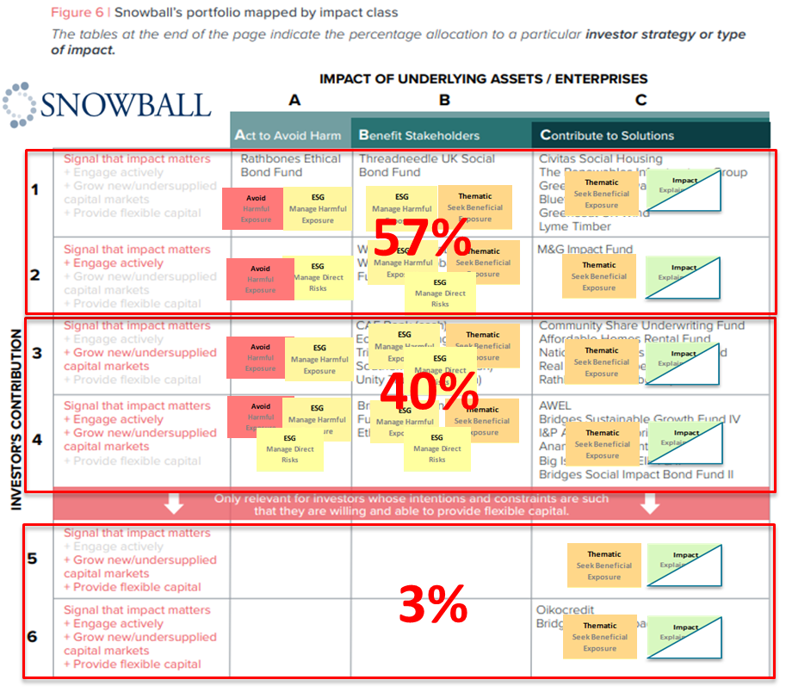
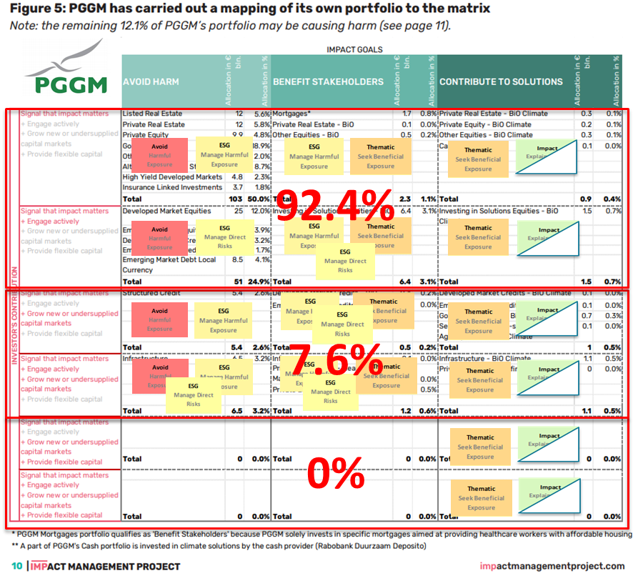
It is Not Surprising that, as Currently Specified, Impact is Not Applied Across Total AUM
Notes:
As might be expected, institutional investors are not free to adopt the mandates of DFIs, NGOs and philanthropists and accept more risk and lower return across their total AUM.
These tables are from exercises analyzing their portfolios in terms of the IMP framework, completed by PGGM a large pension manager ($200bn AUM) and Snowball an impact investor ($20m AUM).
For both PGGM and Snowball the majority of assets do not make it into the ‘impactful’ zones in a mandate-based framework.

Slide 15
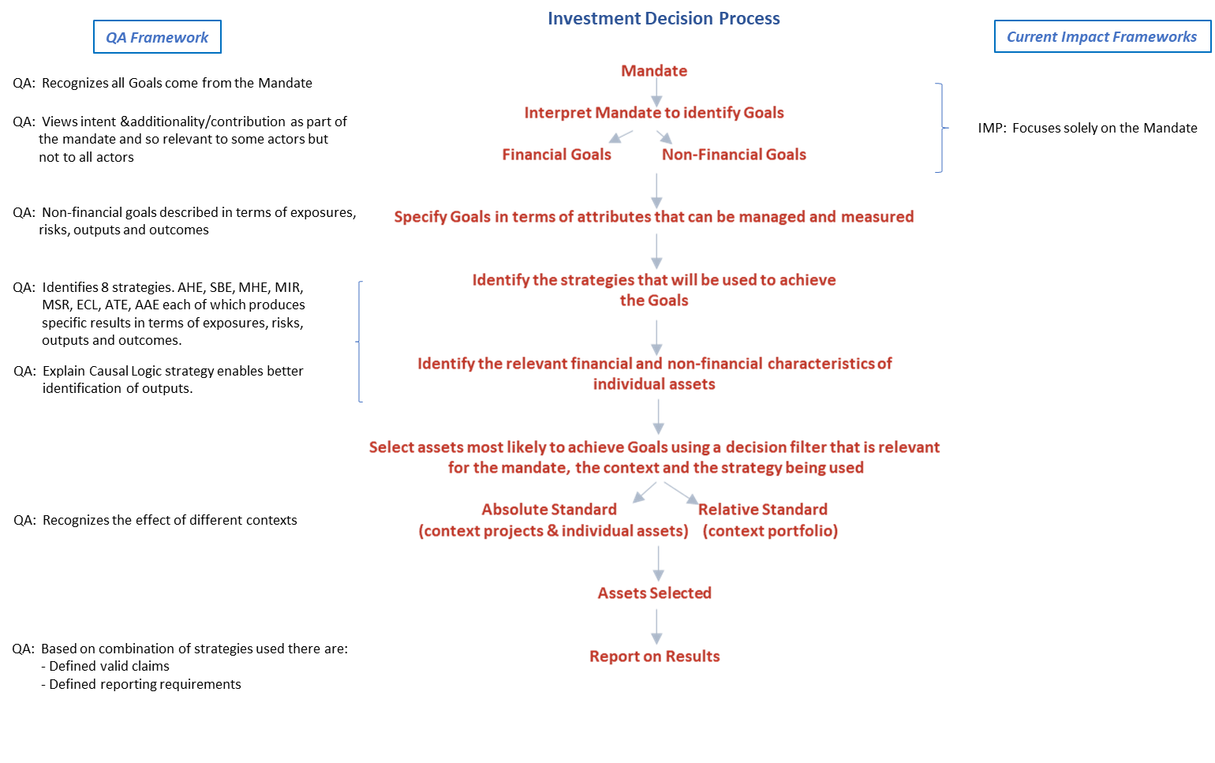
If the Goal is to Maximize or Optimize the Size or Scale of the non-Financial Results,
Framing Analysis of Impact in Terms of the Mandate Makes Many Current Approaches to Impact
Unable to Contribute to Asset Selection & Portfolio Optimization
Notes:
If the goal is to maximize or optimize the size or scale of non-financial results,
then an unfortunate consequence of framing the analysis of Impact in terms of the investor’s mandate is that this analytical framework is unable to provide guidance over the rest of the
investment process.
This is no small omission.
The rest of the investment process addresses key questions such as:
“Of these four assets, which one best helps me to achieve my financial and non-financial goals?”
“Of these four assets, which one is likely to make the largest quantitative contribution to the SDGs?”
The QA framework, being framed in terms of the intensity or scale of the results, provides guidance across the entire investment process.

Slide 16

https://zhengpartners.co/
www.linkedin.com/in/david-wilton-impact-emerging
Notes:
If you have found this thought provoking, check out the course ‘Certified Expert in ESG and Impact Investing” at the Frankfurt School.

