Slide 1
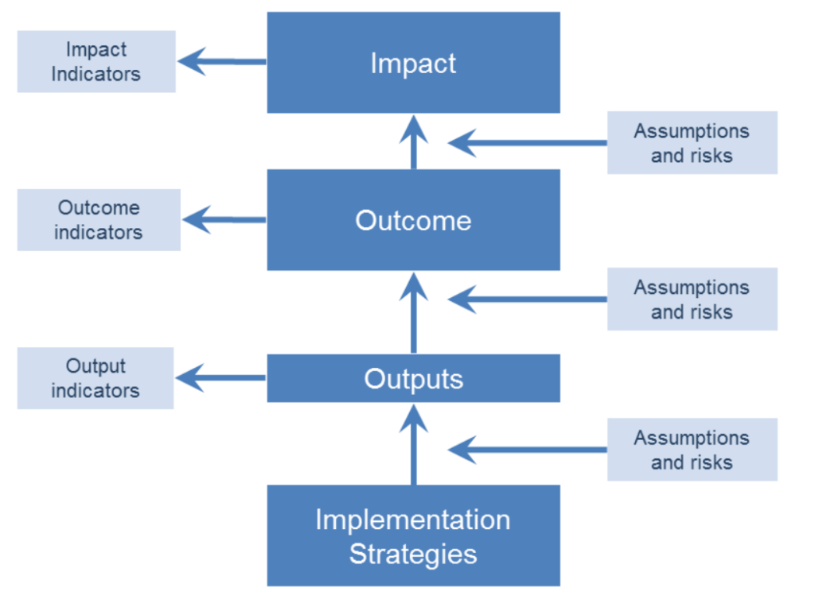
GOALS
Broad Framing of Good Practice
Ex-Post Measurement & Reporting
Ex-Ante Relative Ranking of Impactfulness
Ex-Ante Estimate of Quantity of Impact
Ex-Ante Asset-specific Estimate of Quantity of Impact
Simple Entry Point for Assessing Ex-Ante Impact Quantity
Applicable to Asset Classes for Portfolio Modeling
Able to Map Impact Opportunity Space
Simple Way to Tilt a Portfolio Towards Impact
Ability to Tailor Impact Strategy to Mandate
Rankings not correspond to quantity of impact
Cannot be extended to asset classes as blend quantity, asset-specific attributes like quality and ESG and mandate factors like additionality
Blending in mandate factors limits ability to tailor strategy to individual mandates
Labor intensive
Impact measured specific to goals, not to assets.
Too resource intensive to apply to portfolio management
Missing
The existing ecosystem for impact investing is
incomplete, as described by the blue boxes.
The gaps are due to issues with the ex-ante
prediction/description of the impactfulness of assets.
Existing approaches to ex-ante estimation of impact
are designed in ways which (i) create barriers to fully
incorporating impact into portfolio management and
(ii) are laborious to calculate, to the point of inefficiency
in the context of large portfolios.
All Apply to individual assets only, not asset classes

Slide 2
GOALS
Broad Framing of Good Practice
Asset Classes
Individual Assets
General Theory
4 Factors
General Theory
4 Factors
Portfolio Asset Allocation
Mandate Factors
Mandate Factors
Incorporating the General Theory into the existing ecosystem enables:
Simplified impact assessment
Simple way to gate/tilt and broadly position portfolios toward more impactful assets
Assessment of asset classes & incorporation of impact into portfolio modeling
Ability to map the impact opportunity space
Separation of Mandate Factors enables:
Impact strategy tailored to individual mandates
Creation of greater total impact through capture of more of the impact space
Both together enable:
Mobilizing sufficient capital to price externalities
Individual Assets Selected

