Slide 1
The Legal Environment of Nonprofit Organizations
Lakeview Descendants

Slide 2
What is a Nonprofit Organization ? [a.k.a.– “NPO” or a “501(c)(3)”]
Defined Public Purpose: An organization with a public purpose, including a charitable or educational mission.
Covers a wide range of activities, including hospitals, business associations, little leagues, museums, Elks/Mason social clubs, Chamber of Commerce, Kiwanis Clubs, historical societies, community development corporations, churches, etc.
“Quasi-public” Ownership: Board of Trustees. No personal benefits to “trustees” (salaries to paid staff). Nothing becomes privately owned: rotating leadership -- mission is held in trust for the community. Mission is bigger than a person.
Transparency: must serve the public and make information available to the public. File an informational tax return, IRS 990 that provides information on revenues and expenses – tax return is publicly available (www.Guidestar.org).
Exempt from paying income tax on revenues. They are typically exempted from paying income tax under Section 501(c)(3) of the Internal Revenue Code. Nonprofits can make profits, and don’t pay taxes on such net income.
Donors can deduct contributions. People/entities with federal tax liability can deduct the amount of their charitable contributions from their federal tax liability (i.e., if they owe $1,000 in taxes, and make a $1,000 donation to a public charity, they now owe $0 in taxes.)

Slide 3
Key Differences between for-profit and non-profit corporations
FOR-PROFIT: Can do anything not prohibited by law
NON-PROFIT: Can do exempt purposes allowed by the law
Funders
(Grants)
Board of Directors (owners/investors)
Board of Trustees/Directors (trustees/caretakers)
ROI
DONATIONS
Staffed Operating Entity
(salaried employees)
Staffed Operating Entity
(salaried employees)
FISCAL
AGENT?
The Thing
(paying customers)
The Thing
(charitable purpose)

Slide 4
Stewardship of the mission by “Trustees”
*Trustees generally do not have individual liability for the nonprofit’s acts.
trust·ee
[ˌtrəˈstē]
NOUNLAW
an individual person or member of a board given control or powers of administration of property in trust with a legal obligation to administer it solely for the purposes specified.

Slide 5
What Are Benefits of an NPO?
Entities with a federal tax liability can donate instead of paying taxes to the government.
Businesses with an interest in a certain issue can fund it (donate) directly, instead of paying taxes that are split among many different issues.
The Nonprofit doesn’t pay income tax on revenues it receives (donations) or on profits for its charitable mission.
What Are Potential Drawbacks?
Some administrative and financial requirements.
Most people don’t understand them and some can get suspicious/jealous or have unrealistic expectations.
We should prepare to manage these concerns.

Slide 6
How does an NPO generally work and evolve?
A Board of Trustees (or Board of Directors) serves as “trustees” for the public interest served by the nonprofit.
No person “owns” the nonprofit, its revenues or assets.
Unlike a private corporation, Board members (“Trustees”) cannot have an interest in the profits of the NPO
They cannot get a share of revenues or profits
They cannot own assets of the NPO upon dissolution
But they can get reimbursed for reasonable expenses
The Board of Trustee role is volunteer “everything” in start-up NPOs. The first dollar is the hardest to get, and goes to programs run by volunteers (donors don’t really want to fund staff – especially administrative staff).
Paid staff (“Executive Director”) generally leads day-to-day operations under the oversight of the Board of Trustees in a mature nonprofit

Slide 7
TYPICAL NONPROFIT ORGANIZATIONAL AND GROWTH STRUCTURE
Board of Trustees
Unpaid/Volunteers
Decision-Making/
Governance per
Bylaws
Board Committee 1
Chaired by a Trustee
Can have non-trustees
Board Committee 2
Chaired by a Trustee
Can have non-trustees
Management/Operations
Paid Staff or Consultants
Executive Director
Donors put their money into “programs” – the reason an NPO exists.
Finance Director
Program Director

Slide 8
Basic Documentation for an NPO
Governance:
Board of Trustees
Government
Articles of Incorporation – 1X at formation
Forms a legal entity with state gov’t
Who we are, what we do, who accepts service
Employer Identification Number (“EIN”) – 1X
Bank account and tax filing information
Applications for Recognition as an NPO – 1X
Creates tax exempt status (IRS 1023 and state dep’t of taxation or state Attorney General)
IRS 990
Annual informational tax filing (due May 15 for prior year)
Bylaws (recommended, but not required) – voted on and “owned” by Trustees. Can be amended
How the organization operates
Mission/Vision/Values
Structure of Board of Trustees/Committees
Board Officers
How board is formed/elections/terms
How decisions are made
Conflicts of interest
Relationship of Board to staff

Slide 9
Next Steps to Creating a Nonprofit Organization
File Articles of Incorporation with state through county recorder’s office (1 day)
Name of Organization
Initial Incorporators & Statutory Agent
3 “must have” statements:
Purpose is charitable …
No net earnings inure to the benefit of directors/trustees …
Distribution of assets upon dissolution to other nonprofit organizations …
Submit for EIN with IRS (5 minutes on-line)
Submit IRS Form 1023 Application for Recognition as Nonprofit 501(c)(3) – (6 weeks)
Checkboxes for the “must have” statements
Register with the Illinois Attorney General’s Office (+/-2 weeks?)
Create Bylaws (internal to Board)
How Board is formed: number of members, qualifications of membership, term of office, Officer positions, committees, etc.

Slide 10
INITIAL ARTICLES OF INCORPORATION
STATE OF ILLINOIS
First. Name of Corporation: Lakeview Forever, Inc. This is a placeholder -- what Name Do We Want?
Third. Purpose for which organization is formed:
To preserve the history and secure the legacy of the people, community, and structures of the historic Lakeview settlement.
Fourth. Said corporation is organized exclusively for charitable and educational purposes under Section 501(c)(3) of the Internal Revenue Code, or the corresponding section of any future federal tax code.
Fifth. No part of the net earnings of the corporation shall inure to the benefit of, or be distributed to its members, trustees, officers or other private persons, except that the corporation shall be authorized and empowered to pay reasonable compensation for services rendered and to make payments and distributions in furtherance of the purposes set forth in Article Third hereof. No substantial part of the activities of the corporation shall be the carrying on of propaganda, or otherwise attempting to influence legislation, and the corporation shall not participate in, or intervene in (including the publishing or distribution of statements) any political campaign on behalf of or in opposition to any candidate for public office. Notwithstanding any other provision of these articles, the corporation shall not carry on any other activities not permitted to be carried on (a) by a corporation exempt from federal income tax under section 501(c)(3) of the Internal revenue Code, or the corresponding section of any future federal tax code, or (b) by a corporation, contributions to which are deductible under section 170(c)(2) of the InternalRevenue Code, or the corresponding section of any future federal tax code.
Sixth. Upon the dissolution of the corporation, assets shall be distributed for one or more exempt purposes within the meaning of section 501(c)(3) of the Internal Revenue Code or the corresponding section f any future federal tax code, or shall be distributed to the federal government, or to a state or local government for a public purpose. Any such assets not so disposed of shall be disposed of by a court of competent jurisdiction of the county in which the principal office of the corporation is then located, exclusively for such purpose or to such organization or organizations, as said Court shall determine, which are organized and operated exclusively for such purposes.

Slide 11
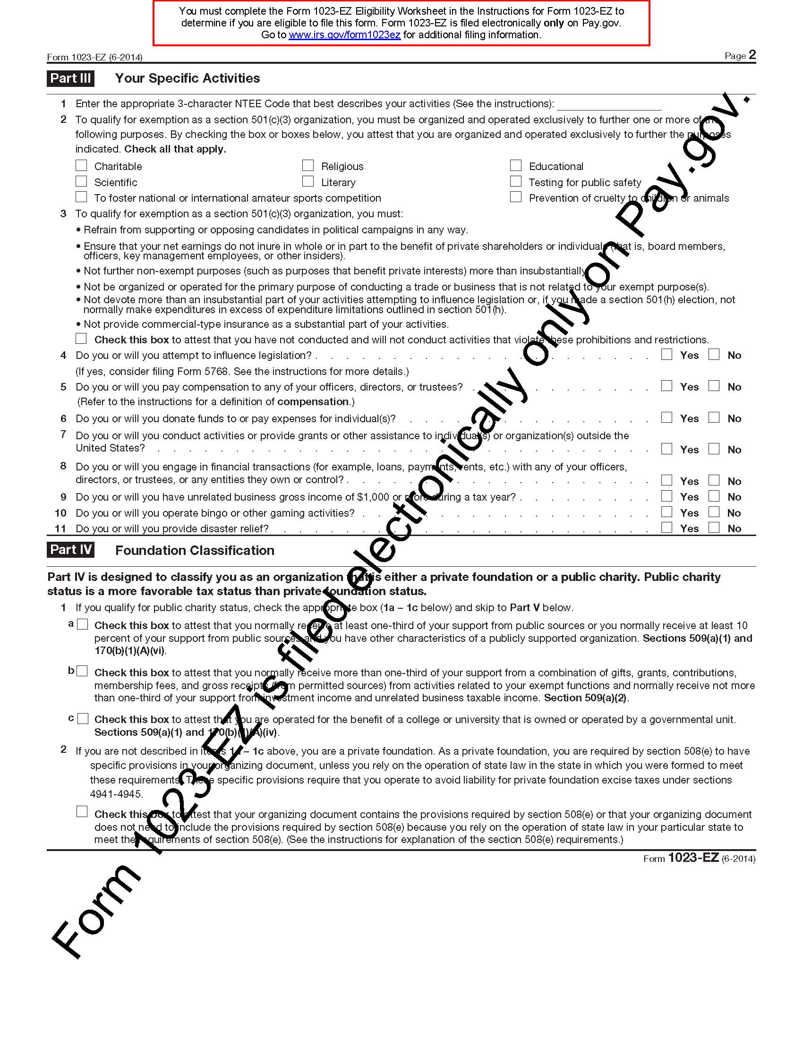
Sec. 4 – Charitable and Educational Purposes
Sec. 5 – Net earnings do not go to Board members, paying officers, and no lobbying/political activity
Sec. 3 – Limited Purpose
Sec. 6 – Assets upon dissolution go to other nonprofits (not to Board members)

Slide 12
General Information about NPO Revenues
“Restricted”
“Unrestricted”
The donor restricts its uses (typically government and often foundation grants are restricted – “grant agreements”)
Time limited period of performance (“use it or lose it”)
Expenses must be documented and “allowability” of the expense determined by grant maker.
“Unallowable expenses” must be reimbursed to grant maker.
The NPO can use it for any purpose allowable to a nonprofit
Usually donations. May, or may not, have a “grant agreement.”
Can “roll over” from year-to-year and build a fund balance
* “Unrelated Business Income” is taxable

Slide 13
Questions? Further Discussion?
Managing potential concerns
What concerns do we have?
Suspicion/jealousy: “They (the Board/founders) are using this to take the money” (personal benefit)
What are ideas on how to manage them?
Transparency
Invite community members to participate in volunteer committees with us
Develop and give local presentations
Talk about our values
Invite community members to serve on volunteer Board committees
Invite local institutions to serve on board
Invite feedback on scope and activities of the nonprofit
Create website with information on plans/activities to quell rumors/pre-empt suspicions – rumors grow in the absence of credible, accurate information
Best practice: 990 is on the website
Annual report includes financials

