Slide 1
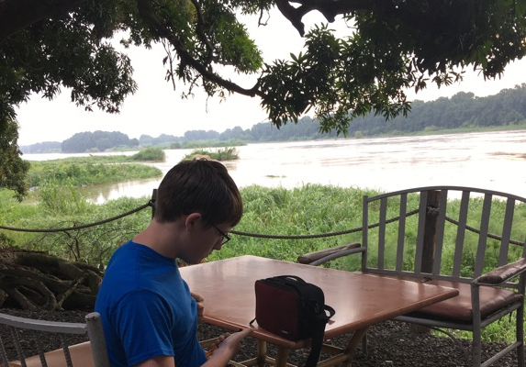
KCC trip to Juba, South Sudan 16-22 August 2019
David (15) is T1D, and has a chance to live because of KCC
Kyle (16) of KCC is T1D; injecting insulin in S. Sudan next to Nile
Saving Lives by Never Giving Up
WHITE NILE CHARITY FOUNDATION
Juba, South Sudan

Slide 2
Who is Kyle? What is KCC? Why Sudan & S. Sudan?
Kyle Thaller
11th grade and 16 years old
Diagnosed with Type-1 Diabetes 4-27-15
Navy SEAL & Naval Academy not possible
Strong desire to be global leader still present
So . . . Formed Kyle’s Campaigns for Change (KCC) in 2016
Goal of KCC: Saving Lives By Never Giving Up
So…. This KCC project involves diabetes (an enormous world problem) in Sudan and South Sudan, two of the world’s most challenging regions.

Slide 3
T1D Children in Sudan and S. Sudan
1,000+ children in South Sudan and rural areas of Sudan die of T1D annually . . . without ever knowing that they have T1D
T1D symptoms are masked by other diseases such as Malaria or TB
T1D takes 2-12 months to fully present itself.
Pancreas sporadically works, and then fails
My own personal symptoms took about 12 months
T1D is a silent killer, and these children will never know . . . Unless diagnosed.

Slide 4
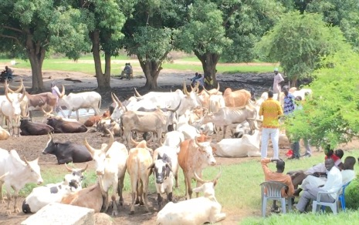
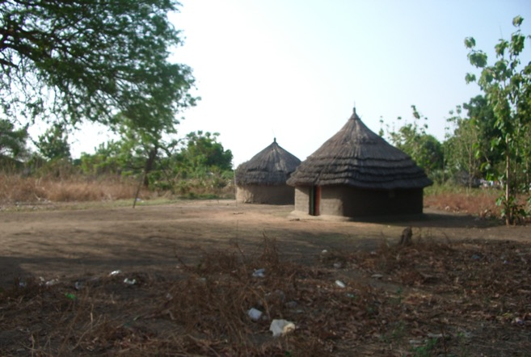
Overall Objective
Save lives and improve lifestyle of people afflicted with diabetes
Test all sick children and adults in South Sudan and in rural areas of Sudan for T1D
Provide glucose test strips for free.
Provide insulin for free.

Slide 5
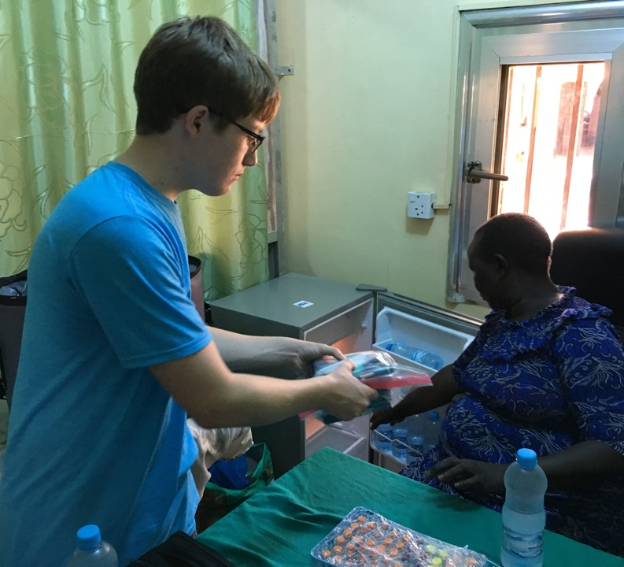
Diabetes Supplies Click Here for video of insulin donation from IFL; Must be in Presentation Mode
KCC and Insulin for Life (IFL) support White Nile Charity Foundation (WNCF).
WNCF supports diabetes clinics and programs in South Sudan
Supplies provided this trip
2,000+ ml of insulin (IFL)
200,000+ blood glucose test strips and 30 meters
Used for diagnosing diabetes
Syringes, needle tips, Keto sticks
Brand new computer
After arrival to Juba, purchased two new refrigerators for redundant insulin storage

Slide 6
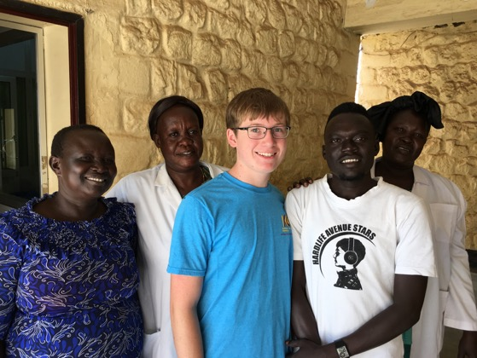
Amazing and Dedicated Staff Malakia Diabetes Clinic & Gurei Diabetes Clinic

Slide 7
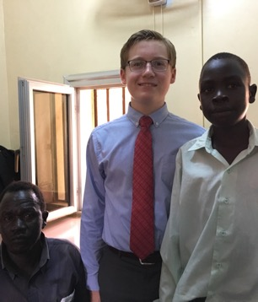
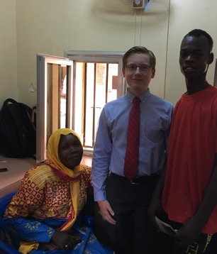
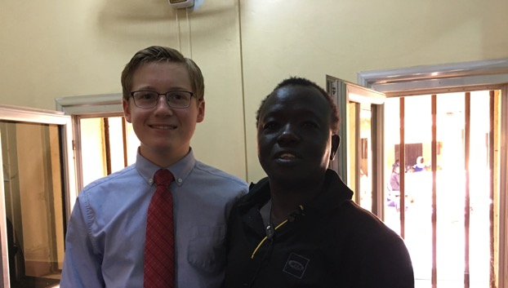
Free insulin from IFL is saving T1D Lives
Bottom Left: Jimmy (26); Diagnosed with T1D 2015; Jimmy is studying at the University of Juba majoring in Urban Development and wants to help South Sudan plan its growth.
Top right: Tommy (17) and his mother; Diagnosed with T1D July ‘19; Tommy wants to be an Ambassador for South Sudan.
Top left & Cover Page: David (15) and his father; Diagnosed with T1D one week prior to this picture. David is very good at math and wants to be an engineer.
Without KCC support and insulin from IFL, at least two of these three (e.g. David and Tommy) would have likely died in the next few months!

Slide 8
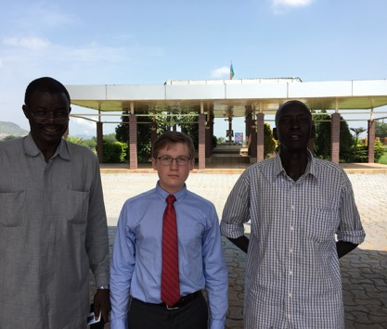
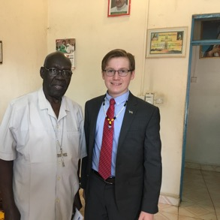
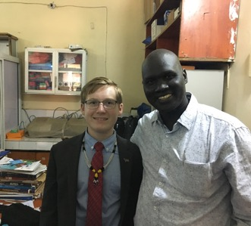
Amazing people helping KCC
Top left; Major General Daniel Justin Boulo Achor – Spokesman of the Ministry of Interior in the Republic of South Sudan Juba: standing with SPLA Officer in charge of John Garang Memorial Mausoleum (background)
Center left; Archbishop Paulino Lukudu Loro, overseeing Roman Catholic Church in Juba, South Sudan
Bottom left: Dr. Oromo Francis - local physician supporting diabetes issues and integral to Malakia and Gurei patients.

Slide 9
Honorable Dr. Sali Samuel, Jubek State Minister of Health

Slide 10
Right Hon. Joseph Bol Chan; Speaker, Council of States (similar to the Majority Leader in the U.S. Senate)

Slide 11
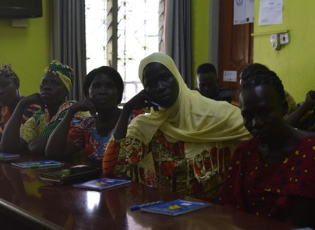
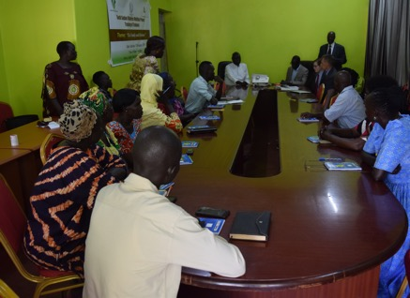
Training of Trainers (TOT) Meeting/training of Diabetes professionals (Scheduled to coincide with KCC visit)

Slide 12
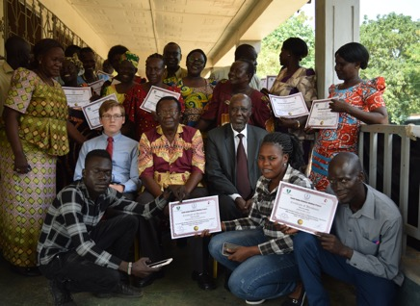
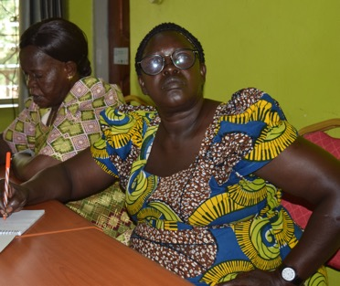
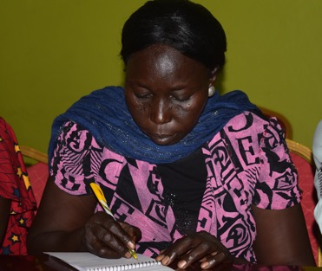
ToT Attendees (Focused on learning)

Slide 13
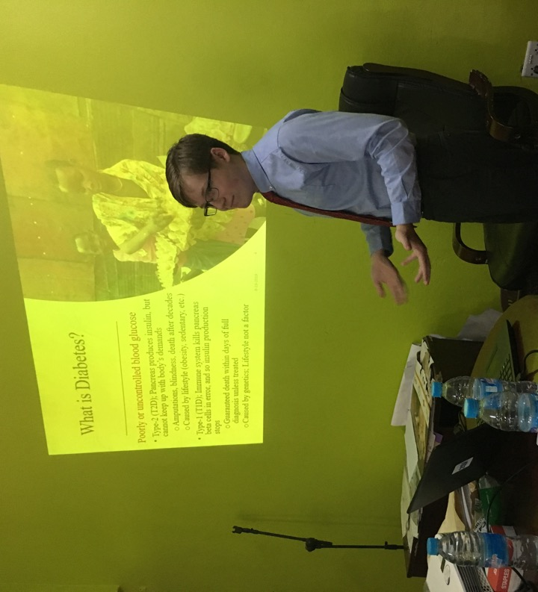
ToT Keynote Presentation
Kyle presented at ToT conference.
Discussed causes of diabetes and importance of early diagnosis.
Provided summary of KCC.
Very well received by all attendees.
Click here for powerpoint of ToT presentation. Must be in Presentation Mode.

Slide 14
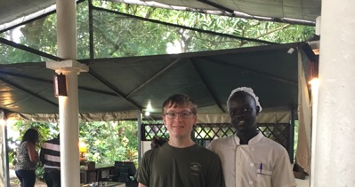
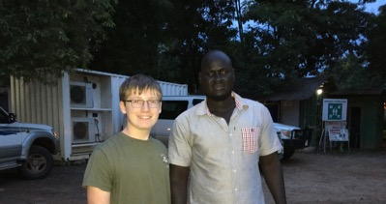
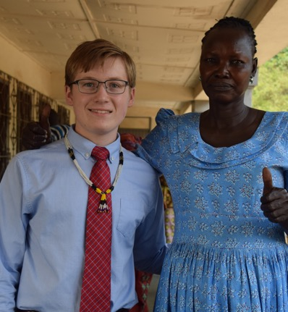
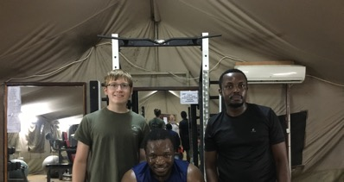
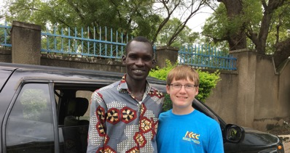
Meeting and interacting with local people is, was and will always be the key to success!!

Slide 15
Amazing Energy and Love from Ms. “Mama” Joyce Guo, Director of Diabetes Clinics in Malakia and Gurei, South Sudan

Slide 16
Dr. Constantine (“Costa”) Jervase Yak is my hero in South Sudan
(Member of National Council; Vice President of White Nile Charity Foundation)
Click here for conversation between Kyle and Dr. Jervase. Must be in Presentation Mode.
WHITE NILE CHARITY FOUNDATION
Juba, South Sudan

Slide 17
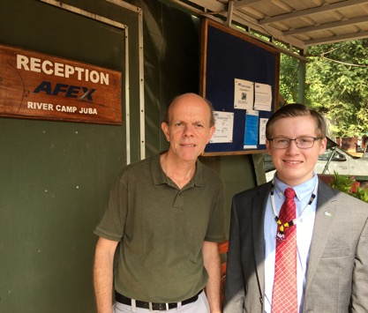
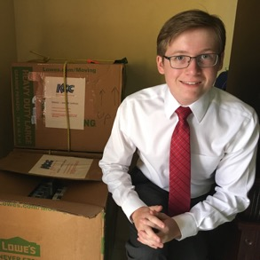
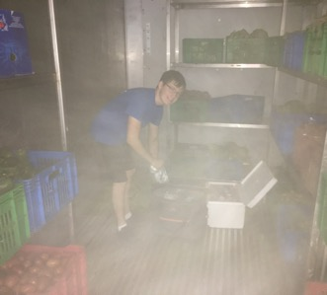
KCC’s Generous and Gracious Supporters
Insulin for Life (Ms. Carol Atkinson; Executive Director)
https://ifl-usa.org
Donated all insulin. THIS IS AMAZING!!
Afex River Camp (Mr. Mark Davis, General Manager)
https://www.afexgroup.com/river-camp.html
Donated all housing in Juba, SS
United Airlines (Ms. Ginger Staffeldt, Office of the CEO)
https://www.united.com/en/us
UA Provided red-carpet service and special support
TestStripz; (Mr. Chad Langley, CEO)
https://teststripz.com/
Donated blood glucose test strips & meters

