Slide 1

South Sudan Diabetes Mellitus Project
Training of Trainers
Saving Type-1 Diabetic (T1D) Children in Sudan & South Sudan
Kyle Thaller
August 17, 2019
Malaria, flu, diseases mask T1D symptoms, and so the T1D child is never diagnosed . . . and 100% die.

Slide 2
Who is Kyle?
What is KCC?
Why Sudan & S. Sudan?
Kyle Thaller
  11th grade and 16 years old
  Diagnosed with Type-1 Diabetes on April 27, 2015
    Navy SEAL & Naval Academy not possible
    Crying for days; Then inspired by S. Hawking
    What are we without our dreams?
Formed Kyle’s Campaigns for Change (KCC) in 2016
Goal of KCC: Saving Lives By Never Giving Up
  So…. This KCC project involves diabetes (an enormous world problem) in Sudan and South Sudan (among world’s most challenging regions).

Slide 3

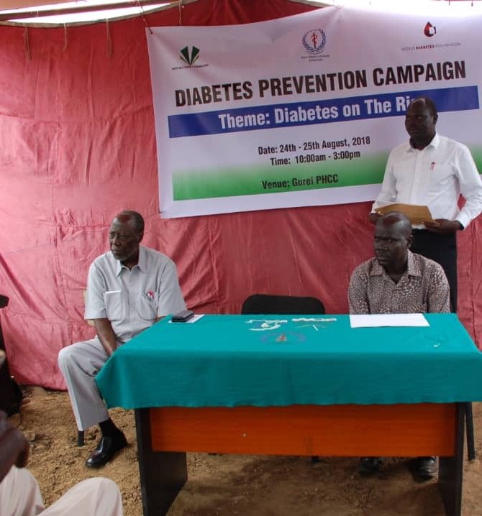
Overall Objective
Save lives and improve lifestyle of people afflicted with diabetes
Test all sick children and adults in South Sudan and in rural areas of Sudan for T1D
  Random (non-fasting Blood Glucose) > 200 mg/DL
KCC has figured out how to do this with minimal financial support!

Slide 4
What is Diabetes?
Poorly or uncontrolled blood glucose
Type-2 (T2D); Pancreas produces insulin, but cannot keep up with body’s demands
  Amputations, blindness, death after decades
  Caused by lifestyle (obesity, sedentary, etc.)
Type-1 (T1D); Immune system kills pancreas beta cells in error, and so insulin production stops
  Guaranteed death within days of full diagnosis unless treated
  Caused by genetics; Lifestyle not a factor

Slide 5
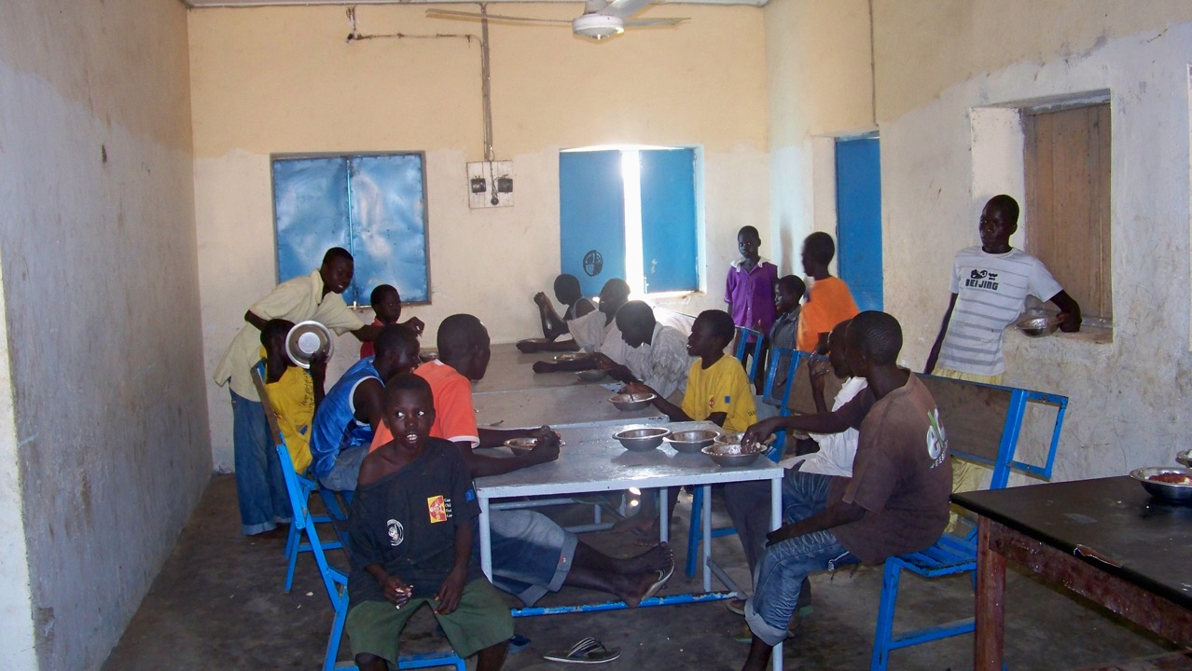
Type-2 Diabetes: World Pandemic
United States
Nearly 25% of all adults in U.S. have diabetes
1985: 30 million people in the world have diabetes
2040: 650+ million people
80% of T2D’s are in developing world where healthcare is a challenge
Africa
65%+ of diabetics are not even diagnosed
T2D is worse than rest of world
Explosive increase circa 2030 as westernized-style lifestyles evolve

Slide 6
Type-1 Diabetes: Silent and Guaranteed Killer
Genetically based
  Not related to lifestyle
  .05% to .1% of population & growing exponentially
60-70% afflicted when 2-20 years old.
  Age 14 most common
100% fatal without treatment within 5 days once fully diagnosed
  Full onset in 2-12 months

Slide 7
"Lost” T1D Boys (& Girls) of S. Sudan
1,000+ children in South Sudan and rural areas of Sudan die of T1D annually . . . without ever knowing that they have T1D
T1D takes 2-12 months to fully present itself.
  Pancreas sporadically works, and then fails
  My own personal symptoms took about 12 months
T1D is a silent killer, and these “Lost” children will never know . . . Unless diagnosed.

Slide 8
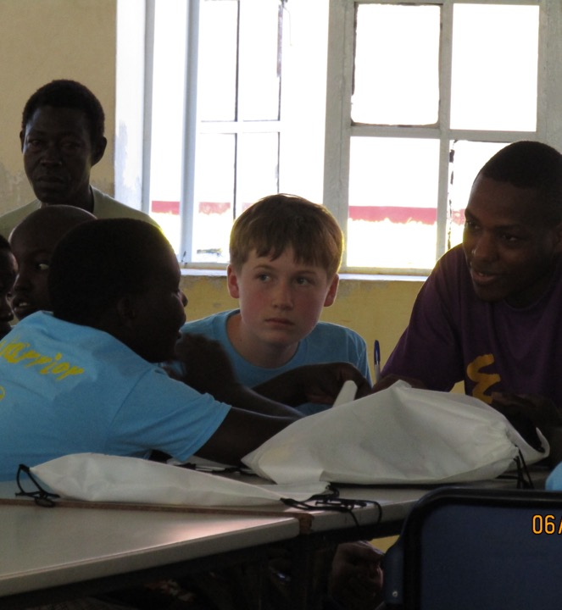
Understanding Diabetes Sets the Stage for this KCC Project
Diagnosis is key for both T1D and T2D
Malaria, flu and other diseases can mask symptoms
Special . . . yet simple equipment needed for diagnosis
Test everybody who is sick

Slide 9
Diabetes Diagnosis and Treatment
Diagnosis
T1D and T2D diagnosis are identical.
Glucose Monitors , Test strips & Lancets to draw blood
  Random Blood Glucose > 200 mg/DL
Treatment
T1D (to stay alive)
    Insulin injections (≈ 1-8 times/day)
T2D (to lengthen lifespan)
    Diet, exercise, loose weight, stop smoking, etc.
    More extreme cases require T2D pills or insulin (akin to T1D)
DIAGNOSIS IS THE KEY

Slide 10
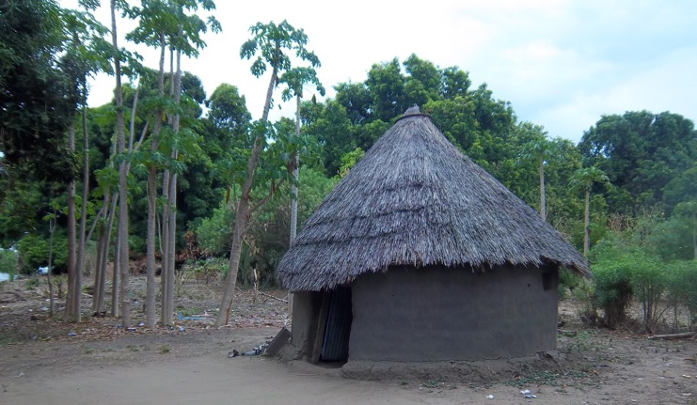
South Sudan Infrastructure is Enormously Challenging
Three decades of civil war and conflict have left South Sudan's education systems and infrastructure devastated
  Nearly 10 million people displaced
  3+ million people killed
Country is almost 10% the size of the USA.
  Only 200 miles of paved roads
  One bridge over the Nile in entire country
Healthcare nearly non-existent in countryside

Slide 11
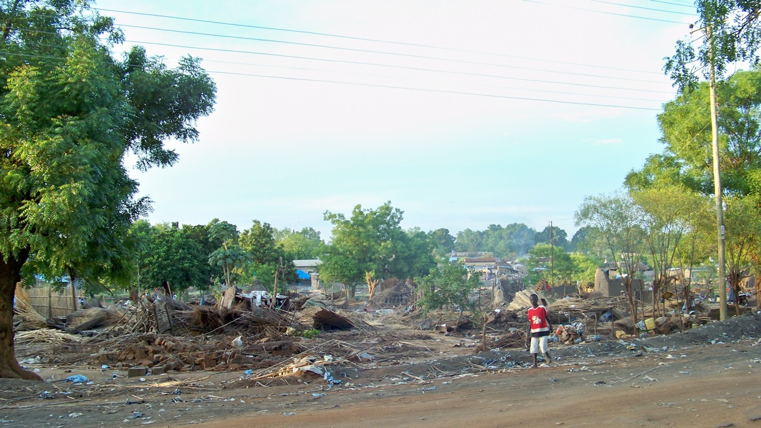
Cost of Medical Supplies
Average supplies’ cost
T1D care in the U.S.: $7,500 - $15,000 per year
T1D care in Sudan & South Sudan: $300-$500/year
T2D care in Sudan & South Sudan: $175/year
Income
South Sudan's average income
  Good job: about $1,000/year
  Average job: commonly < 50$ per year
Without our help . . . T1D in South Sudan and in rural areas of Sudan is a death sentence

Slide 12
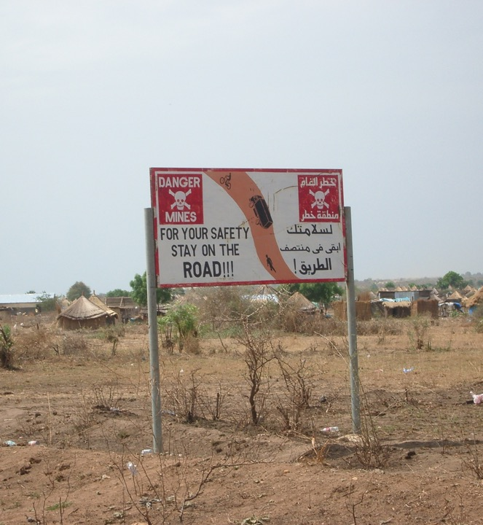
So where is the innovation? Expired Test Strips!
Hundreds of millions of strips annually re-sold on the multi-billion $$ secondary market by hundreds of on-line firms
Test Strips expire quickly (12-18 months)
  Short lifespan imposed by strip manufacturers
Typically work fine for 2-4 more years, and theoretically 10+ years post-expiration
At failure, degradation is gradual and not dramatic.
Once expired, test strips cannot be legally sold or resold. They are officially “worthless”
Since key objective is to see if a person has sky-high blood glucose . . . expired test strips are ideal for initial diagnosis
Since strips are “worthless, . . . KCC can/will obtain millions of expired strips. . . for free!

Slide 13

Tactical Objectives
Support T1D’s and T2D’s via existing clinics
  Malakia and Gurei clinics in Juba, South Sudan
  New clinics in Juba, South Sudan
  Sudanese Diabetes Association; Khartoum, Sudan
  Nuba Mountains hospital
  Visit South Sudan; Meet with patients, officials, healthcare professionals
Ensure insulin support via Insulin for Life is continued. THIS IS CRITICAL!
Solicit funding and support
  Pharma companies in Khartoum and in USA
  Businessmen in Khartoum and in USA
  Leverage relationships with JDRF and Insulin for Life (IFL)
  Prominent and socially motivated (impact) venture capitalists and executives
Media Campaigns
  Keynote speeches and presentations
  Middle East Broadcasting Network (MBN) documentary
  Meetings with congressmen, ambassadors & executives
  Strip resellers as partners; links from other websites

Slide 14
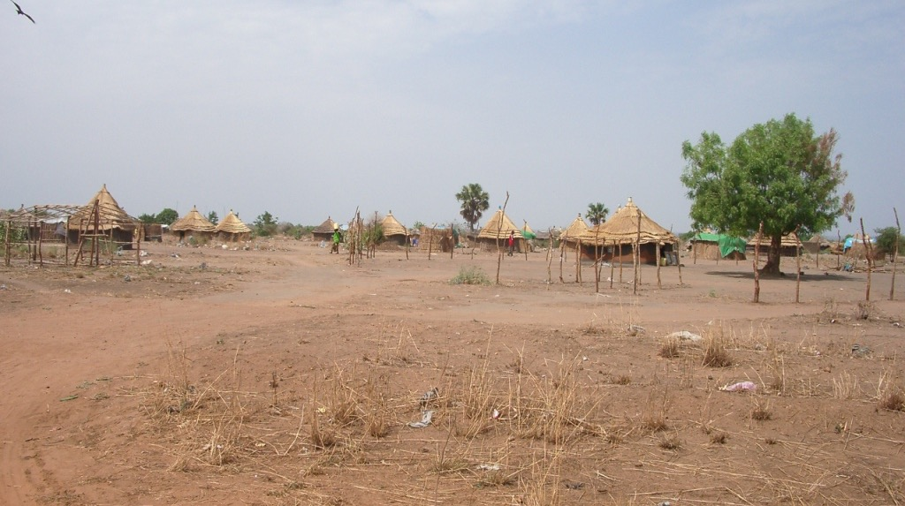
Current Status
250,000 strips collected and donated
100 meters collected and donated
Media is Ramping Up
  Keynote speech
  Congressman Mtg and Ambassador meetings
  Department of State representative to 2-week global leadership program
  Middle East Broadcasting (MBN) documentary in arabic
Indefinite insulin support via Insulin for Life (IFL) for Malakia Diabetes Clinic
Visited South Sudan – August 2019
Hand delivered 200,000 strips and 3,000 ml of insulin in August 2019

Slide 15
Critical Next Steps
Assist the Malakia Clinic
  Ensure insulin via IFL is continued.
  Refrigeration for insulin
  Electrical Power
  Cold Chain??
Find/Diagnose Missing T1D’s
  Screening of all sick children in Juba using strips
---------------------------------------------------------------------------------------------------
Fund Raising
  Individual and Corporate donors
  On-line via website
Logistical
  Refine ability to ship into Sudan and South Sudan w/o customs issues
Medical Supplies
  Continue to obtain free insulin, strips and meters
Media
  MBN (Middle East Broadcasting Network) doing documentary on Kyle and KCC
George Clooney and my Dad are long-term supporter of the people of South Sudan

Slide 16

How to help?
Network and Share Ideas
  KCC.T1D@gmail.com
  Mark.thaller@gmail.com
Stay in touch . . . Please!
SAVE LIVES BY NEVER GIVING UP

Slide 17
Thank You!

Slide 18
References
Ali, A., Zha L. (November, 2018). Knowledge of type 2 diabetes mellitus and adherence to management guidelines: a cross-sectional study in Juba, South Sudan. South Sudan Medical Journal, Retrieved from http://www.southsudanmedicaljournal.com/archive/november-2018/knowledge-of-type-2-diabetes-mellitus-and-adherence-to-management-guidelines-a-cross-sectional-study-in-juba-south-sudan.html
Azevedo, M. (2008). Diabetes in Sub-Saharan Africa: Kenya, Mali, Mozambique, Nigeria, South Africa and Zambia. International Journal of Diabetes in Developing Countries, 28(4), 101-108. Retrieved from https://www.ncbi.nlm.nih.gov/pmc/articles/PMC2822152/
Cham, M., Machuny, M., Manot, D., Riek, Y., Gok, M., Abraham, O., et. al. (2017, December). What is the prevalence of Diabetes Mellitus in Juba City, South Sudan? IJRDO-Journal of Health Sciences and Nursing. Retrieved from https://www.google.com/search?client=firefox-b-1&q=what+is+the+prevalence+of+diabetes+in+juba+city

Slide 19
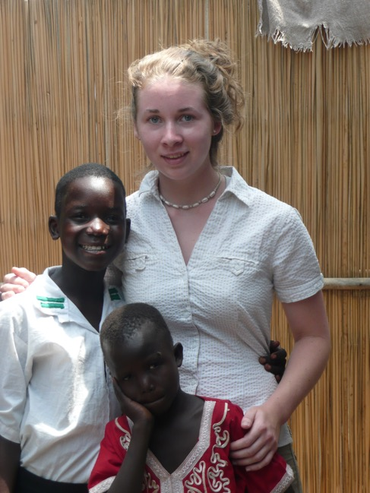
References (continued)
Eliadarous, H. (2017). Exploring the impact of diabetes in Sudan: Out-of-pocket expenditure and social consequences of diabetes on patients and their families. Retrieved from https://openarchive.ki.se/xmlui/handle/10616/45956
Elliot, J. (2017, February 15). America is #1 in diabetes costs. Retrieved from https://www.t1international.com/blog/2017/02/15/america-1-diabetes-costs/
International Insulin Foundation. (n.d.). Diabetes in Sub-Saharan Africa. Retrieved January 6, 2019 from http://www.access2insulin.org/uploads/4/9/1/0/4910107/factsheet.pdf
Mahad, M. (November 25, 2016). Bringing diabetes treatment home. Retrieved from https://www.msf.org/south-sudan-bringing-diabetes-treatment-home

Slide 20
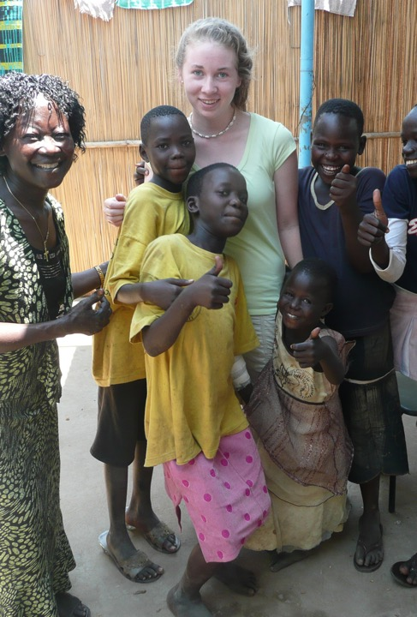
References (continued)
Mednick, S. (June 26, 2018). Suffering in Silence: The Deadly Economic Burden of NCD’s. Retrieved from https://www.devex.com/news/suffering-in-silence-the-deadly-economic-burden-of-ncds-92932
Sawe, B. (2017, April 25). Religious beliefs in South Sudan. Retrieved from https://www.worldatlas.com/articles/religious-beliefs-in-south-sudan.html
Stark, N. (N.D.). My shocking diagnosis out of South Sudan. Retrieved on March 28, 2019 from https://beyondtype1.org/my-shocking-diagnosis-out-of-south-sudan/
World Health Organization (2016). WHO Diabetes Country Profile; South Sudan. Retrieved from https://www.who.int/diabetes/country-profiles/ssd_en.pdf
Yak, C. (N.D.) Diabetes Control in South Sudan WDF13-777. Retrieved on March 28, 2019 from https://www.worlddiabetesfoundation.org/projects/south-sudan-wdf13-777

