Slide 1
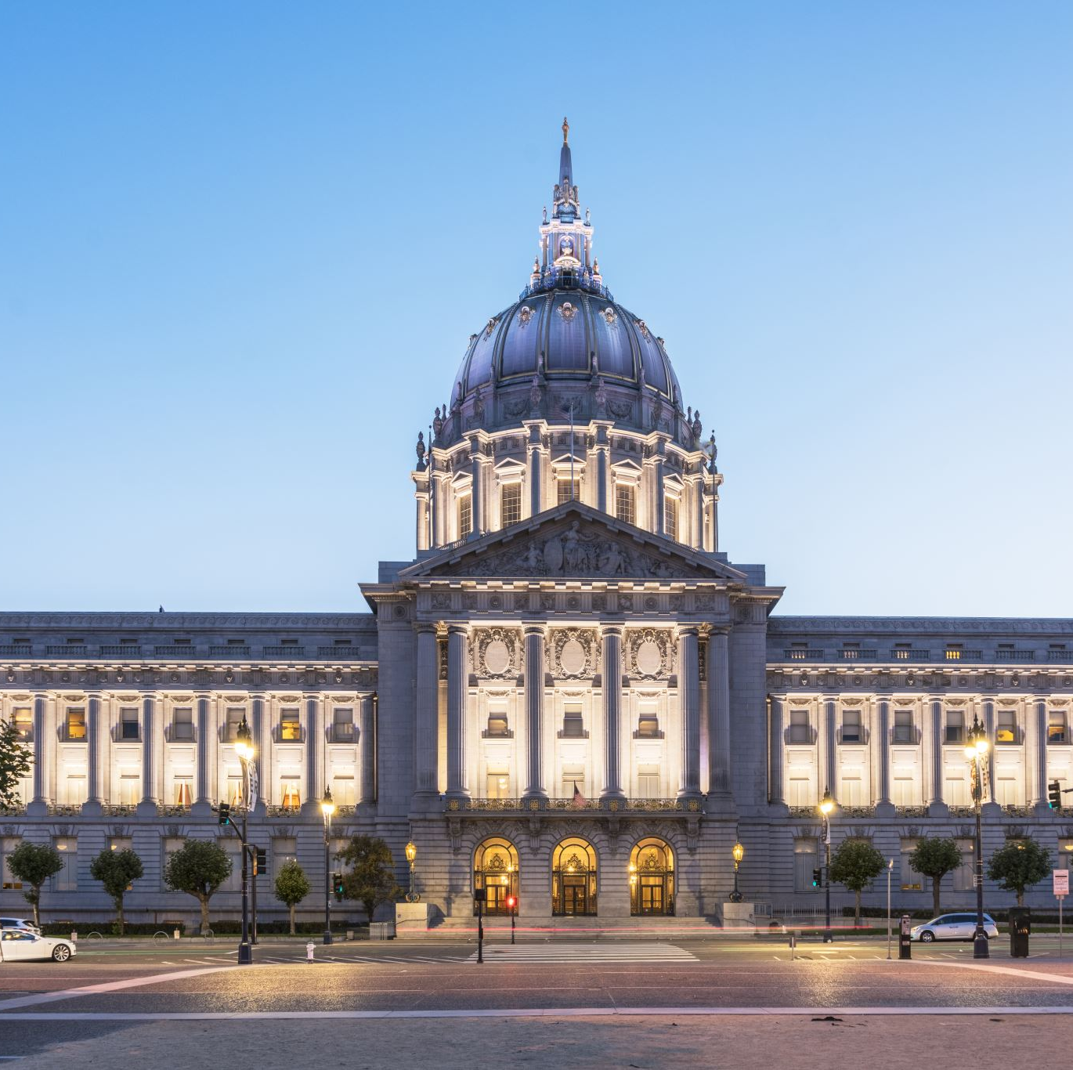
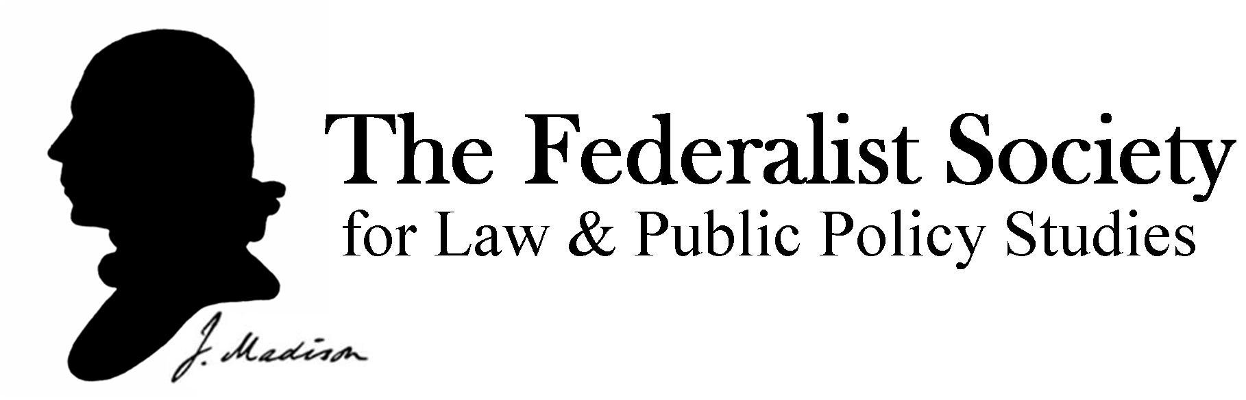
The Federalist Society
Inaugural Meeting
Wednesday September 4, 2024
Room 102
12:20 PM – 1:20 PM
Simmons Law School at Southern Illinois University

Slide 2
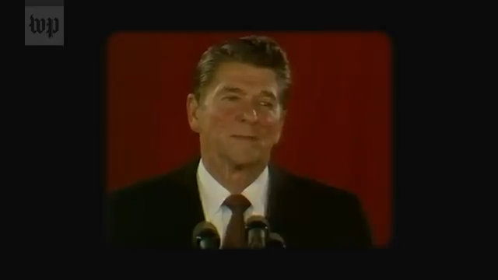
The Conservative Movement Transforming America’s Courts, Washington Post (May 11, 2019)
https://www.youtube.com/watch?v=e1fKkoASTRw&t=809s
Origins of the Federalist Society

Slide 3
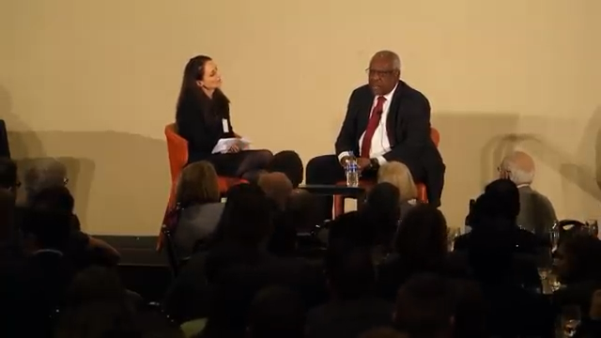
Supreme Court Justice
Clarence Thomas

Slide 4

Why Should You Join the Federalist Society?
The Federalist Society fosters critical thought and debate about the application of conservative principles found in the law and embraces the principle
that the state exists to preserve freedom,
that the separation of governmental powers is central to the integrity of the Constitution of the United States of America,
and that it is emphatically the province and duty of the judiciary to say what the law is not what it should be.

Slide 5
The Society has identified three core places American institutions and the rule of law are undergoing some challenges:
Priority Areas for 2024-2025
____________
DEI’s focus on identity
Attacks on the courts
The Goodness of the Constitution

Slide 6
DEI and the Aftermath of
Students for Fair Admissions v. Harvard
The Supreme Court’s 2023 decision in Students for Fair Admissions v. Harvard made it clear that the institutions that shape our future leaders—selective colleges and universities—run afoul of U.S. Constitution when they to socially engineer our society using racial preferences.
Underpinning the decision is the Court’s rejection of the idea that people should be treated differently on the basis of their identity.
Higher education is not the only area that has been affected by diversity, equity, and inclusion ideology and bureaucracy. Various identity-based preferences have become very widespread in business, government, and the arts, K-12 education, and many other key institutions.

Slide 7
The Integrity, Legitimacy, and Centrality of the Courts
Given the ongoing attacks on the Supreme Court and the judiciary more broadly, we want to present a more accurate picture of the third branch’s role in our constitutional system than what is commonly portrayed in the media.\
For this and other reasons, we aim to host diverse voices—left, right, and center—to distinguish between critiques of and attacks on the judiciary, to examine the dangers of threats and slander, and to highlight the role of the Supreme Court as an institution that applies legal reasoning, not one that conducts politics by other means.

Slide 8
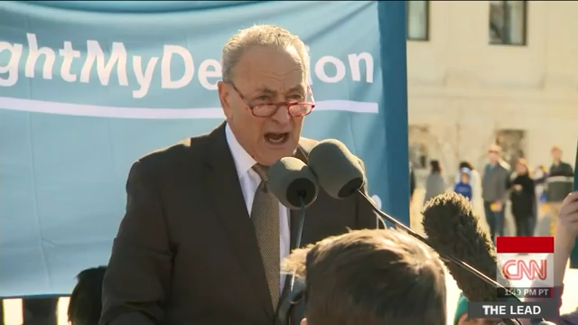
…dangers of threats and slander…

Slide 9
The Constitution is GOOD
Many of our most influential institutions and intellectuals challenge the goodness of the Constitution, arguing or assuming that is is inherently bad.
Our Constitution is also criticized widely because of decisions by the Supreme Court in recent years.
We now need to make a special effort to highlight the history, significance and lasting impact of the United States Constitution and the success of this uniquely American form of government.

Slide 10
Potential Topics for Debate/Discussion
2024-2025
Administrative Law
Presidential Immunity
Criminal Justice Reform
Second Amendment
DEI and Affirmative Action
Gender Identity and the Law
Others???

Slide 11
Potential Topics for Debate/Discussion
2024-2025
ADMINISTRATIVE LAW
In Loper Bright Enterprises v. Raimondo and Relentless Inc. v. Department of Commerce, the Supreme Court considered challenges to Chevron Deference, and ultimately overturned this 40-year-yold precedent. The Court’s decision to overturn Chevron is bound to have far-reaching implications for the administrative state for years to come.

Slide 12
Potential Topics for Debate/Discussion
2024-2025
PRESIDENTIAL IMMUNITY
In United States v. Trump, former president Donald Trump argued that presidents should have immunity from criminal prosecution for acts undertaken during their presidency, and the Supreme Court ultimately ruled that U.S. Presidents do have immunity for official acts. Does this decision afford a president too much protection, or is it necessary in order to empower a president to act during his tenure? Invite a speaker to discuss.

Slide 13
Potential Topics for Debate/Discussion
2024-2025
CRIMINAL JUSTICE REFORM
In recent years, support for calls for criminal justice reform has mounted across the ideological spectrum. Still, there are those who argue that the problem has been overstated and the proposed solutions are likely to backfire. Invite an expert to discuss topics such as overcriminalization or under criminalization, qualified immunity, plea bargaining, and sentencing policy.

Slide 14
Potential Topics for Debate/Discussion
2024-2025
SECOND AMENDMENT
This term, Bruen was put to the test. In United States v. Rahimi, the Supreme Court considered whether a law prohibiting possession of firearms by persons under a domestic violence restraining order is a violation of the Second Amendment. The Supreme Court upheld the constitutionality of the law. Invite a speaker to discuss the evolution of Second Amendment jurisprudence.

Slide 15
Potential Topics for Debate/Discussion
2024-2025
DEI AND AFFIRMATIVE ACTION AFTER STUDENTS FOR FAIR ADMISSIONS
The Court’s decision in Students for Fair Admissions v. Harvard continues to reverberate and raise questions not only in higher education, but also in the private sector, where similar anti-discrimination legislation applies.
What impact does the SFFA decision have on DEI initiatives?
Further, can disparate impact litigation survive the SFFA decision, or is a theory of “disparate impact” even possible without relying on an arbitrary racial classification system?

Slide 16

Potential Topics for Debate/Discussion 2024-2025
GENDER IDENTITY AND THE LAW
Recent advocacy on gender identity raises numerous legal questions. Among them are questions of freedom of speech implicated in pronoun policies, questions of medical malpractice raised by the increasing availability of gender identity treatments to minors, and concerns about the erosion of freedom of thought in the medical community regarding gender identity and treatment. Invite an expert to explore these emerging areas.

Slide 17

Potential Topics for Debate/Discussion
2024-2025
ANY OTHER IDEAS???
What other legal issues, Supreme Court decisions, or Constitutional law concern/fascinate/confuse or otherwise interest you?

Slide 18
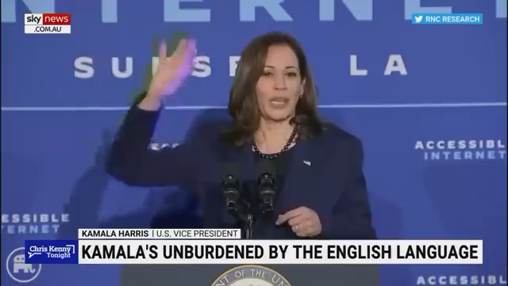
Simmons law school chapter
Moving forward, we will be “unburdened by what has been” : )
Many Federalist Society chapters at other law schools create their own logo that reflects their school in some unique way.
Since COVID, our Chapter has had difficulty gaining traction/growing
This school year, one of my main goals as Chapter President is to reinvigorate and revitalize the Federalist Society
Let’s be ORIGINAL

Slide 19
Simmons law school chapter:
Logo Design Contest
Many Federalist Society chapters at other law schools create their own logo that reflects their school in some unique way.
We want to create a new logo for Chapter: our school was recently renamed, our Chapter is growing, and we want a clever, esthetically-pleasing, and unique design for our Chapter.
Join the contest to create a new Simmons Law School Chapter Federalist Society logo!
Submit your designs to Grace: grace.e.gray@siu.edu.
We will announce the winner of the contest toward the end of the month (or earlier).
PRIZES for the best design and runner-up.
Some examples….

Slide 20


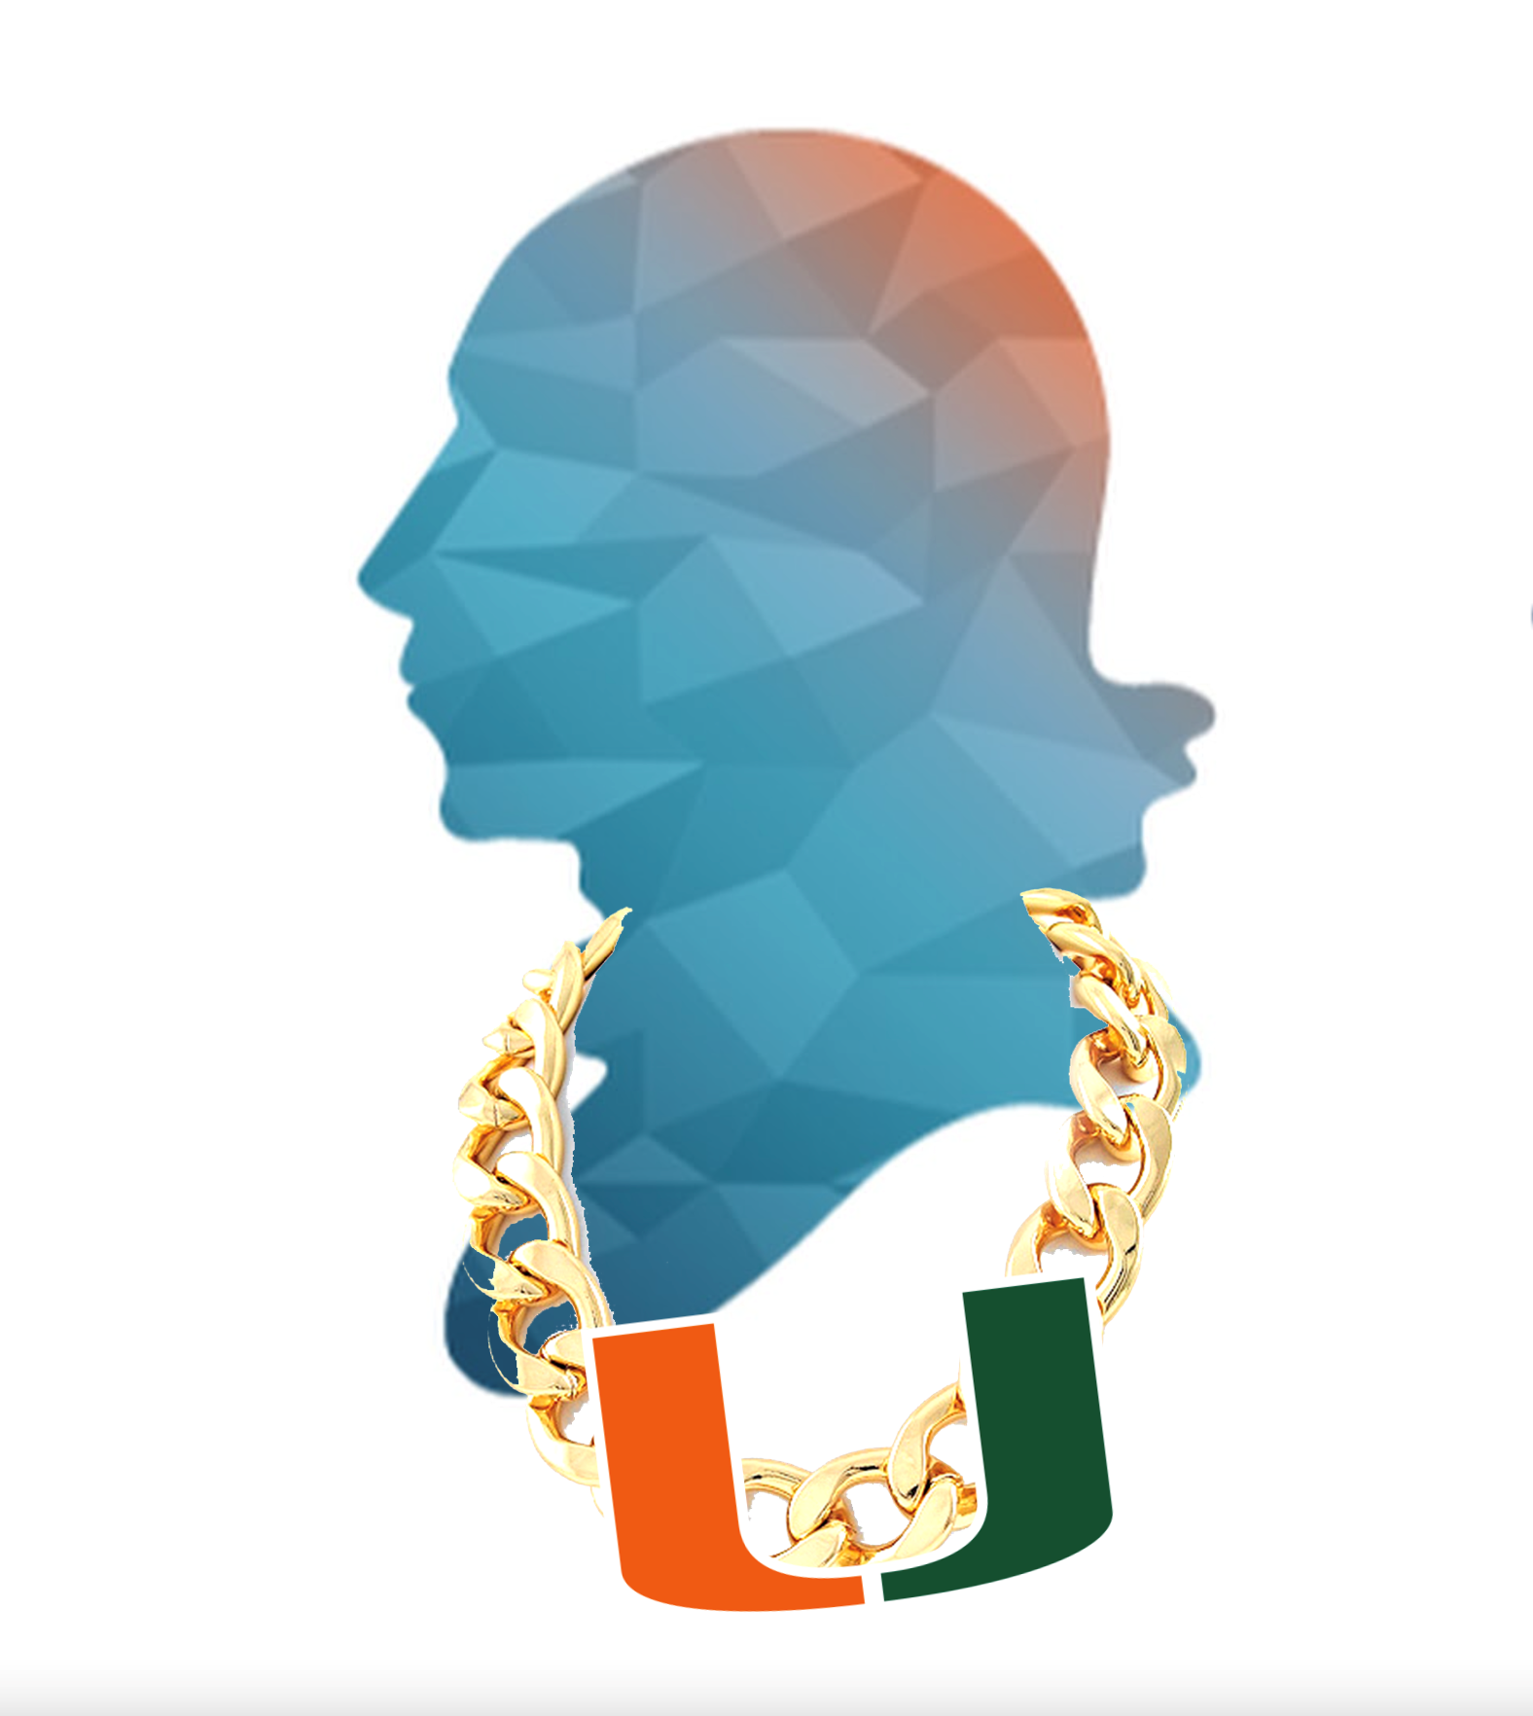






Slide 21


Slide 22


Slide 23
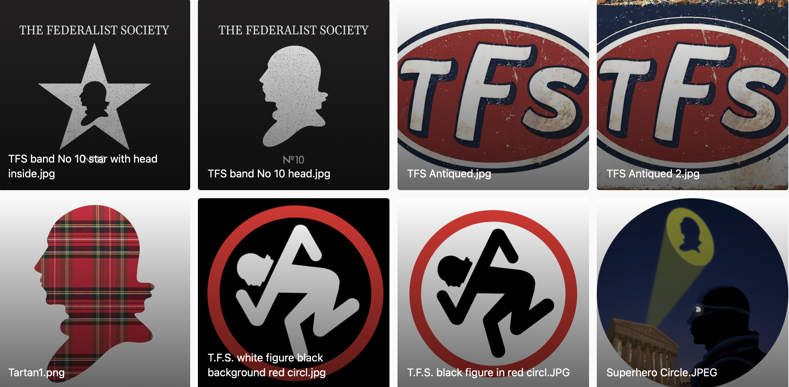

Slide 24
A Preview of the Federalist Society & the Fall Semester
September
Inaugural Meeting
First Friday Happy Hour
Induction Ceremony with Hon. Steven M.J. Bost, at-large circuit judge in the First Judicial Circuit.
Announcement of Class Representatives and Chapter Logo Contest Winner
Cash Bail Panel – with State’s Attorney Joe Cervantez
October
First Friday Happy Hour
Speaker Event: Freedom of Speech on Campus with Casey Mattox, the Vice President, Judicial Strategy, Stand Together (flying in from Virginia)
Guest Speaker: Illinois Supreme Court Justice David K. Overstreet
November
First Friday Happy Hour
Speaker Event: ”Dirty Presidential Campaigns” with Logan Beirne, Faculty Fellow & Lecturer in Law, Yale Law School - flying in from Connecticut

Slide 25
Class Representatives/Liaisons
For those interested in taking a more active role in the Society this year, please apply to be a 1L, 2L, or 3L Federalist Society Class Representative.
Responsibilities and Duties of Representatives:
Attend Induction/Pinning Ceremony later this Month
Encourage and recruit members of your class to join the Federalist Society and attend events – reinvigorate and grow our Chapter.
Assist Board members with various organizational tasks
Attend First Friday Happy Hours when possible and bring a friend (drinking not required)!!
Create a subcommittee of Class Representatives and work with the President and Vice President to create and organize your own speaker event (optional)
Fearlessly represent the Federalist Society in and outside the Law School

Slide 26


1st Round on us!
Sure, we
Monthly Social Gathering
Friday,
The Federalist Society presents:
First Fridays
6:00 PM every first Friday of the Month
@ The Cellar
101 W Monroe St, Carbondale, IL 62901

Slide 27
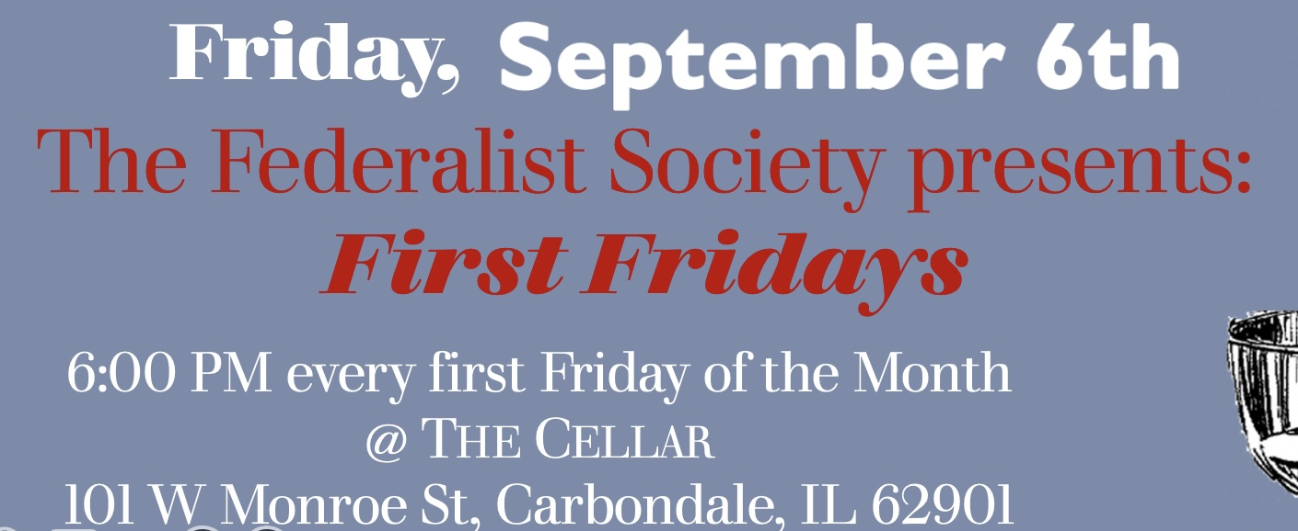

Slide 28
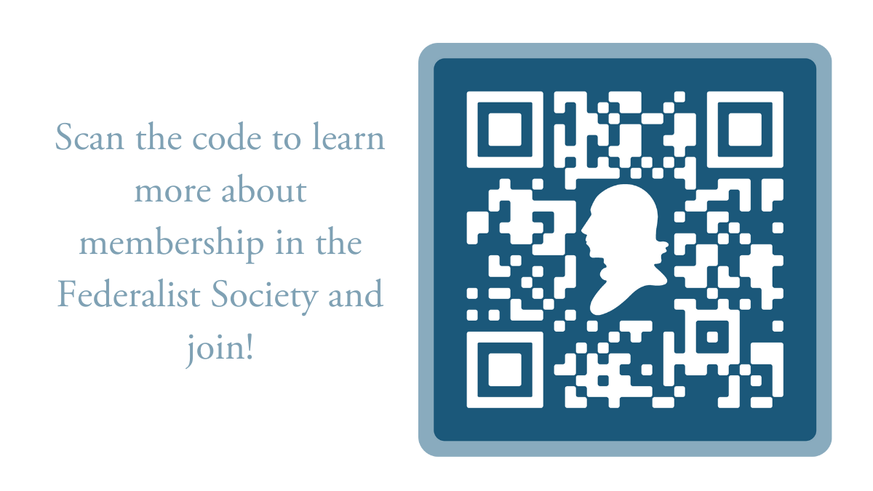

Slide 29
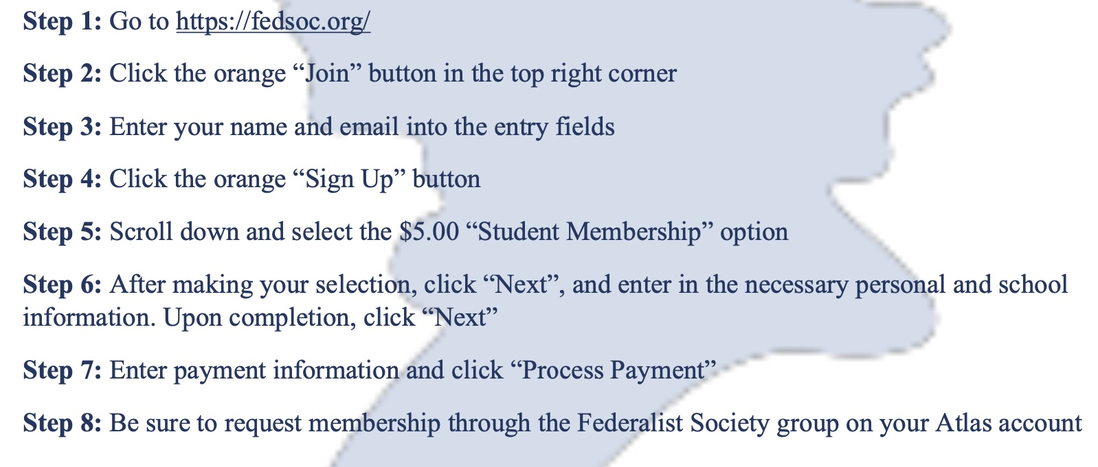
How to Join the Federalist Society

Slide 30

Questions???

