Slide 1



Slide 2
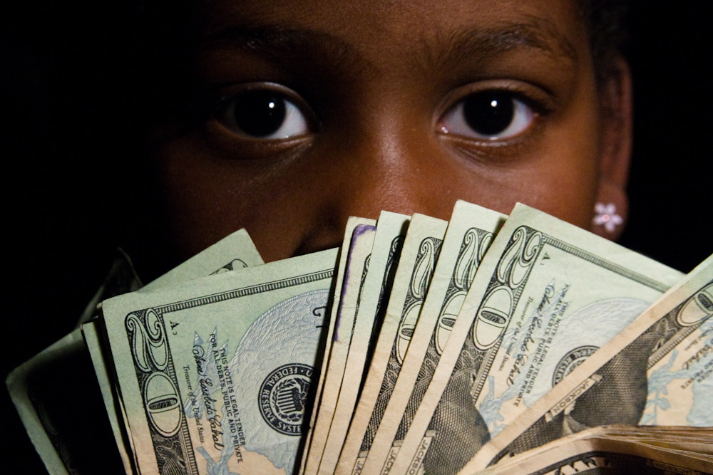


Investing 101
for
Kids Ages 7-10

Slide 3

Investing 101 for
Kids Ages 7-10

Slide 4


Hi Everyone, Financially Fit here.
April is financial literacy month and I've come to pump you up and help you get your money in shape, by filling you up with all kinds of helpful money tips and tricks that can help make you rich. Wouldn’t you like that? I know many of you are a bit bored right now. Believe me, I understand. At first, when you hear the news that you're going to be out of school for a while, you get excited and happy. After a couple of weeks, you realize all your friends where at school and you miss having fun there. That's when you start to wish you were back at school.

Slide 5
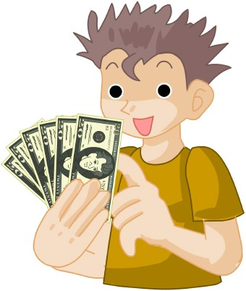
Well we're going to try to help you get through that feeling and come out a winner. We’re going to teach you how not to be confused about what to do with your money. Plus, we’re going to help make you smarter about your money, and we’re going to turn you into a real winner too.
Topic 1
Topic 2
Topic 3
Topic 4
Topic 5

Slide 6
How would you like to play a little game with me? Let’s see if you can show me what dollar bills really look like. I have some pictures of all kinds of dollar bills here, and I just need you to tell me how much each one is worth or what amount they are. Also, can you tell me if any of them are not real dollar bills?
What Dollar Bill Isn't Real?

Slide 9
10- George Washington
20- Andrew Jackson
10- Alexander Hamilton
1000- Grover Cleveland
50- Ulysses S Grant
5000- James Madison
100- Benjamin franklin
5- Abraham Lincoln
2- Thomas Jefferson
500- William McKinley
100,000- Woodrow Wilson
Fake Bill
Notes:
10- George Washington
20- Andrew Jackson
10- Alexander Hamilton
1000- Grover Cleveland
50- Ulysses S Grant
5000- James Madison
100- Benjamin franklin
5- Abraham Lincoln
2- Thomas Jefferson
500- William McKinley
100,000- Woodrow Wilson
Fake Bill

Slide 10
Now that we know what the money looks like, how do we go about getting some? Did I hear someone say “earning it or working for it”? That’ right.
What are some ways you can think of?

Slide 11
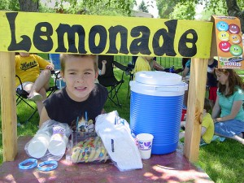
You an set up a business like a lemonade stand. Or you can earn an allowance. Like this little boy.
Did you know that now is the perfect time to help teach you how to be smart with your money. First by earning it, second by saving it, third by spending it wisely and fourth by investing it or putting it aside in a safe place where you can watch it as you help it grow.
What’s he doing?

Slide 12
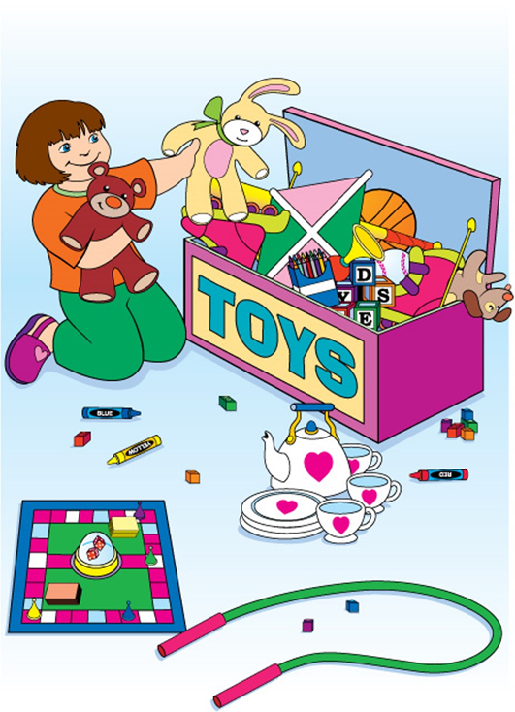
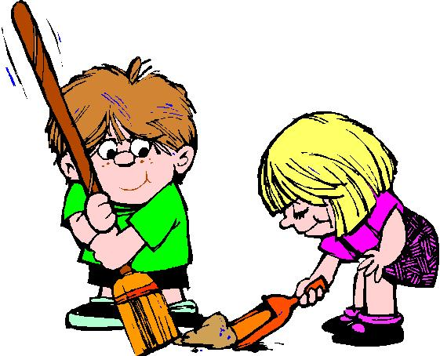
What are they doing?

Slide 13
The little girl is putting away her toys
Doing chores
Cleaning up
The boy and girl are sweeping the floor
Doing household chores
Cleaning up
What do you think these children are probably doing? Their chores. And what do you think usually happens when you do your chores? You earn money. Usually called an allowance.

Slide 14
After you earn your money or someone gives it to you as a gift, what are you going to do with it? One of the first things you should always want to do is save some of it.
Let’s play a little word game. We’re going to see if everyone knows what they are supposed to be learning and doing.

Slide 16
Of course, once you have money and you start to save money, you won’t want to waste it. You’ll want to make sure you spend it wisely on things you need and not just things you want. Can you tell me some of the things you and your family have to spend money on? Some things you need, some things you just want. Let’s look at my list and tell me what things are needs and what things are wants.

Slide 17
Needs versus Wants Game
Nike Sneakers __________
Cheesesteak _________
Nice apartment __________
Wool coat __________
Chinese food __________
iPhone __________
Hairdresser __________
Shoes __________
A Home __________
Manicure/pedicure __________
Good personal hygiene __________
Food __________
Coat __________
Phone __________
Computer __________
Money __________
Heat __________
Clothing __________
Shelter __________
Designer jeans __________

Slide 18
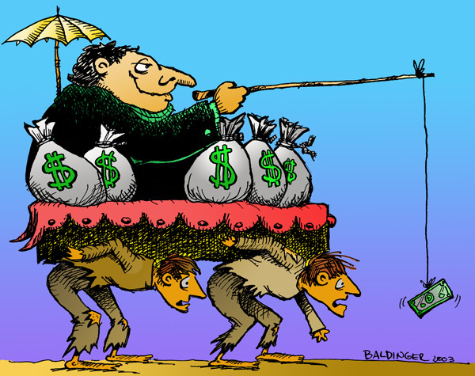
Earn your money, save it and spend it wisely. Don’t be like these guys.

Slide 19

Now, everyone tell me what you’re going to do from now on? Earn, save and spend money wisely. Don’t be like these guys. Why not? What are they doing?
Because you have a rich person breaking the backs of two poor guys who will be chasing money but never be able to get the money that can make them rich if they don’t know how to earn it, save it and spend it wisely.

Slide 20

Show how you’re on the way to success
When we get there, we can learn how to invest money. Next time.

Slide 21
Savings Success

Slide 22
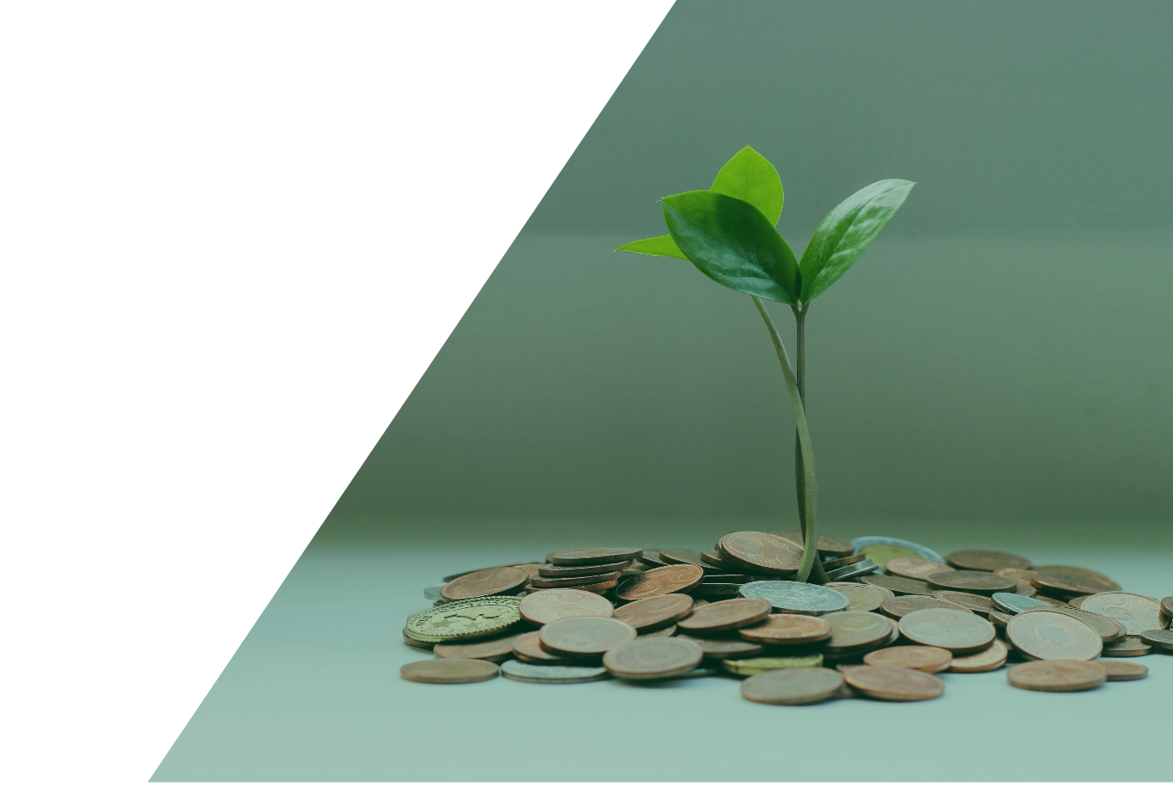
Sunny Chinese Food
Lee’s Nail Salon Shopper’s Meat Market My Bank and Trust
Sal’s Steaks
Neighborhood Bank
Big Beauty Supply

Slide 23
Let’s take a look and see how you did.
Good job everybody. And until next time, remember….
Earn, Save and Spend your money wisely.
This way you’ll have something to invest.
See you soon…

