Slide 2
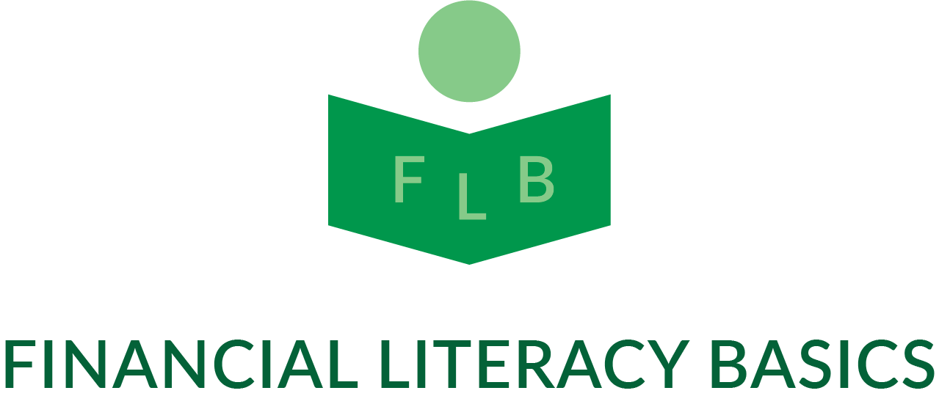
Financial Literacy Basics Investing 101 for Young People

Slide 3
Hi everyone, Financially Fit here,
April is financial literacy month and I've come to pump you up and help you get your finances in shape, by filling you up with all kinds of helpful money tips and tricks that can help make you rich and you can use throughout your life. I know many of you are a bit bored right now. Believe me, I understand. At first, when you hear the news that you're going to be out of school for a while, you get excited and happy. When reality sets in a couple of weeks later and you realize all your friends where at school and you miss the fun you had there, that's when you start to get bored and wish you were back at school.

Slide 4
Well we're going to try to help you get through that feeling and come out a winner. And a much smarter and richer winner at that. If you're like most kids, though you're out of school, you're not out of homework. You can't escape it, and you shouldn't. Homework is not only healthy for the mind, it's exercise for the mind. Sometimes I realize that as a kid, we just think we know enough and have seen enough. I was a kid once, so I know, and I agree.

Slide 5
That being said, we're going to feed you something healthy for the mind, and if you exercise it, you'll always be in financially good shape. What am I talking about? Why it's leaning how to earn, spend and use your money wisely of course. In this class, we're going to concentrate on investing in what is commonly referred to as "the stock market". When you go to school each month, you probably learn a variety of subjects that will help you, mostly later in life, to have a job, a home, maybe a family, and all sorts of things.

Slide 6
They teach you so many things that sometimes they forget to teach you about money, and other times they may just not have time to teach you about money. Most times they leave that up to the parents. And guess what? Parents are often so busy trying to make the money to take care of the family, that they don't have the time to teach you either. That's why I'm here today to talk to you about how to handle your money and make wise decisions about it. Does anyone have any idea what is probably the most common and important thing on most people's minds right now?

Slide 7
Next to staying healthy, of course. It's how they are going to manage their expenses and household if they can't work and/or money doesn't start to come in soon. Some people have made better money management decisions than others and some just haven't had as much opportunity or money to make good decisions. But if you start out early, you'll have a much better chance of doing so. For people who may have made better money decisions, they may be able to go a little longer without working, before their money runs out, but eventually everyone has to have an income of some kind. This is how we pay our bills, buy the things we want and live.

Slide 8
Most kids know they're out of school because there's a big bad virus going around and if we stay home, it will help it go away sooner. We hope. That's the simple explanation, and it's true, but how are we going to pay for our home or buy food or clothing for the family if no one goes to work and because of it, no one can pay the bills? This statement helps to show us, more than many, why it is so important to do smart things with our money. That's why I'm here today, to help you learn how to make some of those decisions.

Slide 9
Let me now take a couple of minutes to introduce myself. My name is Iris Henry and I am owner of Financial Literacy Basics Co., the company that is presenting this virtual class here today called, 'Investing 101 for Kids and/or Young People’. I'm also the founder and president of the nonprofit organization, 'Let's See If We Can Help, Inc.' "Let's See If We Can Help, Inc. is a charitable organization involved in many things, but for the purposes of this course, I will only mention that one of the things we do is offer financial literacy classes and related workshops, free of charge to nonprofit organizations and residents of the Philadelphia area.

Slide 10
As a kid and young person, I was always interested in finding out how rich people got their money and kept it. I remember seeing a movie and, in the movie, one of the characters said the words, "I made my money in the stock market". I always remembered those words, but in my world, there was no such thing. Well, long story short, many, many years later, I would get the opportunity to become part of that stock market world. I didn't get rich, but I was definitely able to enjoy some things that I otherwise would not have been able to.

Slide 11
I'll always appreciate the joy and excitement it brought into my life. When I say "many, many years", I was way past the age of adulthood when I became exposed. For years, all I could think of is how much further ahead, financially or rich I would be if someone had exposed me to that world at a young age. For that reason, I've decided to make it my mission to help expose and introduce young, underexposed youth, especially from similar backgrounds as mine, to the world of investing

Slide 12
In 1996 I went to work for a company that exposed me to the world of investing and also offered me the opportunity to train newly hired brokers for the department. After retirement and a series of other encounters and experiences, I decided it was a good time to share some of the lessons I learned. I studied and received a certification in financial literacy education instruction, and now I'm putting that training to good use. Though I write financial literacy programs for many age groups and backgrounds, this class is designed for youth who have little or no knowledge of investing.

Slide 13
I'm going to give you the topics covered in these classes and there will be course work that you will need to do in order to keep up with the class. Though it's voluntary, it's important that you make the effort to participate fully. Though each class will be scheduled for 1 - 1 1/2 hours, I will let the class coverage and time allowed to be dictated by the class itself.

Slide 14
In other words, I will work at your pace. If there is lively discussion and curiosity about a topic that allows us to go farther into the subject, I prefer to do so rather than rushing through to meet a schedule. The most important thing is that you understand. There's a lot to know about investing and we're going to start with some basics and as time goes on, you'll be able to expand your knowledge. There are many categories and sub categories yet to be explored.

Slide 15
Class Exercise
Think some of the things that you think are going to be discussed today and answer the following questions. Write it down on paper or your workbook. If you would like, write down the points for others to see. We will briefly discuss why your answer was chosen
.
1) What does financial literacy mean to you?
a-________________________________________________
b-________________________________________________
c-________________________________________________
2) Give some examples of people practicing financial literacy.
a-________________________________________________
b-________________________________________________
c-________________________________________________
3) How do you see yourself benefiting from learning financial literacy?
a-________________________________________________
b-________________________________________________
c-________________________________________________

Slide 16
Let me start by telling you what we'll be covering.
Types of Businesses
Types of Securities
Stocks
Bonds
Money Market
Mutual Funds
Why People Invest in these Securities
Where do people invest money
How do I find securities to invest in
Investment Risks
How to monitor or follow your investments
Terms to remember:

Slide 17
Let me start by telling you what we'll be covering in "Investing 101"
Corporate Securities
Business Types
Sole Proprietorship
Partnership
Corporation

Slide 18
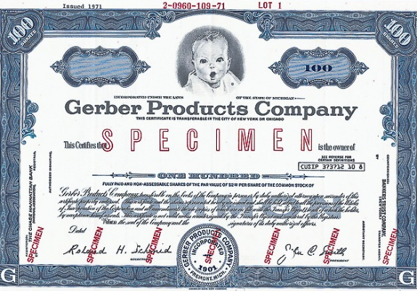
Stocks
Equity
Common Stocks
Growth
Value
Preferred Stocks
Income
Stability of Principal

Slide 19
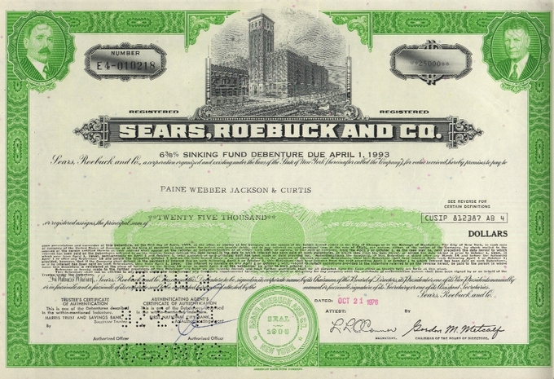
Debt (Bonds)
Loan
Corporate
Municipal
U.S. Government

Slide 20
Money Markets
Stable Principal
Designed for short term investing

Slide 21
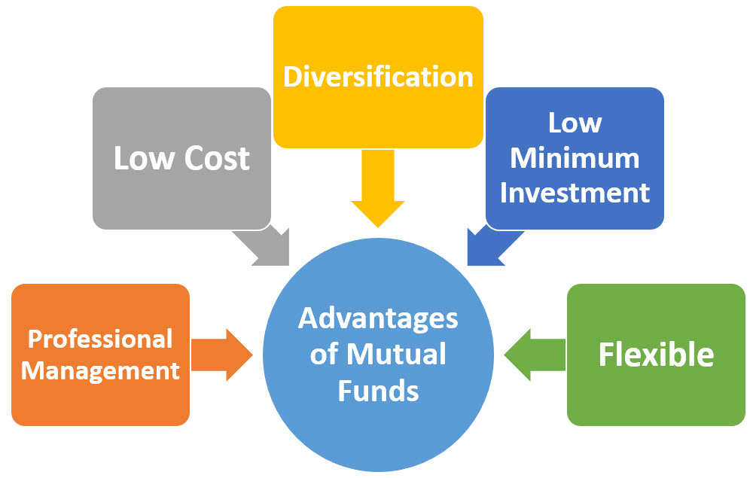
Mutual Funds
Basket of Securities
Less risky
Allows investing in many securities at once

Slide 22
Vanguard Mutual Fund Prices (Net Asset Value)
Vanguard Exchange Traded Funds (ETF's)

Slide 23
Vanguard Money Market Quote
Vanguard Government and Corporate Bond Quotes

Slide 24
Why People Invest in these Securities
To save money
To park or put away money
To make money grow faster

Slide 25
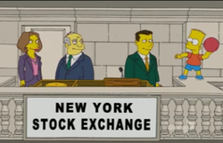
Where do people go to invest money
Exchanges
New York and American
Nasdaq

Slide 26
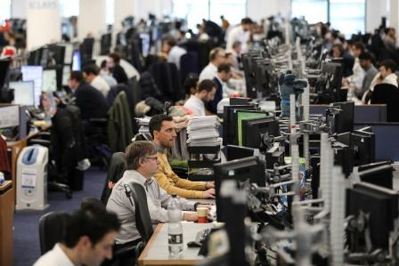
Over-the-counter Market
Pink Sheets
OTC Bulletin Board

Slide 27
How do I find securities I'd like to invest in
Dividend Reinvestment Plan (DRIP)
With an investment broker

Slide 28
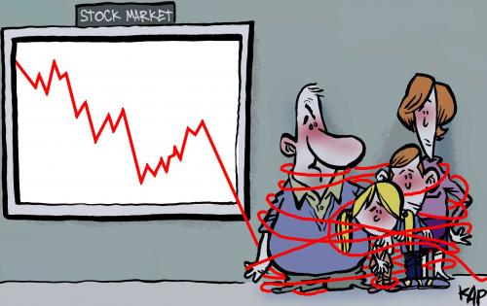
Investment Risks
Market Risks
Economic Risks
Liquidity Risks
Inflation Risks
Financial Risks
Interest rate Risks

Slide 29
How to monitor or follow your investments
newspapers
https.yahoo.com://finance
https://www.tdameritrade.com/home.page
https://www.nasdaq.com/
https://www.nyse.com/index
https://www.investopedia.com/
and other sites

Slide 30
Terms to Remember
Stocks
Bonds
Securities
Investments
Money Market
Corporation
Portfolio
Broker
Principal
Equity
Municipal
Asking or Offering Price
Bid Price
Net Asset value
Dividends
Interest
Taxable
Tax-Exempt
Invest

Slide 31
Terms to Remember Answer Key (in simple terms)
Stocks – ownership shares of a corporation showing how much you own of that corporation as a equitable owner or partner.
Bonds – A certificate (no longer in physical form) showing a debt obligation to the holder or owner by a government or corporation and promise to repay your principal and any interest on the money you loaned them. A promissory note.
Securities – exchangeable financial instruments such as stocks or bonds that hold monetary value and can be traded or exchanged in the financial markets such as the NASDAQ or NYSE.
Investments- an individual or collection of vehicles, instruments or projects such as stocks, real estate or partnerships that you put money into in anticipation of reaping future monetary gain
Money Market - A place to deposit money, possibly for short terms, and it is invested in interest earning securities of very high quality and stable principal.
Corporation – a legally recognized business established by articles of incorporation, protected by laws, governed by a board of directors formed by the founders or owners

Slide 32
Terms to Remember Answer Key (in simple terms)
Portfolio – The total amount and type of investments held by you
Broker – someone or company that buys or sells securities for you or on your behalf
Principal- Amount of money lent to someone or your investment, not including interest which would be additional
Municipal -relating to a city or local government such as the City of Philadelphia bond issues.
Asking or Offering Price – This is the price you will pay for a share of stock. It is the higher of the bid/ask price
Bid Price –If you sell your stock, this is the price you will receive, the lower of the bid and ask prices.
Net Asset Value- The share price or cost of a mutual fund share. It is found by pooling the total of all assets (liabilities are deducted first) and dividing it by the number of shares in existence or in the market place.

Slide 33
Terms to Remember Answer Key (in simple terms)
Dividends- This is the earnings that the company made for every share of stock and it is divided among the shareholders and distributed to them on a periodic basis, usually quarterly or semi-annually.
Interest-This is the cost of borrowing money expressed as a percentage. It is also the amount a bank or financial institution will pay you is they borrow money from you, such as in your savings or checking account.
Taxable-According to the federal and/or local government, you do have to pay them taxes on this item or investment. It is a percentage value of what the item or investment is worth.
Tax-Exempt –According to the federal and/or local government, you don’t owe them any tax money on this item or investment.
Equity- What you own minus what your owe. It’s all yours.
Invest – the use of capital, money as referred to here, to create or generate more money, through income producing vehicles such and stocks or bonds or through risk ventures such as business partnerships

