Slide 1

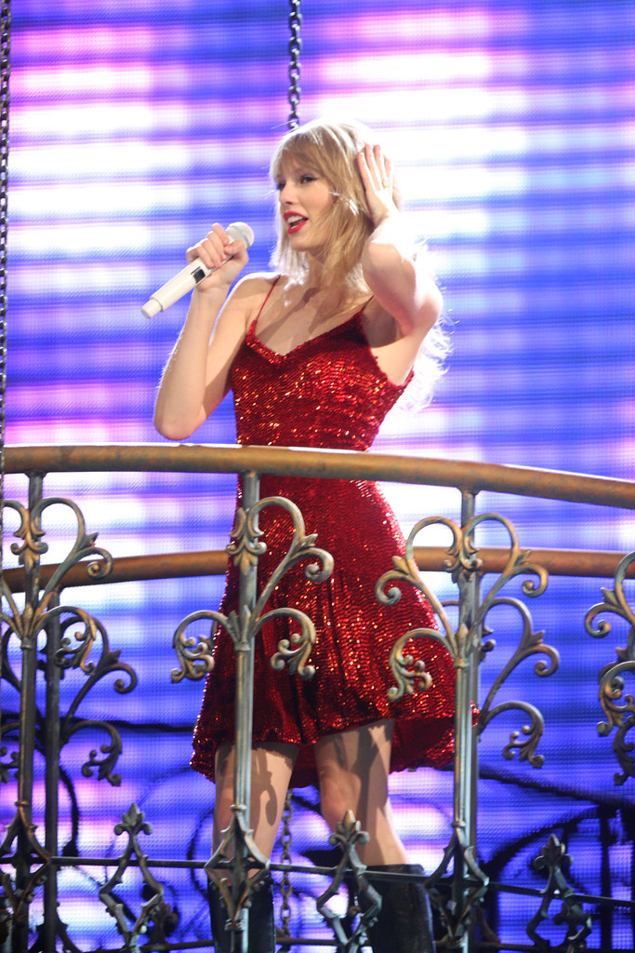
SWIFTY WORKSHOP
With
Ms. Ashley
July 5th & 6th
1-4Pm ( Sat-Sun)
1 day $75 /Both Days -$130
Must pre-register
$75 Per day
2nd Day Discount -if attended 1st day)

