Slide 1
Planned Giving Basics - Bequests, Beneficiary Designations, & Qualified Charitable Distributions
Cathy R. Sheffield, CAP®, CFRE, CSPG, FCEP
President, ThinkGiving
Cathy@ThinkGiving.com
www.thinkGiving.com
Strategic Philanthropy for Nonprofits and Individuals
Notes:
For charities large and small, bequests are the largest source of planned giving revenue. That’s right, the lowly bequest. The real opportunity for nonprofits is in the often under-appreciated bequest. “Bequests” includes gifts from wills, living trusts, beneficiary designations such as IRAs and life insurance and any other donor created mechanism to make an end of life gift. But bequests don't just happen. Proactively promoting bequests and helping your donors make bequests is a way to ensure that their charitable intentions are carried out.
You need not be an expert to make these opportunities available. In this workshop, we will review the ‘Essential Building Blocks’ for an organization’s planned gift program – bequests (wills, beneficiary designations, etc). We will also review Qualified Charitable Distributions and how individuals can take advantage of this unique giving opportunity.
You will leave this workshop with:
An understanding of the various types of bequests
The knowledge to develop internal processes
Samples of intention forms, acknowledgement letters, etc.
Talking points for how to start a conversation

Slide 2
Today we will…
Set the stage
Bequest
Beneficiary Designations
Qualified Charitable Distributions

Slide 3
Why is Planned Giving Important?
A creative way to make a gift
A way to make larger gifts then ever thought possible
A way to achieve philanthropic & financial objectives
A way to insure the longevity and future financial needs of your organization

Slide 4
Planned Gifts Allow Donors To…
Make gifts that are sensitive to their cash flow needs
Address tax, financial and estate planning needs
Provide for family and charity
Make a meaningful impact on an organization
Benefit from enduring recognition for their contribution
Engage their family in philanthropy and instill humanitarian values in their heirs
Make gifts larger than thought possible
Leave their legacy

Slide 5
Why Planned Giving?
$30 trillion: In the next 20 years, there will be more than $30 trillion inherited as the large and wealthy Baby Boomer population ages.
75%: Planned giving helps the entire development team hit their goals. According to research by Dr. Russell James, donors who make bequests increase their giving in the subsequent 5 years goes by 75%.
2.74: A study on IRS data found that bequests are by far the largest type of gifts, averaging 2.74 times the total lifetime giving of a donor.
15x: Planned Giving is widely considered to have the highest ROI of any type of fundraising. A study by AskRight found the average ROI on bequests to be 57:1, more than 15 times higher than the ROI on direct mail.

Slide 6
Some Interesting Facts…
In 2017, more than $410.02 Billion was donated to U.S. nonprofits
8 of the 10 largest gifts in the U.S. were planned gifts, non deferred, by individuals
35 million Americans own securities
From 2014 to 2034, about 80 million people are expected to retire, about 4 million people every year
  Approximately 11,000/day

Slide 7

Goal
The process of developing the optimal legacy plan to reflect the donor’s personal, financial, and philanthropic goals, as well as her values and passions.

Slide 8
The Ultimate Goal of Planned Giving
The Legacy
Assets Available to Give
Personal/Financial Objective
Support Programs
Name a Endowment
Recognition level
Honor/Memorialize a person
Honor a colleague/mentor
Donors want real impact,
innovative ideas, sense
of giving back
Cash
Appreciated stock
Appreciated real estate
Retirement plan assets
Closely-held interests
Tangible personal property
Life Insurance
Other
Income for self
Income for others
Diversification/
Concentration issues
Leverage transfer of
wealth to future
generations
Challenges with loved ones
Tax Planning

Slide 9
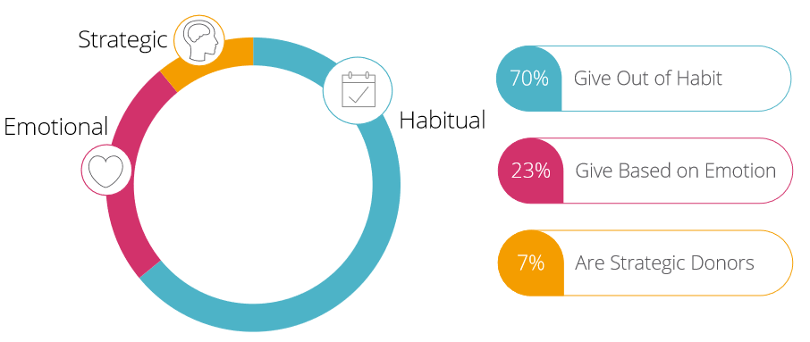

Slide 10
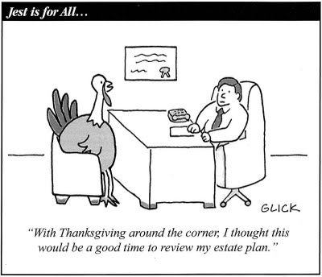

Slide 11
Bequests

Slide 12
What is a bequest?
A gift that is made at death
Simplest means of obtaining an estate tax charitable deduction
A deduction is allowed for the fair market value (FMV) of the property at the date of death
No limitations on deduction amount
85% - 90% of all planned gifts are bequests

Slide 13
Bequests
85% of Americans donate to charities during their lifetime
5.7% of Americans leave a charitable gift in their estate plans
All charitable organizations, regardless of size, can have a bequest program
Organizations with the most successful bequest programs take a proactive approach by marketing and soliciting bequest gifts
Realized bequests may account for 85%-90% or more of all planned gifts

Slide 14
Consider this…
According to a National Association of Charitable Gift Planners Survey of Donors, the average age of people who said they had provided for a bequest was 49…
Think for a moment what that person is saying…
No income tax benefits
Rarely are thinking of public recognition
Only a small percentage ever notify the charitable recipient
Why do they take this step???

Slide 15
Because they are elevating
your charity to the
status of a family member!

Slide 16
What the numbers say…
The National Center for Health Statistics (CDC) reported that 2,813,503 Americans died in 2017
According to a number of surveys…The best estimates are that 8% of Americans plan to include a charity in their estates
This would indicate that charitable bequests could have been included in some 351,688 estates among those who died in 2017

Slide 17
Bequests
When examining the time period between execution of a will that leaves funds to a charity and death, the average time period is approximately 3.5 years and the median is typically 3 years.
Note: 70% or more of charitable bequests and other gifts that are completed at death come from women.

Slide 18
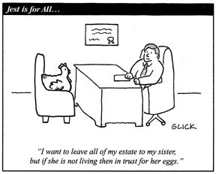

Slide 19
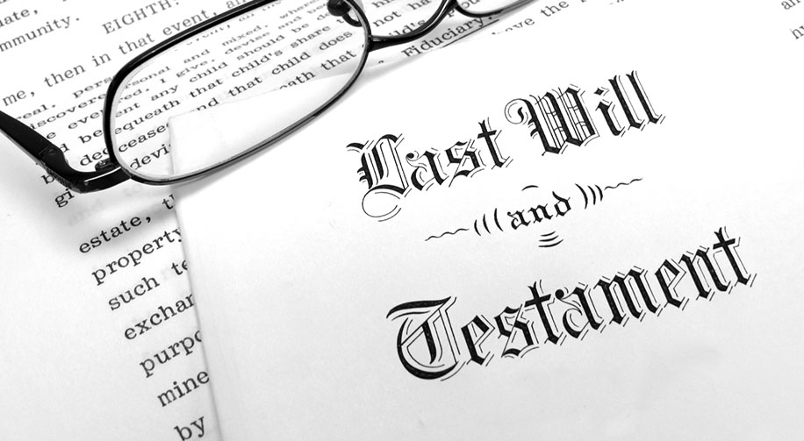
Wills
Notes:
Top Ways to Encourage Bequests
You may already know that 85% of Americans donate to charities during their lifetime, yet fewer than 5.7% of Americans leave a charitable gift in their estate plans. Why is this? Perhaps the charitable organizations never asked or developed the trusted relationships
In this presentation, Cathy R. Sheffield will reveal ways to encourage charitable bequest intentions. necessary to merit being added to a will.
All charitable organizations, regardless of size, can and should have a bequest program. In many planned giving programs, realized bequests may account for 80%-90% or more of all planned gifts. However, many charities choose to passively accept bequests. Organizations with the most successful bequest programs take a proactive approach by marketing and soliciting bequest gifts.
This presentation will review the top ways to encourage bequests – from identifying best prospects, donors’ options for making a bequest, marketing, and stewardship. We will also discuss how to have conversations with donors about making a bequest gift.

Slide 20
Importance of gifts through wills
Bequests are major source of gift revenue received at the death of a benefactor.
Bequests are relatively easy to promote and administer.
Bequests are not properly referred to as "deferred gifts."

Slide 21
Importance of gifts through wills
Bequests are gifts that are not completed as no property has been transferred and they remain revocable so long as the donor retains sufficient testamentary capacity under applicable laws.
Bequest commitments are more properly referred to as “expectancies.”

Slide 22
Importance of gifts through wills
Trusts, gift annuities, and other irrevocable gifts are completed and the donor has irrevocably parted with ownership of the assets comprising the gift, although enjoyment by the ultimate charitable recipient is deferred for the lifetime of one or more persons or for some other period of time depending on the terms of the gift arrangement. Thus they are referred to as “deferred gifts.”

Slide 23
The Importance of Gifts Through Wills
PLANNED GIFT INCOME
TO HIGHER EDUCATION
4,000
4,000
3,500
3,500
TOTAL
3,000
3,000
2,500
2,500
Millions
2,000
BEQUESTS
2,000
Millions
1,500
1,500
1,000
1,000
LIFE INCOME
500
GIFTS
500
0
0
80
81
82
83
84
85
86
87
88
89
90
91
92
93
94
95
96
97
98
99
0
1
Year
Bequest Income
Total Planned Gifts
Life Income Gifts
Planned Giving When That’s Not All You Do
by Robert F. Sharpe, Jr.

Slide 28
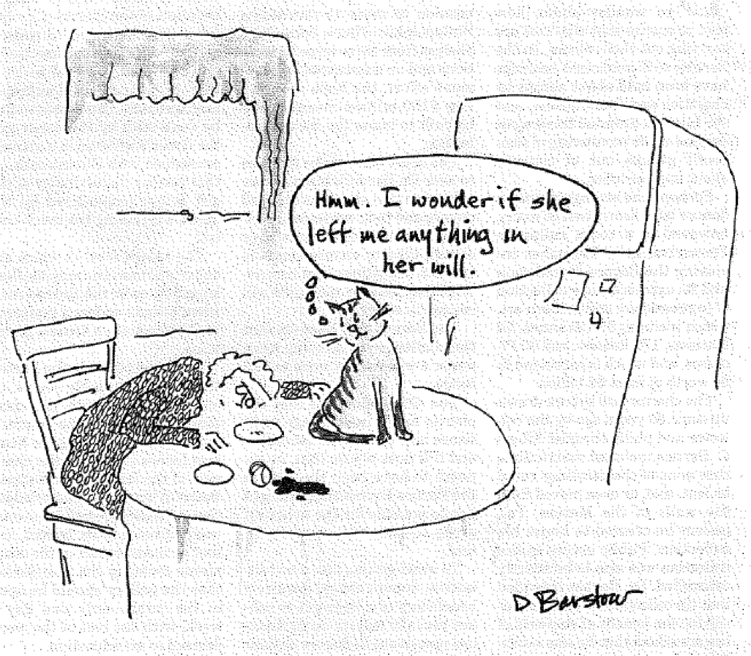

Slide 29
Wills
The keystone of the estate plan
It takes effect at the moment of the individual’s death and can be freely changed up to that point (as long as the individual remains competent)
The Will is usually the critical document

Slide 30
Reasons for having a Will
Make specific bequests to particular persons or charities
Name representatives, such as executor, trustee, and guardian for children
Facilitate administration of the estate and the probate process upon a person’s death
Create trusts and planned gifts
Accomplish estate planning objectives of lowering estate and inheritance taxes

Slide 31
Will requirements
The requirements for creating a valid Will are established by the applicable state law.
Code Section | 11.12.010, et seq.
Age of Testator | 18 years or older and of sound mind
Number of Witnesses | Attested by two or more competent witnesses by subscribing their names to the will or by signing an affidavit (2) while in the presence of and at the direction of the testator.
Nuncupative (Oral Wills) | No real estate; personal property not more than $1000; members of U.S. Armed Forces and persons employed on U.S. Merchant Marine vessels may dispose of wages and personal property; must be made with two witnesses present at time of making that testator requested person to bear witness to will and that it was made at time of last sickness; must be reduced to writing, proof offered within 6 months of words spoken, and citation issued to widows and heirs-at-law that they might contest.
Holographic Wills | Not valid

Slide 32
Components of a good will
Designation of testator
Statement of residency & mental capacity
Revocation of former wills & codicils
Provision for payment of last debts & expenses
Disposition of tangible personal property
Disposition of real property
Creation of testamentary trust
Nomination of personal representatives
Publication – signing of the will in the presence of witnesses
Attestation – signature of witnesses in the presence of the testator and each other with signatures notarized

Slide 33
Marital property system
Separate Property
  Property owned by the spouse before marriage
  Property acquired by the spouse by gift, devise or descent
  Recovery for personal injuries sustained by spouse during marriage
  Property designated as separate property by marital property agreement

Slide 34
Marital property system
Community Property
  Property, other than separate property, acquired by either spouse during the marriage
  Income from separate property such as rent, dividends, and interest, but not including capital gain realized on the sale of separate property
  Salary and compensation earnings

Slide 35
Washington
Washington is a community property state, which means that all property in the state of Washington is either community property or separate property. Separate property is that which is owned before the marriage or received as a gift or inheritance during the marriage.
A married person at death can dispose only of
  his/her separate property and ½ share of the
  community property

Slide 36
How gifts through wills can be structured
Specific Sum:
I give, devise and bequeath to the XYZ Charity located at 123 Main Street, Fort Worth, TX 76102, the sum of $_________.
Specific Property:
  I give, devise and bequeath to the XYZ Charity located at 123 Main Street, Fort Worth, TX 76102, my interest in (describe the property and exact location)
Percentage of Estate Sum:
I give, devise and bequeath to the XYZ Charity located at 123 Main Street, Fort Worth, TX 76102, ____ percent of my estate.
Residue of Estate (all or a portion)
I give, devise and bequeath to the XYZ Charity located at 123 Main Street, Fort Worth, TX 76102, the residual of my estate.

Slide 37
How gifts through wills can be structured
Contingent bequest - A contingent bequest is specific in nature and fails if the condition is not met. (A contingent bequest is also appropriate if you want to name a secondary beneficiary, in case the primary beneficiary doesn't survive you.)
I give $50,000 to my son, Joe, provided he enrolls in college before age 21. A contingent bequest is specific in nature and fails if the condition is not met. (A contingent bequest is also appropriate if you want to name a secondary beneficiary, in case the primary beneficiary doesn't survive you.)

Slide 38
Will alternative: Revocable Living Trust
A Revocable Living Trust, also called a Living Trust, is a tool for determining who will get property when you die. It is used as a way to avoid probate and is created while the Trust maker, or also called Grantor, is alive. (Hence it's a "living" trust).
Just like with a Will, the laws very from state to state on how to set up the trust.

Slide 39
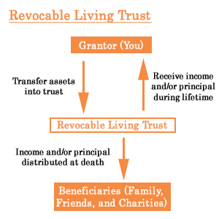

Slide 40
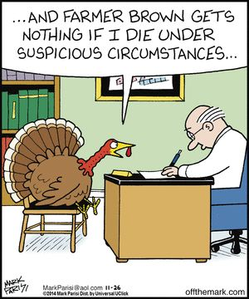

Slide 41
Distribution of Property at Death
Probate asset?
or
Non-probate asset?

Slide 42
Probate Assets
Probate assets pass in accordance with the decedent’s will or by the intestacy laws of the state in which the decedent lived. If there is not a will.
  House
  Tangible Personal Property
  Real Estate
  Jewelry
  Art
  Motor vehicle

Slide 43
Non-Probate Assets
Accounts held as “joint tenants with right of survivorship” or, “pay on death” accounts
Life insurance
Qualified retirement plans
Bank Accounts
Trusts
Community property survivorship agreements

Slide 44


Slide 45
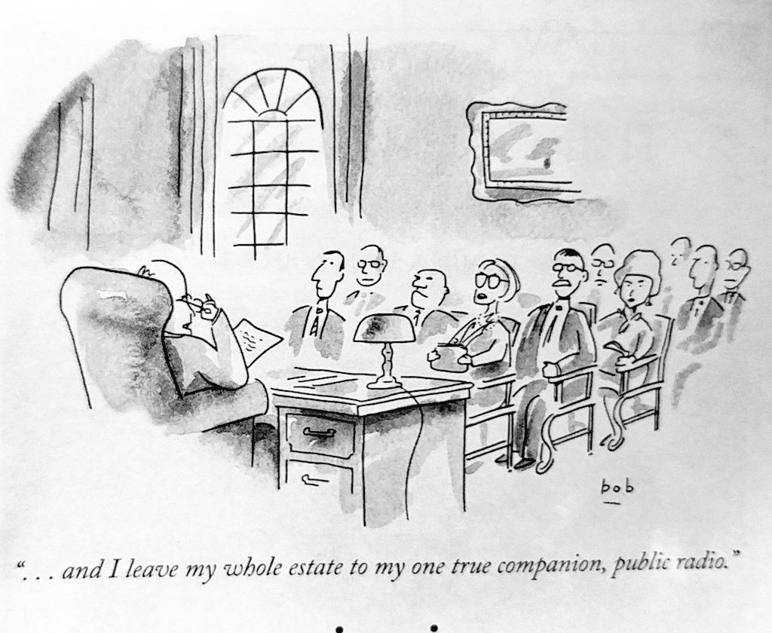

Slide 46
Beneficiary Designations

Slide 47
Beneficiary Designations
A beneficiary designation is the description of the person or persons you want to receive a specific asset upon your death.
  Examples:
  Bank accounts
  CDs
  Investments
  Retirement accounts
  Life insurance

Slide 48
Retirement plans
Retirement Plans include:
  IRAs
  401K and 403B plans
  Keogh (self-employed retirement accounts)
  Company Pension Plans
  Profit-Sharing Plans
  Traditional and Roth IRA
  After-Tax Personal Annuities

Slide 49
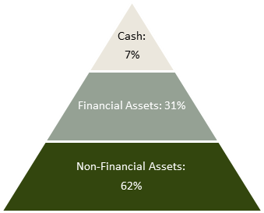
1/3 of assets in retirement accounts ($29.1 trillion)
25% of retirement assets is in IRAs
Baby Boomers
https://www.napa-net.org/news-info/daily-news/retirement-assets-top-29-trillion-while-plan-fees-continue-downward-trend
Source: Federal Reserve. Changes in U.S. Family Finances from 2007 to 2010 (2012) (latest data available); Financial Accounts of the United States (2014) (latest data available).

Slide 50
Retirement assets
Record number of Americans covered under such plans
A principal method of wealth creation for professionals
  Not unusual for balances to be 10 – 20 times annual salary at time of retirement
Changes in social structure lead to increased importance of these plans
  Two earner families
  Childless couples
  Singles

Slide 51
Retirement Assets
Distributions from retirement plans and IRAs are subject to income tax. In addition, special federal rules govern with withdrawal and taxation of distributions.
Currently you can:
  Withdraw your retirement assets, pay related income tax and give the remaining cash to charity
  Name a charity as a beneficiary of your retirement assets
  Use your retirement assets to posthumously fund a charitable trust

Slide 52
Qualified plans are often overlooked as a charitable gift resource
When to consider?
  If your estate has grown so it will provide sufficient retirement income through other investments, retirement funds may become a tax liability whether you draw on them for yourself or leave them to your heirs

Slide 53
Gift of Retirement Plans
Advantages:
  You receive an income tax charitable deduction for lifetime gifts
  Charity doesn’t pay income tax on retirement assets
  Individual beneficiaries benefit from estate tax charitable deduction
  Because of the stepped-up basis, individual beneficiaries can receive non retirement assets on which no income tax will be owed.

Slide 54
Gift of Retirement Plans
Disadvantages:
  Federal rules regarding withdrawal and taxation of retirement assets restrict timing of distributions
  You must ensure that you have sufficient future income before considering a charitable gift of retirement assets
  Tax Threats: Federal and state estate taxes and Income tax

Slide 55
Retirement Assets: Advantages of Charity as Beneficiary
You start with $100,000 IRA Assets and $100,000 Individual Securities (appreciated)
You Bequeath ½ of your estate to charity and ½ to an individual
If Charity and Individual Split Retirement Assets and Securities Charity Receives $ 50,000 (Appreciated Securities) + 50,000 (IRA) $100,000 Individual Receives $ 50,000 (Appreciated Securities) + 50,000 (IRA) $100,000 (Before tax) -$20,000 (After tax) $ 80,000 | If Charity Receives Retirement Assets and Individual Receives Securities Charity Receives $100,000 (IRA) Individual Receives $100,000 (Appreciated Securities) Tax Savings = $20,000

Slide 56
Charitable Gift of Retirement Funds
Make XYZ charity a co-beneficiary or sole beneficiary of your retirement account
Make a charitable remainder trust beneficiary of your retirement account
Name the charity as a percentage beneficiary in the retirement plan, i.e. 50% to my spouse and 50% to the XYZ Charity located at 123 Main Street, Fort Worth, TX 76102

Slide 57
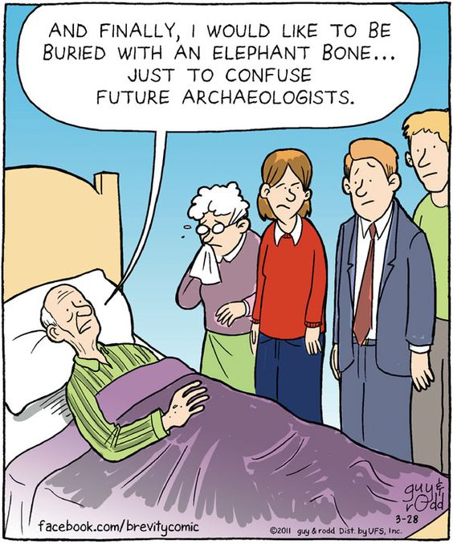

Slide 58
Gifts of Insurance

Slide 59
Terms
Insured – The individual or group covered by the contract of insurance.
Owner – Person/entity who has legal rights to the policy on the insured. That legal title gives them right to change some of the moving parts of the policy, including the beneficiary. In many cases, the owner and the insured are the same person.
Beneficiary – person/entity who gains an advantage and/or profits from something. A beneficiary typically refers to someone who is eligible to receive distributions the life insurance policy.
Insured Interest – Insurable interest exists when an insured person derives a financial or other kind of benefit from the continuous existence, without impairment or damage, of the insured object (or in the case of a person, their continued survival). A person/entity has an insurable interest in something when loss of or damage to that thing would cause the person/entity to suffer a financial or other kind of loss.
Beneficiary Designation – Person/entity named in a life insurance policy or retirement plan to receive the benefit upon the death of the insured. The beneficiary designation on file at the time of your death is binding in the payment of your benefits.
www.lifeinsure.com/education-center/life-insurance-glossary/

Slide 60
Term Life Insurance
Term insurance, such as coverage by a group policy through your employer, has no cash value, so assigning ownership would have no tax advantage
Term insurance can be used to guarantee the payment of a substantial pledge of gifts to a charity payable over a period of years, without potentially obligating the donor’s estate. The term life insurance policy on the donor can be reduced annually as installments are paid on the pledge, with the policy dropped when the gift is complete

Slide 61
Whole Life Insurance
A plan of insurance offering protection for the whole of life, proceeds being payable at death. Premiums may be paid under a continuous premium arrangement or on a limited payment basis for virtually any desired period of years.
Offers protection in case the insured dies and also builds up cash value
Stays in force for the lifetime of the insured, unless the policy is canceled or lapses
Earnings on the cash value in the policy accumulate tax-deferred and can be borrowed against in the form of a loan

Slide 62
Universal Life Insurance
Life insurance that combines the low-cost protection of term life insurance with a savings portion, which is invested in a tax-deferred account earning money market rates of interest.
The policy is flexible; that is, as age and income change, a policyholder can increase or decrease premium payments and coverage, or shift a certain portion of the premiums into the savings account.

Slide 63
A person can make a life insurance gift to charity in two ways:
Name the charity as a beneficiary, to receive the proceeds
Name the charity as owner and beneficiary of the policy

Slide 64
Name Charity as the Beneficiary
Benefits and features:
  Generally revocable - no income tax benefit for gift
  Qualifies for estate tax deduction
Can be outside probate process and thus received more quickly
Remember group life insurance policies

Slide 65
Use of Beneficiary Clause as a Revocable Gift Arrangement
If the donor would rather retain ownership of a policy as an asset for their own financial security or that of others.
Naming a charity as the only or partial primary beneficiary of the policy with the right to change the beneficiary clause as owner of the policy
Naming a charity as the contingent successor beneficiary, receiving the death benefits only if a named individual beneficiary predeceases you
Creating a separate trust named to receive death benefits, with trust terms providing first for financial support of one or more named individuals for specific terms of years or for life, after which the trust terminates and its assets pass to a charity
Naming a charity as the residual beneficiary of an annuity settlement option available under some policies.

Slide 66
Name Charity as Irrevocable Owner and Beneficiary of the Insurance Policy
Gift of a fully paid-up policy
Suggest gifts of policies which are no longer needed for reasons originally purchased
  Protection of children
  Protection of spouse
  Payment of taxes which will no longer be due.
Can be a very sizeable outright gift
Income tax deduction for replacement value of the policy
Deduction is for amount of premiums paid if less than value
Appraisal rules for non-cash property apply

Slide 67
Income Tax Deduction
An income tax deduction (and gift credit) is available only if the charity is named owner and beneficiary of the policy. This is the only way to be sure that the charity will actually receive the proceeds.
If the charity were simply named as beneficiary, the owner could decide later to change that designation and name another person or entity as the beneficiary.

Slide 68
Gift of New or Non-Paid-Up Policy
Immediate income tax deduction approximately equal to cash surrender value, if any.
Deductions for future premiums paid if charity has insurable interest under applicable state laws
Who handles the administration when charity owns numerous policies with numerous payment schedules?
Who works with donor, life insurance agent or development officer, when charity is notified that policy will lapse

Slide 69
Packaged Insurance Programs
Some charities promote packaged insurance programs built around one insurance company and a particular policy
  Donor makes series of gifts to charity
  Charity uses all or a portion of the gifts to purchase a life insurance policy on the life of the donor
  Charity is owner and beneficiary
  Illegal in a number of states including New York. Seek legal opinion on issue of insurable interest

Slide 70
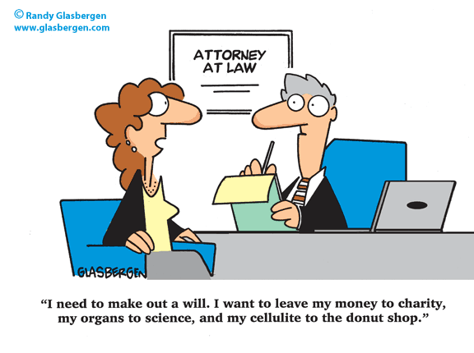

Slide 71
Charitable IRA Rollover
“Qualified Charitable Distribution”

Slide 72
IRA Charitable Rollover
Transfers from IRA directly to a public charity
“Qualified Charitable Distribution”
Requirements:
  Only IRAs qualify
  IRA owner at least age 70½
  Limit of $100,000 per year per taxpayer
  To a qualified public charity
  Direct transfer custodian/trustee to charity
The transfer qualifies for the required minimum distribution

Slide 73
Charitable IRA Rollover - History
The IRA Rollover was first enacted in 2006 as part of the Pension Protection Act
IRA Charitable Rollover is now a permanent law since December 2015, made so through the Protecting Americans from Tax Hikes Act of 2015
Tax-free distributions under section 408(d)(8) for charitable purposes
There is no special reporting of these distributions on Form 1099-R

Slide 74
Charitable IRA Rollover
The provision allows individuals aged 70½ and older to donate up to $100,000 from their Individual Retirement Accounts (IRAs) to public charities without having to count the distributions as taxable income.
For individuals who do not need more income, this withdrawal will count as part or all of the Required Minimum Distribution (RMD)

Slide 75
Charitable IRA Rollover
Both Traditional and Roth IRAs are the only plans acceptable for this provision. The donor and the IRA plan custodian must follow strict rules to ensure there is no taxable event:
  Donor must be at least 70 ½ and have an IRA (can roll a traditional retirement plan into an IRA first, then transfer)
  Donor contacts IRA Custodian in writing and asks for transfer DIRECTLY to the qualifying charitable organization under Sec. 170(b(1)(a), other than a private foundation or donor-advised fund
  The transaction must NOT include a quid pro quo of any kind (something in return) as a result of this transfer. Any gift or benefit will disqualify the transfer and it then becomes taxable to the donor!
  The transfer must be postmarked by Dec 31st of the year of the gift and the charity must receive the gift directly without it going to the donor first

Slide 76
Charitable IRA Rollover
Tax Benefits to the donor:
  Avoids the percentage limitation on charitable contributions – which limits donation of cash to 50% and appreciated assets to 30% of AGI. Thus a donor can effectively go past the limit without tax penalty
  At higher incomes, it won’t push the donor up into the Itemized Deduction & Personal Exemption phase-outs
  Helps those who use Standard Deduction to still get a tax break on the donation and won’t increase the amount of income subject to the tax on Social Security

Slide 77

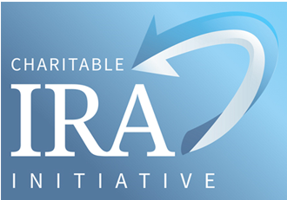
The mission of the Charitable IRA Initiative is to promote philanthropy through the use of personal IRA assets to fund outright and life income gifts by convincing Congress to enact permanent legislation authorizing the transfer of IRAs to charity.
www.charitableira.org

Slide 78
H.R. 1337 Legacy IRA Act
Amends the Internal Revenue Code to expand the tax exclusion for distributions from individual retirement accounts (IRAs) for charitable purposes
The bill increases from $100,000 to $400,000 the annual limit on the aggregate amount of distributions for charitable purposes that may be excluded from the gross income of a taxpayer
The bill permits tax-free distributions from IRAs to a split-interest entity until December 31, 2021. A split-interest entity is exclusively funded by charitable distributions and includes: a charitable remainder annuity trust, a charitable remainder unitrust, or a charitable gift annuity. A charitable gift annuity must commence fixed payments of at least 5% no later than one year from the date of funding
A distribution to a split-interest entity may only be treated as a qualified charitable distribution if: (1) no person holds an income interest in the entity other than the individual for whose benefit the account is maintained, the spouse of such individual, or both; and (2) the income interest in the entity is nonassignable
The bill limits the exclusion annually to: $100,000 for distributions to charitable organizations, and $400,000 for distributions to split-interest entities
Tax-free distributions to a split-interest entity may be made when the account beneficiary attains age 65. (Under current law, the beneficiary must attain the age of 70-1/2 for IRA distributions to a charitable organization.)

Slide 80
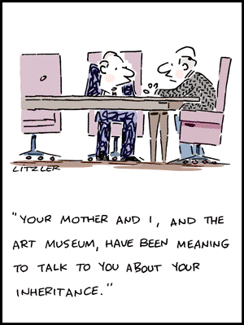

Slide 81
Glossary of Terms

Slide 82
Actuarial - As used in planned giving, refers to the factors used to calculate the value of lifetime payments based on the life expectancies of income beneficiaries or the term of years for a trust.
Adjusted Gross Income (AGI) - Your total gross income adjusted downward by specific deductions allowed by the tax code, before taking your standard or itemized deductions. AGI is the number you write at the bottom of page 1 of your 1040. Individuals may deduct charitable cash contributions up to 50% of AGI in any given tax year. For gifts of appreciated property the deductible limit is 30% of AGI in any given tax year.
Annuity - A contractual arrangement to pay a fixed sum of money to an individual at regular intervals. The charitable gift annuity is a gift that secures fixed lifetime payments to the benefactor and/or another individual.
Appraisal - A professional assessment of the value of a piece of property. Generally, benefactors contributing real or tangible personal property (books, collectibles, etc.) worth $5,000 or more must secure an independent appraisal of the property to substantiate the value they claim as a charitable deduction.
Appreciated Property - Securities, real estate, or any other property that has risen in value since the benefactor acquired it. Generally, appreciated property held by the donor for more than a year may be donated at full fair market value with no capital gains cost.

Slide 83
Basis - The benefactor’s purchase price for an asset, possibly adjusted to reflect subsequent costs or depreciation. If Mrs. Quinn bought stock for $100 per share and sold it for $175, her cost basis in the stock is $100 per share.
Beneficiary - The recipient of a bequest from a will or a distribution from a trust, retirement plan, or life insurance policy.
Bequest - A transfer of property or cash to an individual or organization under a will.
Capital Gains Tax - A federal tax on the appreciation in an asset between its purchase and sale prices.
Codicil - A document that amends, rather than replaces, a previously executed will. Amendments made by a codicil may add or revoke a few small provisions (e.g., changing executors), or may completely change the majority or all of the gifts under the will. Each codicil must conform to the same legal requirements as the original will, such as the signatures of the testator and, typically, two or three (depending on jurisdiction) disinterested witnesses.
Cost Basis - See Basis, above.

Slide 84
Endowment Fund - An invested fund owned by a charity from which the capital appreciation and/or income is used to support the general or specific objectives of that charity’s mission.
Estate Tax - A federal tax on the value of the property held by an individual at his or her death (paid by the individual estate, not the heirs or recipients of bequests). In contrast, state inheritance tax is applied to the value of bequests passing to beneficiaries; it is also paid by the estate before the distributions are made.
Executor - The person named in a will to administer the estate (known in some states as the “personal representative”).
Fair Market Value - The price that an asset would bring on the open market.

Slide 85
Grantor - The individual transferring property into a trust.
Income Interest - In a trust, the right to receive payments from the trust for the recipients lifetime or a term of years.
Inter Vivos Trust - A trust that is created by an individual while he or she is still living as opposed to a testamentary trust which is created by a will after someone’s passing.
Intestate - Dying without a legal current will or living trust.
K-1 (also 1099-R) - The IRS forms sent to life-income gift participants detailing how payments they received from their gifts during the year will be taxed.
Life Expectancy - A statistical measure of the average length of an individual’s life.
Life Income Gift - A planned gift that makes payments to the benefactor and/or other beneficiaries for life or a term of years, then distributes the remainder to charity.

Slide 86
Personal Property - Securities, artwork, business interests, and items of tangible property as opposed to “real property,” used in planned giving to refer to land and the structures built on it.
Personal Representative - See Executor, above.
Planned Giving - A method of supporting charities that enables generous individuals to make larger gifts than they could make from their income. While some planned gifts provide a lifelong income to the donor, others use estate and tax planning techniques to provide for charity and other heirs in ways that maximize the gift and/or minimize its impact on the donor’s estate.
Present Value - The value on a given date of a future payment or a series of future payments, discounted to reflect the time value of money based on various factors such as investment risk and inflation.
Probate - The review or testing of a will before a court (the Probate Court) to ensure that the will is authentic and the estate is distributed properly.

Slide 87
Remainder Interest - In a trust, the portion of the principal left after the income interest has been paid to the beneficiary(ies). A charitable remainder trust pays income to the benefactor or other individuals and then passes its remainder to charity.
Remainderman - A legal term for the individual or organization who receives the trust principal after the income interest has been satisfied.
Testamentary Trust - Refers to a trust that is created in a will after someone’s passing as opposed to a living or inter vivos trust, which is created by a living grantor.
Testator - The individual making the will.
Trust - A legal entity created by a written agreement by a grantor to hold and invest property for the benefit of the grantor and/or other beneficiaries.
Trustee - An individual or organization carrying out the wishes of the person who established the trust (the “grantor”), paying income to the beneficiaries and preserving the principal for ultimate distribution.

Slide 88
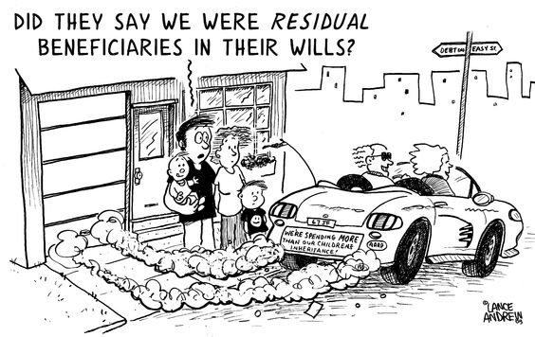

Slide 89



Cathy R. Sheffield, CAP®, CFRE, CSPG, FCEP
President, ThinkGiving
Cathy@ThinkGiving.com
817-371-0597
www.thinkGiving.com
Strategic Philanthropy for Nonprofits and Individuals

