Slide 1
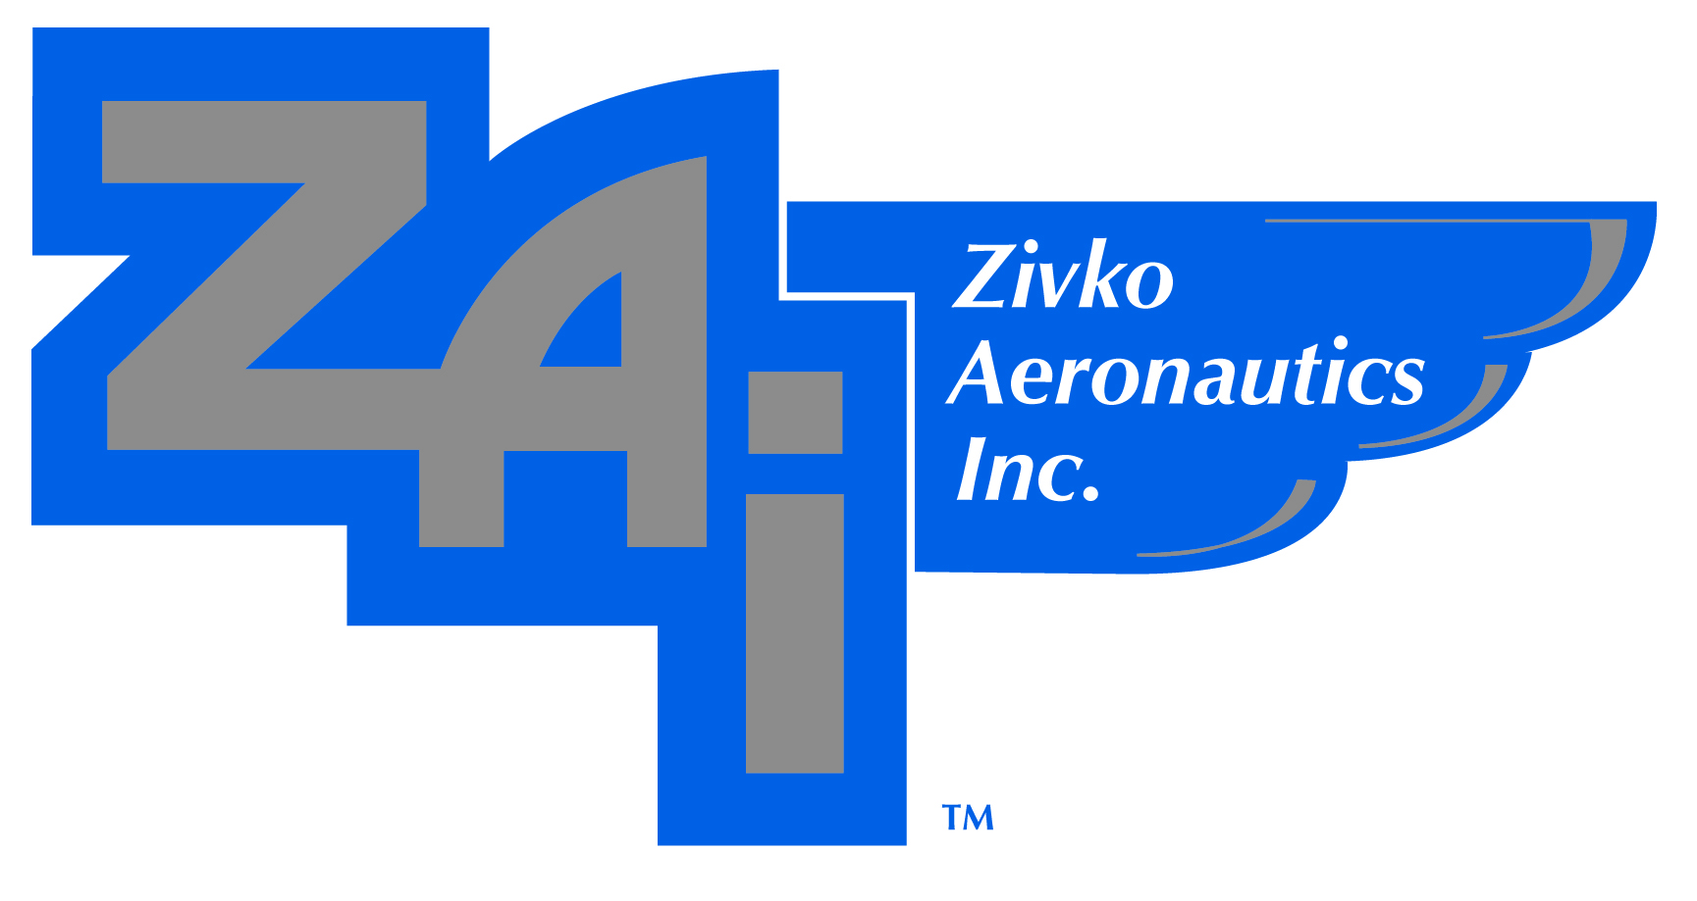
Supplier Anti-Human Trafficking
Requirements overview

Slide 2
Table of Contents
Introduction
FAR Requirements
Zivko Aeronautics Approach
Risk Factors
Industry Information
Due Diligence/Training Resources

Slide 3
Introduction
As a responsible corporate citizen, ZAI fully supports the elimination of human trafficking and slavery from the supply chain. Our policies, practices and procedures reflect our strong commitment to human rights.
Zivko Aeronautics, does not tolerate trafficking in persons, including the procurement of commercial sex acts, and the use of forced or child labor. We believe the transparent disclosure of our anti-human trafficking efforts is critical, and we report consistent with the requirements of current laws and regulations.
We have implemented comprehensive policies and procedures, including our company Code of Business Conduct and Ethics, which requires our employees and suppliers to comply with applicable law and behave in an ethical manner. We believe our standards help to mitigate the risk of human trafficking in our supply chain.
In addition, our standard procurement terms and conditions contain provisions requiring our suppliers to comply fully with all applicable laws and regulations, including explicit obligations regarding anti-human trafficking.

Slide 4
FAR Requirements
FAR Contract Clause 52.222-50 – Combating Trafficking in Persons
Applies to all procurement actions
Requires a compliance plan and annual certification (see conditions below)
FAR Contract Clause 52.222-56 – Certification Regarding Trafficking in Persons Compliance Plan
Applies to all procurement action (prior to award and annually thereafter)
Conditions: where a procurement, is for (i) supplies, other than commercially available off-the-shelf (COTS) items, to be acquired outside the United States, or services to be performed outside the United States; and (ii) has an estimated value that exceeds $550,000.

Slide 5
Contractor/Subcontractor Requirements
The Contractor shall maintain a compliance plan during the performance of the contract that is appropriate –
(i) to the size and complexity of the contract; and
(ii) to the nature and scope of the activities to be performed for the U.S. Government, including the number of non-United States citizens expected to be employed and the risk that the contract or subcontract will involve services or supplies susceptible to trafficking in persons.
The obligations cover the entire supply chain and are not limited to the Contractor. As such, Contractors need to ensure that all of their supplies and their extended supply chain similarly comply with the contractual obligations.

Slide 6
FAR Compliance Plan Elements
An awareness program to inform contractor employees about the Government’s policy prohibiting trafficking related activities describe in paragraph (b) of FAR Clause 52.222-50, the activities prohibited, and the action that will be taken against the employee for violations.
A process for employees to report, without fear of retaliation, activity inconsistent with the policy prohibiting trafficking in persons, including a means to make available to all employees the hotline plone number of the Global Human Trafficking Hotline at 1-844-888-FREE and its email address at help@befree.org.
A recruitment and wage plan that only permits the use of recruitment companies with trained employees, prohibits charging recruitment fees to the employee, and ensures that wages meet applicable legal requirements or explains any variance.

Slide 7
FAR Compliance Plan Elements (con’t)
A housing plan, if the Contractor or subcontractor intends to provide or arrange housing, that ensures that the housing meets hose-country housing and safety standards.
Procedures to prevent agents and subcontractors at any tier and at any dollar values from engaging in trafficking in persons (including activities in paragraph (b) of FAR Clause 52.222-50 and to monitor, detect, and terminate any agents, subcontracts, or subcontractor employees that have engaged in such activities.
The Contractor shall post the relevant contents of the compliance plan, no later than the initiation of contract performance, at the workplace (unless the work is to be performed in the field or not in a fixed location) and ton the Contractor’s Web site (if one is maintained) If posting at the workplace or on the Web site is impracticable, the Contractor shall provide the relevant contents of the compliance plan to each worker in writing.

Slide 8
Subcontractor Monitoring
The prime contractor’s monitoring efforts will vary based on
The risk of trafficking in persons related to the particular product or service being acquired and whether the contractor has direct access to a work site or not.
Where a prime contractor has direct access, the prime contractor would be expected to look for signs of trafficking in persons at the workplace, and if housing is provided, inspect the housing conditions.
For cases where the employees and subcontracts are distant, or for laower tier subcontractors, the prime contractor must review the plans and certifications of its subcontractors to ensure they include adequate monitoring procedures, and to compare this information to public audits and other trafficking in persons data available.

Slide 9
ZAI Approach and Guidance
ZAI’s Code of Business Conduct and Ethics
ZAI’s Combating Trafficking in Persons Policy
Supplier Profile/ZAI Annual Offeror Registration Data, Reps and Certs (Form 3001)
ZAI Combating Trafficking in Persons Due Diligence Rep and Cert (Form 311A)

Slide 10
ZAI’s Standard Terms and Conditions
Anti-Trafficking in Persons clause
Flow-down clause FAR 52.222-50 - Combating Trafficking in Persons
Flow-down clause FAR 52.222-56 – Certification Regarding Trafficking in Persons Compliance Plan (when applicable)

Slide 11
Global Supply Chain Due Diligence
Level of Risk determined by performing an evaluation of Supplier Information and Scope of Work:
Supplier responses to ZAI Form 1003, Reps and Certs
Specific country where work will be performed
Type of Work to be performed
Duration of the work to be performed
Almost all of ZAI’s supplies and services are manufactured or performed in the United States.

Slide 12
Risk Factors
Risks deriving from the Characteristics of the Product or Industry
Low-skilled labor and “Dirty, Dangerous, or Difficult work”
Seasonal or short product lifecycles
Highly competitive industries with low barrier to entry
Risks related to Business Processes Involved in Production and/or Supply of the Product
Offshore manufacturing
Reliance on labor recruiting
Long, complex, or non-transparent supply chains
Risks related to the Characteristics of the Workforce involved
Poor, vulnerable, low-skilled workers
Migrant workers

Slide 13
Risk Factors (con’t)
Political Risk Factors in the Country of Production
Weak legal protection for civil liberties and workers’ rights
Widespread corruption
High level of crime and violence
State persecution
Political instability or conflict
Socio-Economic Risk Factors in the Country of Production
Level of national economic development
High degree of gender inequality
Use of “Export Processing Zones” (EPZs) (or Free Trade Zones/Industrial Free Zones)

Slide 14
Risk Factors (con’t)
Policy-Related Risk Factors in the Country of Production
Immigration policies limiting the employment options or movement of migrants
Lack of (or weak) bilateral agreements with migrant-sending countries
Failure to ratify International Labor Organization (ILO) conventions related to human trafficking or rights or workers and migrants.
Environmental Factors in the Country of Production
Post-natural disaster

Slide 15
Industries with Significant Risk of Human Trafficking
Agriculture
Housekeeping/Facilities Operation
Textile and Apparel Manufacturing
Transportation and Warehousing
Construction
Electronics and Electrical Products Manufacturing
Mining and Basic Metal Production
Forestry
Healthcare
Hospitality
Fishing and Aquaculture

Slide 16
Due Diligence Resources
Responsible Sourcing Tool: https://www.responsiblesourcingtool.org/
Business & Human Resource Center: http://www.business-humanrights.org/en
Corporate Register: http://www.corporateregister.com/
Ethical Trading Initiative: http://ethicaltrade.org/
Fair Labor Association: http://www.fairlabor.org/
Global Reporting Initiative: http://www.globalreporting.org/
Social Accountability International: https://www.sa-intl.org/

Slide 17
Training Resources
State Department Human Trafficking Resources and Training
https://www.state.gov/j/tip/
U.S. Department of Labor, Reducing Child Labor and Forced Labor Toolkit
https://www.dol.gov/ilab/complychain/
U.S. Agency for International Development, Countering Trafficking in Persons
https://www.usaid.gov/trafficking

