Slide 1
SNOWBALL Exit Ticket
Get Ready to Throw!

Slide 2
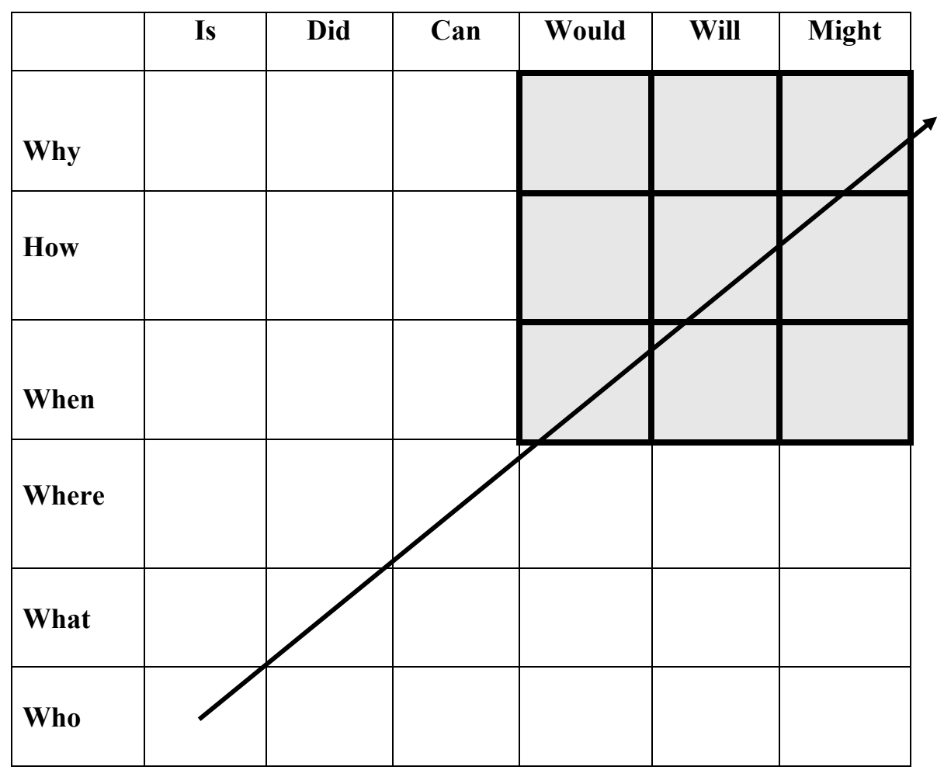
Writing Effective Questions
The simplest questions are in the lower left, like “Who is…?” (e.g., “Who is the main character?”).
As questions become more complex, they move up and to the right. The most complex questions are in the upper right, such as “How might…?”
Examples:
“How might Jesse have felt when Leslie gave him the paint set?” (Bridge to Terabithia)
“Why will the society return to books?”

Slide 3
Steps of Snowball Exit Ticket
On Your Mark
Get Clever
01
04
Think about what you learned today.
(What was the main idea?)
Make your question make someone think (not yes/no).
Get Ready
Get Set
02
05
Pick one important idea.
(Don’t try to ask about everything—just one thing.)
Check it:
Is it clear?
Does it match today’s lesson?
Get Creative
GO!
03
06
Start your question with a strong word:
Easy: Who, What, When, Where
Better: Why, How
When I say “go” throw the “snowballs” around the room.

Slide 4
Snowball Steps
STOP!
Turn In
Answer
Check
Pick Up the Snowball Closest to you.
Turn in your Snowball Quiz
Open it up and answer it.
Find who wrote it and check your answer.

Slide 5
Ready? Set? Go!
Crumble Your Ball
Throw Balls Until Time Runs Out!

