Slide 1
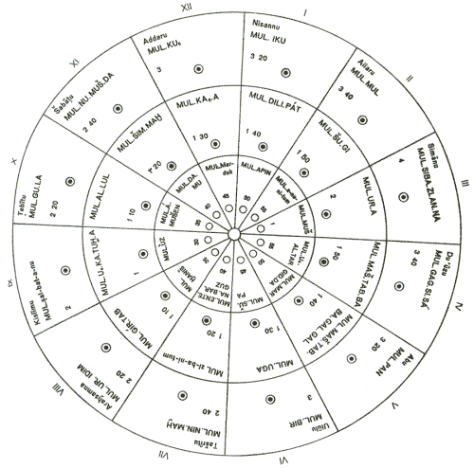
According to the Babylon Talmud Yisrael returned in 350 BCE Back to Yerushalayim with this Pagan Babylon Calendar as is Today. HaYom!

Slide 2
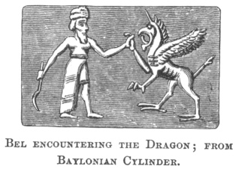
Jewish Civil Pagan Babylon Calendar or The Calendar of Torah
1st month-chodesh Nisan or Nisanu is Bel-Ba’al
The Chief 1st deity of Babylon worshiped on their first month of the year. Bel-Ba’al Nisanu

Slide 3
NISAN -Bel The first week of this month was the Babylonian New Year’s celebration. This is speculation or facts! but it seems likely that this is where the idea of Nisan as the beginning of the year comes from. Pre-Babylonian exile, the months of the Jewish year were numbered rather than named, and the numbering started in the spring. Yet now Nisan is called the new year for the months, and Tishrei in the new year for the year. In the Babylonian calendar, Nisan is the beginning of the year and of the first half-year, and Tishrei was that beginning of the second half-year. That these months are both considered new years in the Jewish calendar is too much of a coincidence. Bel, known as Baal in Israel, is one of the 5 Ba’al deities names which it means “lord” and refers to Marduk, first amongst the deities in the Babylonian Calendar , and later Persian, pantheon. Bel Marduk has the distinction of being both the most vilified deity in TaNaK.

Slide 4
Nisan-Bel-Ba’al
Correction –In Hebrew Ri’shown or Ha’Rishon Chodesh, 6 X in scriptures as AVIV or ABIB Chodesh found in Exo 13:4 “Today you are going out, in the month Aḇiḇ. Also in these verses. Abib H24
Ex.Shemoth 23:15; 34:18; &
Deut.Debarim 16:1;

Slide 5
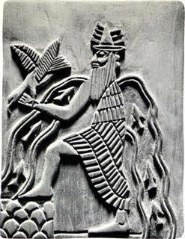
2ed month
Iyar Babylonian: Āru / Ayaru - Bull or Herd, Prosperity. Presided over by Ea, the Babylonian name for the (earlier) Sumerian deity Enki, the deity of life. Originally the deity of water, Enki is often depicted with the Tigris and Euphrates rivers flowing from his shoulders.

Slide 6
Iyar 2ed month
In 1 Kings Melakim Aleph 6:1 & verse 37
Says the month of ZIU-ZIV-ZIF –zeev H2099
Month of flowers or brightness . But even though this is in the scriptures only twice it is questionable of it having a deity meaning also.
But there is no evidence .
Correction 2ed (month-chodesh) is Sheniy= H8145 Sheniy- meaning a 2ed part.
Ha Sheniy Chodesh

Slide 7
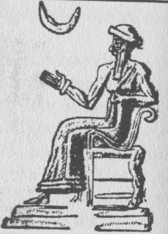
3rd Month Sivan-Simanu Babylonian: Simanu - Brick-making. Presided over by Sin, the deity of the moon, after the conflation of the Semitic deity Sin with the Sumerian deity Nanna. Interestingly, the main centers of Sin worship were Ur and Haran, both cities which figure prominently in Avraham’s story: the first as his birthplace and the second as his long-time adopted home.

Slide 8
3rd Month Sivan
Found in the book of Esther 8:8-9; But remember this was written During the Babylon Captivity . Which verse 9 reveals that it was the Babylon Sovereign’s Scribes called
It The 3rd month “Sivan” after their Pagan Babylonian Calendar!
Corrections; H7969 Sh’liyshiy-She’lee’shee Chodesh =meaning 3rd part

Slide 9
4th month Tammuz Babylonian: Dumuzu – Babylonian name of the deity known in Hebrew as Tammuz. This month to share its name with a deity. Originally the deity of vegetation and later of the sun, Tammuz must spend six months a year in the underworld, a mythical explanation for winter. According to the myth, his wife, Inanna, descended to the underworld to visit her sister, Ereshkigal. Once there, Inanna sat on her sister’s throne, and immediately became a corpse. To return to the world of the living, Inanna had to find someone to take her place in the underworld. Tammuz agreed to exchange himself for her, but had second thoughts and was hidden by his sister, Geshtinana. Demons were sent to find him and drag him to the underworld. Eventually an arrangement was agreed to where Tammuz and Geshtinana each spend six months in the underworld.

Slide 10
The 4th month of Tammuz,
--during which the summer solstice fell and the days began to get shorter, marked Tammuz’s annual death and descent to the underworld. It was a time of ritualistic mourning in the ANE. Tammuz’s annual funeral was a week-long Babylonian holiday. According to Chazal, the name Tammuz was kept despite being the name of a pagan deity deliberately to remind us of the bad things that happen as a result of avoda zara – as attested to by the breach of Yerushalayim’s walls on the 9th of Tammuz, the disruption of the avoda in the Beis HaMikdash on the 17th, and the annual “three weeks” period, starting on sheva assur b’Tammuz, during which we observe mourning rituals and there is supposedly an increased danger of bad things happening.

Slide 11
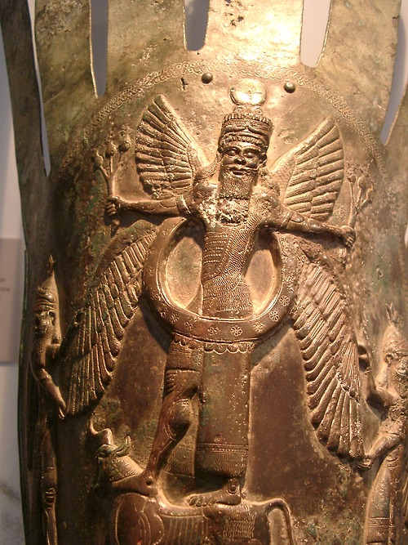
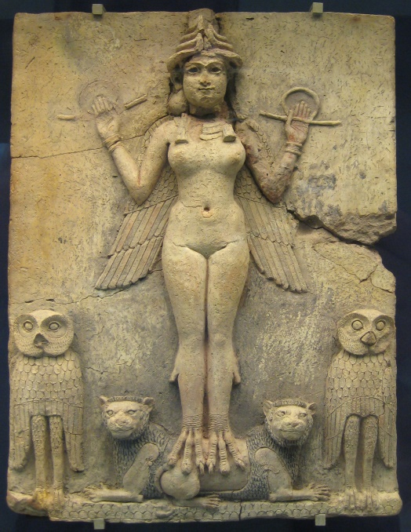
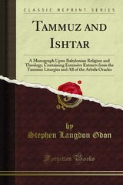
4th Month Tammuz
There is no reason to make up Rabbinical Babylon Talmud stories to try and make this pagan tradition Jewish and apart of their Calendar. Is it a coincidence, though, that there was a widespread tradition of mourning during Tammuz, and that the Jewish people just happen to have their own, independent reason for mourning at the exact same time? Or is it more likely that we today are observing during sheva assur b’Tammuz and the three weeks the last vestiges of the ancient mourning rites for the annual death of Tammuz?

Slide 12
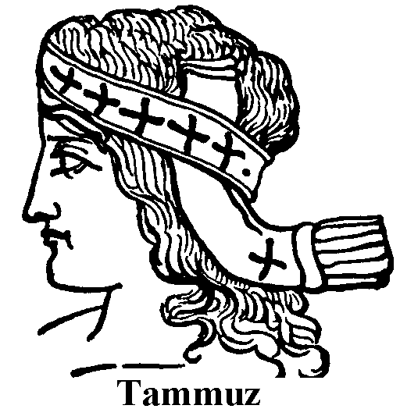
4th Month Tammuz
Corrections H7243 Rebiyiy Rebee’ee Chodesh. Meaning a 4th part
The Babylon Talmud calls this month, Omer is it in scripture as a month NO! Omer is 5X in scriptures as Exo 16:36 And an omer is one-tenth of an ĕphah. A measurement ! Is it Bad, No!

Slide 13
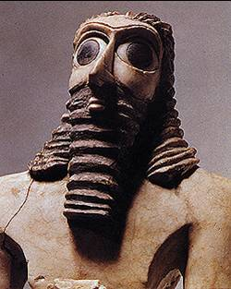
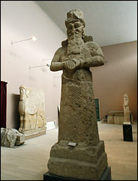
5th Month called Av-Ab-Abu Babylonian: Abu – Fire, a deity of FIRE ABU
Correction; H2549 Chamiy’shiy Chodesh
Meaning 5th Part

Slide 14
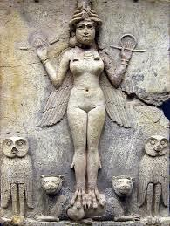
6th Month Elul -“El’lul”
Was originally “Ululu” in Babylonian and “Elulu” in Akkadian. It comes from a root meaning “harvest” and also refers to the “mission” of the reigning deity of the month, Ishtar. Ishtar was the Babylonian fertility goddess, and shared a similar-sounding name and near-identical story and powers with the Egyptian goddess Isis and the Semitic Astarte. So, using "Ellul" as a the basis for creating divrei Torah directly from the name of a Mesopotamian Deity , but certainly it is a word that has nothing to do with repentance and closeness to Yah. “Ellul” is at best a straightforward name for the time of year – “harvest time” – and is at worst a reference to the role the Babylonian fertility goddess was believed to play in the annual agrarian cycle for this Harvest time. Also known as Esther.

Slide 15
6th Month El’ul
Found in the book of Nehemyah 6:15; but keep in mind these scribes
Are the returnee's to Yisrael from Babylon and only one time in
The whole scriptures TaNaK H435-'ĕlûl el-ool‘ of a foreign derivation; Elul, the sixth Jewish month:
Corrections; Shish’shee Chodesh meaning 6th part

Slide 16
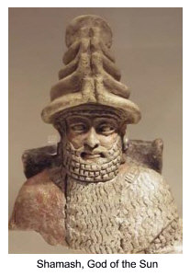
7th Month Tishrei- Babylonian-Tashritu Babylonian: Tashritu – Beginning. The beginning of the second half-year of the Babylonian calendar. Presided over by Shamash, the Mesopotamian deity of the sun and the likely origin of the Hebrew word “shemesh.” But-
Found in 1 Kings Melakim Bet 8:2; as the 7th month called Eythanim H388 a “Permanent Brooks” seems to be a clean word in scriptures for the 7th month. 1x only. Corrections; H7637-Shebiy’iy-sheb ee’ee- Chodesh meaning
a 7th part.

Slide 17
8th Month Cheshevan -Marcheshvan Babylonian: Arachsamna - Eighth month. Presided over by Marduk, here going by his name rather than his title.
Corrections
Found in scripture only as in Zach. Zakaryah 1:1, as H8066-
Shem’iy-niy-shem-ee-nee Chodesh –meaning
8th part of the year.

Slide 18
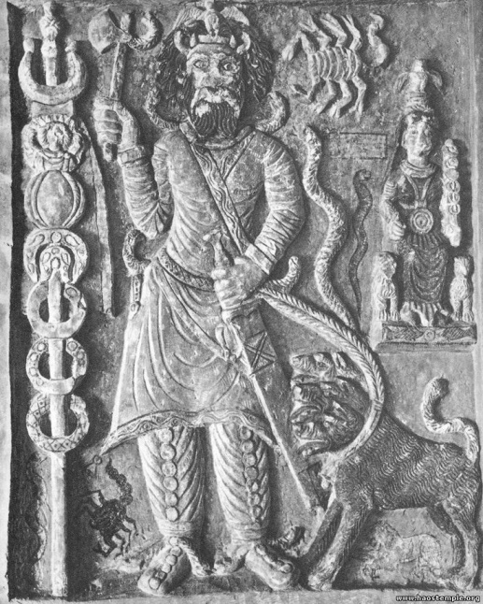
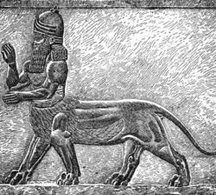
9th month –Kislev a Babylon deity Kishlimu
Babylonian: Kislimu (meaning uncertain). Presided over by Nergal, a deity of the sun as it appears during specific times of day and of the year this is a war deity. Corrections are
Found in Scriptures only as in Jere. Yirmeyahu 36:9, H8671 Teshiy’iy -
Tesh-ee-ee Chodesh,
meaning the 9th part of the year.

Slide 19
10th Month Tevet- Babylonian: Tebetu – Violent rain. Presided over by Papsukkal, the messenger deity >>
As we see in scriptures found in Gen.
Bereshith 8:5, H6224 it was always called
Asiy’riy-As-ee-ree Chodesh
meaning a 10th part of the year.

Slide 20
11th Month Shevat Babylonian: Shabatu – Rain.
H7627 שׁבט sh^{e}bâṭ sheb-awt‘ Of foreign origin not originally Hebrew ; Shebat, a Jewish month: called Sebat. Found 1 time at Zacharyah 1:7, mentioning the Babylon sovereign Darius as a their Babylon Calendar 11th month. But in the
Torah of Moshah only uses Deut. Debarim 1:3, H6249
Ashtey-Ash-tay Chodesh
meaning the 11th part.

Slide 21
12th Month Adar
Babylonian: Adaru – Threshing time. Presided over by Erra, an Akkadian plague deity, also responsible for political confusion (perhaps like that found in the Purim story?). Children sacrifice also.
Atar ninib Adar is found 10 X scriptures 8x in the book of Esther 3:7; alone which Is recorded during the time of Yisrael’s captivity in Babylon .
H143 'ădâr ad-awr‘ Of foreign derivation; perhaps meaning fire; Adar, the 12 th Babylonian month: - Adar.
H8147 is Shenayim Shen-ah-yim or Shet-tah-yim Chodesh
Meaning the twelfth part

Slide 22
The 12 Months-Chodesh in Scriptures;
1.Aviv or Abib is Ha Rishon Chodesh .
2. Zif or Ziu is Ha sheniy Chodesh.
3. Ha She’lee’shee Chodesh.
4. Omer is Ha Rebiy’iy -Rebee-ee Chodesh
5. Ha Cham’iy shiy Chodesh
6. Ha Shish’shee Chodesh
7. Eythanim is Ha Sheb’iy’iy Chodesh
Ha Shem’iy’niy –shem-ee-nee Chodesh
HaTesh’iy’iy-Tesh-ee-ee Chodesh
Ha Asiy’riy-As-ee-ree Chodesh.
Ha Ashtey – Ash-tay Chodesh.
12. Ha Shan-ah-yim-or shet-tah-yim Chodesh

