Slide 1
Pro 30:4 Who hath ascended up into heaven, or descended? who hath gathered the wind in his fists? who hath bound the waters in a garment? who hath established all the ends of the earth? what is his Name, and what is his son's Name, if thou canst tell?
Pro 30:5 Every word of Yah is pure: he is a shield unto them that put their trust in him.
Pro 30:6 Add you not unto his words, lest he reprove you, and you be found a liar.
KJV

Slide 2
Exo 3:14 And Yah said unto Moses, I AM THAT I AM: and he said, Thus shalt thou say unto the children of Israel, I AM hath sent me unto you.
Exo 3:15 And Yah said moreover unto Moses, Thus shalt thou say unto the children of Israel, YHUH Yah of your fathers, the Yah of Abraham, the Yah of Isaac, and the Yah of Jacob, hath sent me unto you: this is my Name for ever, and this is my memorial unto all generations.

Slide 3
Exo 3:14 And God^{H430} said^{H559} unto^{H413} Moses,^{H4872} I AM^{H1961} THAT^{H834} I AM^{H1961}
^{EH-YAH ASHER EH-YAH}
Exo 9:16 And in very deed for this cause have I raised thee up, for to shew in thee my power; and that my Name may be declared throughout all the earth. KJV-+

Slide 4
Exo 34:5 And יהוה came down in the cloud and stood with him there, and proclaimed the Name, יהוה.
Exo 34:6 And יהוה passed before him and proclaimed, “יהוה, יהוה, an Ěl compassionate and showing favour, patient, and great in kindness and truth,
{Hebrew Manuscripts}

Slide 5
Isa 7:14 “Therefore יהוה Himself gives you a sign: Look, the maiden conceives and gives birth to a Son, and shall call His Name Immanu’ĕl¹.H6005 Footnote: Ěl with us. See also Matt. 1:23. Immanu’el
Elohiym with us.

Slide 6
Isa 8:8 And he shall pass^{H2498} through Judah;^{H3063} he shall overflow^{H7857} and go over,^{H5674} he shall reach^{H5060} even to^{H5704} the neck;^{H6677} and the stretching out^{H4298} of his wings^{H3671} shall fill^{H4393} the breadth^{H7341} of thy land,^{H776} O Immanuel.^{H6005}
KJV+

Slide 7
Mat 1:23 Behold, a virgin shall be with child, and shall bring forth a son, and they shall call his name Emmanuel, which being interpreted is, G-d with us. {KJV}
G1694 Emmanou’el /Heb.origin H6005
Mat 1:23 “See, a maiden shall conceive, and she shall give birth to a Son, and they shall call His Name Immanu’ĕl,” which translated, means, “Ěl with us.” [ Manuscripts Hebrew]

Slide 8
Luk 1:31 And, behold, thou shalt conceive in thy womb, and bring forth a son, and shalt call his name JESUS.kj
G2424 Iesous Hebrew origin H3091
Jehoshua-Yahushua the Name of our Saviour and two other Yisraelites.
Luk 1:31 “And see, you shall conceive in your womb, and shall give birth to a Son, and call His Name יהושע.¹ Footnote: ¹Mt. 1:21.

Slide 9
Joh 17:6 I have manifested thy Name unto the men which thou gavest me out of the world: thine they were, and thou gavest them me; and they have kept thy word.
Joh 17:11 And now I am no more in the world, but these are in the world, and I come to thee. Holy Father, keep through thine own Name those whom thou hast given me, that they may be one, as we are.
Joh 17:12 While I was with them in the world, I kept them in thy Name: those that thou gavest me I have kept, and none of them is lost, but the son of perdition; that the scripture might be fulfilled. KJV

Slide 10
Joh 17:26 And I have declared unto them thy name, and will declare it: that the love wherewith thou hast loved me may be in them, and I in them. KJV
Act 3:16 And his Name through faith in his Name hath made this man strong, whom you see and know: yea, the faith which is by him hath given him this perfect soundness in the presence of you all. KJV

Slide 11
Act 4:7 And when they had set them in the midst, they asked, By what power, or by what Name, have you done this?
Act 4:12 Neither is there salvation in any other: for there is none other Name under heaven given among men, whereby we must be saved.
Eph 1:21 Far above all principality, and power, and might, and dominion, and every Name that is named, not only in this world, but also in that which is to come: KJV

Slide 12
Php 2:9 Wherefore God also hath highly exalted him, and given him a Name which is above every Name:
Php 2:10 That at the Name of Jesus every knee should bow, of things in heaven, and things in earth, and things under the earth; KJV
Php 2:9 Elohim, therefore, has highly exalted Him and given Him the Name which is above every name, { YAHushua}
Php 2:10 that at the Name of יהושע every knee should bow, of those in Shamayim,and of those on earth, and of those under the earth, HebV

Slide 13
Php 2:11 And that every tongue should confess that [Jesus Christ is Lord,] to the glory of God the Father. KJV
Php 2:11 and every tongue should confess that יהושע Messiah is Master, to the esteem of Elohim the Father. HebV
Php 2:12 Wherefore, my beloved, as you have always obeyed, not as in my presence only, but now much more in my absence, work out your own salvation with fear and trembling.
KJV

Slide 14
Act 22:1 Men, brethren, and fathers, hear ye my defence which I make now unto you.
Act 22:2 (And when they heard that he spake in the Hebrew tongue to them, they kept the more silence: and he said,)
Act 22:3 I am verily a man which am a Jew, born in Tarsus, a city in Cilicia, yet brought up in this city at the feet of Gamaliel, and taught according to the perfect manner of the law of the fathers, and was zealous toward G-d, as you all are this day. KJV

Slide 15
Act 22:7 and I fell to the ground and heard a voice saying to me, ‘Sha’ul, Sha’ul, why do you persecute Me?’
Act 22:8 “And I answered, ‘Who are You, Master?’ And He said to me, ‘I am יהושע {Yahushua} Nazoraean, whom you persecute.’
HebV

Slide 16
YeHoshua/Yohushah/Yahushua but by the year 117-138ACE the Greco Roman created the Name as YH-Zeus merging the popular first century Egyption g-d,Serapis,Osiris, and Apis. And eventually Iesous,Iesus ee-ay-SUS or ee-ah-ZOOS and now with the letter Jj latin letter making it’s way into the greek name iesus.

Slide 17
Jer 16:19 O YHWH, my strength, and my fortress, and my refuge in the day of affliction, the Gentiles shall come unto thee from the ends of the earth, and shall say, Surely our fathers have inherited lies, vanity, and things wherein there is no profit.
Jer 16:20 Shall a man make g-ds unto himself, and they are no g-ds?
Jer 16:21 Therefore, behold, I will this once cause them to know, I will cause them to know mine hand and my might; and they shall know that my name is The YHWH. KJV

Slide 18
Jer 16:19 O יהוה, my strength and my stronghold and my refuge, in the day of distress the gentiles shall come to You from the ends of the earth and say, “Our fathers have inherited only falsehood, futility, and there is no value in them.”¹ Footnote: ¹See Ps. 147:19, Isa. 2:3, Isa. 60:2-3, John 4:22, Rom. 2:20, Rom. 3:2, Rom. 9:4.
Jer 16:20 Would a man make mighty ones for himself, which are not mighty ones?
Jer 16:21 “Therefore see, I am causing them to know, this time I cause them to know My hand and My might. And they shall know that My Name is יהוה!”
HEBV

Slide 19
.
Jer 23:26 “Till when shall it be in the heart of the prophets? – the prophets of falsehood and prophets of the deceit of their own heart,
Jer 23:27 who try to make My people forget My Name by their dreams which everyone relates to his neighbour, as their fathers forgot My Name for Baʽal (Lord) HEBV
Jer 12:15 “And it shall be, after My plucking them out, I shall return, and have compassion on them and bring them back, everyone to his inheritance and everyone to his land.
Jer 12:16 “And it shall be, if they learn well the ways of My people, to swear by My Name, ‘As יהוה lives,’ as they taught My people to swear by Baʽal,(Lord) then they shall be established in the midst of My people.
Jer 12:17 “But if they do not obey, I shall pluck up, pluck up and destroy that nation,” declares יהוה. KJV

Slide 20
Amo 5:26 But ye have borne the tabernacle of your Moloch and Chiun your images, the star of your god, which ye made to yourselves.
Amo 5:27 Therefore will I cause you to go into captivity beyond Damascus, saith the YHWH, whose name is The G-d of hosts. KJV
Amo 5:26 But you took up Sikkuth your sovereign and Kiyyun, your idols, your astral mighty ones¹, which you made for yourselves! Footnote: ¹Acts 7:43.
Amo 5:27 “Therefore I shall send you into exile beyond Damascus,” said יהוה Elohim of hosts – His Name. HEB,V

Slide 21
Amo 6:10 And a man's uncle shall take him up, and he that burneth him, to bring out the bones out of the house, and shall say unto him that is by the sides of the house, Is there yet any with thee? and he shall say, No. Then shall he say, Hold thy tongue: for we may not make mention of the Name of the YHWH.
KJV
Amo 6:10 And if a relative, or his undertaker, brings the remains out of the house, he shall say to one inside the house, “Is anyone with you?” and he says, “No,” then he shall say, “Hush!” For we have not remembered the Name of יהוה!
HEBV

Slide 22
Eze 36:20 “And when they came to the gentiles, wherever they went, they profaned My set-apart Name for it was said of them, ‘These are the people of יהוה, and yet they have gone out of His land.’
Eze 36:21 “But I had compassion on My set-apart Name, which the house of Yisra’ĕl had profaned among the gentiles wherever they went.
Eze 36:22 “Therefore say to the house of Yisra’ĕl, ‘Thus said the Master יהוה, “I do not do this for your sake, O house of Yisra’ĕl, but for My set-apart Name’s sake, which you have profaned among the gentiles wherever you went.
Eze 36:23 “And I shall set apart My great Name, which has been profaned among the gentiles, which you have profaned in their midst. And the gentiles shall know that I am יהוה,” declares the Master יהוה, “when I am set-apart in you before their eyes.
Eze 36:24 “And I shall take you from among the gentiles, and I shall gather you out of all lands, and I shall bring you into your own land.

Slide 23
Jer 44:25 “Thus spoke יהוה of hosts, the Elohim of Yisra’ĕl, saying, ‘You and your wives have spoken with your mouths, and have filled with your hands, saying, “We shall perform our vows that we have made, to burn incense to the sovereigness of the heavens and pour out drink offerings to her.” Then confirm your vows and perform your vows!’
Jer 44:26 “Therefore hear the word of יהוה, all Yehuḏah who are dwelling in the land of Mitsrayim, ‘See, I have sworn by My great Name,’ declares יהוה, ‘My Name shall no longer be called upon by the mouth of any man of Yehuḏah in all the land of Mitsrayim, saying, “As the Master יהוה lives...”

Slide 24
Mic 4:5 For all the peoples walk, each one in the name of his mighty one,{God} but we walk in the Name of יהוה our Alohiym forever and ever¹. Footnote: ¹Zech. 10:12.
Zec 10:12 “And I shall make them mighty in יהוה, so that they walk up and down in His Name,” declares יהוה.

Slide 25
1Ki 18:20 Aḥaḇ then sent for all the children of Yisra’ĕl, and gathered the prophets on Mount Karmel.
1Ki 18:21 And Ěliyahu came to all the people, and said, “How long would you keep hopping between two opinions? If יהוה is Aloahym, follow Him; and if Baʽal,{lord} follow him.” But the people answered him not a word.
Exo 23:13 “And in all that I have said to you take heed. And make no mention of the name of other mighty ones, let it not be heard from your mouth.
Jos 23:7 so as not to go in among these nations, these who remain among you. And make no mention of the name of their mighty ones¹, a nor swear by them, nor serve them nor bow down to them. Footnote: ¹See Exo 23:13.

Slide 26
Orthodox Jewish Translation
Jos 23:6 Therefore chazak! Be very courageous to be shomer and to do all that is written in the Sefer Torah Moshe, that ye turn not aside therefrom to the right or to the left;
Jos 23:7 That you come not among these Goyim, these that remain among you; neither make mention of the shem-name of (their) eloheihem, nor have to swear by them, neither serve them, nor bow down unto them;

Slide 27
The name (הושׁע, hōshēª‛ Septuagint ̓Ωσηέ, Ōsēé; for other forms see note in DB), probably meaning “help,” seems to have been not uncommon, being derived from the auspicious verb from which we have the frequently recurring word “salvation.” It may be a contraction of a larger form of which the Divine name or its abbreviation formed a part, so as to signify “Yah is help,” or “Help”,Yah.” according to Num_13:8, Num_13:16 that was the original name of Joshua son of Nun, till Moses gave him the longer name (compounded with the name Hb#3068 Yahweh)which he continued to bear(יהושׁע, y^{e}hōshuª’Hb3091,“Yahweh is salvation.”The last king of the Northern Kingdom was also named Hosea (2Ki_15:30), and we find the same name borne by a chief of the tribe of Ephraim under David (1Ch_27:20) and by a chief under Nehemiah (Neh_10:23). ISBEncyclopedia
HOSHEA Heb.#1954

Slide 28
Luk 1:31 And,^{G2532} behold,^{G2400} thou shalt conceive^{G4815} in^{G1722} thy womb,^{G1064} and^{G2532} bring forth^{G5088} a son,^{G5207} and^{G2532} shalt call^{G2564} his^{G846} name^{G3686} JESUS.G2424 KJV+w Strong’s Numbers ^{Inoous, Iesous ee-ay-sooce’}
Jesus jē´zus (Ἰησοῦς, Iēsoús, for יהושׁע, y^{e}hōshuª‛):
Jehoshua/Joshua/origen H.3091 Yehoshua roots of=H3068-long YHWH/ short , of H3050-YAHH+Hoshea-H1954=H3091
Dictionary; International Standard Bible Encyclopedia.

Slide 29
H3091
יהושׁע יהושׁוּע
y^{e}hôshûa‛ y^{e}hôshûa‛
yeh-ho-shoo'-ah, yeh-ho-shoo'-ah
From H3068 and H3467; YHWH-YHUH-saved; Jehoshua (that is, Joshua), the Jewish leader: - Jehoshua, Jehoshuah, Joshua. Compare H1954, H3442.

Slide 30
G2424
Ἰησοῦs Iesous ̄see-ay-sooce'
Of Hebrew origin [H3091]; Jesus (that is, Yehoshua), the name of our Master and two (three) other Israelites: - Joshua .
Luk 2:21 And^{G2532} when^{G3753} eight^{G3638} days^{G2250} were accomplished^{G4130} for the circumcising^{G4059} of the^{G3588} child,^{G3813(G2532)} his^{G846} name^{G3686} was called^{G2564} JESUS,^{G2424} which was so named^{G2564} of^{G5259} the^{G3588} angel^{G32} before^{G4253} he^{G846} was conceived^{G4815} in^{G1722} the^{G3588} womb.^{G2836}

Slide 31
Mat 1:21 And^{G1161} she shall bring forth^{G5088} a son,^{G5207} and^{G2532} thou shalt call^{G2564} his^{G846} name^{G3686} JESUS:^{G2424} for^{G1063} he^{G846} shall save^{G4982} his^{G848} people^{G2992} from^{G575} their^{G846} sins.^{G266}
Mat 1:22 Now^{G1161} all^{G3650} this^{G5124} was done,^{G1096} that^{G2443} it might be fulfilled^{G4137} which^{G3588} was spoken^{G4483} of^{G5259} the^{G3588} Lord^{G2962} by^{G1223} the^{G3588} prophet,^{G4396} saying,^{G3004}
Mat 1:23 Behold,^{G2400} a virgin^{G3933} shall be with child,^{G2192 G1722 G1064} and^{G2532} shall bring forth^{G5088} a son,^{G5207} and^{G2532} they shall call^{G2564} his^{G846} name^{G3686} Emmanuel,^{G1694} which^{G3739} being interpreted^{G3177} is,^{G2076} God^{G2316} with^{G3326} us.^{G2257}
Mat 1:24 Then^{G1161} Joseph^{G2501} being raised^{G1326} from^{G575} sleep^{G5258} did^{G4160} as^{G5613} the^{G3588} angel^{G32} of the Lord^{G2962} had bidden^{G4367} him,^{G846} and^{G2532} took^{G3880} unto him his^{G848} wife:^{G1135}
Mat 1:25 And^{G2532} knew^{G1097} her^{G846} not^{G3756} till^{G2193} she had brought forth^{G5088} her^{G848} firstborn^{G4416} son:^{G5207} and^{G2532} he called^{G2564} his^{G846} name^{G3686} JESUS.^{G2424} KJV

Slide 32
Zec 6:9 And the word of יהוה came to me, saying,
Zec 6:10 “Receive the gift from the exiles, from Ḥeldai, Toḇiyah, and Yeḏayah, who have come from Baḇel. Then you shall go the same day and enter the house of Yoshiyah son of Tsephanyah.
Zec 6:11 “And you shall take the silver and gold, make a crown, and set it on the head of Yehoshua H3091; the son of Yehotsaḏaq, the high priest,

Slide 33
Zec 6:12 and shall speak to him, saying, ‘Thus said יהוה of hosts, saying, “See, the Man whose name is the Branch¹! And from His place He shall branch out, and He shall build the Hĕḵal of יהוה. Footnote ¹See 3:8.
Zec 6:13 “It is He who is going to build the Hĕḵal of יהוה. It is He who is going to bear the splendour. And He shall sit and rule on His throne, and shall be a priest on His throne, and the counsel of Shalom shall be between Them both,” ’

Slide 34
Zec 6:14 while the crown is for a remembrance in the Hĕḵal of יהוה to Ḥĕlem, and to Toḇiyah, and to Yeḏayah, and to Ḥĕn son of Tsephanyah.
Zec 6:15 “And those who are far away shall come and build the Hĕḵal of יהוה. And you shall know that יהוה of hosts has sent Me to you. And this shall be, if you diligently obey the voice of יהוה your Elohim.” ISR (Go to E-sword now)

Slide 35
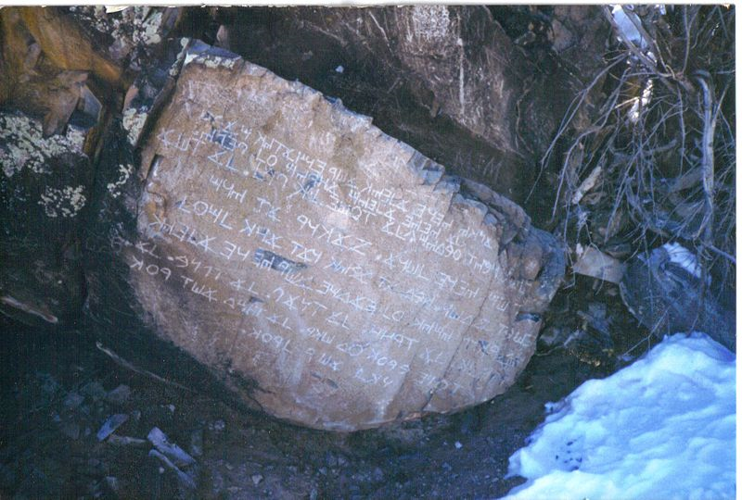

Slide 36
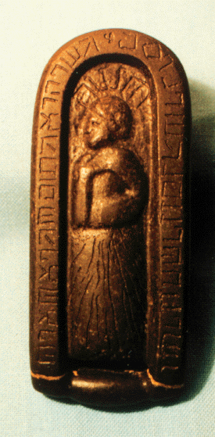
The first of these artifacts, popularly known as the Keystone due to its shape, was excavated in June 1860. Unlike other ancient artifacts found previously in this region, the Keystone was inscribed with Hebrew.^{[3]} It contains one phrase on each side:
Kadosh Ha Kedoshim
Melech of the Earth
The Torah of Aloahym
The Word of Aloahym
The second find came later in November 1860 when Wyrick and his excavation team came across a sandstone box which contained a small, black limestone rock within^{[4]} (the type of rock was identified by geologists Dave Hawkins and Ken Bork of Denison University^{[5]}). This rock was carved with post-Exilic square Hebrew letters on all sides translated to be a condensed version of the Ten Commandments.[

Slide 37
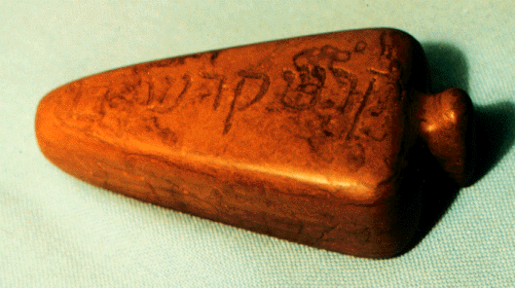
Newark Kadosh Stones
Wyrick in 1860 within a cluster of ancient Indian burial mounds near Newark, Ohio . ... collections from an ancient American Indian culture ...

Slide 38

Paleo Heb.in Greek manuscript.

Slide 39
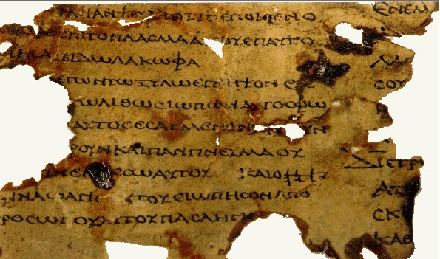
YHUH Paleo Heb.in Greek script. Septuagint

Slide 40
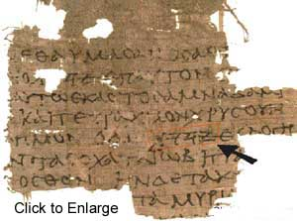
Septuagint

Slide 41
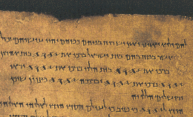
Paleo Hebrew in old Heb script.

Slide 42
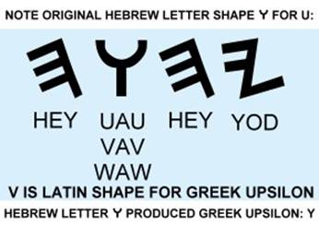

Slide 43
