Slide 1
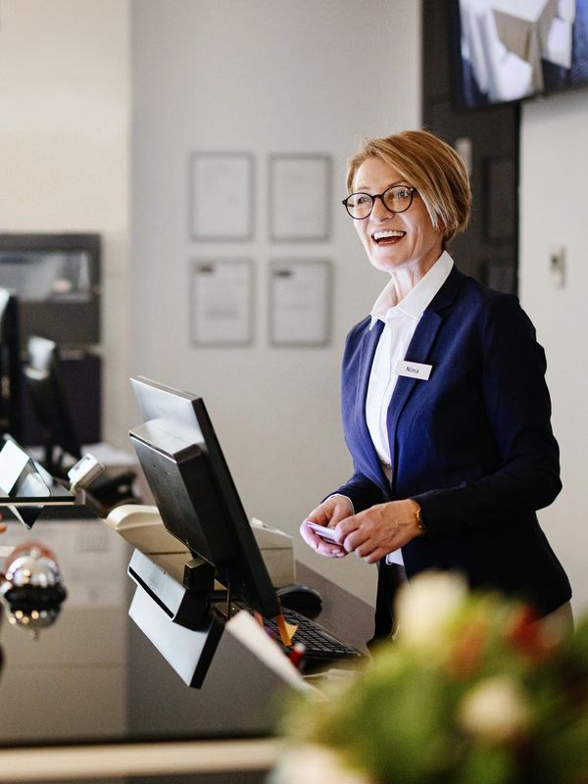
Front-of-House (FOH) Training Course
Master the Art of Hospitality & Launch Your Career!
Highfield Accreditation | Delivered by Charlton Premier Skills

Slide 2
Why Choose This Course?
Highfield Accreditation | Delivered by Charlton Premier Skills
Course Title: Front-of-House (FOH) Training
Duration: One Day
Study Method: Online (with optional in-person sessions)
Certification: Certificate of Completion included
Qualification: No formal requirements
Industry-Ready Skills: Excel in restaurants, hotels, and hospitality venues.
Flexible Learning: Study online 24/7 at your own pace.
Expert Support: Dedicated tutor guidance throughout.
Career Boost: 12 weeks of employability support (CV, job applications).

Slide 3
Course Highlights
Highfield Accreditation | Delivered by Charlton Premier Skills
Customer Service Excellence: Master the 5 Pillars of Hospitality. POS Systems & Order Management: Confidently handle reservations, orders, and payments. Professional Etiquette: Learn appearance standards and guest interaction techniques. Conflict Resolution: Turn complaints into positive experiences. Safety & Compliance: Adhere to hygiene, alcohol laws, and emergency procedures. Teamwork & Upselling: Collaborate with BOH and boost revenue.
Who Should Enrol?
Aspiring servers, hosts, bartenders, or hotel staff.
Current hospitality workers seeking promotion.
Career changers entering the dynamic hospitality industry.
Managers training new FOH teams.

Slide 4
What You’ll Learn
Highfield Accreditation | Delivered by Charlton Premier Skills
Module 01: Introduction to FOH Operations
Module 02: Customer Service Excellence
Module 03: Professional Appearance & Etiquette
Module 04: Reservation & Seating Management
Module 05: Order Taking & POS Systems
Module 06: Food & Beverage Service Standards
Module 07: Allergen Awareness
Module 08: Safety, Hygiene & Compliance
Module 09: Teamwork & Communication
Module 10: Practical Training & Role-Playing

Slide 5
Enrol Today and Take the First Step!
Highfield Accreditation | Delivered by Charlton Premier Skills
Graduates can pursue roles like:
Waiter/Waitress | Bartender | Restaurant Host
FOH Supervisor | Hotel Front Desk Agent
Event Staff | Sommelier (with further training)
How to Enrol
Visit our website and sign up in minutes.
Start learning immediately—no experience needed!
Earn your certificate and stand out to employers.
Transform Your Passion for Service into a Thriving Career!
Contact Us:
📞 07908174875 | 📧 Courses@charltonpremierskills.org.uk
| 🌐 www.charltonpremierskills.org.uk

