Slide 1
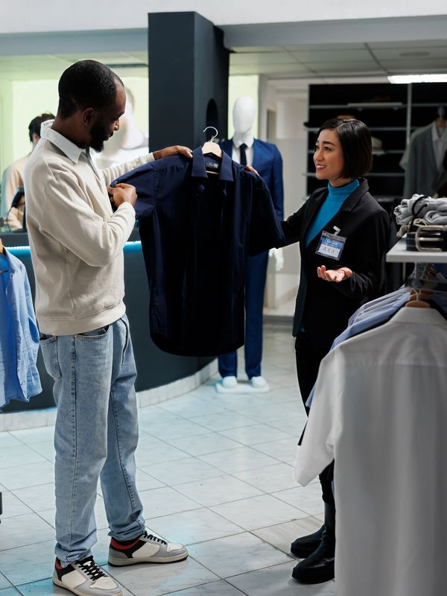
Retail Team Member Excellence Certification
Highfield Accreditation | Delivered by Charlton Premier Skills
Your Pathway to Retail Success!

Slide 2
Course Overview
Highfield Accreditation | Delivered by Charlton Premier Skills
Why Choose This Course?
✅ Industry-Relevant Skills: Master customer service, POS systems, stock management & visual merchandising.
✅ Flexible Learning: Study online anytime, anywhere—perfect for busy schedules.
✅ Expert Support: 24/7 tutor guidance to help you succeed.
✅ Career Boost: Stand out to top employers like Tesco, Sainsbury’s, Asda & more!
Duration: One Day
Study Method: Online (with optional in-person sessions)
Certification: Certificate of Completion
Employability Support: 12 weeks of CV & job application assistance

Slide 3
Course Highlights
Highfield Accreditation | Delivered by Charlton Premier Skills
What You’ll Learn
📌 Module 01: Introduction to Retail Excellence 📌 Module 02: Making Customer Matter (MCM) 📌 Module 03: Merchandising & Store Presentation 📌 Module 04: Handling Complaints & Conflict Resolution 📌 Module 05: Health, Safety & Security in Retail 📌 Module 06: Teamwork & Communication Skills 📌 Module 07: Sales Techniques & Promotions 📌 Module 08: Retail Trends & Career Development

Slide 4
Career Opportunities
Highfield Accreditation | Delivered by Charlton Premier Skills
Who Is This For?
✔ Aspiring retail professionals
✔ Current team members looking to upskill
✔ Career changers seeking entry into retail
✔ Anyone passionate about customer service & sales
Graduates can pursue roles such as:
Retail Team Member
Customer Service Assistant
Cashier
Visual Merchandiser
Department Supervisor
Store Manager

Slide 5
Enrol Today and Take the First Step Toward a Rewarding Career!
Highfield Accreditation | Delivered by Charlton Premier Skills
How to Enrol
Visit our website and sign up.
Start learning immediately—no formal requirements!
Receive your certificate upon completion.
Contact Us:
📞 07908174875
📧 Courses@charltonpremierskills.org.uk
🌐 www.charltonpremierskills.org.uk

