Slide 1
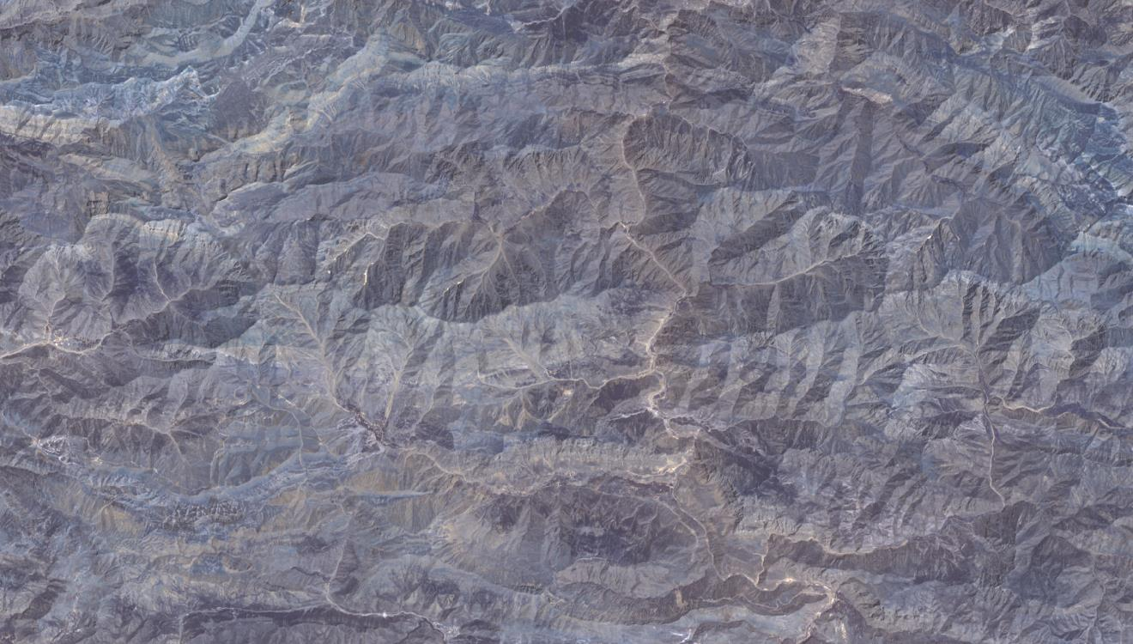
Importance of Geologic Remote Sensing and Photogeology Studies in Mineral Exploration Projects…
by Target Geology
989 km2
23 km
43 km
There is a place… Only coordinates… and seen only at Google Earth… This will be first time …

Slide 2
Importance of Geologic Remote Sensing and Photogeology Studies in Mineral Exploration Projects…
by Target Geology
989 km2
- Geologists ?
- Logistics ?
- Accomodations ?
- etc …
It means, more and more …
Time,
Energy,
Money,
Risks
and many unknowns…
We don’t know the … the Region … the People … the Topography … the Geology … the Roads … etc

Slide 3
Importance of Geologic Remote Sensing and Photogeology Studies in Mineral Exploration Projects…
by Target Geology
We have a chance to do preliminary studies at office to determine and map the mineralized areas … TARGET AREAS

Slide 4
Importance of Geologic Remote Sensing and Photogeology Studies in Mineral Exploration Projects…
by Target Geology
We have a chance to explain why we should go to the TARGET AREAS with geologic proves…

Slide 5
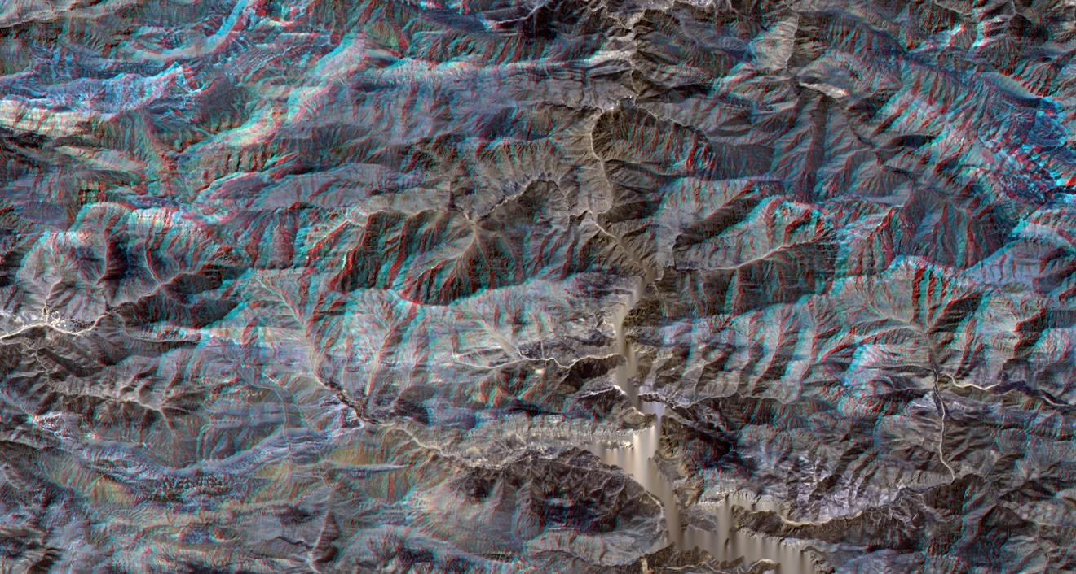
Importance of Geologic Remote Sensing and Photogeology Studies in Mineral Exploration Projects…
by Target Geology
Today’s capabilities give us to image the region with stereoscopic methods…This means we could see the region in 3D

Slide 6
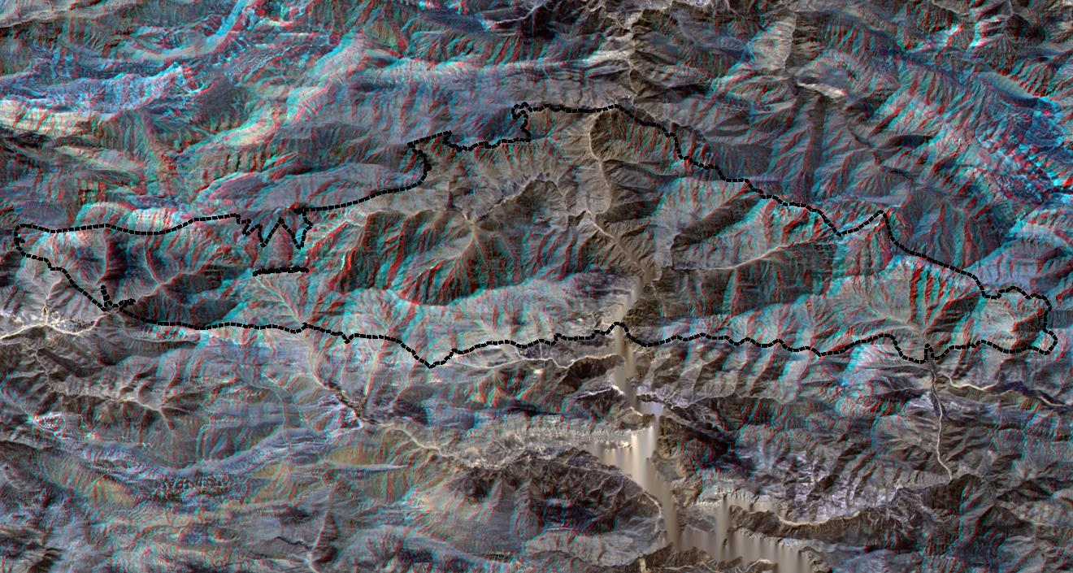
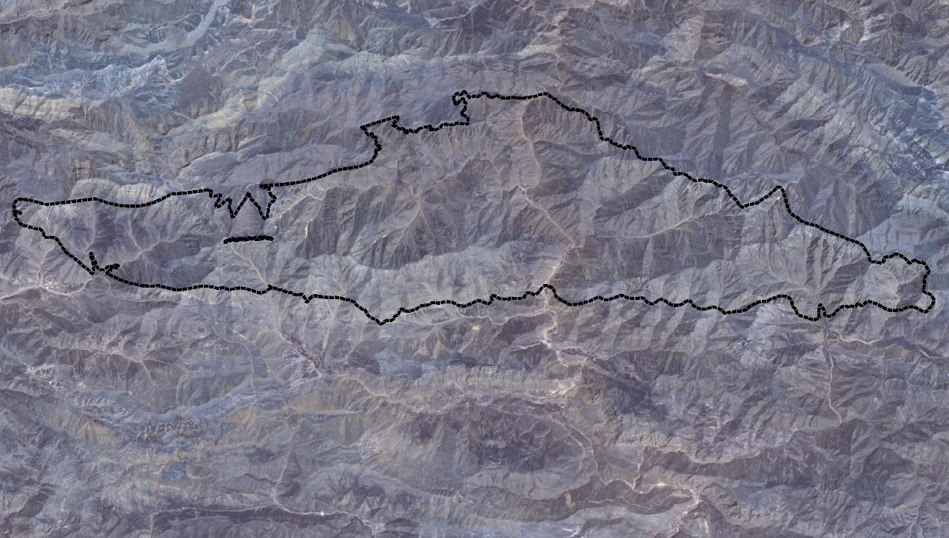
Importance of Geologic Remote Sensing and Photogeology Studies in Mineral Exploration Projects…
by Target Geology
We can easily map the geologic formations ; the base Precambrian aged rocks which hosts the mineralizations…

Slide 7
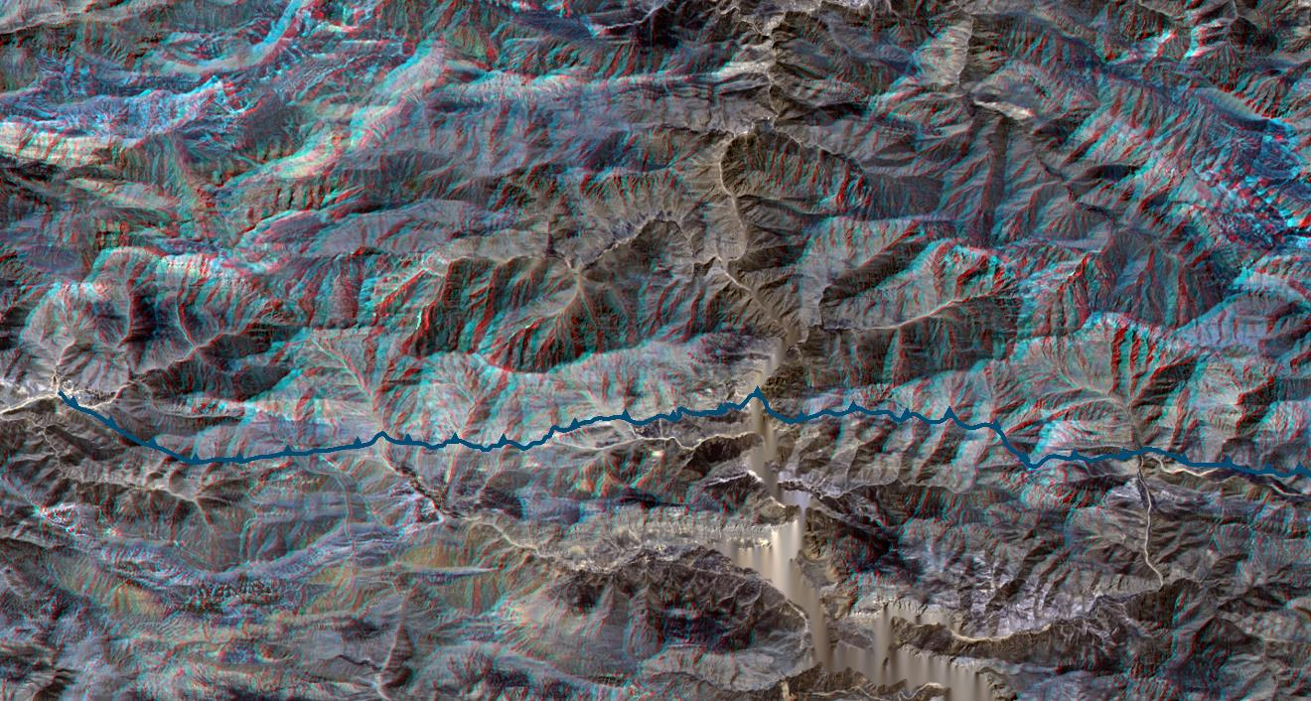
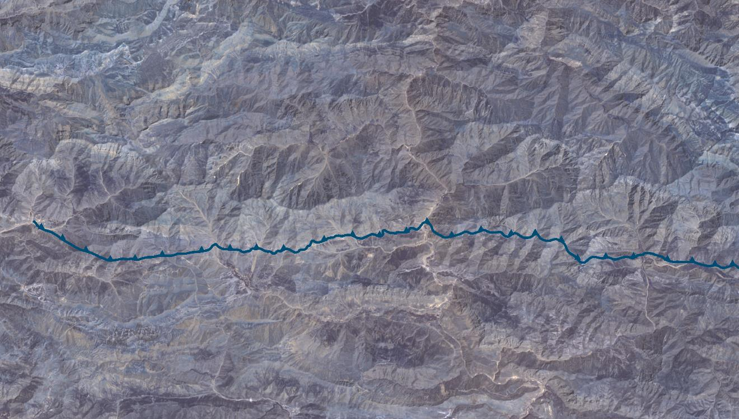
Importance of Geologic Remote Sensing and Photogeology Studies in Mineral Exploration Projects…
by Target Geology
We can easily map the Thrust Faults and determine it’s relations to the mineralizations…

Slide 8
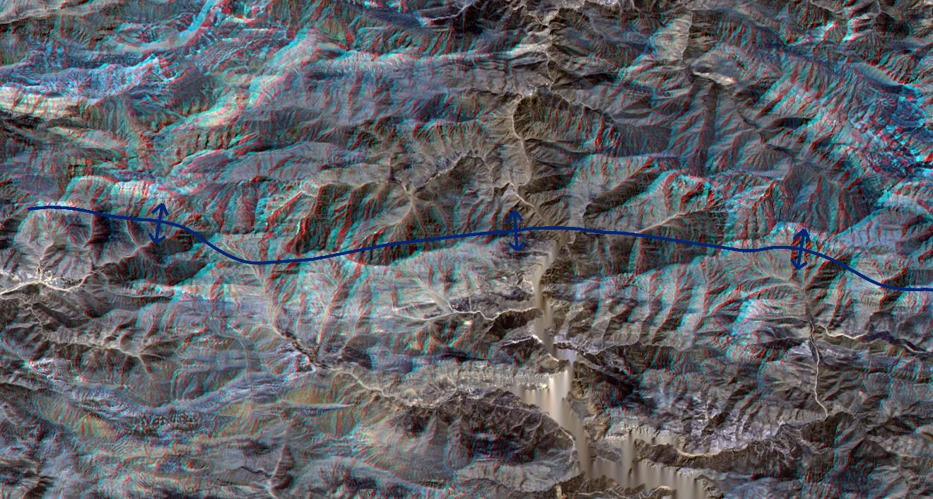
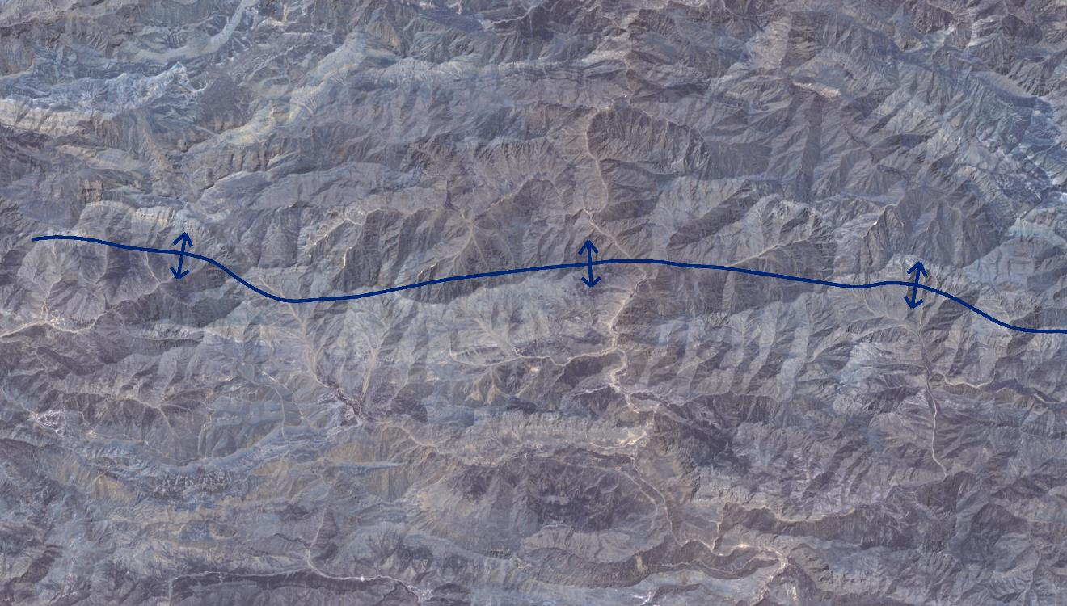
Importance of Geologic Remote Sensing and Photogeology Studies in Mineral Exploration Projects…
by Target Geology
We can easily map the Geosynclines and determine it’s relations to the mineralizations…

Slide 9
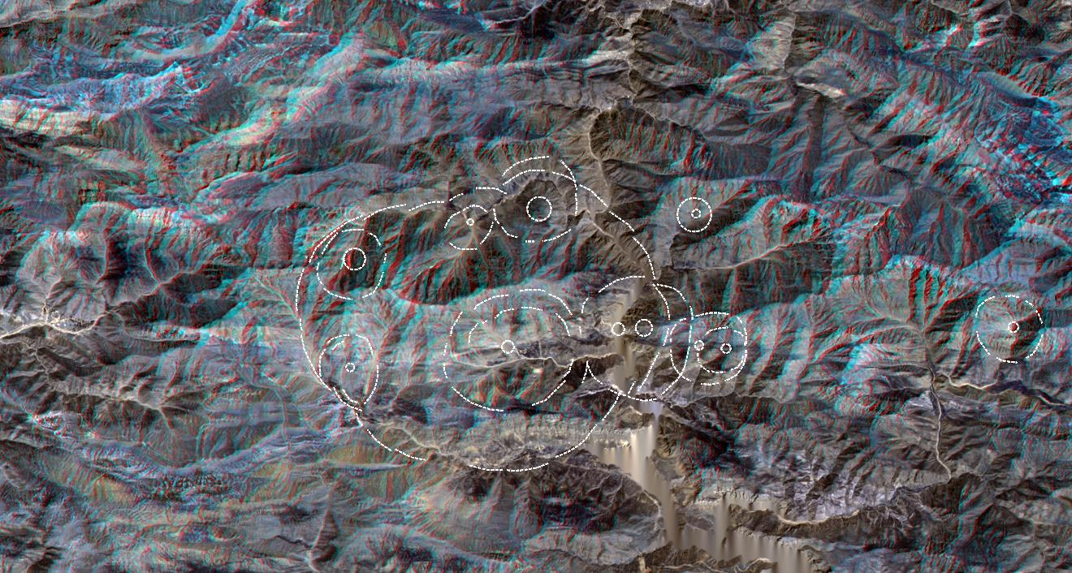
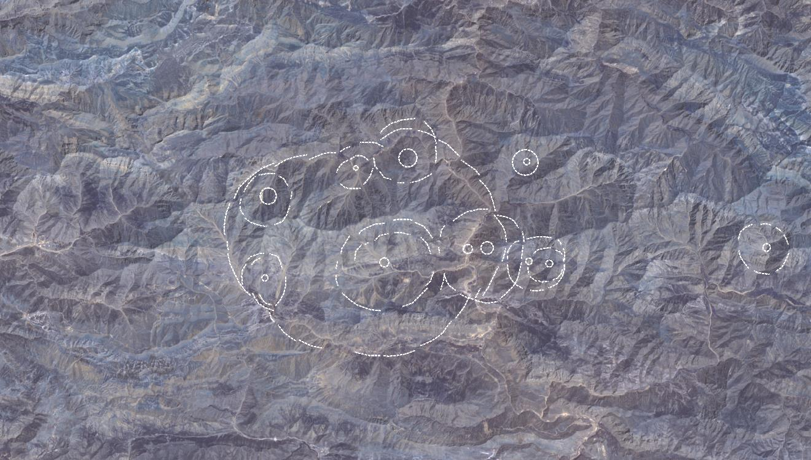
Importance of Geologic Remote Sensing and Photogeology Studies in Mineral Exploration Projects…
by Target Geology
We can easily map the Circular Fractures and it’s relations to the mineralizations…

Slide 10
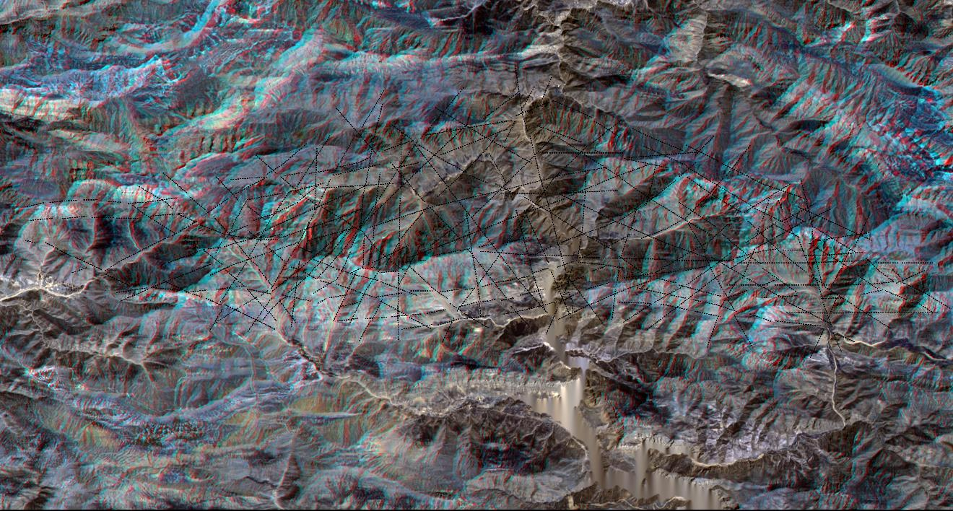
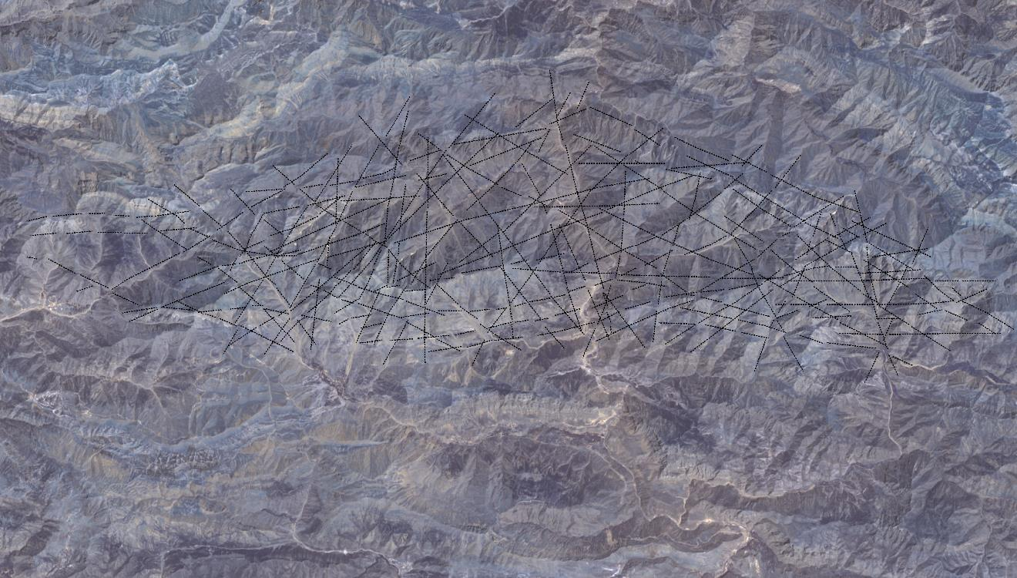
Importance of Geologic Remote Sensing and Photogeology Studies in Mineral Exploration Projects…
by Target Geology
We can easily map the Fracture Pattern and it’s relations to the mineralizations…

Slide 11
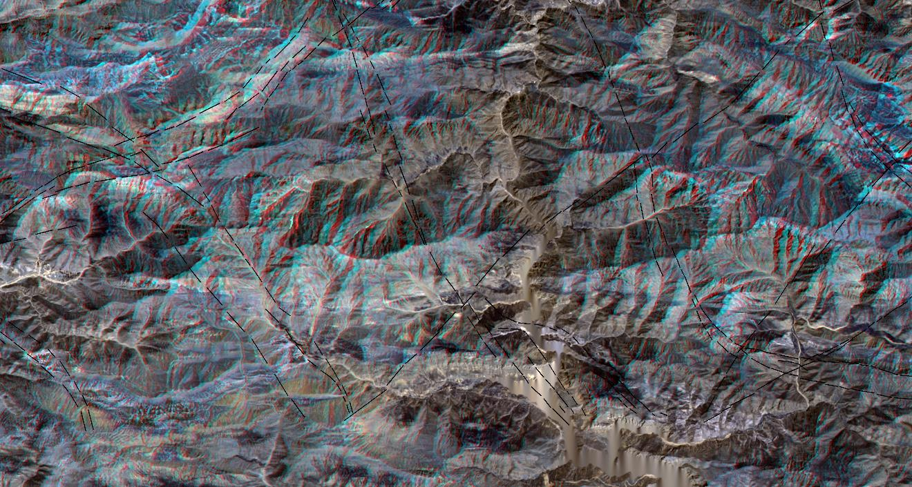
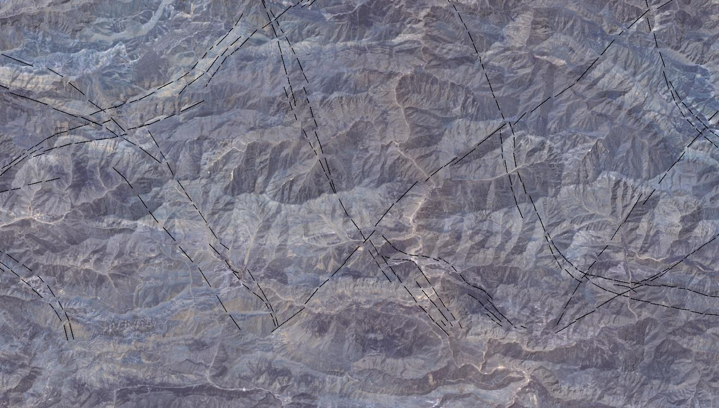
Importance of Geologic Remote Sensing and Photogeology Studies in Mineral Exploration Projects…
by Target Geology
We can easily map the Main Ductile Fractures and it’s relations to the mineralizations…

Slide 12

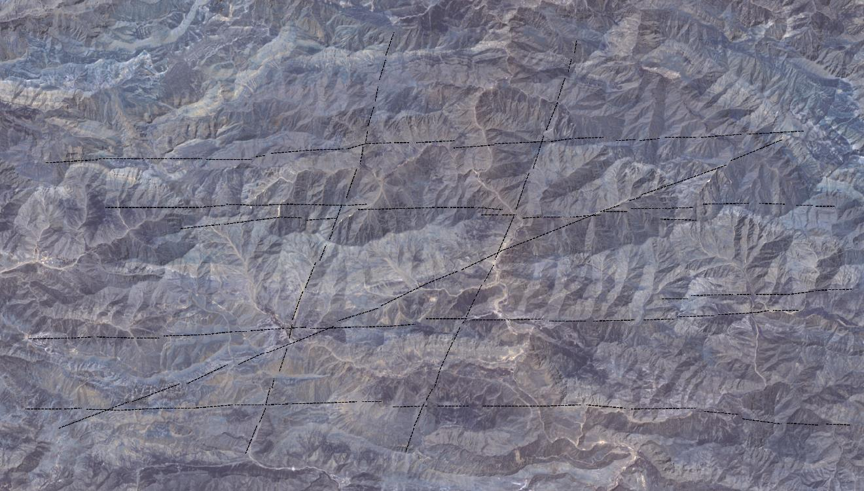
Importance of Geologic Remote Sensing and Photogeology Studies in Mineral Exploration Projects…
by Target Geology
We can easily map the Main Brittle Fractures and it’s relations to the mineralizations…

Slide 13
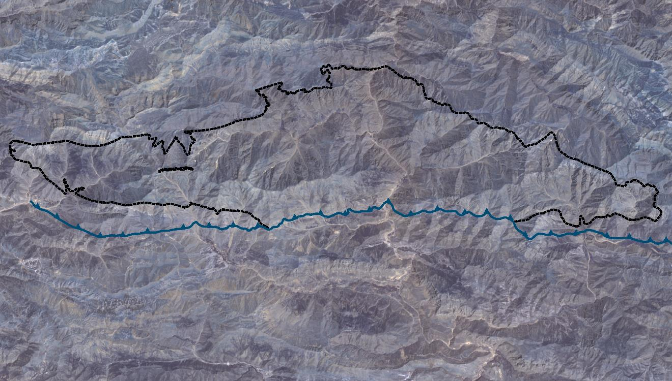
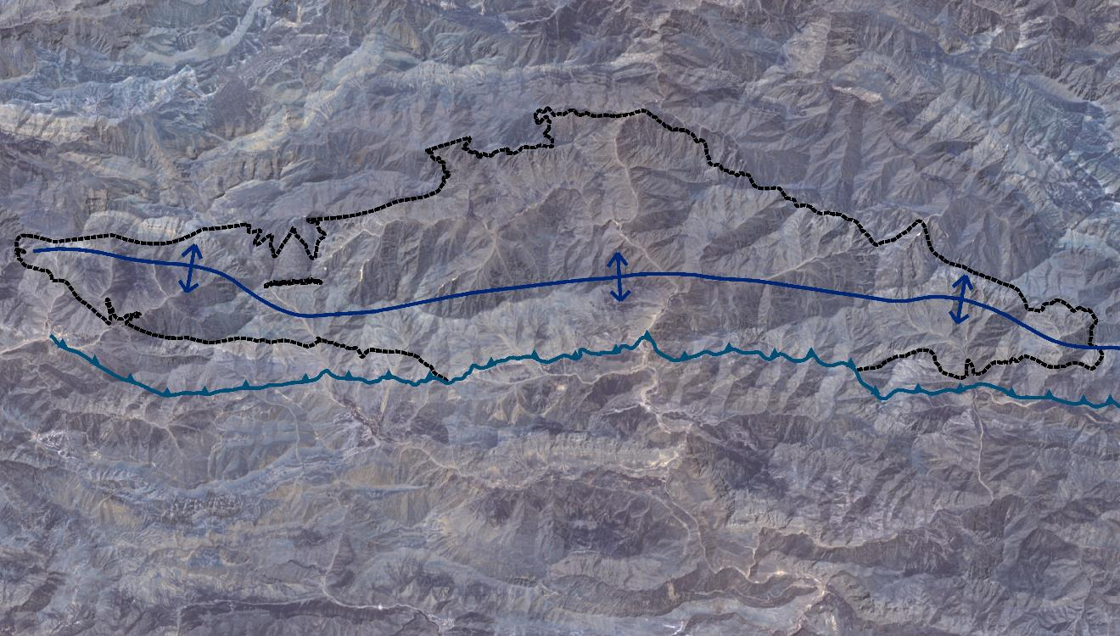

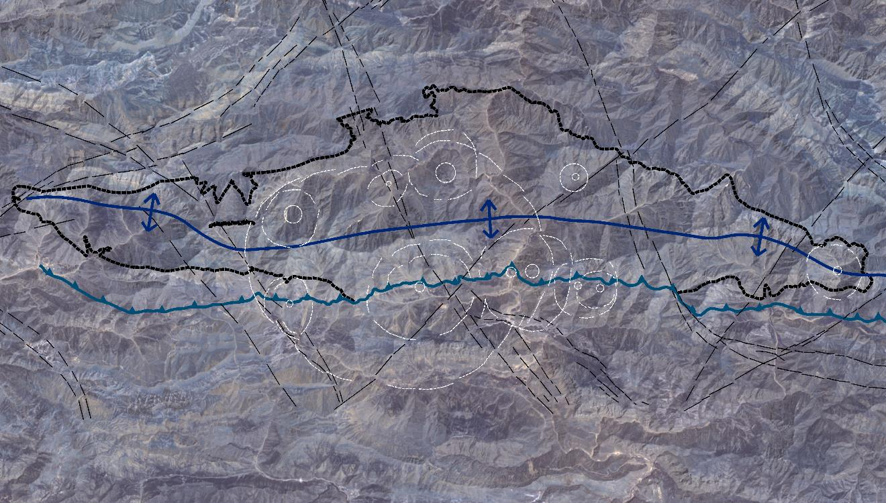
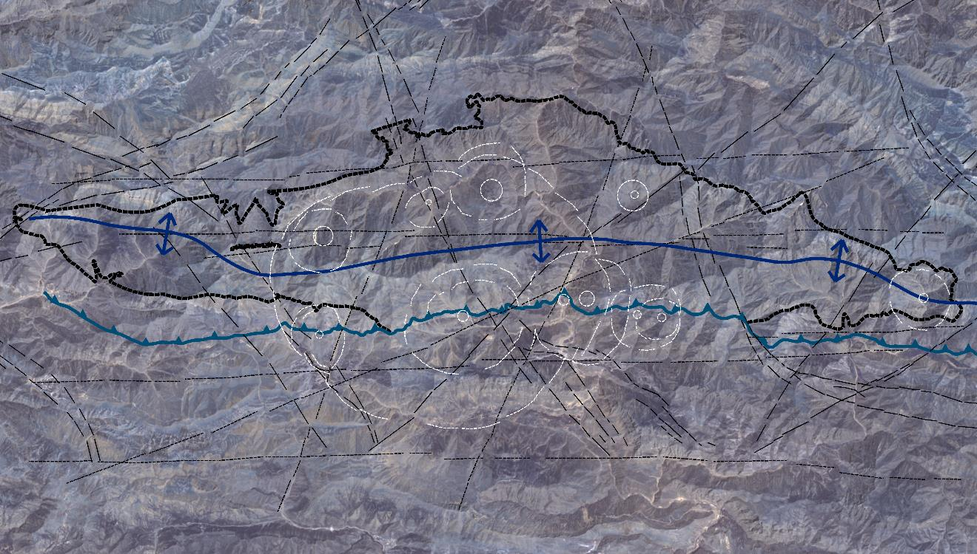
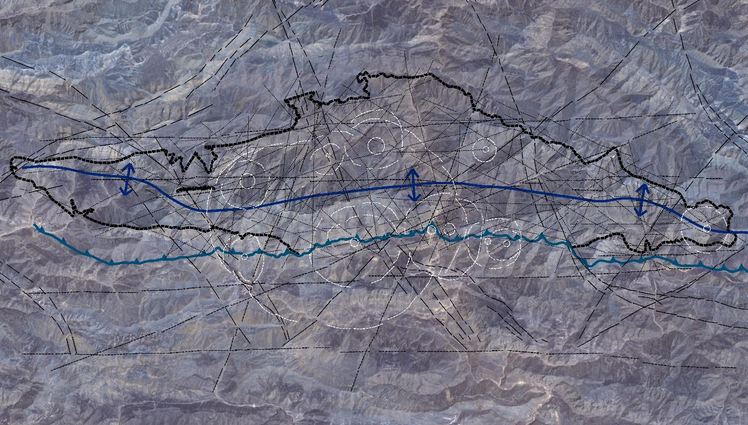
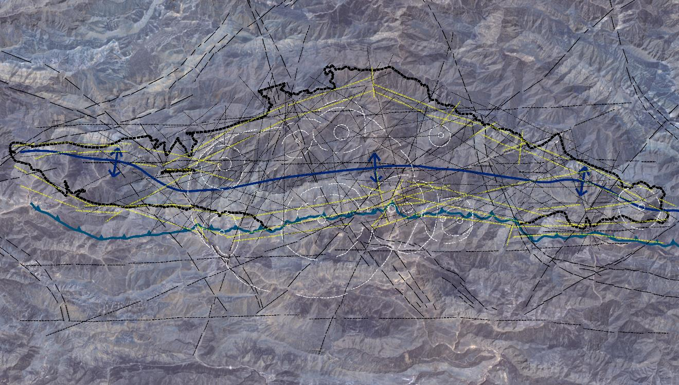
Importance of Geologic Remote Sensing and Photogeology Studies in Mineral Exploration Projects…
by Target Geology
All the extracted and mapped geologic features listed … mineralizations and zones shows itself easily…

Slide 14
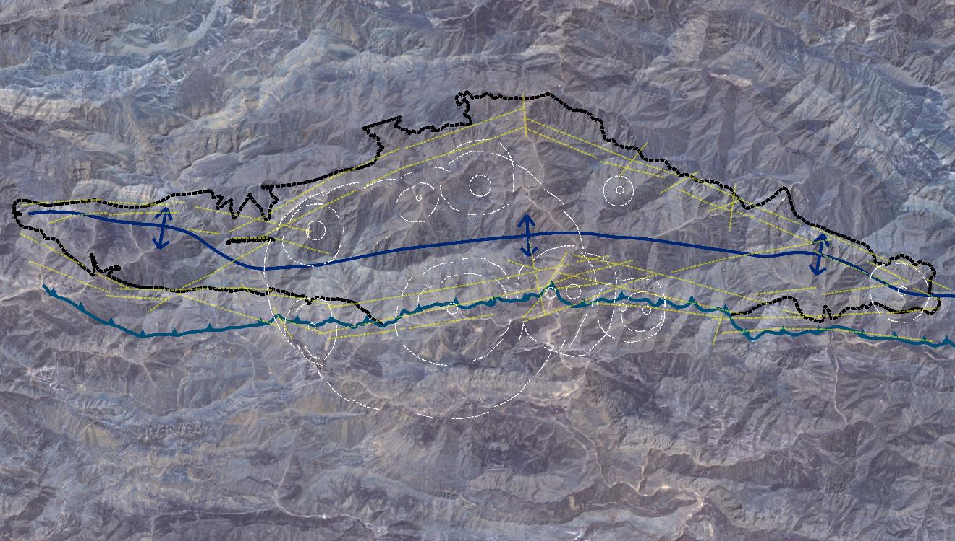
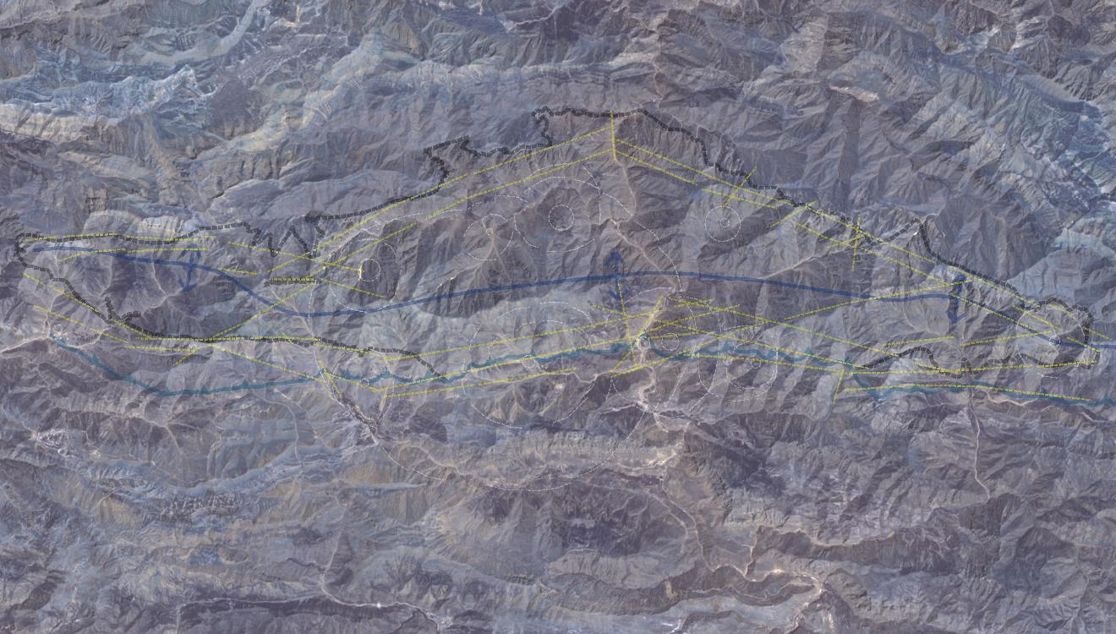

Importance of Geologic Remote Sensing and Photogeology Studies in Mineral Exploration Projects…
by Target Geology
All the extracted and mapped geologic features listed … mineralizations and zones shows itself easily…

Slide 15
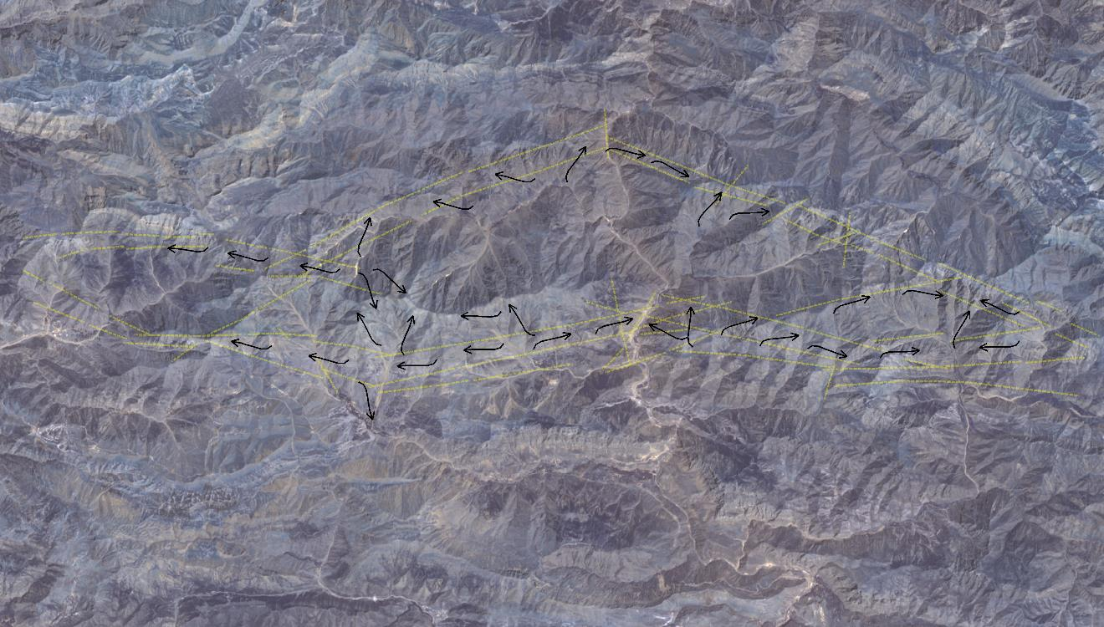
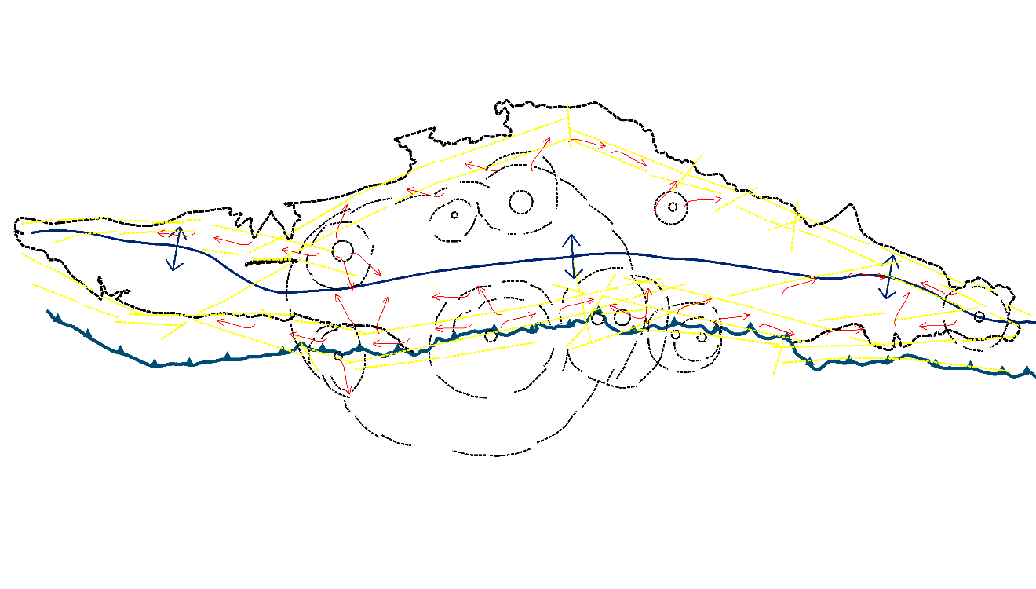
Importance of Geologic Remote Sensing and Photogeology Studies in Mineral Exploration Projects…
by Target Geology
Hydrothermal Fluids paleo flow channels (high fractured – porose zones) and mineralization corridors shows itself …

Slide 16
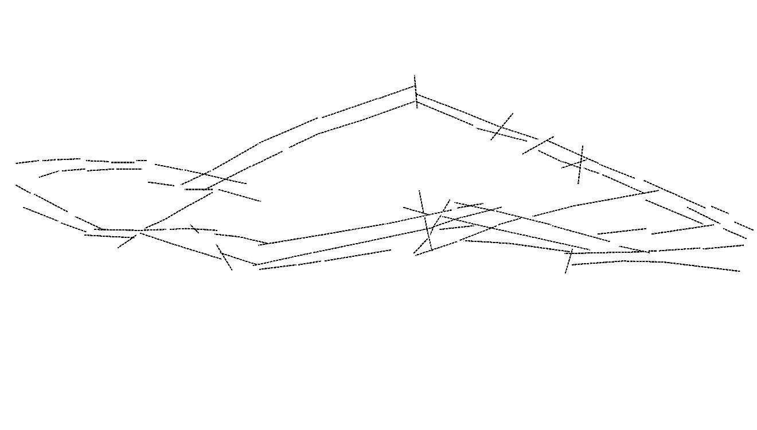
Importance of Geologic Remote Sensing and Photogeology Studies in Mineral Exploration Projects…
by Target Geology
According to the Photogeologic Results … High probable mineralization corridors …

Slide 17
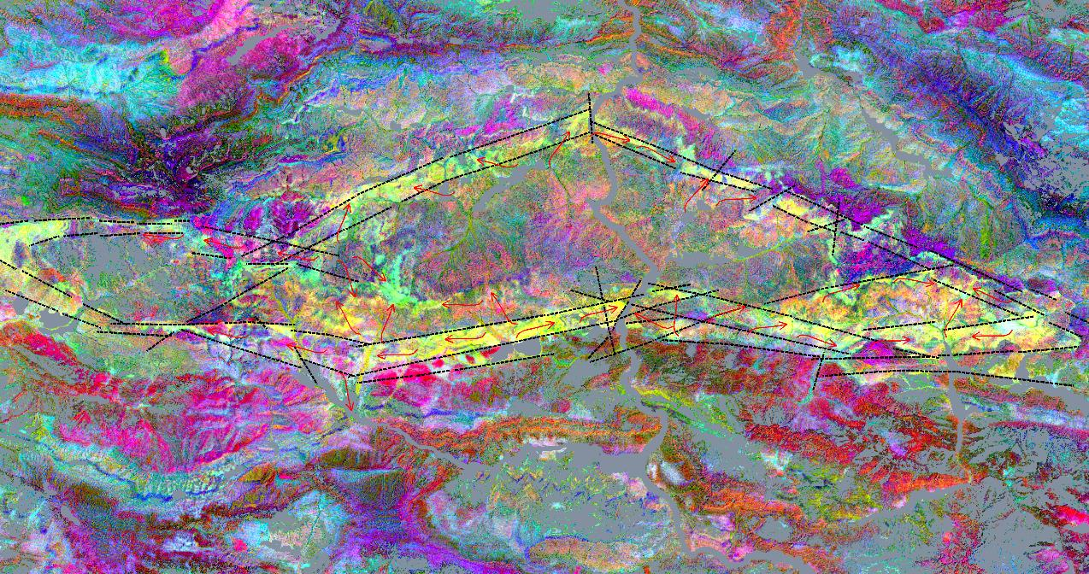
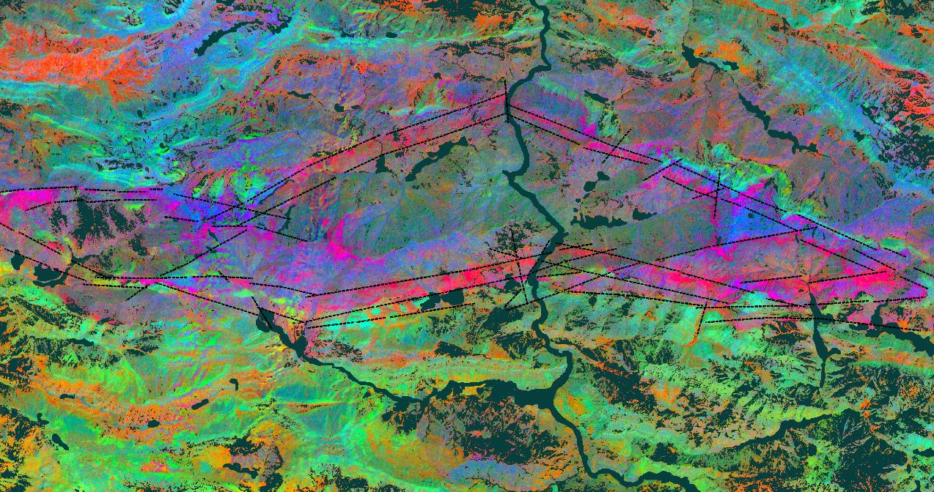
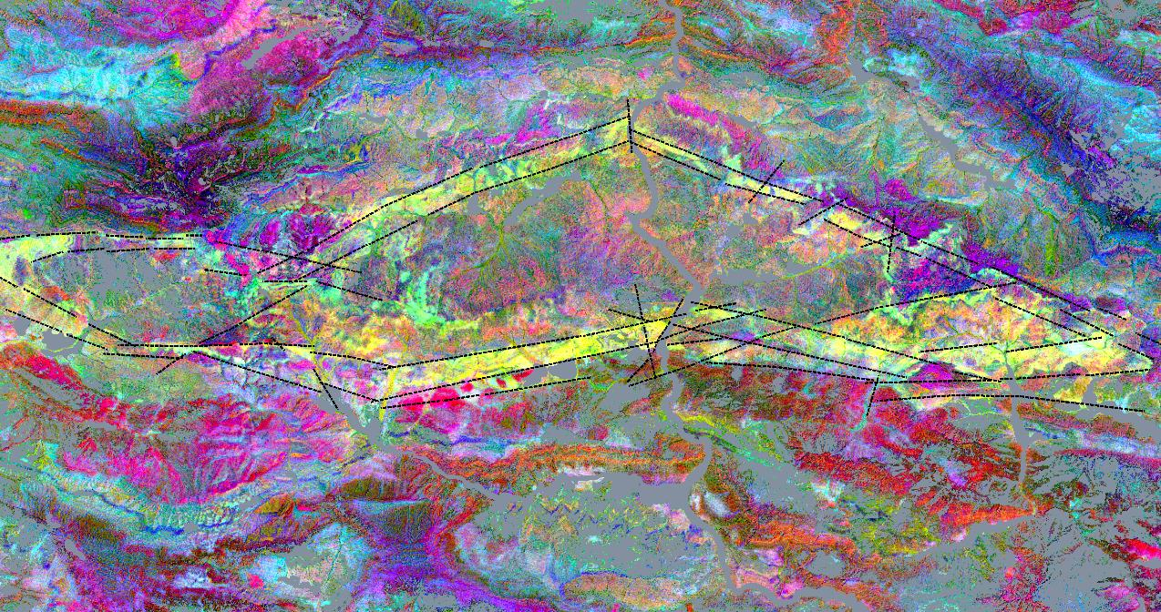
Importance of Geologic Remote Sensing and Photogeology Studies in Mineral Exploration Projects…
by Target Geology
According to the Spectral and Photogeologic Results … High probable mineralization corridors and Hydrothermal Alterations…

Slide 18
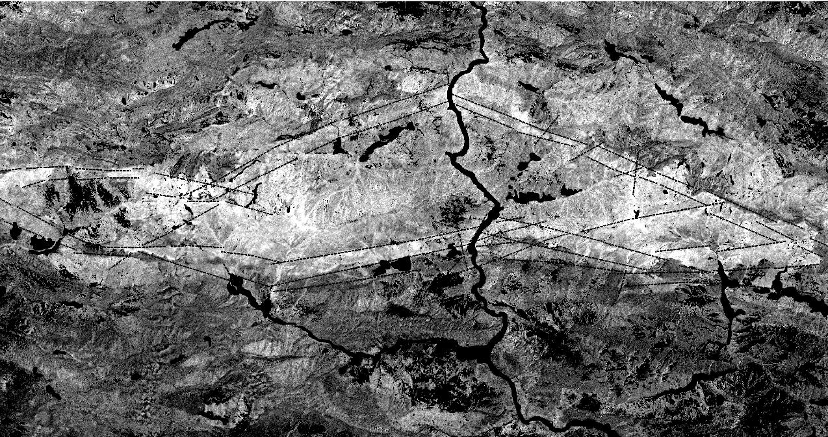
Importance of Geologic Remote Sensing and Photogeology Studies in Mineral Exploration Projects…
by Target Geology
According to the Spectral and Photogeologic Results … High probable mineralization corridors and Phyllitic Alterations…

Slide 19
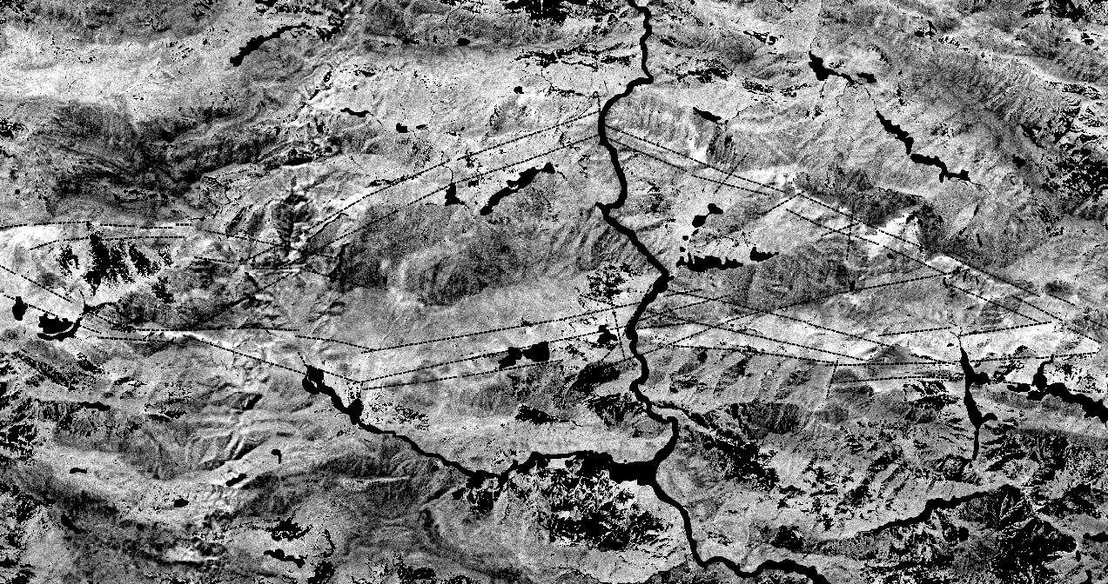
Importance of Geologic Remote Sensing and Photogeology Studies in Mineral Exploration Projects…
by Target Geology
According to the Spectral and Photogeologic Results … High probable mineralization corridors and Advanced Argillic Alterations…

Slide 20
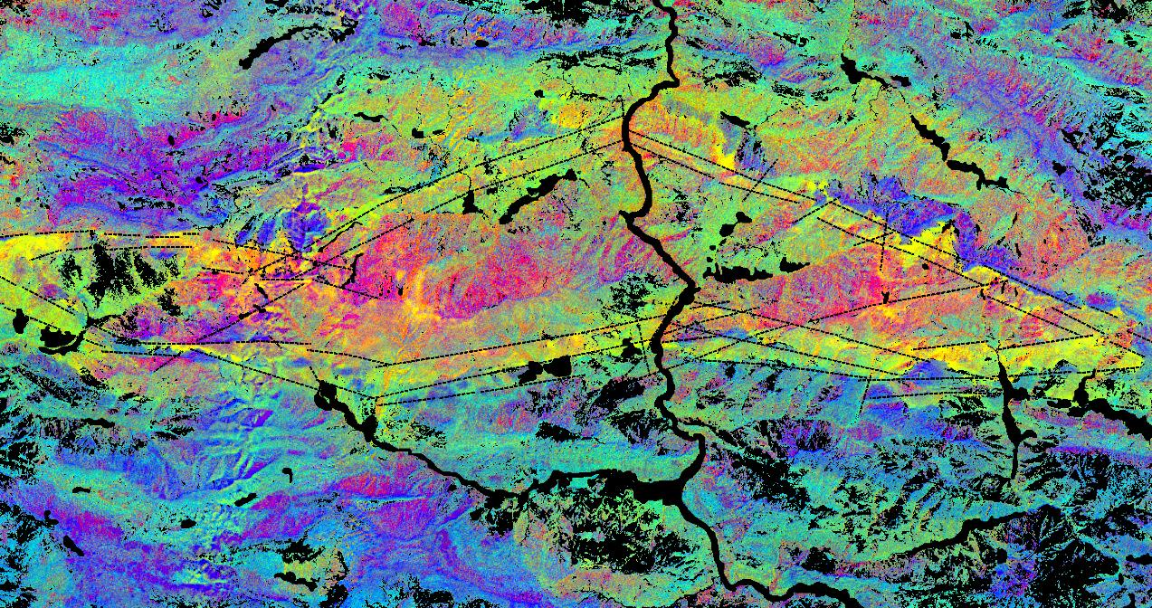
Importance of Geologic Remote Sensing and Photogeology Studies in Mineral Exploration Projects…
by Target Geology
According to the Spectral and Photogeologic Results … High probable mineralization corridors and Phyllitic, Adv.Argillic and Pyrophyllitic Alterations…

Slide 21
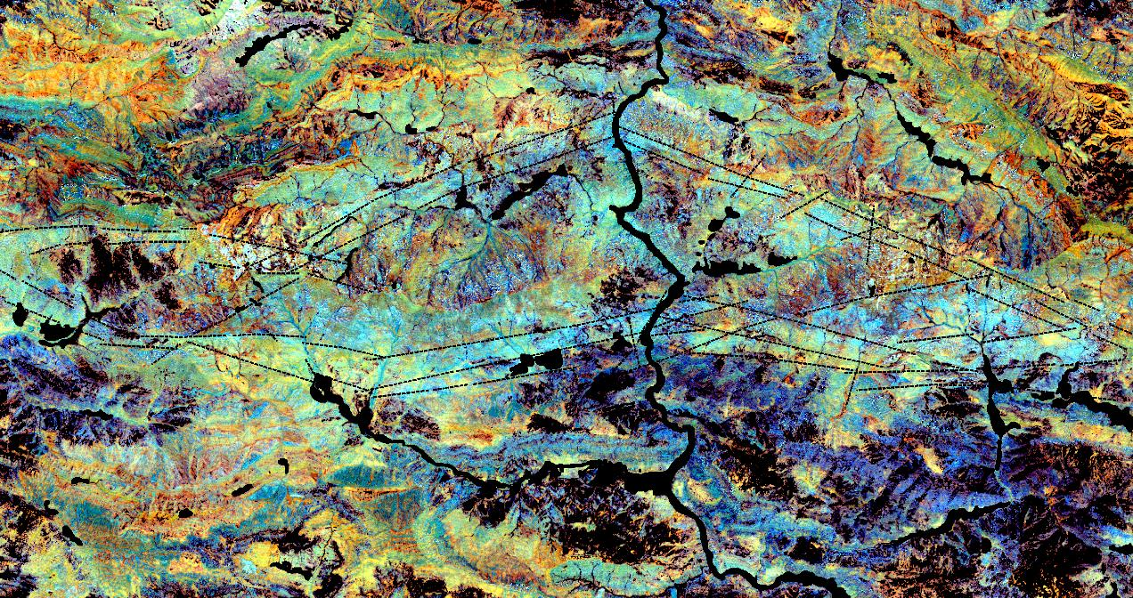
Importance of Geologic Remote Sensing and Photogeology Studies in Mineral Exploration Projects…
by Target Geology
According to the Spectral and Photogeologic Results … High probable mineralization corridors and Ironoxides and – hydroxides Alterations…

Slide 22
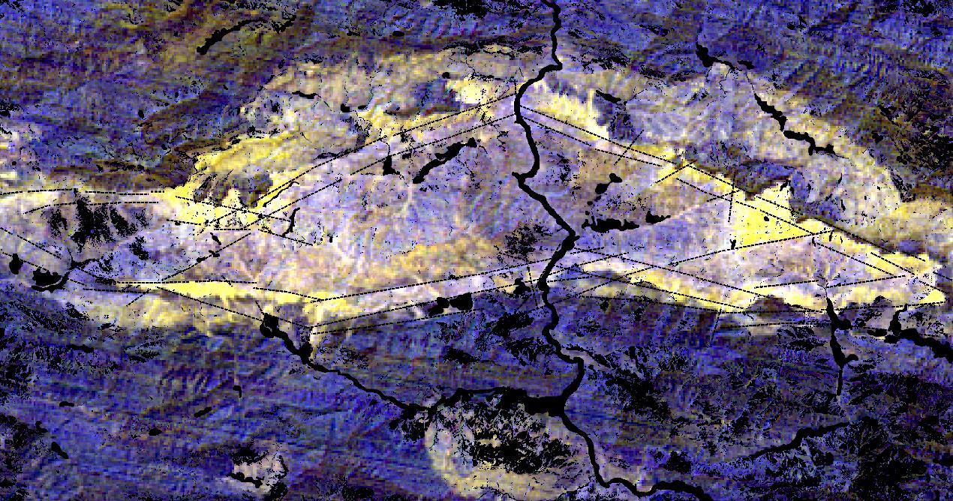
Importance of Geologic Remote Sensing and Photogeology Studies in Mineral Exploration Projects…
by Target Geology
According to the Spectral and Photogeologic Results … High probable mineralization corridors and Silica – Quartz and HydroSilica Alterations…

Slide 23
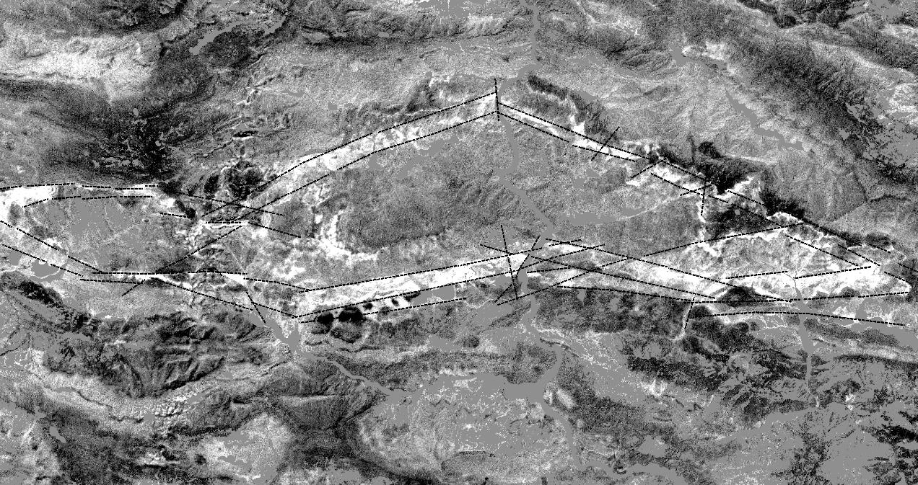
Importance of Geologic Remote Sensing and Photogeology Studies in Mineral Exploration Projects…
by Target Geology
According to the Spectral and Photogeologic Results … High probable mineralization corridors and Hydroxyls Group Alterations…

Slide 24
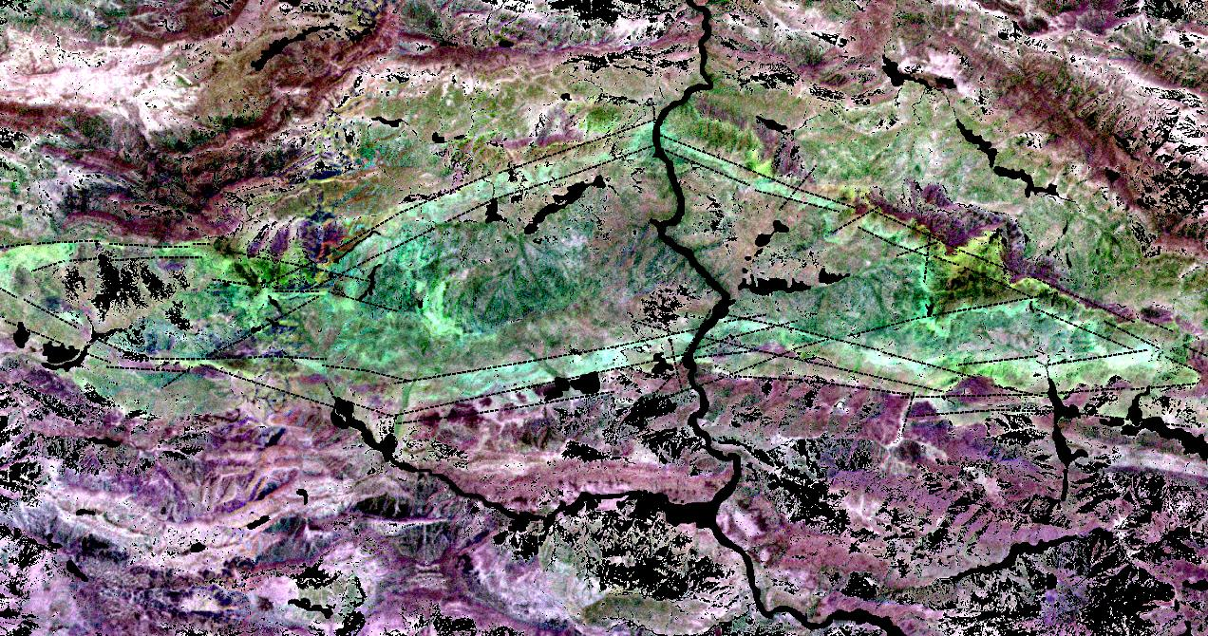
Importance of Geologic Remote Sensing and Photogeology Studies in Mineral Exploration Projects…
by Target Geology
According to the Spectral and Photogeologic Results … High probable mineralization corridors and Important Clay Group Alterations…

Slide 25
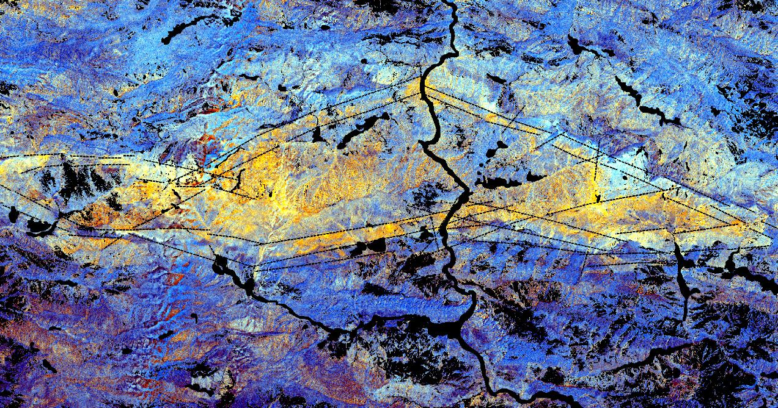
Importance of Geologic Remote Sensing and Photogeology Studies in Mineral Exploration Projects…
by Target Geology
According to the Spectral and Photogeologic Results … High probable mineralization corridors and AlOH – White Mica related Group Alterations…

Slide 26
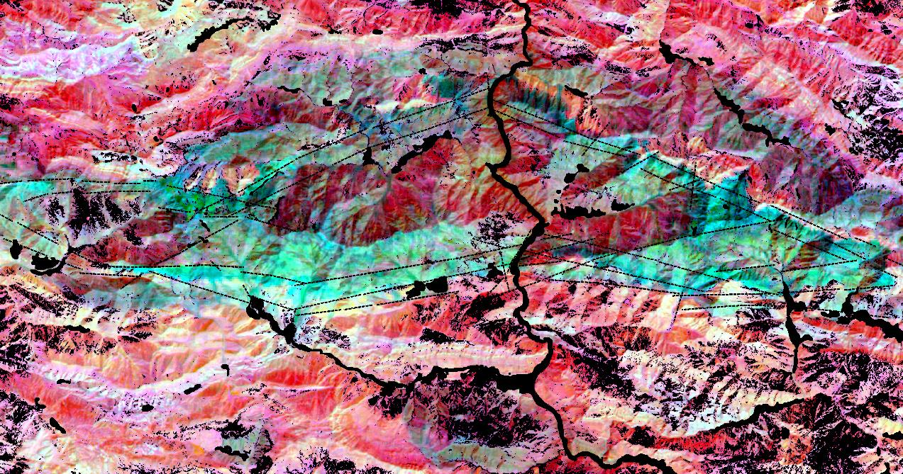
Importance of Geologic Remote Sensing and Photogeology Studies in Mineral Exploration Projects…
by Target Geology
According to the Spectral and Photogeologic Results … High probable mineralization corridors and Sulfidation Image …

Slide 27
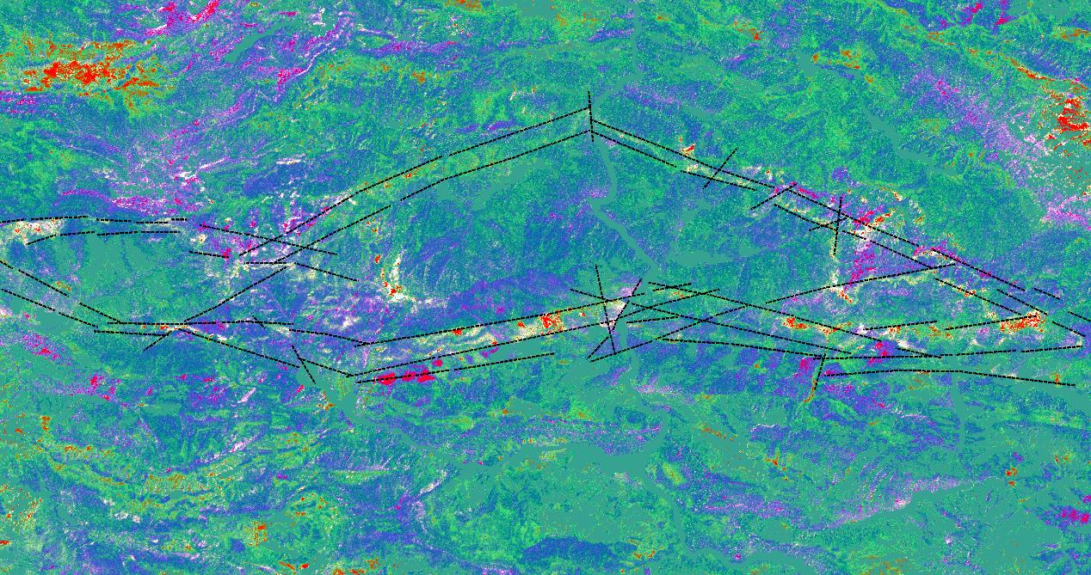
Importance of Geologic Remote Sensing and Photogeology Studies in Mineral Exploration Projects…
by Target Geology
According to the Spectral and Photogeologic Results … High probable mineralization corridors and Temperature Sensible Areas Image (via Day - Night Temperature and Albedo Images)…

Slide 28
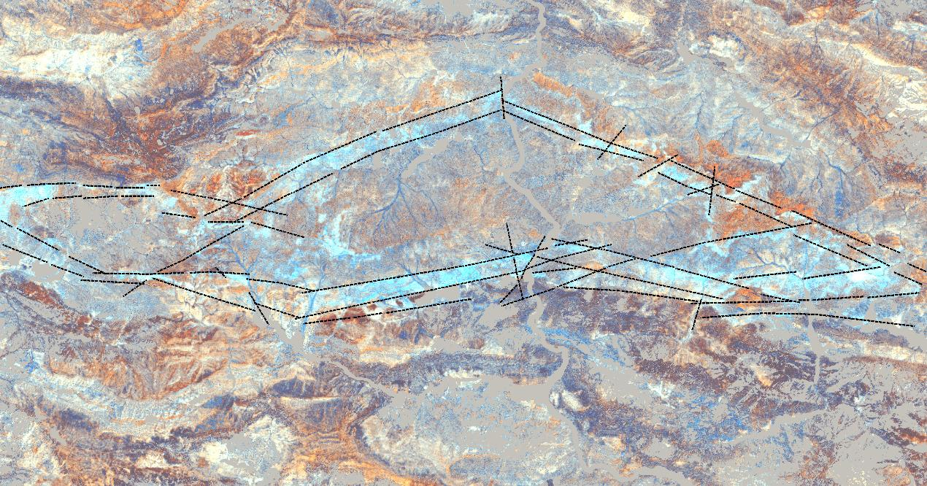
Importance of Geologic Remote Sensing and Photogeology Studies in Mineral Exploration Projects…
by Target Geology
According to the Spectral and Photogeologic Results … High probable mineralization corridors and FINAL POTENTIAL GOLD MINERALIZATION IMAGE …1…

Slide 29
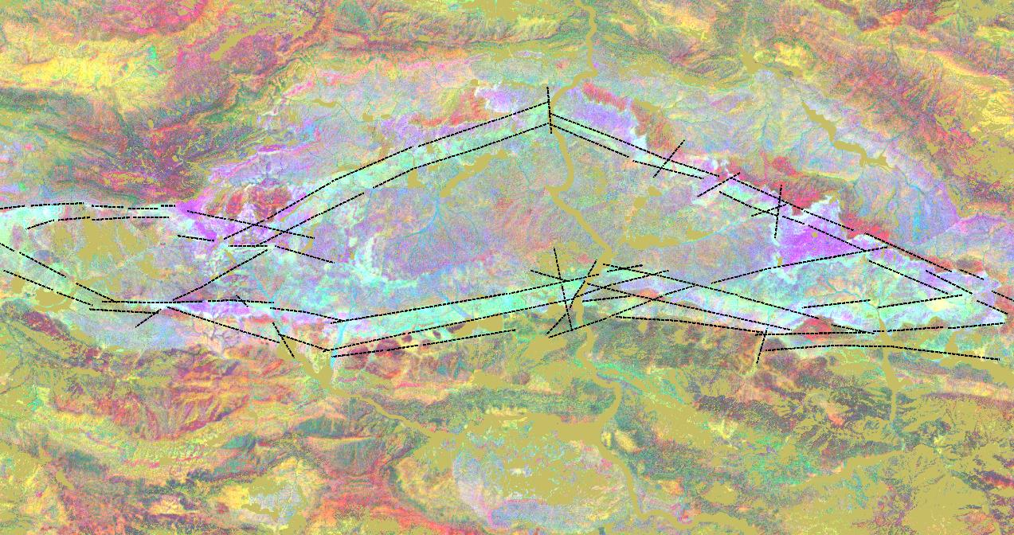
Importance of Geologic Remote Sensing and Photogeology Studies in Mineral Exploration Projects…
by Target Geology
According to the Spectral and Photogeologic Results … High probable mineralization corridors and FINAL POTENTIAL GOLD MINERALIZATION IMAGE …2…

Slide 30
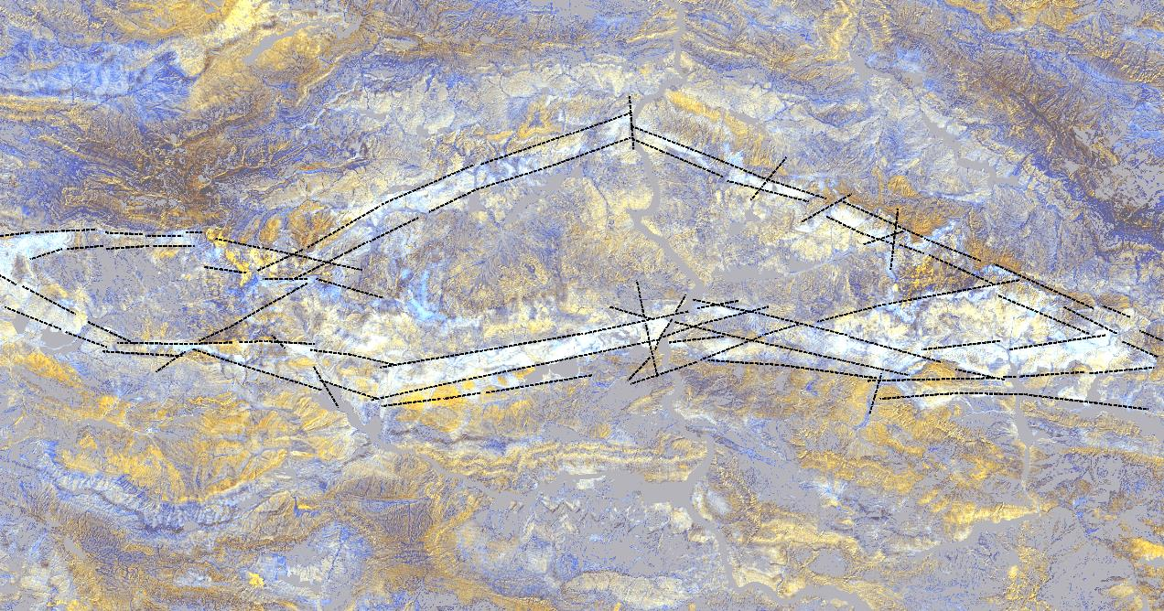
Importance of Geologic Remote Sensing and Photogeology Studies in Mineral Exploration Projects…
by Target Geology
According to the Spectral and Photogeologic Results … High probable mineralization corridors and FINAL POTENTIAL GOLD MINERALIZATION IMAGE …3…

Slide 31
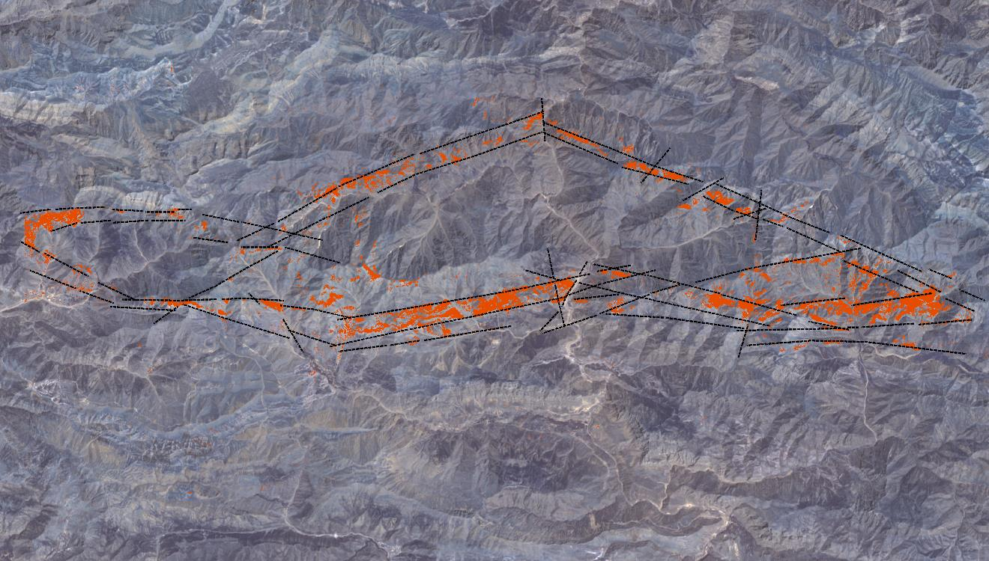
Importance of Geologic Remote Sensing and Photogeology Studies in Mineral Exploration Projects…
by Target Geology
According to the Spectral and Photogeologic Results … High probable mineralization corridors and FINAL POTENTIAL GOLD MINERALIZATION distribution IMAGE …

Slide 32
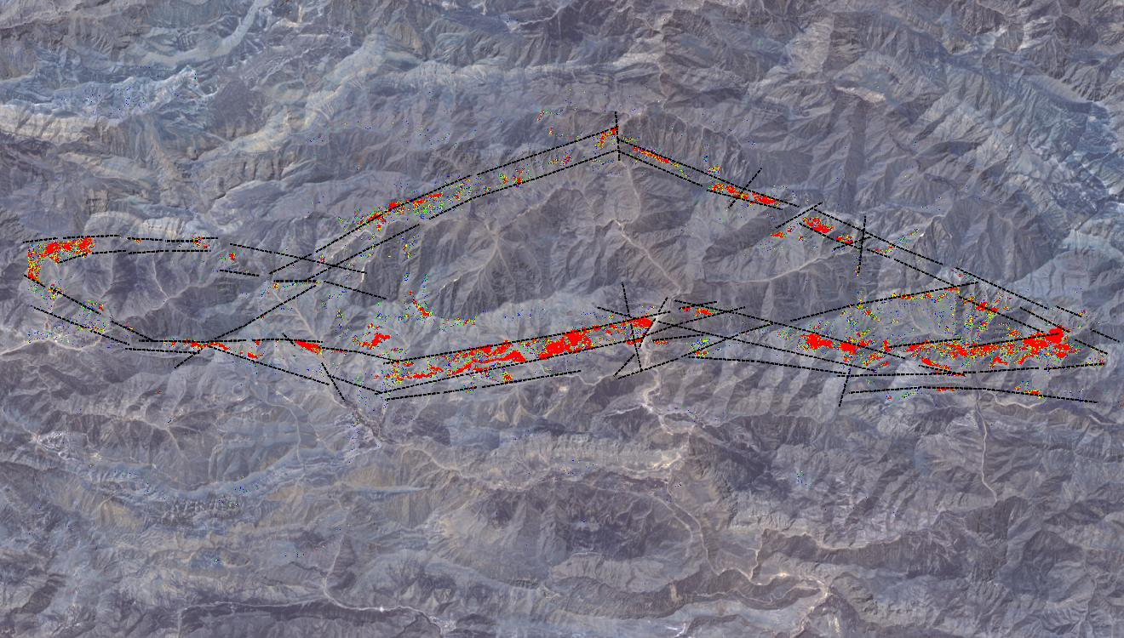
Importance of Geologic Remote Sensing and Photogeology Studies in Mineral Exploration Projects…
by Target Geology
According to the Spectral and Photogeologic Results … High probable mineralization corridors and FINAL POTENTIAL GOLD MINERALIZATION distribution and relative intensity IMAGE …

Slide 33
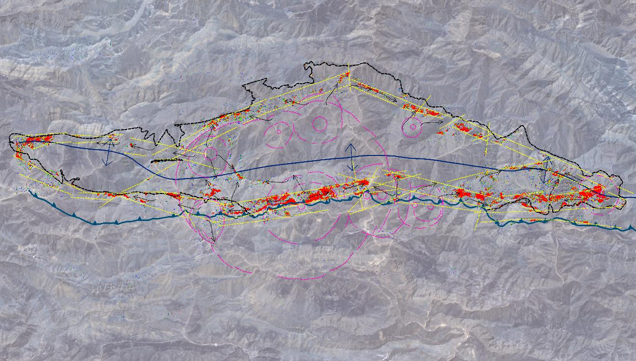
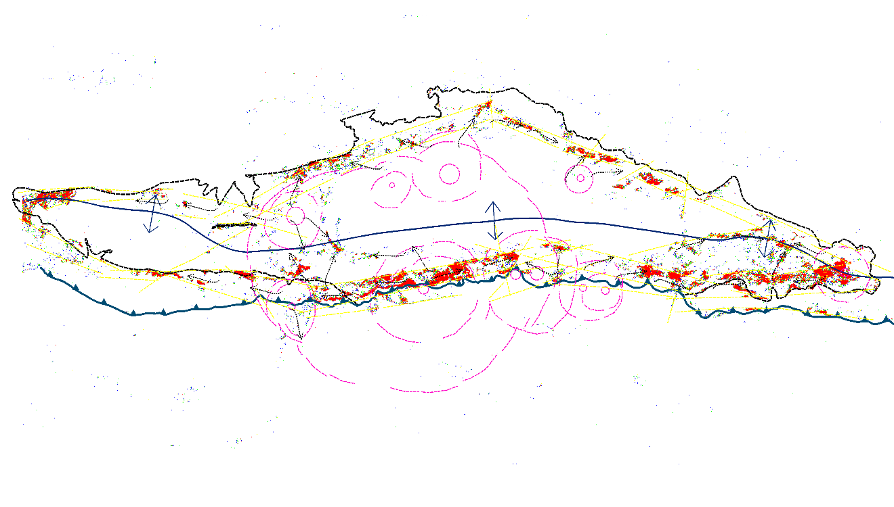
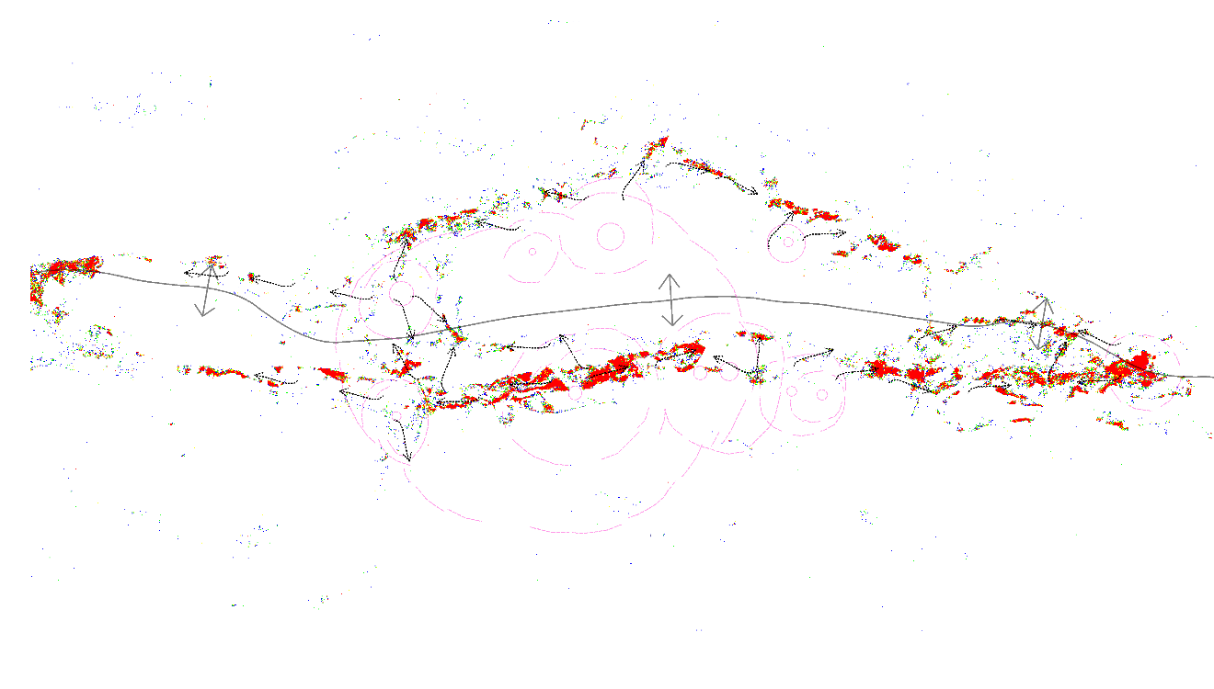
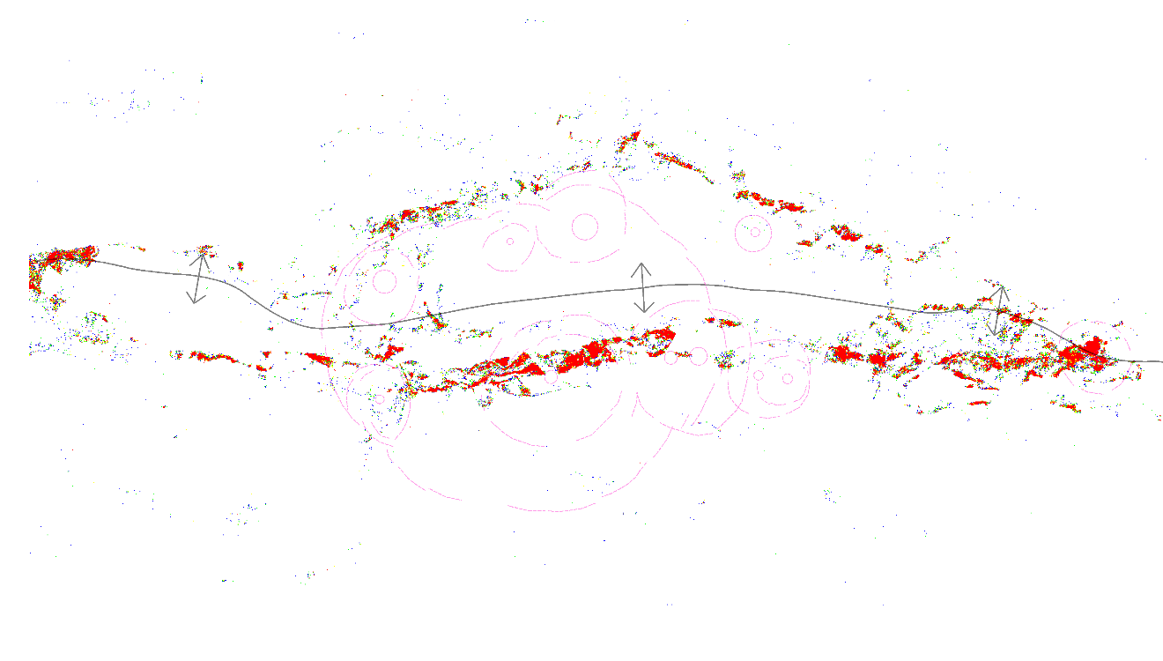
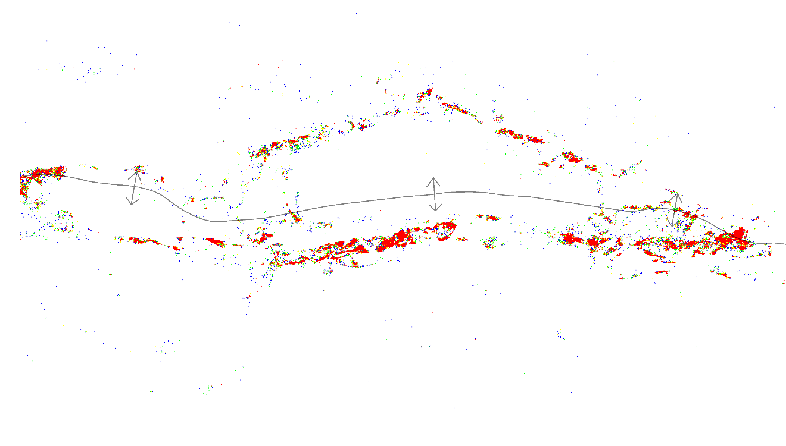
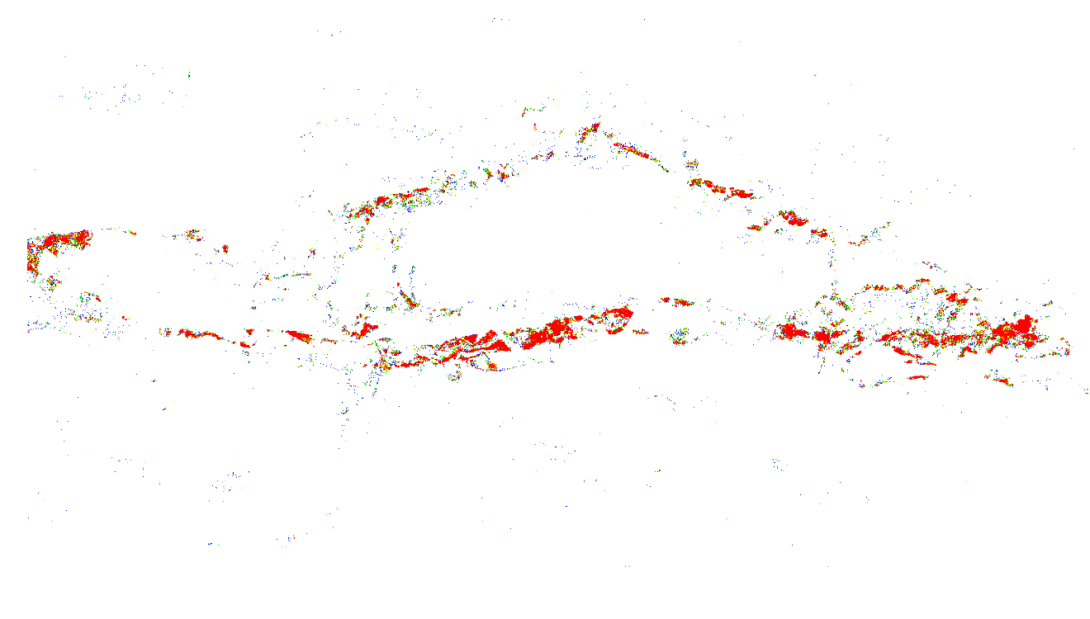

Importance of Geologic Remote Sensing and Photogeology Studies in Mineral Exploration Projects…
by Target Geology
According to the Spectral and Photogeologic Results … High probable mineralization corridors and FINAL POTENTIAL GOLD MINERALIZATION distribution and relative intensity IMAGE …

Slide 34

Importance of Geologic Remote Sensing and Photogeology Studies in Mineral Exploration Projects…
by Target Geology
According to the Spectral and Photogeologic Results … High probable mineralization corridors and FINAL POTENTIAL GOLD MINERALIZATION distribution and relative intensity IMAGE … Field sampling points…

Slide 35
Importance of Geologic Remote Sensing and Photogeology Studies in Mineral Exploration Projects…
by Target Geology
Easy,
Low Cost,
Low Risk,
Fast Time,
No Location Limit,
No Time Limit,
No Environmental Limit,
FINAL REMARKS…

