Slide 1
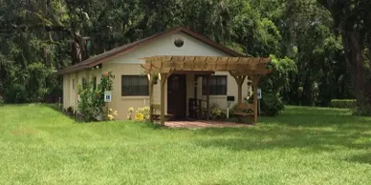
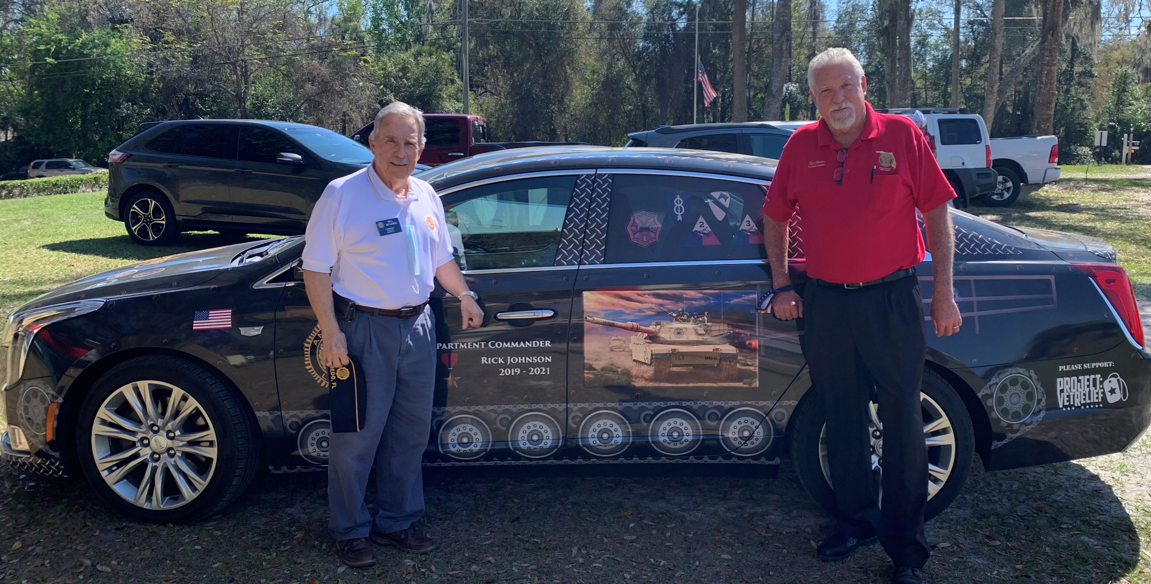
Police & Fire
On April 15th, we will be honoring our local Police Officers and Firefighters of the year for 2020 and 2021. Come help us thank them and their families at our dinner and presentation.
The Central Florida Chapter of the Gary Sinise Foundation will be providing and serving our steak dinners ~ Serving Heroes. We look forward to hosting them at our location and continuing to build a relationship with this great organization.
Post 243
Newsletter
Volume 2 | Issue 8 | March 2021
From the Commander
Reasons for optimism surround us. Springtime is here, most of us at Post 243 have had our vaccine shots, and Post activities are recovering from the pandemic. Those that haven’t gotten their shots, keep watching, your turn is coming soon! Our March meeting program was the same one we had scheduled pre-virus, and our April program will include our Fire & Police Appreciation awards for this year AND last year! I hope we can all join in feeling a bit better about our lives and futures. Ready?
Bill
Guardian Angels
Medical Service Dogs Inc
Department of Florida Visit
Key Dates
Department Commander Rick Johnson and some of his staff visited the post this last month. They were impressed with our commitment to our community and ability to persevere throughout the pandemic.
Commander Johnson also named our very own Bill M to the Department Finance Committee, a five-year commitment to the American Legion and the state of Florida. Congratulations, Bill!
Mar 31, 1000-1400 | Mobile Vet Center
Apr 15, 1900 | Police & Fire Recognition
~Leadership Voting opens~
Apr 18, 1400 | Poker Tournament
Apr 25, 1200-1700 | Blood Drive
Apr 28, 1000-1400 | Mobile Vet Center
May 20, 1900 | Know Your Post
~Leadership Voting closes~
May 22, 0800 | Florida’s Fallen Memorial Set-up
May 19, 0900 | Flag Planting at Oviedo Cemetery
May 26, 1000-1400 | Mobile Vet Center
May 31, TBD | Memorial Day Service
May 31, 1200-1700 | Blood Drive
Blood Drive Appointment Link

Slide 2
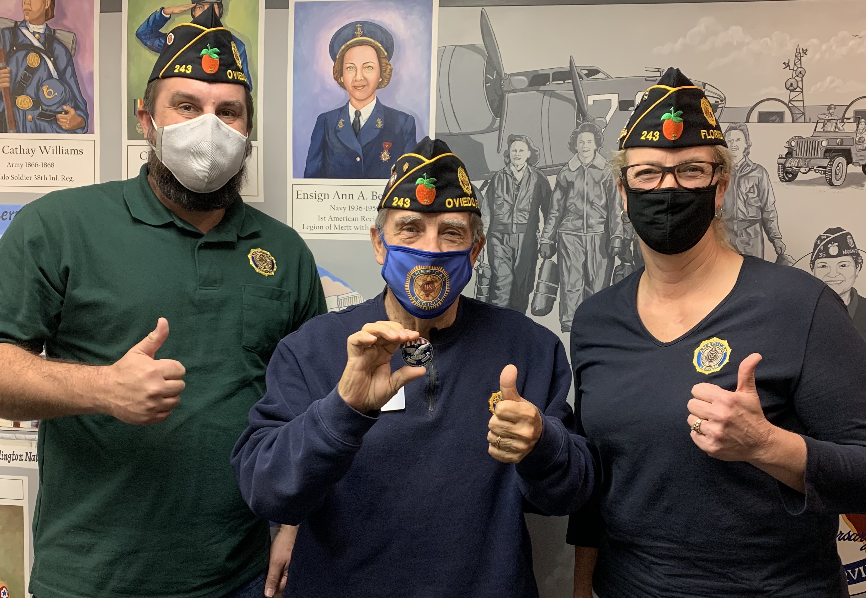
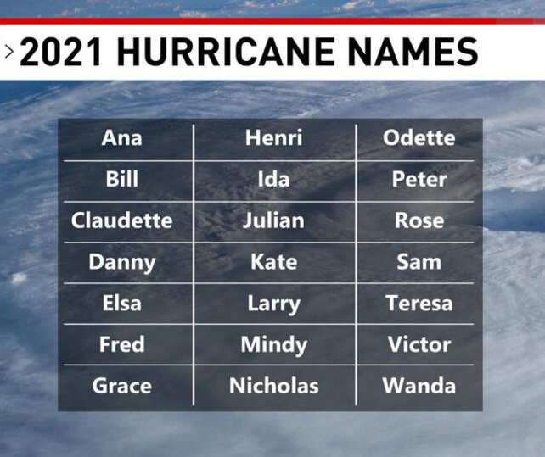
Membership
Key Date Info
We were recently awarded the Department of Florida Silver Membership award. Our Oviedo Post was the first in our District and sixth in the state to receive this recognition. Members Alex M, Bill M and Laurel R were there to receive the award.
Way to go Post 243!
Blood Drive
Donate and share our collection dates. Rule changes regarding time in Europe, piercings, tattoos and more. Click here to check eligibility.
Flag Planting at Oviedo Cemetery
Come join us to plant flags for our interred Servicemembers just in time for Memorial Day.
Florida’s Fallen Memorial Set-up
Bring your gloves, sunscreen, big spray, water and strong back to help set up over 400 crosses for our community event.
Know Your Post
Do you wish you knew more about what your post was doing or how you could get involved? Do you know what resources are available to you? Come get your questions answered this evening.
Mobile Vet Center at Post 243
Now scheduled the last Wednesday of each month for 2021! They will have basic VA information, a representative from the Orlando VAMC, and someone from Seminole County Veteran Service office. Available to entire community, spread the word.
Poker Tournament
Texas Hold ‘em Tournament, $25 buy-in, for more information and/or to reserve your spot, contact rproctor@barterfirst.net.
Police and Fire Recognition
Join us as we celebrate and honor four of Oviedo’s First Responders and their families during our annual event.
Be Prepared
Post Member Bob P compiled some great information for us to prepare for our hurricane season.
Download the information from the bottom of the Calendar page of our website or by clicking here. Thanks, Bob!
Stay in Touch
Help us spread the word! Follow us on at least one of our social media platforms & share
Facebook:
American Legion Oviedo
Instagram:
americanlegionpost243
LinkedIn:
American Legion Oviedo Post 243
Twitter:
@OviedoFLPost243
If you’d like to be added to our email distribution, please send your contact information to the email address below. If you need help getting to or from Post events, just ask, we’re here to help!
Website: www.OviedoLegion.org
Emails: Post@OviedoLegion.org
ALMPost243@gmail.com
Thank you to all who helped down and clear our trees!
Brad S, Laurel R, Mike S,
Scott C, Tom F, Tom M & Willie!

