Slide 1
Executive Overview
Presented by
Charlene Jacka
Chief Engineer
Distribution A. Approved for public release; distribution unlimited. AFRL-2025-3815
Notes:
Thank the Texas Space Coalition. Name-check that you're talking to the right room — engineers, entrepreneurs, economic developers who want to understand what's actually happening in the space economy and how to get in.
- This talk is 20 minutes. You'll leave with a clear picture of what SpaceWERX is, what we fund, and where West Texas already has an edge.
- Quick note: this deck is Distribution A — approved for public release.

Slide 2
WHY SPACE, WHY NOW
The Opportunity is Here
$570B
$1T+
$29.4B
8%+
Global Space Economy
Projected by 2040
USSF FY25 Budget
Annual Growth Rate
2023 Revenues · Space Foundation
Morgan Stanley Forecast
DoD Budget Request
Space Foundation 2024
Sources: Space Foundation Space Report 2024 · Morgan Stanley (2020, updated) · DoD FY25 Budget Request · USSF Commercial Space Strategy April 2024
Notes:
The space economy isn't just rockets and NASA anymore. It's satellite broadband, GPS precision agriculture, weather monitoring, defense, and manufacturing in orbit.
- The U.S. Space Force was stood up in 2019 as a recognition that space is now a warfighting domain. That changed the funding calculus.
- Unlike traditional defense, the Space Force actively wants commercial companies building solutions — not just the Lockheed Martins and Raytheons. That's a new and real opportunity for small businesses.
- SpaceWERX is the mechanism. Think of it as the Space Force's venture arm — early-stage investment in companies that solve national security problems in space.

Slide 3




THE WEST TEXAS SPACE ADVANTAGE
The Infrastructure Is Already Here
SPACE PARK MIDLAND
AST SPACEMOBILE
Lunar & Mars analog test range in the Permian Basin
Direct-to-cell broadband from orbit — no special hardware
One of very few surface mobility facilities in the country
Publicly traded ($ASTS), HQ'd in Midland, TX
Attracts NASA, DoD, and commercial R&D missions
Proof that a world-class space company belongs here
ENGINEERING TALENT PIPELINE
LAUNCH CORRIDOR PROXIMITY
UTEP · NMSU · Texas Tech produce 000s of engineers/year
White Sands / Spaceport America: ~90 mi east
Currently flowing to oil/gas, automation, light industrial
SpaceX Starbase (South Texas): ~5 hours south
Same skill sets space urgently needs (see next slide)
Emerging need for ground support, logistics & ISR infrastructure
Distribution A. Approved for public release; distribution unlimited. AFRL-2025-3815
Notes:
- West Texas is not on the sidelines of the space economy. You have infrastructure, institutions, and companies already operating here.
- Space Park Midland is a facility that NASA, the DoD, and commercial companies need — you can't test lunar surface operations in a parking lot. [spacepark.org or reference Midland Development Corporation announcements]
- AST SpaceMobile is proof that a space company can be built here. They're solving a hard problem — direct-to-cell satellite broadband — from Midland. [ast-science.com]
- The talent pipeline from UTEP, NMSU, and Texas Tech is the variable. Those engineers are going to oil/gas right now. SpaceWERX needs them.

Slide 4
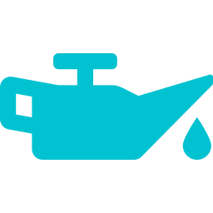





YOUR SKILLS TRANSFER TO SPACE
Oil & Gas · Automation · Manufacturing → Space Force Capability
WEST TEXAS CAPABILITY
→
SPACE FORCE APPLICATION
Downhole drilling, pressure & fluid systems
▶
Spacecraft propulsion & fuel management
SCADA, remote monitoring & industrial automation
▶
Satellite ground systems & on-orbit operations
Precision machining & advanced manufacturing
▶
Spacecraft structures, components & payloads
Pipeline sensors, NDT & anomaly detection AI/ML
▶
Space domain awareness & pLEO constellation sensing
Industrial cybersecurity (OT/SCADA networks)
▶
Defensive cyber for Space Force satellite systems
Extreme environment operations (heat, dust, remote)
▶
Lunar/Mars surface systems & EVA hardware
Distribution A. Approved for public release; distribution unlimited. AFRL-2025-3815
Notes:
- The joke in the space industry is that the hardest part isn't the physics — it's finding people who can build hardware in harsh environments on a schedule. You have those people here.
- Propulsion engineers who understand fluid dynamics and pressure seals? That's a spacecraft propulsion engineer. They just need a different customer.
- Remote sensing, SCADA, AI for anomaly detection — all of that maps directly to what SpaceWERX is funding today. The problem set is different, the skillset is the same.
- The path isn't "drop everything and become a space company." It's "apply your existing capability to a new customer: the Space Force."

Slide 5


SPACEWERX: DRIVING COMMERCIAL INNOVATION
Where Space Force Needs and Innovative Technologies Meet
SpaceWERX strategically invests in small businesses to rapidly develop emerging space technology for the U.S. Space Force and the commercial market.
Innovative Commercial Technology
Space Force Capability Gaps
Distribution A. Approved for public release; distribution unlimited. AFRL-2025-3815
Notes:
SpaceWERX is headquartered at The Bridge in Los Angeles — but its portfolio reaches everywhere, including West Texas.
- Division of AFWERX, the innovation arm of the Air Force Research Laboratory. Partnered with Space Systems Command's Commercial Space Office (COMSO).
- Mission: accelerate agile and affordable capability transitions by connecting innovative technology with Airmen and Guardians.
- The key word is "transition." SpaceWERX doesn't just fund research. It funds things that end up in the hands of warfighters.
- Since 2021: 1,470+ contracts totaling $1.46B. 50-person team, $468M annual budget executing SBIR/STTR.

Slide 6
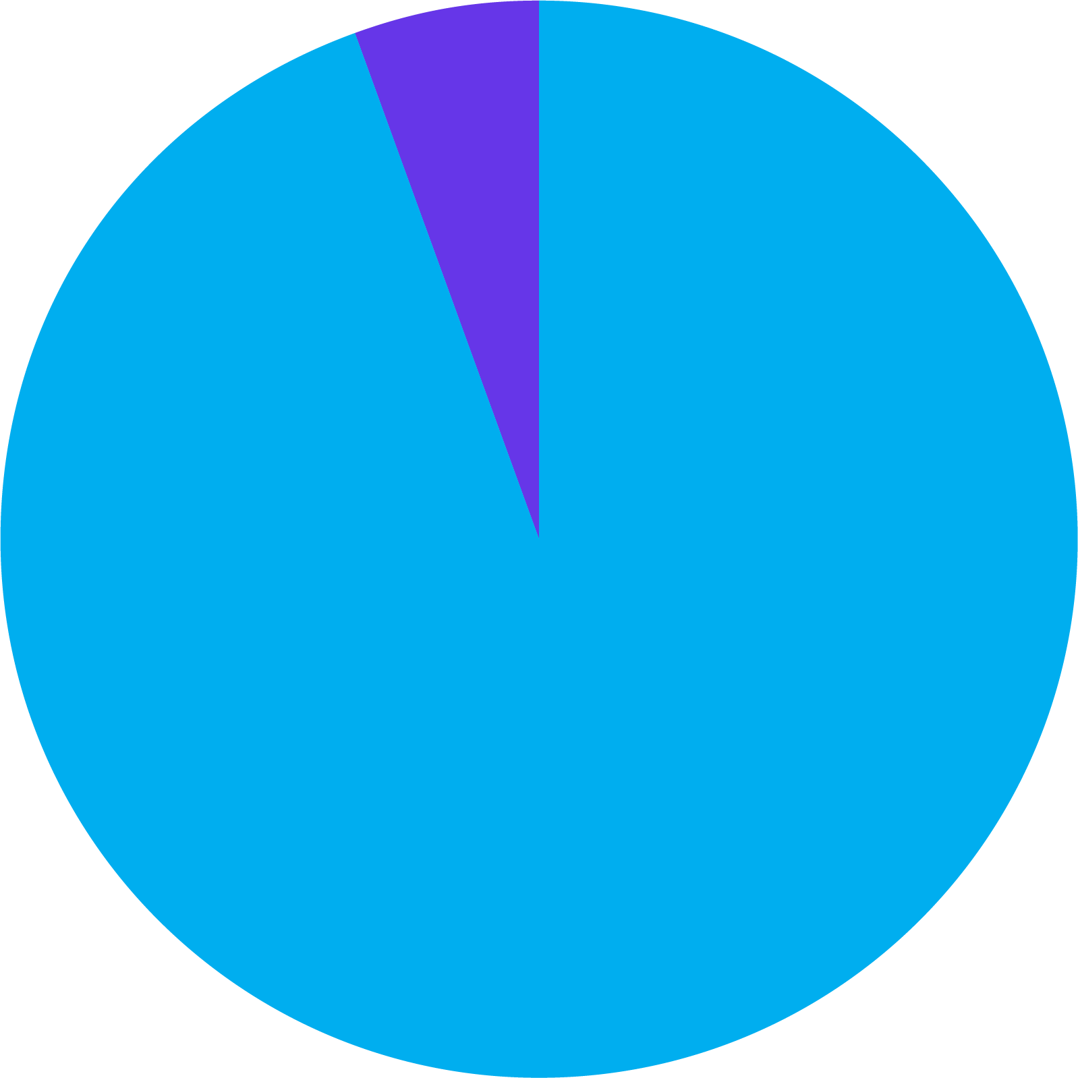
SPACEWERX SBIR/STTR BUDGET
Small Business Innovation Research/Small Business Technology Transfer
$1.5B+
Invested in commercial space innovation since 2019
STTR
1400
Companies awarded
FY25 Budget Summary
SBIR: $443,032,596.91
STTR: $25,683,049.00
Total: $468,715,646.91
SBIR
45%
New to Government
Distribution A. Approved for public release; distribution unlimited. AFRL-2025-3815
Notes:
- $468M per fiscal year. That's not a grant program — that's a structured investment portfolio.
- This comes from a congressional mandate: a percentage of the DAF's total R&D budget must flow through SBIR/STTR to small businesses. This money exists. It has to go somewhere.
- The question isn't whether SpaceWERX will fund companies — it's whether those companies are yours.
- SBIR is the predominant mechanism ($443M of the $468M). STTR is smaller but important for university-industry partnerships — highly relevant for UTEP, NMSU, and Texas Tech spinouts.

Slide 7
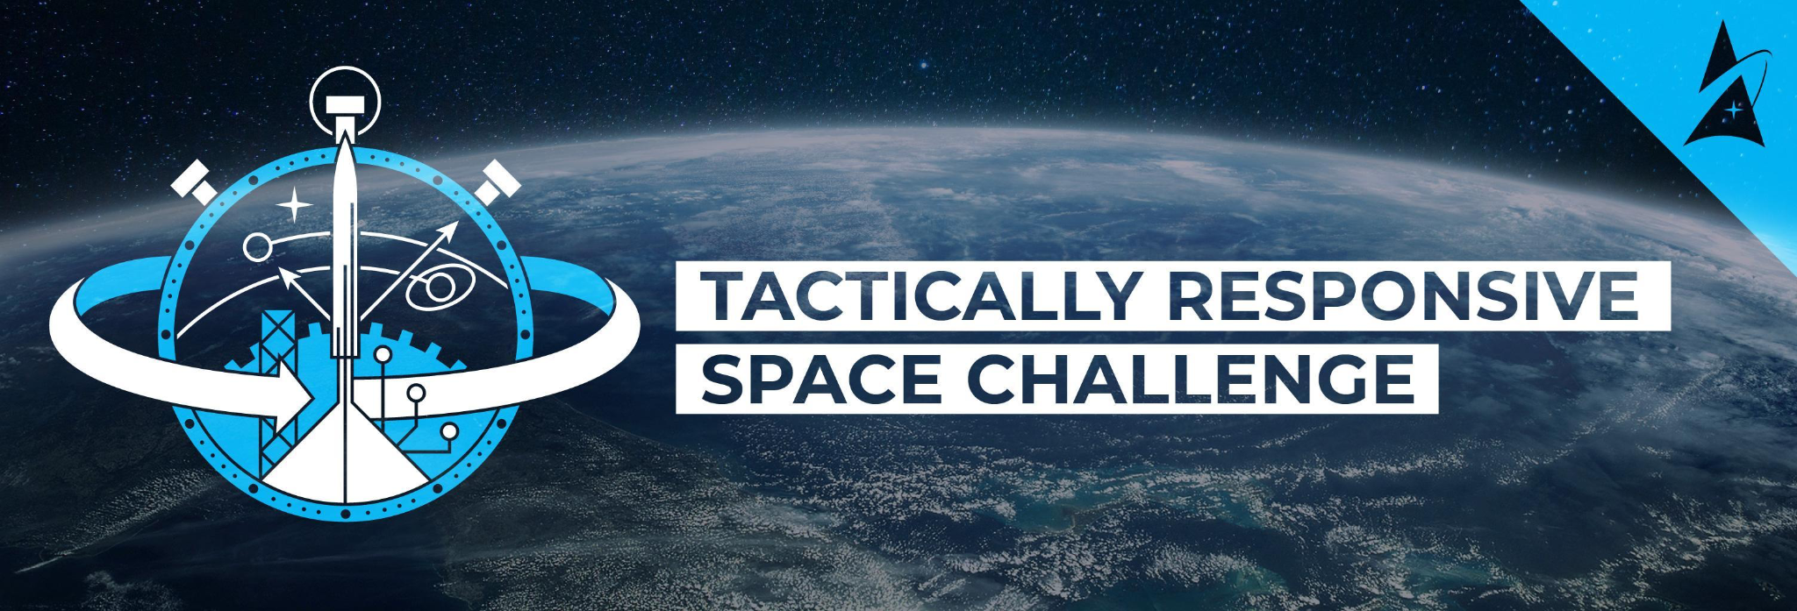
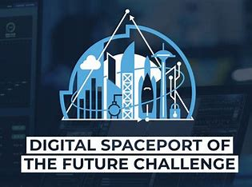

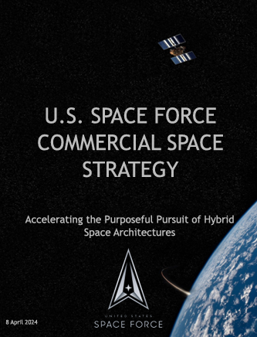

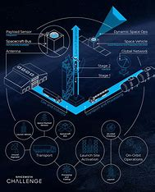
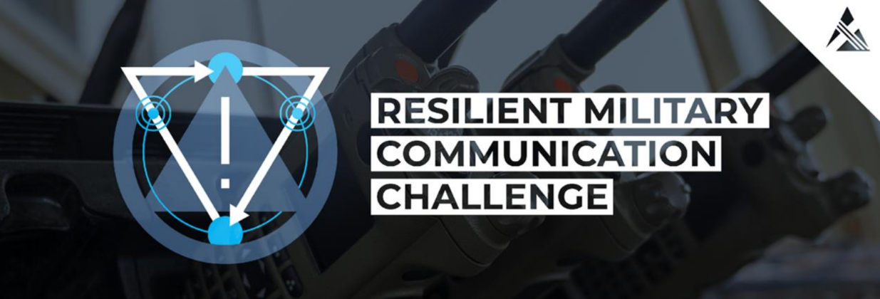

Focus on Critical Gaps
Funding Priorities
For the purposes of this strategy, mission areas considered for commercial support will be subdivided into Space Domain Awareness (SDA); Satellite Communications (SATCOM); Space Access, Mobility, and Logistics (SAML); Intelligence, Surveillance, and Reconnaissance (ISR) – hereafter referred to as Tactical, Surveillance, Reconnaissance, and Tracking (TacSRT); Space based Environmental Monitoring (SBEM); Cyberspace Operations; Command and Control (C2); and Positioning, Navigation, and Timing (PNT).
USSF Commercial Space Strategy
DISTRIBUTION A. APPROVED FOR PUBLIC RELEASE; DISTRIBUTION UNLIMITED. AFRL-2025-2339
‹#›
Notes:
Flip the funnel: Start with warfighter needs (via CDTs, Spark, operational commanders), not just open tech discovery.
Embed acquirers early: Ensure Programs of Record (PoRs) are aware and aligned with topic development and downselects.
Use “challenge-first” models: Collider events, problem curation workshops, and end-user reverse pitches help shape relevant topics.
Geo-strategic targeting: Prioritize gaps in contested domains (e.g., cislunar, comms resilience, space domain awareness).
Key
High-Quality Market Research Program
TacRS Challenge
Background
SpaceWERX launched three strategically relevant Challenges to support key elements of the USSF Strategy. Each Challenge brought together thought leaders, industry and academia to learn from each other on the current state of the art in a rapid form of collaborative high-quality market research that helps the USSF get solutions to problems.
Operational Impact
The Tactically Responsive Space Challenge connected SpaceWERX with cutting-edge capabilities that will enable the USSF to rapidly and flexibly respond to emerging on-orbit threats, and can reduce USSF response times from months or weeks to days or hours, significantly impacting U.S. and ally resilience. Every Challenge helps the service to increase knowledge by building out an ecosystem worth of knowledge and accelerating the path from idea to deployed solution.
Collaboration Organizations
SSC Space Safari, SSC/CG, SSC/AATS
AFWERX value
Powerful Market Influence: Success of the program relies on industry collaboration and high-quality submissions. Industry benefits by receiving access to government end-users and decision-makers. Since 2018, AFWERX has hosted 50 Challenges, received more than 7,600 solutions and awarded $78.8 million for 122 prototypes.
Dual-Use Tech Maturation: The technologies brought into the Challenge process currently exist within industry. Multiple solutions are leveraged and developed. There is also an opportunity for industry teaming.
Meaningful Defense Industrial Base Growth: AFWERX Challenge is a rapid, high-quality market research program that helps the DAF get solutions to problems from collaboration with industry and academia. The process is designed to bring together government, business, academia, and military to help advance operational readiness within the DAF and DoD. While the standard government contracting process can take multiple years, technologies vetted through the Challenge model move from selection to formal agreement in 12 weeks, on average.
VICTUS HAZE
Joint effort with DIU to support Tactically Responsive Space (TacRS) missions. VICTUS HAZE is an end-to-end, commercial Tactically Responsive Space mission designed to build upon lessons learned from VICTUS NOX, develop commercial vendor capabilities to support future TacRS needs, and demonstrate shortened response timelines in preparation for real-world missions.
True Anomaly and Rocket Lab will demonstrate their ability to build rendezvous and proximity operation (RPO) capable space vehicles and command and control centers with a delivery target of Fall 2025.
Under the Emergent Need SBIR program, SpaceWERX awarded True Anomaly a $60 million STRATFI contract, while DIU awarded Rocket Lab a $32 million contract for this effort.
COMPANY FOCUS:
True Anomaly was awarded a $1.7M Direct-to-Phase-II SBIR through SpaceWERX’s TacRS Challenge program. Under this SBIR, True Anomaly will demonstrate rapid payload integration, and responsive propulsion system design, and perform a multi-orbit capability assessment of its Jackal space vehicle. Jackal is a high-thrust, high delta-V, modular, and multi-mission capable space vehicle designed to rapidly initialize, maneuver without regret, and execute high-resolution, multi-face imaging and characterization via RPO. The 15-month effort kicked off 3 April 24 and will conclude late next year.
Additionally, through a partnership with Space Safari, True Anomaly was selected for an emergent need Phase IIB SBIR, funding a rapid on-orbit demonstration of their Jackal spacecraft as part of the Victuz Haze TacRS mission.
Space Safari and SpaceWERX are also working with the Office of Strategic Capital (OSC) to provide additional funding to the emergent need Phase IIB to accelerate operationalization of the capability. ((SBA is waffling on approving the OSC contribution. Would not discuss this unless it comes up.))
SPACEWERX CHALLENGE OBJECTIVE: The Tactically Responsive Space Challenge (TacRS) seeks cutting-edge capabilities to enable the USSF to rapidly and flexibly respond to emerging on-orbit threats by 2026.
https://www.afrl.af.mil/News/Article-Display/Article/3459615/spacewerx-launches-tactically-responsive-space-challenge-definition-workshop/
Traditional defense acquisitions involve complex and lengthy procurement processes that often span years or decades. This slow pace hampers the integration of cutting-edge technologies and doesn't allow for effective adoption. To address these challenges, SpaceWERX has launched the SpaceWERX Challenge Program, which explores alternative acquisition models such as rapid prototyping, agile development, and increased collaboration with commercial industries. This approach aims to foster innovation, reduce development cycles, and enable the adoption of cutting-edge technologies.
Up to $91M in SBIR funding for SPACEWERX
Total contracts:
19 from TacRS
20 from Alt-PNT
10 from DSPOTF
Company, technology, and award amount breakdown https://docs.google.com/spreadsheets/d/1gspkM7WZmOjuQA9r59ZKHWVjxxu1KLpGLmk-15q1y-4/edit?usp=sharing
FYSA totals add up to $87,148,927.88,. Per Jareth, the $91M number was the allocated budget across all three Challenges (max contract value x # of awards). Ultimately what’s awarded is slightly lower due to negotiations and individual proposal prices. Also, note that TacRS had funding allocated for 20 companies at $1.9M max each but ended up with only 19 companies due to a due diligence/timing concern.
-------------------------------------------------------
TacRS timeline:
Challenge Definition Workshop: 31 May 31 - 1 June 2023
Solicitation period: 30 Aug 23 - 28 Sept 23
Evaluation period: 5 Oct 23 - 19 Oct 23
Select List Finalized: 27 Oct 23
Award Sprint: 4 Dec 23 - 15 Dec 23
Showcase: Jan 23, 2024
—-------------------------------------------------------
AFWERX CHALLENGE OBJECTIVE (Challenge background slide deck)
AFWERX Challenge is a proven open crowdsourcing program that casts a wide net for industry and academic innovators to apply their latest technologies and solutions to government problems and accelerate the path from idea to deployed solution. Accelerates ideas to demonstrated and deployed solutions to DAF problems which enhance warfighting capabilities.
ORGANIZATIONS/PARTICIPANTS
Civilians, military, and contractors from AFLCMC, AF Sustainment Center, AFWERX, AFMC and Sandia National Lab Sandia National Lab, Federally Funded R&D teams (MIT, Lincoln Labs, Georgia Tech Research Institute, Kansas City National Security Campus, MITRE, and Johns Hopkins University Applied Physics Laboratory.
CURRENT CHALLENGES:
Sustained Space Maneuver Challenge Definition Workshop (June 5-6)
Alt Positioning, Navigation, & Timing (PNT) Challenge Showcase (July 10-11)
Super Goggle Challenge Showcase (July 24-25) https://docs.google.com/document/d/1uGD7TKzpFg7Y4W1NIyDRsIa7tFTOOffGvUF178WEVlw/edit
QUOTE:
https://www.geekwire.com/2024/pacific-northwest-space-companies-awards-space-force-venture-fund/
SpaceWERX announced the awardees of the 2023 SpaceWERX TacRS Challenge.
“The TacRS Challenge SBIR Direct to Phase II contracts are going to propel the U.S. Space Force toward future responsive and dynamic space operations,” said Col Erik Stockham, USSF Space Systems Command (SSC/SZA). “The future of space power requires capabilities that can respond to adversary action on tactical timelines. These innovative small businesses are developing groundbreaking approaches to employ space capabilities when and where it counts.”
“The TacRS SpaceWERX Challenge shows how impactful the collaboration with our mission owners can be. We’re thrilled to have supported the TacRS program team on what is clearly going to be an impressive cohort of companies and technologies,” said Lt. Col. Vinny Pande, Chief of SpaceWERX Ventures.
Awardees included:
Agile Space Industries, Inc.
Apex Technology, Inc.
Argo Space Corp.
Circle Optics, Inc.
Gravitics, Inc.
Impulse Space, Inc. (two awards)
K2 Space Corporation
Map Large, Inc.
PickNik, Inc.
Portal Space Systems Inc.
SCOUT Inc.
Space Rig Systems Inc.
Starfish Space
Ten One Aerospace, LLC
True Anomaly, Inc.
Turion Space Corp.
Varda Space Industries
Xtenti, LLC
The awardees were invited to the TacRS Challenge Showcase held in El Segundo, CA on 23 January. At the event, companies were given the opportunity to participate in an Ask Me Anything (AMA) session to ask questions to the Challenge Sponsor team; networking opportunities to meet other teams to assess collaboration opportunities; private pitches to the Challenge Sponsor team and other Air Force evaluators; and a trade show-style event for all teams to meet each other, the Challenge team, and other interested Airmen and Guardians.

Slide 8

Upcoming Areas of Investment
Cis-lunar Space Domain Awareness
  Object tracking in lunar or cis-lunar orbit
In-orbit Logistics
  Managing network of refueling and servicing satellites on orbit
Novel Space and Ground Based Sensing
  Proliferated dim target tracking
Defensive Cyber Operations
  New capability enabling protection of Space Force assets
Space Manufacturing
  Address bottlenecks in manufacturing for space technology (batteries, propulsion, etc)
‹#›
Notes:
- These are areas SpaceWERX has flagged as upcoming investment priorities. This is your advance notice — not a solicitation, but a directional signal.
- Cis-lunar Space Domain Awareness: tracking objects in lunar orbit. Nobody has this capability. It's a completely open field.
- In-orbit Logistics: refueling and servicing on orbit. This is a huge manufacturing and systems integration challenge — exactly the kind of problem West Texas industrial companies can address.
- Space Manufacturing: batteries, propulsion components, structures. These are real manufacturing problems, not software. If you run a precision machine shop or advanced materials company, this is your door.
- Defensive Cyber for Space: protecting satellite systems. If you're doing industrial cybersecurity for oil/gas pipelines and SCADA, the skill set maps directly.

Slide 9
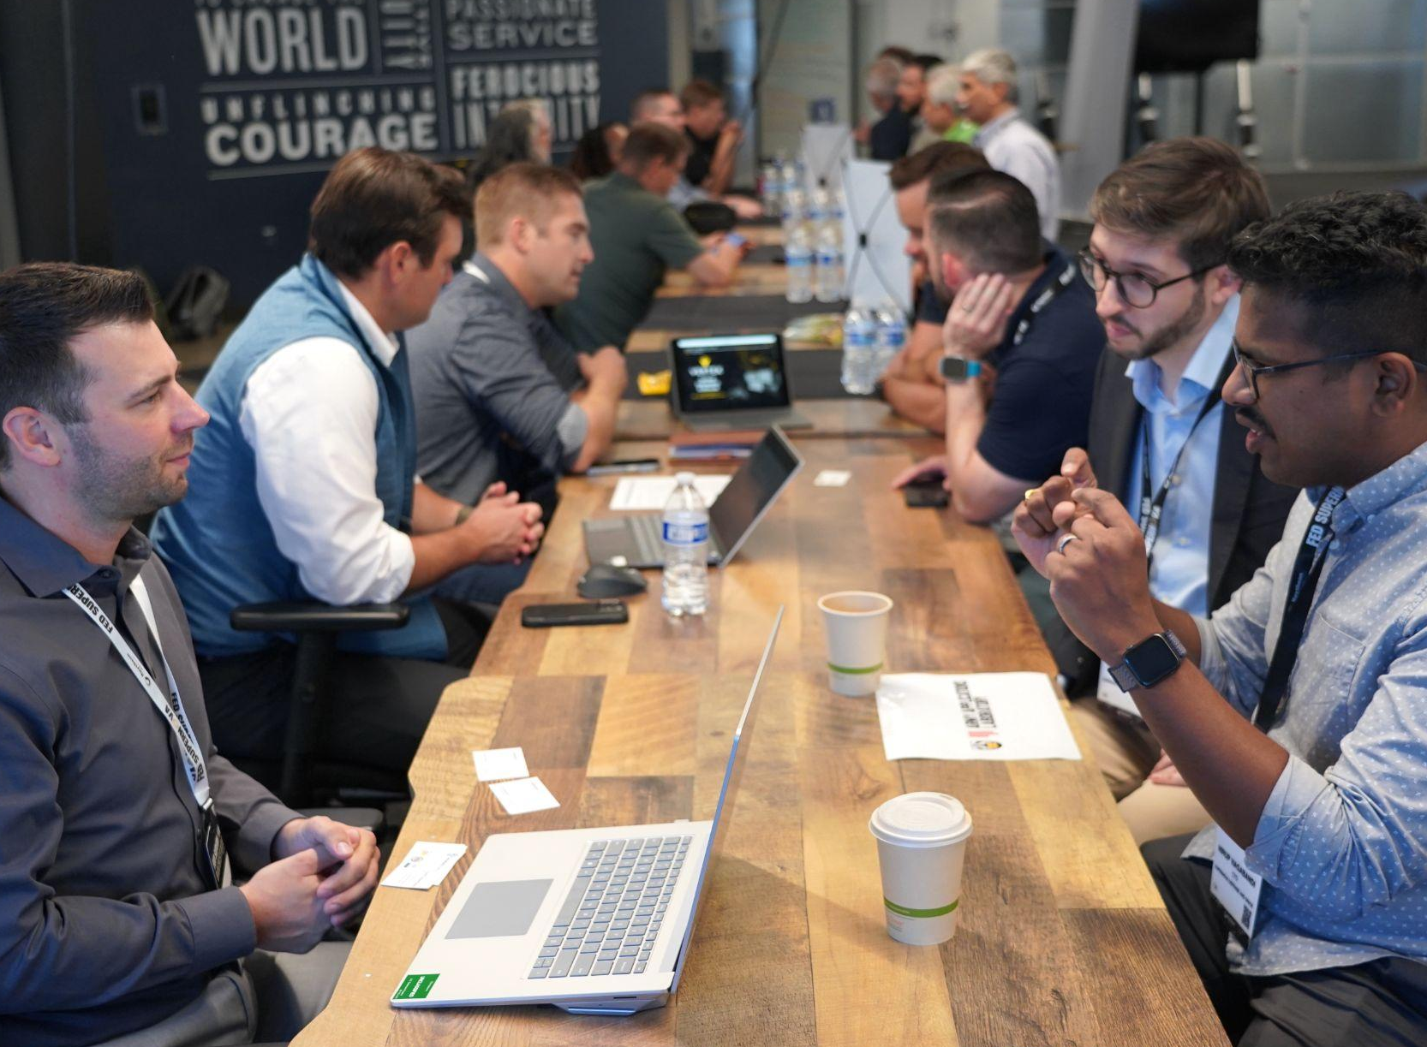
SMALL BUSINESS INNOVATION RESEARCH (SBIR)
The SpaceWERX SBIR program awards funding to a Small Business Concern (SBC) for the purposes of Research, Development, Test, & Evaluation (RDT&E) to meet agency needs and missions.
Eligibility for Award:
Have 500 or fewer employees
Be a for-profit company
Primarily U.S. owned/based, at least 51% ownership by U.S. citizens and/or permanent resident aliens
***Be sure to read the full eligibility requirements on SBA.gov
Distribution A. Approved for public release; distribution unlimited. AFRL-2025-3815
Notes:
- Basic requirements: 500 or fewer employees, for-profit, at least 51% U.S. owned.
- That's it. You don't need a government contracting background. You don't need a facility clearance to apply at Phase I.
- A lot of companies assume defense contracting is only for large primes. SBIR was specifically designed to exclude them. This program is for you.
- Full eligibility details at SBA.gov — always read those before you apply.

Slide 10
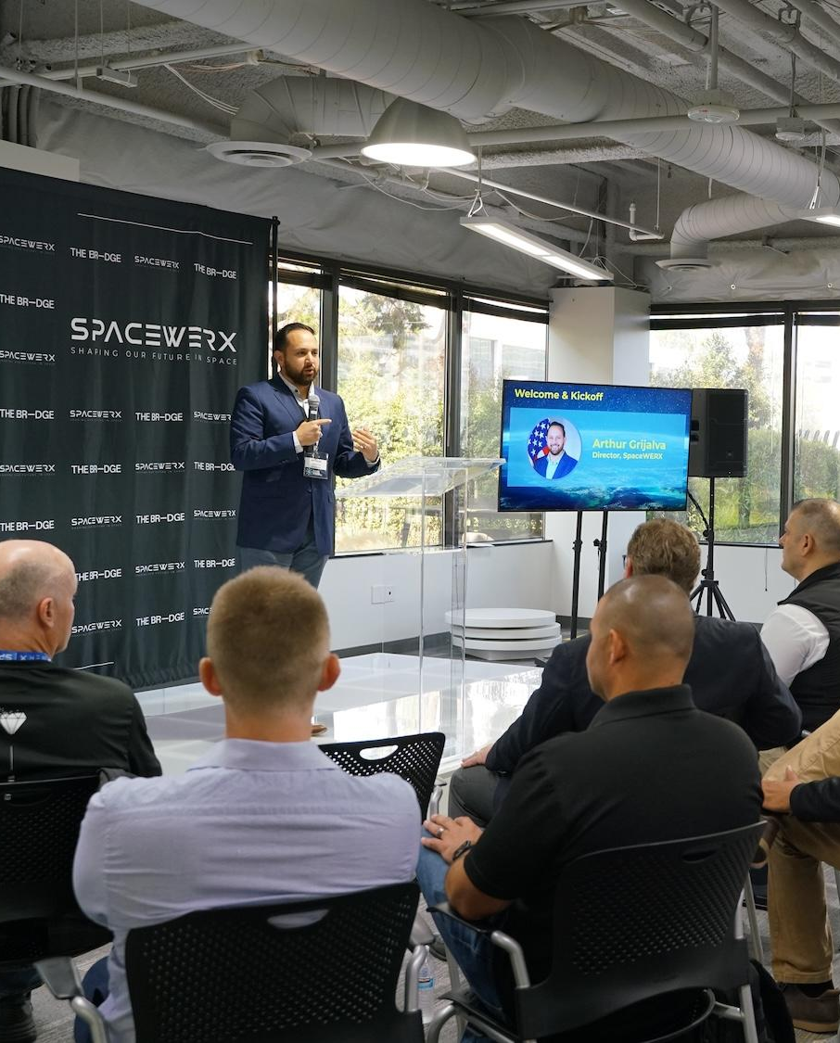
SMALL BUSINESS TECHNOLOGY TRANSFER (STTR)
The SpaceWERX STTR program is similar to the SBIR program, but requires a research partner consisting of one of the following:
University/University Affiliated Research Center
Federally Funded R&D Center
Qualified non-profit research institution
Eligibility for Award is the same as SBIR, and also includes:
Minimum of 40% of the research and development (R&D) work is performed by the SBC
Minimum of 30% of the R&D is performed by partnering research institution
The remaining percentage can be allocated to either the small business, the research institution, or a third party
The small business must be the prime contractor and the entity ultimately responsible for the award's success
***Be sure to read the full eligibility requirements on SBA.gov
Distribution A. Approved for public release; distribution unlimited. AFRL-2025-3815
Notes:
STTR requires a research partner: a university, federally funded R&D center, or qualified nonprofit.
- For this room, that means UTEP, NMSU, and Texas Tech are not just talent pipelines — they're formal partners that unlock a different funding track.
- The small business stays the prime contractor. At least 40% of the work performed by the SBC, 30% by the research institution.
- If you're a startup that spun out of one of these schools, or you have an existing faculty relationship, STTR is the faster path.

Slide 11
AWARD PHASES
Small Business Innovation Research/Small Business Technology Transfer
Phase I Award
Feasibility Study
$75K - $180K award
3 - 6 month Period of Performance (PoP)
Approx 1K awards made annually
Phase II Award
Prototype
$1.25M - $2M award
21 - 24 month PoP
Approx 500 awards annually
Direct to Phase II option available
TACFI & STRATFI (Phase IIB)
Accelerate
Initiated by Gov’t; Options to increase funding after Phase II award
Total funding (including match*) ranges from $750K to $60M
TACFI: 24 months PoP STRATFI: 48 months PoP
*Matches additional SBIR/STTR funds with other government agency and/or private funding
Phase III Award
Transition
Partnering with a government Program Office
Technology is considered mature
Uses non-SBIR/STTR funds
Low Technology Maturity
High Technology Maturity
Distribution A. Approved for public release; distribution unlimited. AFRL-2025-3815
Notes:
- Phase I: Feasibility. Is this idea worth pursuing? $75K–$180K, 3–6 months. Low barrier. Designed to let you prove a concept without betting the company.
- Phase II: Prototype. Does it actually work? $1.25M–$2M, 21–24 months. This is where you build something real.
- TACFI/STRATFI (Phase IIB): If your Phase II is going well, the government can inject more money to accelerate — up to $60M total with matching. This is the growth stage.
- Phase III: Transition. Your technology is mature, you're partnering with a government Program Office, and you're using non-SBIR funds. This is the "you made it" stage.
- The Direct-to-Phase II track is important: if you've already demonstrated feasibility on your own, you can skip Phase I and go straight to prototype funding.
Think of this as a funnel: broad at the top, focused at the bottom.
- Open Topics: SpaceWERX doesn't specify the problem. You bring the solution. Fastest path to an award (2–3 months from customer memo to contract). Best for companies that have a technology looking for a government customer.
- Specific Topics: SpaceWERX has identified the problem. You propose the solution. Built-in government customer, no need to find your own end-user. Better for companies that want a clearer problem statement before investing proposal effort.
- ~1,000 Phase I awards per year. ~500 Phase II awards per year. These are real numbers.
- Current solicitations are live on DSIP now. Pre-release topics open May 6, close June 3. Future topics release the first Wednesday of each month for the rest of the fiscal year (except July).

Slide 12
TACFI / STRATFI Program Details
Making Big Bets on Great Ideas
 | DEFENSE-ONLY | OR DUAL-USE
TACFI | 1 : 1 SpaceWERX : Program Office | 1 : 1 SpaceWERX: Private
STRATFI | 1 : 2 SpaceWERX : Program Office | 1 : 1 : 2 SpaceWERX : Program Office : Private
 | MINIMUM | UP TO MAXIMUM
TACFI | $374K SpaceWERX Contribution | $1.9M SpaceWERX Contribution
STRATFI | $3M SpaceWERX Contribution | $15M SpaceWERX Contribution
Notes:
TACFI (Tactical Funding Increase): $375K–$1.9M from SpaceWERX, matched 1:1. Either defense funding or private investment. 24-month period.
- STRATFI (Strategic Funding Increase): $3M–$15M from SpaceWERX, matched at 1:2 (defense) or 1:1:2 (with private capital). 48-month period.
- This is where SpaceWERX bridges the "valley of death" — the gap between a promising prototype and a fielded capability. Most DoD programs die here. STRATFI/TACFI exists specifically to prevent that.
- 63.5% of STRATFI companies have transitioned to Phase IIIs. That's not theoretical success — that's warfighter adoption.
- Eligibility: must have an active or recent (within 2 years, no earlier than 90 days) Phase II award. Must not have prior STRATFI for the same tech.
spacewerx.us — start here. Events, opportunities, program announcements.
- DSIP (dodsbirsttr.mil) — the actual submission portal. This is where proposals go.
- SBIR.gov — eligibility requirements, program guidance, and a database of all funded SBIR awards (useful for market research on what's been funded before).
- SpaceWERX Spark Help Desk (spacewerx.spark@afwerx.af.mil) — this is real. Email them. They respond.
- Market Research AI Tool (cdao.turboinnovate.com) — useful for understanding what the DoD has already funded in your technology area before you write a proposal.
- QR code goes to spacewerx.us. Pull it up on your phone now if you want.

Slide 13
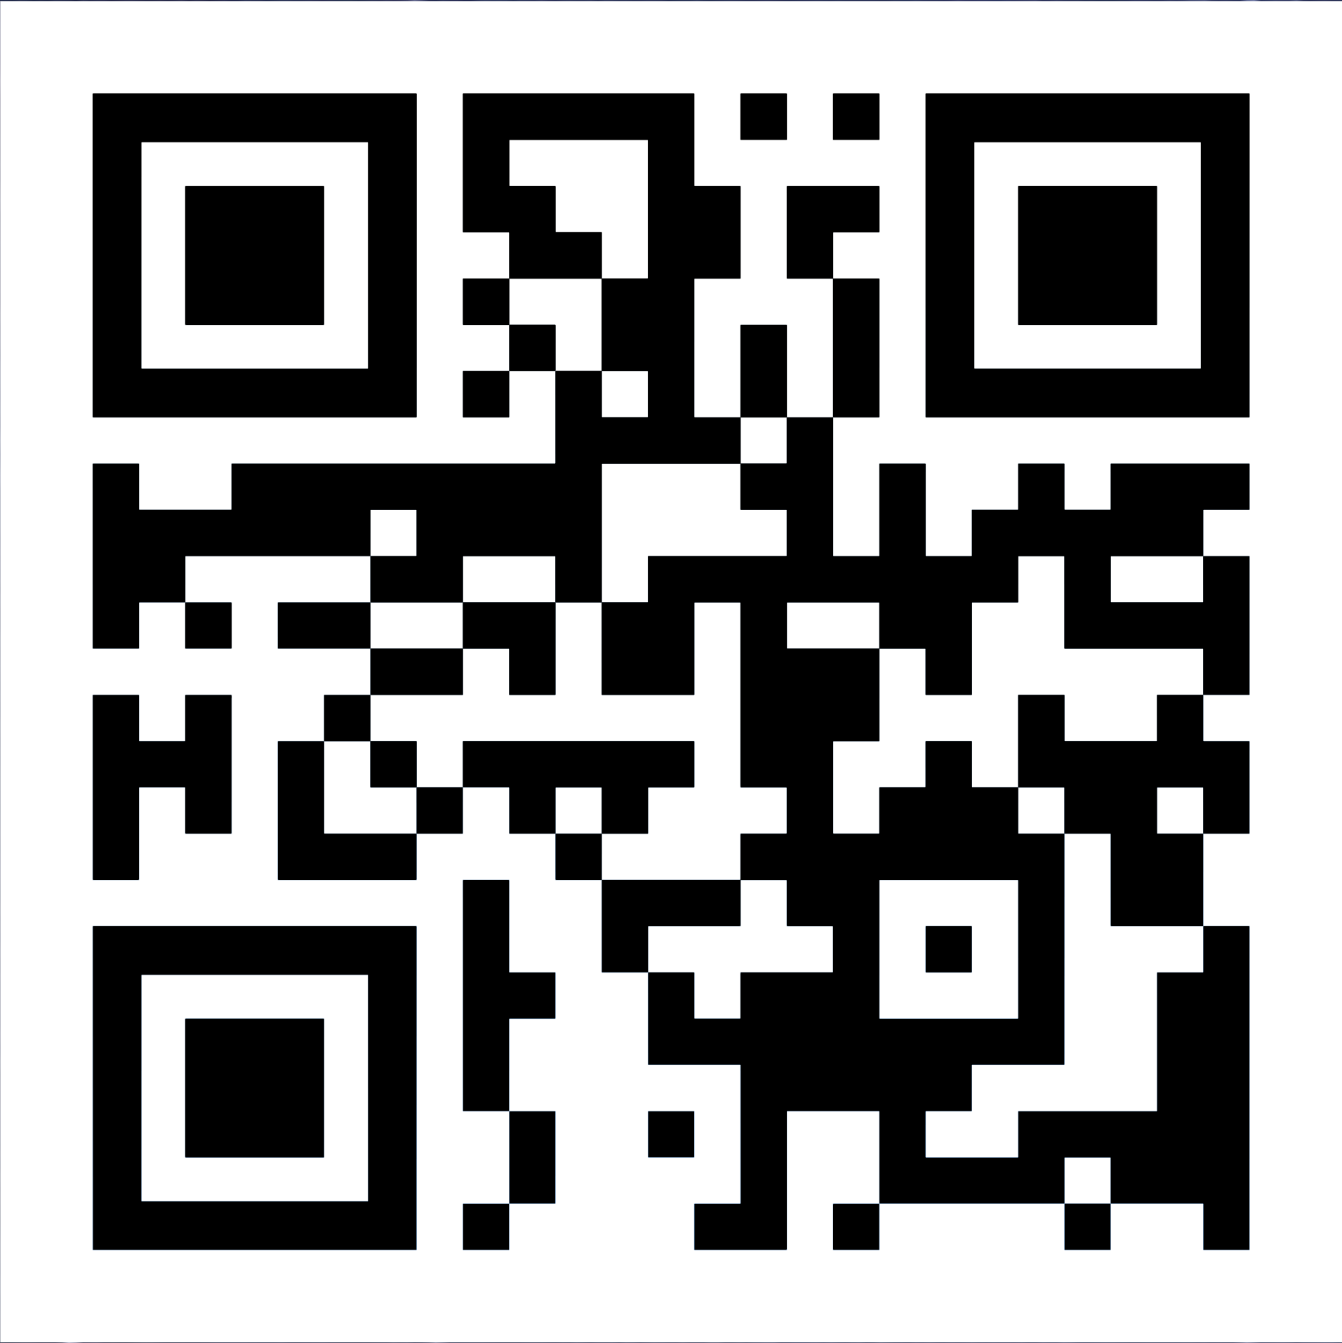
Additional Resources
Connect and Learn More!
Join the SPACEWERX Ecosystem
https://afwerx.com/about-us/afwerx-alerts/
SpaceWERX Spark Help Desk
spacewerx.spark@afwerx.af.mil
SBIR.gov
https://www.sbir.gov/
Market Research AI Tool
https://cdao.turboinnovate.com/
DSIP
https://www.dodsbirsttr.mil/
spacewerx.us
Distribution A. Approved for public release; distribution unlimited. AFRL-2025-3815

Slide 15
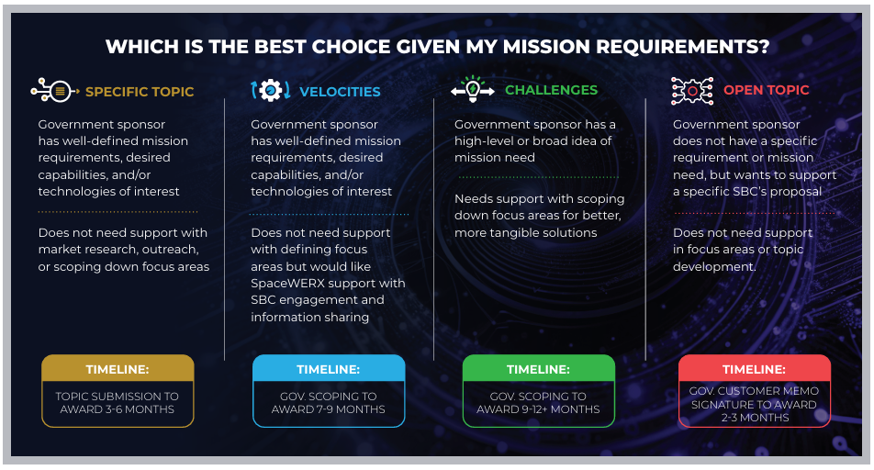
Distribution A. Approved for public release; distribution unlimited. AFRL-2025-3815

