Slide 1
Epidural Catheters

Slide 2
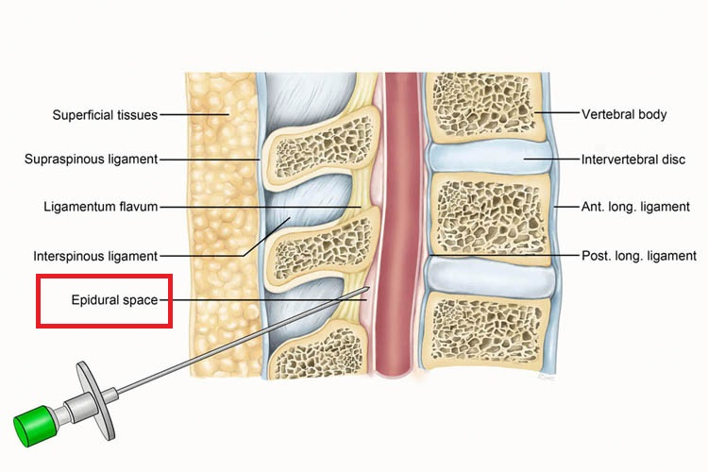
WHAT IS AN EPIDURAL?
Epidural space is the empty area posterior to the spinal cord.
Medications administered to the epidural space absorb into the CSF for effect.
Either a single injection or an indwelling catheter can be used to dose the epidural space.

Slide 3
Why Use An Epidural?
An epidural is placed for the purpose of pain management.
Allows the patient to receive an effective dose of medication while minimizing side effects.
This means:
  Limited systemic opioid effects
  Less sedation
  Patient is more likely to ambulate earlier
  Patient is able to cough and deep breath more effectively

Slide 4
Where Is It And When Is Commonly Used?
May be placed in the thoracic, lumbar or caudal regions
Provide pain management for patients with medical, surgical or traumatic needs
The placement of an epidural catheter procedure is done by anesthesia
A signed informed consent must be completed
Some examples include
  Thoracic surgery
  Rib fractures
  Chest tubes
  Abdominal surgery
  Lower extremity amputation
  Lower extremity orthopedic surgery

Slide 5
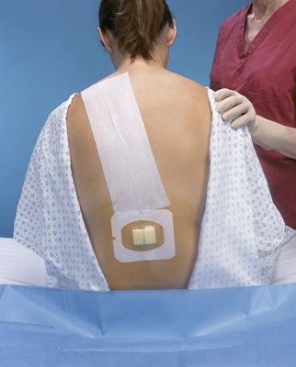
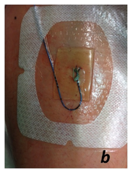
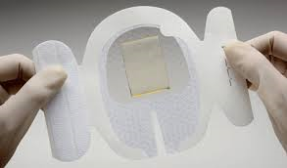
Epidural Dressings
A clear CHG dressing is used for visualization of the site
  Assess for blood, oozing, or tenderness and document
  A small amount of blood at the site is common
Google Images
Google Images

Slide 6
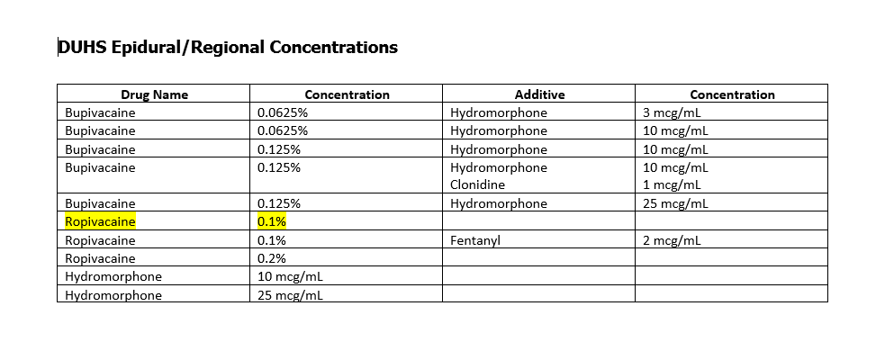
Now medication can be delivered…
Various medications may be infused via the epidural catheter, usually local analgesics and opioids. To provide a synergistic effects, the combination of these is utilized.

Slide 7
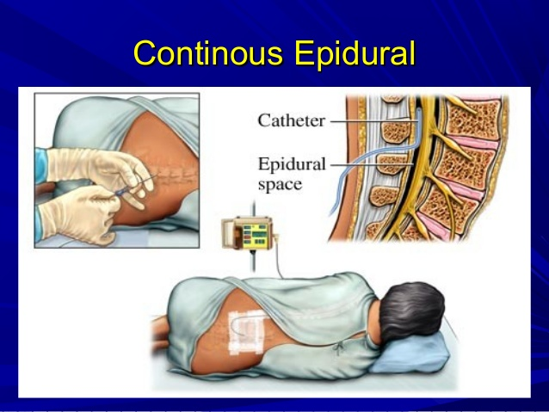
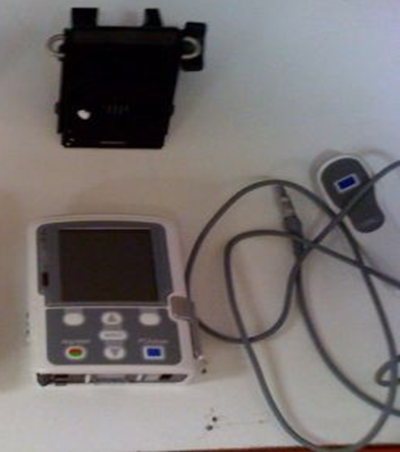
Managing Pain Via Epidural:
Continuous Infusion
Provider Orders for continuous epidural infusion will include:
Continuous rate
PCEA (optional)
  Patient bolus
  Bolus frequency
  1 hour lockout
Google Images
CADD Pump, W.Molasky
Notes:
Typical regimens
Who wont get a PCEA

Slide 8
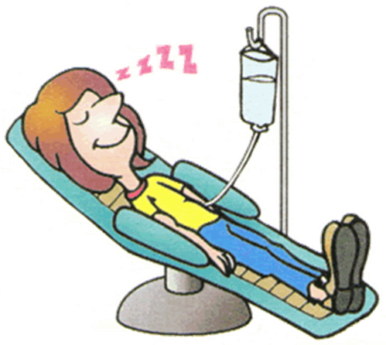
PATIENT ASSESSMENT OVERVIEW
Q2 hours for 24 hours after initiation, increase in dose or bolus, change in solution, or reportable condition, then Q4 hours
  Pain score, scale, and pt satisfaction
  RASS
  Respiratory Rate
  Quality of Respirations
  O2 Sat
Qshift
  Epidural site
  Bromage Scale, motor function
  Local anesthetic toxicity
  Adverse Effects: N/V, itching
  Nausea/vomiting
  Pruritus
Q4 hours
  Clear pump

Slide 9
PATIENT ASSESSMENT OVERVIEW
General
Vital signs, Pain
Mental status, Sedation
Motor/sensory assessment
Adverse Effects
Abnormal vital signs (BP, RR)
Nausea/vomiting
Pruritus
Local anesthetic toxicity
Notes:
Pain assessed using appropriate scale q2hr or within hour with bolus/dose/rate/solution change at Duke
RASS sedation scale used at Duke
Motor scales: Bromage, Miller Hahn

Slide 10
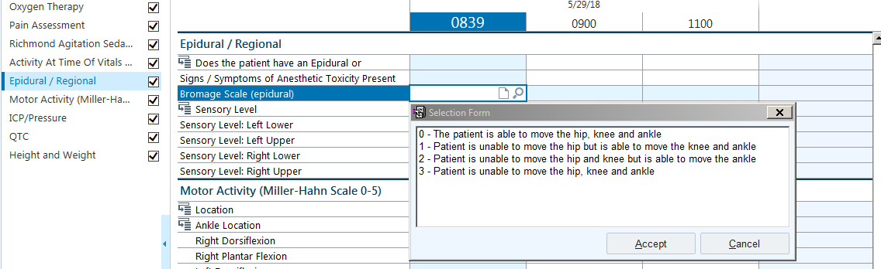
Bromage Scale (Epidurals)
Notes:
Notify provider/IPS of any changes

Slide 11
EPIDURAL DOCUMENTATION
Pain score, RASS & Respiratory rate Q2 hours
Reassess RASS, pain assessment and respiratory rate within 1 hour of bolus
Vital signs as ordered
Verification of epidural medication and settings
Adverse effects r/t epidural therapy
Site assessment and dressing
Motor and/or sensory deficits
Patient teaching related to pain/epidural therapy

Slide 12
PATIENT/FAMILY EDUCATION
Ongoing patient and family education is critical during every encounter with the patient to ensure safe, effective pain management using epidural medications.
Topics may include:
  Use of equipment of PCEA pump/button
  Side effects and actions to address
  Use of non-opioid and non-pharmacologic pain interventions to address pain
  Patient/family goals and desires for pain management
  Expected progression during post-surgical care

Slide 13
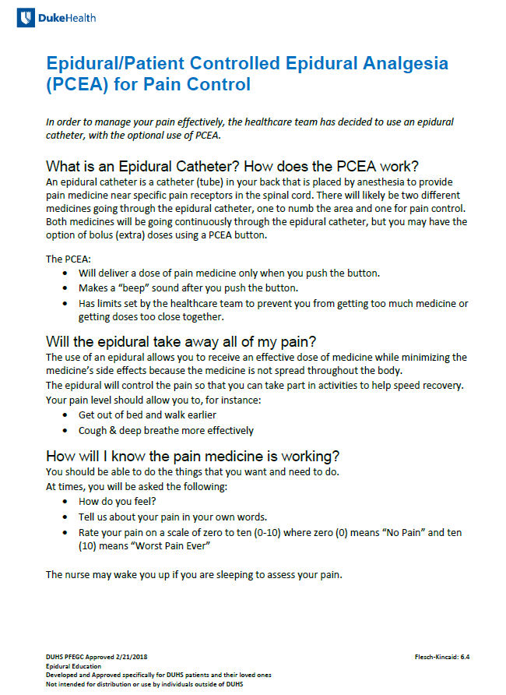
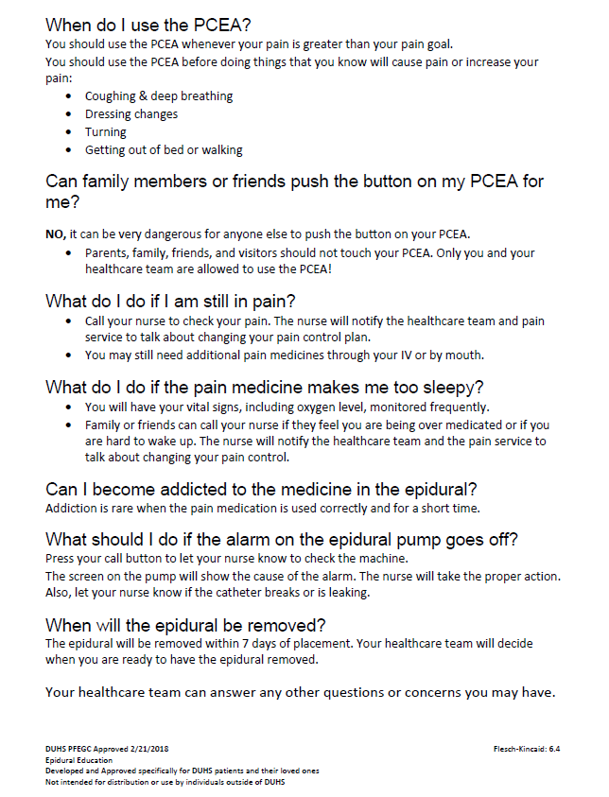
Patient and Family Education
Available on CEPD Website, ExitCare, or Pain Champion SharePoint Site

Slide 14
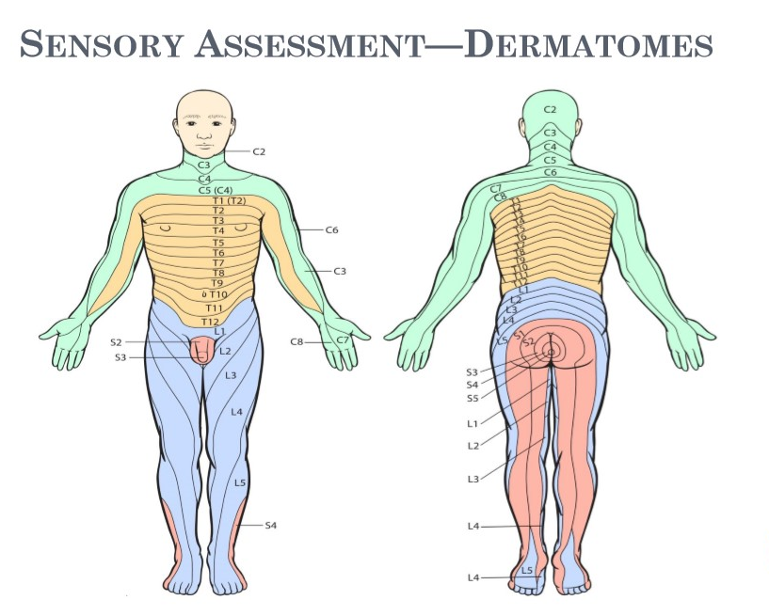
Checking Levels
Google Images
Notes:
Something you as the RN can do…it covering at all? One sided?

Slide 15
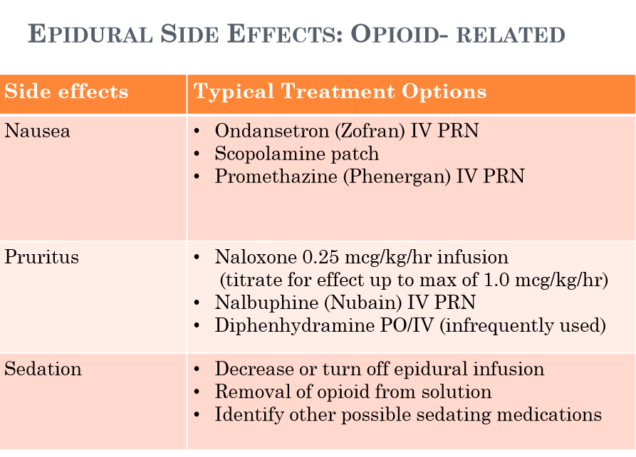
Notes:
When treating nausea, the medications used in combination with opioids may increase the patient’s risk for sedation
Opioid receptor antagonist- mu receptor antagonist

Slide 16
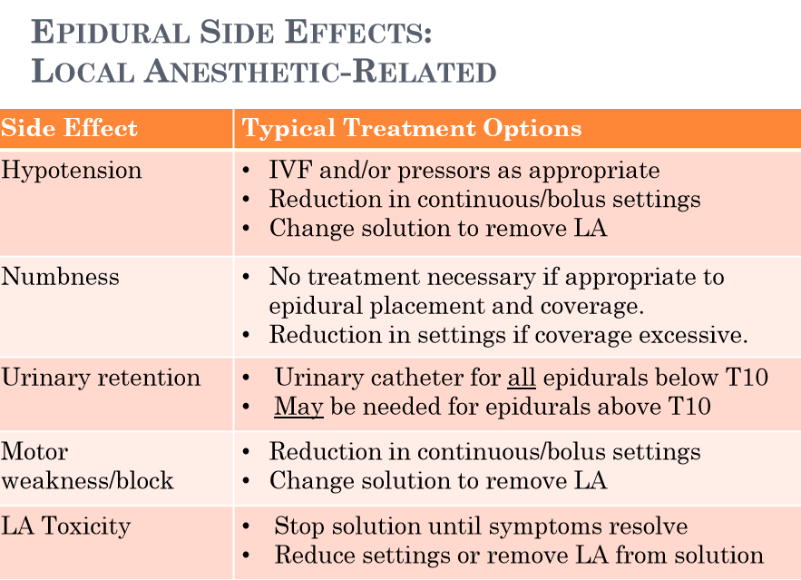

Slide 17

Notes:
Cosyntropin and/or caffeine can be used to treat pdph too
Pdph better when lying flat

Slide 18
WHEN TO CALL THE PROVIDER
Oversedation (RASS <-1) and/or mental status changes
Respiratory depression (RR<10, hypercarbia)
Catheter concerns: tubing disconnect/break, dislodgement
New or worsening medication/epidural side effects
Motor blockade/weakness

Slide 19
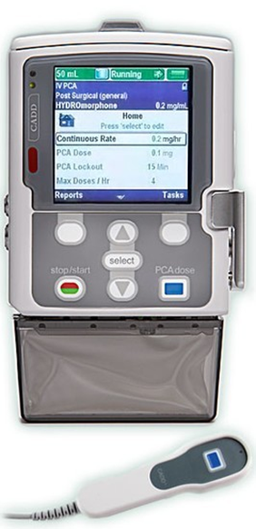
The Infusion Pump
The CADD© Solis pump model 2100 is used to deliver epidural infusions at DUH. With a competent preceptor, you will need demonstrate use of this pump. This includes:
  On/Off
  Prime
  Setting up a continuous infusion
  Setting up PCEA
  Increasing and decreasing rate
  Clinician Bolus
  Starting and stopping infusions

Slide 20
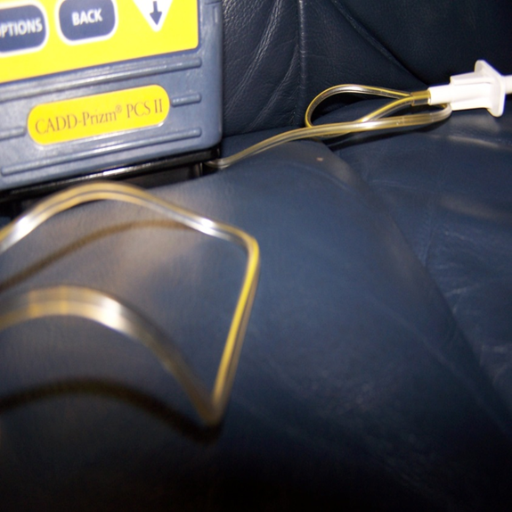

What Else
Do I Need To Know about Epidurals?
  The Tubing . . .
  Tubing Must Not be connected to any other line except the epidural catheter
  The tubing has a yellow line in it and is port free
  It is labeled with date, time and initials of change
  Do not “cap” an epidural catheter unless instructed to do so by a Pain Service Provider

