Slide 1
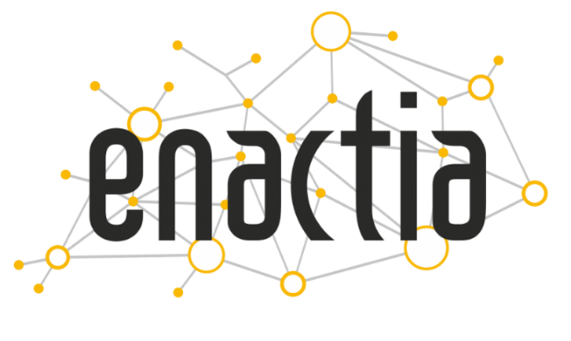
Simplifying
Governance
Risk
Compliance
Investment Pitch Deck - February 2023
Case Studies
April 2024

Slide 2
Customer Success Story
500+ Processing Activities have been recorded since June 2020 and constantly updated by the Bank’s employees.
Hellenic Bank: Largest Bank in Cyprus
Hellenic Bank is one of the largest banking and financial institutions in Cyprus. Established in 1976, it serves both individual customers and businesses, providing solutions like loans, deposits, payment services, and internet banking. Over the years, Hellenic Bank has grown significantly, marked by strategic acquisitions and an expanding presence in the Cypriot market. The bank is known for its commitment to innovation and has been a frontrunner in adopting digital banking technologies to enhance customer experience and operational efficiency.
800 + Assessment have been performed within the system for Data Protection Impact Assessments, (DPIAs), DPIAs Pre-Assessment Evaluation, Legitimate Interest Assessments, Compliance Assessments
The problem & challenge phased by the Organization and how Enactia supported
www.hellenicbank.com
3 Years + 3 Years renewal which validates Enactia and assures the value added to the Organization
Return of Investment
5x less cost in Compliance since using Enactia
One of the greatest challenges faced by the bank was automating their internal procedures to document all business processes involving the processing of personal data, ensuring compliance with the Data Protection Law (GDPR) requirements. Initially, during the early stages of GDPR enforcement, this documentation was manually handled using spreadsheets. However, the bank later decided to adopt a digital solution to streamline this process. Today, Enactia serves as the bank's core solution for governing privacy and cybersecurity compliance. It automates previously manual procedures and facilitates collaboration among all departmental heads and management staff.

Slide 3
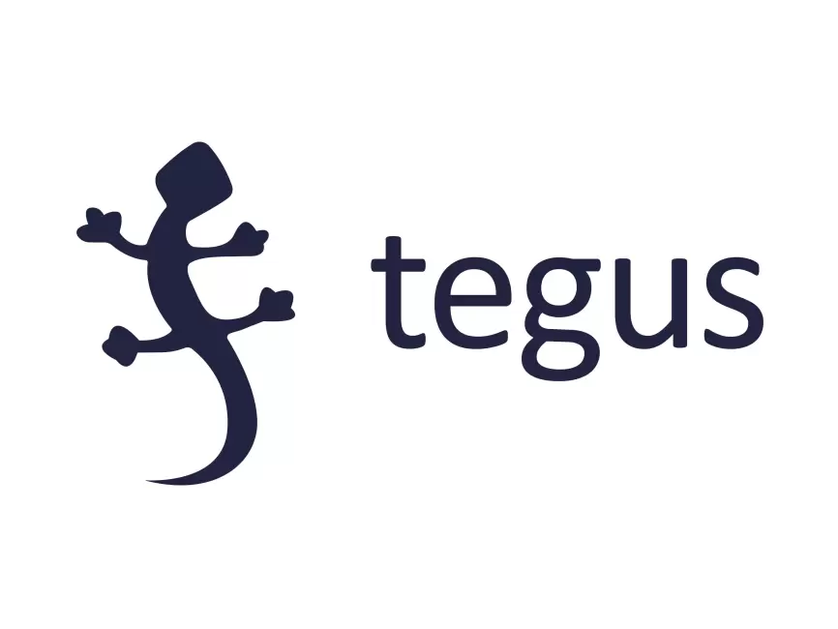
Customer Success Story
Tegus: US based entity with international presence
425+ Processing Activities have been recorded since Jan 2023 and constantly updated by the Bank’s employees
Tegus Inc. is a leading platform that specializes in providing comprehensive qualitative insights for investment professionals. It offers a vast database of expert interviews and industry analyses, facilitating deeper understanding and more informed decision-making in the investment process. Tegus helps investors, analysts, and other financial professionals stay ahead in a rapidly evolving economic landscape.
4000 + handled requests from individuals (Data Subject Request) that exercised their rights for data handling, alteration, deletion on time and according to Privacy Regulations
The problem & challenge phased by the Organization and how Enactia supported
The organization faced significant challenges in monitoring compliance with diverse privacy laws across multiple jurisdictions, including Australia, Europe, and the USA. To address this complex issue, they selected Enactia over other market-leading tools due to its robust capabilities and superior user experience. Enactia has empowered them to efficiently manage thousands of data subject requests (alter data, delete data, etc.) globally, handle supplier and third-party relationships, and monitor associated risks. Moreover, Enactia has enhanced collaboration among employees, fostering teamwork and facilitating a comprehensive approach to achieving compliance objectives. Enactia has enabled the organization to maintain high standards of privacy and data protection in a multi-regulatory environment.
www.tegus.com
1 Years + 1 Years renewal which validates Enactia and assures the value added to the Organization
Return of Investment
A team of more than 50 people using Enactia saves the company several hundreds of thousands per annum

Slide 4
Customer Success Story
Remedica: Pharmaceutical Company
Remedica is a pharmaceutical company based in Cyprus, known for producing high-quality generic pharmaceutical products. The company specializes in a range of therapeutic categories, including cardiovascular, infections, psychiatric, neurological, and oncological diseases. Remedica has a significant international presence, exporting to over 100 countries across Africa, the Middle East, Europe, and Asia. They play a crucial role in supplying affordable medications to developing markets, supporting local healthcare systems.
New Win - April 2024
CISO & DPO Assisting the CISO and DPO of the organization with their daily tasks and responsibilities.
Privacy & Cybersecurity Creating appropriate governance structures to ensure compliance, reduce risks, and enhance resilience.
Return of Investment Company is looking to optimize its internal processes according to several frameworks for saving money and time while it excels in compliance and risk management
The problem & challenge phased by the Organization and how Enactia supported
Remedica is embarking on a comprehensive digital transformation journey aimed at enhancing its operational efficiencies and compliance with various legal and regulatory frameworks. As part of this transformative initiative, Remedica is digitizing its compliance and governance to meet multiple obligations, including Good Manufacturing Practice (GMP), cybersecurity, and data protection. This also includes a wholesale infrastructure transformation, such as moving its operations to the cloud. To support this extensive digital overhaul, Remedica has selected Enactia as the solution of choice. Enactia will facilitate a more transparent approach to risk identification and monitoring, thereby ensuring Remedica achieves and maintains compliance across its operations.
www.remedica.eu

Slide 5
Customer Testimonials
“Enactia is a user-friendly solution assisting the Bank to comply with its regulatory obligation to maintain a record of its processing activities. Through the solution we also carry out the necessary assessments required under GDPR. It offers a holistic management of all the processing activities of the Bank. Enactia team has been really supportive in setting up the Bank’s specific parameters and met our expectations duly and with the utmost professionalism.”
Maria Aristidou Demetriou
Data Protection Officer (DPO)
"Enactia UI is extremely intuitive, making it easy for even novice and experienced users to navigate and interact with the various features. The in-depth knowledge base and the helpful Enactia Team further enhance the user experience, providing valuable resources for those looking to fully utilize the capabilities of the software. One of the standout features of this software is its ability to address risk and compliance challenges. The built-in controls, automation, alerting, assessment templates and monitoring tools help ensure that all actions taken within the software adhere to relevant regulations and policies, providing a high level of assurance for users and their organizations."
Costas Tziazas
Chief Information Security Officer (CISO)

Slide 6
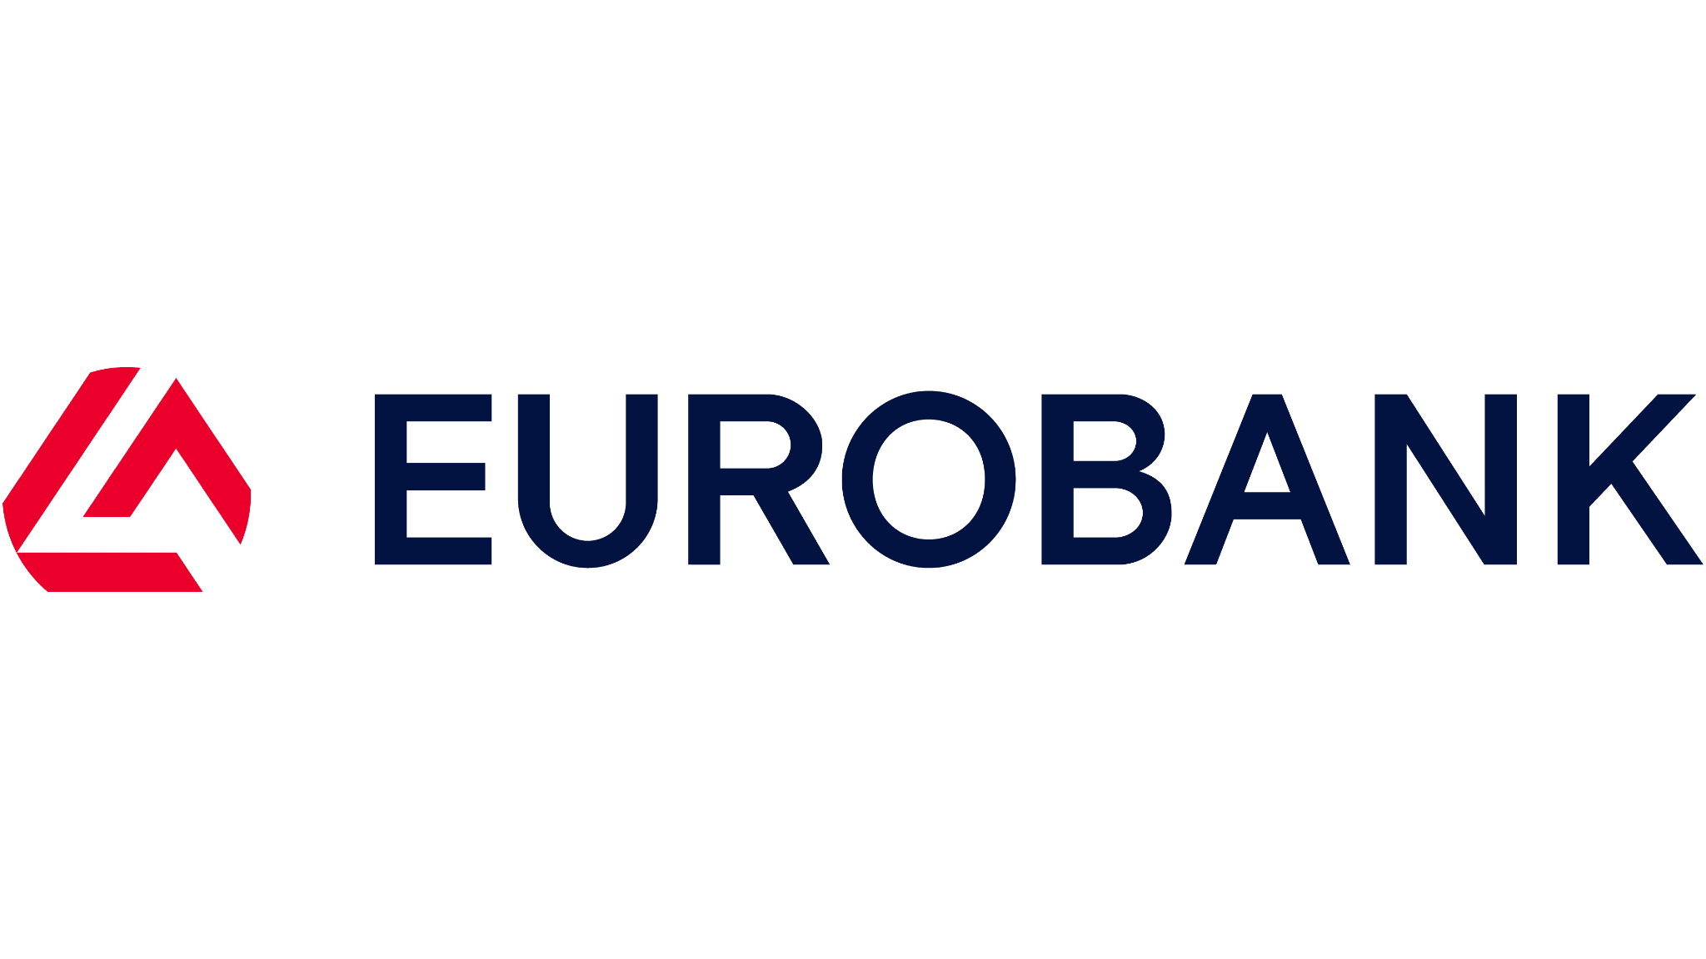
Customer Testimonials
“Digitalization of our Compliance with the use of Enactia, helped our organization maintain compliance effortlessly and enhanced foster collaboration with the Information Security, Risk management and Privacy functions. With Enactia we have access to a plethora of compliance assessments (ISO Frameworks, GDPR, NIS Directive, SOC2) with the flexibility of customization”.
Anna Papaonisiforou
Senior Manager, Digital Risk | Advisory
“Eurobank Cyprus faces a variety of challenges based on the various regulatory obligations and GRC frameworks they need to abide by. As such, it is essential to have a centralized way of monitoring and managing control effectiveness. Enactia platform makes it easier for a business to stay in control of these challenges from a process standpoint. The platform also facilitates risk management processes by highlighting what risks each business unit is exposed to, by providing controls to mitigate risks and by assigning responsibilities to different owners”.
Christina Georghiadou
Information Security Officer and Data Protection Officer

Slide 7
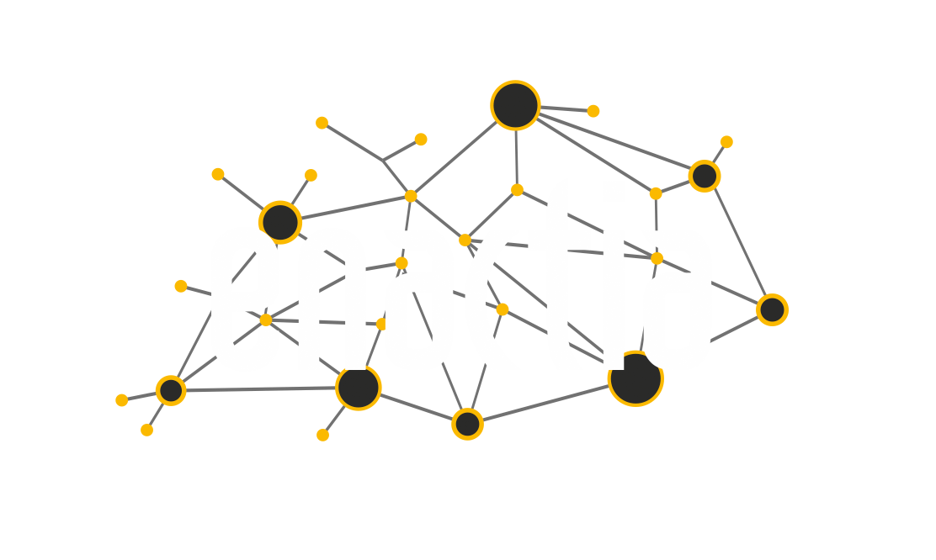
Empowering individuals and encouraging businesses across the globe to respect privacy, build trust and safeguard data.
E: team@enactia.com | W: www.enactia.com
enactia
@enactia
EnactiaLtd

