Slide 1
Take Action Before a Diagnosis
Dietary and lifestyle interventions for blood sugar dysregulation and cholesterol management
Lara Lattman, MS, CNS, LDN

Slide 2
Blood Sugar Dysregulation
Blood sugar dysregulation can refer to either hypoglycemia or hyperglycemia.
Hypoglycemia: when blood sugar dips too low
Hyperglycemia: When blood sugar rises too high

Slide 3
What should my blood sugar be?
Conventional Rage:
Normal: 70-100
Prediabetes: 100-120
Diabetes: >120
Functional Range:
Normal: 80-90

Slide 4
Prediabetes
Blood Glucose of 100-120
Hemoglobin A1c of 5.7 to 6.4
Often Metformin is introduced here. Metformin will not prevent you developing diabetes, it will only delay the development.
This is a warning sign from your body.

Slide 5
Symptoms of Hypoglycemia
Dizziness
Feeling lightheaded
Irritability when skipping meals
Feeling shaky
Hunger
Sweating
Symptoms alleviated by eating

Slide 6
Symptoms of Hyperglycemia
Headache
Blurred Vision
Increased Thirst
Frequent Urination
Fatigue

Slide 7
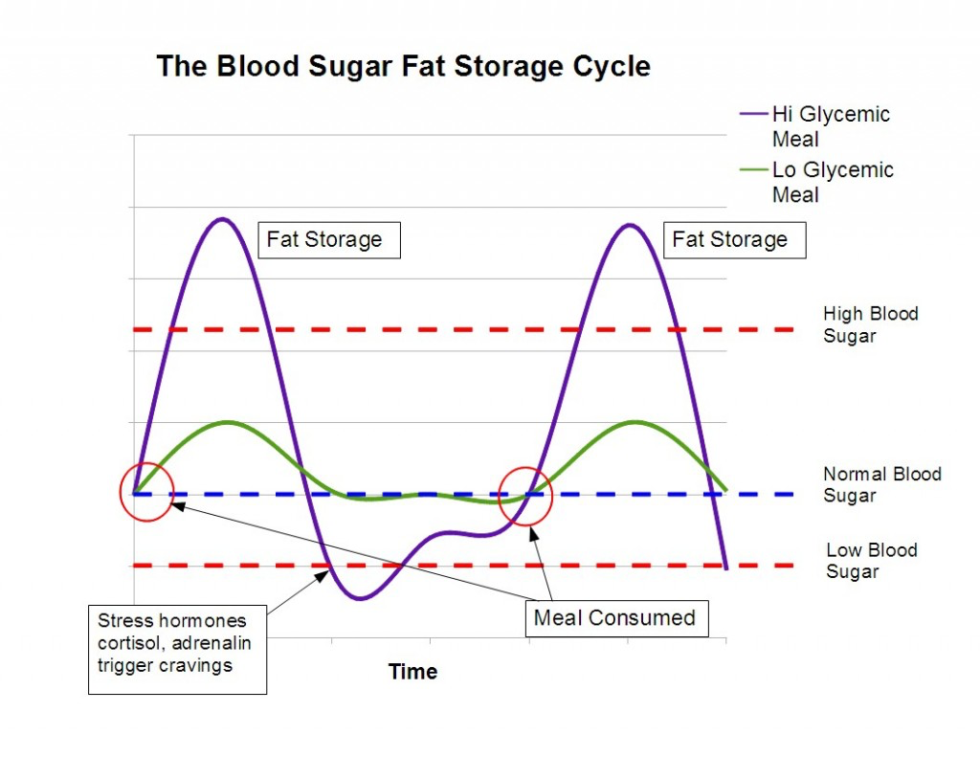

Slide 8
Avoid the Rollercoaster
Eat meals at regular intervals
6 small meals every 3 hours
3 meals about every 5 hours
Do not skip meals!
There is benefit from intermittent fasting
Only eat when the sun is up
Have at least a 12 hour break from eating

Slide 9
Healthy Portions
Whole Grains – limit to ½ cup at each meal
Nuts and seeds – a palm-full is 1 serving
Vegetables – limit starchy vegetables such as corn and white potatoes
Fruit- Limit to 2 servings a day. 1 serving is 1 cup or 1 medium sized fruit. (1 cup berries, 1 apple, ½ a grapefruit)
Beans and legumes 1 cup for protein
Organic meats, wild caught fish – 4-5 oz is 1 serving

Slide 10
Carbohydrates
For a person with uncontrolled blood glucose you may need to limit carbohydrate intake to 15g per meal:
1 slice of bread = 15g carbohydrates
1 bagel= 52g carbohydrates
½ cup cooked wild rice= 15g carbohydrates
½ cup white rice = 21g carbohydrates
½ cup cooked spaghetti = 21g carbs
½ cup black beans = 22g carbs

Slide 11
Healthy Snacking
Snacks should always contain protein and healthy fat
Apple with nut butter
Vegetables with hummus or guacamole
Organic Jerky (Epic is a good brand)
Berries with a hard-boiled egg
Goat cheese on rice crackers (Mary’s Gone are great!)
Snacks should never give you energy or make you tired. They should sustain you.

Slide 12
What is Cholesterol?
Cholesterol is an antioxidant in the body
Your body needs cholesterol to create all sex hormones
HDL particles gather up used cholesterol to be taken back to the liver for elimination
The LDL particles take cholesterol from the liver to the rest of the body to be used by every single cell

Slide 13
Healthy Cholesterol Numbers
Total Cholesterol: < 200
LDL Cholesterol: < 100
HDL Cholesterol: >40
Triglycerides: <150
With the exception of HDL, there are no lower limits as of now on conventional cholesterol tests. However, there is evidence that having a total cholesterol lower than 120 can increase mortality.
For HDL Cholesterol, tests do not set an upper limit, but HDL above about 96 is indicative of inflammation.

Slide 14
Other Important Numbers
If you have elevated cholesterol, it is important to look at numbers beyond LDL, HDL and Total Cholesterol.
LDL Particle size: >20
Bigger is better! The smaller the particle size, the more damage done to the epithelial cells in the arteries
CRP: <1
CRP is an indication of inflammation, and can be an independent marker of cardiovascular risk.

Slide 15
Eat Right
Increase Fiber
Aim for 40g daily
4-6 servings of fresh vegetables
2-3 servings of fresh fruit
Avocado, chia seeds, flax seeds, lentils are great sources of fiber
Limit Animals
Healthy plant fats such as avocado, olives, and nuts have been shown to decrease LDL and increase HDL
Increase wild caught fish for Omega-3 fatty acids
Limit Sweeteners & Alcohol
Cholesterol is more negatively impacted by sugar
Triglycerides are negatively impacted by sugar, alcohol and artificial sweeteners

Slide 16
Sample Day
Breakfast: Spinach Quiche Cups and an Orange
Snack: Greek yogurt with Blackberries
Lunch: Chicken Quinoa Salad and Sugar Snap Peas, Carrots and Yellow Pepper Sticks
Snack: Almonds with 1oz dark chocolate
Dinner: Vegetable Soup with Tempe and Mary’s Gone Crackers

Slide 17
Do You Need to Detox?
Are you doing everything right with your diet but still seeing your numbers climb? You may need to reduce your toxin exposure:
Eat organic, grass fed, wild caught as much as possible
Reduce your plastic use around food
Reduce chemical use through household cleaners and personal care products
Consider a metabolic detox

Slide 18
Key points for regulating blood sugar and cholesterol:
Nutrients: Eat a diet rich in different colored vegetables and fruits.
Fiber: your fiber intake should be 40g daily at minimum.
Water: Drink ½ your body weight in ounces daily
Exercise: Regular and daily exercise, weight bearing as well as cardio
Relax: lower your stress with meditation, yoga, walking outside, taking a bath, etc.

Slide 19
Go to www.table2mat.com
Click “events”
Download presentation

