Slide 1

Why assessment may tell you less than you think
@ProfCoe
Robert Coe, Durham University
researchED Durham, November 2018
Notes:
Good assessment must contain information (see cem.org/blog) but how much information does a typical assessment contain? In particular, single-question assessments such as hinge questions or exit tickets may not actually tell us as much as we might think. In this session I will outline how a little knowledge of assessment theory could enable us to be more realistic in our expectations and help us to design and use assessments that maximise information.

Slide 2
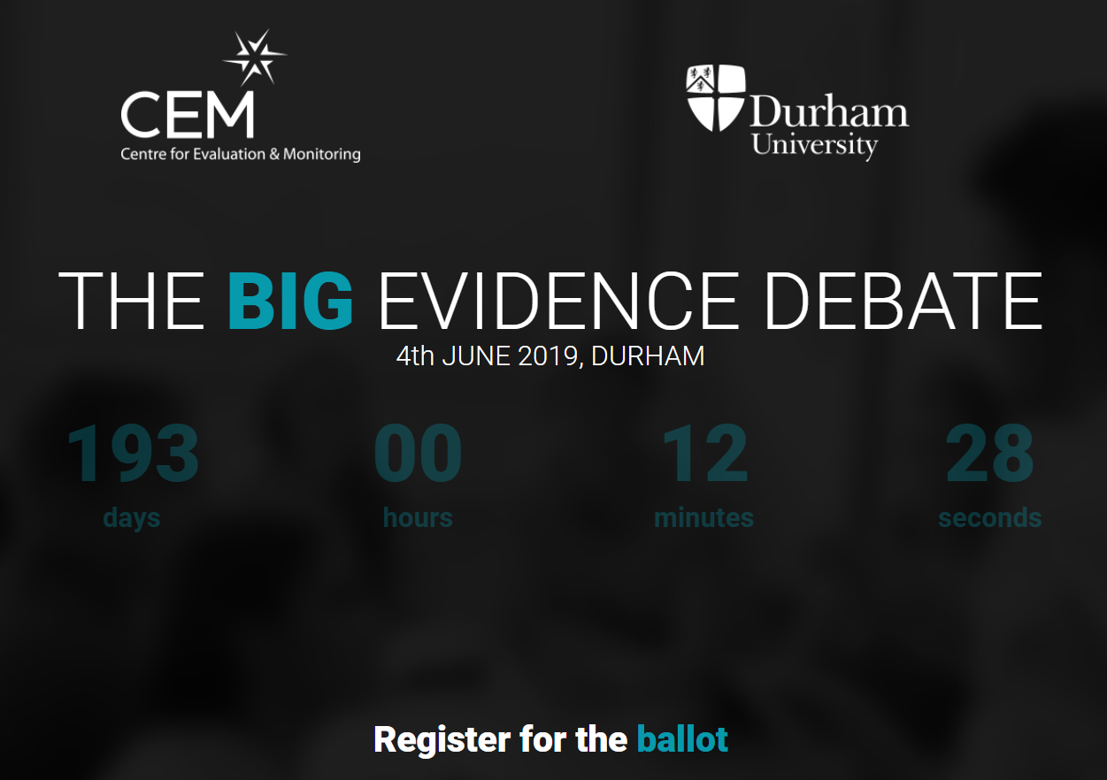
How should we be using meta-analysis and effect sizes?
http://thebigevidencedebate.com/
4 June 2019, Durham

Slide 3
Quiz

Slide 4
How precise is a test score?
You have created a 20-item right-wrong test and given it to your class of 30 pupils. How far apart do two scores have to be before you can be confident one is really better than the other?
  3 marks
  6 marks
  8 marks
(Assume scores cover the full range 0-20, SD=5, Cronbach alpha = 0.7)
Notes:
Standard Error(individual score) = SD x √(1- reliability) = 5 x √0.3 = 5 x 0.55 = 2.74
Standard Error(difference of two scores) = √2 x SE = √2 x 2.74 = 3.87
95% confidence interval for difference = ±1.96 x SE = 1.96 x 3.87 = 7.59
Hence two scores must be 8 marks apart to be statistically significantly different (p<0.05)
If the items fit the Rasch model, simulation suggests the minimum difference between observed scores for confident separation is 5-6 marks, though it depends on the spread of item facilities.

Slide 5
How much information is there in a ‘hinge question’?
You have taught and seen a student working on this topic and estimate their probability of mastery at 80%, but they get the hinge question wrong.
What is your new estimate of their probability of mastery of the concept?
  20%
  50%
  70%
Notes:
This assumes item fit to Rasch model and uses Bayes’ Theorem to estimate probabilities. ‘Mastery’ of topic operationalised as being above a particular threshold on a continuum of understanding that corresponds to 80% probability of answering hinge question correctly. Prior estimate of pupil’s location is subject to error (quantified as its standard error in logit units)
Three cases modelled:
No prior information, other than that pupil is of secondary school age (uncertainty SE taken as 2 logits). From 80% initial confidence, wrong answer reduces this to 63%
Pupil prior attainment data available, but not specific to topic (uncertainty SE taken as 1 logit, based on correlation of 0.8 between prior and ‘mastery’ measure). From initial 80% confidence, wrong answer reduces this to 67%
Specific information on topic knowledge reduces standard error of teacher estimate to 0.5 logits. From initial 80% confidence, wrong answer reduces this to 72%

Slide 6
How should you respond to an exit ticket?
You ask a question as an exit ticket at the end of a lesson. 25 of a class of 30 get it right. Next lesson, would you
  Move on (maybe review/revisit later)
  Re-teach to all
  Re-teach to those who got it wrong
  Do none of these (ie something else)
If the number getting it right had been lower than 25, would you have done something different?
How much lower would it have to be to change your response?

Slide 7
Why does this matter?

Slide 8
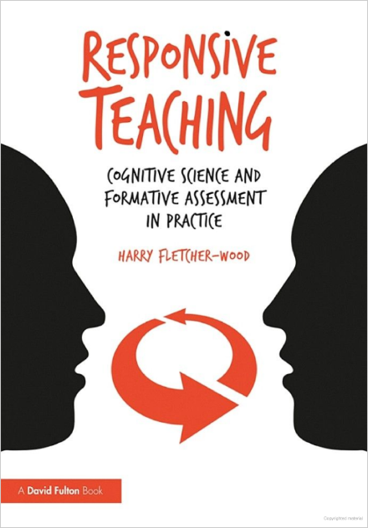
A chapter each on
Hinge questions
Exit tickets

Slide 9
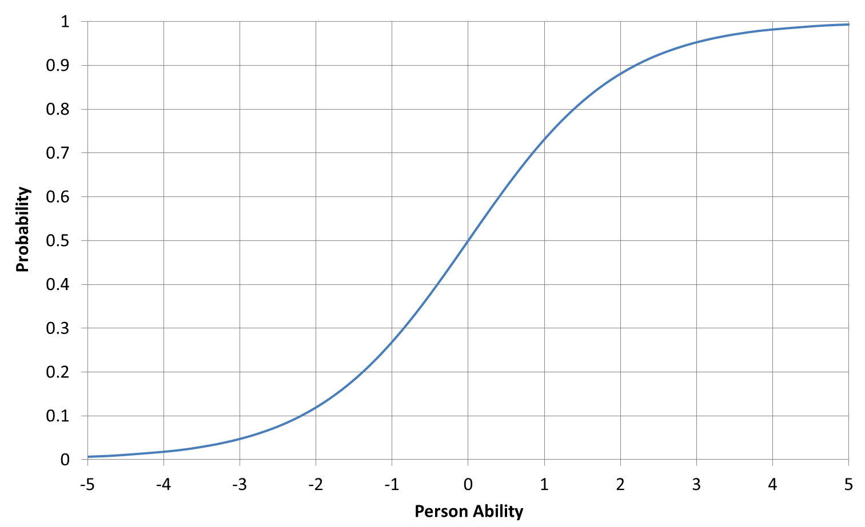
Item Characteristic Curve

Slide 10
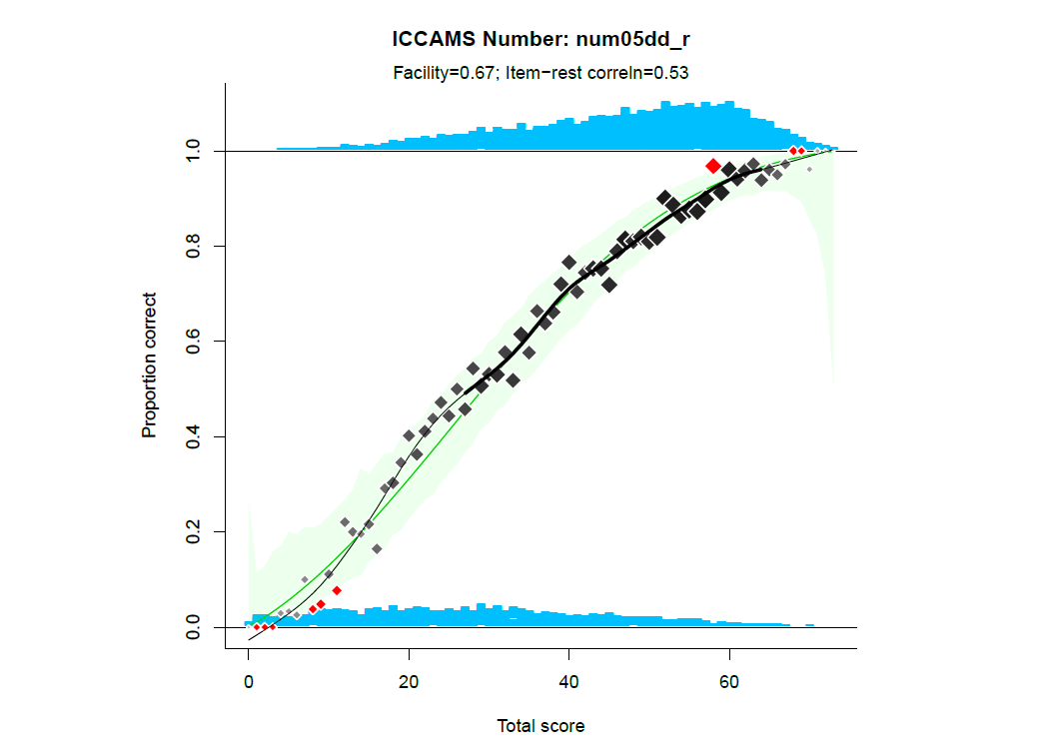

Slide 11

http://www.cem.org/blog/but-that-is-not-an-assessment/
Assessment
must be
  Informative
  Accurate
  Independent
  Generalisable
  Replicable

Slide 12
A bit of assessment theory …
Assessment is the process of capturing and scoring aspects of task performance in order to support inferences
Inferences are usually about a person and are time-bound
  ‘She doesn’t currently understand this’
  ‘He will make a good employee’
Decisions may be informed by those inferences
  ‘I need to re-teach it’
  ‘Offer him the job’
A binary distinction between ‘formative’ and ‘summative’ is pretty much nonsense

Slide 13
Myths about assessment
Common sense view | Reality
Learners either understand something or they don’t, in a binary sort of way | Understanding is best seen as a continuum, imperfectly observed
Once you ‘get it’ you never go back (threshold concepts) | There is no observable behaviour that corresponds to having ‘got it’, but what is observable is very erratic
The subjective feeling of ‘mastery’ is a good guide to learning | It just isn’t
Whether someone gets a question right or completes a task satisfactorily mostly depends on their knowledge, understanding, competence, etc | So many other factors affect responses and scores. Signal:noise ratio is often woeful

Slide 14
Not all questions are assessment
Questions may not be intended to provide information as a basis for inference or decision-making
  Rhetorical device
  Pedagogical device
    Retrieval practice
    Maintain attention
  To elicit thinking
  To provoke dialogue

Slide 15
Test information, accuracy, reliability and generalisability

Slide 16
Problems with exit tickets
If 25 out of 30 get a question right, what does this tell us about their true knowledge/understanding?

Slide 17
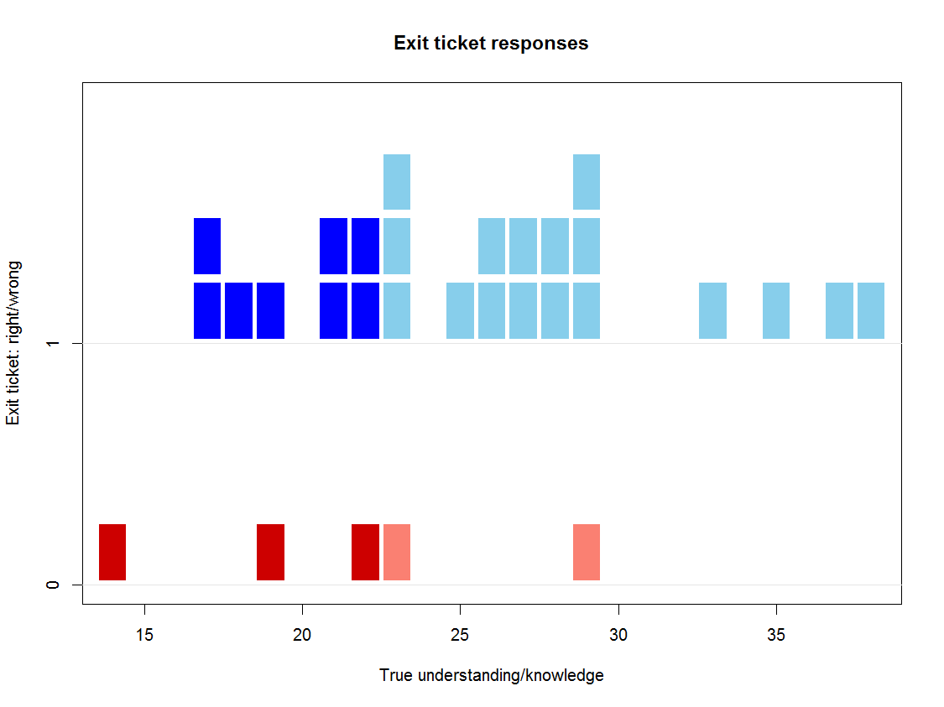
Probability of correct answer
Actual ‘mastery’

Slide 18
Problems with exit tickets
If 25 out of 30 get a question right, it might tell you that
  25 of 30 have reached the required level
  The question was easier than you thought (so the number who have actually reached the required level is lower than 25)
  The question was harder than you thought (so the number who have actually reached the required level is higher than 25)

Slide 19
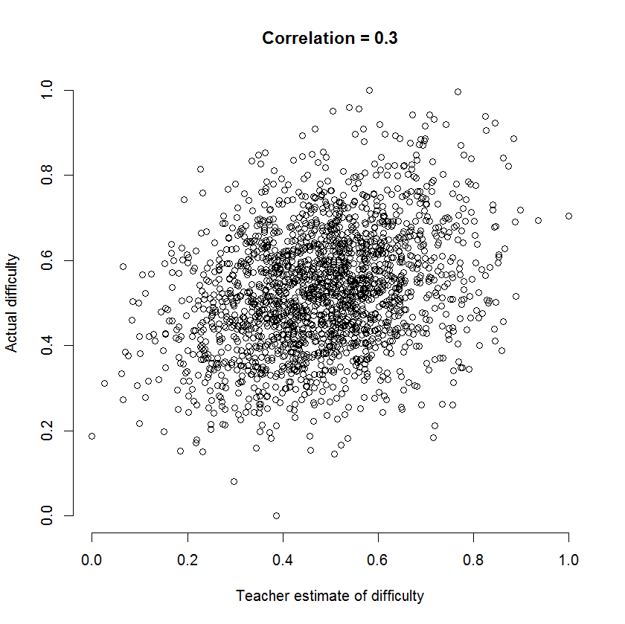
How well can teachers estimate the difficulty of a question?
Correlations between estimated and actual facility often 0.2 – 0.3
(Bramley & Wilson, 2016; Attali et al, 2014)
Notes:
Bramley, T. and Wilson, F. (2016). Maintaining test standards by expert judgement of item difficulty. Research Matters: A Cambridge Assessment publication, 21, 48-54. http://www.cambridgeassessment.org.uk/our-research/all-published-resources/research-matters/rm-21/
Attali, Y., Saldivia, L., Jackson, C., Schuppan, F., & Wanamaker, W. (2014). Estimating item difficulty with comparative judgments. ETS Research Report Series, 2014(2), 1-8. https://onlinelibrary.wiley.com/doi/full/10.1002/ets2.12042

Slide 20
How should you respond to an exit ticket?
You ask a question as an exit ticket at the end of a lesson. 25 of a class of 30 get it right. Next lesson, would you
  Move on (maybe review/revisit later)
  Re-teach to all
  Re-teach to those who got it wrong
  Do none of these (ie something else)
If the number getting it right had been lower than 25, would you have done something different?
How much lower would it have to be to change your response?

Slide 21
Hinge questions
Bayes’ Theorem
  If they understand it, what is the chance they will get a question right?
  If they got the question right, what is the probability they understand it?
We have to start with a ‘prior’:
  Before we find out whether they got the question right, what is our estimate of the probability they understand it?
  How confident/precise are we about this?

Slide 22
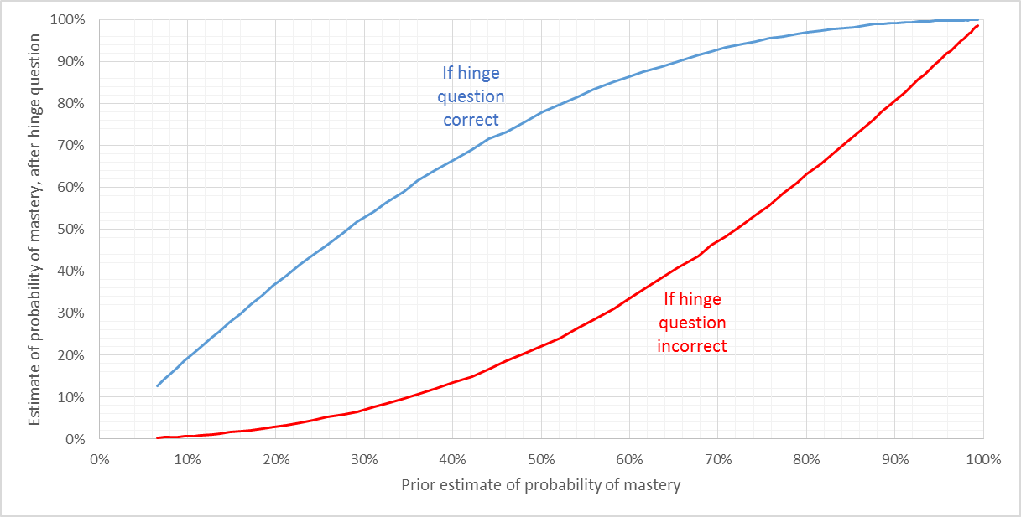
Hinge questions
How much does a correct/incorrect answer affect your estimate of whether a student has ‘mastered’ the concept?
Case 1: You know nothing about the student before asking

Slide 23
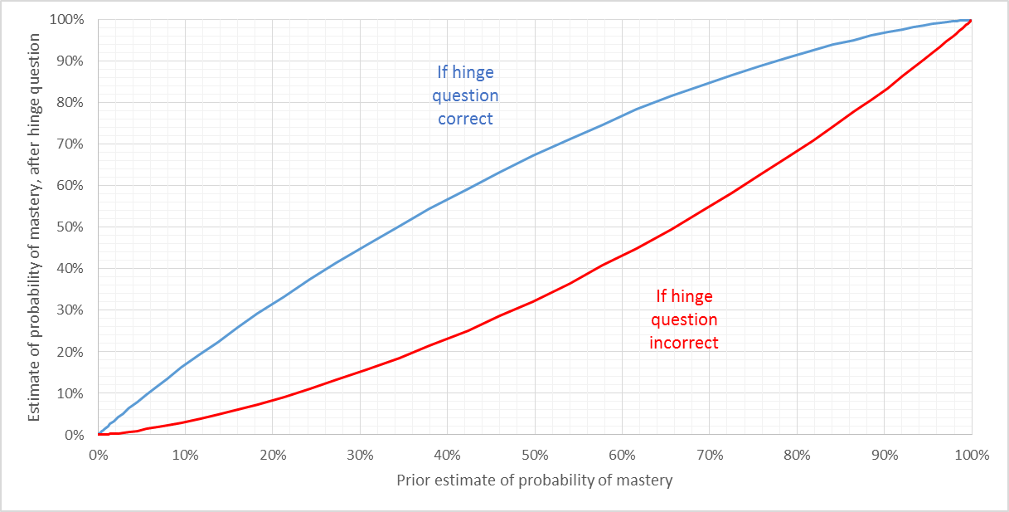
Hinge questions
How much does a correct/incorrect answer affect your estimate of whether a student has ‘mastered’ the concept?
Case 2: You have good prior attainment data

Slide 24
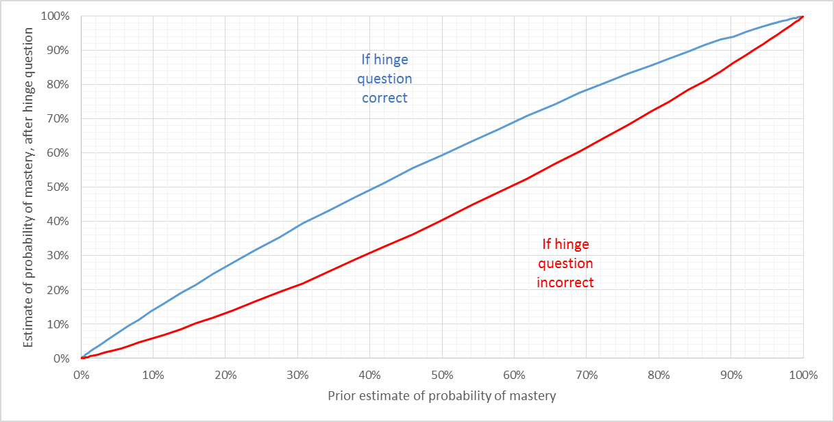
Hinge questions
How much does a correct/incorrect answer affect your estimate of whether a student has ‘mastered’ the concept?
Case 3: You have good feedback about the student’s learning of this concept

Slide 25
How much information is there in a ‘hinge question’?
You have taught and seen a student working on this topic and estimate their probability of mastery at 80%, but they get the hinge question wrong.
What is your new estimate of their probability of mastery of the concept?
  20%
  50%
  70%
Notes:
This assumes item fit to Rasch model and uses Bayes’ Theorem to estimate probabilities. ‘Mastery’ of topic operationalised as being above a particular threshold on a continuum of understanding that corresponds to 80% probability of answering hinge question correctly. Prior estimate of pupil’s location is subject to error (quantified as its standard error in logit units)
Three cases modelled:
No prior information, other than that pupil is of secondary school age (uncertainty SE taken as 2 logits). From 80% initial confidence, wrong answer reduces this to 63%
Pupil prior attainment data available, but not specific to topic (uncertainty SE taken as 1 logit, based on correlation of 0.8 between prior and ‘mastery’ measure). From initial 80% confidence, wrong answer reduces this to 67%
Specific information on topic knowledge reduces standard error of teacher estimate to 0.5 logits. From initial 80% confidence, wrong answer reduces this to 72%

Slide 26
Hinge questions and exit tickets
May be valuable for
  Provoking thinking and discussion
  Giving insight into students’ thinking
  Maintaining students’ attention
Is there ever a time when you should base a decision about what to do on the outcomes of a single question?
  No

Slide 27
How precise is a test score?
You have created a 20-item right-wrong test and given it to your class of 30 pupils. How far apart do two scores have to be before you can be confident one is really better than the other?
  3 marks
  6 marks
  8 marks
(Assume scores cover the full range 0-20, SD=5, Cronbach alpha = 0.7)
Notes:
Standard Error(individual score) = SD x √(1- reliability) = 5 x √0.3 = 5 x 0.55 = 2.74
Standard Error(difference of two scores) = √2 x SE = √2 x 2.74 = 3.87
95% confidence interval for difference = ±1.96 x SE = 1.96 x 3.87 = 7.59
Hence two scores must be 8 marks apart to be statistically significantly different (p<0.05)
If the items fit the Rasch model, simulation suggests the minimum difference between observed scores for confident separation is 5-6 marks, though it depends on the spread of item facilities.

Slide 28
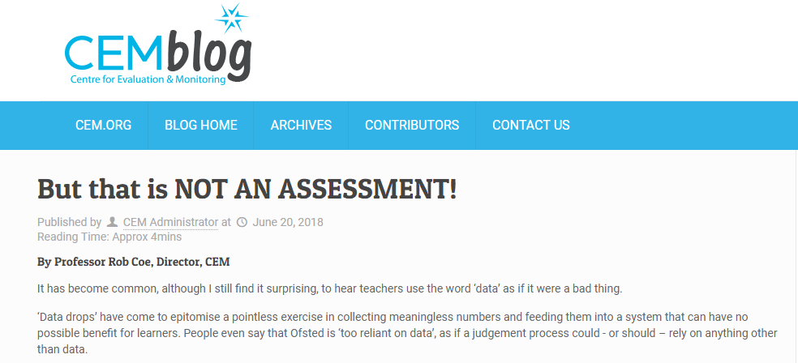
Reliability
Reliability can be
interpreted as
  Replicability: how consistently would an observed score be reproduced if elements of the measurement process that we wish to treat as arbitrary, unimportant and interchangeable were changed? (eg when taken, which paper sat, which questions came up, who marked it, etc)
  Accuracy: with what precision can an observed score be taken as an estimate of a true score?

Slide 30
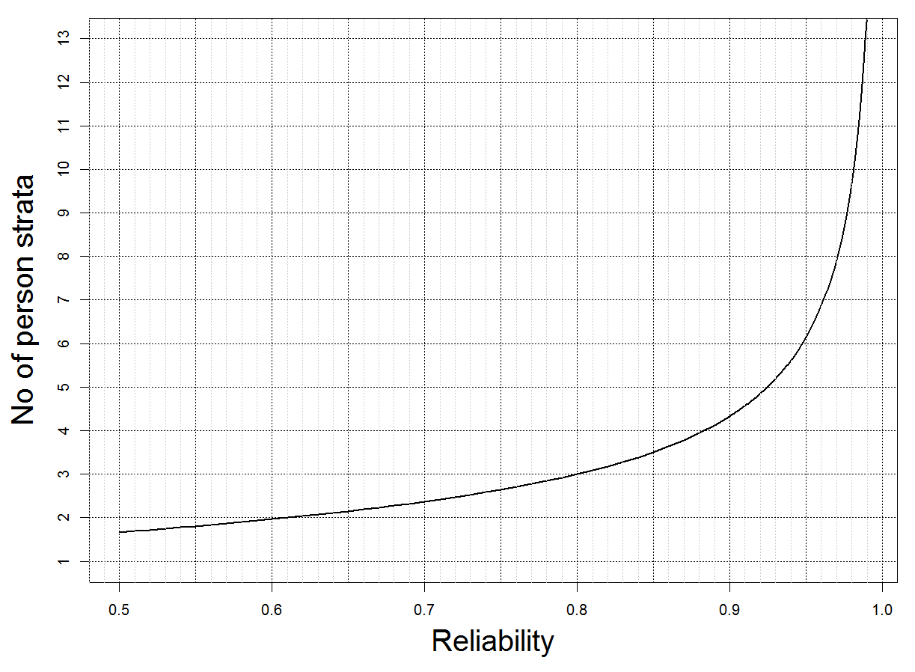
How many strata can persons be confidently separated into?
Wright and Masters (1982)
Notes:
Wright, B. D., & Masters, G. N. (1982, pp. 92, 105-106). Rating scale analysis: Rasch measurement. Chicago, Illinois: MESA Press.
https://www.rasch.org/rmt/rmt163f.htm

Slide 31
Test reliability and precision
Cronbach’s alpha (and other indices of ‘internal consistency’) estimate the variation due to arbitrary selection of questions. Many other factors can arbitrarily affect scores (eg occasion, marker). These should be added to the error variance
Even good classroom tests can only separate respondents confidently into 2-3 categories

Slide 32
Summary
People who use assessments (ie teachers) and those who help them to design and use assessment better (ie school assessment leads and those who train and support them) need to understand some of the limitations of what assessment can and cannot tell you.
Often, it tells you less than you think.

