Slide 1
Evidence-based improvement: Research knowledge, implementation and avoiding crap assessment
@ProfCoe
Robert Coe, Durham University
Festival of Education, Wellington College, June 2018

Slide 2
Elements of evidence-based improvement
Knowledge of existing research
Study, understand and internalise what is already known
Translation/implementation in context
Think and plan what you actually do that will still work in (your) real life situation
Evaluation in situ
Design and implement robust, real-time, local evaluation
Monitoring and QA
Develop, track and respond to trustworthy indicators of performance and quality

Slide 3
Knowledge of existing research
I

Slide 4
Impact vs cost
www.educationendowmentfoundation.org.uk/toolkit
Most promising for raising attainment
8
Feedback
May be worth it
Meta-cognitive
Mastery
Homework (Secondary)
Peer tutoring
1-1 tuition
Early Years
Effect Size (months gain)
Reading comprn
Collaborative
Behaviour
Phonics
Small gp tuition
Parental involvement
Smaller classes
Social
ICT
Individualised learning
Summer schools
After school
Small effects / high cost
Homework (Primary)
Mentoring
Teaching assistants
0
Performance pay
Aspirations
£0
Ability grouping
£1000
Cost per pupil
Repeating a year

Slide 5
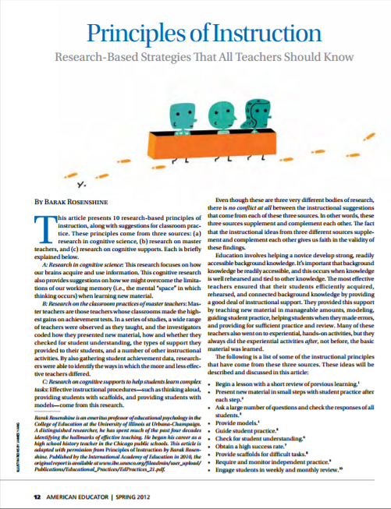
Starter pack: 50 pages
Notes:
Coe, R., Aloisi, C., Higgins, S. and Elliot Major, L. (2014) ‘What makes great teaching? Review of the underpinning research’. Sutton Trust, October 2014 http://www.suttontrust.com/researcharchive/great-teaching/
Rosenshine, B. (2012) Principles of Instruction: Research based principles that all teachers should know. American Educator, Spring 2012. http://www.aft.org/pdfs/americaneducator/spring2012/Rosenshine.pdf
Deans for Impact (2015). The Science of Learning. Austin, TX: Deans for Impact. http://deansforimpact.org/pdfs/The_Science_of_Learning.pdf
Cordingley, P., Higgins, S., Greany, T., Buckler, N., Coles-Jordan, D., Crisp, B., Saunders, L., Coe, R. (2015) Developing Great Teaching: Lessons from the international reviews into effective professional development. Teacher Development Trust. http://tdtrust.org/about/dgt/

Slide 6
Professional reading http://cem.org/blog/what-is-worth-reading-for-teachers-interested-in-research
Tom Sherrington (@Teacherhead)
https://teacherhead.com/2017/06/03/teaching-and-learning-research-summaries-a-collection-for-easy-access/
Harry Fletcher-Wood (@HFletcherWood)
https://improvingteaching.co.uk/2017/06/04/a-reading-list-learning-teaching-professional-development/
Nick Rose (@Nick_J_Rose)
https://www.tes.com/news/tes-magazine/tes-magazine/are-these-7-pillars-classroom-practice?amp
Paul Kirschner (@P_A_Kirschner)
https://3starlearningexperiences.wordpress.com/2017/02/28/seminal-papers-in-educational-psychology/
Notes:
http://cem.org/blog/what-is-worth-reading-for-teachers-interested-in-research

Slide 7
Translation/implementation in context
II

Slide 8
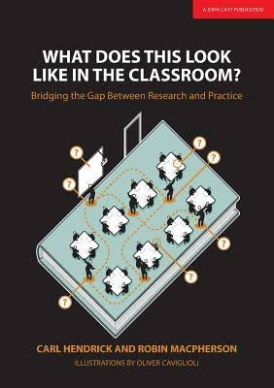
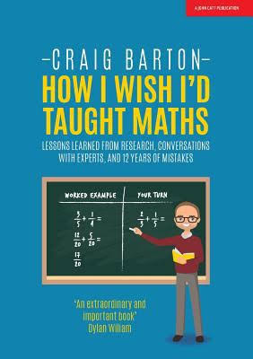
Implementing research ideas
Notes:
IFT The Learning Curriculum: https://drive.google.com/file/d/1zj3bJeaB2ssfPIhxi3hH3IcoeBsJv28o/view
EEF Putting Evidence to Work: https://educationendowmentfoundation.org.uk/tools/guidance-reports/a-schools-guide-to-implementation/

Slide 9
Evaluation in situ
III

Slide 10
Key elements of good evaluation
EEF DIY Evaluation Guide
Clear, well defined, replicable intervention
Good assessment of appropriate outcomes
Well-matched comparison group
Notes:
Coe, R., Kime, S., Nevill, C. and Coleman, R. (2013) ‘The DIY Evaluation Guide’. London: Education Endowment Foundation. [Available at:
http://educationendowmentfoundation.org.uk/library/diy-evaluation-guide
https://v1.educationendowmentfoundation.org.uk/uploads/pdf/EEF_DIY_Evaluation_Guide_(2013).pdf
http://educationendowmentfoundation.org.uk/uploads/pdf/EEF_DIY_Evaluation_Guide_(2013).pdf
https://educationendowmentfoundation.org.uk/resources/diy-guide/getting-started/

Slide 11
Monitoring and QA
IV

Slide 12
How good a teacher are you?
Well above average
Above average
Average
Below average
Well below average
Don’t know / abstain / hate audience participation
How do you know?
Do you even care?

Slide 13
Lesson observation: It’s harder than you think
Notes:
http://www.cem.org/blog/414/

Slide 14
Let’s talk about assessment
crap
What makes great assessment?

Slide 15
http://www.cem.org/blog/but-that-is-not-an-assessment/
Assessment must be
Informative
Accurate
Independent
Generalisable
Replicable

Slide 16
Assessment must contain information
An assessment that cannot surprise you is not an assessment:
Post-topic assignment
Exit ticket
Challenging question
What is already in your head
A single judgement (eg an intuitive ‘best fit’ level) is not an assessment
Tasks, responses, scoring, aggregation
✓
✓
✓
✗

Slide 17
Assessment must be accurate
All information has a ‘weight’ or ‘level of precision’ associated with it – we need to know this
Surprising and accurate → change your mind
Surprising and inaccurate → don’t change
‘Weight’, ‘accuracy’, ‘precision’ are related to ‘reliability’

Slide 18
How much information is there in a ‘hinge question’?
You have taught and seen a student working on this topic and estimate their probability of mastery at 80%, but they get the hinge question wrong. What is your new estimate of their probability of mastery of the concept?
20%
50%
70%
Notes:
This assumes item fit to Rasch model and uses Bayes’ Theorem to estimate probabilities. ‘Mastery’ of topic operationalised as being above a particular threshold on a continuum of understanding that corresponds to 80% probability of answering hinge question correctly. Prior estimate of pupil’s location is subject to error (quantified as its standard error in logit units)
Three cases modelled:
No prior information, other than that pupil is of secondary school age (uncertainty SE taken as 2 logits). From 80% initial confidence, wrong answer reduces this to 63%
Pupil prior attainment data available, but not specific to topic (uncertainty SE taken as 1 logit, based on correlation of 0.8 between prior and ‘mastery’ measure). From initial 80% confidence, wrong answer reduces this to 67%
Specific information on topic knowledge reduces standard error of teacher estimate to 0.5 logits. From initial 80% confidence, wrong answer reduces this to 72%

Slide 19
How precise is a test score?
You have created a 20-item right-wrong test and given it to your class of 30 pupils. How far apart do two scores have to be before you can be confident one is really better than the other?
3 marks
6 marks
8 marks
(Assume scores cover the full range 0-20, SD=5, Cronbach alpha = 0.7)
Notes:
Standard Error(individual score) = SD x √(1- reliability) = 5 x √0.3 = 5 x 0.55 = 2.74
Standard Error(difference of two scores) = √2 x SE = √2 x 2.74 = 3.87
95% confidence interval for difference = ±1.96 x SE = 1.96 x 3.87 = 7.59
Hence two scores must be 8 marks apart to be statistically significantly different (p<0.05)

Slide 20
Assessment must be independent
A judgement that is pre-constrained is not an assessment
Normative levels: ‘working towards’ (inadequate), ‘working at’ (acceptable), ‘exceeding’ (good)
Any students ‘working towards’ get scrutiny from SLT, extra work for teachers and hassle from parents
What level were they last year? (add a bit for ‘expected’ progress)
‘I gave that a 4. What did you think?’

Slide 21
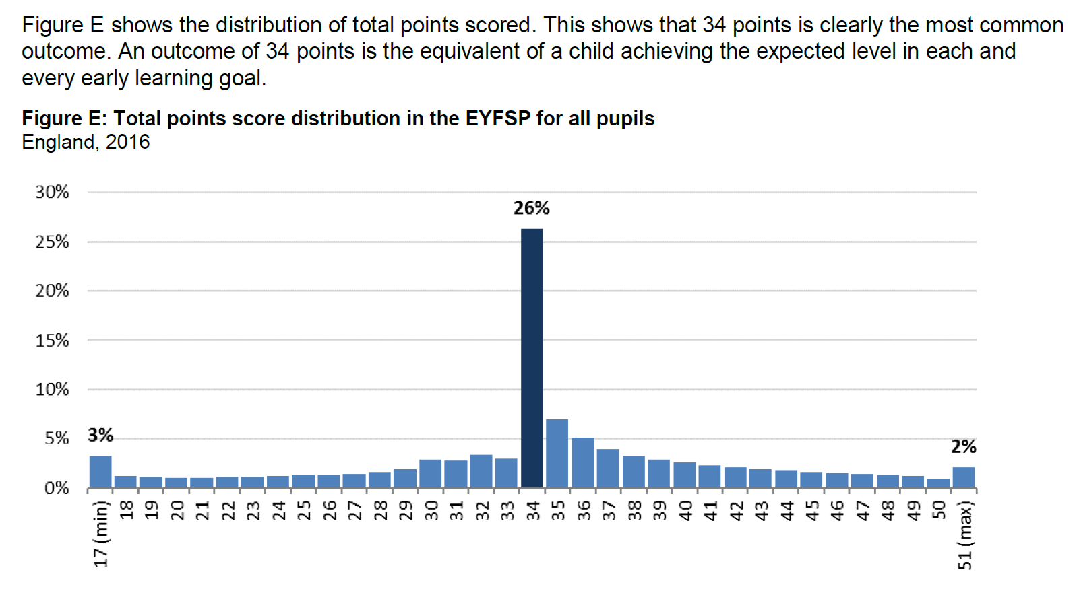
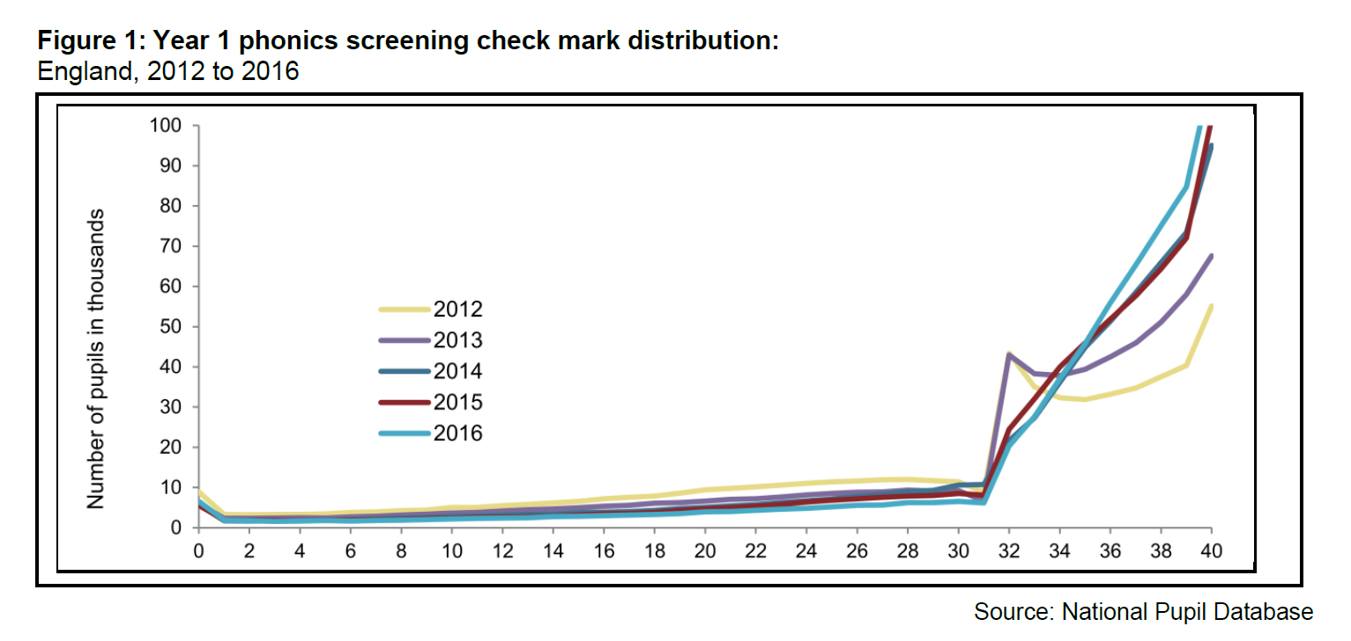
Signs that an assessment is not independent
Notes:
EYFSP: Figure E in https://www.gov.uk/government/uploads/system/uploads/attachment_data/file/561224/SFR50_2016_Text.pdf
Phonics check: Figure 1 in https://www.gov.uk/government/uploads/system/uploads/attachment_data/file/577806/SFR42_Phonics_KS1_2016.pdf

Slide 22
Assessment must be generalisable
No one cares that they did it once, on one particular day, in a particular room, with those exact questions
Predictable (or known) questions
Questions are artificial or formulaic
Coursework where students can respond to ‘feedback’
Guessing or chance (esp on a short test)

Slide 23
Assessment must be replicable
‘Reliability’ = the interchangeability of arbitrary aspects of the assessment process that we want to be able to ignore, such as the time or occasion of testing, the particular questions presented or the particular marker who assessed it.
‘Reliability’ = ‘replicability’, ‘weight’, ‘accuracy’, ‘precision’, ‘dependability’

Slide 24
Elements of evidence-based improvement
Knowledge of existing research
Study, understand and internalise what is already known
Translation/implementation in context
Think and plan what you actually do that will still work in (your) real life situation
Evaluation in situ
Design and implement robust, real-time, local evaluation
Monitoring and QA
Develop, track and respond to trustworthy indicators of performance and quality

