Slide 1
What makes great teaching?
Robert Coe
Reflective Practice Conference, Durham, January 2019

Slide 2
Reflective Practice Conference
Why do children vary in their success in learning?
  One important (but controversial) reason is that teaching varies in its effectiveness
Do we know which teaching practices produce the best learning?
  There is a lot of good evidence about this, but interpreting it is quite complicated
Can all teachers learn to be more effective?
  Yes!

Slide 3
Outline
What can research tell us about ‘great teaching’?
How can we tell whether we are doing (or seeing) it?
How do we get more of it?

Slide 4
True or false?
Reducing class size is one of the most effective ways to increase learning [evidence]
Differentiation and ‘personalised learning’ resources maximise learning [evidence]
Praise encourages learners and helps them persist with hard tasks [evidence]
Technology supports learning by engaging and motivating learners [evidence]
The best way to raise attainment is to enhance motivation and interest [evidence]
Notes:
Rob Coe EMC blog on class size: http://educationmediacentre.org/researchnews/whats-the-evidence-on-class-size/
John Hattie on individualisation (eg https://cdn.auckland.ac.nz/assets/education/about/research/documents/influences-on-student-learning.pdf).
See also Harry Webb’s blog: ‘The Evidence on Differentiation’ http://websofsubstance.wordpress.com/2014/07/
Deborah Stipek on praise: How Do Teachers' Expectations Affect Student Learning http://www.education.com/reference/article/teachers-expectations-affect-learning/
Steve Higgins et al’s summary for EEF: The Impact of Digital Technology on Learning http://educationendowmentfoundation.org.uk/uploads/pdf/The_Impact_of_Digital_Technologies_on_Learning_FULL_REPORT_(2012).pdf
Stephen Gorard et al for JRF on aspirations: The impact of attitudes and aspirations on educational attainment and participation http://www.jrf.org.uk/sites/files/jrf/education-young-people-parents-full.pdf

Slide 5
1. Research-based practices: Pedagogy

Slide 6

Notes:
Coe, R., Aloisi, C., Higgins, S. and Elliot Major, L. (2014) ‘What makes great teaching? Review of the underpinning research’. Sutton Trust, October 2014 http://www.suttontrust.com/researcharchive/great-teaching/

Slide 7
Dimensions of great teaching
(Pedagogical) content knowledge
Quality of instruction
Classroom management / behaviour / control
Classroom climate / relationships / expectations
Beliefs (theory) about subject, learning & teaching
Wider professional elements: collegiality, PD, stakeholder relationships
Notes:
Coe, R., Aloisi, C., Higgins, S. and Elliot Major, L. (2014) ‘What makes great teaching? Review of the underpinning research’. Sutton Trust, October 2014 http://www.suttontrust.com/researcharchive/great-teaching/

Slide 8
1. We do that already (don’t we?)
Reviewing previous learning
Setting high expectations
Using higher-order questions
Giving feedback to learners
Having deep subject knowledge
Understanding student misconceptions
Managing time and resources
Building relationships of trust and challenge
Dealing with disruption

Slide 9
2. Do we always do that?
Challenging students to identify the reason why an activity is taking place in the lesson
Asking a large number of questions and checking the responses of all students
Raising different types of questions (i.e., process and product) at appropriate difficulty level
Giving time for students to respond to questions
Spacing-out study or practice on a given topic, with gaps in between for forgetting
Making students take tests or generate answers, even before they have been taught the material
Engaging students in weekly and monthly review

Slide 10
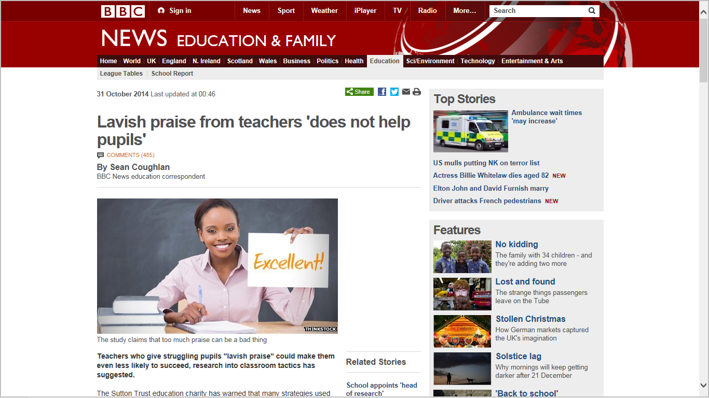

Slide 11
3. We don’t do that (hopefully)
Use praise lavishly
Allow learners to discover key ideas for themselves
Group learners by ability
Encourage re-reading and highlighting to memorise key ideas
Address issues of confidence and low aspirations before you try to teach content
Present information to learners in their preferred learning style
Ensure learners are always active, rather than listening passively, if you want them to remember

Slide 12
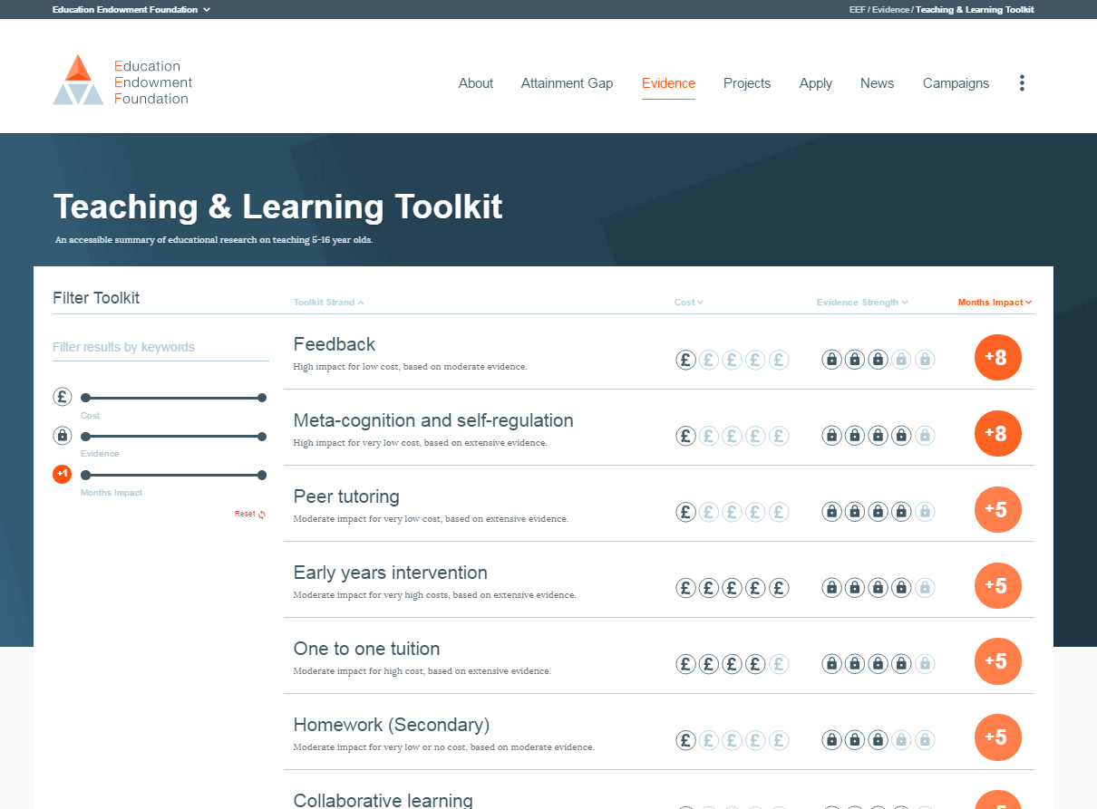

Evidence about the impact of interventions
EEF Teaching and Learning Toolkit
www.educationendowmentfoundation.org.uk/toolkit
Notes:
Higgins, S., Katsipataki, M., Kokotsaki, D., Coleman, R., Major, L.E., & Coe, R. (2013). The Sutton Trust-Education Endowment Foundation Teaching and Learning Toolkit. London: Education Endowment Foundation. [Available at http://www.educationendowmentfoundation.org.uk/toolkit]
Hattie, J. (2009) Visible Learning: A synthesis of over 800 meta-analyses relating to achievement. Abingdon: Routledge.

Slide 13
Impact vs cost
www.educationendowmentfoundation.org.uk/toolkit
Most promising for raising attainment
8
Feedback
May be worth it
Meta-cognitive
Mastery
Homework (Secondary)
Peer tutoring
1-1 tuition
Early Years
Effect Size (months gain)
Reading comprn
Collaborative
Behaviour
Phonics
Small gp tuition
Parental involvement
Smaller classes
Social
ICT
Individualised learning
Summer schools
After school
Small effects / high cost
Homework (Primary)
Mentoring
Teaching assistants
0
Performance pay
Aspirations
£0
Ability grouping
£1000
Cost per pupil
Repeating a year

Slide 14
Poor Proxies for Learning
Students are busy: lots of work is done (especially written work)
Students are engaged, interested, motivated
Students are getting attention: feedback, explanations
Classroom is ordered, calm, under control
Curriculum has been ‘covered’ (ie presented to students in some form)
(At least some) students have supplied correct answers, even if they
  Have not really understood them
  Could not reproduce them independently
  Will have forgotten it by next week (tomorrow?)
  Already knew how to do this anyway

Slide 15
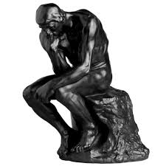
A better proxy for learning?
Learning happens when people have to think hard

Slide 16
Hard questions about your students
How many minutes does an average student on an average day spend really thinking hard?
Do you really want students to be ‘stuck’ in your lessons?
If they knew the right answer but didn’t know why, how many students would care?

Slide 17
2. Identifying great practice

Slide 18
Methods of identifying effectiveness
classroom observations by peers, school leaders or external evaluators
‘value-added’ models (assessing gains in student achievement)
student ratings
headteacher judgement
teacher self-reports
analysis of classroom artefacts
and teacher portfolios
Notes:
Coe, R., Aloisi, C., Higgins, S. and Elliot Major, L. (2014) ‘What makes great teaching? Review of the underpinning research’. Sutton Trust, October 2014 http://www.suttontrust.com/researcharchive/great-teaching/

Slide 19
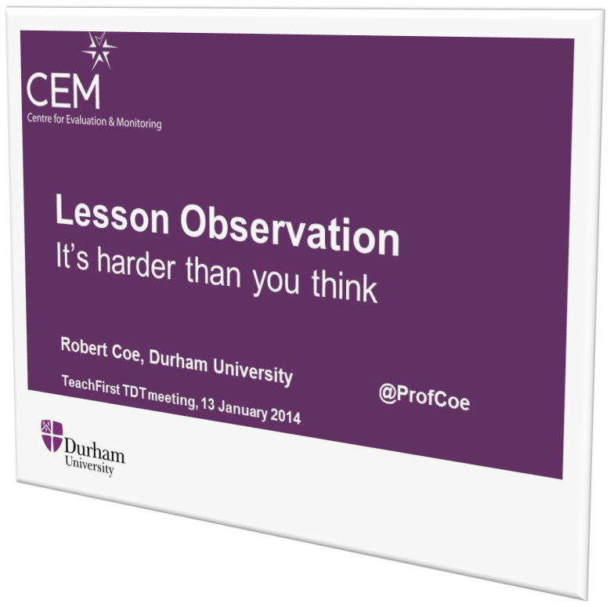
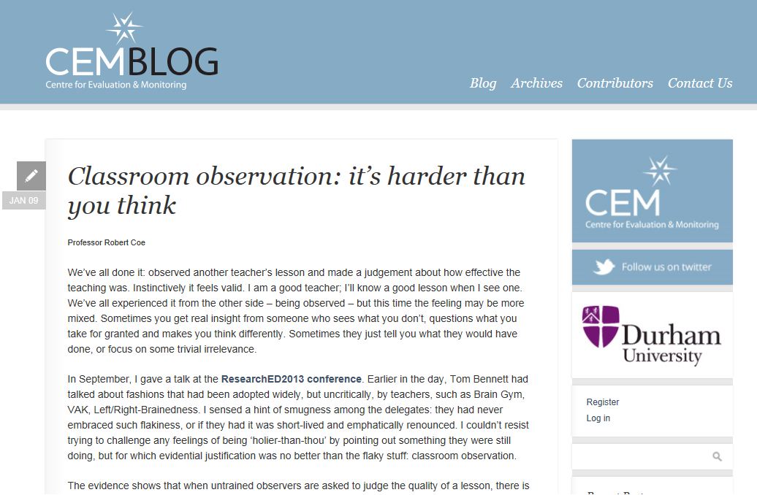
Do we know a good lesson when we see one?
Notes:
http://www.cem.org/blog/414/

Slide 20
Lesson Observation
Two teachers observe the same lesson, one rates it ‘Inadequate’. What is the probability the other will agree?
  a) 10% b) 40% c) 60% d) 80%
An observer judges a lesson ‘Outstanding’. What is the probability that pupils are really making sustained, outstanding progress?
  a) 5% b) 30% c) 50% d) 70%
www.cem.org/blog
Notes:
Answers:
1: probably a; best case for a research-validated, quality-assured, rigorous process is b
2: probably a; best case for a research-validated, quality-assured, rigorous process is b
See “Classroom observation: it’s harder than you think” http://www.cem.org/blog/414/ and my presentation to
Teach First / Teacher Development Trust Event on Lesson Observation, 13 Jan 2014, London
Powerpoint (http://www.cem.org/attachments/Lesson%20Observation%2013Jan14.pptx) and video (http://www.l4l.co.uk/?p=13050)

Slide 21
3. Promoting and developing great practice

Slide 22

www.gov.uk/government/publications/standard-for-teachers-professional-development
Notes:
https://www.gov.uk/government/publications/standard-for-teachers-professional-development

Slide 23

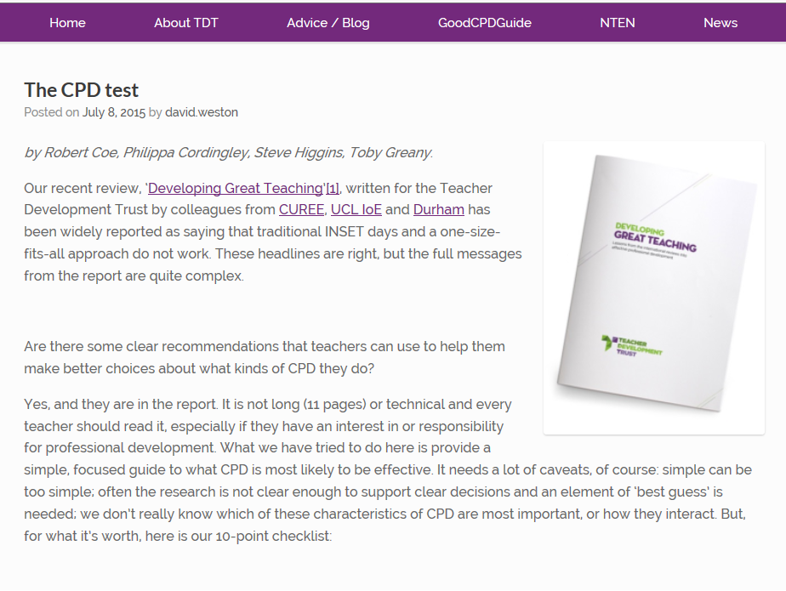
Cordingley et al 2015
http://tdtrust.org/about/dgt/
Notes:
Cordingley, P., Higgins, S., Greany, T., Buckler, N., Coles-Jordan, D., Crisp, B., Saunders, L., Coe, R. (2015) Developing Great Teaching: Lessons from the international reviews into effective professional development. Teacher Development Trust. http://tdtrust.org/about/dgt/
The CPD Test: http://tdtrust.org/cpdtest/

Slide 24

Some pitfalls of professional learning
Don’t assume that teachers learn differently from other people
Don’t underestimate the
importance of trust
Don’t expect genuine
change to be quick

Slide 25
1. Teachers learn just like normal people
You’re a teacher.
You know how to help
people learn hard stuff.
Do that.

Slide 26
All good learning & teaching …
Takes you from where you are at
Is clear what success looks like
Creates challenging expectations
Assesses and feeds back on the gap
Requires exposition, modelling, scaffolding and guidance from an expert
Requires a coaching & mentoring role
Benefits from peer support
Requires trust: ‘OK to fail’

Slide 27
2. Learning requires trust
Inter-dependence, risk of harm
“willingness to be vulnerable to another party based on the confidence that the latter party is
(a) benevolent,
(b) reliable,
(c) competent,
(d) honest, and
(e) open”
(Tschannen-Moran & Hoy, 2000)
Good intentions, would not exploit
Lack of anxiety
Predictability, consistency of behaviour
Skills, abilities, power
Willing to share (personal) information
character, integrity, authenticity
Notes:
Tschannen-Moran, M., & Hoy, W. K. (2000). A multidisciplinary analysis of the nature,
meaning, and measurement of trust. Review of Educational Research, 70(4), 547-593.

Slide 28


3. You have to work at it
Deliberate practice
  Challenge
  Specific goals
  Focus on sub-tasks
  Feedback
  Mental representations
Notes:
Ericsson, K. A. & Pool, R. (2016). Peak: Secrets from the New Science of Expertise. Boston, MA: Houghton Mifflin Harcourt
Deans for Impact (2016). Practice with Purpose: The Emerging Science of Teacher Expertise. Austin, TX: Deans for Impact.
https://deansforimpact.org/resources/practice-with-purpose/

Slide 29
Summary …

Slide 30
Take-home messages
The effectiveness of teaching depends on teachers’ knowledge, skills, judgement, intuition, etc.
An understanding of what is effective should be informed by research evidence (it is not obvious or universally practised)
Identifying effective pedagogy is harder than you think
Learning to develop effective knowledge, skills, judgement, intuition, etc., is hard, but every teacher can do it

Slide 31
“After 30 years of doing such work, I have concluded that classroom teaching…is perhaps the most complex, most challenging, and most demanding, subtle, nuanced, and frightening activity that our species has ever invented…The only time a physician could possibly encounter a situation of comparable complexity would be in the emergency room of a hospital during or after a natural disaster.”
Lee Shulman, The Wisdom of Practice

