Slide 1
Why you need feedback more than you think you do
Rob Coe
researchED National, 7 September 2024

Slide 2
Do you believe any of these:
I can judge how well a lesson has gone
I can judge whether students are learning
I already get good feedback about my work
I do learn from experience
I can manage a complex organisation based on intuition

Slide 3
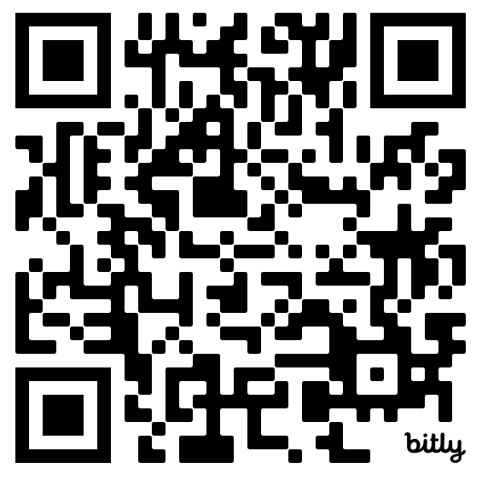
Feedback quiz
If the effectiveness of your teaching were assessed
objectively, where do you think you would be
(relative to all the teachers you have known)?
  Top 20%: Excellent
  2nd 20%: Above average
  3rd 20%: Average
  4th 20%: Below average
  Bottom 20%: Weak/developing
What sources of feedback on your teaching have you received in the last year?
In the last year, how often have you viewed video of your own teaching?
How keen would you be to get objective measures of the effectiveness of your teaching?
https://bit.ly/wantfbk
Notes:
https://forms.office.com/r/s28Fhm8uVA
https://bit.ly/wantfbk

Slide 4
I can judge how well a lesson has gone
1.

Slide 5
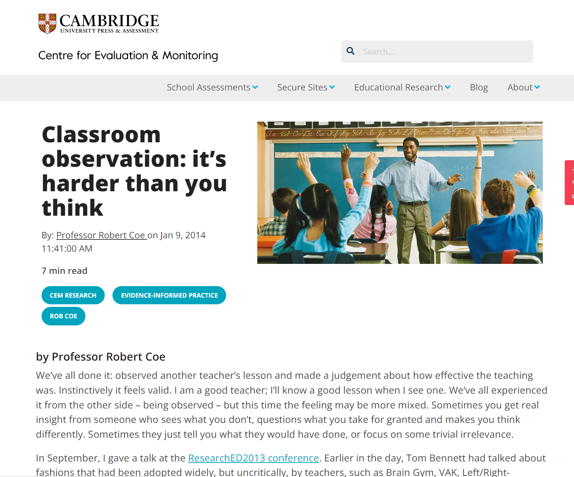
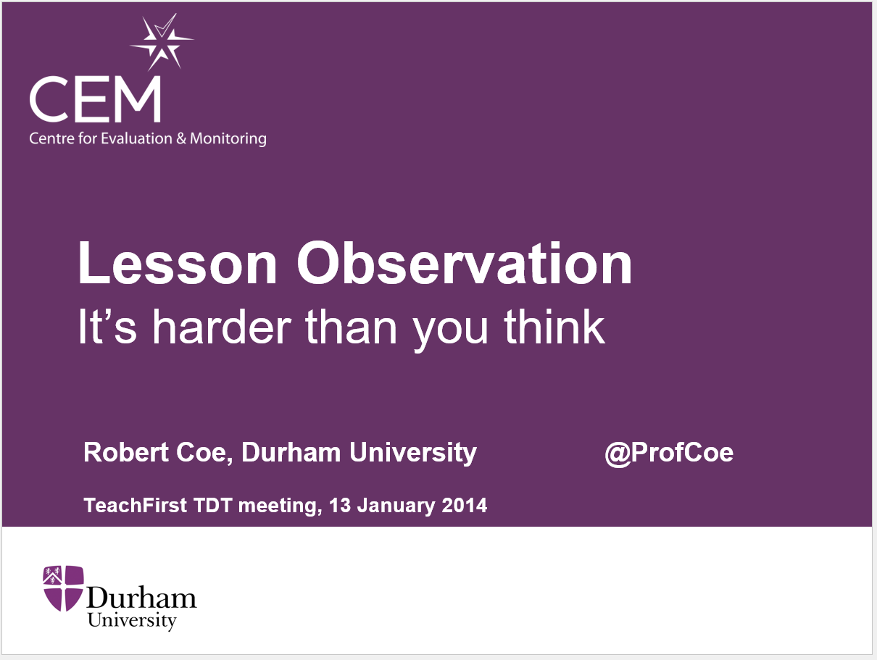
Jan 2014: TF / TDT seminar
https://www.cem.org/blog/classroom-observation
Notes:
Reliability, based on MET study
“For observations conducted by Ofsted inspectors or professional colleagues, ‘training’ in observation is generally not of the quality and scale used in these studies, and no evidence of reliability is available. Hence, we are probably justified in assuming that the true value will be close to the worst case. In other words, if your lesson is judged ‘Outstanding’, do whatever you can to avoid getting a second opinion: three times out of four you would be downgraded. If your lesson is judged ‘Inadequate’ there is a 90% chance that a second observer would give a different rating.”
Validity:
“At this level of accuracy, fewer than 1% of those judged to be ‘Inadequate’ are genuinely inadequate; of those rated ‘Outstanding’, only 4% actually produce outstanding learning gains; overall, 63% of judgements will be wrong.”

Slide 6
Do We Know a Successful Teacher When We See One?
Filmed lessons (or short clips) of effective (value-added) and ineffective teachers shown to
  School Principals and Vice-Principals
  Teachers
  Public
Some agreement among raters, but unable to identify effective teaching
No difference between education experts and others
Training in CLASS did help a bit
Strong et al 2011
Notes:
Strong, M., Gargani, J., & Hacifazlioglu, O. (2011). Do we know a successful teacher when we see one? Experiments in the identification of effective teachers. Journal of Teacher Education, 62(4), 367–382. [Abstract at: http://jte.sagepub.com/content/62/4/367.abstract ]

Slide 7
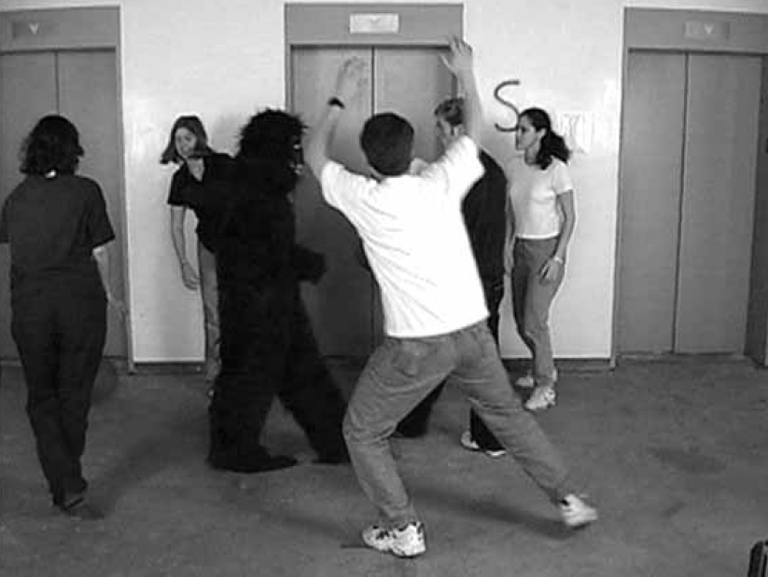
Simons & Chabris (1999)
Notes:
Simons, D J, Chabris, C. F (1999) Gorillas in our midst: sustained inattentional blindness for dynamic events. Perception, 1999, volume 28, pages 1059 – 1074.

Slide 8
Obvious – but not true
Why do we believe we can spot good teaching?
We absolutely know what we like
  Strong emotional response to particular behaviours/styles is hard to over-rule
We focus on observable proxies for learning
  Learning is invisible
Preferences for particular pedagogies are widely shared, but evidence/understanding of their effectiveness is limited
We assume that if you can do it you can spot it
We don’t believe observation can miss so much

Slide 9
I can judge whether students are learning
2.

Slide 10
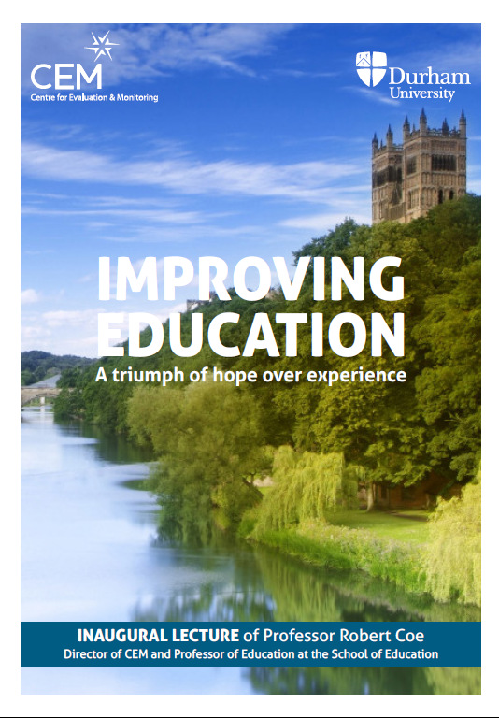
2013: Improving Education: A triumph of hope over experience
www.profcoe.net/publications
Notes:
Coe, R. (2013) Improving Education: A triumph of hope over experience. Inaugural Lecture of Professor Robert Coe, Durham University, 18 June 2013. Essay version available at www.profcoe.net/publications
Video at https://vimeo.com/70471076

Slide 11
Poor Proxies for Learning
Students are busy: lots of work is done (especially written work)
Students are engaged, interested, motivated
Students are getting attention: feedback, explanations
Classroom is ordered, calm, under control
Curriculum has been ‘covered’ (ie presented to students in some form)
(At least some) students have supplied correct answers (whether or not they really understood them or could reproduce them independently)

Slide 12
I already get good feedback about my work
3.

Slide 13
Two problems with self-evaluation
Self-evaluation is very inaccurate
‘Better-than-average’ effect

Slide 14
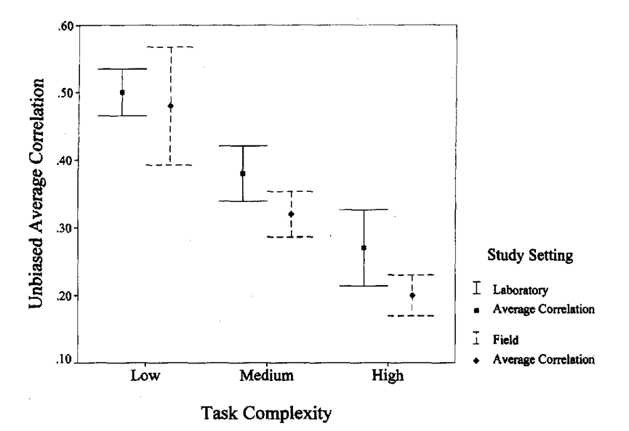
Self-evaluation is very inaccurate
Dunning, D., Heath, C., & Suls, J. M. (2004). Flawed self-assessment. Psychological Science in the Public Interest, 5(3), 69–106. https://doi.org/10.1111/j.1529-1006.2004.00018.x
Hansford, B. C., & Hattie, J. A. (1982). The relationship between self and achievement/performance measures. Review of Educational research, 52(1), 123-142.
Stajkovic, A. D., & Luthans, F. (1998). Self-efficacy and work-related performance: A meta-analysis. Psychological bulletin, 124(2), 240.
Zell, E., & Krizan, Z. (2014). Do people have insight into their abilities? A metasynthesis. Perspectives on Psychological Science, 9(2), 111–125. https://doi.org/10.1177/1745691613518075
Blanch-Hartigan, D. (2011). Medical students' self-assessment of performance: Results from three meta-analyses. Patient Education and Counseling, 84(1), 3–9. https://doi.org/10.1016/j.pec.2010.06.037
Ernst, H. M., Wittwer, J., & Voss, T. (2023). Do they know what they know? Accuracy in teacher candidates' self‐assessments and its influencing factors. British Educational Research Journal, 49(4), 649-673.
Borkenau, P., & Liebler, A. (1993). Convergence of stranger ratings of personality and intelligence with self-ratings, partner ratings, and measured intelligence. Journal of Personality and Social Psychology, 65(3), 546.
Stajkovic & Luthans (1998)
Correlations between self-ratings and objective measures (or peer ratings) are typically 0.2 – 0.3

Slide 15
What does a correlation of 0.3 look like?
People who are actually in the top 20%
People who think they are in the top 20%

Slide 16
Better-than-average?
“Motorcyclists believe they are less likely to cause an accident than is the typical biker (Rutter, Quine, & Albery, 1998). Business leaders believe their company is more likely to succeed than is the average firm in their industry (Cooper, Woo, & Dunkelberg, 1988; Larwood & Whittaker, 1977). People think they are less susceptible to the flu than their contemporaries, and as a result avoid getting flu shots (Larwood, 1978). Of college professors, 94% say they do above-average work (Cross, 1977). People signing up to bungee jump believe they are more likely to avoid injury than the average bungee jumper, although their friends and family do not share this impression (Middleton, Harris, & Surman, 1996).”
Dunning et al (2004)
Notes:
Zell, E., Strickhouser, J. E., Sedikides, C., & Alicke, M. D. (2020). The better-than-average effect in comparative self-evaluation: A comprehensive review and meta-analysis. Psychological bulletin, 146(2), 118.
Dunning, D., Heath, C., & Suls, J. M. (2004). Flawed self-assessment. Psychological Science in the Public Interest, 5(3), 69–106. https://doi.org/10.1111/j.1529-1006.2004.00018.x

Slide 17
Bias blind spot
Special case of the better-than-average effect
We all think we are better at self-assessment than we really are
“Others suffer these biases, but I don’t”
Pronin et al, 2002
Notes:
Pronin E., Lin D.Y., Ross L. (2002). The bias blind spot: Perceptions of bias in self versus others. Personality and Social Psychology Bulletin, 28, 369–381.

Slide 18
What sources of feedback on your teaching have you received in the last year? (Tick all that apply)
Formal lesson observation by manager
Informal lesson observation by peer
Video of your teaching
Student survey
Other student perceptions
Analysis of student attainment outcomes
Parent feedback
Other
In the last year, how often have you viewed video of your own teaching?

Slide 19
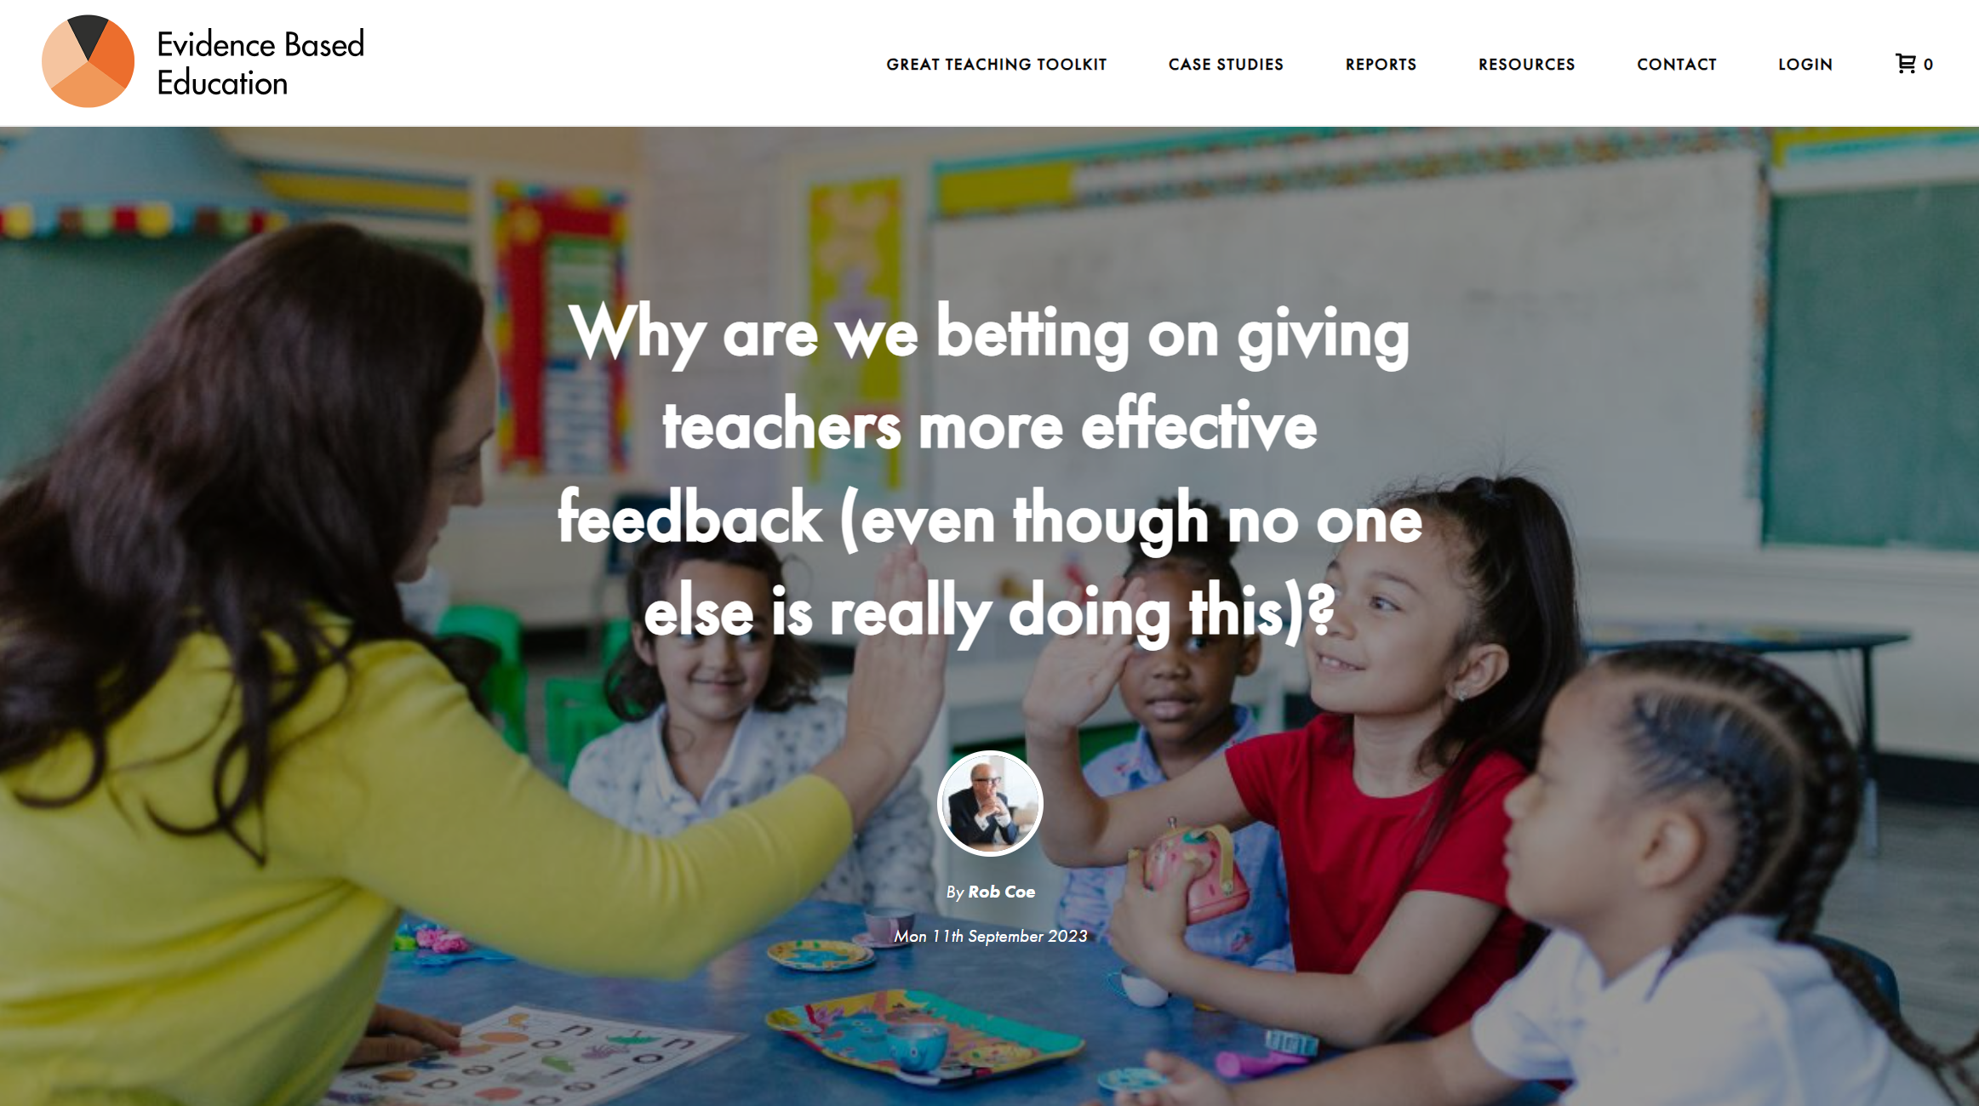
Self-assessment
Most of our perceptions are too positive
  “Better than average effect”
Self-assessments correlate (at best) weakly with objective measures
  “Bias blind spot”
Takeaways:
  We are not as good as we think we are
  Our self-assessments (and other perceptions) are a lot less accurate than we think
  Feedback can be a reality check
https://evidencebased.education/why-are-we-betting-on-giving-teachers-more-effective-feedback-even-though-no-one-else-is-really-doing-this/
(Dunning et al., 2004)
Notes:
Dunning, D., Heath, C., & Suls, J. M. (2004). Flawed self-assessment. Psychological Science in the Public Interest, 5(3), 69–106. https://doi.org/10.1111/j.1529-1006.2004.00018.x
Zell, E., Strickhouser, J. E., Sedikides, C., & Alicke, M. D. (2020). The better-than-average effect in comparative self-evaluation: A comprehensive review and meta-analysis. Psychological bulletin, 146(2), 118.
Dunning, D. (2011). The Dunning-Kruger effect: On being ignorant of one’s own ignorance. Advances in Experimental Social Psychology, 44, 247–296. http://dx.doi.org/10.1016/B978-0-12-385522-0.00005-6
Pronin E., Lin D.Y., Ross L. (2002). The bias blind spot: Perceptions of bias in self versus others. Personality and Social Psychology Bulletin, 28, 369–381.

Slide 20
I do learn from experience
4.

Slide 21
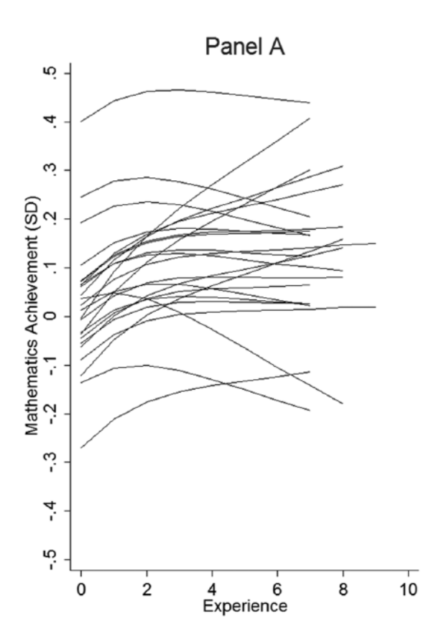
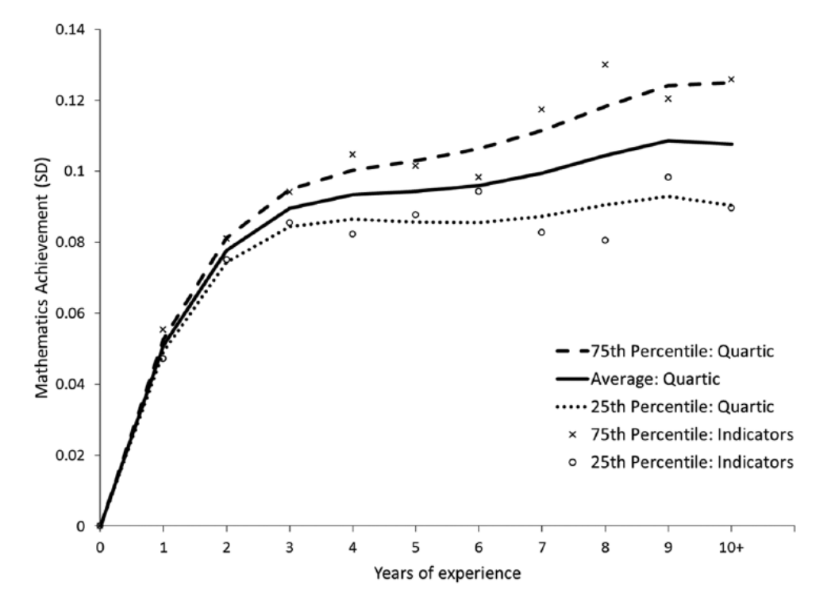
Kraft & Papay (2014)
Notes:
Kraft, M. A., & Papay, J. P. (2014). Can professional environments in schools promote teacher development? Explaining heterogeneity in returns to teaching experience. Educational Evaluation and Policy Analysis, 36(4), 476-500.

Slide 22
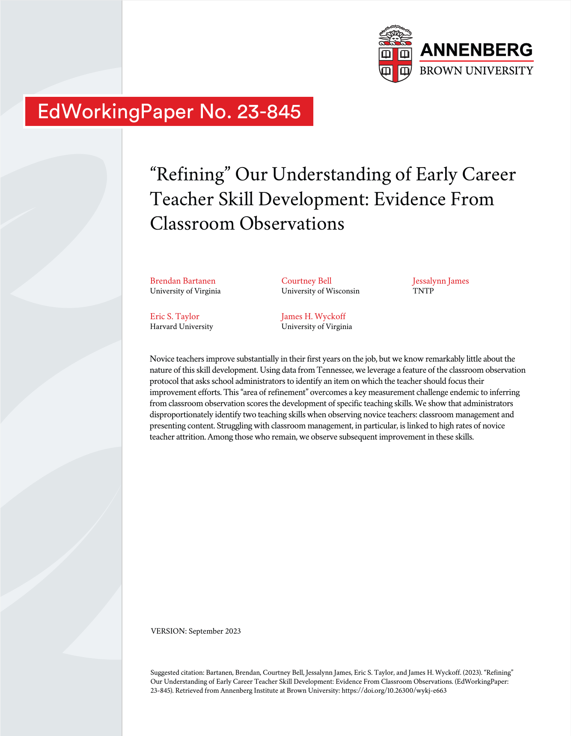
What areas improve most?
Biggest improvements are for
  Novice teachers
  Lower performing teachers
  In classroom management
Higher order teaching skills, and higher levels of performance, seem to be much less likely to improve
Bartanen et al (2023)
Notes:
Bartanen, B., Bell, C., James, J., Taylor, E. S., & Wyckoff, J. H. (2023). " Refining" Our Understanding of Early Career Teacher Skill Development: Evidence from Classroom Observations. EdWorkingPaper No. 23-845. Annenberg Institute for School Reform at Brown University.
https://files.eric.ed.gov/fulltext/ED639209.pdf

Slide 23
I can manage a complex organisation based on intuition
5.

Slide 24
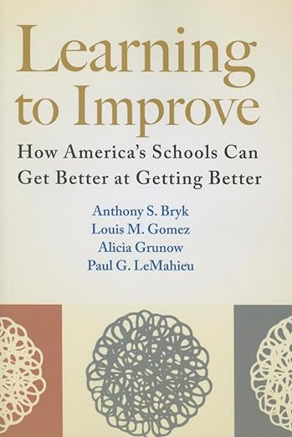
Six Core Principles of Improvement
https://www.carnegiefoundation.org/our-work/improvement-in-education/six-core-principles-improvement
Bryk et al 2015 Learning to Improve
Notes:
Bryk, A. S., Gomez, L. M., Grunow, A., & LeMahieu, P. G. (2015). Learning to improve: How America’s schools can get better at getting better. Harvard Education Press.
See also
Lewis, C. (2015). What is improvement science? Do we need it in education?. Educational Researcher, 44(1), 54-61.
Yeager, D., Bryk, A., Muhich, J., Hausman, H., & Morales, L. (2013). Practical measurement. Palo Alto, CA: Carnegie Foundation for the Advancement of Teaching, 78712. https://labs.la.utexas.edu/adrg/files/2013/12/Practical-Measurement.pdf

Slide 25
1. Make the work problem-specific and user-centered.
It starts with a single question: “What specifically is the problem we are trying to solve?”
It enlivens a co-development orientation: engage key participants early and often.

Slide 26
2. Variation in performance is the core problem to address.
The critical issue is not what works, but rather what works, for whom and under what set of conditions.
Aim to advance efficacy reliably at scale: Not 'can it work' but 'how to make it work reliably'

Slide 27
3. See the system that produces the current outcomes.
It is hard to improve what you do not fully understand. Go and see how local conditions shape work processes.
Make your hypotheses for change public and clear.

Slide 28
4. We cannot improve at scale what we cannot measure.
Embed measures of key outcomes and processes to track if change is an improvement.
We intervene in complex organizations. Anticipate unintended consequences and measure these too.

Slide 29
5. Anchor practice improvement in disciplined inquiry.
Engage rapid cycles of Plan, Do, Study, Act (PDSA) to learn fast, fail fast, and improve quickly.
That failures may occur is not the problem; that we fail to learn from them is.

Slide 30
6. Accelerate improvements through networked communities.
Embrace the wisdom of crowds. We can accomplish more together than even the best of us can accomplish alone.

Slide 31

How does feedback to teachers help?
By
Giving insights into their classroom
Clarifying what good looks like
Focussing attention on what matters
Showing progress in their professional learning
Diagnosing strengths and areas for development
Feedback turns experience into learning

Slide 32
Good luck!
rob@evidencebased.education
@ProfCoe @EvidenceInEdu
https://evidencebased.education/

