Slide 1
Teacher expertise What it is, why it matters and how to get more of it
Rob Coe
researchED London, 6 September 2025

Slide 2

Burroughs et al. (2019)
Researchers agree that teachers are one of the most important school-based resources in determining students’ future academic success and lifetime outcomes, yet have simultaneously had difficulties in defining what teacher characteristics make for an effective teacher.
Notes:
Burroughs, N., Gardner, J., Lee, Y., Guo, S., Touitou, I., Jansen, K., & Schmidt, W. (2019). A review of the literature on teacher effectiveness and student outcomes. Teaching for Excellence and Equity, 7-17. IEA Research for Education.
https://link.springer.com/chapter/10.1007/978-3-030-16151-4_2

Slide 3
Do teachers make a difference?

Slide 4
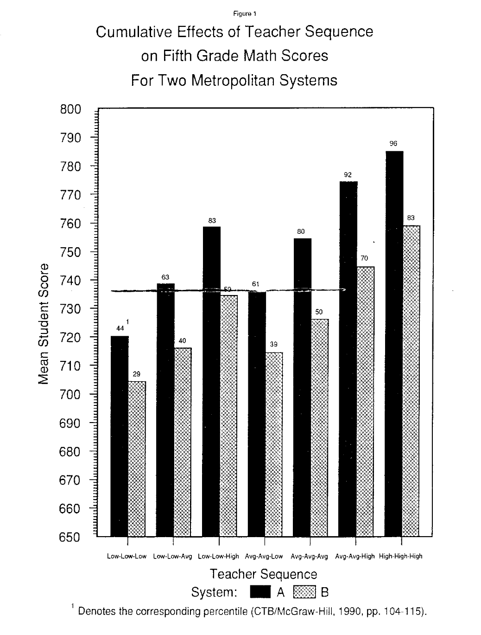
Tennessee: Sanders & Rivers, 1996
“Differences in student achievement of 50 percentile points were observed as a result of teacher sequence after only three years.
The effects of teachers on student achievement are both additive and cumulative with little evidence of compensatory effects
As teacher effectiveness increases, lower achieving- students are the first to benefit. The top quintile of teachers facilitate appropriate to excellent gains for students of all achievement levels.
Students of different ethnicities respond equivalently within the same quintile of teacher effectiveness.”
Notes:
Sanders, W. L., & Rivers, J. C. (1996). Cumulative and residual effects of teachers on future student academic achievement. University of Tennessee Value-Added Research and Assessment Center, Research Progress Report, November 1996
https://www.beteronderwijsnederland.nl/files/cumulative%20and%20residual%20effects%20of%20teachers.pdf
Low = bottom quintile; High = top quintile

Slide 5
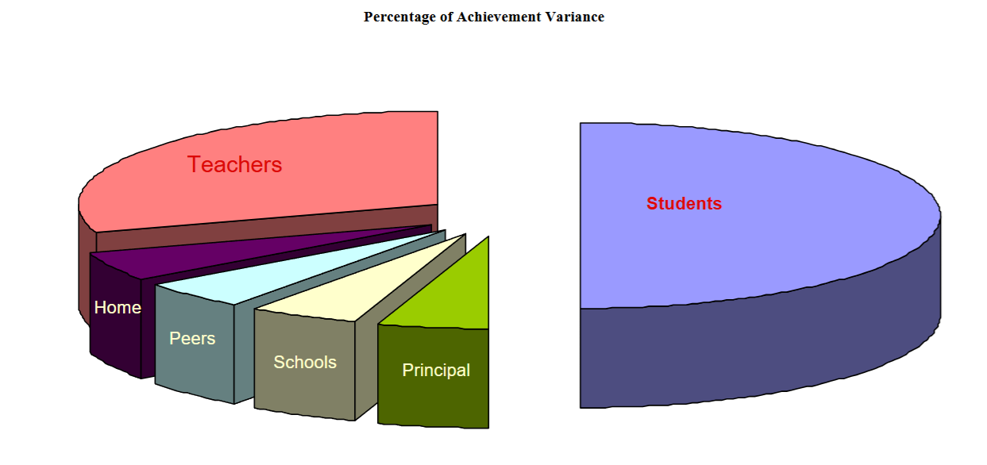
Hattie (2003) Teachers make a difference: What is the research evidence?
“what teachers know, do, and care about”
Notes:
Hattie, J.A.C. (2003). Teachers make a difference: What is the research evidence? Paper presented at the Building Teacher Quality: What does the research tell us ACER Research Conference, Melbourne, Australia, October 2003.
https://research.acer.edu.au/cgi/viewcontent.cgi?article=1003&context=research_conference_2003

Slide 6
Economic impact
25 point rise in national PISA scores corresponds to £4,000,000,000,000 (4 trillion) boost in GDP (Hanushek & Woessmann, 2010)
“… students assigned to high-VA teachers in primary school are more likely to attend college, earn higher salaries, and are less likely to have children as teenagers. Replacing a teacher whose VA is in the bottom 5% with an average teacher would increase the present value of students' lifetime income by approximately $250,000 per classroom.” (Chetty, Friedman & Rockoff, 2014)
Notes:
Hanushek E.A. & Woessmann L. (2010) The High Cost of Low Educational Performance: The Long-run Economic Impact of Improving PISA Outcomes. OECD Programme for International Student Assessment. http://www.oecd.org/dataoecd/11/28/44417824.pdf
Chetty, R., Friedman, J. N., & Rockoff, J. E. (2014). Measuring the impacts of teachers II: Teacher value-added and student outcomes in adulthood. American Economic Review, 104(9), 2633-79.

Slide 7
What do they do differently?

Slide 8

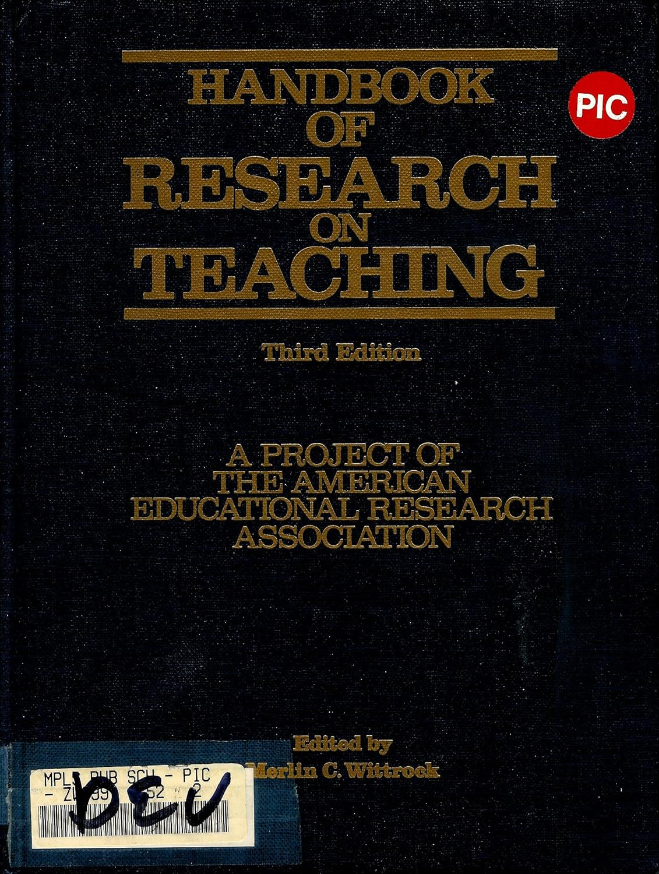
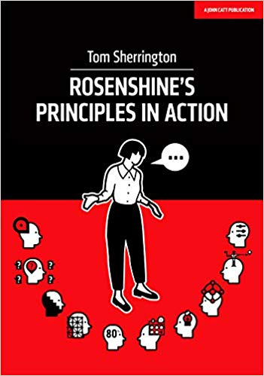
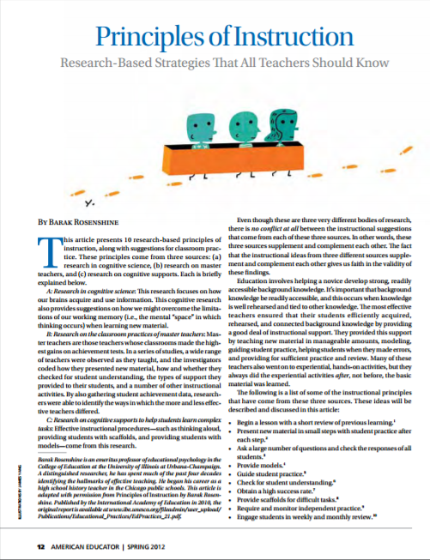
Early work on effective classroom practices
Barak Rosenshine
2019
2010 / 2012
Brophy & Good 1986
1971
Notes:
Sherrington, T. (2019) Rosenshine’s Principles in Action. Woodbridge: John Catt
Rosenshine, B. (2012) Principles of Instruction: Research based principles that all teachers should know. American Educator, Spring 2012. http://www.aft.org/pdfs/americaneducator/spring2012/Rosenshine.pdf
Rosenshine, B. (2010) Principles of Instruction. International Academy of Education, UNESCO. Geneva: International Bureau of Education. http://www.ibe.unesco.org/fileadmin/user_upload/Publications/Educational_Practices/EdPractices_21.pdf
Rosenshine, B. (1971) Teaching behaviours and student achievement. London, National Foundation for Educational Research
Brophy, J., & Good, T. (1986). Teacher behavior and student achievement. In M. Wittrock (Ed.), Handbook of research on teaching (pp. 340–270). New York: Macmillan.

Slide 9
The Dynamic Model (Creemers & Kyriakides, 2006)
Orientation
Providing the objectives for which a specific task/lesson/series of lessons take(s) place
Challenging students to identify the reason why an activity is taking place in the lesson.
Structuring
Beginning with overviews and/or review of objectives
Outlining the content to be covered and signalling transitions between lesson parts
Drawing attention to and reviewing main ideas
Questioning
Raising different types of questions (i.e., process and product) at appropriate difficulty level
Giving time for students to respond
Dealing with student responses
Teaching modelling
Encouraging students to use problem-solving strategies presented by the teacher or other classmates
Inviting students to develop strategies
Promoting the idea of modelling
Application
Using seatwork or small-group tasks in order to provide needed practice and application opportunities
Using application tasks as starting points for the next step of teaching and learning
The classroom as a learning environment
Establishing on-task behaviour through the interactions they promote (i.e., teacher–student and student–student interactions)
Dealing with classroom disorder and student competition through establishing rules, persuading students to respect them and using the rules
Management of time
Organizing the classroom environment
Maximizing engagement rates
Assessment
Using appropriate techniques to collect data on student knowledge and skills
Analysing data in order to identify student needs and report the results to students and parents.
Teachers evaluating their own practices
Notes:
Creemers, B. P. M., & Kyriakides, L. (2006). Critical analysis of the current approaches to modelling educational effectiveness: The importance of establishing a dynamic model. School Effectiveness and School Improvement, 17, 347–366.
Creemers, B., & Kyriakides, L. (2007). The dynamics of educational effectiveness: A contribution to policy, practice and theory in contemporary schools. Routledge.
Creemers, B. P., & Kyriakides, L. (2011). Improving Quality in Education: Dynamic Approaches to School Improvement. Routledge, Taylor & Francis Group.

Slide 10
CLASS: Classroom Assessment Scoring System
Emotional Support
Positive Climate: Reflects the emotional connection and relationships among teachers and students, and the warmth, respect, and enjoyment in verbal and non-verbal interactions.
Negative Climate: Reflects the level and intensity of expressed negativity among teachers and students in the classroom.
Teacher Sensitivity: Encompasses the teacher’s awareness and responsiveness to the academic, social-emotional, and developmental needs of individual students and the entire class.
Regard for Adolescent Perspectives: Focuses on the extent to which the teacher is able to meet and capitalize on the social and developmental needs of adolescents by providing opportunities for student autonomy and leadership. Also considered are the extent to which student ideas and opinions are valued and content is made useful and relevant to adolescents.
Classroom Organization
Behavior Management: Encompasses the teacher’s use of clear behavioral expectations and effective methods to prevent and redirect misbehavior.
Productivity: Considers how well the teacher manages time and routines so that instructional time is maximized.
Instructional Learning Formats: Focuses on the ways in which the teacher maximizes students’ interest and engagement in learning. This includes teachers’ use of interesting and engaging lessons and materials, active facilitation, and clarity of learning objectives.
Instructional Support
Content Understanding: Refers to both depth of the lesson content and the approaches used to help students comprehend the framework, key ideas, and procedures in an academic discipline. At a high level, this refers to interactions among the teacher and students that lead to an integrated understanding of facts, skills, concepts, and principles.
Analysis and Inquiry: Assesses the degree to which the teacher facilitates students’ use of higher-level thinking skills, such as analysis, problem solving, reasoning, and creation through the application of knowledge and skills. Opportunities for demonstrating meta-cognition, that is, thinking about thinking, are also included.
Quality of Feedback: Assesses the degree to which feedback expands and extends learning and understanding and encourages student participation. (At the secondary level, significant feedback may be provided by peers)
Instructional Dialogue: Captures the purposeful use of dialogue-structured, cumulative questioning and discussion that guide and prompt students—to facilitate students’ understanding of content and language development. The extent to which these dialogues are distributed across all students in the class and across the class period is important to this rating.
Notes:
Hafen, C. A., Hamre, B. K., Allen, J. P., Bell, C. A., Gitomer, D. H., & Pianta, R. C. (2015). Teaching through interactions in secondary school classrooms: Revisiting the factor structure and practical application of the Classroom Assessment Scoring System–Secondary. The Journal of early adolescence, 35(5-6), 651-680.
https://www.ncbi.nlm.nih.gov/pmc/articles/PMC5319784/

Slide 11
The Danielson Framework for Teaching
Domain 1: Planning and Preparation
Demonstrating Knowledge of Content and Pedagogy
Demonstrating Knowledge of Students
Setting Instructional Outcomes
Demonstrating Knowledge of Resources
Designing Coherent Instruction
Designing Student Assessments
Domain 2: The Classroom Environment
Creating an Environment of Respect and Rapport
Establishing a Culture for Learning
Managing Classroom Procedures
Managing Student Behavior
Organizing Physical Space
Domain 3: Instruction
Communicating With Students
Using Questioning and Discussion
Techniques
Engaging Students in Learning
Using Assessment in Instruction
Demonstrating Flexibility and Responsiveness
Domain 4: Professional Responsibilities
Reflecting on Teaching
Maintaining Accurate Records
Communicating with Families
Participating in a Professional Community
Growing and Developing Professionally
Showing Professionalism

Slide 12
Three Basic Dimensions (German Framework – Praetorius et al, 2018)
Student support
Create a climate of motivation and trust
Classroom management
Maximise productive time on task
Cognitive activation
Make students think hard (elaborate, connect & embed)
Notes:
Praetorius, A. K., Klieme, E., Herbert, B., & Pinger, P. (2018). Generic dimensions of teaching quality: the German framework of Three Basic Dimensions. ZDM, 50(3), 407-426.

Slide 13
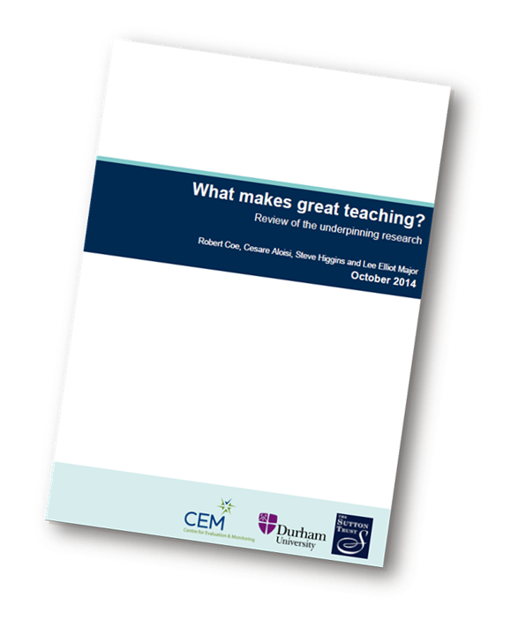
What Makes Great Teaching? (Coe et al., 2014)
Curriculum-related content knowledge
Cognitive activation
Classroom management
Classroom culture and relationships
Teacher knowledge about education
Teacher professionalism

Slide 14
The challenge
To develop a list/framework of teacher characteristics (skill, knowledge, ability, behaviour, attitude, belief, etc) whose elements
Include everything you might want to use to evaluate or improve teaching quality (eg for recruitment, retention, performance management, professional development, etc)
Are supported by evidence and theory as related to learner outcomes
Are well-defined and observable
Can be learnt/improved
If you do improve them, students learn more

Slide 15
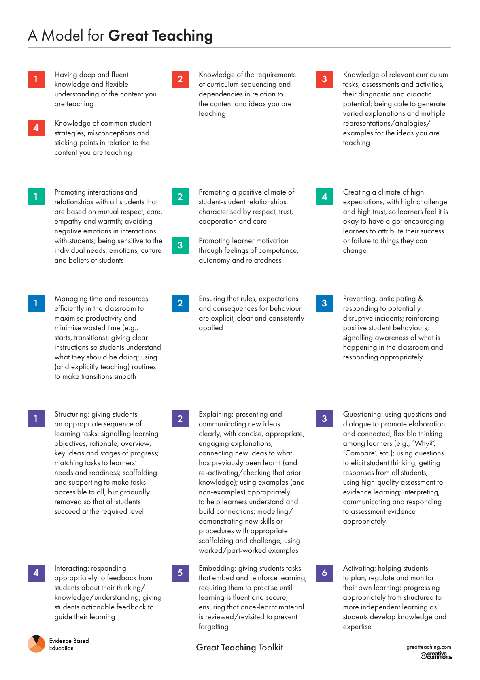

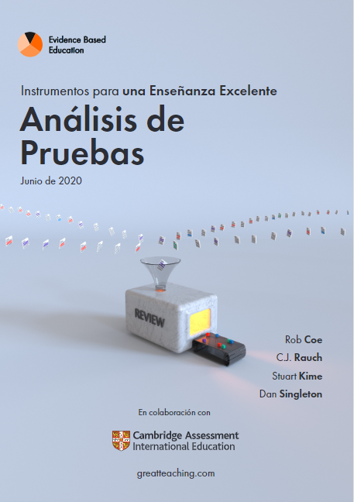


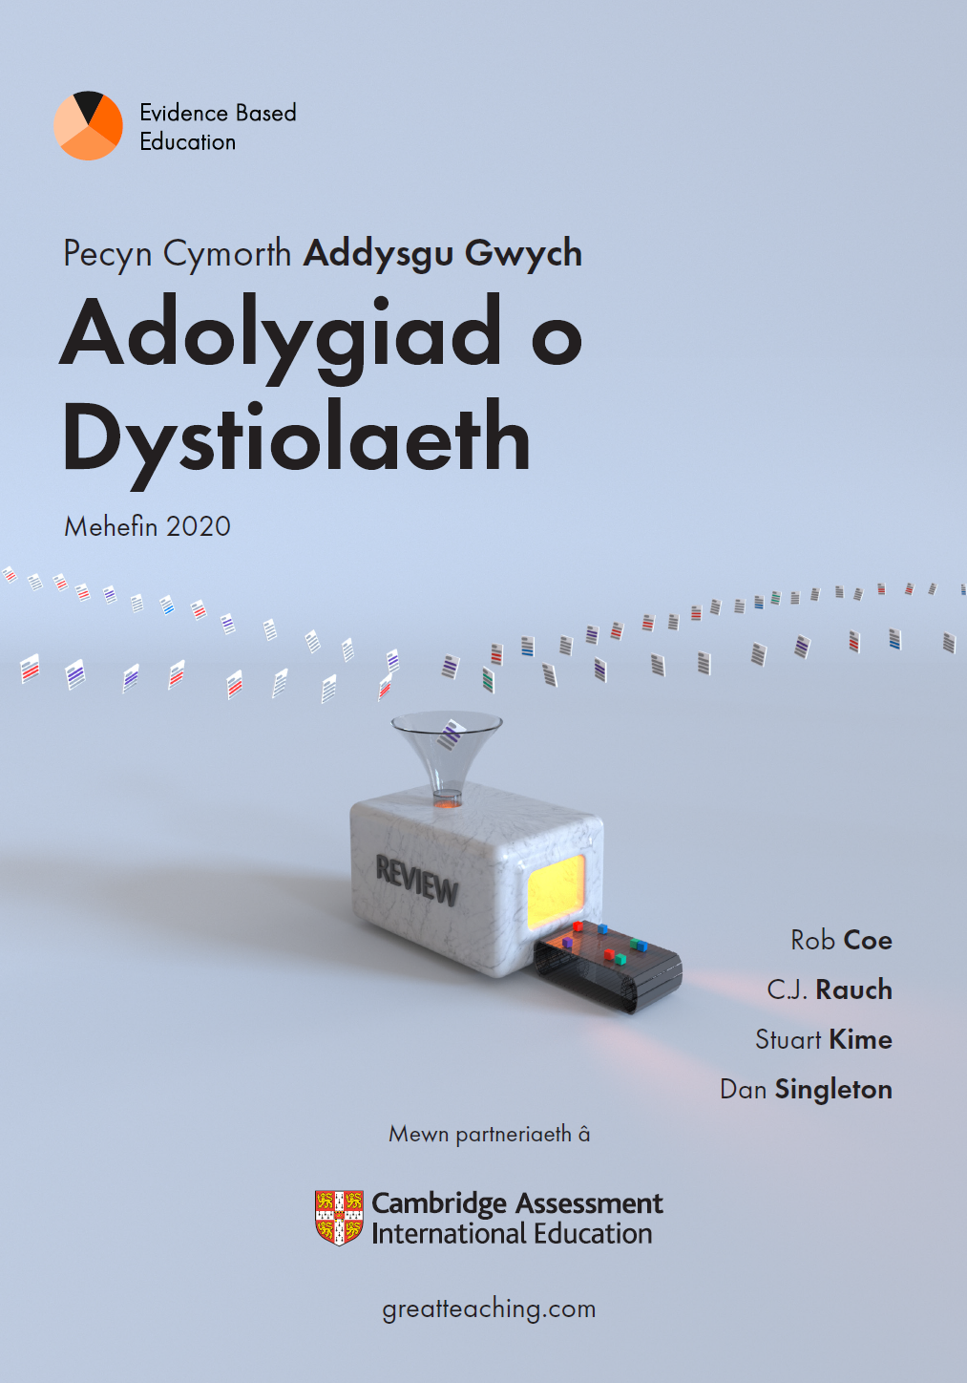
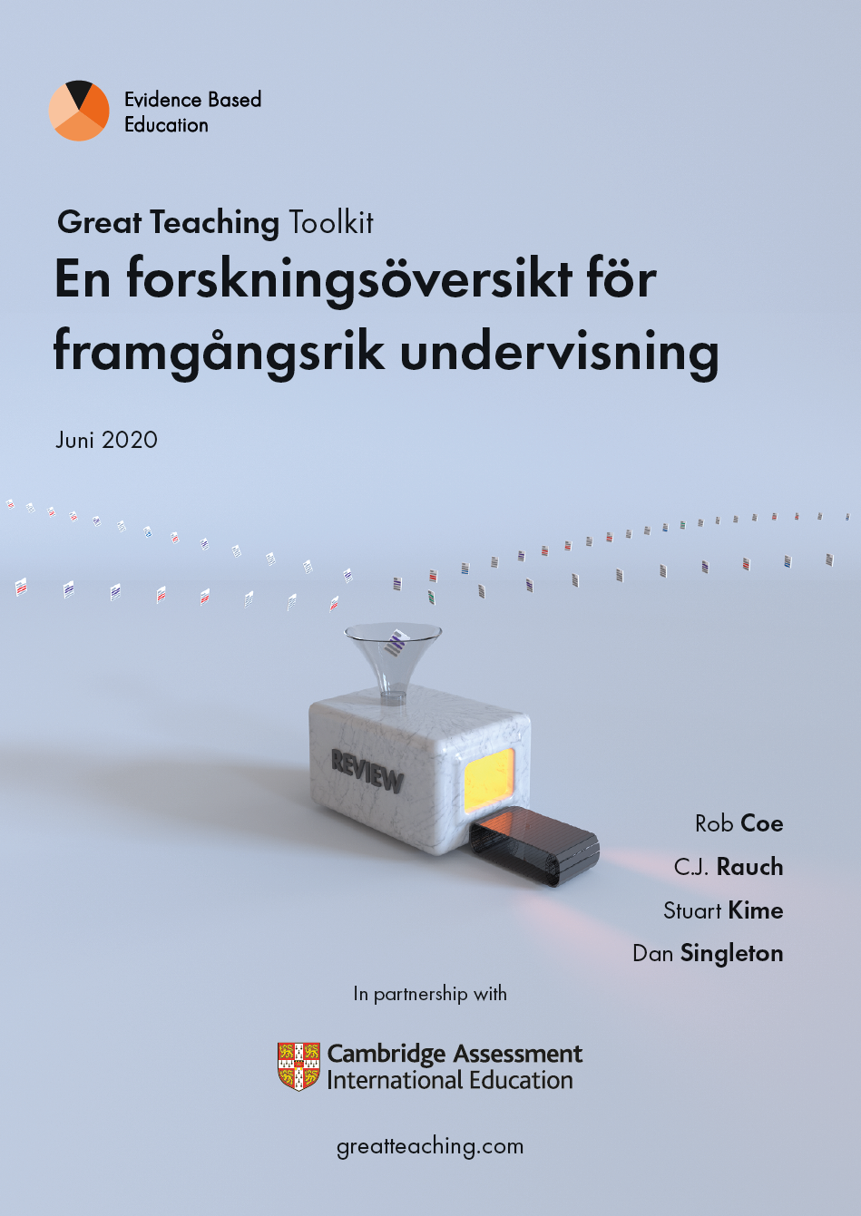
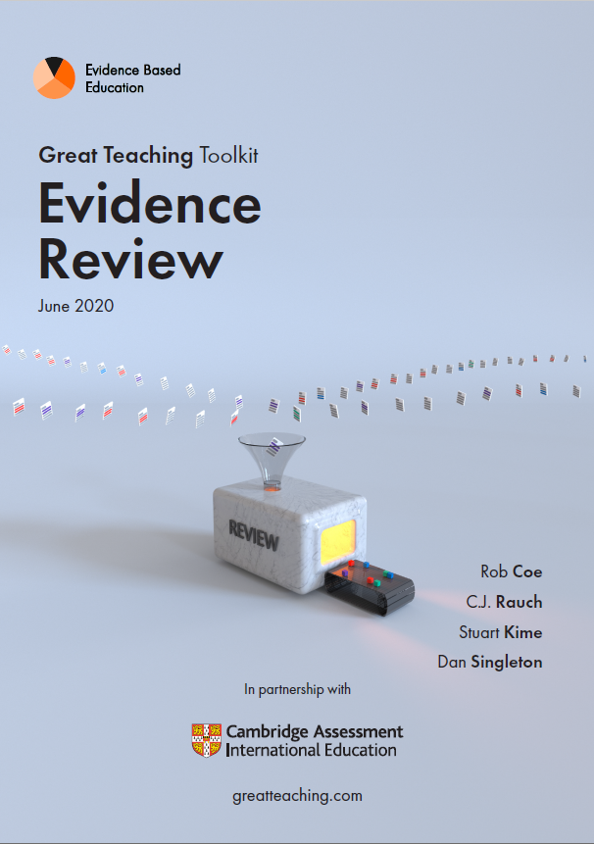
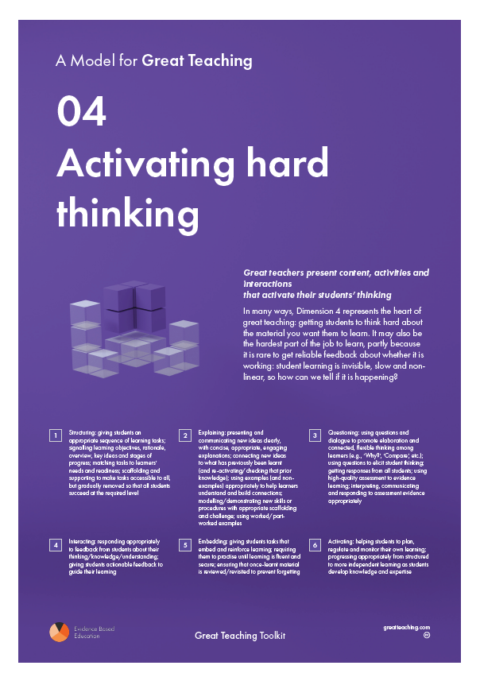

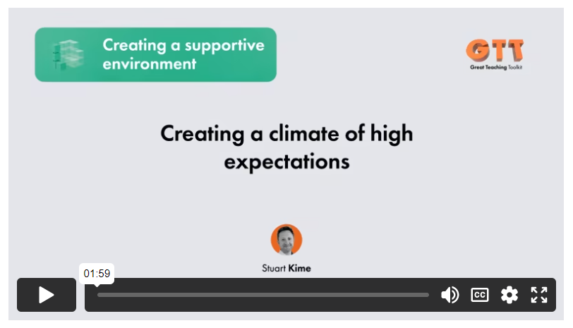
Great Teaching Toolkit: Evidence Review
https://evidencebased.education/great-teaching-toolkit-evidence-review/
Notes:
Coe, R., Rauch, C.J., Kime, S. and Singleton, D. (2020) Great Teaching Toolkit Evidence Review. Evidence Based Education, in partnership with Cambridge Assessment International Education. greatteaching.com

Slide 16
Overview of the GTT Model for Great Teaching
Great teachers:
01 understand the content they are teaching and how it is learnt
02 create a supportive environment for learning
03 manage the classroom to maximise opportunity to learn
04 present content, activities and interactions that activate their students’ thinking
Notes:
Coe, R., Rauch, C.J., Kime, S. and Singleton, D. (2020) Great Teaching Toolkit Evidence Review. Evidence Based Education, in partnership with Cambridge Assessment International Education. greatteaching.com

Slide 17

Elements of Great Teaching What is worth learning for teachers?
01 Understanding the content
1.1 Deep and fluent content knowledge
1.2 Curriculum knowledge: sequencing
1.3 Knowledge of tasks, assessments, multiple explanations
1.4 Knowledge of student thinking: misconceptions
02 Creating a supportive environment
2.1 Relationships with students, cultural sensitivity
2.2 Student-student relationships & climate
2.3 Promoting learner motivation
2.4 High expectations, challenge and trust
03 Maximising opportunity to learn
3.1 Managing time and resources to maximise productivity
3.2 Clear and consistent rules, expectations, consequences
3.3 Preventing & responding to disruption, showing awareness
04 Activating hard thinking
4.1 Structuring: matching tasks, scaffolding, signalling objectives
4.2 Explaining: presenting & connecting ideas, modelling examples
4.3 Questioning: promoting hard thinking, assessing
4.4 Interacting: giving, receiving and responding to feedback
4.5 Embedding: practising, reinforcing & spacing learning
4.6 Activating: building independence, supporting metacognition
Notes:
Coe, R., Rauch, C.J., Kime, S. and Singleton, D. (2020) Great Teaching Toolkit Evidence Review. Evidence Based Education, in partnership with Cambridge Assessment International Education. greatteaching.com

Slide 18
How and why does this happen?
Theory and mechanisms

Slide 19

What has to change for students to learn more?
Teacher expertise
School environment
Teacher
Classroom
T
Interactions
D2: Environment
D1: Content
D3:
Opportunity
Students
Curriculum
S
D4: Activation
C
Based on
Bryk et al (2010),
Cohen, Raudenbush & Ball (2003)
Student learning
Notes:
Bryk, A. S., Sebring, P. B., Allensworth, E., Easton, J. Q., & Luppescu, S. (2010). Organizing schools for improvement: Lessons from Chicago. University of Chicago Press.
[in ToC]
Cohen, D. K., Raudenbush, S., & Ball, D. L. (2003). Resources, instruction and research. Educational Evaluation and Policy Analysis, 25, 119–142.
[in RQ2&3]

Slide 20
What is teacher expertise?
Knowledge
Insights
Techniques
Theories
Principles
Practical abilities
Understanding
Skills
Why, how, when and with what?
Fluent
Automatic
Practical application
Judgement
Context
Adaptive
Wisdom
Stigler & Miller, 2018
Notes:
https://evidencebased.education/why-do-we-see-teacher-expertise-as-needing-knowledge-skill-and-judgement/
Stigler, J. W., & Miller, K. F. (2018). Expertise and Expert Performance in Teaching. Ch 24, pp431-452, in Ericsson, K. A., Hoffman, R. R., & Kozbelt, A. (Eds.). The Cambridge Handbook of Expertise and Expert Performance. Cambridge University Press.

Slide 21
Understanding (D1)
Eric is watching a burning candle very carefully. After all of the candle has burned, he wonders what happened to the wax. He has a number of ideas; which one do you agree with most?
The candle wax has turned into invisible gases.
The candle wax is invisible and still in the air.
The candle wax has been completely destroyed after burning.
All of the wax has melted and dripped to the bottom of the candle holder.
The candle wax has turned into energy.
(Sadler et al 2013)
Notes:
Correct answer is a), chosen by 17% of pupils. Common misconception is (d), chosen by 59%.
Sadler, P. M., Sonnert, G., Coyle, H. P., Cook-Smith, N., & Miller, J. L. (2013). The influence of teachers’ knowledge on student learning in middle school physical science classrooms. American Educational Research Journal, 50(5), 1020-1049.

Slide 22
Understanding (D4)
After studying and learning a topic, students remember for longest if they then spend an equivalent amount of time
Studying it again in a single session
Studying it again in shorter, multiple sessions
Studying it again, and then being tested on it
Repeatedly being tested on it, with no further study
Notes:
Roediger, H. L., & Karpicke, J. D. (2006). Test-enhanced learning: taking memory tests improves long-term retention. Psychological science, 17(3), 249-255. http://learninglab.psych.purdue.edu/downloads/2006_Roediger_Karpicke_PsychSci.pdf
Dunlosky, J., Rawson, K. A., Marsh, E. J., Nathan, M. J., & Willingham, D. T. (2013). Improving students’ learning with effective learning techniques: Promising directions from cognitive and educational psychology. Psychological Science in the Public Interest, 14(1), 4-58.
http://www.millersville.edu/millersville/academics/gened/files/PDFs%20Faculty%20Handbook/3_Improving%20Students%20Learning%20with%20Effective%20Learning%20Techniques%20%20Promising%20Directions%20from%20Cognitive%20Educational%20Psychology.pdf

Slide 23
Skills (D1)
307
- 168
261
A pupil writes
How would you respond?
Another says, ‘Take 8 away from both’
How would you respond?
307
- 168
299
- 160
(from Ball et al, 2008)
Notes:
Ball, D. L., Thames, M. H., & Phelps, G. (2008). Content knowledge for teaching what makes it special?. Journal of teacher education, 59(5), 389-407. http://conferences.illinoisstate.edu/nsa/papers/thamesphelps.pdf
Hill, H. C., Rowan, B., & Ball, D. L. (2005). Effects of teachers' mathematical knowledge for teaching on student achievement. American Educational Research Journal, 42(2), 371-406.

Slide 24
Skills
Video:
Record yourself introducing Shelley's Ozymandias to a Y10 class
Record an episode of classroom questioning where you use wait time and name-at-end
Record yourself using a retrieval quiz, including giving feedback
Approximations: ‘learning to kayak on calm waters’ (Grossman et al, 2009)
Student surveys
GTT 4.2 Explaining:
My teacher is able to make new ideas interesting
My teacher explains difficult things clearly
My teacher will explain something until we understand
My teacher often explains too much at once for us
We are always interested when the teacher is explaining
When the teacher is explaining he or she uses really good examples to help us understand
We enjoy listening to my teacher
Notes:
Idea of ‘approximations’ ‘learning to kayak on calm waters’ Grossman et al, 2009
Grossman, P., Compton, C., Igra, D., Ronfeldt, M., Shahan, E., & Williamson, P. (2009). Teaching practice: A cross-professional perspective. Teachers College Record, 111(9), 2055-2100.

Slide 25
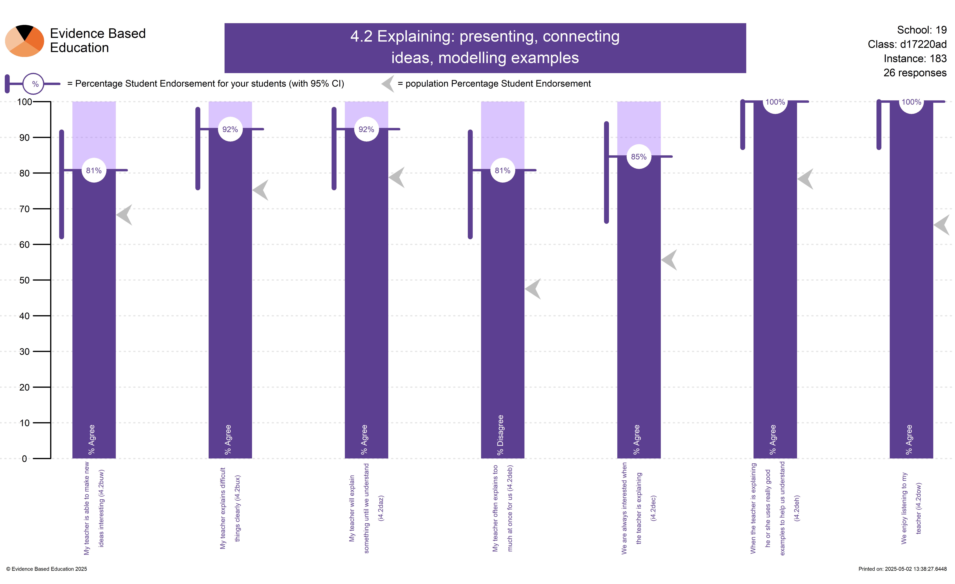
An example of a survey that was very positive
Notes:
7500 classes surveyed by 3800 teachers (as of April 2025)

Slide 26
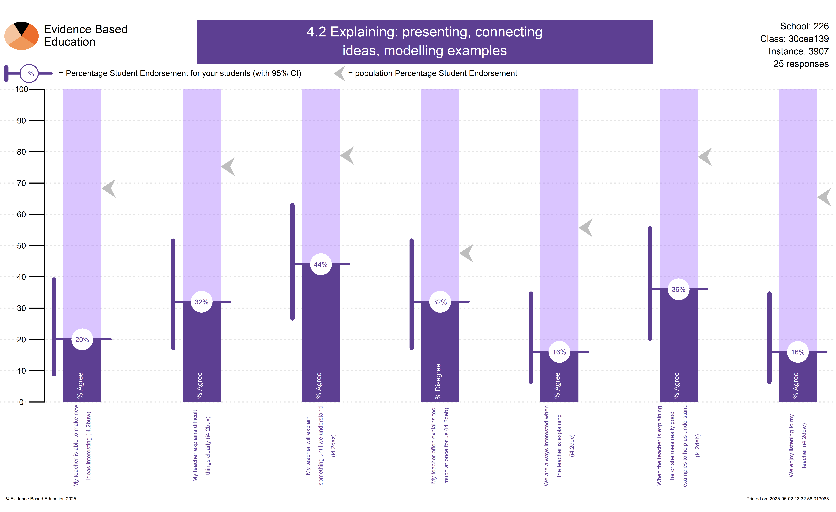
An example of a survey that was very negative

Slide 27
Differences between experts and novices (Berliner, 1988)
How they see and interpret classrooms: purposes and routines, vs surface-level description.
Discerning the importance of events
Using routines
Predicting classroom phenomena
Ignoring the ‘typical’
Evaluating performance
Responsibility and emotions: experts coped less well with teaching in an artificial lesson context
→ Don’t expect ‘trial lessons’ to identify more than basic competence
Notes:
Berliner D.C. (1988) The development of expertise in pedagogy. Charles W. Hunt Memorial Lecture, American Association of Colleges for Teacher Education, February 17, 1988
https://files.eric.ed.gov/fulltext/ED298122.pdf

Slide 28
Expertise and experience

Slide 29
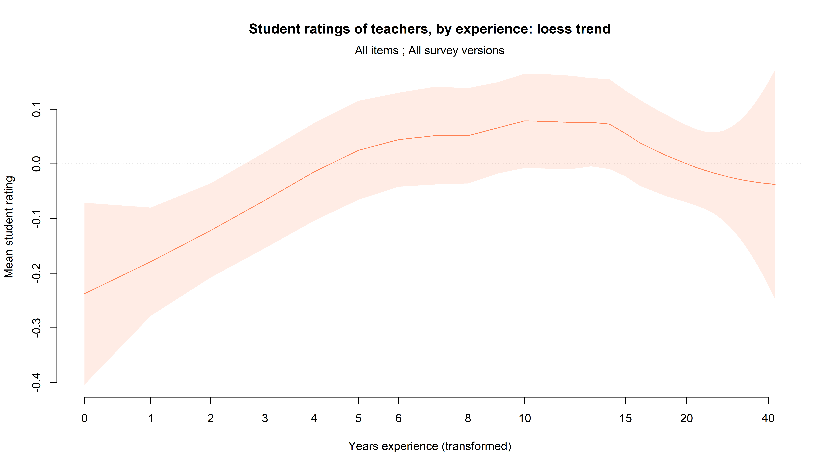
Overall, at least the first ten years of teaching are associated with increasing ratings

Slide 30
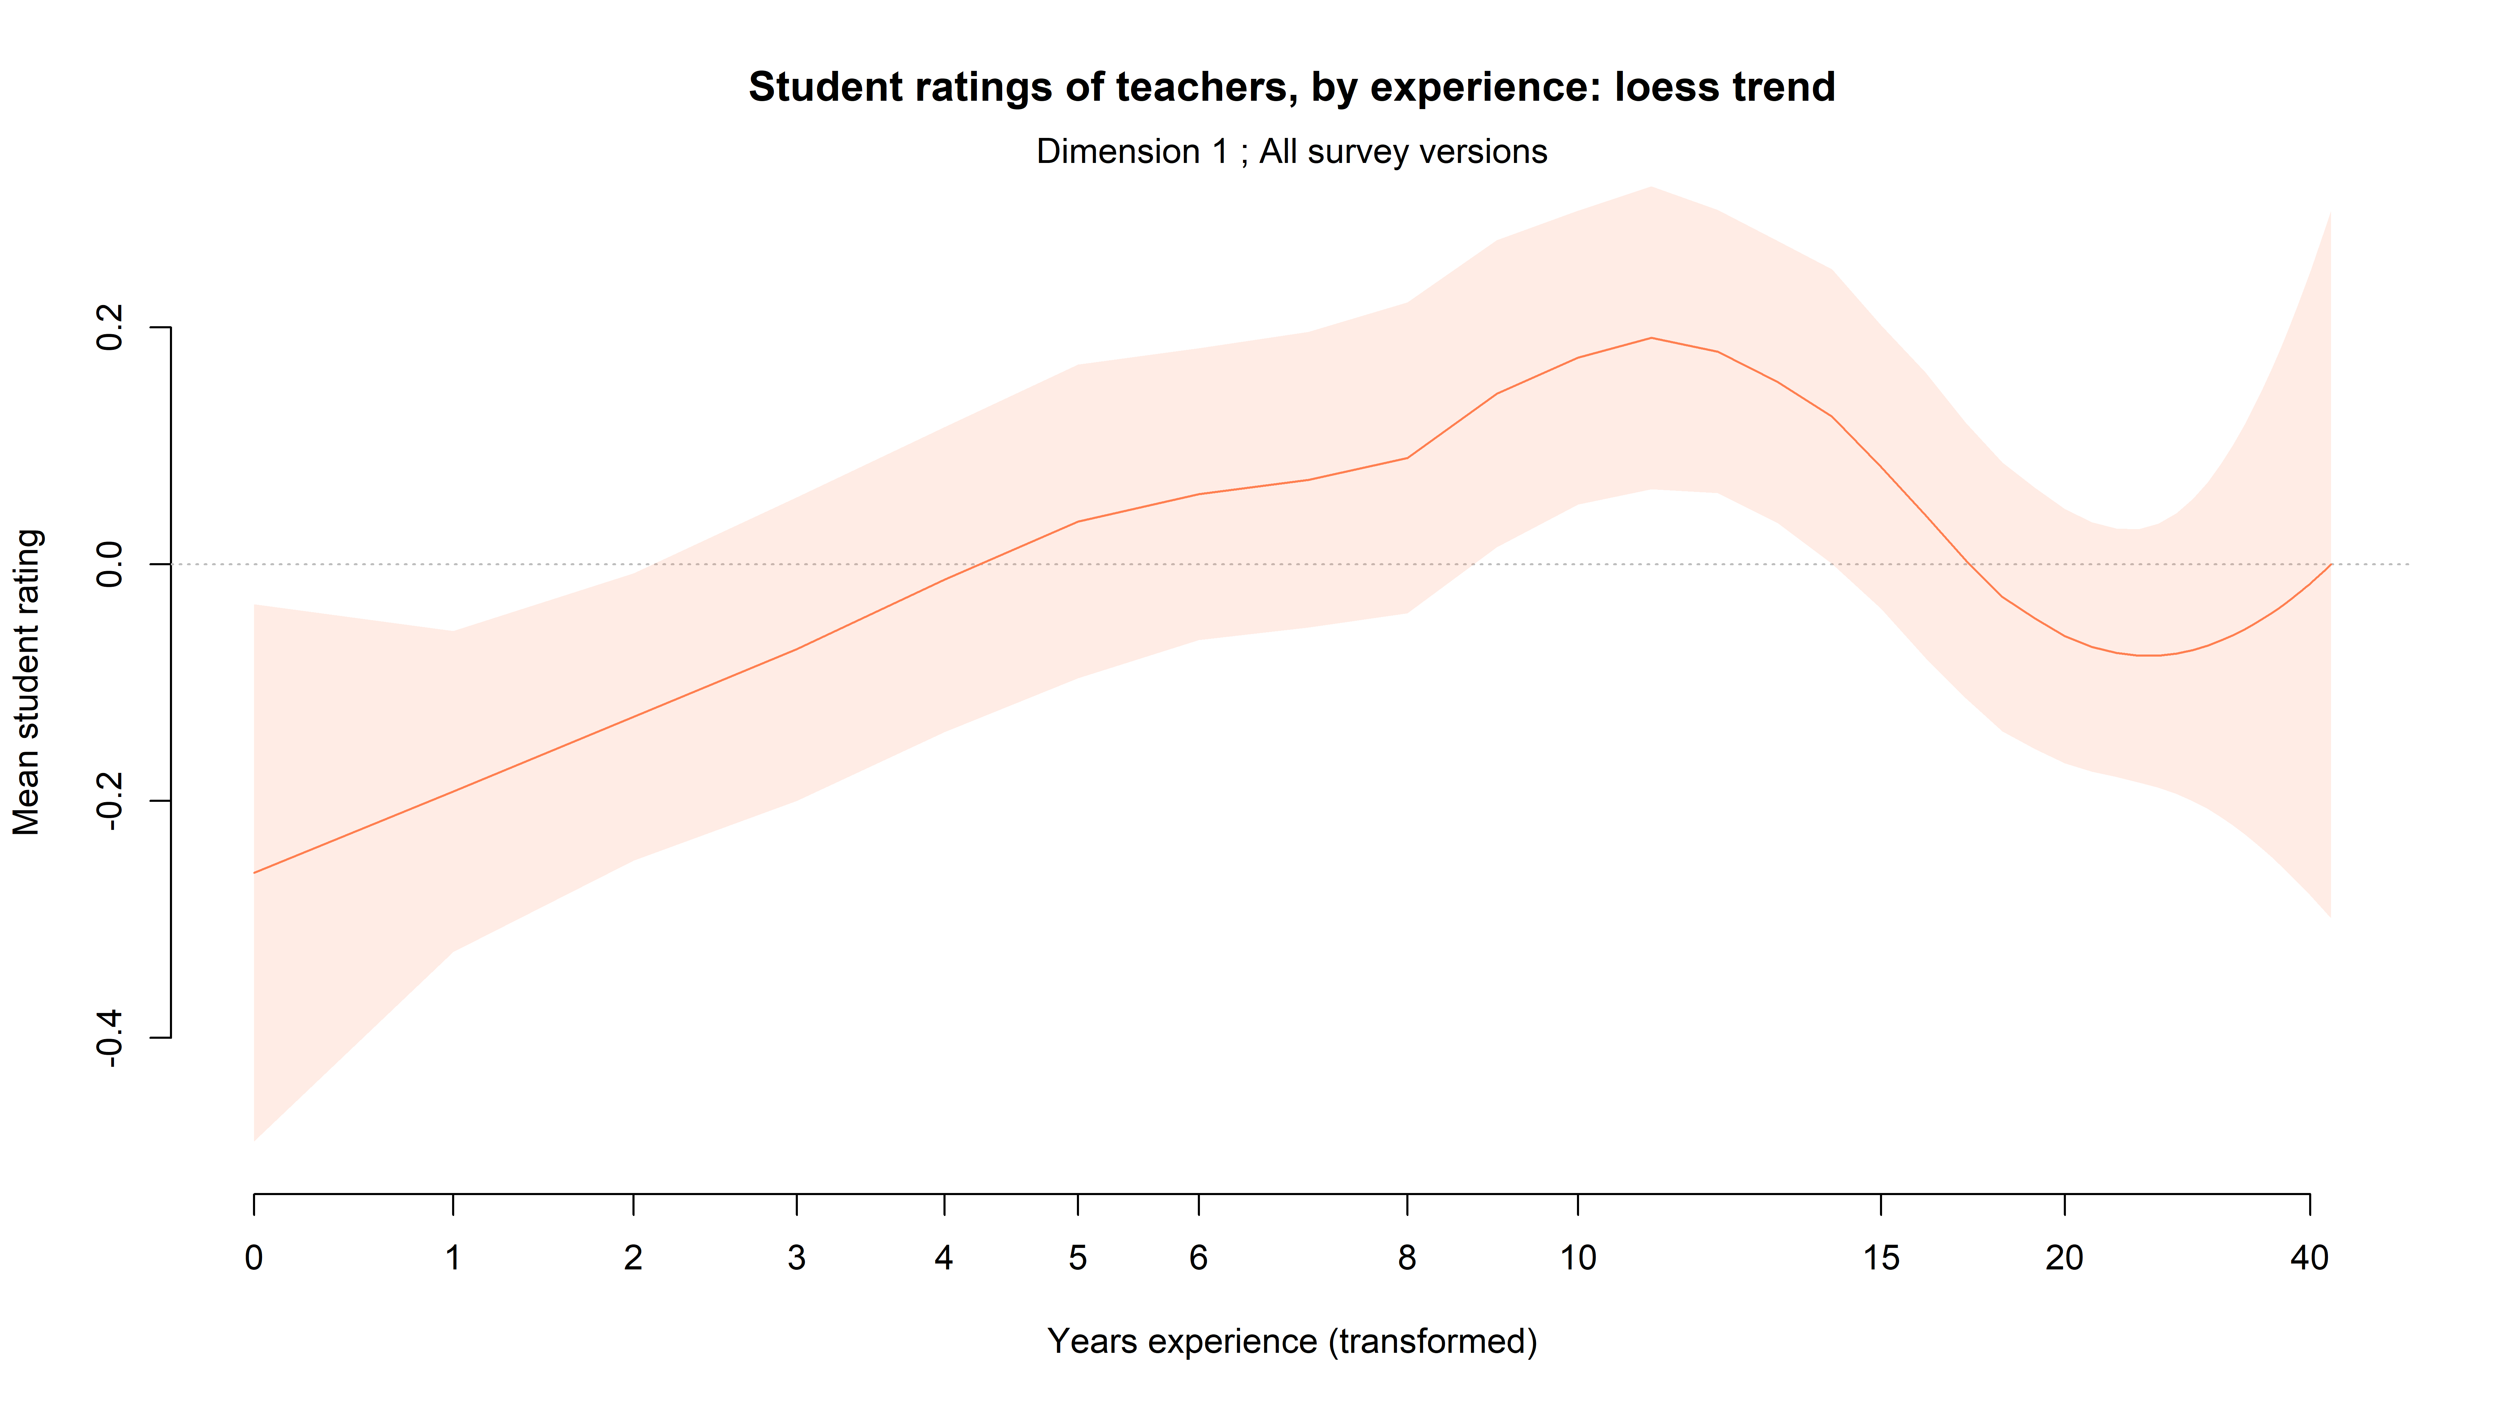
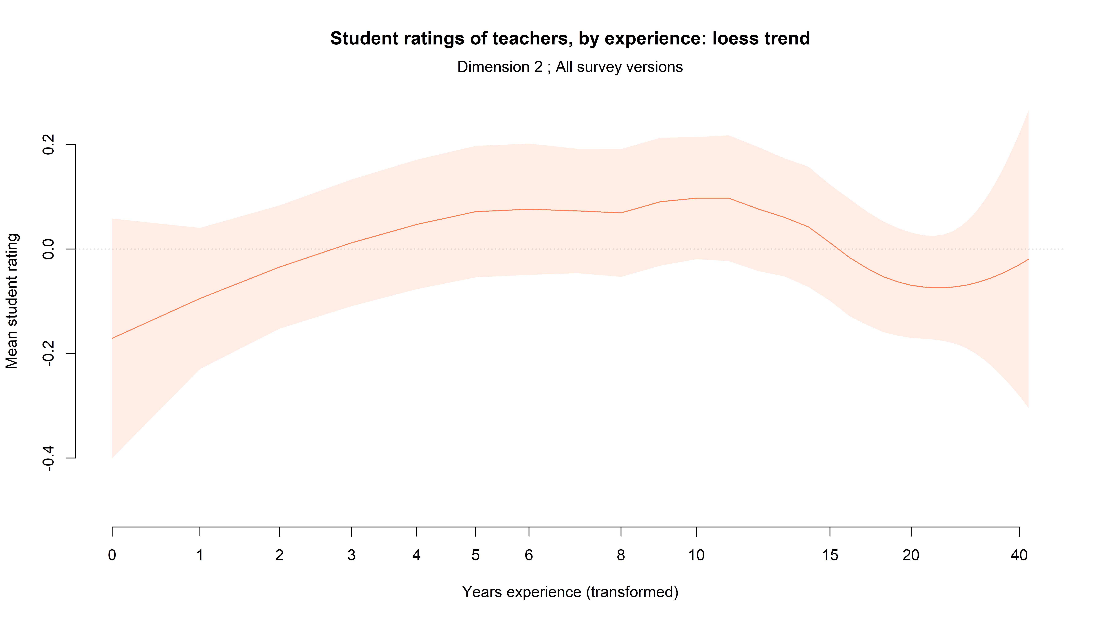
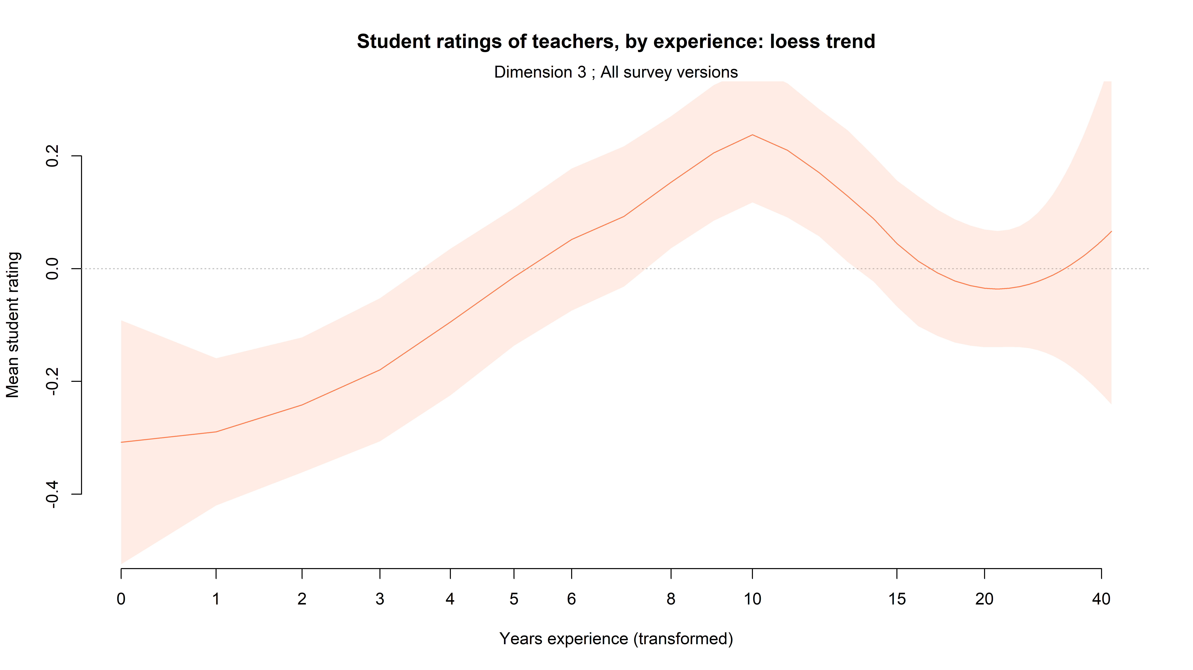
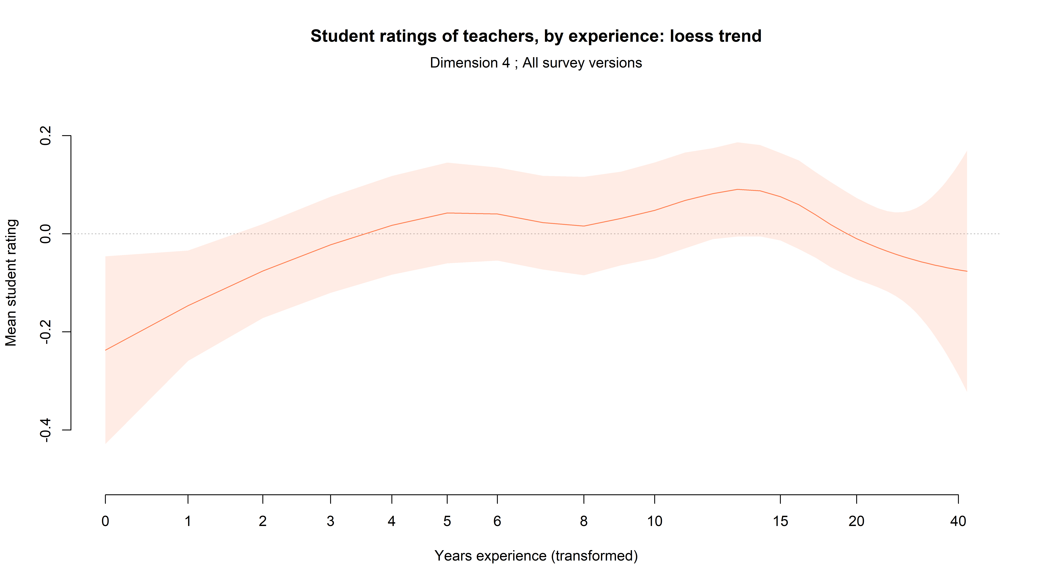
Trajectories are quite different in different GTT dimensions: D1 & D3 improve a lot over 0-10 years, D2 & D4 are flatter & plateau earlier
D1
D2
D3
D4

Slide 31
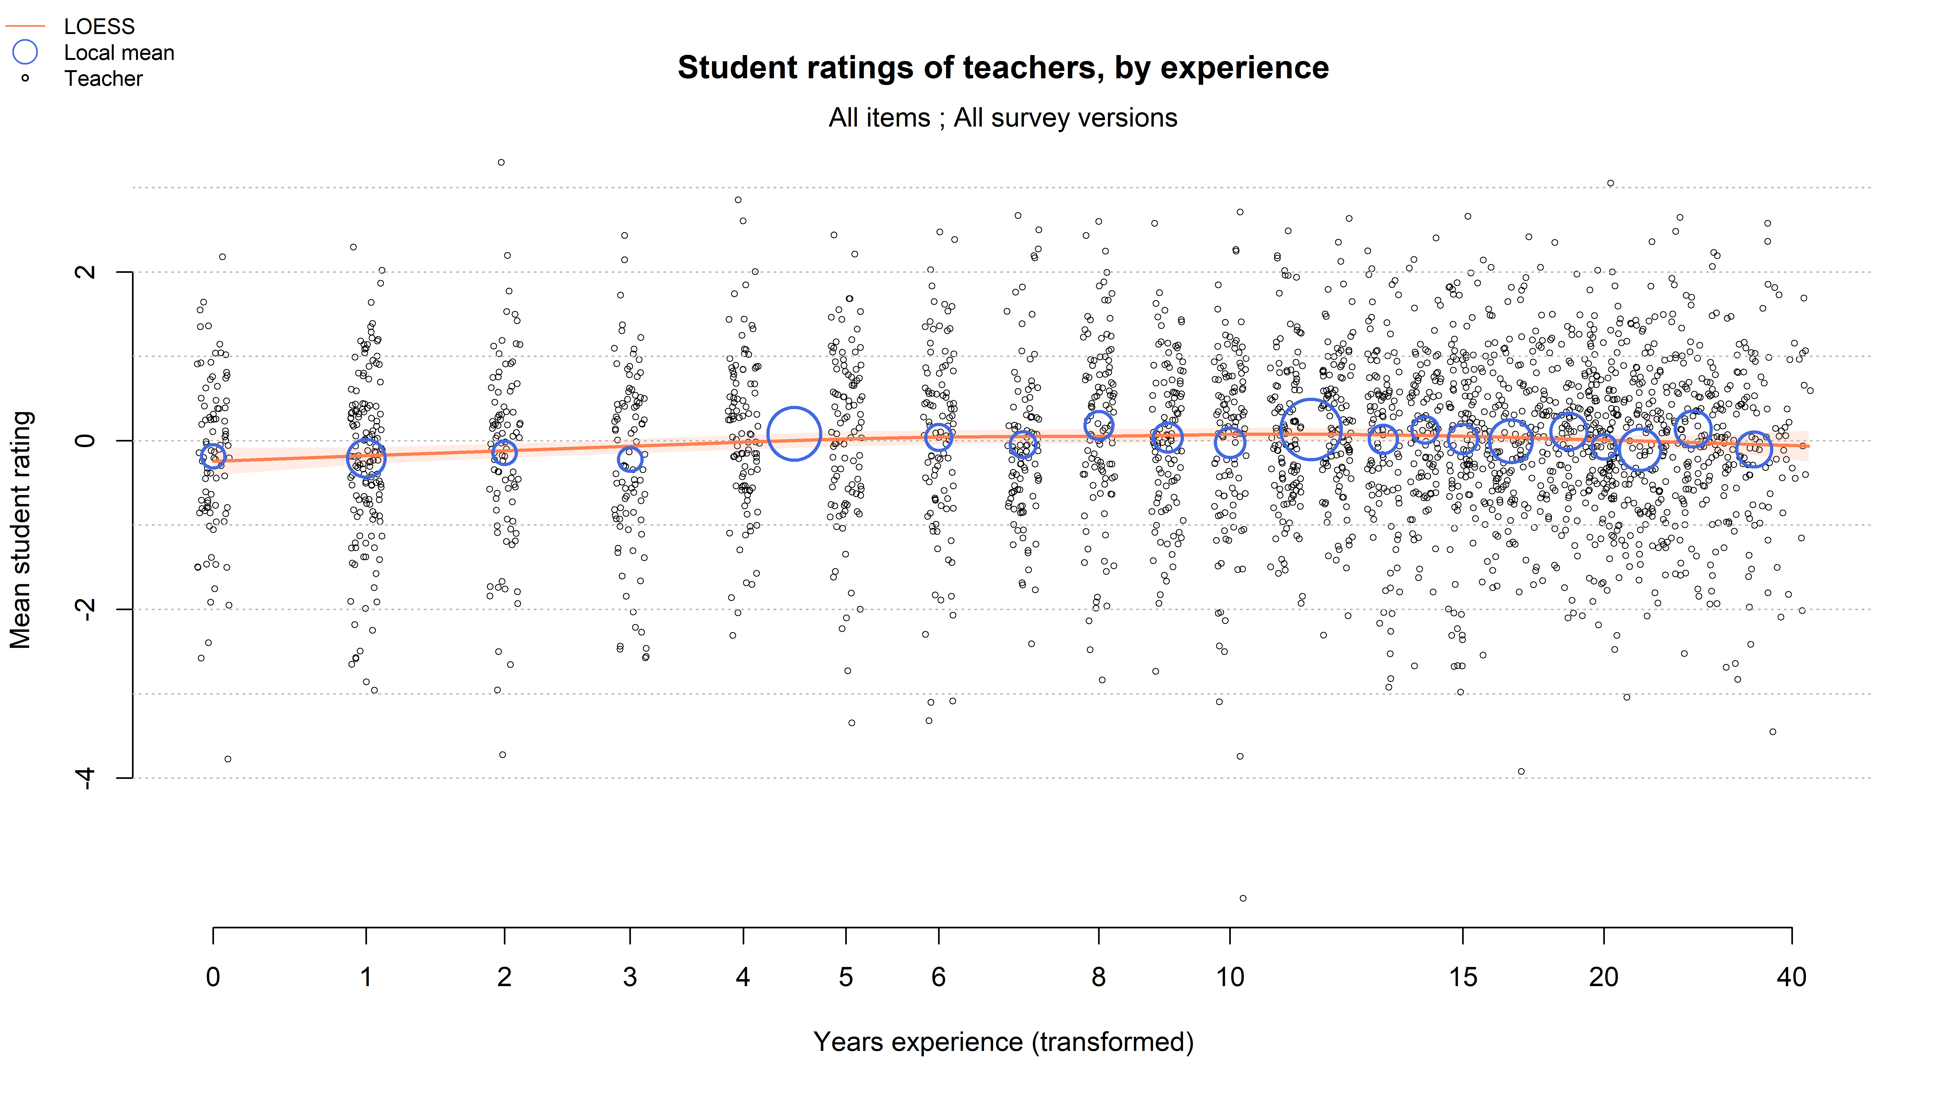
But the change with experience is tiny compared with the variation at any given time

Slide 32
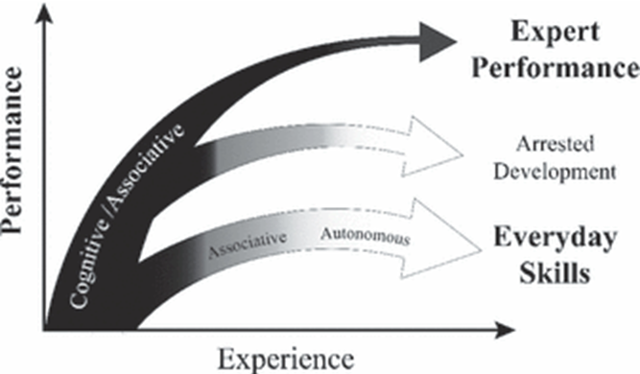
Why does expertise plateau?
Performance quickly becomes automatic, and is then insensitive to experience
Teachers don’t get rich enough feedback to inform their learning
Developing expertise is not a priority in most schools
(Ericsson, 2008; Hobbiss et al, 2020; Yeager et al, 2013; Hogarth, 2001)
Notes:
Ericsson, K.A. (2008). Deliberate practice and acquisition of expert performance: a general overview. Academic Emergency Medicine, 15(11), 988-994.
https://onlinelibrary.wiley.com/doi/full/10.1111/j.1553-2712.2008.00227.x
Hobbiss, M., Sims, S., & Allen, R. (2020). Habit formation limits growth in teacher effectiveness: A review of converging evidence from neuroscience and social science. Review of Education, rev3.3226. https://doi.org/10.1002/rev3.3226. Available at https://drive.google.com/file/d/1ivsudQPJ63qedkAOcB9dvrXGRAHaYLBy/view
Yeager, D., Bryk, A., Muhich, J., Hausman, H., & Morales, L. (2013). Practical measurement. Palo Alto, CA: Carnegie Foundation for the Advancement of Teaching, 78712. https://labs.la.utexas.edu/adrg/files/2013/12/Practical-Measurement.pdf
Hogarth, R. M. (2001). Educating intuition. University of Chicago Press.

Slide 33
Good luck!
rob@evidencebased.education
@ProfCoe @EvidenceInEdu
https://evidencebased.education/

