Slide 1

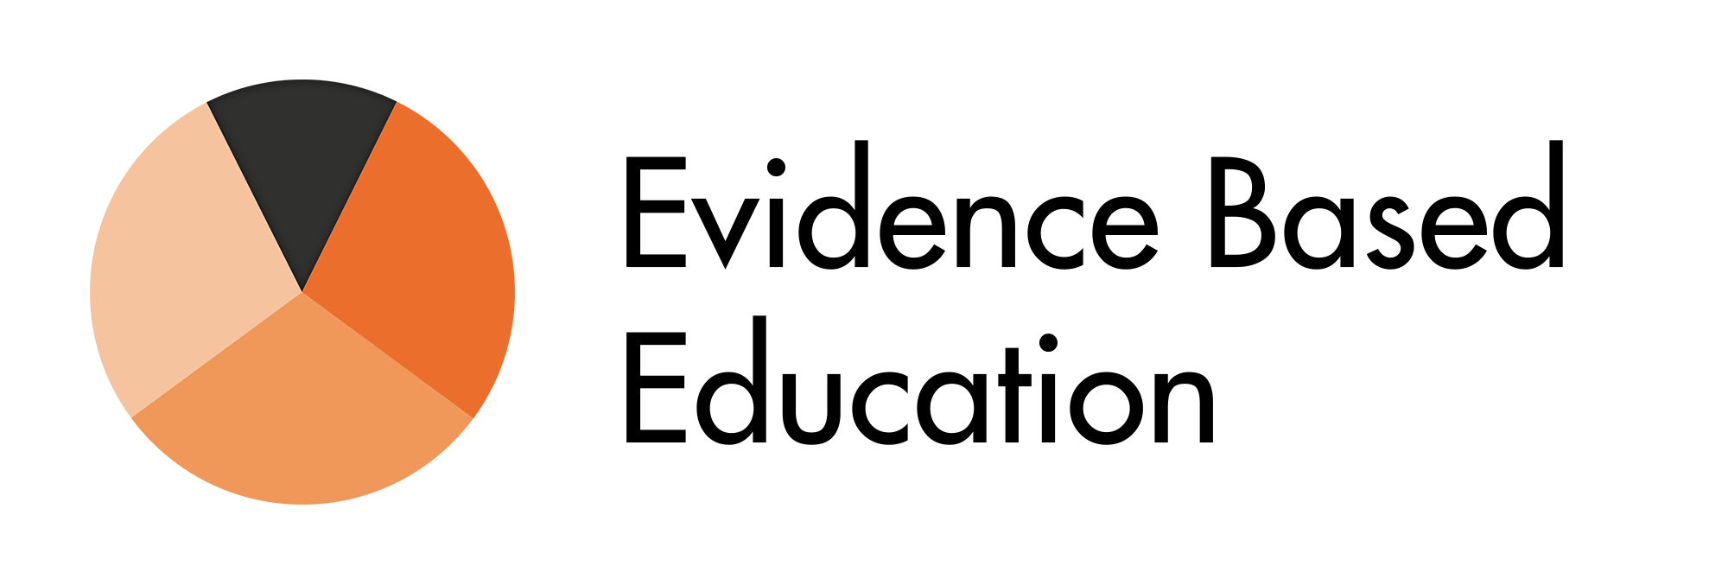
We Need a Revolution in Professional Learning
Rob Coe
researchEd National Conference, 5 September 2026

Slide 2
Outline
What is wrong with current PL/CPD?
Why is PL worth getting right?
Why should we evaluate PL?
What should we do instead?

Slide 3
What is wrong with current PL/CPD?
05

Slide 4
One-off sessions
Is each bit of learning part of a coherent curriculum?
Are we clear what we want learners to learn?
Are we clear how we will know if they have?
Do we assess where learners are at before trying to teach them new stuff?
Do we revisit any ideas that we need learners to retain?
Do we require learners to retrieve that information (after a gap to allow forgetting)?

Slide 5
Routines with no understanding
In teaching a new procedure, what should be the balance between ‘rote learning’ and ‘conceptual understanding’?
Do we aim for ‘routine’ or ‘adaptive’ expertise?
Do we believe that if learners can follow a script precisely, they have learnt what we need them to?
Do we believe that complex, interactive practices can be specified by a set of ‘non-negotiable’ criteria?
Do learners need to question, challenge, discuss and think deeply?

Slide 6
Theory with no practice
Would we present learners with all the theory before they get a chance to do anything?
For learners to master a procedure, do they need to see examples of it done well?
Should we break a complex practice into component parts and practise each separately?
Should learners get feedback on their first (and subsequent) attempts to do something new?
How much ‘overlearning’ does it take before routines become embedded?

Slide 7
Balance between doing the job and improving
Google’s 70-20-10 rule
Core business
Improvement
Innova-tion
5 INSET days = 2½%
DFE surveys = 1%

Slide 8
Improvement strategies
Quality assurance
  Monitoring, tracking, performance management
Building expertise
  Professional learning
Interventions
  Extra sessions
  Targeted support (individual / small group)
  Bought-in programmes

Slide 9
Interventions vs Expertise
Evidence for this:
Coe et al, 2026; Lortie-Forgues & Inglis, 2019; Sims et al., 2023, 2025; Cheung & Slavin, 2016; Kraft et al., 2024; Slavin & Smith, 2009; Jacob et al., 2010; Watts et al., 2019, 2025; Abenavoli, 2019; Bailey et al., 2020; Fletcher-Wood & Zuccollo, 2020; McJames et al., 2023; Smet, 2021; Worth et al., 2026
Interventions (as per EEF Toolkit)
  Have small effects at best
  Effects are typically short-lived
  Effects reduce at scale and when normalised
  Are often expensive to introduce and maintain
  Vulnerable to lethal mutations (without expertise)
  Most of the effect is explained by expertise building
Building expertise
  The gift that keeps on giving: every subsequent class benefits
  Motivates teachers, supports wellbeing & retention
  Matthew effects: those with more gain faster
  Grows organically, in a culture of feedback and collaboration

Slide 10






An improvement mindset
Proud
Evidence
Own it
“I know what I am doing is great,
and I want you to help me
make it even better”
Collaboration
Improvement is for everyone
Never satisfied
Always proud, never satisfied
Evidence | Collaboration

Slide 11
Why is PL worth getting right?
15

Slide 12

What makes most difference to how much students learn?
“Raising the quality of teaching within existing schools is probably the single most effective thing we could do to
promote
both overall
attainment
and equity”
(Coe et al, 2020)
Quality Teaching
“what teachers know, do, and care about” (Hattie 2003)
https://evidencebased.education/reports
Notes:
Biggest impact is from helping every teacher to be a little bit better, with every class, every lesson, every day.
Building quality teaching is the gift that keeps on giving
Coe, R., Rauch, C.J., Kime, S. and Singleton, D. (2020) Great Teaching Toolkit Evidence Review. Evidence Based Education, in partnership with Cambridge Assessment International Education. https://evidencebased.education/reports/

Slide 13
Who benefits most from great teaching?
Working memory
Abstract reasoning
Our most precious source of feedback
Motivation
Poverty
Home support
Pupils who find it hardest to learn
SEND
Language
Learners who are insensitive to the quality of teaching
High ability pupils
Pupils who find it easiest to learn
=
=

Slide 14


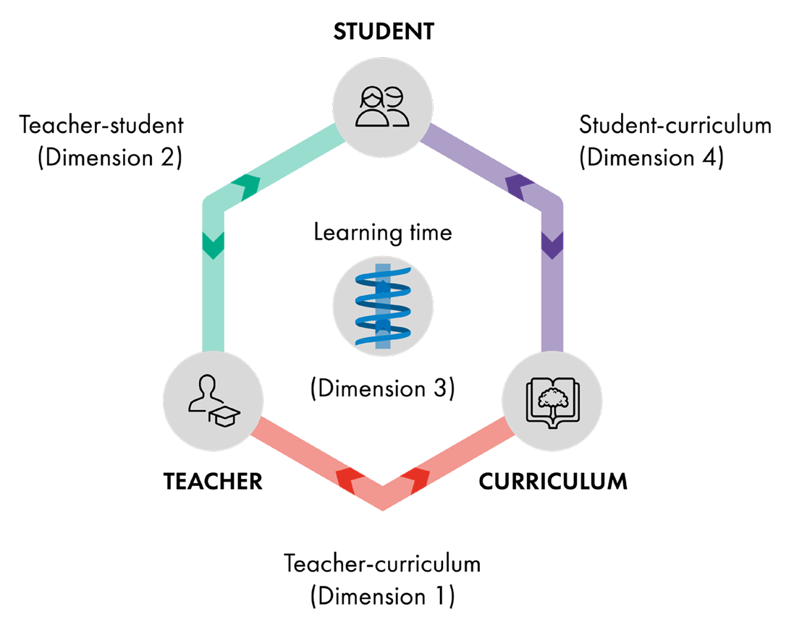
What has to change for students to learn more?
Teacher expertise
School environment
Classroom
Interactions
https://evidencebased.education/reports/
Based on
Bryk et al (2010),
Cohen, Raudenbush & Ball (2003)
Student learning
Notes:
Bryk, A. S., Sebring, P. B., Allensworth, E., Easton, J. Q., & Luppescu, S. (2010). Organizing schools for improvement: Lessons from Chicago. University of Chicago Press.
[in ToC]
Cohen, D. K., Raudenbush, S., & Ball, D. L. (2003). Resources, instruction and research. Educational Evaluation and Policy Analysis, 25, 119–142.
[in RQ2&3]

Slide 15
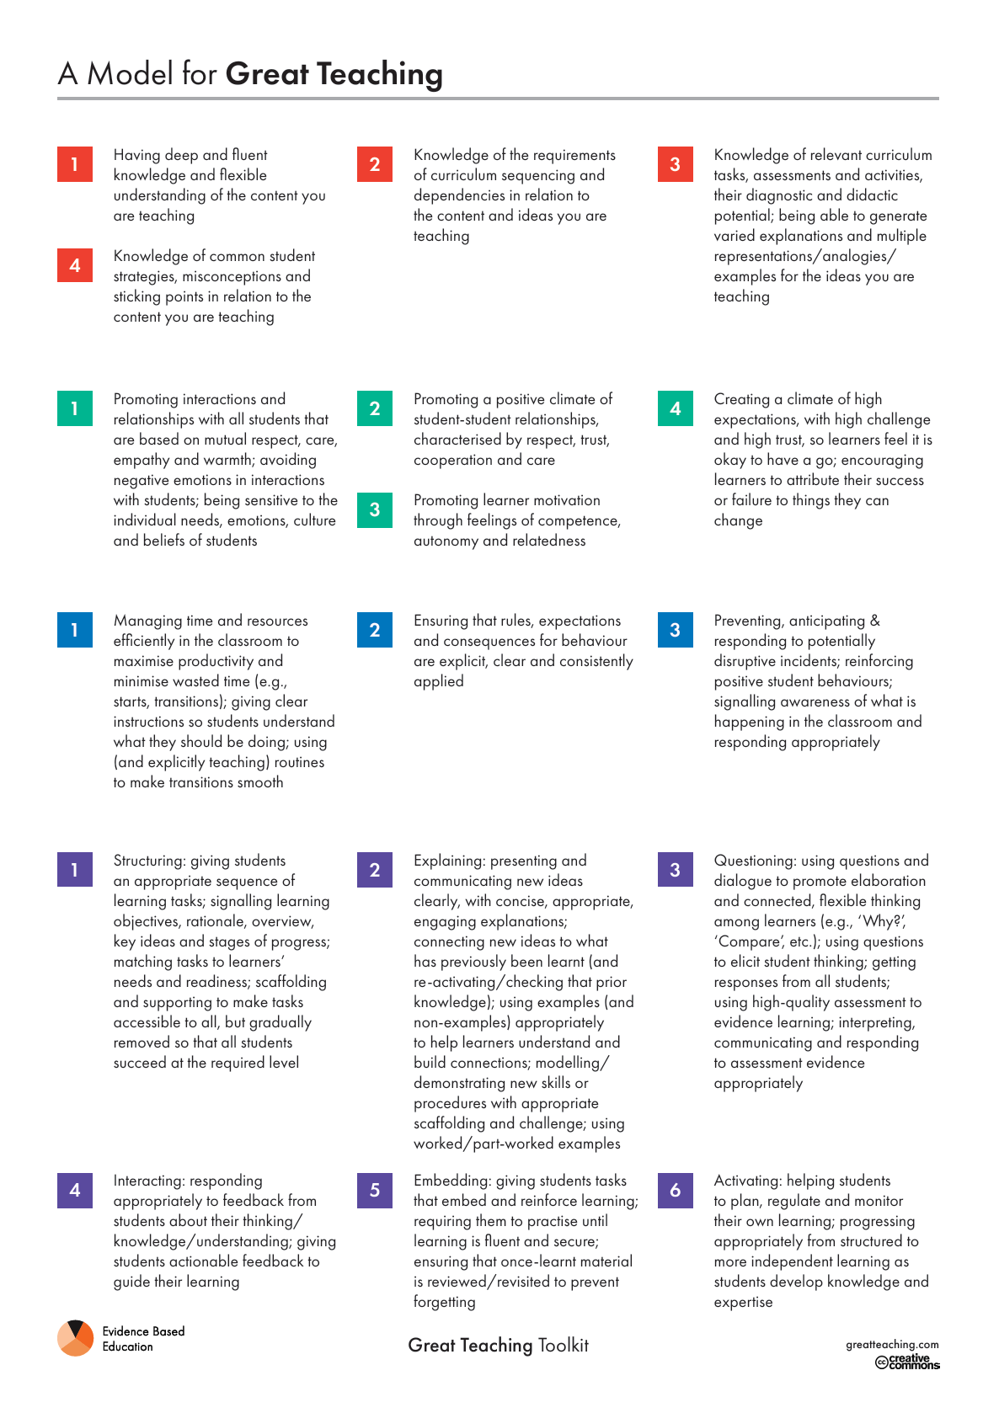
What is teacher expertise?
Knowledge
Insights
Techniques
Theories
Principles
Practical abilities
Understanding
Skills
Why, how, when and with what?
Fluent
Automatic
Practical application
Experience
Judgement
Context
Adaptive
Wisdom
Notes:
https://evidencebased.education/why-do-we-see-teacher-expertise-as-needing-knowledge-skill-and-judgement/
https://evidencebased.education/reports

Slide 16
What affects teacher expertise?
Professional learning
Feedback
Collaboration
Teacher Expertise
Understanding
Skills
Judgement

Slide 17

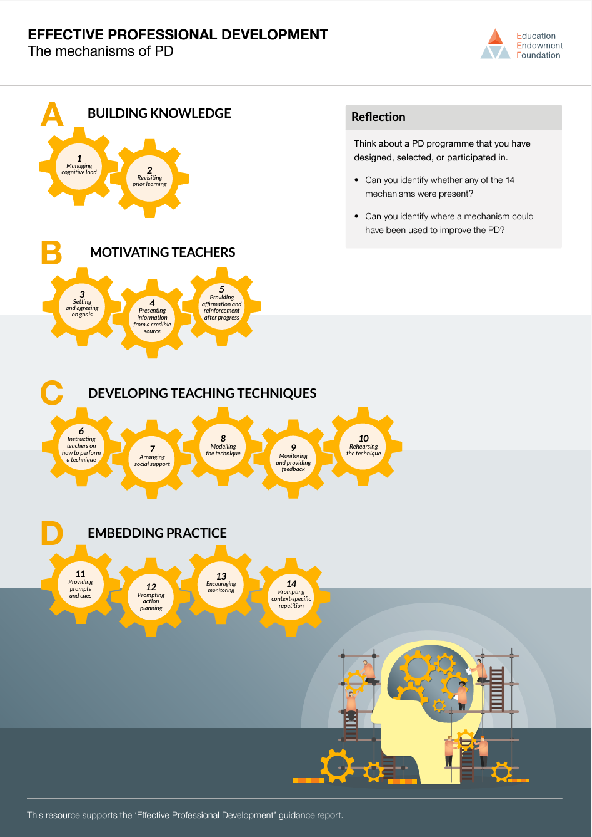
Effective CPD: Sims et al (2022)
Active ingredients: Insights, Goals, Techniques, and Practice
Building knowledge; motivating teachers; developing teaching techniques; embedding habits
Motivate Goals: aims, values, beliefs, commitment
Build Understanding: knowledge, theories, insights, wisdom
Develop Skills: techniques, practical abilities
Embed Habits: automatic behaviours, routines, practice
Notes:
Sims, Sam, Harry Fletcher-Wood, Alison O’Mara-Eves, Sarah Cottingham, Claire Stansfield, Josh Goodrich, Jo Van Herwegen, and Jake Anders. (2022). Effective teacher professional development: new theory and a meta-analytic test. (EdWorkingPaper: 22-507). Retrieved from Annenberg Institute at Brown University: https://doi.org/10.26300/rzet-bf74
Original EEF version of the review (with guidance report, posters, etc) is available at
https://educationendowmentfoundation.org.uk/education-evidence/guidance-reports/effective-professional-development

Slide 18
Why should we evaluate PL?
20

Slide 19
Why don’t we evaluate (properly)?
We assume good intentions + time and effort spent + sensible judgements = impact
We don’t understand how complex systems need feedback
We don’t have an improvement mindset
We don’t really know how
We’d rather avoid the bad news that robust evaluation might give.

Slide 20
Poor proxies for CPD impact
Participants feel positive about the programme/session
Participants feel inspired or commit to change
Participants believe it will change (or has changed) their practice
Participants say the programme has increased their confidence and abilities
Participants have undertaken a range of activities:
  Training sessions have been attended
  Courses have been worked through
  Coaching sessions have been logged
‘Cascading’ has taken place, where participants share their learning with others.
Notes:
Positive: If they have invested time and effort into, or enjoyed, it, they are likely to feel this. These feelings are almost unrelated to any impact
Inspired: nice to have, but a very poor predictor of anything that matters)
Believe/perceive change: although any change might not be visible to others, or, if it is, to last more than a few weeks
Confidence: that’s a good thing, but people’s assessments of their own abilities are a weak predictor of what they can actually do – see eg Zell & Krizan, 2014)
Activities: with varying levels of engagement and no evidence of actual learning
Cascading: but the low-intensity, inexpert version they have shared is unlikely to develop real expertise

Slide 21
Professional Development: Evaluation framework
Statement of a robust Theory of Change
Judgements of programme alignment with
  Evidence-based practice
  Organisational/individual context
Judgements of quality of delivery
Assessment of teacher learning / thinking / attitudes / culture, for a) participants, and b) non-participants
Evidence of change in teachers’ practice
Evidence that these changes are sustained
Plausible evidence of changes in student outcomes
Strong evidence of changes in student outcomes attributable to the PD
Was the programme appropriate?
Has it led to change?
Has it improved student outcomes?

Slide 22
4. What should we do instead?
30

Slide 23
The Professional Learning Promise
Make expertise our top priority
Protect regular time for PL
Design PL in line with evidence
Evaluate whether it is working

Slide 24

Make the pledge
“I’m supporting Evidence Based Education’s Professional Learning Revolution. Professional learning should be protected, evidence-based and given the conditions to make a lasting difference.”
https://evidencebased.education/professional-learning-revolution/

Slide 25

Help us build evaluation tools
Register interest and try out our PL audit tool at:
https://bit.ly/helpEBE

Slide 26
Summary
What is wrong with current PL/CPD?
Why is PL worth getting right?
Why should we evaluate PL?
What should we do instead?

Slide 27


Thank you!
Always proud, never satisfied
Rob Coe
Evidence Based Education
rob@evidencebased.education
https://evidencebased.education
@ProfCoe @EvidenceInEdu
https://bit.ly/never-satisfied

