Slide 1
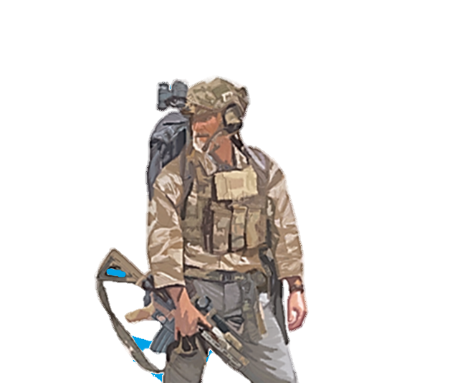
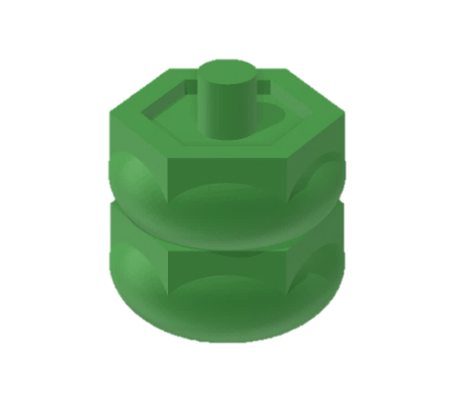
Welcome to the team brother. We’ve got a lot on our plate and could always use an extra set of hands. This is a complex problem we are dealing with. Network development is critical. We must build our surrogate network to be self sufficient and capable of fighting oppression. There are a lot of challenges ahead of us. Don’t worry though! If we stay flexible and remember that everything we do is for God and Country, then we can prevent this tyrannical adversary from dominating. Keep your rifle clean and your boots dry… See you out there!
LIBERATORS
SETUP: Choose a map board and place 1 x HQ on the highest or lowest jungle tile. If there are two of equal value, choose the most advantageous tile.
Add 4 x Influence to Influence Pool
Add 5 x Tyranny to Tyranny Pool
PLAY STYLE: Your attributes are flexibility and charisma. Accessing these attributes unlocks your ability to patrol with your surrogate force and build strong partnerships. You prefer to see and not be seen and operate best in jungle and rural areas with supportive population.

Slide 2
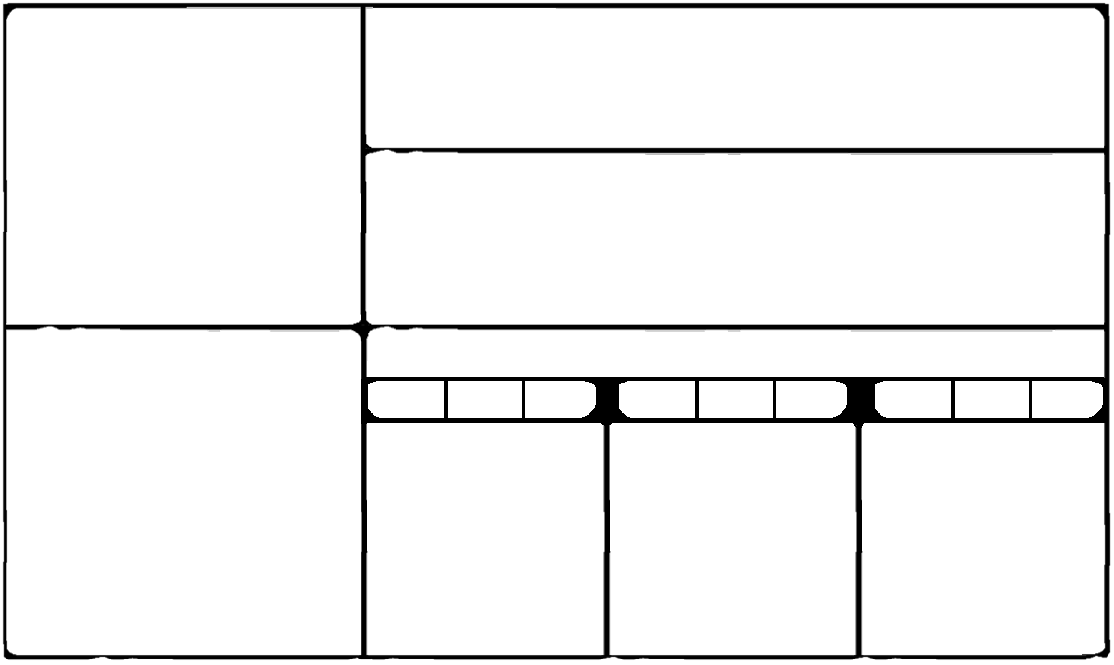
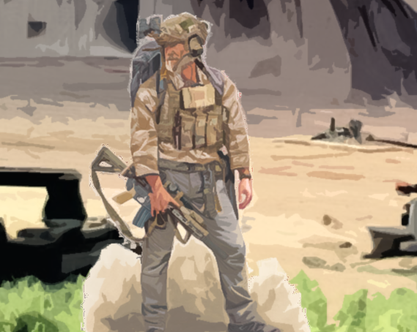
LIBERATORS
REFIT (PICK 2 DIFFERENT OPTIONS)
+1
→3
+1
+1
+3
OR
RECLAIM
ALL
GAIN 1 CAPABILITY
ADD 1 PRESENCE
GAIN 1
AT BASE
GAIN 1 CAPABILITY
GAIN 1 RESOURCE
GAIN 3 RESOURCES
PRESENCE
RESOURCES/TURN
1
2
3
4
5
2
FLEXIBILITY
3
4
CHARISMA
5
1
2
3
1
4
4
5
CARD PLAYS
2
3
RECLAIM 1
4
4
5
SPECIAL RULES
MOVEMENT:
Your PRESENCE may move with a S.
RECRUITING SURROGATES (S):
Your PRESENCE may Recruit a S in a [JUNGLE/RURAL] tile adjacent to or with BLUE CIVILIAN(S) per turn for free. If S is Recruited from an adjacent tile, then that S may be pulled into a tile with PRESENCE
ESTABLISHING S BASE:
Your PRESENCE may Establish a S BASE in a [JUNGLE/RURAL] tile with a S (That S will remain there permanently). Additionally, the tile must be adjacent to or with BLUE CIVILIAN(S). A S BASE costs 3 Resources and may produce 1 S per turn if your PRESENCE is in that tile. S are produced on the next turn after Establishment and are free.
CONSTRAINTS:
Your PRESENCE cannot Establish a S BASE in a tile adjacent to a RED CIVILIAN.
Your PRESENCE cannot convert CIVILIANS.
COLLATERAL DAMAGE: -2 Influence for each CIVILIAN killed.
Your PRESENCE cannot move or be placed into a RED CIVILIAN tile without a S present.
ORGANIC CAPABILITIES
SPEED
RANGE
TARGET
SPEED
RANGE
TARGET
SPEED
RANGE
TARGET
1
JUNGLE RURAL
0
NO TYRANNY
1
FORCE MANAGEMENT
PATROL
STRONG PARTNERSHIP
(see Special Rules)
2X
IN ORDER
YOU MAY PULL 1 S
1X
3X
+1 INFLUENCE, 2 DAMAGE,
AND 1 S IS REMOVED.
cost
RECRUIT 1 S
PER TURN
0
*** THEN ***
*** IF / AND ***
1X
3X
2X
1X
3X
1 DAMAGE PER S
+1 INFLUENCE,
+1 DAMAGE.
*** OR ***
ESTABLISH 1 S
BASE PER TURN
*** THEN ***
*** IF / AND ***
cost
3X
2X
3X
3
2X
+1 INFLUENCE,
+1 DAMAGE.
YOU MAY PUSH 2 S

Slide 3
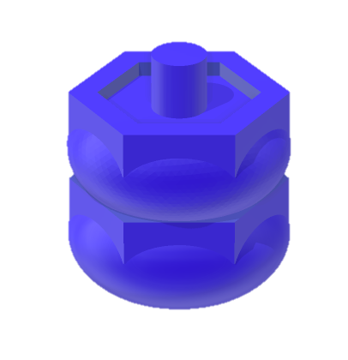
Congratulations Comrade, you have joined an elite group that will stop at nothing to ensure the success of the mother land. We are masters of subversion and rely heavily on intermediary tactics to achieve our goals while avoiding redlines. Collateral damage is an unfortunate but acceptable consequence of success. Some say we take too much risk and others accuse us of corruption. We see this as the ends justifying the means. Get ready to move fast and strike hard. Try to keep up!
COMRADES
SETUP: Choose a map board and place 1 x HQ on the highest border or coastal hex. If there are two of equal value, choose the most advantageous tile.
Add 4 x Influence to Influence Pool
Add 5 x Tyranny to Tyranny Pool
PLAY STYLE: Your attributes are risk and corruption. Accessing these attributes unlocks your ability to patrol with your surrogate force and conduct collateral damage. You can only gain influence through violence and have little control over the alignment of ethnic populations.

Slide 4
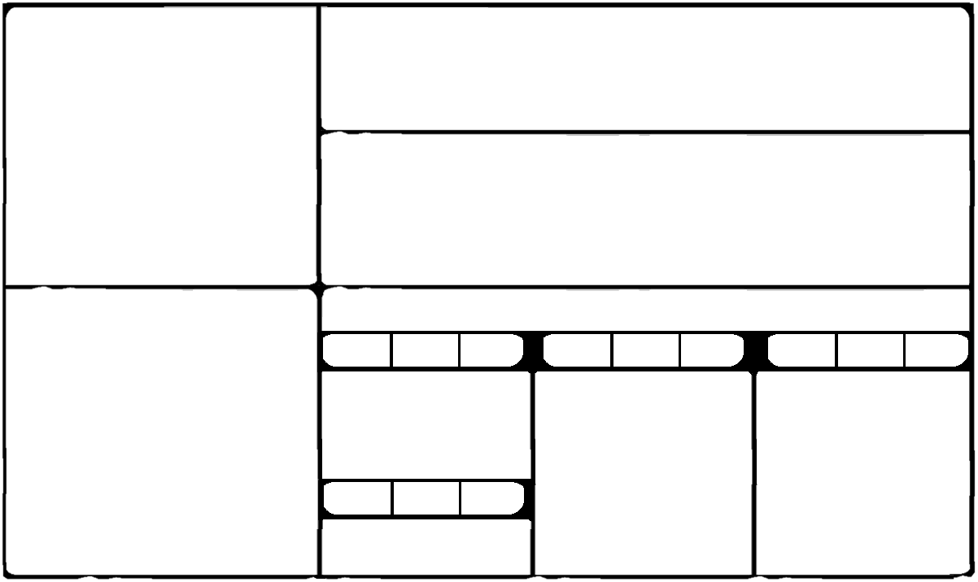
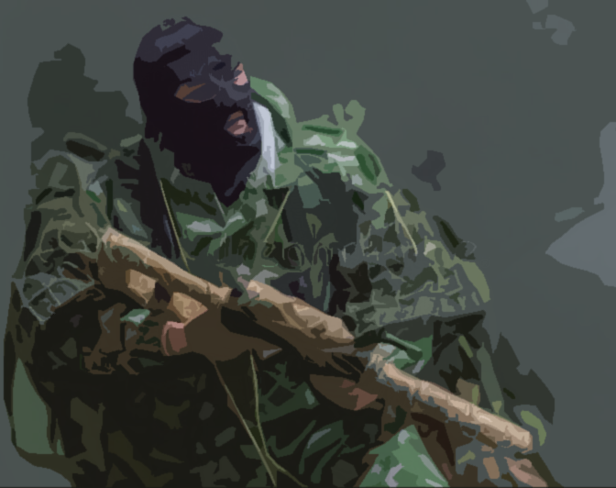
COMRADES
REFIT (PICK 1)
+1
+1
→2
→1
+4
→1
RECLAIM
ALL
GAIN 2 CAPABILITIES
ADD 1 PRESENCE
ADD 1 PRESENCE
ADD 1 PRESENCE
GAIN 4 RESOURCES
PRESENCE
RESOURCES/TURN
1
2
3
4
5
2
RISK
3
4
CORRUPTION
5
1
2
2
3
1
3
4
CARD PLAYS
2
2
3
RECLAIM 1
3
4
SPECIAL RULES
MOVEMENT:
Your PRESENCE may move with a S.
RECRUITING SURROGATES (S):
Your PRESENCE may recruit up to 5 S in or adjacent to a BORDER/COASTAL tile per turn. Each S costs 1 Resource.
ESTABLISHING S BASE:
Your HQ may Establish a S BASE in a tile with a S (That S will remain there permanently). Additionally, the tile must be adjacent to or with CIVILIANS. Each S BASE costs 3 Resources and may produce 1 S per turn. S each cost 1 Resource
CONSTRAINTS:
Your PRESENCE cannot convert CIVILIANS
MISC:
COLLATERAL DAMAGE: Your PRESENCE does not lose Influence when CIVILIANS are killed.
ORGANIC CAPABILITIES
SPEED
RANGE
TARGET
SPEED
RANGE
TARGET
SPEED
RANGE
TARGET
1
BORDER COASTAL
0
ANY
2
FROM HQ
ANY
FORCE MANAGEMENT
PATROL
COLLATERAL DAMAGE
(see Special Rules)
IN ORDER
YOU MAY PULL 1 S
*** THEN ***
1 DAMAGE PER S
*** THEN ***
YOU MAY PUSH 2 S
2X
2X
RECRUIT UP TO
5 S PER TURN
1X
2 DAMAGE AND
KILL 1 CIVILIAN.
cost
1
1X
2X
2X
3X
*** IF / AND ***
*** OR ***
+1 DAMAGE AND
-1 INFLUENCE.
0
FROM HQ
CIVILIAN
ESTABLISH 1 S
BASE PER TURN
*** IF / AND ***
cost
1X
2X
2X
+1 DAMAGE AND
KILL 1 CIVILIAN.
3

Slide 5
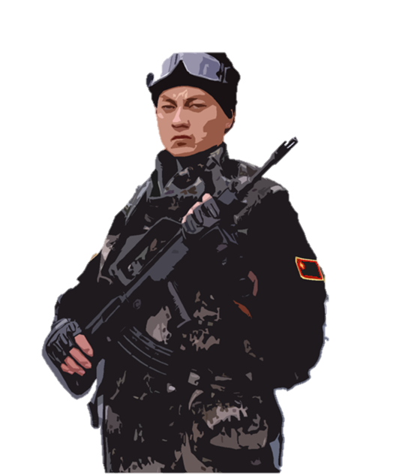
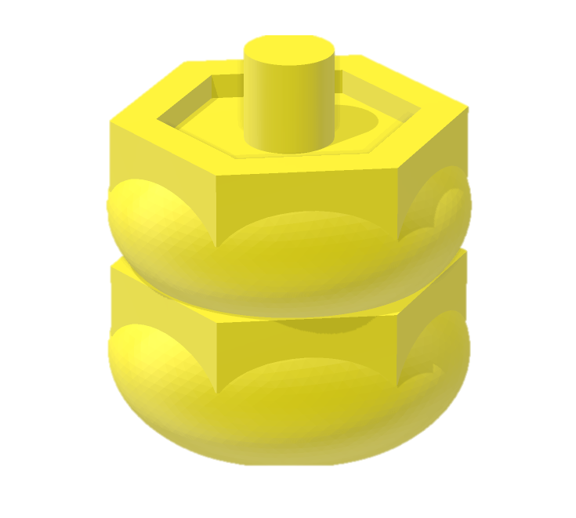
You are now among the best, brightest, and bravest warriors in the dynasty. The survival of our great empire is hanging in the balance. Our strength is in numbers and population support is our greatest resource. Our objectives span far further into the future than our competitor’s. We can afford tactical loss if it provides an advantage for long term success. We approach this environment with the three warfares of psychology, public opinion, and lawfare to ensure that our cooperative venire masks our ultimate goal of global primacy.
PARTISANS
SETUP: Choose a map board and place 1 x HQ on the highest or lowest rural tile. If there are two of equal value, choose the most advantageous tile.
Add 4 x Influence to Influence Pool
Add 5 x Tyranny to Tyranny Pool
PLAY STYLE: Your attributes are persistence and logistics. Accessing these attributes unlocks your ability to patrol with your surrogate force and incite revolution. You have a powerful presence that is capable converting population alignment in your favor.

Slide 6
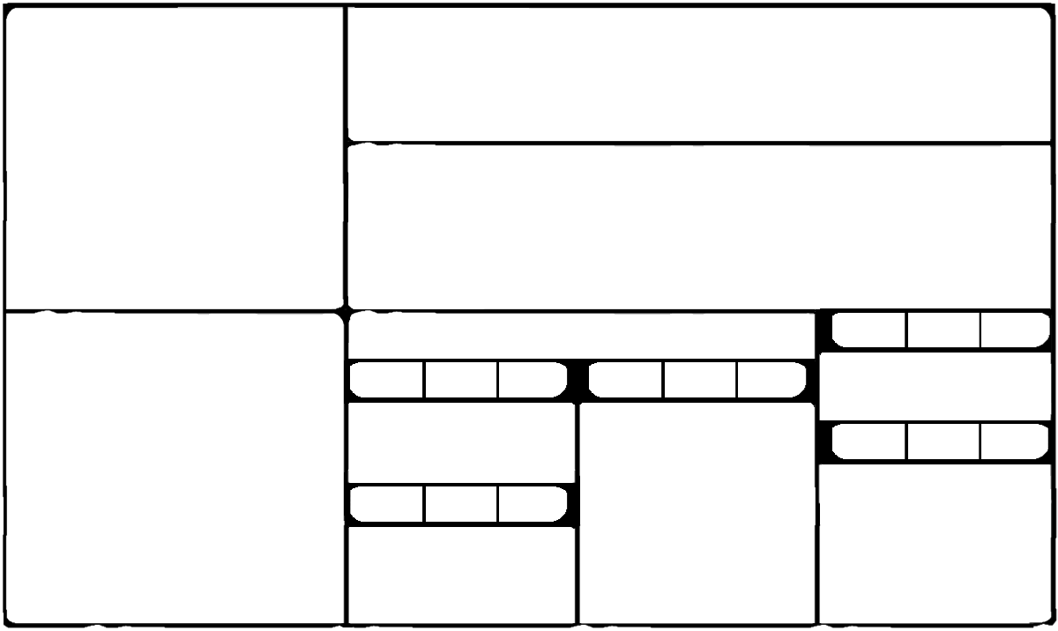
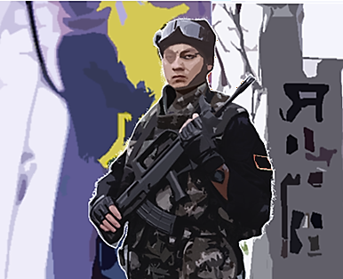
PARTISANS
REFIT (PICK 1)
→1
+1
+1
+1
+3
ALWAYS ROLL TO ADD 1 PRESENCE.
1-5 FAILURE
6-10 SUCCESS
→1
RECLAIM
ALL
GAIN 1 CAPABILITY
ADD 1 PRESENCE
GAIN 1 CAPABILITY
GAIN 1 CAPABILITY
GAIN 3 RESOURCES
PRESENCE
RESOURCES/TURN
1
2
4
5
6
2
PERSISTENCE
4
LOGISTICS
5
6
1
1
2
2
3
3
4
CARD PLAYS
1
2
2
3
3
4
SPECIAL RULES
MOVEMENT:
Your PRESENCE may move with a S.
RECRUITING S:
Your PRESENCE may recruit 1 S in any tile with CIVILIANS per turn for 2 Resources.
ESTABLISHING G BASE:
Your HQ may establish a S BASE in a tile with a S (That S will remain there permanently). Additionally, the tile must be adjacent to or with CIVILIANS, costs 5 Resources, and may produce up to 2 S per turn for free.
CONVERTING:
Your PRESENCE may convert a RED CIVILIAN to BLUE CIVILIAN for 1 Resource.
MISC:
Whenever ADVERSARY would Develop or Dominate in a tile with HQ, you may prevent it by Destroying one of your PRESENCE in that tile.
Your PRESENCE is never permanently Destroyed; instead, it is placed back on your PRESENCE track.
ORGANIC CAPABILITIES
0
ANY
SPEED
RANGE
TARGET
SPEED
RANGE
TARGET
0
0
ANY
PEASANT REVOLUTION
CIVILIANS
ANY 1 CAPABILITY MAY
FORCE MANAGEMENT
PATROL
3X
BE A CAPABILITY
(see Special Rules)
2X
IN ORDER
YOU MAY PULL 2 S
1
RURAL
JUNGLE
cost
2
RECRUIT 1 S
*** OR ***
*** THEN ***
PEASANT REVOLUTION
0
FROM HQ
CIVILIANS
2X
3X
1X
3X
DESTROY 1 OUTPOST
PER 2 CIVILIANS IN
ADJACENT TILES.
1 DAMAGE PER S
cost
ESTABLISH 1 S BASE
5
*** THEN ***
*** IF / AND ***
*** OR ***
2X
2X
3X
CONVERT 1 RED CIV
to BLUE CIV
2X
YOU MAY PUSH 1 S
DESTROY 1 GARRISON
PER 3 CIVILIANS IN
ADJACENT TILES.
cost
1

Slide 7
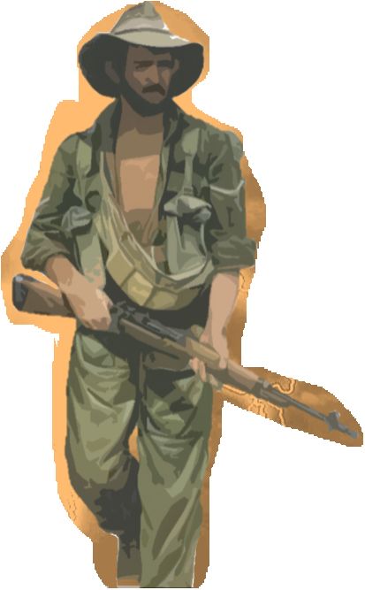
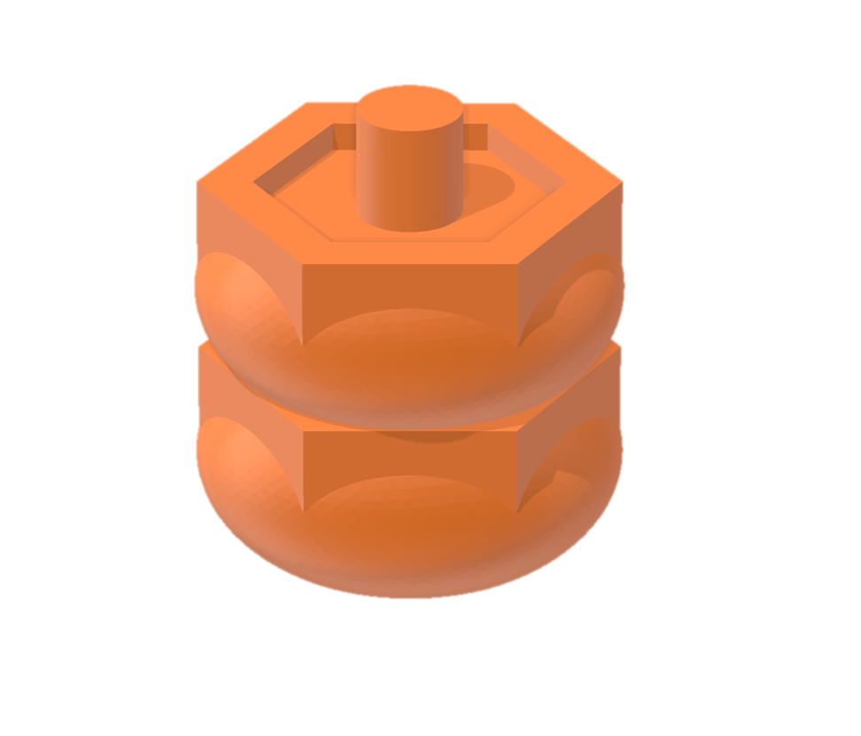
Its time to roll up your sleeves and get to work. Your unique role as an Advisor affords you incredible access and placement, however your small footprint means survival depends on the ability to influence population groups. Therefore, your goal is to gain and maintain influence wherever you go. That could involve anything from infrastructure development to stirring up a social media frenzy. Sure, this can be a dangerous business, but you have Surrogates for that!
ADVISORS
SETUP: Choose a map board and place 1 x HQ on the highest or lowest urban tile. If there are two of equal value, choose the most advantageous tile.
Add 4 x Influence to Influence Pool
Add 5 x Tyranny to Tyranny Pool
PLAY STYLE: Your attributes are oversight and integrity. Accessing these attributes unlocks your ability to send your surrogate force on patrol and exercise diplomacy. Your greatest strength is gaining influence, but with a little creativity, you can still manage to stop tyranny.

Slide 8
ADVISORS
REFIT (PICK 1)
+1
1
→1
+1
→2
+1
+4
RECLAIM
ALL
GAIN 1 CAPABILITY
RECLAIM
1
ADD 1 PRESENCE
GAIN 1 CAPABILITY
ADD 1 PRESENCE
GAIN 1 CAPABILITY
GAIN 4 RESOURCES
PRESENCE
RESOURCES/TURN
2
2
3
4
5
6
2
3
OVERSIGHT
4
INTEGRITY
5
6
2
2
3
3
3
∞
CARD PLAYS
2
3
3
3
∞
SPECIAL RULES
ORGANIC CAPABILITIES
MOVEMENT:
Your PRESENCE may move when BLUE CIVILIANS move.
RECRUITING S:
Your PRESENCE may Recruit a S in a tile adjacent to or with BLUE CIVILIAN(S) per turn for 1 Influence. If S is Recruited from an adjacent tile, then that S is pulled into tile with PRESENCE.
CONVERTING
Your PRESENCE may Convert a RED CIVILIAN to BLUE CIVILIAN for 1 Influence and 1 Resource.
CONSTRAINTS:
Your PRESENCE cannot move with a S.
Your PRESENCE cannot move or be placed into an ADVERSARY tile.
You cannot establish a S BASE.
MISC:
Player can never directly cause Damage or Kill/Destroy. When your PRESENCE, through Event or Capability, would Kill/Destroy or do enough damage to Kill/Destroy, receive 1/2/5 Influence for ADVERSARY CELL/OUTPOST/GARRISON and Move all ADVERSARIES it would Kill/Destroy. S and CIVILIANS can still Damage and Kill/Destroy.
Your PRESENCE is treated as an HQ (2x PRESENCE) for Capabilities.
A TYRANNY TOKEN will Remove all your presence in a tile.
COLLATERAL DAMAGE: -3 Influence for each CIVILIAN killed.
SPEED
TARGET
SPEED
RANGE
TARGET
SPEED
RANGE
TARGET
RANGE
0
BLUE CIVILIANS
0
ANY
0
BLUE CIVILIANS
FORCE MANAGEMENT
PATROL
COLLATERAL DAMAGE
(see Special Rules)
2X
IN ORDER
YOU MAY PULL 2 S
2X
3X
+1 INFLUENCE AND
+1 RESOURCE.
cost
RECRUIT 1 S
1
*** THEN ***
*** IF / AND ***
1X
2X
2X
2X
3X
*** OR ***
YOU MAY PUSH 1 S
+1 INFLUENCE AND
+2 RESOURCES.
cost
1
CONVERT 1 RED
CIV TO BLUE CIV
*** THEN ***
*** IF / AND ***
+
1X
2X
3X
3X
+2 INFLUENCE.
cost
1
1 DAMAGE PER S

Slide 9
PLAYER ACTIONS
All Players play simultaneously
TURN ORDER
All Players play simultaneously
PLAYER PHASE
REFIT
GAIN RESOURCES
ACTION
Organic Capabilities
Force Management:
Recruit/Establish/Convert)
Patrol
Special
Select Card Capabilities (MINOR/MAJOR)
1. PLAYER PHASE (SEE PLAYER ACTIONS)
2. IMMEDIATE CAPABILITIES
(ORGANIC AND CARDS)
3. ADVERSARY PHASE
EVENT CARD
INFLUENCE CARD(S) (IF EARNED)
DOMINATE
ADVERSARY does damage based on piece characteristics killing S and/or adding a TYRANNY TOKEN if ADVERSARY does more than 2 damage on a tile.
DEVELOP
If an ADVERSARY CELL is present, the ADVERSARY constructs an OUTPOST or GARRISON. (SEE DEVELOP RULES)
DEPLOY
If an OUTPOST/GARRISON/ BORDER/COASTAL is adjacent/present add an ADVERSARY CELL.
(SHIFT TERRAIN CARDS(DEPLOY GOES TO DEVELOP, DEVELOP GOES TO DOMINATE, DOMINATE IS DISCARDED)
4. LONG-TERM CAPABILITIES
(ORGANIC AND CARDS)
CAPABILITY AND INFLUENCE EFFECTS
+/- Influence: Generate Influence.
+/- Damage: Takes away Defense, possibly Killing/Destroying piece. Excessive Player damage can Kill Civilians and hurt Influence.
+/- Defense: Protects from Damage, based on tile terrain, Ethnic support, Capabilities, Events, Influence Cards, and/or piece characteristics.
Pull: PRESENCE gathers pieces from adjacent tiles.
Push: PRESENCE sends pieces to adjacent tiles.
Move: Player moves pieces irrespective of their PRESENCE when directed by Capabilities, Events, or Influence Cards.
Remove: Take off board. Does not give Influence.
Replace: Switch with designated piece. Does not give Influence.
Kill/Destroy: Take off board, possibly providing influence depending on piece.
Repeat: Use the effects of a capability again.

Slide 10
PLAYER ACTIONS
All Players play simultaneously
TURN ORDER
All Players play simultaneously
PLAYER PHASE
REFIT
GAIN RESOURCES
ACTION
Organic Capabilities
Force Management:
Recruit/Establish/Convert)
Patrol
Special
Select Card Capabilities (MINOR/MAJOR)
1. PLAYER PHASE (SEE PLAYER ACTIONS)
2. IMMEDIATE CAPABILITIES
(ORGANIC AND CARDS)
3. ADVERSARY PHASE
EVENT CARD
INFLUENCE CARD(S) (IF EARNED)
DOMINATE
ADVERSARY does damage based on piece characteristics killing S and/or adding a TYRANNY TOKEN if ADVERSARY does more than 2 damage on a tile.
DEVELOP
If an ADVERSARY CELL is present, the ADVERSARY constructs an OUTPOST or GARRISON. (SEE DEVELOP RULES)
DEPLOY (Reveal Terrain Card)
If an OUTPOST/GARRISON/ BORDER/COASTAL is adjacent/present add an ADVERSARY CELL.
(SHIFT TERRAIN CARDS(DEPLOY GOES TO DEVELOP, DEVELOP GOES TO DOMINATE, DOMINATE IS DISCARDED)
4. LONG-TERM CAPABILITIES
(ORGANIC AND CARDS)
CAPABILITY AND INFLUENCE EFFECTS
+/- Influence: Generate Influence.
+/- Damage: Takes away Defense, possibly Killing/Destroying piece. Excessive Player damage can Kill Civilians and hurt Influence.
+/- Defense: Protects from Damage, based on tile terrain, Ethnic support, Capabilities, Events, Influence Cards, and/or piece characteristics.
Pull: PRESENCE gathers pieces from adjacent tiles.
Push: PRESENCE sends pieces to adjacent tiles.
Move: Player moves pieces irrespective of their PRESENCE when directed by Capabilities, Events, or Influence Cards.
Remove: Take off board. Does not give Influence.
Replace: Switch with designated piece. Does not give Influence.
Kill/Destroy: Take off board, possibly providing influence depending on piece.
Repeat: Use the effects of a capability again.

Slide 11
PLAYER ACTIONS
All Players play simultaneously
TURN ORDER
All Players play simultaneously
PLAYER PHASE
REFIT
GAIN RESOURCES
ACTION
Organic Capabilities
Force Management:
Recruit/Establish/Convert)
Patrol
Special
Select Card Capabilities (MINOR/MAJOR)
1. PLAYER PHASE (SEE PLAYER ACTIONS)
2. IMMEDIATE CAPABILITIES
(ORGANIC AND CARDS)
3. ADVERSARY PHASE
EVENT CARD
INFLUENCE CARD(S) (IF EARNED)
DOMINATE
ADVERSARY does damage based on piece characteristics killing S and/or adding a TYRANNY TOKEN if ADVERSARY does more than 2 damage on a tile.
DEVELOP
If an ADVERSARY CELL is present, the ADVERSARY constructs an OUTPOST or GARRISON. (SEE DEVELOP RULES)
DEPLOY
If an OUTPOST/GARRISON/ BORDER/COASTAL is adjacent/present add an ADVERSARY CELL.
(SHIFT TERRAIN CARDS(DEPLOY GOES TO DEVELOP, DEVELOP GOES TO DOMINATE, DOMINATE IS DISCARDED)
4. LONG-TERM CAPABILITIES
(ORGANIC AND CARDS)
CAPABILITY AND INFLUENCE EFFECTS
+/- Influence: Generate Influence.
+/- Damage: Takes away Defense, possibly Killing/Destroying piece. Excessive Player damage can Kill Civilians and hurt Influence.
+/- Defense: Protects from Damage, based on tile terrain, Ethnic support, Capabilities, Events, Influence Cards, and/or piece characteristics.
Pull: PRESENCE gathers pieces from adjacent tiles.
Push: PRESENCE sends pieces to adjacent tiles.
Move: Player moves pieces irrespective of their PRESENCE when directed by Capabilities, Events, or Influence Cards.
Remove: Take off board. Does not give Influence.
Replace: Switch with designated piece. Does not give Influence.
Kill/Destroy: Take off board, possibly providing influence depending on piece.
Repeat: Use the effects of a capability again.

Slide 12
PLAYER ACTIONS
All Players play simultaneously
TURN ORDER
All Players play simultaneously
PLAYER PHASE
REFIT
GAIN RESOURCES
ACTION
Organic Capabilities
Force Management:
Recruit/Establish/Convert)
Patrol
Special
Select Card Capabilities (MINOR/MAJOR)
1. PLAYER PHASE (SEE PLAYER ACTIONS)
2. IMMEDIATE CAPABILITIES
(ORGANIC AND CARDS)
3. ADVERSARY PHASE
EVENT CARD
INFLUENCE CARD(S) (IF EARNED)
DOMINATE
ADVERSARY does damage based on piece characteristics killing S and/or adding a TYRANNY TOKEN if ADVERSARY does more than 2 damage on a tile.
DEVELOP
If an ADVERSARY CELL is present, the ADVERSARY constructs an OUTPOST or GARRISON. (SEE DEVELOP RULES)
DEPLOY (Reveal Terrain Card)
If an OUTPOST/GARRISON/ BORDER/COASTAL is adjacent/present add an ADVERSARY CELL.
(SHIFT TERRAIN CARDS(DEPLOY GOES TO DEVELOP, DEVELOP GOES TO DOMINATE, DOMINATE IS DISCARDED)
4. LONG-TERM CAPABILITIES
(ORGANIC AND CARDS)
CAPABILITY AND INFLUENCE EFFECTS
+/- Influence: Generate Influence.
+/- Damage: Takes away Defense, possibly Killing/Destroying piece. Excessive Player damage can Kill Civilians and hurt Influence.
+/- Defense: Protects from Damage, based on tile terrain, Ethnic support, Capabilities, Events, Influence Cards, and/or piece characteristics.
Pull: PRESENCE gathers pieces from adjacent tiles.
Push: PRESENCE sends pieces to adjacent tiles.
Move: Player moves pieces irrespective of their PRESENCE when directed by Capabilities, Events, or Influence Cards.
Remove: Take off board. Does not give Influence.
Replace: Switch with designated piece. Does not give Influence.
Kill/Destroy: Take off board, possibly providing influence depending on piece.
Repeat: Use the effects of a capability again.

