Slide 2
In 2018, the U.S. National Defense Strategy shifted the Department of Defense’s priority to Great Power Competition, now known as Strategic Competition. Though the relevance of U.S. Special Operations Forces (SOF) in Strategic Competition was initially questioned, careful analysis determined that posturing General Purpose Forces (GPF) for large-scale combat operations (LSCO) only addressed the direct method of competition. The indirect method of competition manifested through irregular warfare (IW), aligns directly with SOF’s core competencies. SOF are the DOD’s best option to to exploit competitor vulnerabilities on geographic peripheries by subverting their efforts to expand influence and control.
Twenty years of Counterinsurgency (COIN) and Counterterrorism (CT) operations led by U.S. SOF have generated a widespread misconception among the U.S. military that SOF’s core capabilities are constrained to these two competencies. Correcting this misconception requires the lengthy process of incorporating sweeping doctrinal instruction changes in the professional military education system for both officer and non-commissioned officers. An interim solution is the implementation of educational wargames that address doctrinal capabilities in simulated environments.
This project aims to develop an educational Strategic Competition IW wargame for ARSOF soldiers and leaders responsible for orchestrating and managing special operations abroad. The wargame will provide an interactive approach within a simulated competition environment that will force players to think critically about the effective implementation of SOF capabilities. Game mechanics will immerse players in a tactical competition environment with strategic implications. The game will serve as a tool to educate SOF operators and as a proof of concept highlighting the advantages of including educational wargaming in U.S. Army training and leadership doctrine.
i

Slide 3
IN THE BOX:
1 RULE BOOK
16 SEPTET BOARD PIECES
8 COAST/BORDER PIECES
1 PHASING BOARD
4 PLAYER PANELS
4 SCENARIO PANELS
4 PLAYER SMART CARDS
2 INFLUENCE LEVEL CARDS
39 MAJOR CAPABILITY CARDS (including 4 x earmarked cards)
53 MINOR CAPABILITY CARDS (including 12 x earmarked cards)
24 EVENT CARDS
28 INFLUENCE CARDS
56 TERRAIN CARDS
96 POPULATION PIECES
8 INFRASTRUCTURE PIECES
32 RESOURCE PALLETS (20x1 and 12x3)
20 INFLUENCE MARKERS
25 TYRANNY TOKENS
14 PRESENCE per PLAYER
30 SURROGATE FORCES per PLAYER
12 SURROGATE BASES
2 PLACE MARKERS per PLAYER
140 ADVERSARY PIECES: (80 CELLS, 40 OUTPOSTS, 20 GARRISONS)
ii

Slide 4
Tears of tyranny is an educational wargame for one to four players designed to reinforce principles of irregular warfare and provide a low-cost opportunity to exercise decision making in an environment of risk and uncertainty. This wargame is not a simulation of a hypothetical future event, nor an abstracted reproduction of an event from history. The environment in Tears of Tyranny has been completely abstracted from time and space to allow players to focus on principles and critical thinking.
The game features a fictional land under the threat of a tyrannical and oppressive regime (the origins, nature, and political philosophy of the oppressors are intentionally ambiguous) referred to as the adversary. The sympathies of the local population are divided between passively supporting and passively opposing the adversary’s security forces. The players represent sources of external support who infiltrate the environment, organize indigenous resistance movements, and confront the adversary’s aggressive expansion. The adversary wins if their security services expand their control to the point where indigenous resistance is no longer feasible. The players win if they eliminate the adversary or develop enough influence to stimulate an unstoppable popular uprising.
1

Slide 5
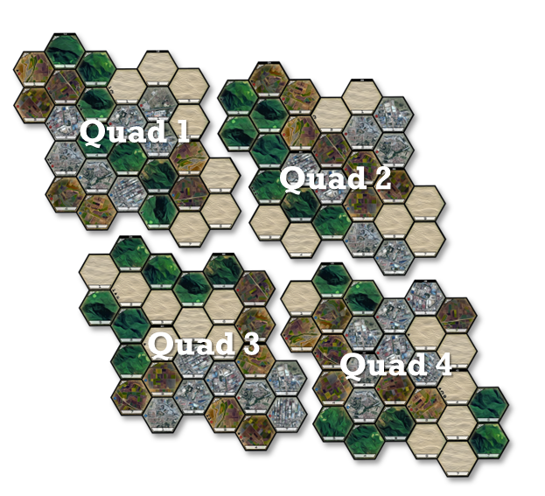
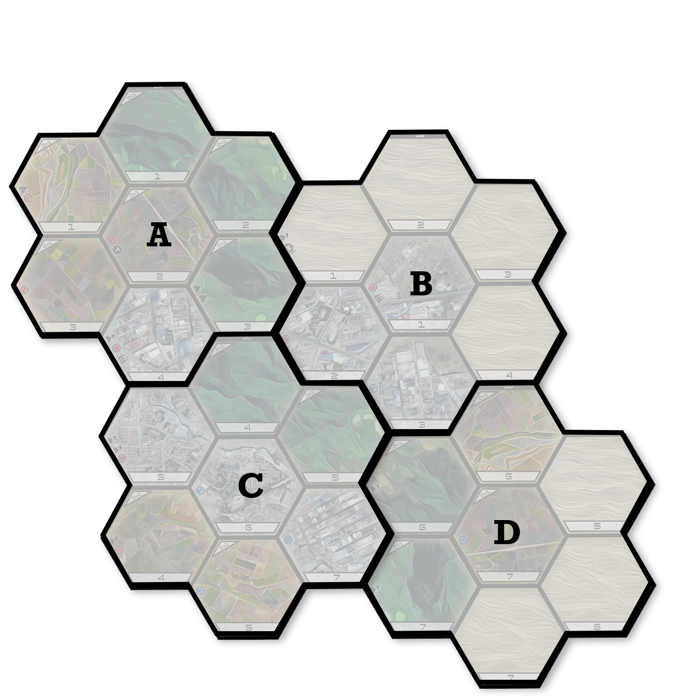
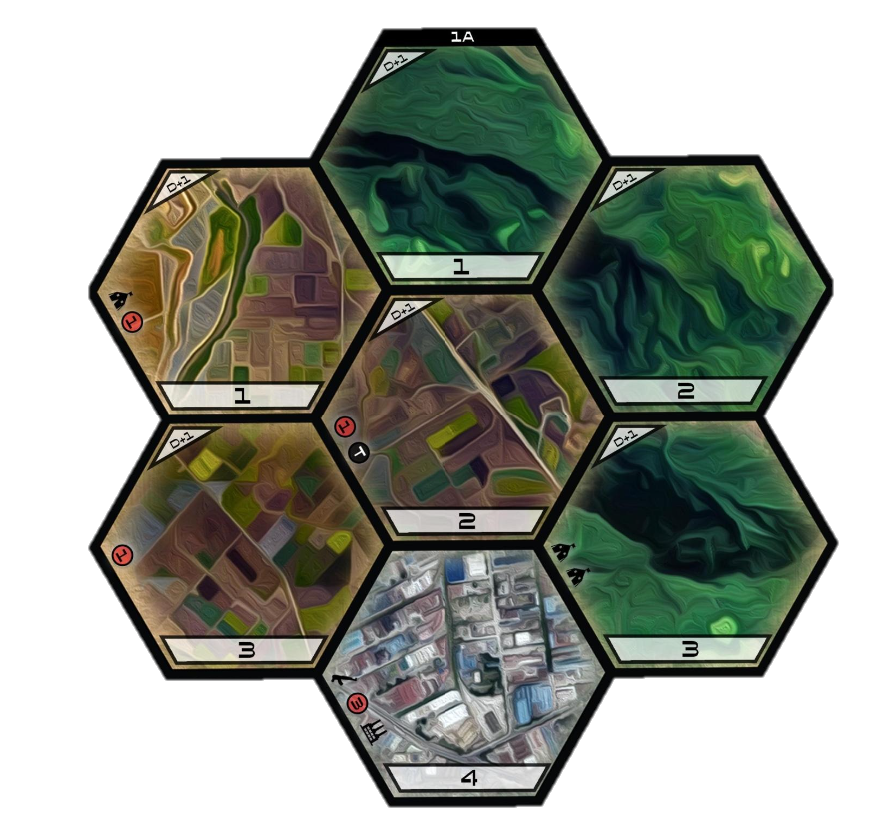
1. ABOUT THE GAME
1.A. Game Board: The map, or board, consists of hexagonal tiles representing different types of terrain. Each player is assigned a quadrant composed of four re-arrangeable septets. These septets are composed of seven tiles.
Map ⟩⟩⟩
Quadrant ⟩⟩⟩
Septet ⟩⟩⟩
Septet reference Number
Terrain Defense Modifier
Starting Condition
Indicator:
Adversary Cell
Adversary Outpost
Adversary Garrison
Tyranny Token
Number of Red Civilians
Number of Blue Civilians
Infrastructure Piece
Terrain Tile. Each septet contains seven terrain tiles
Terrain Card Reference Number
2

Slide 6
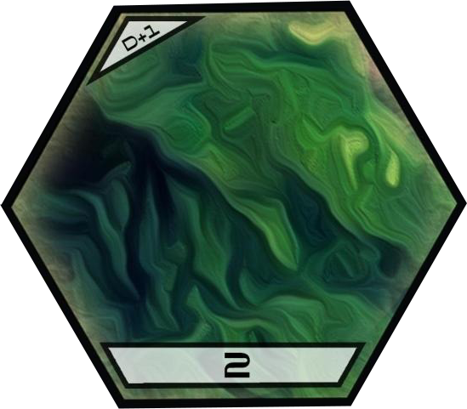
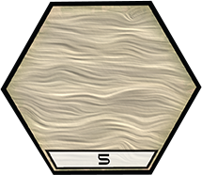
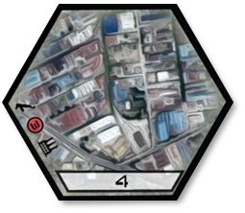
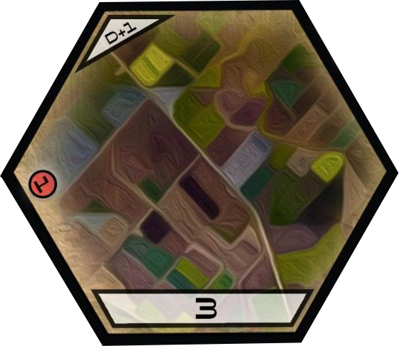
Terrain Tiles ⟩⟩⟩
Jungle Terrain: Tiles with jungle terrain represent restricted undeveloped terrain. The restricted nature of the terrain makes mobility more difficult for attacking forces, giving these areas a defense modifier of +1.
Desert Terrain: Tiles with desert terrain are barren unrestricted terrain. The terrain offers neither side an advantage.
Urban Terrain: Tiles with urban terrain represent densely populated areas. The urban terrain only provides an advantage if the adversary or resistance can induce the support of the population.
Rural Terrain: Tiles with rural terrain represent productive agrarian regions that remain sparsely populated. The compartmented terrain makes massing combat power more difficult, giving these areas a defense modifier of +1.
Border Tiles ⟩⟩⟩
Coast/Border: The coast and border are the outer-limits of the operational area. The adversary has complete control across the border and can move across at will. The adversary also has enough amphibious assets to allow freedom of maneuver across the ocean and into coastal tiles. Any tile that is adjacent to the coast or border is considered a coastal or border tile. If a tile does not share an edge with the coast or border, even if the edge of that tile is on the edge of the board, it is not considered a coastal or border tile.
3

Slide 7
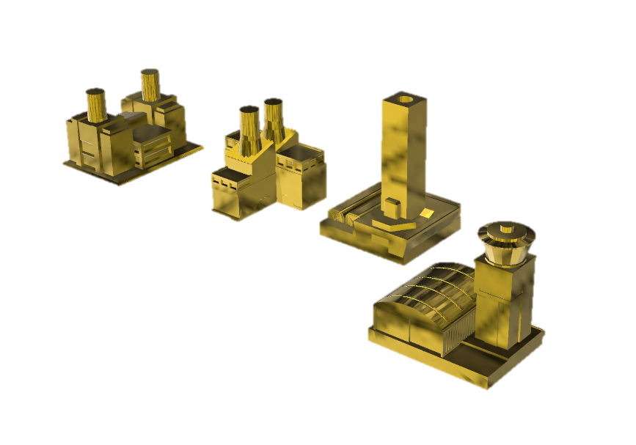
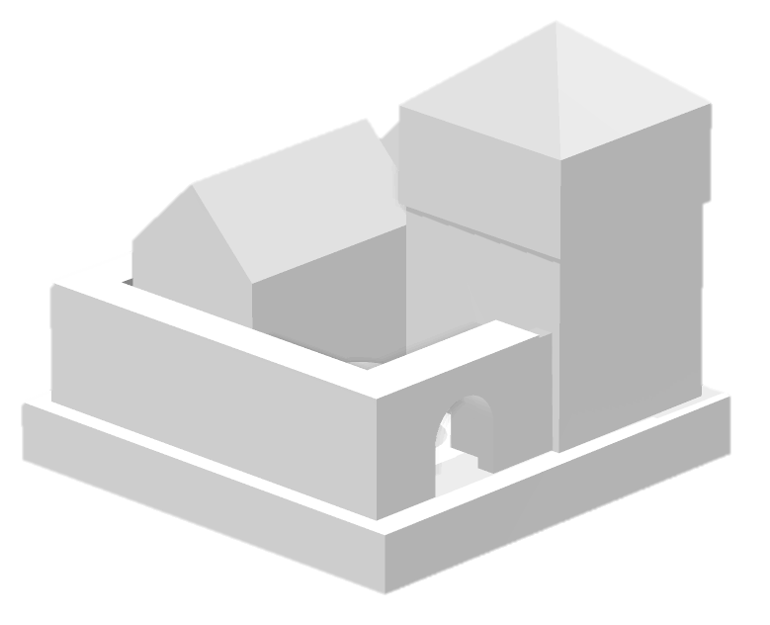
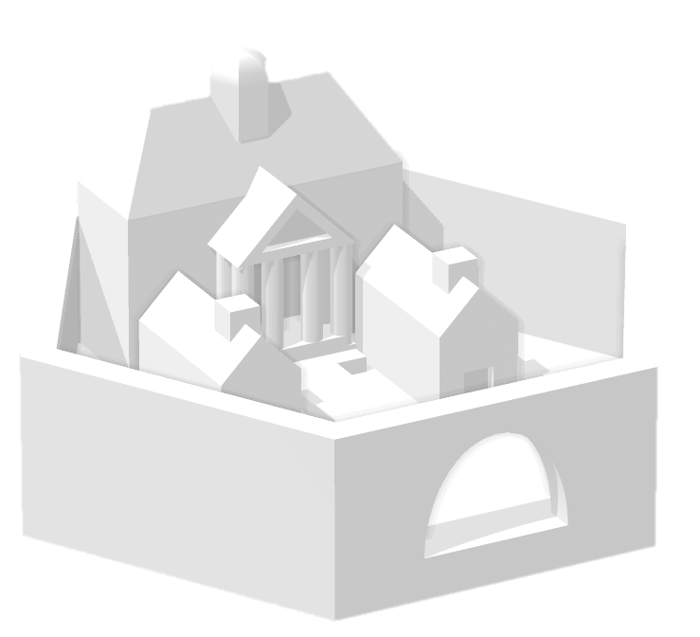
Infrastructure ⟩⟩⟩
Certain components of key infrastructure provide economic, morale or tactical advantages to the resistance. If the player occupies a tile with this infrastructure and eliminates the adversary occupying the tile, then the player gets an additional +1 resources per turn. If two or more players occupy a tile with infrastructure the player with the most presence gets the resource bonus, and if they have equal amount of presence no one gets the resource bonus. Tiles with infrastructure are indicated with a small icon ( ) in the starting conditions position and receive an infrastructure piece during game setup.
1.B. The Adversary: The adversary represents the security services of an unnamed power attempting to exert control over the map board. The political nature of the adversary is intentionally ambiguous, they could be a government exerting oppressive control over an autonomous region or an invading government subverting the legitimate but weak current governing authority.
Adversary Cells ⟩⟩⟩
Outposts ⟩⟩⟩
Garrisons ⟩⟩⟩
A cell represents the intelligence and advanced force apparatus of the adversary security forces. The adversary does not commit forces to a tile until they have built out logistic and intelligence nets to support their security forces. These cells deploy into uncontrolled tiles and begin preparing the environment for follow on security forces. Cells have a health value of one and a damage value of one.
Outposts represent adversary police, militia, or irregular units. These units rely on the networks established earlier by adversary cells, and they conduct small scale offensive operations to exert adversary influence over a tile. Outposts have a health value of two and a damage value of two. Destroying an outpost gives the player one influence point.
Garrisons represent adversary conventional military capability. These units are the strongest and most capable adversary units. Garrisons have a health value of three and a damage value of three. Destroying a garrison gives the player two influence points.
4

Slide 8
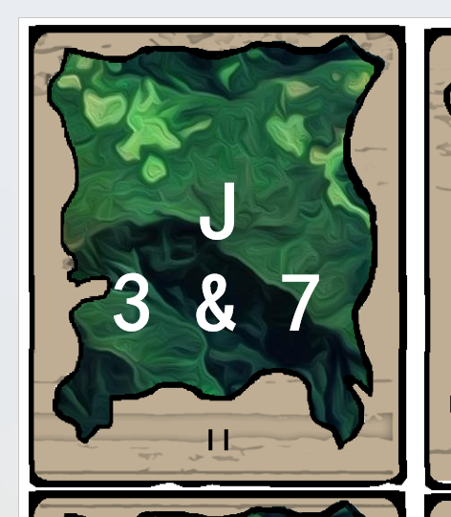
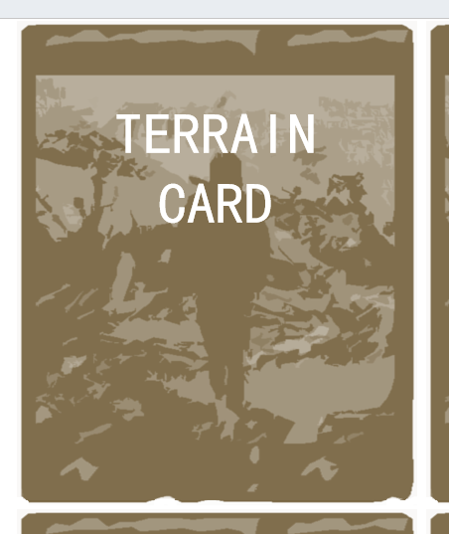
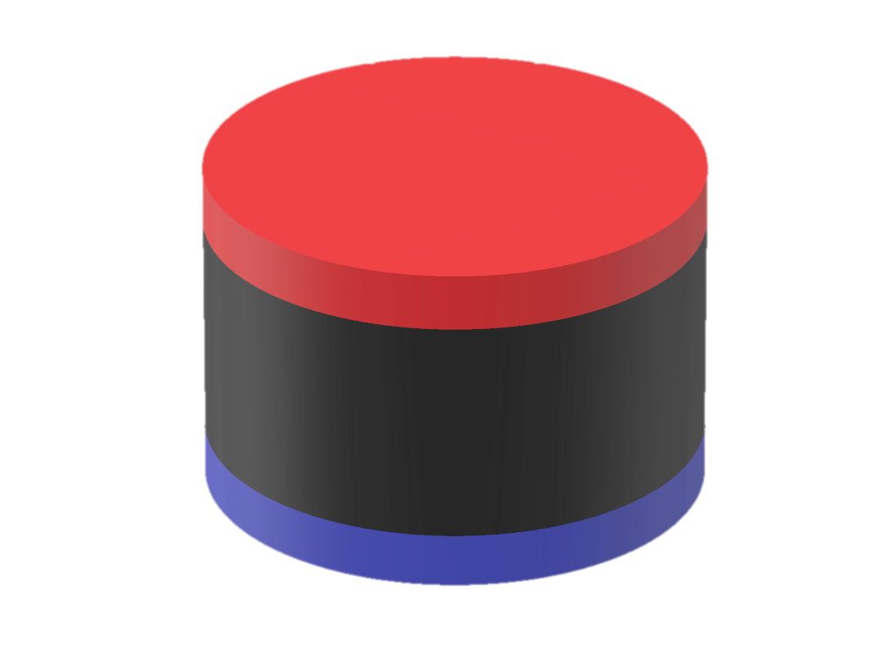
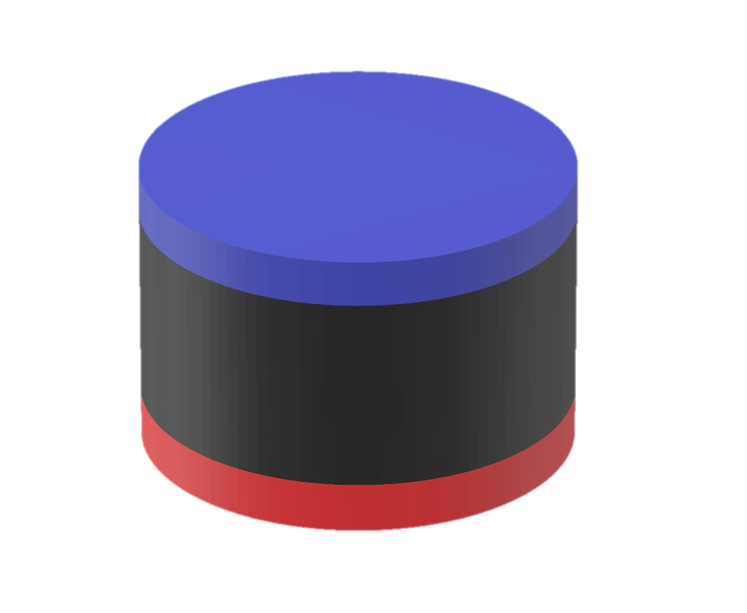
Tyranny Token⟩⟩⟩
Tyranny tokens represent a tile where the adversary has eliminated all resistance, cowed the population, and effectively denied the area to foreign presence. A tyranny token provides the adversary a defense modifier of +5. Presence tokens cannot enter a tile with a tyranny token. An area under tyranny is significantly more difficult to organize resistance, but nothing is ever permanently denied to the resistance. If the resistance eliminates all adversary units and red civilians from a tyrannized tile, then the tyranny token is
removed from the game. If a capability card removes a tyranny tile, then the tyranny token is returned to the tyranny pool. If the adversary places over half available tyranny tokens on the board, then the general state of the map board moves from free to tyrannical. If the adversary places all the tyranny tokens on the board, the players lose the game.
Terrain Cards⟩⟩⟩
Terrain cards dictate where the adversary will conduct operations. Using cards to drive adversary actions create an environment of uncertainty and risk for the player. The player cannot derive any discernible strategy from the adversary, which creates an element of uncertainty. However, once an adversary has deployed a cell to a tile, the player generally knows the sequence of events and can make decision to balance the risk of adversary outcomes.
1.C. Population: the civilian population is homogenous but divided in their sympathies. Some of the population supports the adversary and some of the population supports the resistance. The civilian population is fickle, and they are influenced by propaganda and battlefield success and failure. For the liberators and advisor killing civilians, regardless of their sympathies, results in minus one influence token. For the partisans and comrades, killing civilians has no effect on influence.
Red Civilians⟩⟩⟩
Blue Civilians⟩⟩⟩
Civilian populations that generally support the adversary. Each red civilian provides one defense point to the adversary in their tile.
Civilian populations that generally support the resistance. Each blue civilian provides one defense point to surrogate forces in their tile.
5

Slide 9
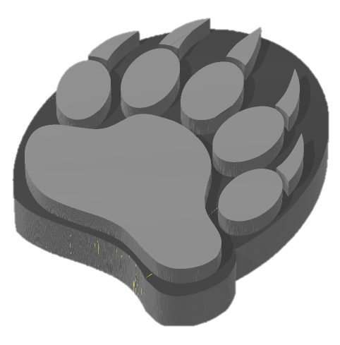
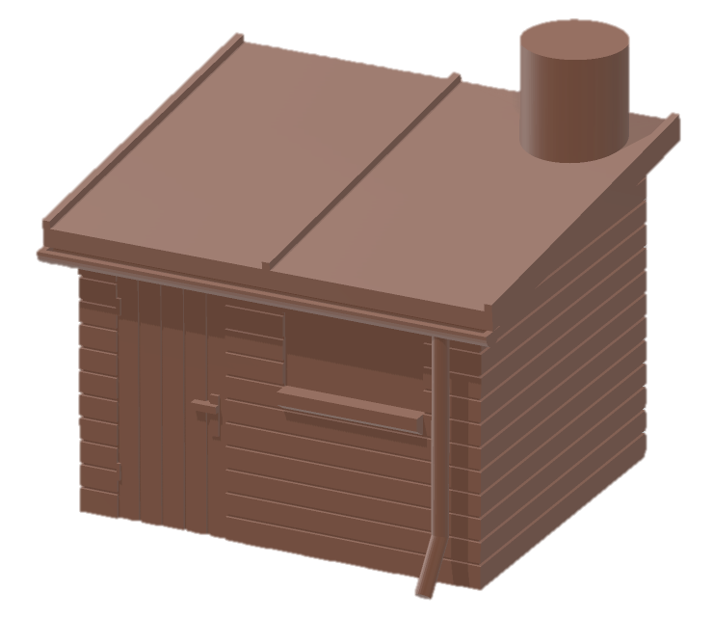
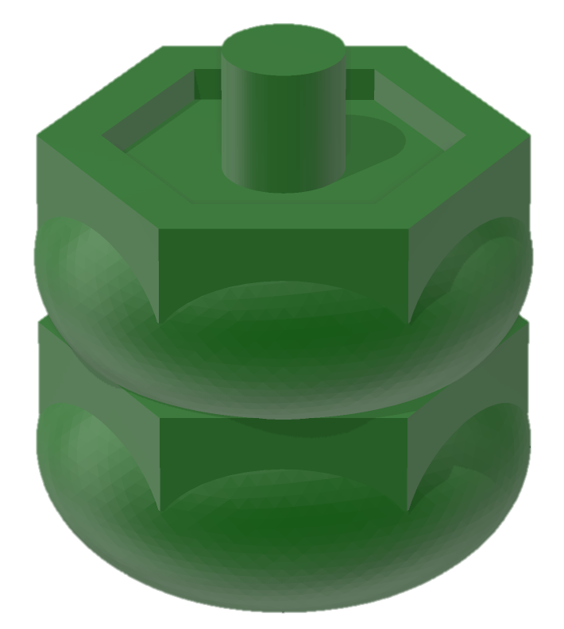
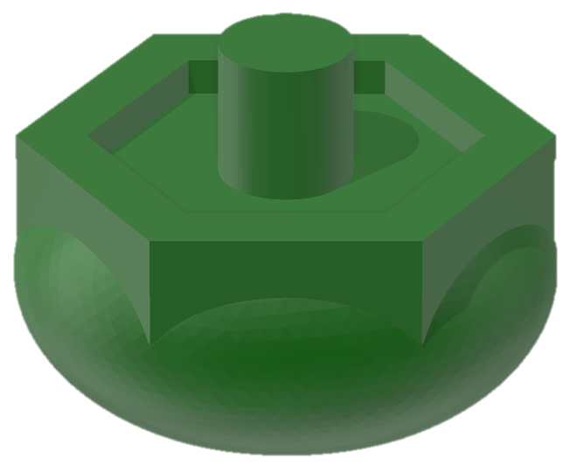
1.D. The Resistance: the surrogates represent the indigenous armed resistance to the adversary’s oppression.
Surrogate Force ⟩⟩⟩
Game cards (capabilities, events, etc.) will refer to the Surrogate Force as S or (e.g. “Each S does +1 damage this turn”)
Surrogates are recruited from the population. They provide the players combat power to attack the adversary, but they require operational direction and advanced capabilities from the player. Surrogates have a health value of one and a damage value of one. Surrogates do not conduct defensive operations, and therefore they do not provide any defense against adversary tyranny. If there are too many surrogates in a tile, they place too high a burden on the population, so at the end of the turn if there are more than four surrogate forces in a tile, the player will have to pay one resource per surrogate, or that surrogate force will be removed. Players may only move/push/pull surrogates they have recruited, but any surrogate forces in a tile will participate in attacks in that tile.
Surrogate Base ⟩⟩⟩
The surrogate base represents a liberated zone or safe house where surrogate forces can organize, train and equip. They provide the player an advantage in surrogate recruitment and organization. A surrogate base must be occupied by a surrogate force to provide inner security. A surrogate base has a health value of two and a damage value of two. If destroyed the player loses two influence points. In accordance with each player's special rules, surrogates can, but are not require to, generated from a guerrilla base each turn.
1.E. Game Players: the players represent outside entities who conduct operations by, with, or through the surrogate force to support resistance against the adversary. Each player is modeled on the attributes of a specific military organization, but the player should not feel confined to their preconceived notion of that organization’s motivations, techniques, and procedures. The purpose of different player types is to provide each player a different perspective on how the indirect approach can be applied. These approaches may be complementary or competitive. The presence of a player unit is represented by a presence token ( ), and a larger advanced operating base is represented by two tokens or a headquarters ( ). Each player has unique capabilities, attributes, and special rules. It is important that each game participant read and understand their special rules before the start of game play. Special rules will define many aspects of how each player approaches the competition space. Additionally, each player has complementing attributes and capabilities. For a player to access their organic capabilities, they must access attributes specific to that player. Attributes are accessed by playing capability cards. When a player plays a capability card, they earn the attributes indicated on the bottom of the card.
1.E.i. Player Panel: each player receives a “Player Panel” at the start of the game. The panel describes the player’s approach to the competition space, provides starting conditions, acts a quick reference for special rules, helps players track internal capabilities, and is a bank for presence. The player panel helps with organizing each participant’s approach to the game.
6

Slide 10
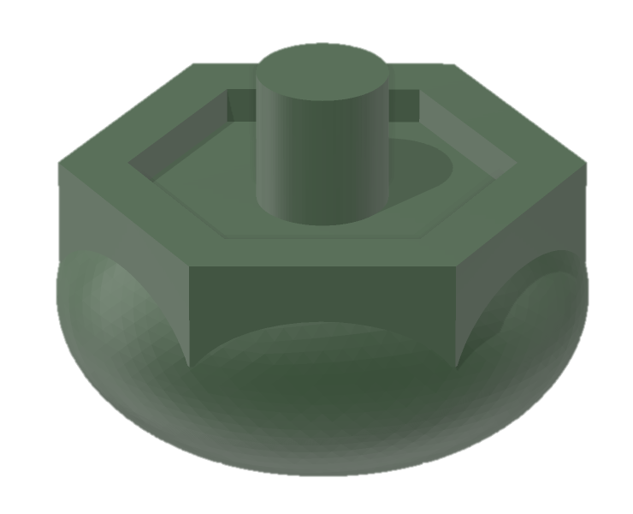
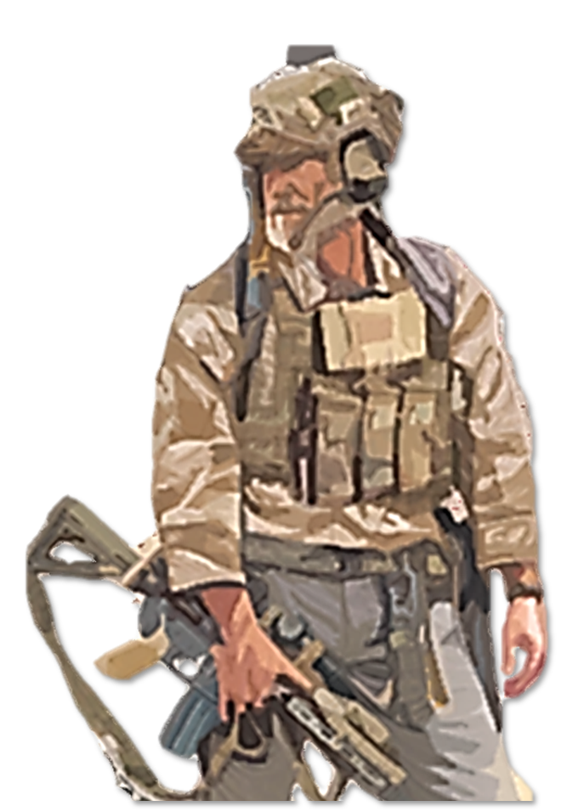
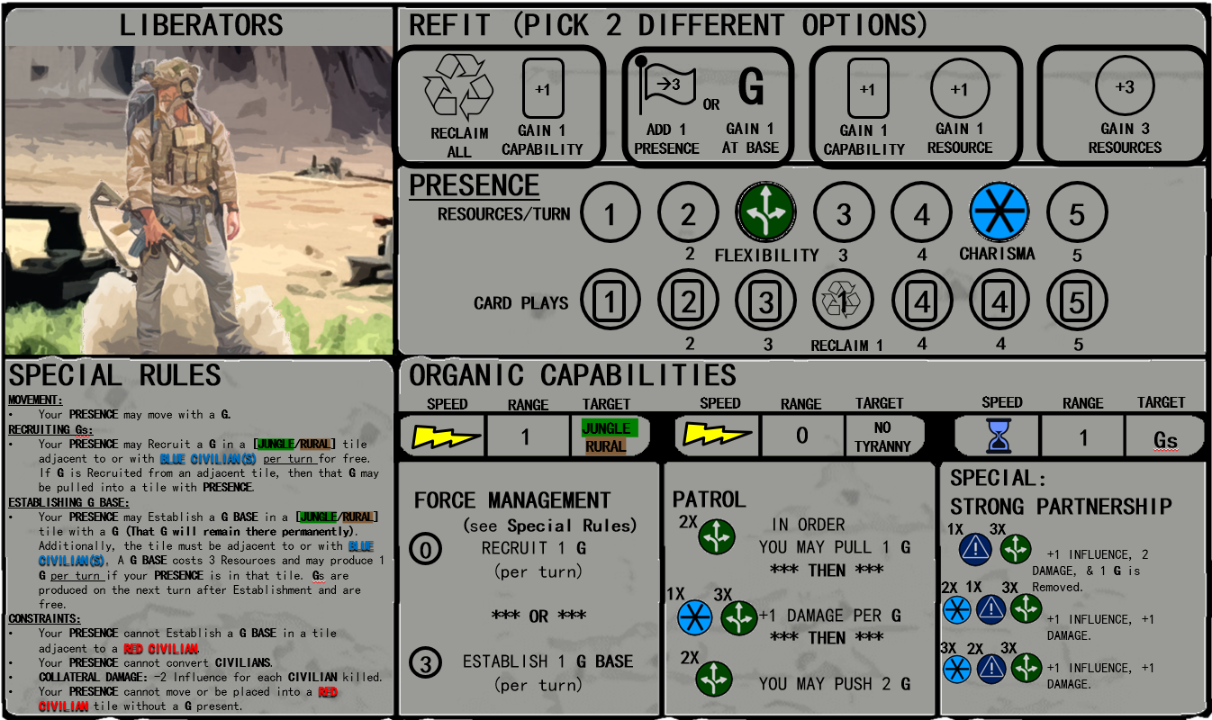
Liberators⟩⟩⟩
Modelled after U.S. Special Forces, their attributes are flexibility and charisma. These attributes enable their ability to patrol with the surrogate force and build strong partnerships. They prefer to see and not be seen and operate best in jungle and rural areas with supportive population. Collateral damage is detrimental to the liberator’s influence.
FLEXIBILITY
CHARISMA
Presence is held in the presence block. Presence tokens are placed on the circles in the resource and card rows. When presence is added to the board, circles are uncovered from left to right. When a circle is uncovered, players gain resources, attributes, or access to capability cards as annotated in the circle.
Liberators refit at the beginning of each turn. Liberators get to pick two refit options each turn from this block
Each round. liberators can either recruit 1x G in accordance with their special rules or establish a G base. The cost of these actions are annotated by the resource identifier bullet to the left.
Special Rules for each player are different. Carefully read these rules before starting the game.
Liberator Special capabilities are executed during the long-term capabilities phase and require the associated attributes. Attributes are awarded when a player plays a capability card with those attributes. Attributes reset each turn.
Liberators can access their patrol capabilities when they play cards with the attributes annotated in the patrol box. Liberator’s patrol can be executed during the immediate capabilities phase, as annotated by the lightning bolt
7

Slide 11
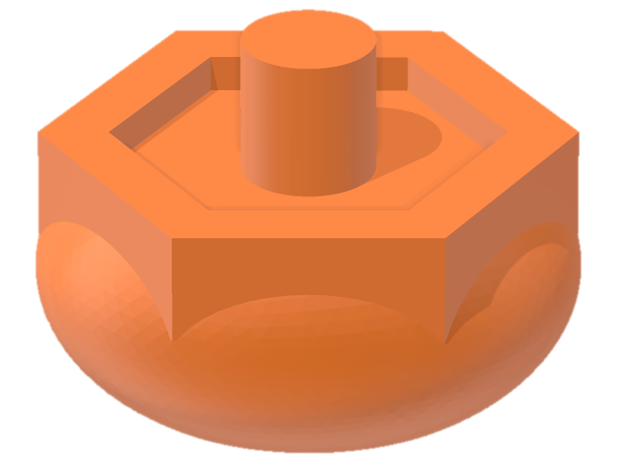
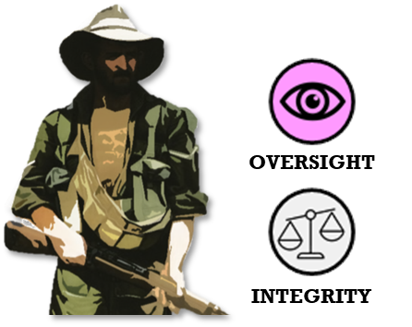
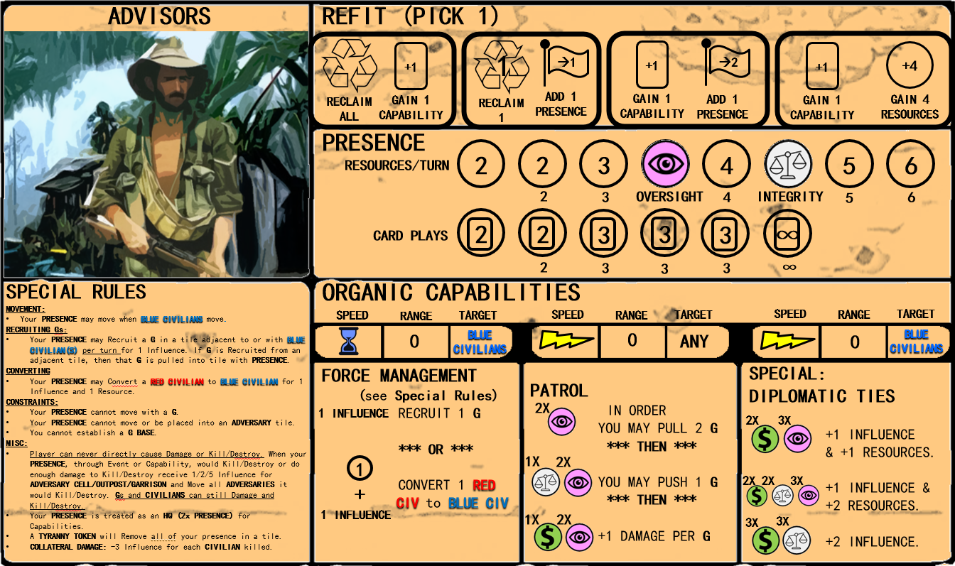
Advisors⟩⟩⟩
Modeled on US CA and PSYOPS units, their attributes are oversight and integrity. Advisors operate more overtly than the liberators, meaning their presence cannot enter tiles with adversary. Their effects are less kinetic, and they function best by converting the population and inducing the adversary to move around the board aimlessly. They can’t destroy the adversary directly, but they can induce the adversary to move through push/pull affect and destroy adversary through their proxies. They don’t have the authorities to recruit surrogates with money, so their currency is influence, which they spend to enlist the help of surrogates or convert civilian populations.
Advisors refit at the beginning of each turn. Advisors pick one refit option
For the Advisors, when all presence is removed from the card row, they can play as many cards as they can afford
Each round, during long-term phase advisors can either recruit 1x G in accordance with their special rules or convert civilians. The cost of these actions are annotated by the resource and influence identifier bullet to the left.
Advisor Special capabilities are executed during the immediate capabilities phase and require the associated attributes. Attributes are awarded when a player plays a capability card with those attributes. Attributes reset each turn.
Advisors can access their patrol capabilities when they play cards with the attributes annotated in the patrol box. Advisor’s patrol can be executed during the immediate capabilities phase, as annotated by the lightning bolt
8

Slide 12
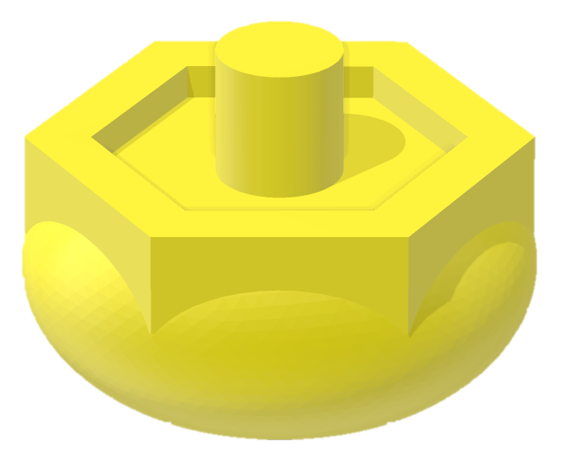
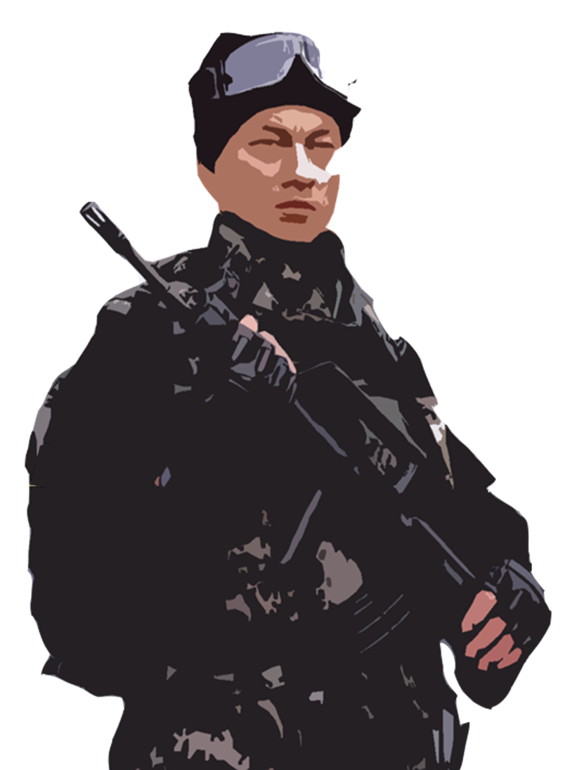
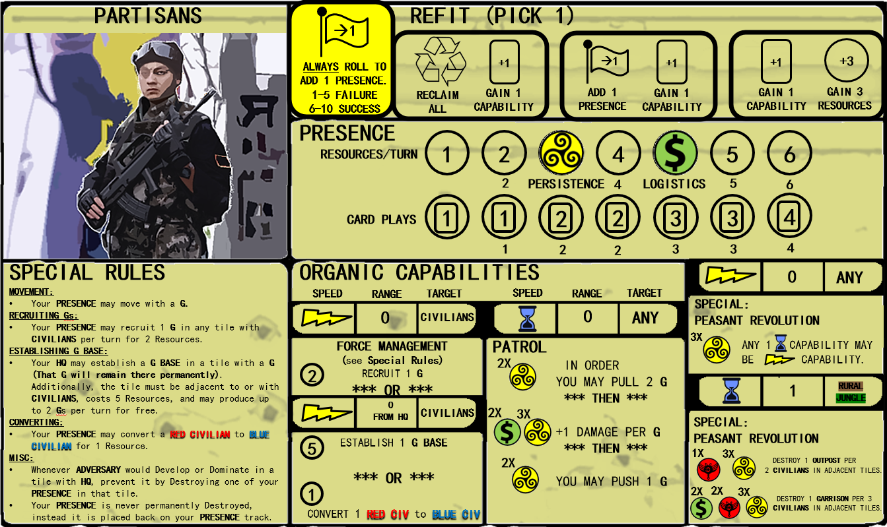
Partisans⟩⟩⟩
Modelled on PLA advisors and “volunteers” their attributes are persistence and logistics. The partisans spend freely and develop their network aggressively. Their aggressive and relatively overt network development backfires occasionally, which is why every turn prior to refit they roll a die to see if a presence token is deployed. The partisans can buy the support of the civilian population, but it doesn’t result in any true long-lasting influence. The partisans are resilient and are the only players whose presence are never permanently destroyed, just returned to the presence track.
PERSISTENCE
LOGISTICS
Partisans refit at the beginning of each turn. Partisans attempt to add presence each turn, followed by an additional refit option
Partisans' special capabilities are split between immediate and long-term phases and require the associated attributes. Attributes are awarded when a player plays a capability card with those attributes. Attributes reset each turn.
Each round, during immediate capabilities phase partisans can either recruit 1x G in accordance with their special rules, convert civilians, or establish a G-base. The cost of these actions are annotated by the resource identifier bullet to the left.
Partisans can access their patrol capabilities when they play cards with the attributes annotated in the patrol box. Partisan’s patrol can be executed during the long-term capabilities phase, as annotated by the hourglass
9

Slide 13
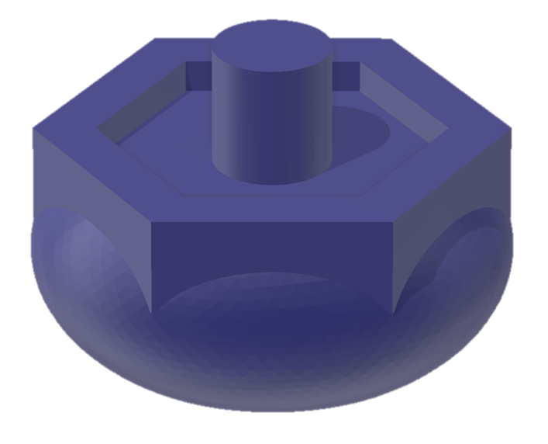
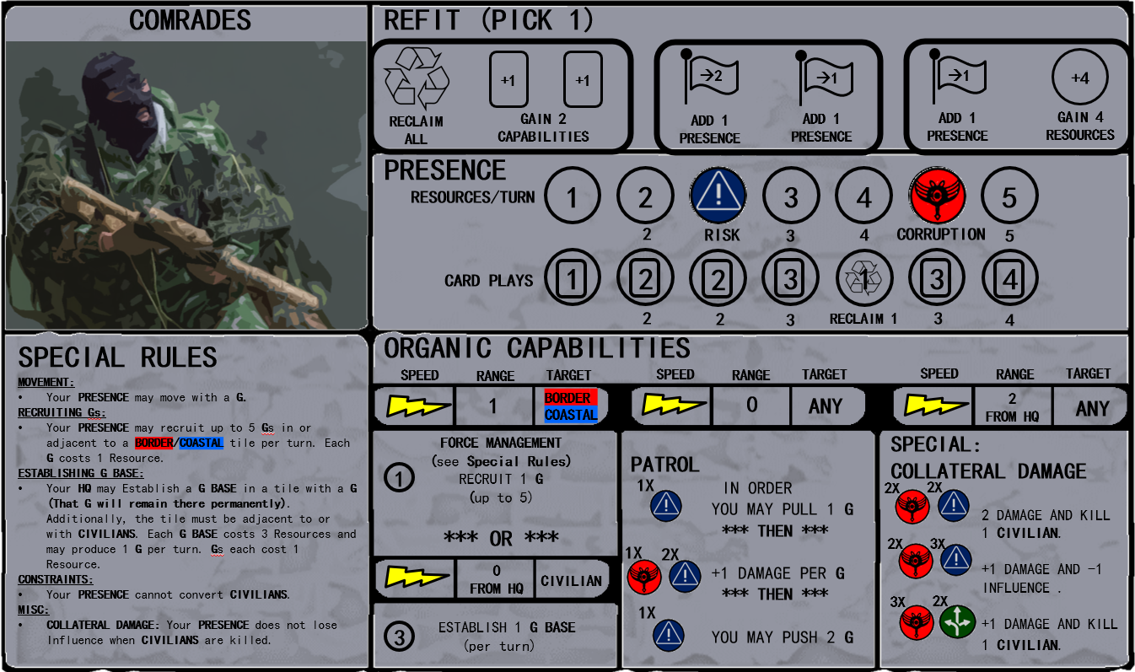
Comrades⟩⟩⟩
Modelled after Russian private military contractors their attributes are risk and corruption. Comrade networks are aggressive and function best on nebulous border regions. The Comrades’ surrogate forces are modelled as mercenary proxies, so their surrogates infiltrate from the border and are easy to recruit. Collateral damage has no detrimental effect on comrade influence.
RISK
CORRUPTION
Comrades refit at the beginning of each turn. Comrades choose 1 of 3 refit options each turn
When this circle is uncovered, the player can reclaim 1 x locally discarded capability card each round
Each round, during immediate capabilities phase comrades can recruit 1x G in accordance with their special rules or establish a G-base. The cost of these actions are annotated by the resource identifier bullet to the left.
Comrade’s Special capabilities accessed during immediate phases and require the associated attributes. Attributes are awarded when a player plays a capability card with those attributes. Attributes reset each turn.
Comrades can access their patrol capabilities when they play cards with the attributes annotated in the patrol box. Comrades patrol can be executed during the immediate capabilities phase, as annotated by the lightning bolt
10

Slide 14
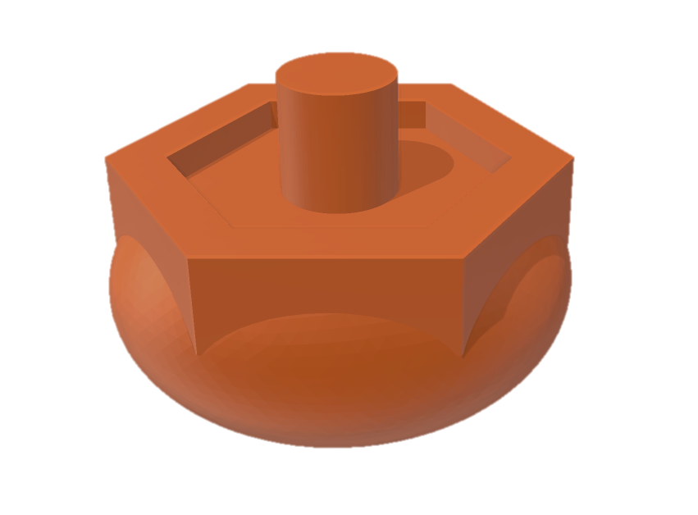
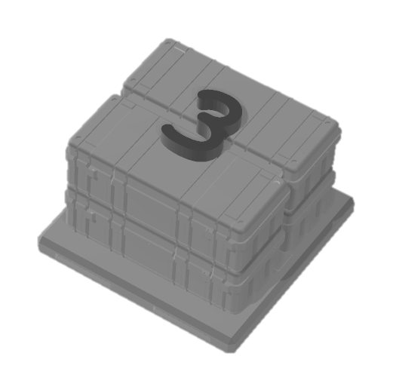
Player Presence Tokens⟩⟩⟩
A player’s presence token placed inside a tile represents access and placement for the player in the tile. The presence token should not be considered as simply members of the player’s unit, rather the token represents the player’s ability to influence events in the tile through the development of their networks. A player's presence may move with surrogate forces, except for advisors who can only move with friendly civilians. A player’s presence cannot enter a token with a tyranny tile.
Player Headquarters Token⟩⟩⟩
Two presence tokens in a single tile constitute a headquarters. This can be considered as physical members of the player’s unit. Establishing a headquarters requires more physical investment by the player but allows them to employ more advanced capabilities. The advisor’s presence tokens are considered to all be headquarters to emphasize the more overt nature of their relationships to proxy forces. This limits their ability to directly target and destroy the adversary but increases their ability to exert influence and apply advanced capabilities.
Resource Token⟩⟩⟩
The players bring advanced capabilities to support the resistance, but they are constrained by limited resources. Resource tokens represent supplies, money, rations and all the other logistical requirements to execute operations. Players gain resources during the refit phase.
1. F. Capabilities: There are two sources of player capabilities. Organic capabilities are listed on the player card, and external capabilities are found in the capability cards in the player’s hand. Capabilities are divided into two categories, immediate (represented by a lightning bolt) and delayed (represented by an hourglass). Immediate capabilities are played during phase 1, while delayed capabilities are played during phase 4. All capabilities affect a single target tile, unless explicitly stated otherwise.
External Capabilities⟩⟩⟩
External capabilities are executed by playing capability cards. The maximum number of capability cards a player may use each turn is the highest uncovered number on the card plays track. External capabilities cost resources to execute, denoted by the number on the top left corner of the card. Capability cards also bestow certain attributes on the player. Demonstrating these attributes are required to execute organic capabilities. Capability cards are divided into major and minor capabilities. Major capabilities cost more resources to execute and have more dramatic effects. If a player draws a major capability card they must “forget” or discard a capability card already in their hand. (the discarded capability can be a major or a minor capability). When capability cards are played during a turn, that card is then “locally” discarded. The card can then be reclaimed during the refit phase if the player chooses the “reclaim” option.
11

Slide 15
Attributes⟩⟩⟩
Each player has two attributes that are representative of the distinguishing characteristics of each player. When you play a capability card you unlock the attributes displayed at the bottom of the card. These attributes can be used to enhance the effectiveness of some external capabilities, and unlock the organic capabilities found on your player card. Attributes are gained the moment you pay resources for a capability, regardless of whether the capability is fast or slow (this will be in phase 2, execute immediate capabilities). Attributes only last until the end of the round and reset at the refit phase.
Organic Capabilities⟩⟩⟩
Organic Capabilities are found on the bottom right of the player panel. Each player has a patrolling capability and a special capability. These capabilities do not require resources, instead they require demonstrated attributes. These attributes are demonstrated through the execution of external capabilities. The player adds all the attributes from the capability cards executed that turn (regardless of whether the capabilities are immediate or delayed) and if there are enough attributes to execute their organic capabilities the player may do so during the appropriate phase. An organic capability is executed in one tile (i.e. if the organic capability is to pull 2 surrogates, then push one, they must be pulled into and then pushed from the same tile). The patrol capability and special capability may be executed in different tiles.
Capability Range⟩⟩⟩
Every capability has a maximum effective range. Capabilities are executed by allocating resources equal to the capability requirement to one of your presence tokens (i.e. a node in your network). The range indicates how many tiles away from the tile with your presence the capability can affect. A range of zero means that the capability must be executed in a tile with your presence. Push/Pull actions have a range of zero, meaning the targets must be pulled into a tile with your presence, or pushed from a tile with your presence.
Capability Target⟩⟩⟩
Some capabilities may only be executed against specific targets or in specific environments, this will be indicated on the capability card under capability target.
Range
Target
Capability Timing⟩⟩⟩
Capabilities are executed either during the immediate phases or long-term phases. Immediate capabilities are annotated by a lightning bolt ( ) and Long-Term capabilities are annotated by an hourglass ( ).
Timing
12

Slide 16
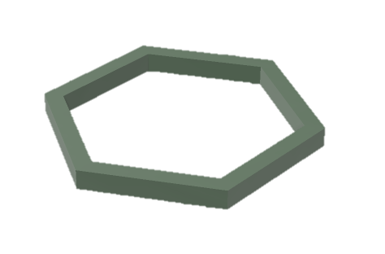
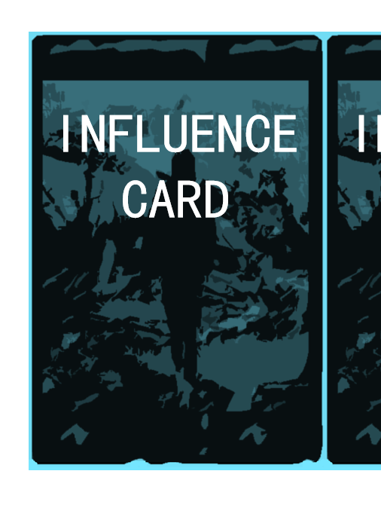
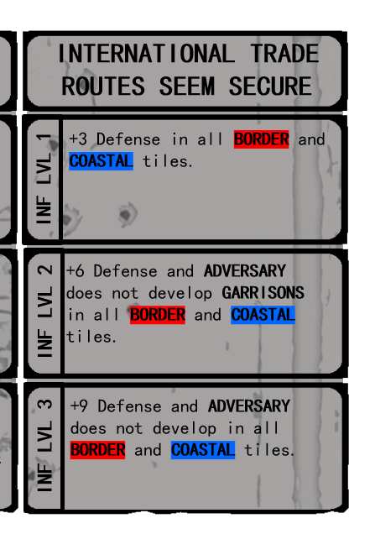
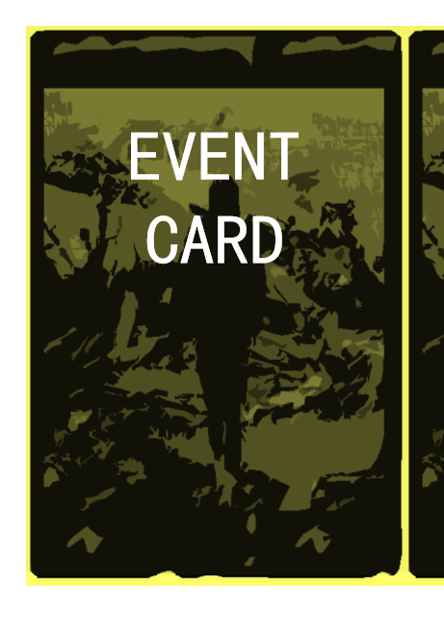
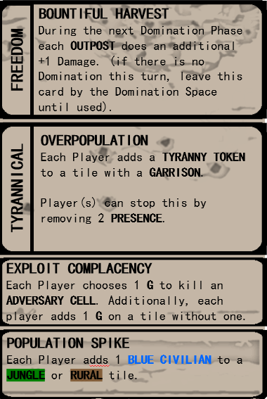
1.G. Hex of Protection: Some capabilities increase a tile’s defense capability or prevent adversary action inside a tile for the duration of a turn. When the player executes these capabilities the hex of protection may be placed around the tile as a reminder that the tile’s defenses are augmented for the remainder of the turn.
1.H. Influence: The ultimate determination of the success of the resistance will be the influence they exert over the population. Influence is gained by destroying adversary units, specific influence operations, or by demonstrating a capability the convinces the population the surrogate forces are more likely to win than the adversary. Occasionally, adverse events cause players to lose influence. If influence is lost, influence tokens are taken out of the influence box and returned to the influence pool. If there are no influence tokens in the influence box, then the player must pay one resource or remove one presence from the board.
Influence Tokens⟩⟩⟩
Any action that results in a gain of influence moves an influence token into the influence pool. There are four influence tokens per player. Once all influence tokens are inside the influence box, an influence card is revealed.
Influence Cards⟩⟩⟩
Influence cards represent the beneficial effects of the perceptible shift in popular support to the cause of the resistance. Once every influence card has been played, the momentum of popular support has reached a climatic tipping point, and the players win the game.
1.I. Event Cards: Event cards represent the friction of war. Events outside the control of player and adversary will change conditions in ways that could be favorable or disastrous. This addition of uncertainty influences player decision making and injects a degree of chance into the game.
13

Slide 17
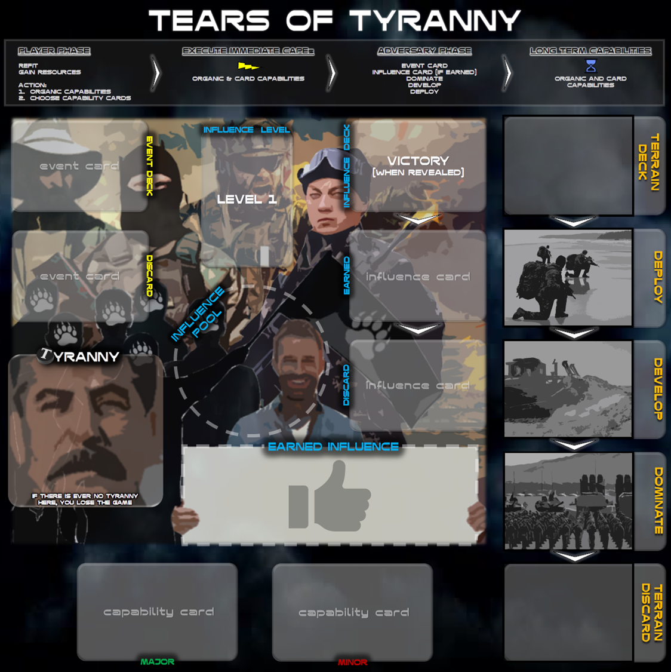
2. SETUP
Phasing Board⟩⟩⟩
Shuffle event cards and place here.
Create the influence deck and place here. See paragraph 2.A.
Create the terrain deck and place here. See paragraph 2.B.
***Place Excess game components in small piles next to the phasing board
Place five tyranny tokens per player into the Tyranny Box
Place four influence tokens per player in the Influence Pool
Remove player starting cards (earmarked with corresponding player color), issue starting capability cards to players, shuffle major capability cards, and place remaining deck here.
Shuffle minor capability cards, remove player starting cards (earmarked with corresponding player color), issue starting capability cards to players and place remaining deck here
2.A. Influence Deck Setup: The influence deck is composed of ten randomly selected influence cards.
⟩⟩⟩ Place the influence level 3 marker between cards seven and eight of the influence deck.
⟩⟩⟩ Place the influence level 2 marker between cards four and five of the influence deck.
⟩⟩⟩ Place the influence cards on the influence deck space.
x 4
x 3
14
x 3

Slide 18
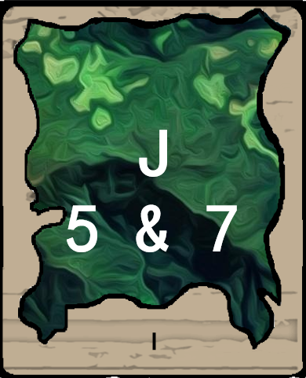
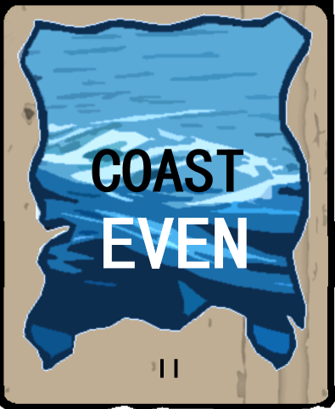
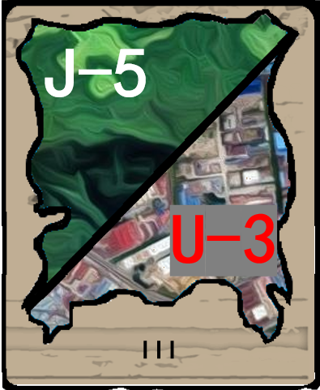
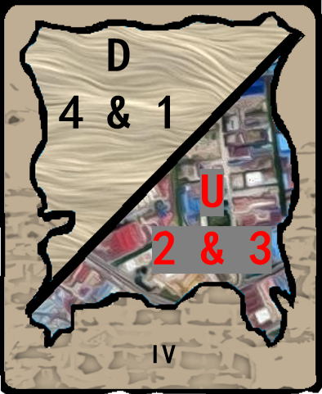
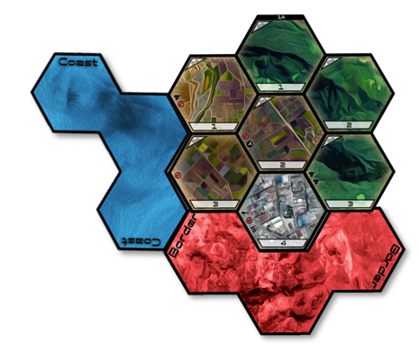
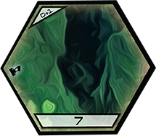
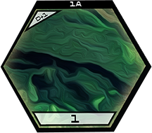
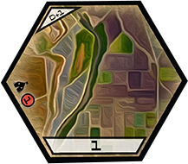
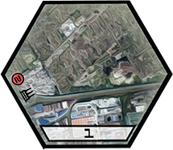
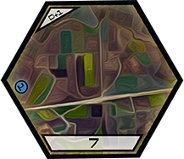
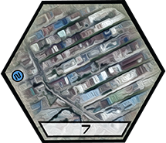
2.B. Terrain Deck Setup: The terrain deck is composed of 16 cards: four Stage I cards, four Stage II cards, four Stage III cards, and four Stage IV cards.
⟩⟩⟩ Stage IV cards compose the bottom of the deck, then stage III cards, stage II cards and finally stage I cards. The players do not look at the reverse side of the terrain cards.
⟩⟩⟩ Place the terrain card deck, faced down, in the deck box on the upper right of the phasing board.
x 4
x 4
x 4
x 4
***For a more advanced game create a terrain deck of 12 cards: three Stage I, three Stage II, three Stage III and three Stage IV cards. This will create a more aggressive adversary who will increase the tempo of their operations before the players can build an extensive network of presence and develop an extensive set of capabilities.
Map Board⟩⟩⟩
Arrange one quadrant per player to form the operational area. See page 2 for quadrant setup.
2.C. Populate the map board:
⟩⟩⟩ Populate adversaries, tyranny, civilians, and infrastructure according to the labels on each tile. See page 2 for explanation of tile labels.
⟩⟩⟩ Establish initial presence. the players place a headquarters element on the following tiles:
Liberators: highest or lowest jungle tile on their map board
Comrades: highest or lowest tile adjacent to a border/coast tile
or
Partisans: highest or lowest rural tile on their map board
Advisors: highest or lowest urban tile on their map board
or
or
15

Slide 19
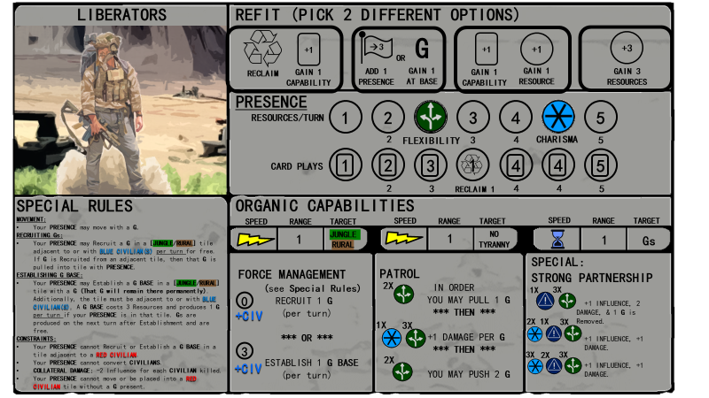
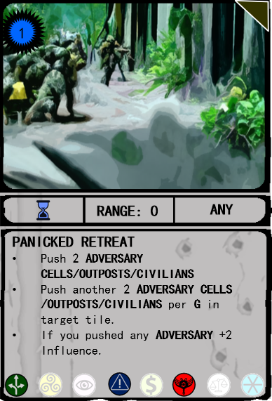
Player Panel⟩⟩⟩
⟩⟩⟩ Each player selects one player panel
⟩⟩⟩ Presence tokens are placed over the blank token spaces on the board, leaving the first space in resources and the first space in card plays open.
⟩⟩⟩ A player’s hand consists of the four capability cards specifically corresponding to their character.
Player capability card earmark
Initial Adversary Action⟩⟩⟩
⟩⟩⟩ The adversary has the initiative and begins their first deployment. Flip the top card of the adversary deck and place it in the deploy box. The adversary deploys to the corresponding tile (see paragraph 3.f, deploy).
⟩⟩⟩ The card is then moved to the develop box
16

Slide 20
3. SEQUENCE OF PLAY
⟩⟩⟩ Each turn is broken into four phases. Players execute their actions simultaneously each phase, and the game does not progress from one phase to the next until all player actions are complete.
Players can execute the Player Phase and Immediate Capabilities Phase actions in the order of their choosing before advancing to the Adversary Phase.
Player Phase⟩⟩⟩
3.A. Refit: Each player chooses one option (except for the Liberators who may choose two – but not the same options twice) in the refit portion of their player card. Generally, refit actions fall into the following categories:
Reclaim: This allows the player to reclaim expended capability cards
Gain Capability: This allows a player to gain a new capability. The player draws four capability cards and chooses one. The remaining three cards are returned to the bottom of the deck. If a player decides to draw a major capability card, they must discard a capability card in their hand.
Gain resources: this allows a player to gain additional resources. This does not take the place of the resources gained later in the phase.
Add presence: This allows a player to place a presence tile on the board. The player card will indicate how close the new presence must be to an existing presence. A player cannot add a presence in a tile with a tyranny token. There are some special rules for each player regarding their presence
Liberators may not place presence in a tile with only red civilians unless there is a surrogate force present
Advisors may not place presence in a tile with adversary
3.B.Gain resources: Each player gains a number of resources equal to the highest uncovered number on the resources track of their player card, plus one resource per infrastructure tile they control. To control an infrastructure tile, a player must have the highest level of presence in the tile without adversary.
3.C. Force Management: Each player has the option to recruit surrogate forces, build surrogate bases or convert civilians from adversary sympathizers (red civilians) to resistance sympathizers (blue civilians). Refer to the player cards to determine the resource cost and requirements for each action. (Note: The advisors are unique in that they spend influence tokens instead of resources for their force management)
3.D. Select Capabilities: Each player selects the capability cards they wish to play that turn. They may play the number of capability cards equal to the highest uncovered number on the card plays track. The player places the required resources on the card to ensure they have the appropriate number of resources to execute all capabilities. Players are advised to pay special attention to the attributes bestowed by their capability cards, as these may allow them to execute organic capabilities.
17

Slide 21
Execute Immediate Capabilities⟩⟩⟩
⟩⟩⟩ Players execute their immediate external and organic capabilities. Capabilities are executed simultaneously.
⟩⟩⟩ Some capabilities consist of multiple actions, actions connected by “then” must be performed sequentially, actions connected by “and” may be performed in any order.
⟩⟩⟩ Players must pay attention to the limitations of each capability. Capabilities are limited by:
Range: the number in this box defines the distance from a presence or headquarters where the action from this card is eligible to originate. The tile chosen to apply the capability card is known as the “Target” tile.
Target: this indicates the conditions that must exist inside the tile to be eligible for executing a capability. In the picture to the right, “Any” indicates that there are no restrictions. Other possible restrictions could limit the player to a specific type of terrain or civilian presence.
⟩⟩⟩ Capability cards generally result in the following effects:
Gain influence: Player moves an influence token from the influence pool to the earned influence box.
Pull surrogates/adversaries/civilians: The player moves the targeted element from another tile to a tile with player presence.
Push surrogates/adversaries/civilians: The player moves the targeted element from a tile with player presence to another tile.
Increase Defense: Strengthening a tiles defense makes it more challenging for the adversary to dominate it. The value of the defense increase will be subtracted from the adversary’s strength during the dominate phase.
Damage adversaries: Damaging adversaries makes them more vulnerable to attacks later in the turn. If damage is equal to the adversarial defense (including defense modifier), that adversary is immediately removed from the tile. A damaged adversary can still apply their entire strength during the dominate phase. A damaged outpost is placed on its side, a garrison with one damage is placed on its side, and a garrison with two damage is placed upside down. Damage accumulates throughout the entire turn. (Defense modifiers must be overcome with each attack, for example an immediate capability with two damage against an adversary outpost in a jungle tile will do one damage to the outpost, a follow-on attack must do at least two damage to finally destroy the outpost). At the end of the turn damaged adversaries are returned to full strength. If the number of damage exceeds the combined adversaries, the excess damage results in collateral damage. Collateral damage kills a corresponding number of civilians in the tile, and one influence token is lost for each civilian killed. Also, the presence of civilians sympathetic to the adversary (red civilians) increases the adversary defense by one.
Destroy adversaries: If an adversary is destroyed or killed, they are removed from the board. Destroying an outpost increases your influence by one, destroying a garrison increases your influence by two. Some cards will indicate that an adversary is removed rather than destroyed, if an adversary is removed (i.e. conducts a strategic withdrawal) then the player earns no influence.
Replace: A capability card can replace a civilian or an adversary with a surrogate force. This action does increase influence.
All immediate actions must be complete before moving to the adversary phase.
18

Slide 22
COMBAT ADJUDICATION
Combat adjudication between surrogate and adversary is a function of three elements: health, defense, and damage. Combat is only initiated by the player if directed by a capability, event, or influence card, and the adversary only initiates combat during the domination phase or as directed from an event card. Co-location of surrogate and adversary units does not automatically result in combat between the units.
⟩⟩⟩ Health. The health of the unit indicates how much damage it can absorb before it is destroyed. Surrogate forces, adversary cells, and civilians have a health value of one, surrogate bases and adversary outposts have a health value of two, and adversary garrisons have a health value of three.
⟩⟩⟩ Defense. Defense values represent conditions inside a tile that make attacks more difficult. Defense values apply to the entire tile, not each individual unit inside the tile. Thus, a tile with a defense value of +1 and two adversary cells would only require an attack of three damage to destroy the adversary cells. One damage point to overcome the defense modifier, and two damage points to destroy the two adversary cells. Defense modifiers must be overcome during each individual attack. Thus, if an outpost was in the tile mentioned above, a follow-on attack would require another three damage points to destroy the outpost. Defense points can be derived from the terrain, civilian support, tyranny, or capabilities. Some capability cards instruct the player to disregard defense modifiers. Unless the capability card specifically targets a tile with tyranny, the tyranny defense modifier is never disregarded.
⟩⟩⟩ Damage. Damage represents the effectiveness of an attacking unit. Surrogate forces and adversary cells do one damage, adversary outposts do two damage, and adversary garrisons do three damage. Players can damage the adversary by playing capability cards. Note: the advisors do not damage the adversary through the direct application of their capabilities. Their capabilities can only push adversary out of tile, to damage an adversary the advisors must apply capabilities indirectly through their surrogates. If the damage value from a player attack exceeds the combined health and defense of the adversaries, the excess damage results in collateral damage. Collateral damage kills a corresponding number of civilians in the tile, and one influence token is lost for each civilian killed. For example, a capability with a damage value of two used against a tile with no defense modifiers and an adversary cell and civilian token would result in the destruction of the cell and the civilian, and a corresponding loss of one influence point. The comrades and the partisans do not lose influence from collateral damage. Adversary attacks do not cause collateral damage.
Combat Quick Reference Chart
19

Slide 23
Adversary Phase⟩⟩⟩
3.D. Event Cards: Event cards represent the friction of war.
Determine if the board is in a state of freedom or tyranny. If half or more of the tyranny tokens have been taken from the tyranny pool and placed on the board, then the board is in a state of tyranny. Otherwise, the board is in a state of freedom. (Four players would be ten tokens, three players seven tokens, two players five tokens, and one player two tokens)
Draw the top event card and follow the instructions on the card. Most cards show two possible primary events. The executed event will depend on whether the board is in a state of freedom or tyranny.
Follow the instructions on the bottom two boxes of the event card, actions from the bottom two boxes are always executed regardless of the state of the map board
3.E. Influence Cards:
Influence is earned by executing actions that demonstrate the strength of the resistance. Anytime influence is earned an influence token is placed into the earned influence box. Any time influence is lost a token is taken out of the earned influence box and returned to the influence pool.
An influence card is earned when all available influence tokens are placed in the earned influence box. Influence cards may be earned at any point in a turn, but the card will not be executed until this phase. Place earned influence cards in the earned influence card box on the phasing board
If there is an earned influence card on the phasing board, flip the card and follow the instructions. Once complete place the influence card in the discard box on the phasing board. If there are multiple earned cards, execute all earned influence cards in the order in which they were earned.
Lost influence
Earned influence
Influence cards are divided into three levels. Follow the instructions on the card corresponding to the current influence level. The influence level is marked at the top left portion of the phasing board. The game begins at influence level one and progresses to influence level three. When you reveal an influence level divider, the influence level and the new victory conditions take effect immediately.
20

Slide 24
3.F. Dominate:
The adversary dominates in the tiles indicated by the adversary card placed in the dominate box on the phasing board. There will be no domination in the first round.
In each tile suffering domination determine the adversary’s strength. The adversary's strength is determined by adding all the adversary unit's capability to inflict damage. Garrisons inflict three damage, outposts two damage, and cells one damage.
If the tile contains population unfriendly to the adversary (BLUE CIVILIANS) subtract one point for each blue civilian marker from the adversary’s strength.
If the tile is difficult terrain (jungle or rural) subtract one from the adversary’s combined strength.
Any defense modifiers from capability cards played during the immediate action phase are subtracted from the adversary’s combined strength
If the adversary has at least two strength points remaining then they successfully tyrannize the tile, and a tyranny token is placed on the tile. Any player presence in that tile is removed from the game. (Note: the partisans may replay removed presence, when the partisans remove presence, it is returned to the presence track on the player card)
If a dominated tile already has a tyranny token, the tyranny escalates, and a second tyranny token is placed in that tile and another tyranny token and adversary cell is placed in an adjacent tile. All civilians in the tile switch to red, and the adjacent tile is chosen by player consensus.
The remaining adversary strength is then targeted against surrogate forces in the tile. Destroying a surrogate base requires two strength points and destroying a surrogate force requires one strength point. The adversary prioritizes the destruction of surrogate bases. If the adversary has only one strength point to apply against a surrogate base than the surrogate base is damaged, and the surrogate base token is placed on its side. A destroyed surrogate base results in the loss of the surrogate force defending the base in addition to two influence tokens.
Surrogate counterattack. If any surrogate elements survive the adversary onslaught they immediately counterattack. surrogate strength is tallied with one point for every surrogate force. Civilians sympathetic to the adversary (red civilians) subtract one from the surrogate strength. The remaining surrogate strength can be targeted against the adversary at the player’s discretion. (3 points to destroy a garrison, 2 points to destroy an outpost, and 1 point to destroy a cell). Collateral damage rules still apply. Use the damage flow chart below, and included in the game box, for quick reference during game play.
21

Slide 25
3.G. Develop:
The adversary develops in the tiles indicated by the adversary card placed in the develop box on the phasing board.
In each tile under development, a cell builds an outpost (the cell remains, making the adversary composition a cell and an outpost) and an outpost builds a garrison (the outpost also remains, resulting in the presence of an outpost and a garrison). If a garrison is present, another garrison is added. If you have run out of garrison tokens, then the outpost builds two additional outposts, resulting in three outposts.
3.H.Deploy:
A card is taken from the adversary deck and placed face up in the deploy box on the phasing board.
If the indicated tile is next to the coast, the border, a tile with an adversary garrison, or a tile with an adversary outpost then an adversary cell is placed into that tile.
No more than one new adversary cell is deployed into a single targeted tile during this phase, but multiple tiles may receive an adversary cell.
3.I.Shift Terrain Cards:
⟩⟩⟩ At the end of the adversary phase, shift every adversary card down one box on the phasing board. The dominate card will be discarded, the develop card moves to dominate, and the deploy card moves to develop. Do not reveal the next deploy card until the adversary phase of the next turn.
Execute Delayed Capabilities⟩⟩⟩
⟩⟩⟩ Players execute their delayed external and organic capabilities. Capabilities are executed simultaneously.
⟩⟩⟩ Delayed capabilities are executed in the same manner as immediate capabilities.
⟩⟩⟩ At the end of this phase, all played capability cards are discarded but kept by the player. During the refit phase, the player can choose to reclaim their discarded capability cards.
⟩⟩⟩ Damaged adversary is returned to full health.
⟩⟩⟩ If a player has more than four surrogate forces in one tile, that player must pay one resource per excess surrogate or that surrogate force will be eliminated.
22

Slide 26
4. VICTORY AND DEFEAT
Victory Conditions⟩⟩⟩
⟩⟩⟩ Victory conditions depend on the influence level. As the players gain influence the conditions for victory become less onerous.
Influence level 1: No adversaries in the operational area
Influence level 2: No adversary outposts or garrisons in the operational area
Influence level 3: No adversary garrisons in the operational area
Influence level 4: If all influence cards are played then the players win through the weight of their overwhelming influence
Defeat Conditions⟩⟩⟩
⟩⟩⟩ The players lose when the adversary has achieved a decisive foothold of tyranny. This occurs three ways:
Total Tyranny: All available tyranny tokens are on the map board.
Presence annihilation: If a player’s presence is completely removed from the map board, that player loses
Time runs out: If the adversary deck is exhausted, the players lose
23

Slide 27
5. SCENARIOS
Scenarios subtly change the operating environment and goals of the players. They are intended to expedite gameplay, re-create specific strategic competition scenarios, or provide a change of pace to the players. It is recommended that players use scenarios after they have developed a good feel for the mechanics of the game. The scenario panels explain the background, rules adjustments, and winning conditions in more detail.
6. AAR
After the game, don’t forget to conduct an After Action Review with all the players. The purpose of this game is to provide a platform to experience and learn about irregular warfare. Discuss with the other players your approach, what you may have done different, and things you liked or disliked about the game. Try to make colorations between the events and capabilities that you saw during the game to current competition environments.
24

