Slide 1
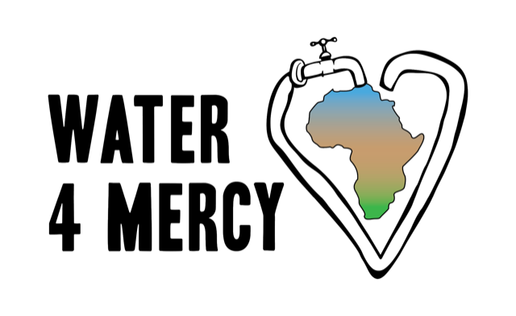
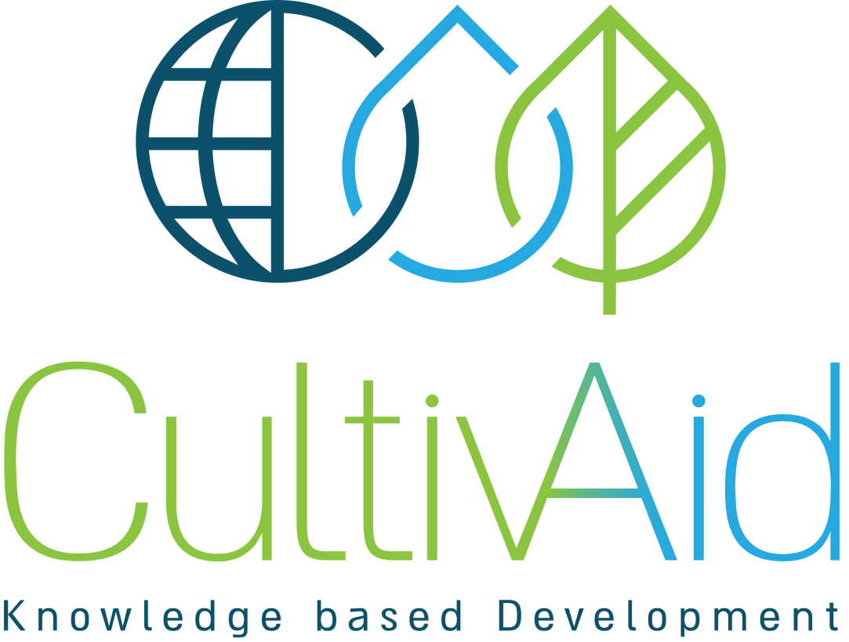
Water 4 Mercy School of Agriculture (WAMSA) with Don Bosco Technical Institute
Conceptual Design
Notes:
Add iA

Slide 2
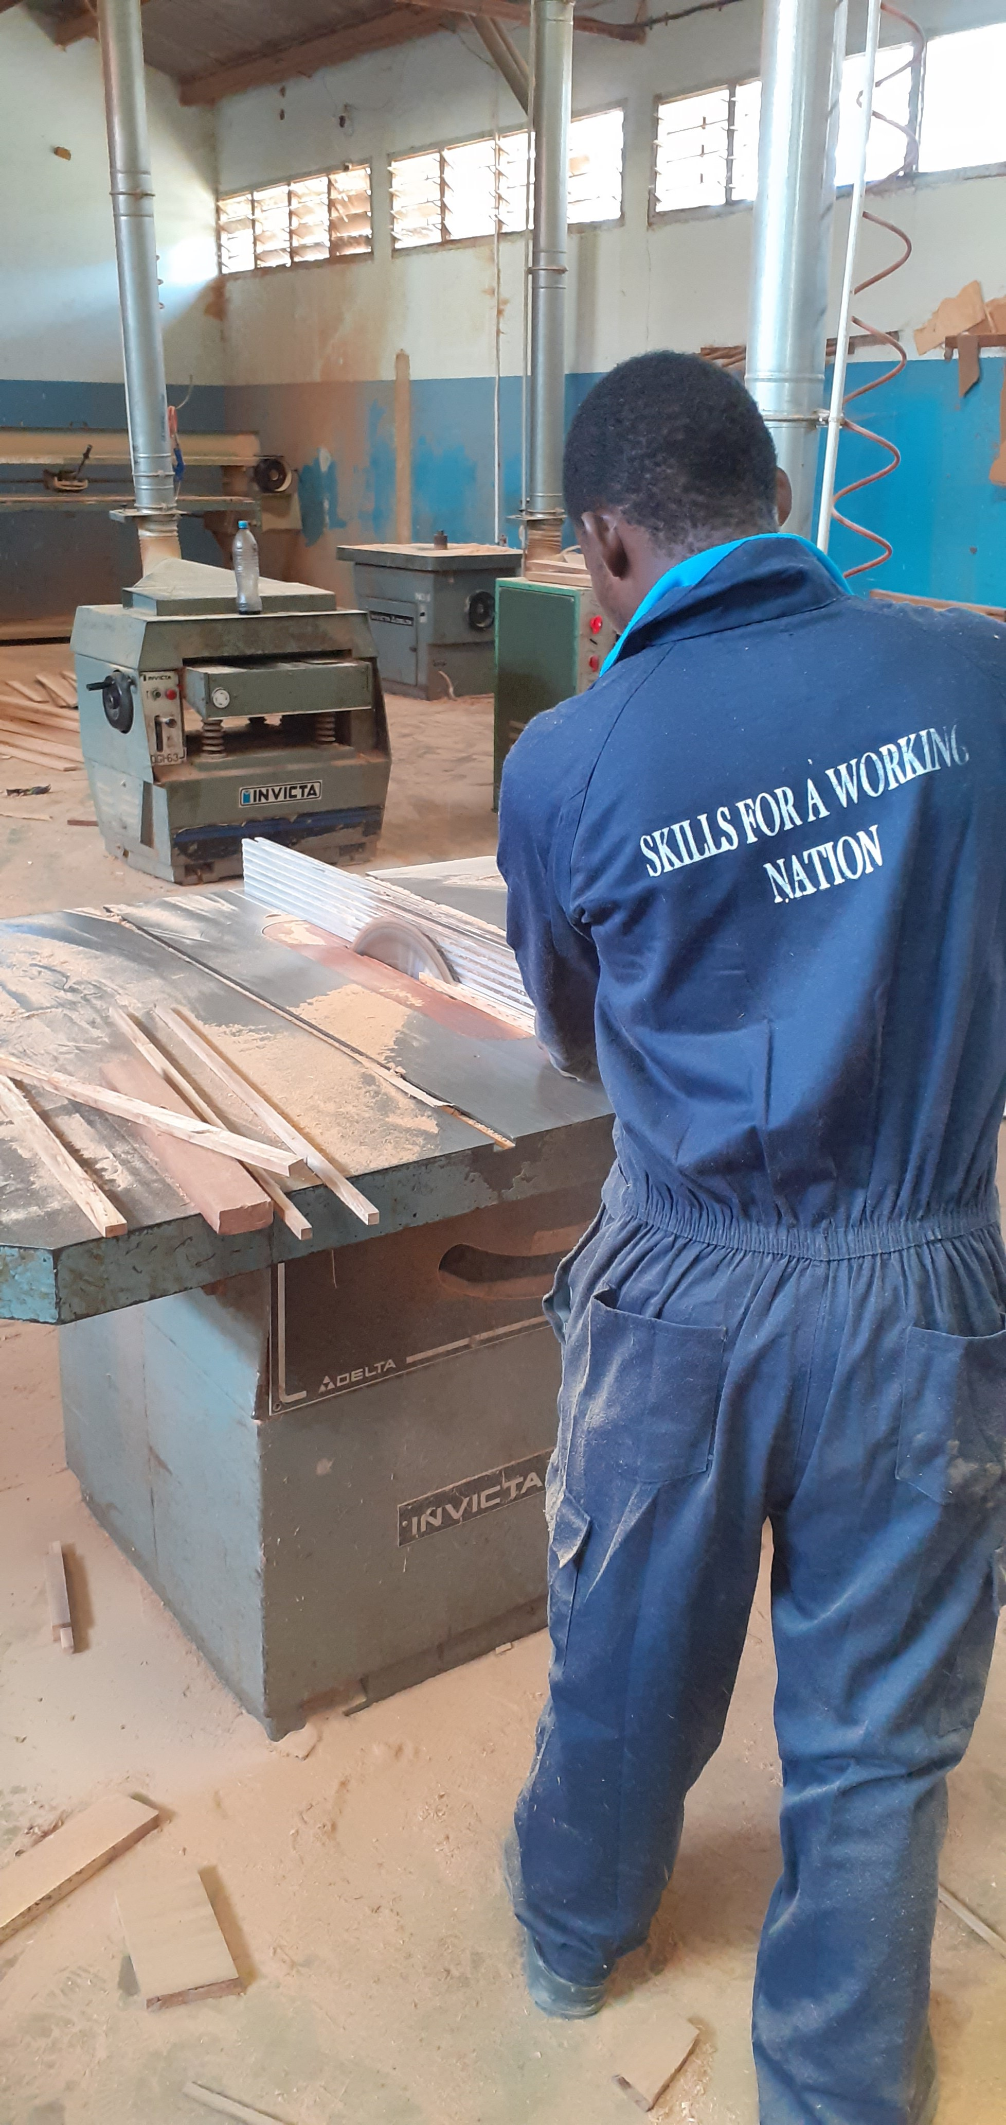
Introduction
The Water 4 Mercy School of Agriculture (WAMSA) is a revolutionary partnership between Water 4 Mercy, CultivAid, innovation:Africa, and Don Bosco Tech Africa designed to transfer knowledge.
WAMSA utilizes the Water 4 Mercy Training, Demonstration and Research (WATDR) site at the Don Bosco Technical Institute in Dodoma, Tanzania.
The Water 4 Mercy Training, Demonstration and Research (WATDR) site will support students to become skilled professionals with the ability to implement commercial and income generating projects, and will train teachers and program managers for ongoing, scalable education.

Slide 3
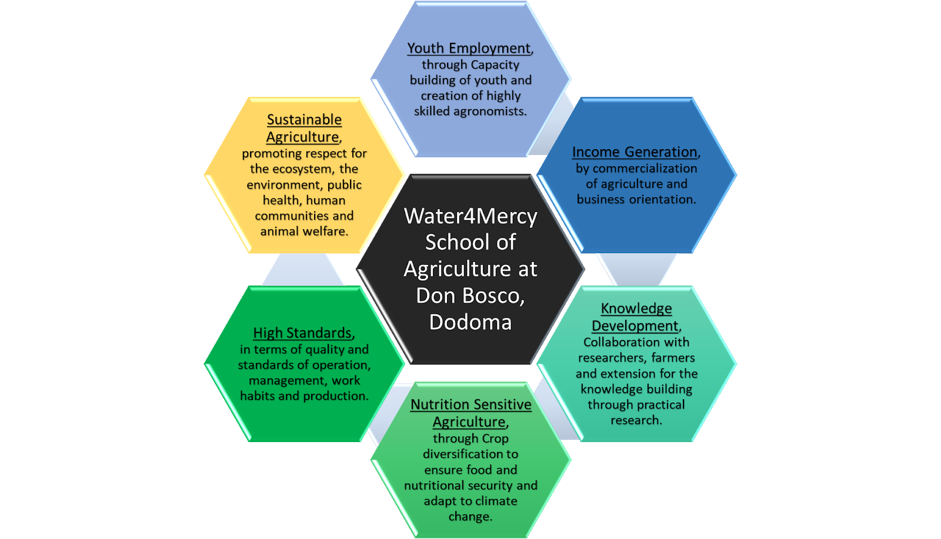
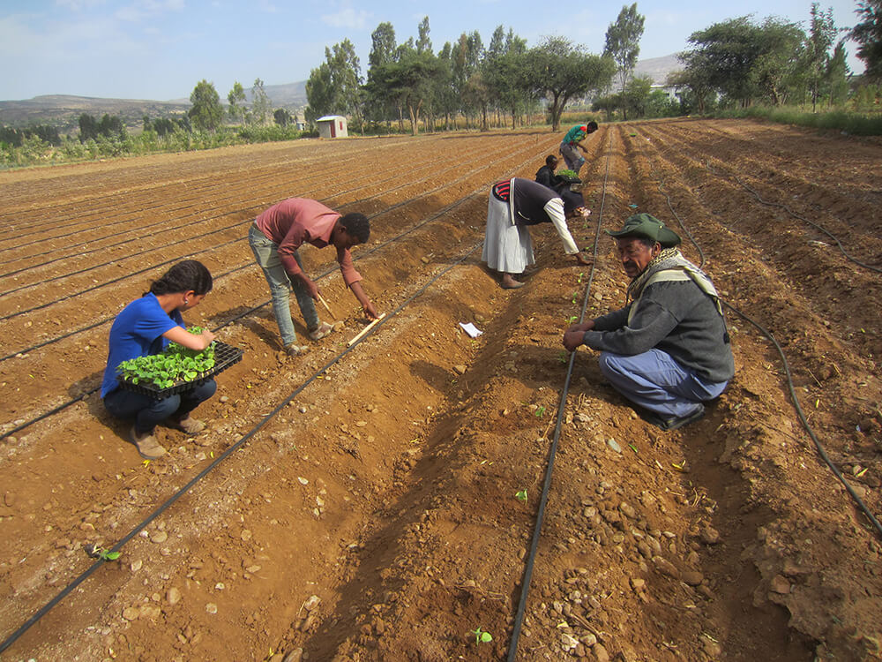
WAMSA Objectives
WAMSA will provide students with the skills they need to support their communities. WAMSA’s program is driven by youth employment, income generation, knowledge development, nutrition sensitive agriculture, high standards, and sustainable agricultural practices. These goals require students (and eventually, graduates) introduce and diffuse sustainable technologies.
Partner Cultivaid AITEC project in ElShadai, Ethiopia

Slide 4
Water 4 Mercy Training, Demonstration and Research (WATDR) Overview
Components
Horticulture
Animal Husbandry
Knowledge Development Program
Courses
Training
Site Description
Horticulture Acreage
Animal Husbandry Acreage
Notes:
Add hort and l

Slide 5
Components
Horticulture
Open field vegetables
Green house vegetables
Nursery seedlings
Fruit orchards
Promotion of “Eating the Rainbow” or dietary diversity and thus greater intake of nutrients and healthy foods that are required to combat malnutrition and childhood stunting.
Animal Husbandry
Eggs
Poultry
The production method will be a "Free-Run Housing System" allowing the hens to roam freely within an enclosed barn. The Free-Run System provides a variety of enrichments for the hens along the barn floor, including nesting boxes and perches. These types of systems take into consideration animal welfare and provide more space per animal.

Slide 6
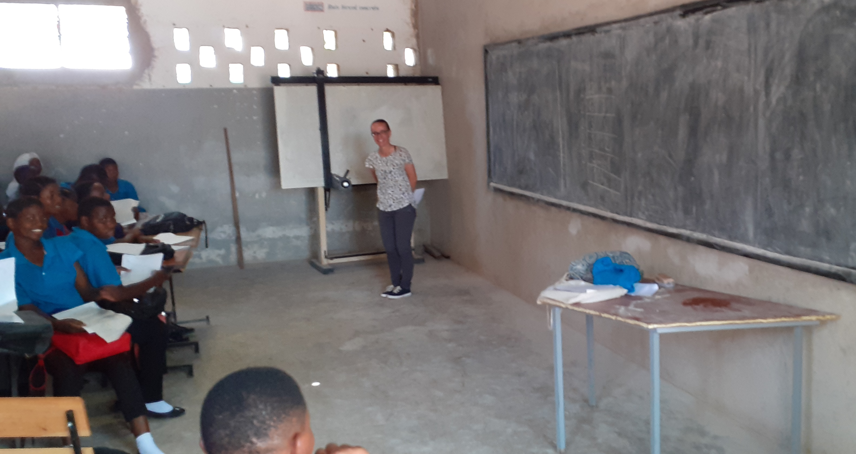
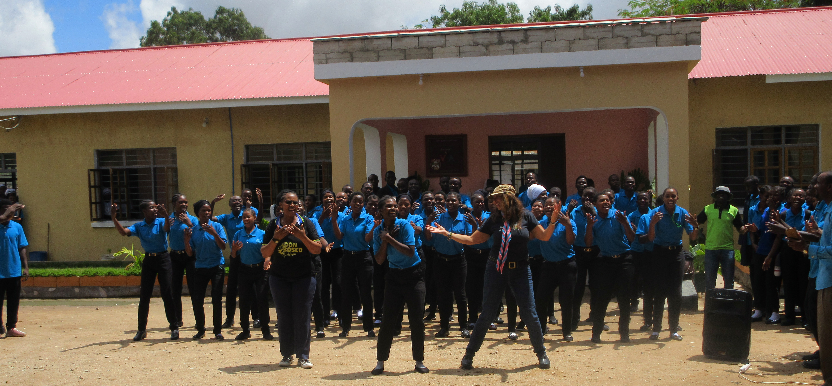
Knowledge Development Program
Courses
Short Course (8 months): The short course program is comprised of a practical session (65%) and a theoretical session (35%) for 6 months. After the 4-6-month program, students will undertake a 2-4 months of field placement. There will be two types of tracks, one in Agronomy and one in Livestock track.
Long Course (3 years): Similar to the Short Course, the long course will have tracks for Agronomy and Livestock. Following the program, graduates will be provided a plot of land at one of the Don Bosco sites. At these sites, trained graduates will have the opportunity to grow crops and manage livestock based on what they have learned.
Training
Regional Training: The WATDR site will be a resource and offer a wide range of ‘training courses’ to regional and national entities. These sessions will be purchased by customers and serve as an additional source of income for WAMSA.
Open Days: WATDR will organize seasonal activities to demonstrate the agricultural technologies being implemented within the wider community to build the reputation of Don Bosco Institute as a leader in agricultural training programs and can increase the market demand of these products.
Teacher Training: Vocational, Technical and Skills-based Education for teachers is required for scaling up the knowledge and skills developed at Don Bosco throughout Tanzania. A teacher training curriculum and practical training program will be developed to be conducted by the newly established teacher college.
Agriculture Equipment and Mechanization: Potential training with courses including Agricultural Mechanization, Equipment Development for Greenhouses, Manufacturing, Assembly and Production of Agricultural Tools.
Don Bosco Students

Slide 7
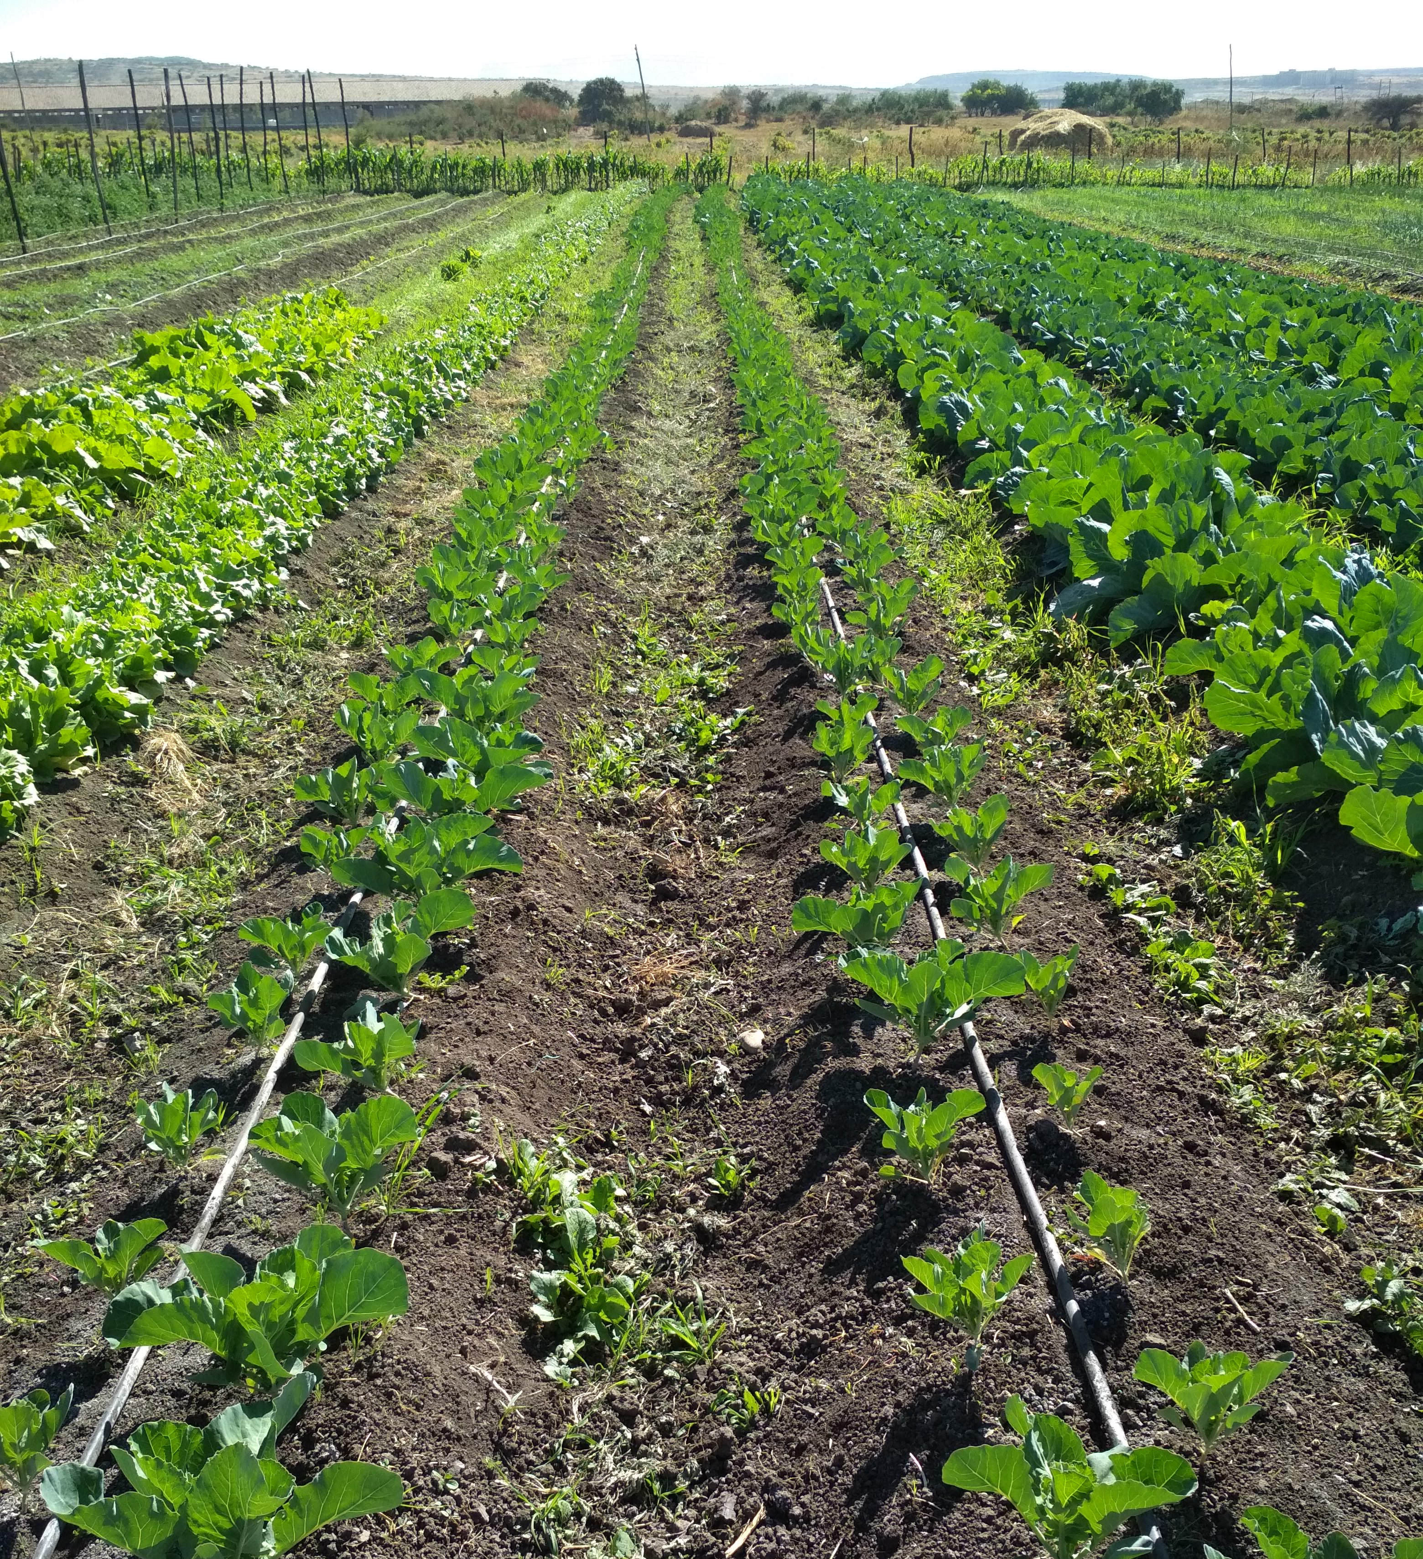
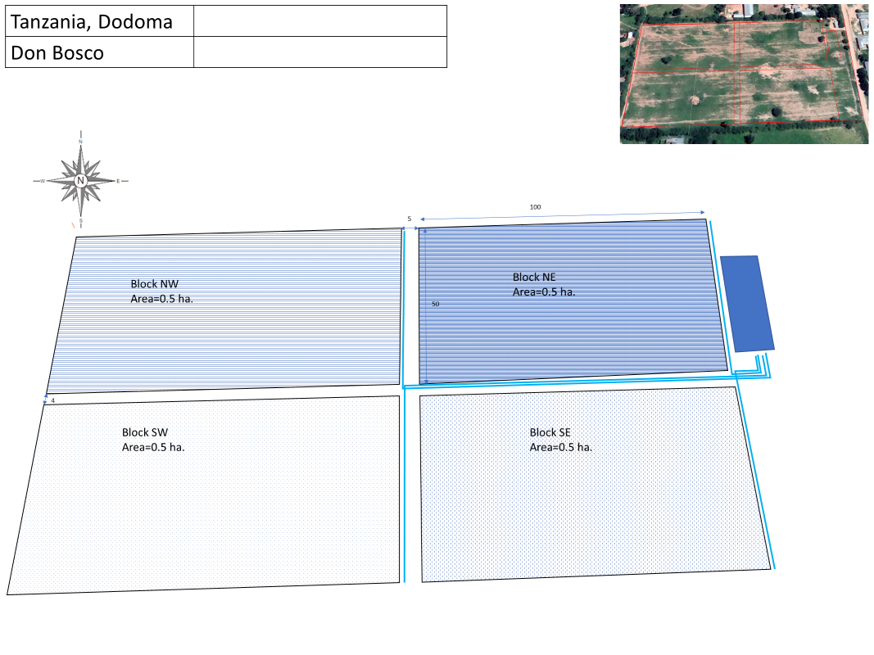
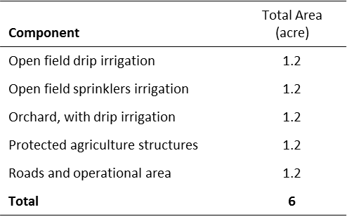
Site Description
Partner Cultivaid AITEC farms in Kallamino, Ethiopia
(left – open field drip irrigation right – nursery)
Horticulture Acreage
Animal Husbandry Acreage
Component | Total Area (acre)
Poultry house | 0.15
Cooling room | 0.01
Roads and operational area | 0.06
Total | 0.81

Slide 8
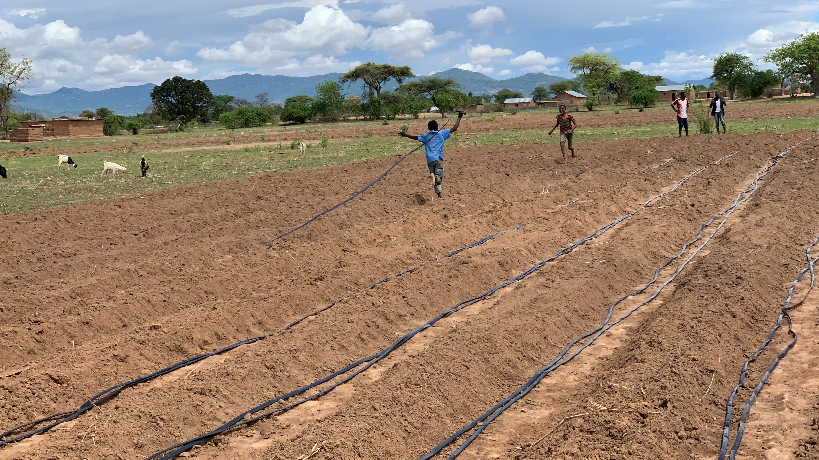
Budget and Estimated Costs
Summary of WATDR Budget
Summary of WATDR Cost-Benefit Analysis
Description | Cost (USD $)
Horticulture project design | 25,850
Horticulture capital cost | 140,156
Field staff program | 230,860
Animal husbandry project design | 9,283
Animal husbandry capital cost | 168,196
Overhead | 86,152
Total | $660,497
Description | Total inputs | Total revenue | Total profit (USD$)
Year 1 | 147,225 | 247,048 | 99,823
Year 2 | 147,225 | 247,048 | 99,823
Year 3 | 147,225 | 247,048 | 99,823
Year 4 | 147,225 | 252,166 | 104,941
Year 5 | 147,225 | 256,645 | 109,420
5-year total |  |  | $513,830

Slide 9
Water 4 Mercy
Don Bosco Tech Africa
Visionary and Facilitator
WAMSA and WATDR Training Site Participants
CultivAid
innovation: Africa
Technical Experts, Agronomists, and Program Implementers
Technical Experts, Extension Services and Internships

