Slide 1
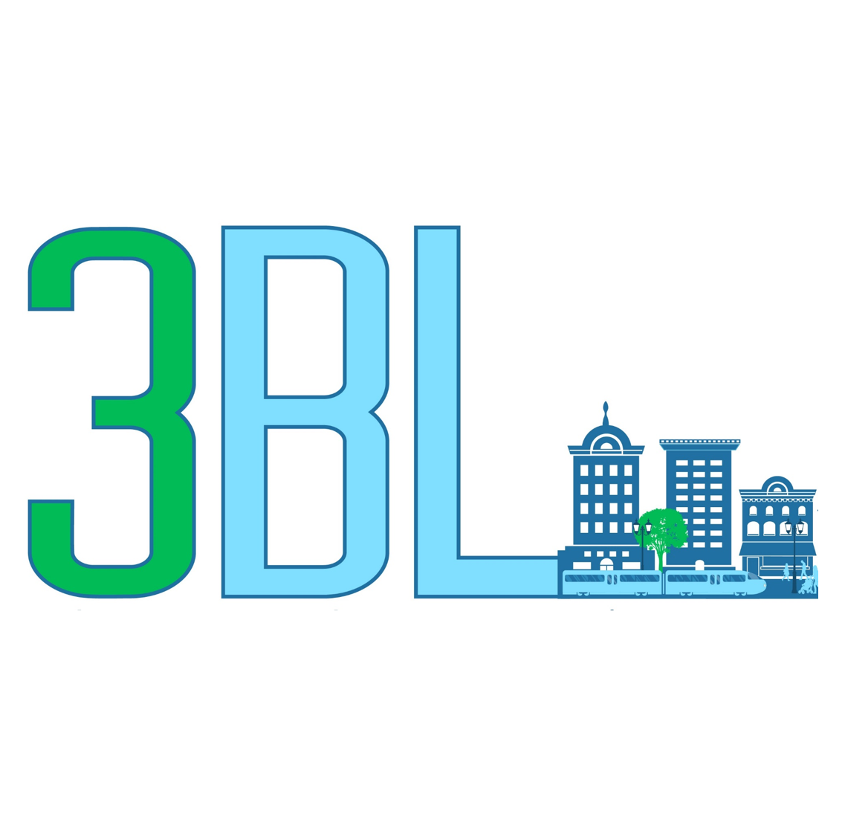
Mixed-Use and Transit Oriented Development and Advisory Triple Bottom Line Mission
January 2022

Slide 2
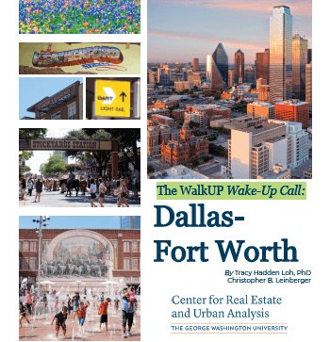
Introduction:
3BL Overview
Formed in 2016
20 Years Mixed-Use Development Experience
25 Years Marketing, Communications, Gov’t Relations
Experience across product types
Master Developer experience
Deep knowledge of U.S. Markets and Key Players
Leader in suburban mixed-use, public engagement, and place branding

Slide 3
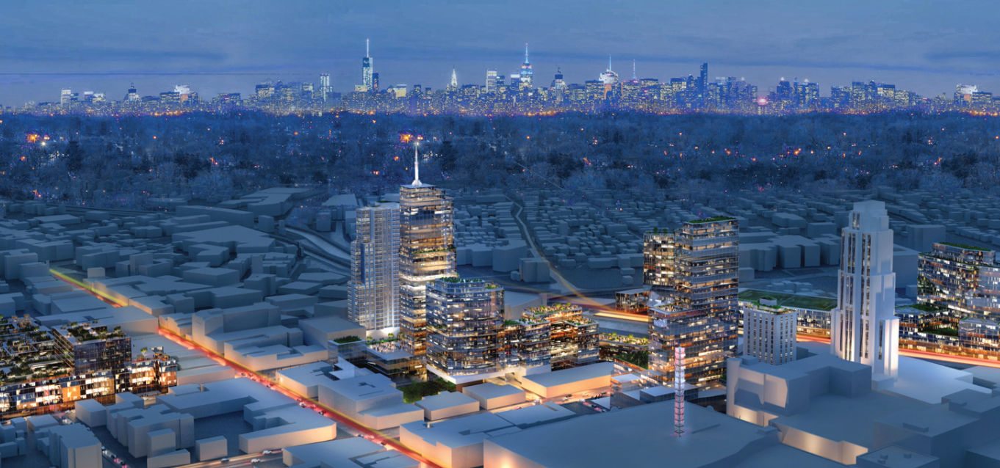
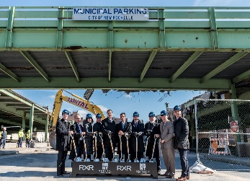
New Rochelle, NY
Program:
6,500+ Residential Units
2+ Million SF Commercial
1+ Million SF Retail
300k SF Hospitality
2+ Million SF
Senior Living
Student Housing
Institutional

Slide 4
New Rochelle, NY
Key Roles:
Business Development
Municipal Affairs
PR / Spokesperson
Public Engagement CSPM
Planning/Urban Design (Support Role)
Project Awards:
William H. Whyte Award, APA

Slide 5
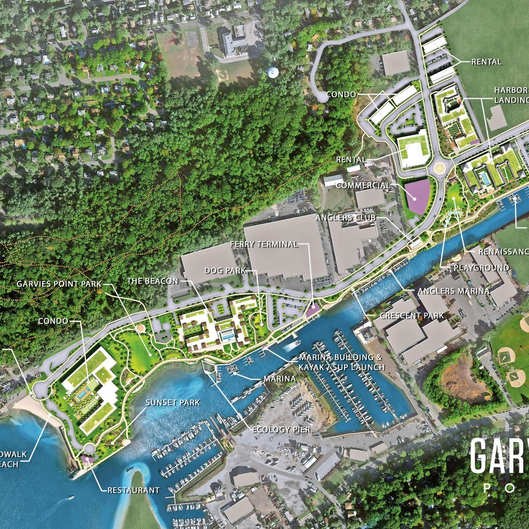
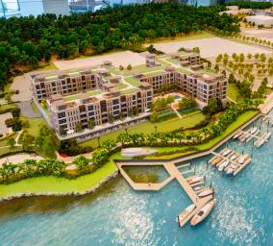
Glen Isle Partners (Now Garvies Point)
Superfund Showcase Site (EPA)
$120mm+ In Remediation
Led Public Engagement and Public Affairs
Successful Rezoning, Led to Sale/JV

Slide 6
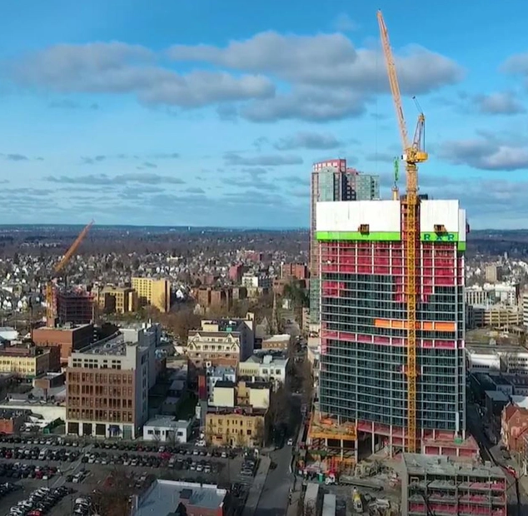
Economic Benefits
1,200+ high paying jobs
Millions in new tax revenues
Additional spending $$
Enhanced tourism

Slide 7
It’s all about community: Public Engagement
Co-creator of Crowdsourced Placemaking program
National recognition and Press
Bottom up, community driven
Yields greater ROI
Reduces development timeline

Slide 8
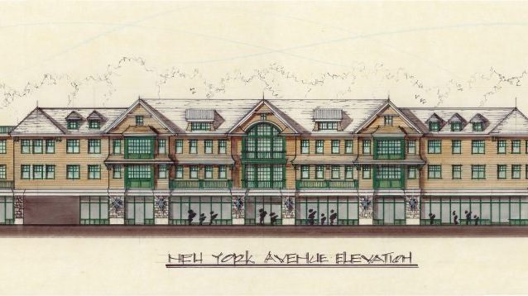
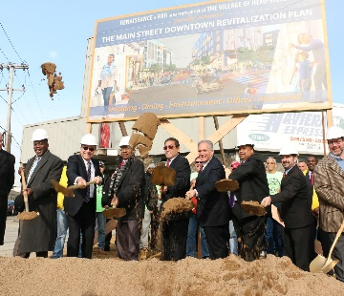
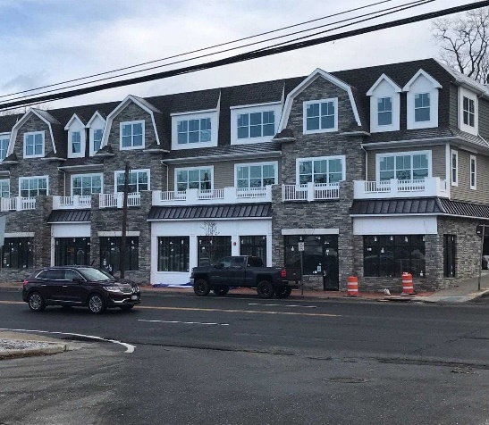
Additional Projects
Hempstead
Successful Public Engagement for rezoning of entire downtown
Implementation of Form-Based Code
Development potential $1.5B+
Press coverage in NY Times & Wall Street Journal
Huntington Station
Successful Public Engagement for rezoning of TOD
Implementation of Form-Based Code
Initial phases complete, additional underway

Slide 9
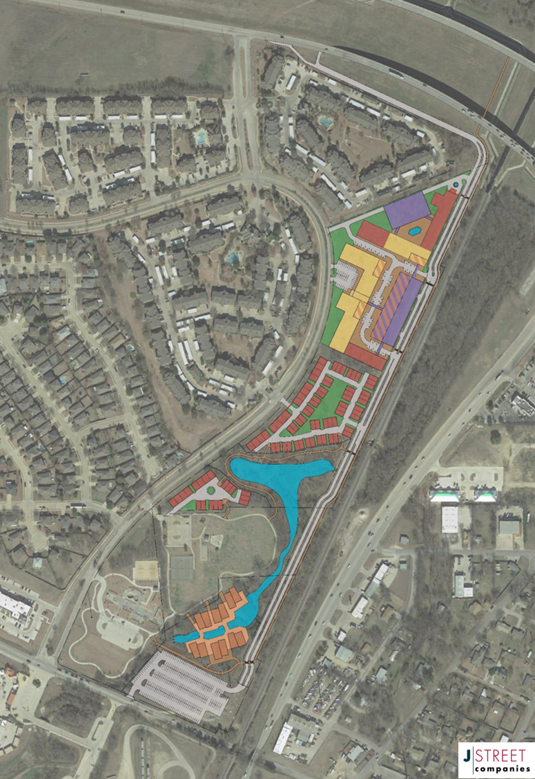
THE CAMPUS AT CADE CREEK A Mixed-Use Urban Village Roanoke, Texas

Slide 10
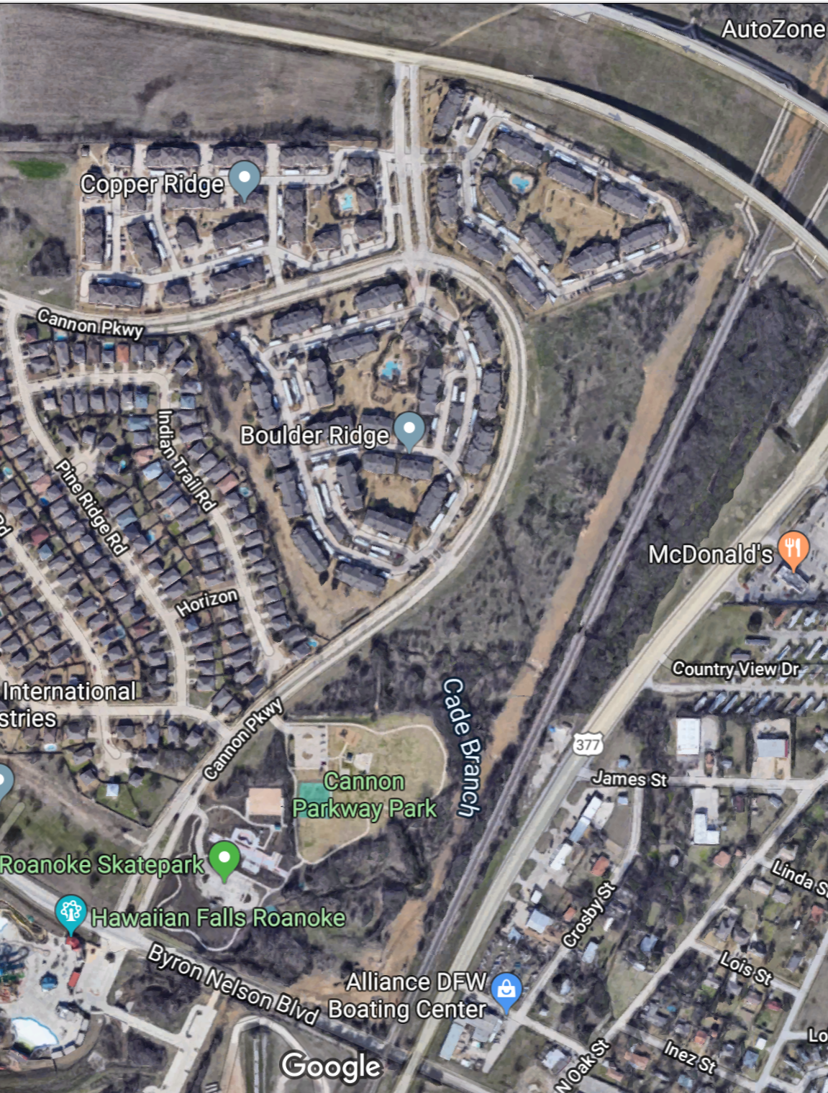
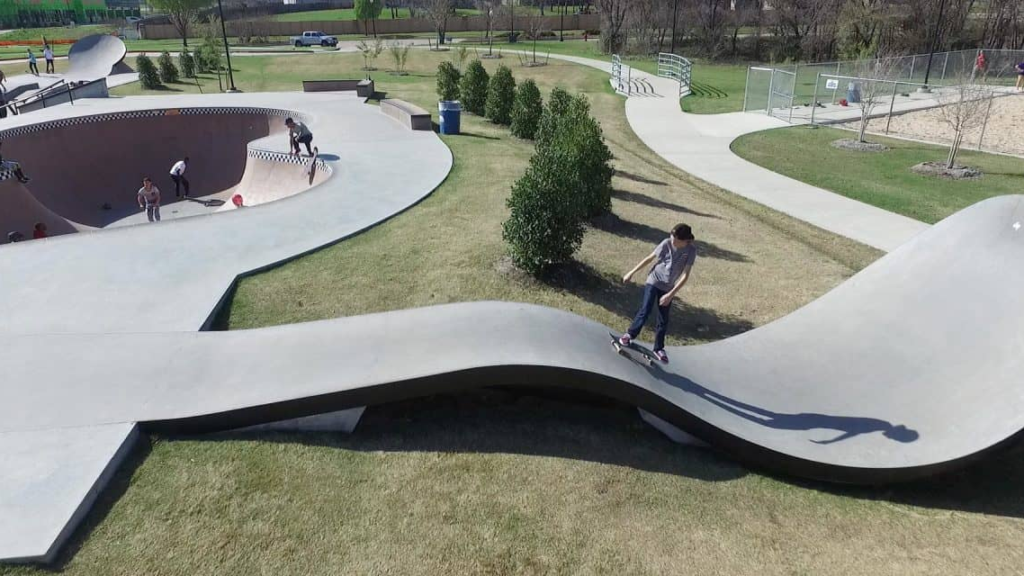
Existing Site Conditions
Proximate to, but disconnected from, downtown
Recreational amenities
Environmental constraints
Abutting residential communities
Zoned for Industrial / Commercial

Slide 11
THE CAMPUS AT CADE CREEK A Mixed-Use Urban Village

Slide 12
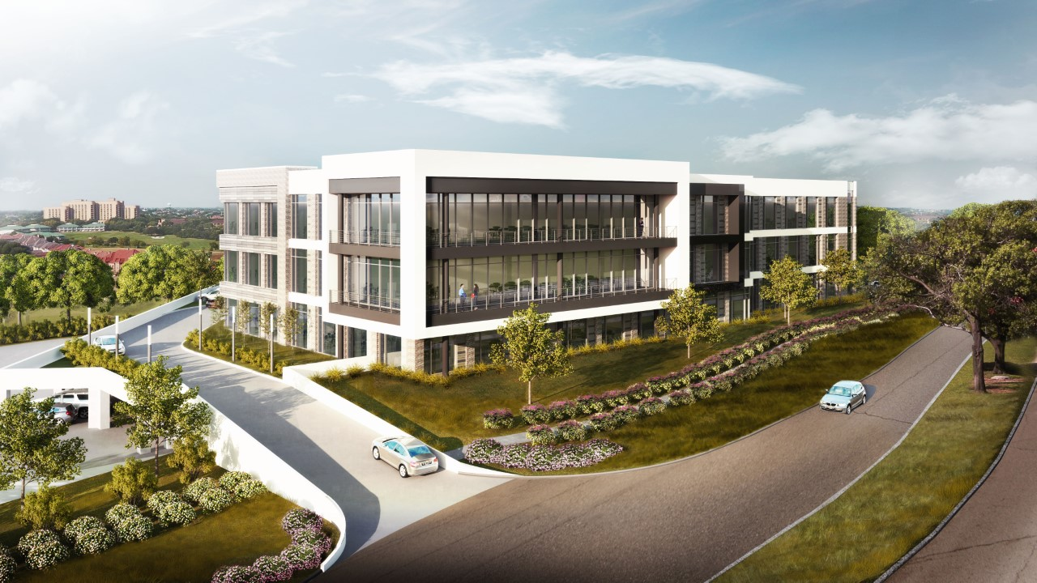
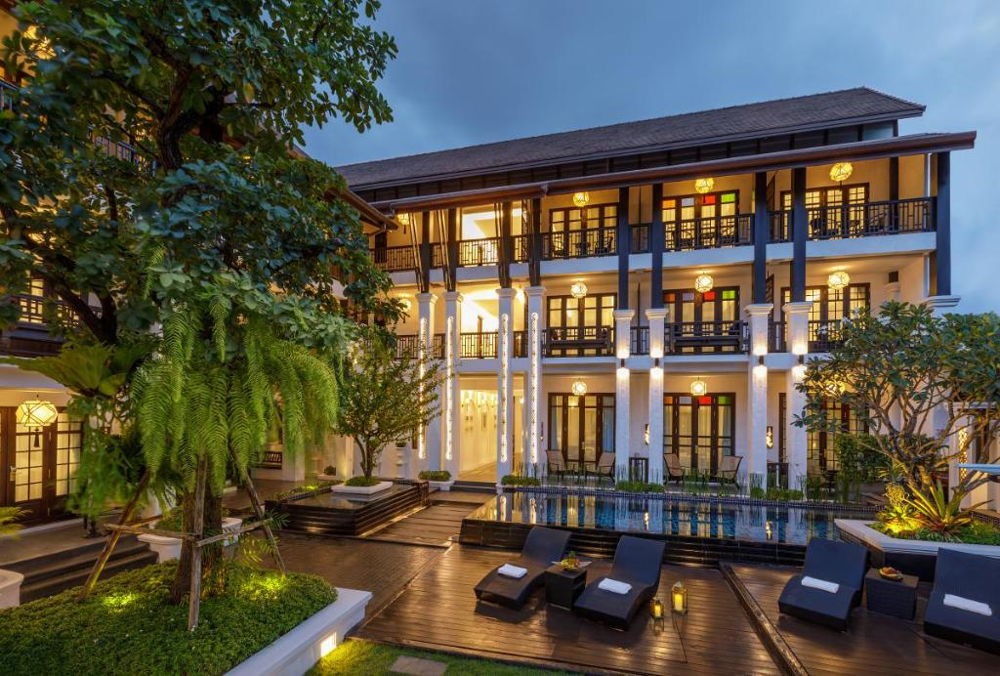
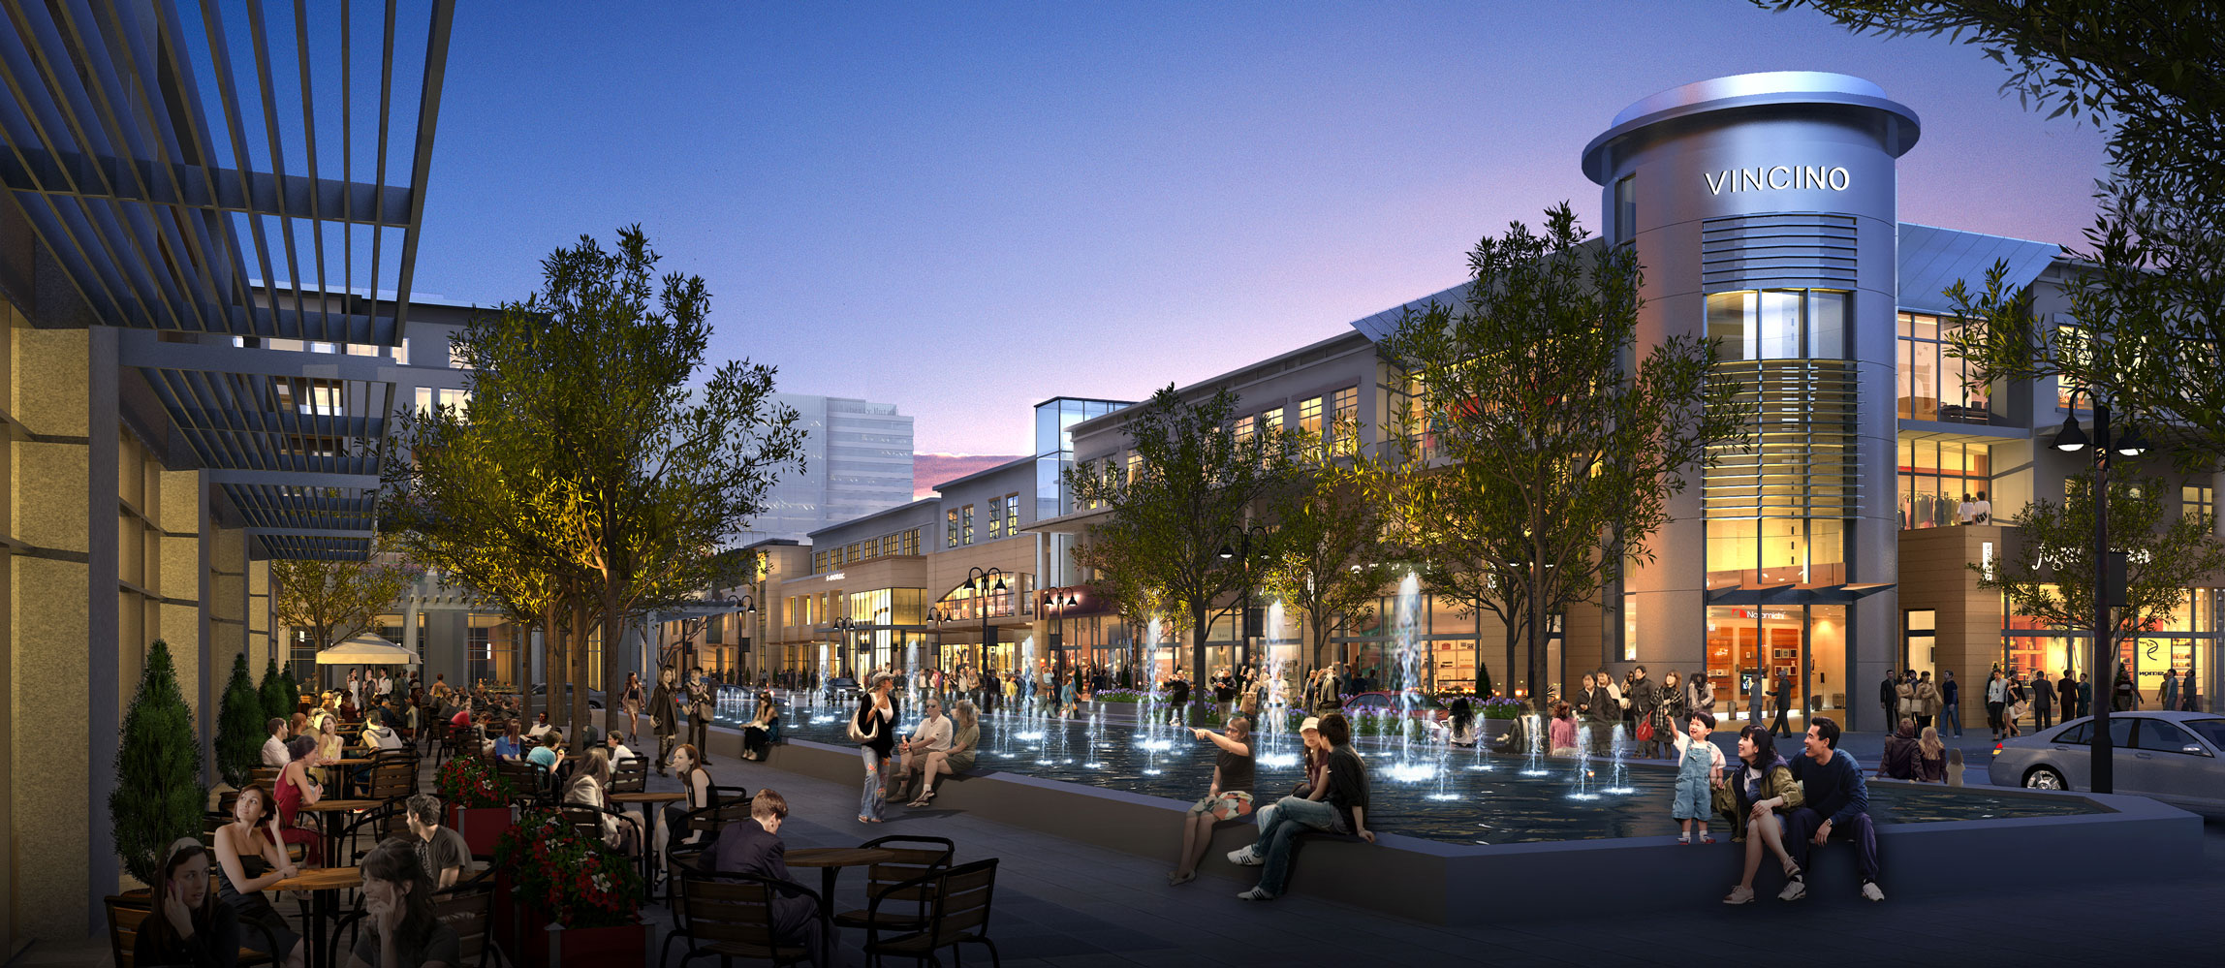
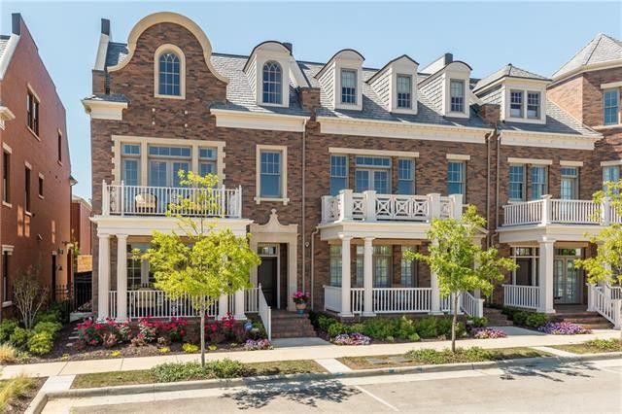
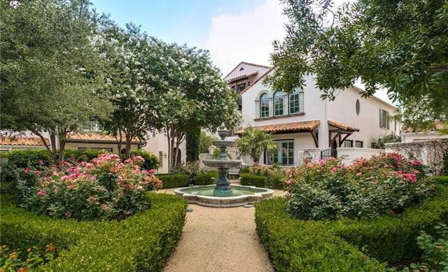
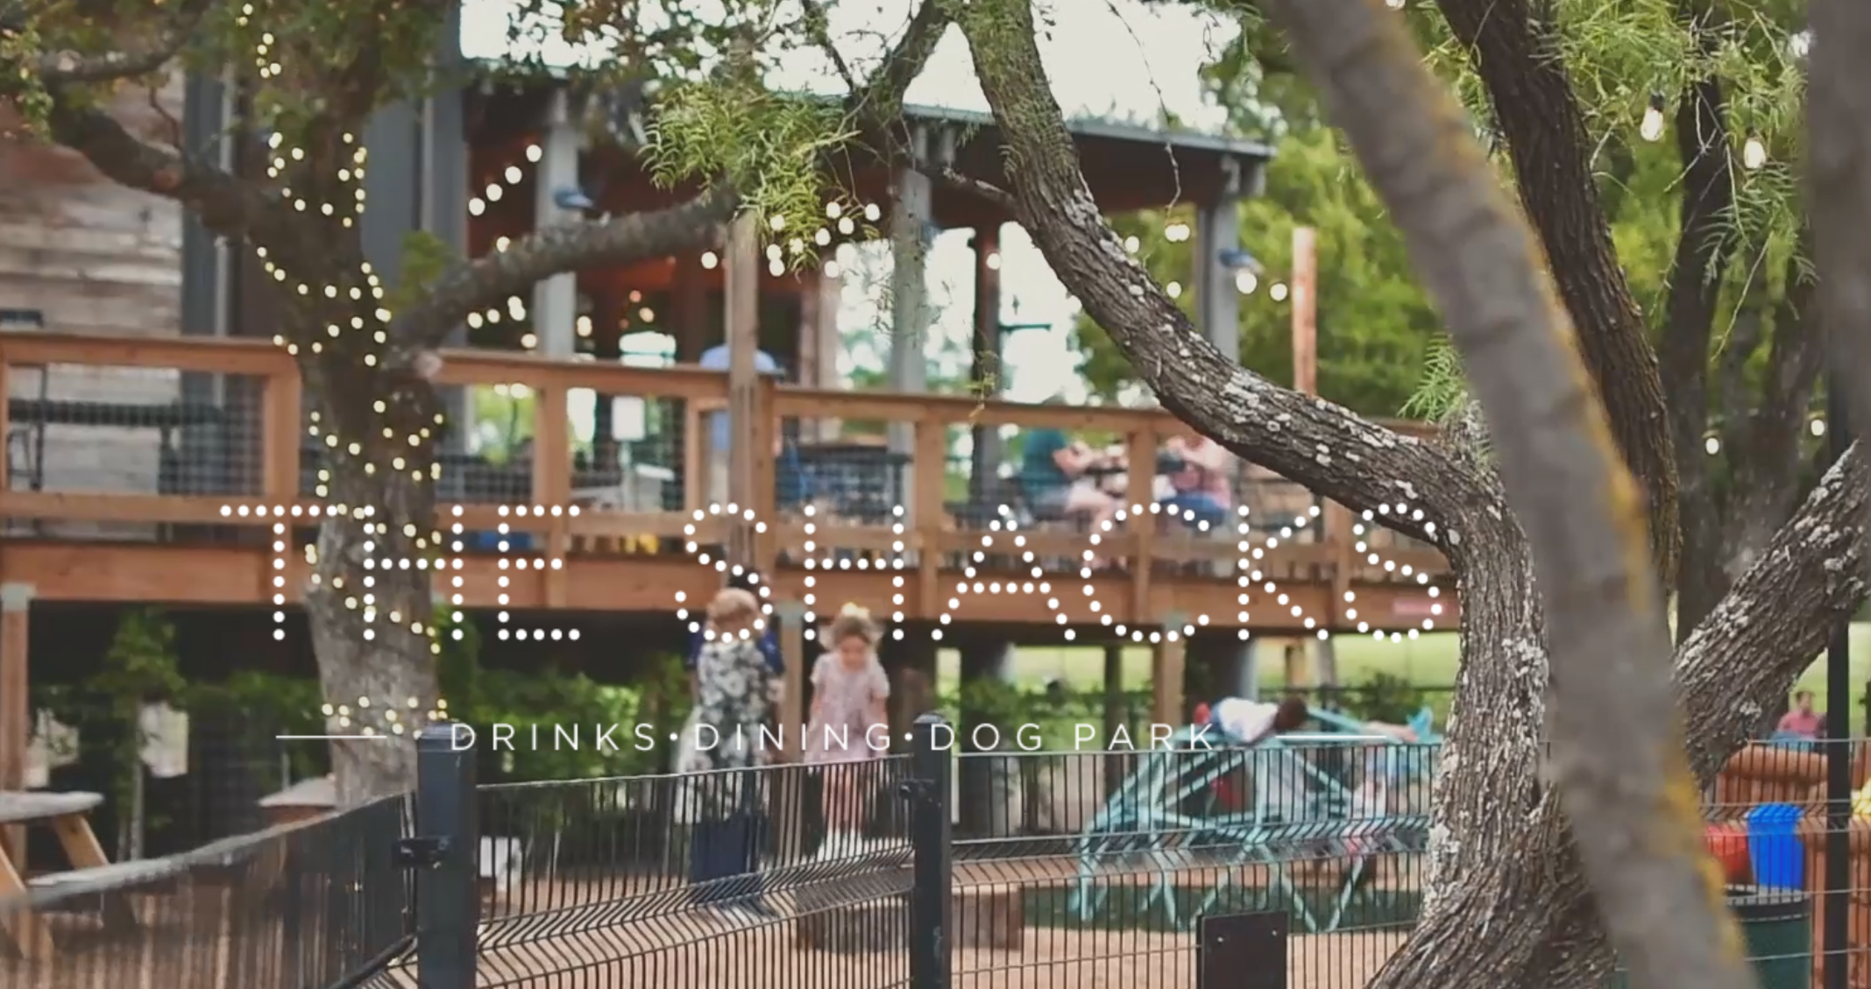
Class A Office
Boutique Hotel
Mixed-Use, Pedestrian Friendly
Urban Living
Urban Village
Experiential Retail/Restaurant

Slide 13
Potential Program & Mix
Class A Office 200,000 sf
Mixed Use Office 140,000 sf
Hotel 160,000 sf / 315 Keys
Urban Village Residential 88 Townhomes
Restaurant / Retail 30,000 sf (12 Restaurants)
TOTAL: 850,000 sf
$250,000,000+

Slide 14
Phased Master Developer Approach
Continually provide and enhance user experience
Build off existing assets (recreational, nature)
Inform (and listen to) the market that will drive successful development
Provide immediate boost to downtown
Partner with best-in-class vertical developers

Slide 15
Activation Strategies
Entertainment Focused
Temporary Uses
Semi-permanent venues
Pop-Up Events
Food Truck and Micro-Retail
Events and Programming

Slide 16
Activation Strategies
Entertainment Focused
Temporary Uses
Semi-permanent venues
Pop-Up Events
Food Truck and Micro-Retail
Events and Programming

Slide 17
Economic Benefits
Potential for 1,200+ high paying jobs
Millions in new tax revenues
Additional spending $$ at local businesses
Provides complement to downtown redevelopment
Enhanced tourism as a regional destination

Slide 18
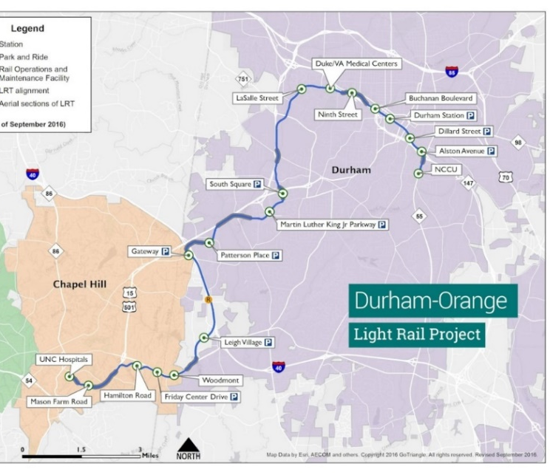
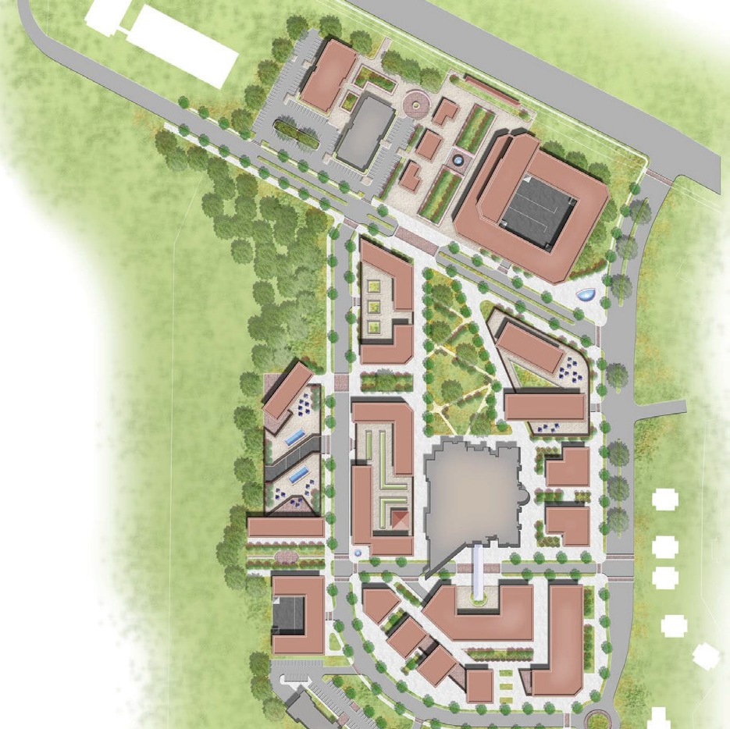
Durham-Chapel Hill, NC TOD and Planning
Hired by Local Council of Governments
Provided Real Estate Advisory Services
Led Public Engagement and Gov’t Affairs
18 Train Stations: Proposed New Rail Line
Utilized Form-Based Code & Value Capture

Slide 19
San Bernardino River Walk Conceptual Vision

Slide 20
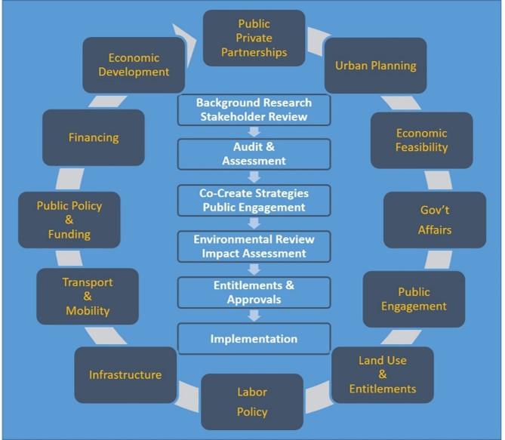
Process Must Lead… the Plan will Follow
Build the Right Team to Integrate:
Placemaking & Urban Design
Real Estate & Land Use Regulations
Public Works and Infrastructure
Transportation & Mobility

Slide 21
The right PROCESS
conducted by the best TEAM
=
Triple Bottom Line Success
Notes:
Many of us in this room already recognize the value of planning and urban design in terms of promoting outcomes – those we want, and unintended consequence. Certainly one of those desired outcomes from planning is to implement changes in the physical environment that will foster economic development and growth… be it private sector development or public investments in place and infrastructure. That said, there need be an understanding of key audiences – be they our clients, partners, the decision makers as elected and municipal staff, and certainly the public at large. w

